Slide 1



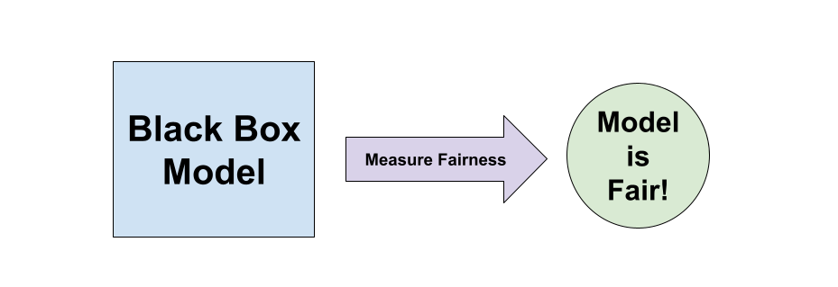
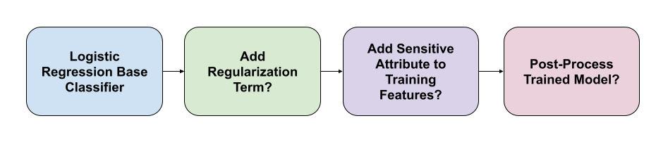
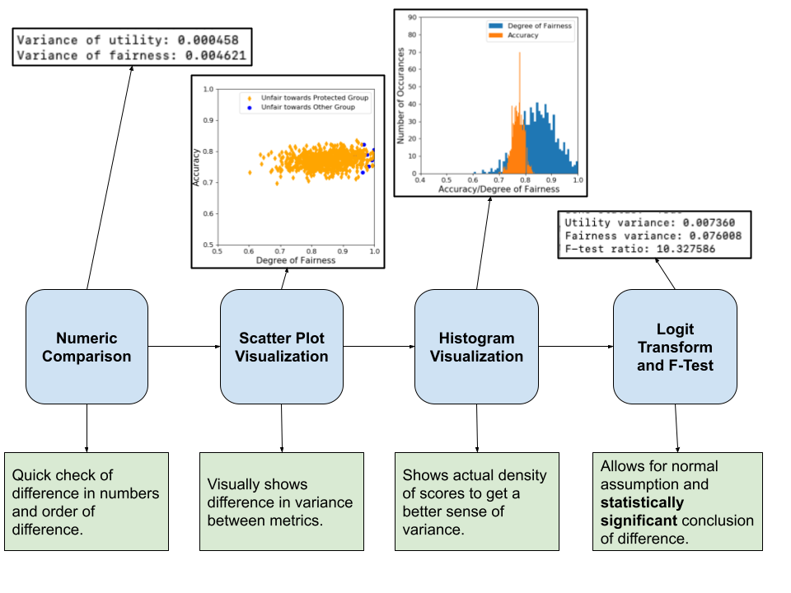
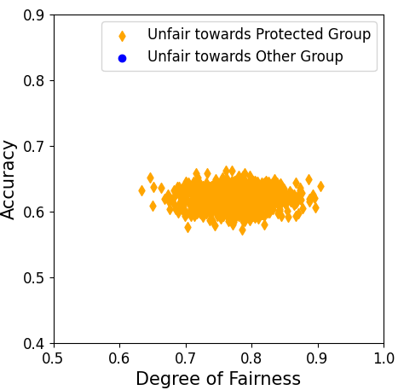
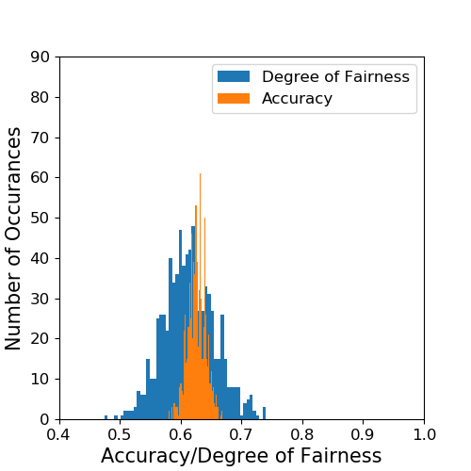
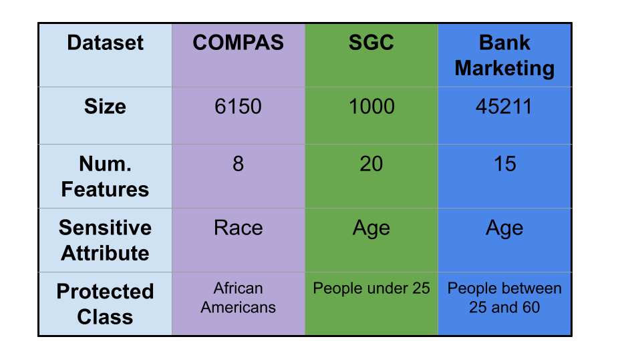
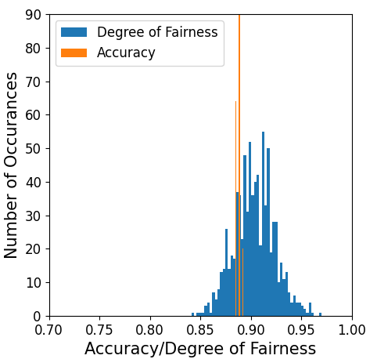
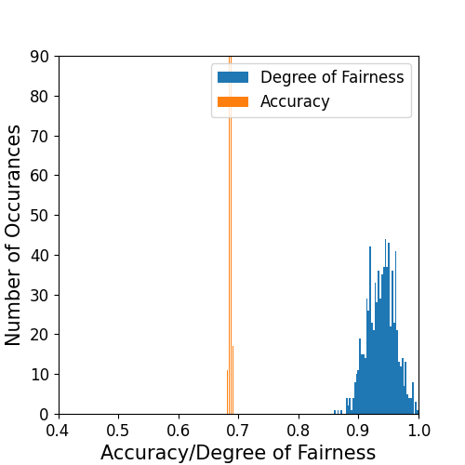
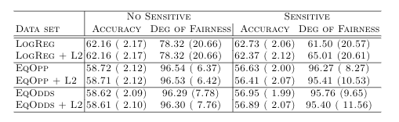
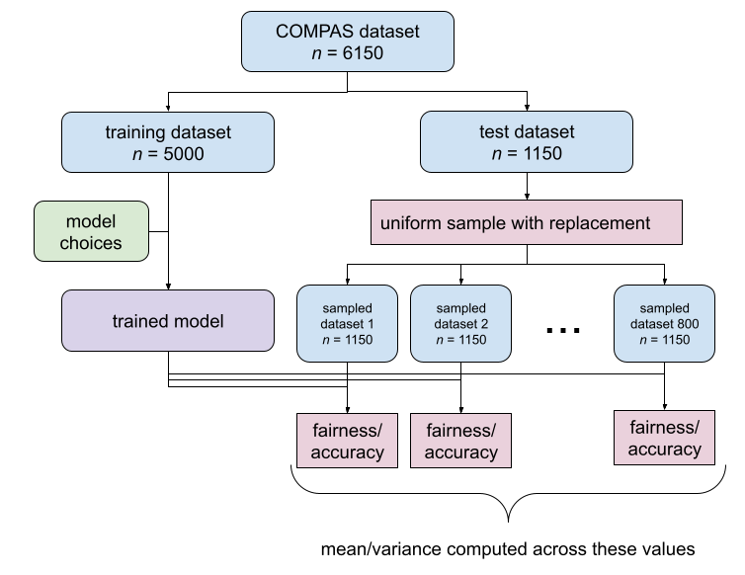
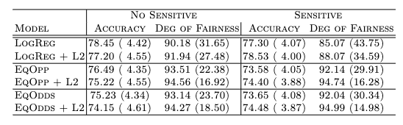
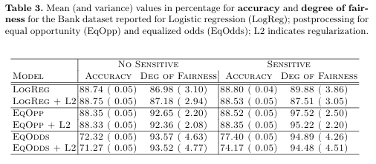
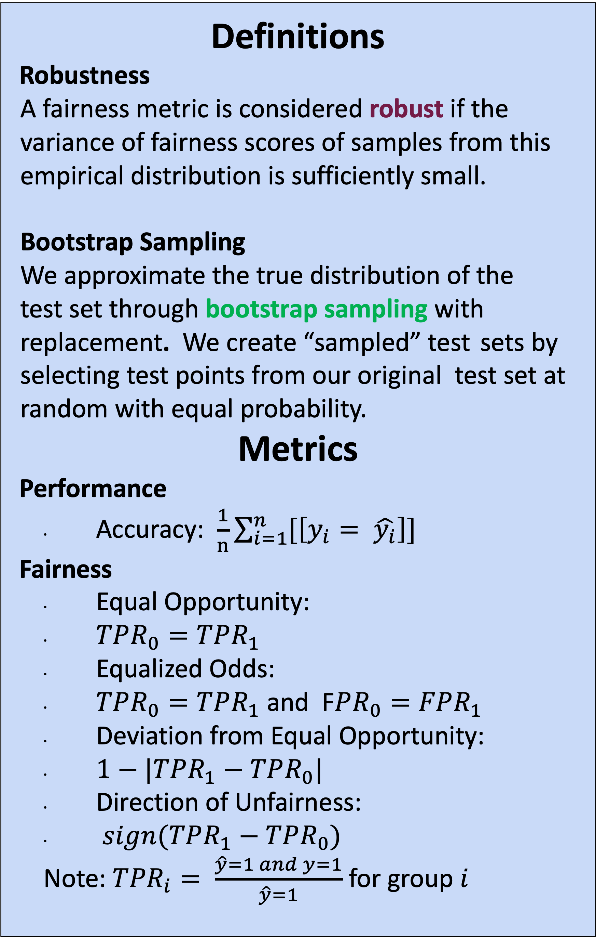
Robustness of Fairness in Machine Learning: An Empirical Analysis
Serafina Kamp¹ (Honors Capstone), Andong Luis Li Zhao², Sindhu Kutty¹
¹University of Michigan, ²Northwestern University
Motivation
Fairness metrics are becoming increasingly widespread to ensure decision-driving algorithms are fair.
Can we trust the above conclusion?
Research Questions:
Is the equal opportunity fairness metric robust?
How does the variation of this fairness metric compare to more traditional performance metrics?
How do different model design choices affect the robustness of a metric?
Are the same effects repeated across different domains and datasets?
Model Design
We create 12 variations of our base classifier:
Datasets
COMPAS - Predicting recidivism
South German Credit - Predicting loan repayment
Bank Marketing - Predicting term deposit subscription
Evaluation
We compare the variance of our performance metric and our fairness metric to evaluate the robustness of the fairness metric.
We compare the variances in four different ways as shown below with the South German Credit dataset:
Results - Numerical
For all datasets and all model choices, fairness metric variance is significantly larger.
  COMPAS
  BANK
Definitions
Robustness
A fairness metric is considered robust if the variance of fairness scores of samples from this empirical distribution is sufficiently small.
Bootstrap Sampling
We approximate the true distribution of the
test set through bootstrap sampling with replacement. We create “sampled” test sets by selecting test points from our original test set at random with equal probability.
Metrics
Performance
Accuracy: $\frac{1}{n}\sum_{i=1}^{n}{[\left[y_{i}= \hat{y_{i}}\right]]}$
Fairness
Equal Opportunity:
$TPR_{0}=TPR_{1}$
Equalized Odds:
$TPR_{0}=TPR_{1}$ and F$PR_{0}=FPR_{1}$
Deviation from Equal Opportunity:
$1−|TPR_{1}−TPR_{0}|$
Direction of Unfairness:
$sign(TPR_{1}−TPR_{0})$
Note: ${TPR}_{i}= \frac{\hat{y}=1 and y=1}{\hat{y}=1}$ for group $i$
Results - Numerical
For all datasets and all model choices, fairness metric variance is significantly larger.
  COMPAS
  SGC
  BANK
Experimental Setup
Conclusions
We have empirically shown that equal opportunity is significantly less robust than accuracy for three datasets
For COMPAS and South German Credit, the direction of unfairness is generally towards the protected group.
Our work identifies robustness as a desirable criterion in evaluating fairness metrics.
Significant References
[1] - Hardt, M., Price, E., Price, E., Srebro, N.: Equality of opportunity in supervised learning. In: Lee, D., Sugiyama, M., Luxburg, U., Guyon, I., Garnett, R. (eds.)Advances in Neural Information Processing Systems. vol. 29. Curran Associates,Inc. (2016)
[2] - Kamp, Serafina, Andong Luis Li Zhao, and Sindhu Kutty. "Robustness of Fairness: An Experimental Analysis." Joint European Conference on Machine Learning and Knowledge Discovery in Databases. Springer, Cham, 2021.

