Slide 1


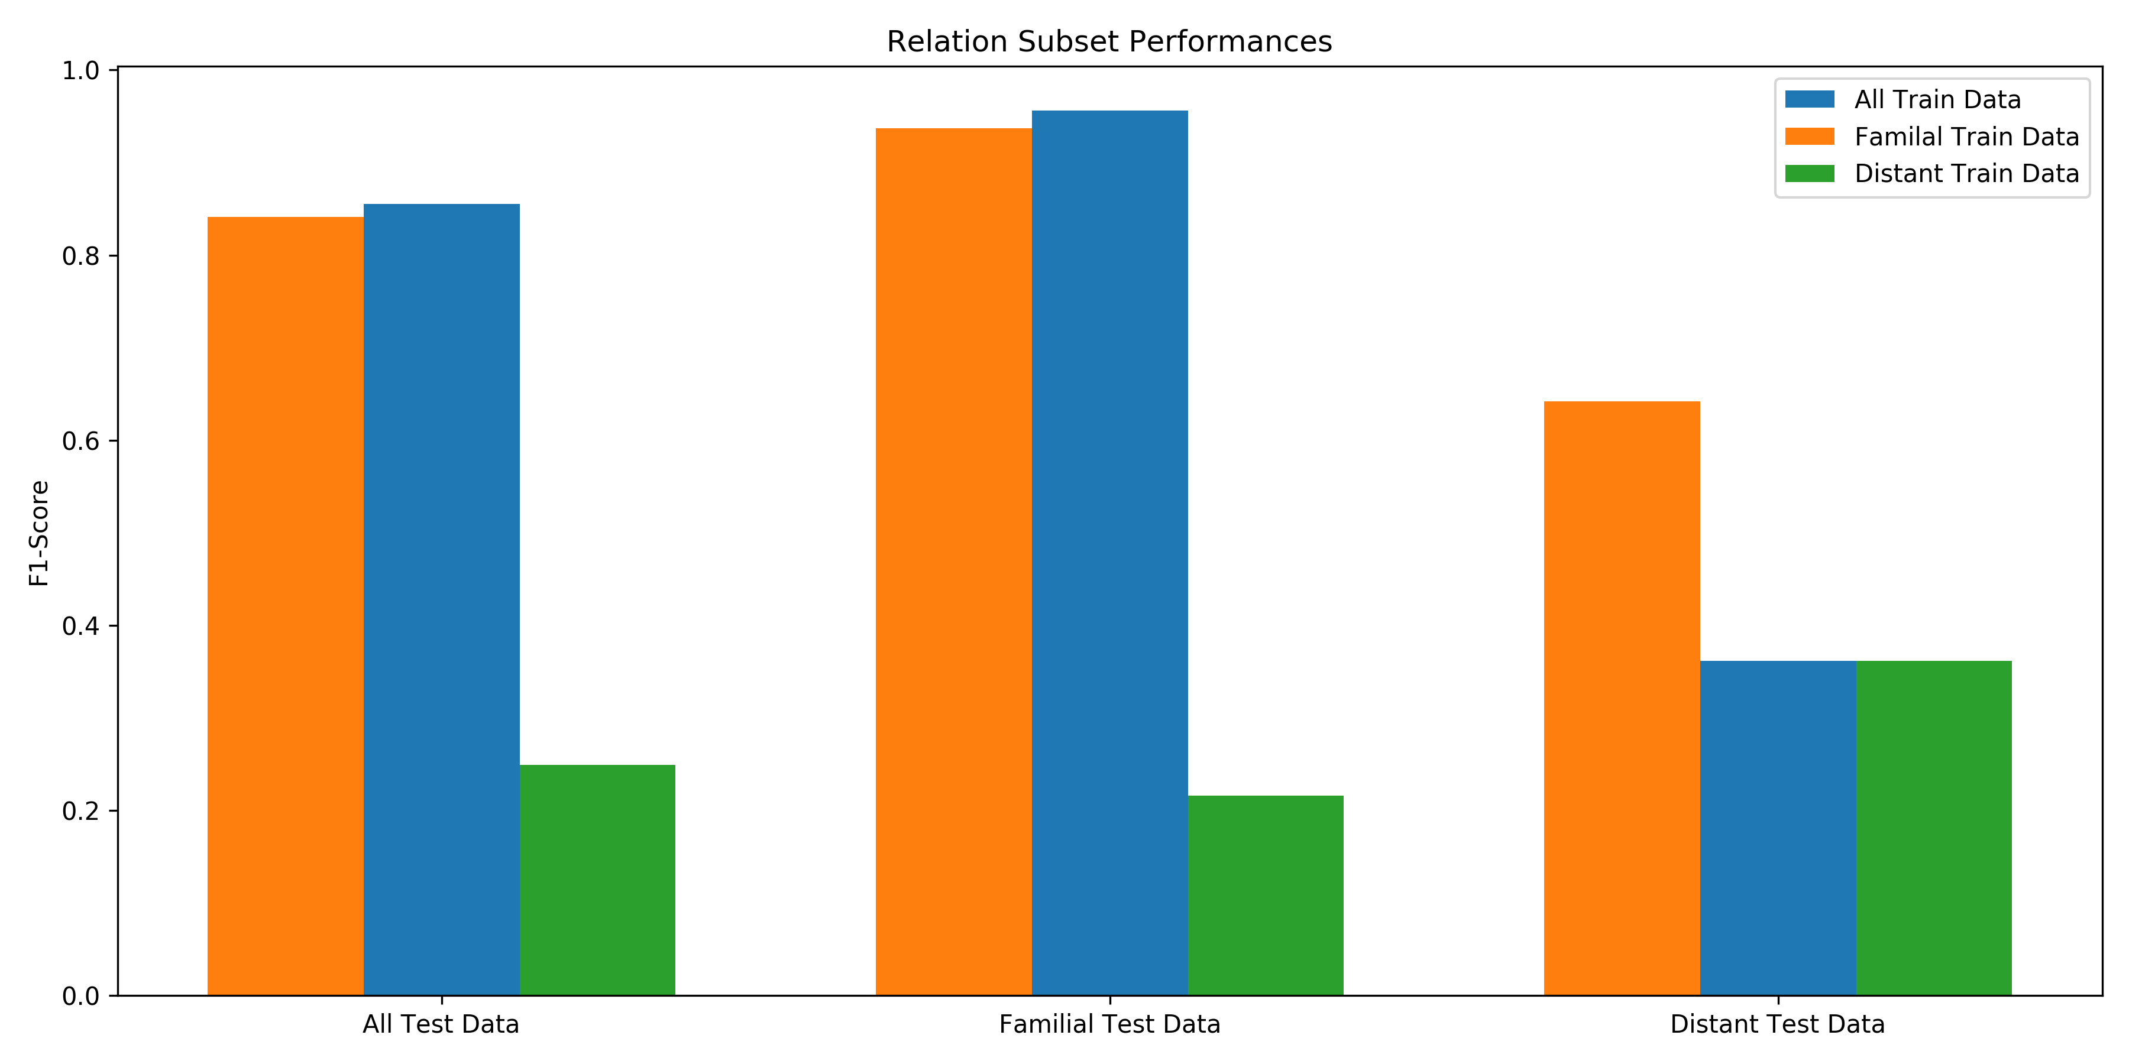
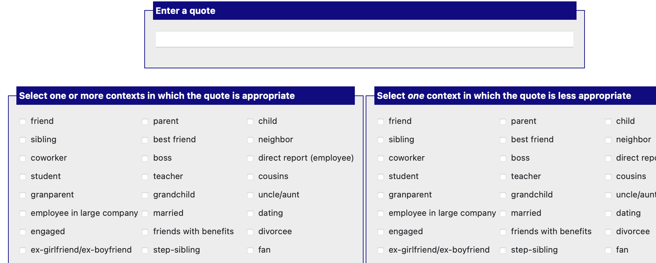
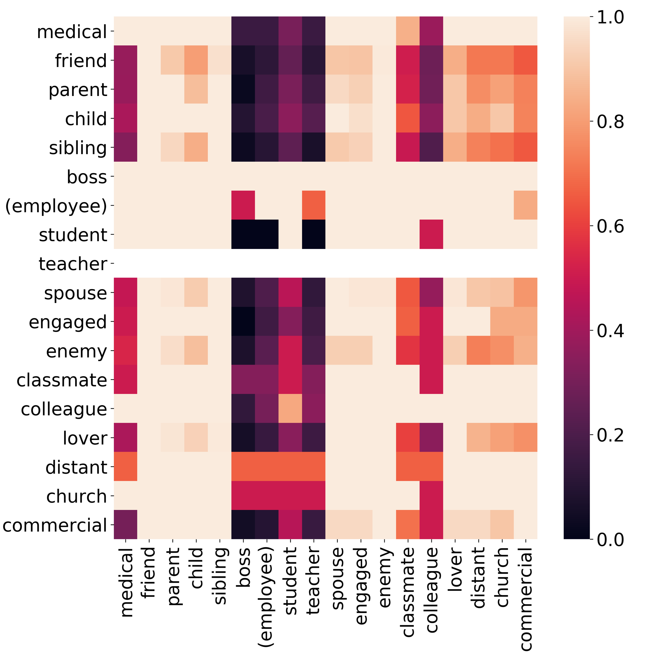
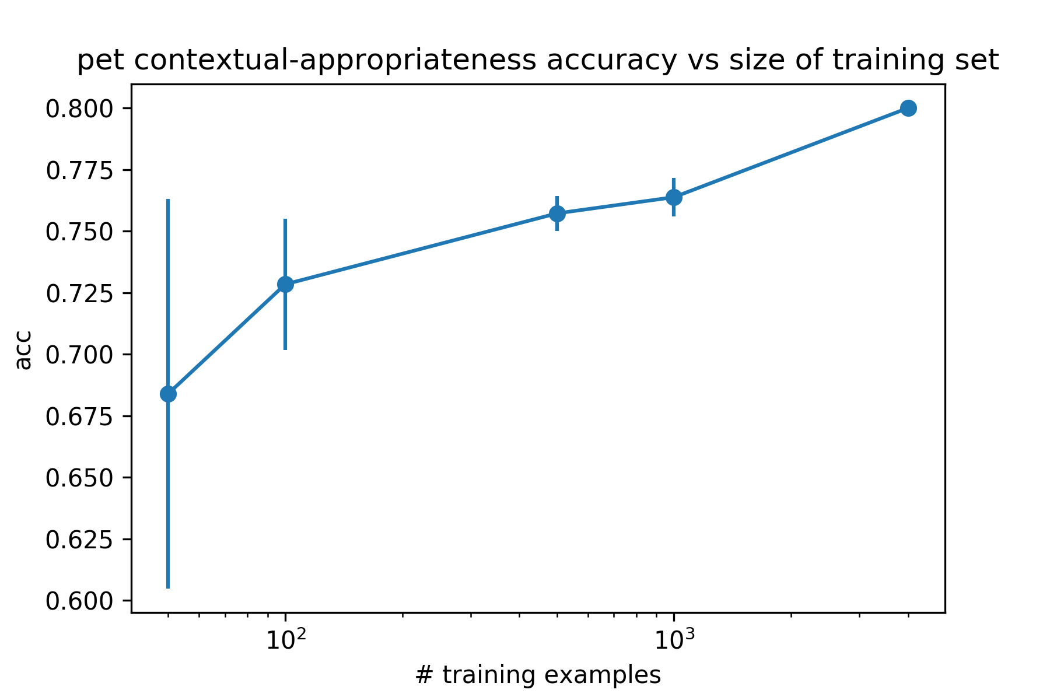
I should not have said that: Measuring contextually inappropriate language in different social settings
Jackson Sargent, Dr. Jurgens,
Athena Aghighi, Michael Geraci
Objectives
Methods
Investigate how context affects language appropriateness using computational methods
Build dataset of language, relationship and appropriateness labels for use in further research
Investigate what social information our model captures, and how appropriateness in common language is dependent on social context
Data Collection
We generated 4096 examples of language snippets and relationships that are either appropriate or not appropriate to use in fine tuning the model
Holdout performance
Modeling
Probability of appropriate staying appropriate
Background
After training our model we performed 2 experiments
Holding out certain relationship types to see from what relationships the model learns the most
Investigating a dataset of movie/tv dialogue and relationships to identify how often changing context affects appropriateness
Contextual Appropriateness
Context exists at different layers and in different dimensions: intimacy, power, setting
The appropriateness is often dependent on the context in which something is said
Open question of how language models understand this spectrum of appropriateness
PRIDE heatmap
Results
Language Modeling
History of measuring language understanding in machines through social challenges
Some include measuring offensiveness, intimacy, or sentiment
Incorporating context into these problems is limited to previous language utterances, not social relationships
Pet performance
Conclusions
We can predict appropriateness given an utterance and the social context
Using only familial relationships we are able to retain a high score, where using only distant relationship we are not
Relationships do affect appropriateness, specifically a difference between personal and professional relationships
Pet Model
A language model designed to utilize language patterns that are pre-trained in the model
Input is phrased as a fill in the blank task
What d'you want anyhow? What you come and bother me for?
Appropriate to say to a sibling
Inappropriate to say to your boss
[personA], to [personB], saying [term] would be [very/not] appropriate

