Slide 1

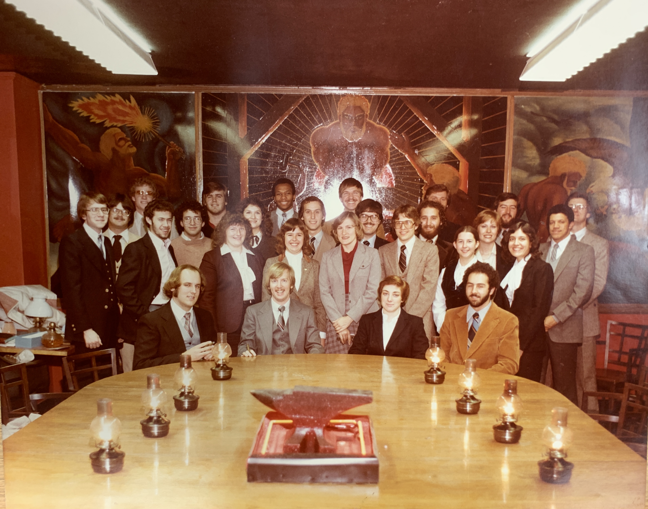
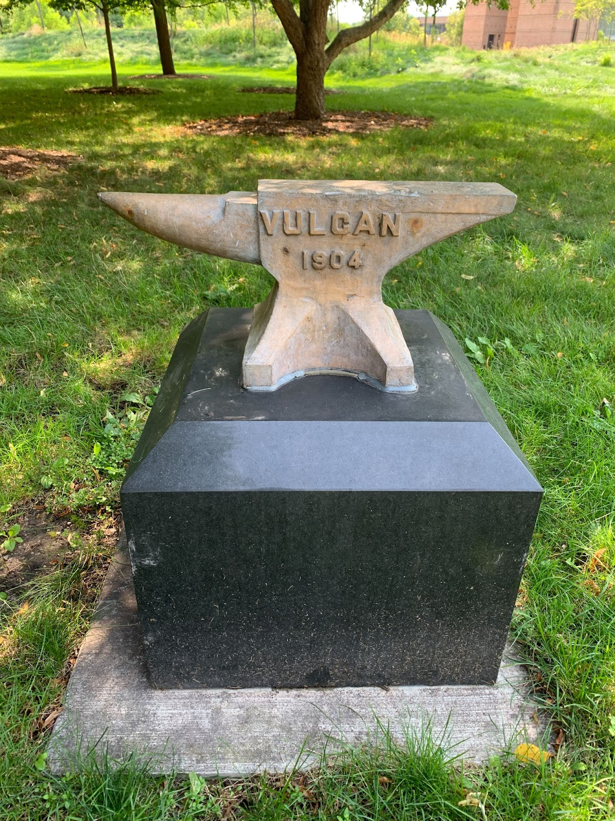
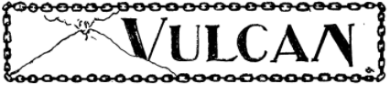
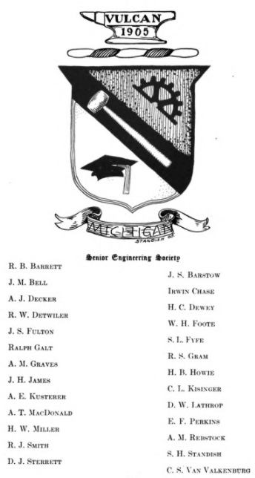
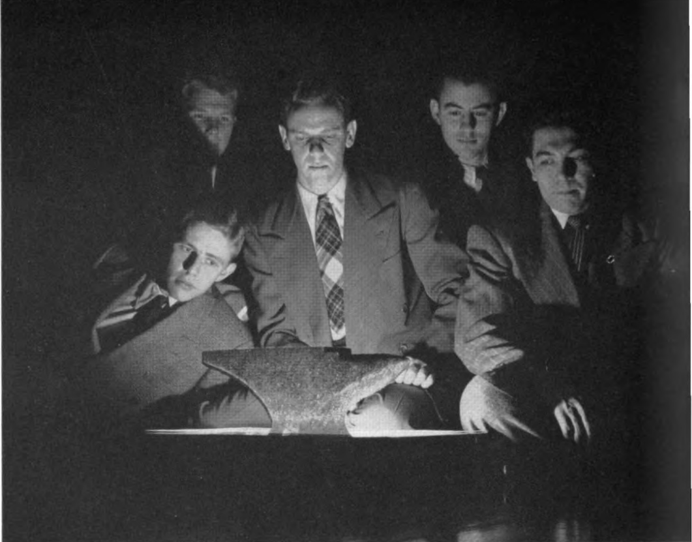
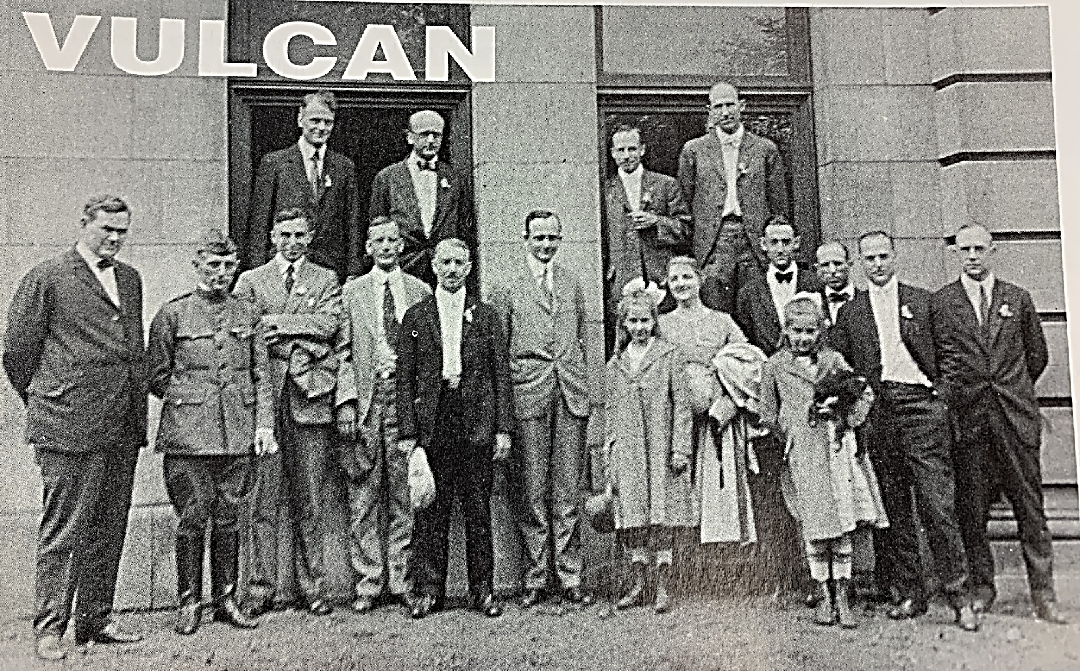
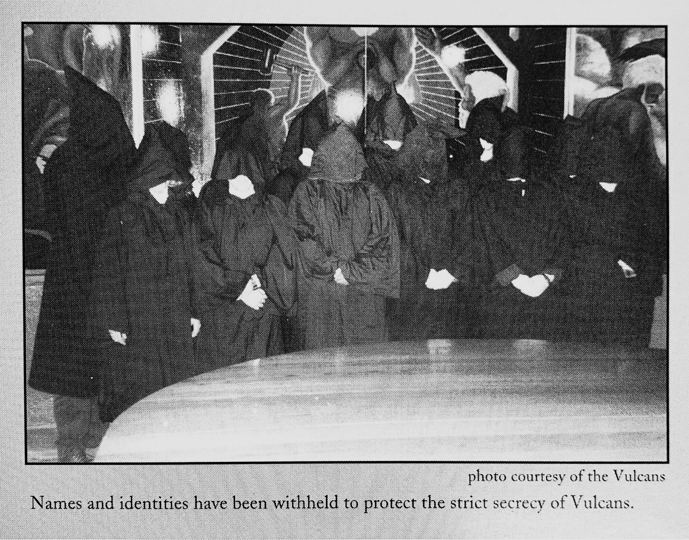
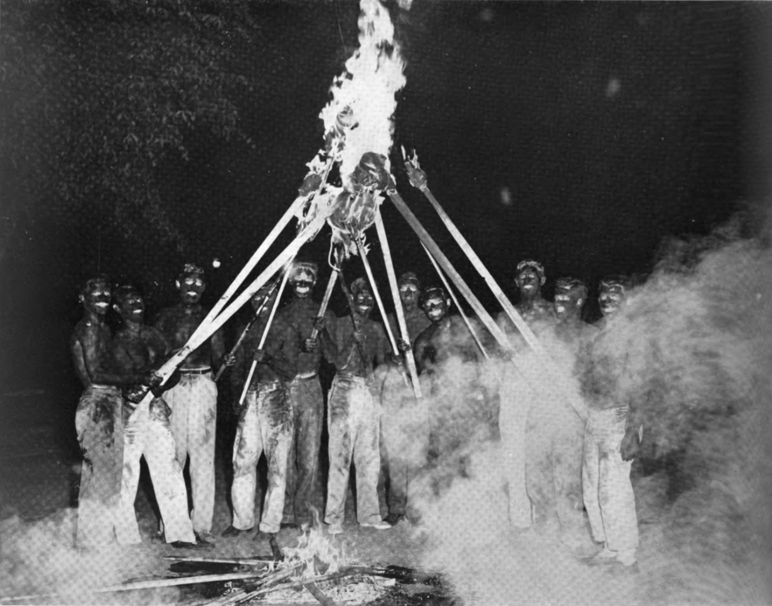
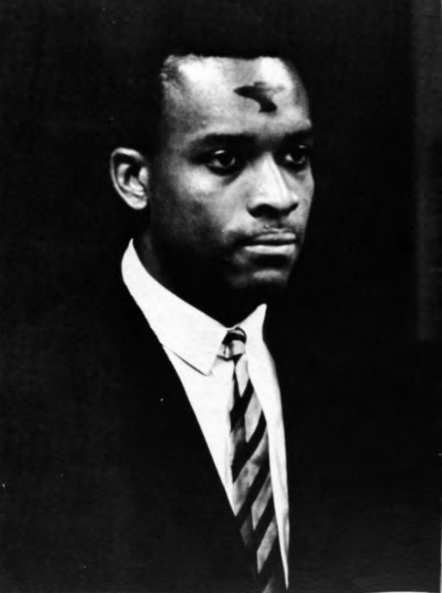
The Vulcans: A Reflective and Critical History of the College of Engineering's Secret Society
Engineering Honors Capstone
1st Jason Manassa, 2nd Deirdre De La Cruz²
¹Biomedical Engineering, University of Michigan, Ann Arbor, MI. ²History, University of Michigan, Ann Arbor, MI
Introduction
Materials and Methods
The Vulcans, a senior engineering honorary society, was organized in 1904. In addition to social activities, the society raises money for scholarships for engineering students.
Three kinds of membership were established: active, graduate, and honorary. Scholarship is not the sole requirement for initiation; a candidate must be popular and active in both scholastic and social affairs in the College of Engineering to be considered for membership.
Meetings were held in the Vulcan room in the tower of the Michigan Union until 2000 when they were told to vacate the building. Since 2010, no written records from the organization have surfaced leading to a mystery as to their current whereabouts.
Aside from providing its members with this form of fellowship and inspiration, the society's principal active function is to participate in student affairs of the College of Engineering and of the University as a whole, in cooperation with the other honorary societies on the campus. Engineering Deans and Professors are regularly offered membership and Google cofounder Larry Page was one of the hundreds of Vulcan alumni making a difference in their respective engineering fields.
Regular trips to the Bentley Historical Library on North Campus were how I collected and found my sources. I used only primary/secondary source documents when constructing my history of the Vulcans. Additionally, I utilized the Michigan Daily online newspaper database to chronical additional “unfavorable” events not recorded by the Vulcans, such as their arrest during the 1934 initiation.
Figure 1: Original Vulcan image for the 1904 Michiganensian yearbook next to later Anvil iconography
Figure 3: Vulcan meeting in Union room prior to being removed (left) Anvil used in initiation now sits in front of EECS building on North Campus (right)
Results
Discussion and Conclusions
A 54 page document comprising the Vulcans History from 1904-2022 was compiled and reflects both the attitudes of the time when sources were written, alongside modern reflections on the Vulcan’s past. The Vulcans were instrumental in organizing College of Engineering events, funding community projects, and supporting the University Hospital through donations and entertainment for the sick. The society has generated a variety of initiation rituals that change with the times based on availability to certain venues, and the campus climate towards certain aspects of initiation.
The group used to cover themselves in crankcase and ash to imitate the trials of Vulcan, but it gave the group an image of blackface. Vulcan members also would wear pointy hoods during initiation that scared away potential recruits due to the appearance of KKK iconography. Despite the Vulcans best intentions, these among other controversies forced the group to go into secrecy, a period that they still have not come out of. The group was ahead of other societies on campus, inducting its first black member in 1968 and first female member in 1972. They remain the last secret society on campus after the 2021 dissolution of the Order of Angell (formerly Michigamua) and Adara (formerly Phoenix) groups amid similar controversy.
Overall, the Vulcans were founded with the goal of aiding the College of Engineering, and their focus on public service has resulted in many parts of College life that seem standard to students today. They founded the Honor Council, helped raise funds for construction projects on campus, and worked alongside other student groups and Engineering Student Government to host events that benefit and welcome all students. Similar to other societies however, the have a past riddled with controversy and have chosen to plunge into secrecy rather than formally apologize and implement transparency into their dealings. Other societies that have adopted openness have dissolved completely, so the Vulcans secrecy may also be the success to their longevity. Today the Vulcans remain an active, yet elusive, part of student life for Michigan Engineering students.
Objectives
Compile and publish the first public record of the Vulcans available to anyone interested in the society’s history
Work to discern current Vulcan members and gather primary accounts on their current activities and their more recent contributions to the College of Engineering
Shine a light on problematic practices of the Vulcans’ past that reflected the College of Engineering and people of color poorly
Provide the Vulcans with a more comprehensive overview of their organization’s history that is unbiased in its portrayal of past traditions and events
Figure 4: Vulcan class of 1904 (left) Vulcan class of 1992 (right)
Acknowledgements
I would like to thank the University of Michigan Bentley Library for its resources on Vulcan history. I would also like to thank Dr. De La Cruz from the Department of History for her mentorship
Figure 2: Torch burning ceremony during initiation (left) first black member (right)

Slide 2
The Vulcans: A Reflective and Critical History of the College of Engineering's Secret Society
Engineering Honors Capstone
Jason Manassa, Deirdre De La Cruz²
¹Biomedical Engineering, University of Michigan, Ann Arbor, MI. ²History, University of Michigan, Ann Arbor, MI

Slide 3
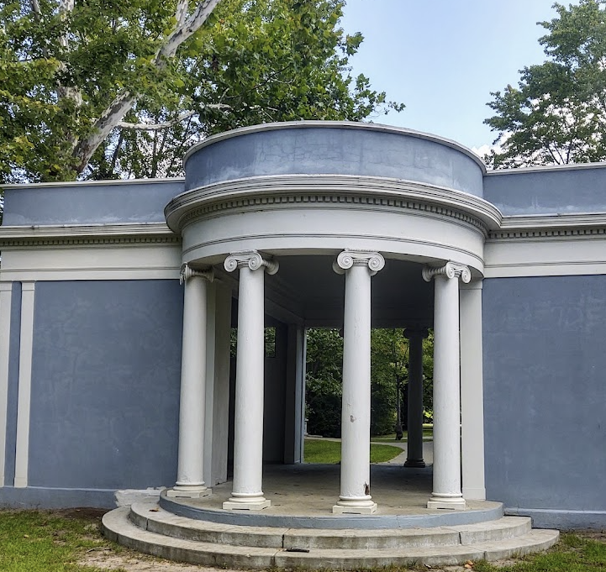
How did I get here?
How did you get involved in this project?
How did you connect with your capstone advisor, lab, team?
What problems or challenges did you encounter, and how did you handle them?
Is there anything you didn’t have time for in this project that you wish you could explore?

Slide 4
Introduction
The Vulcans, a senior engineering honorary society, was organized in 1904. In addition to social activities, the society raises money for scholarships for engineering students.
Three kinds of membership were established: active, graduate, and honorary. Scholarship is not the sole requirement for initiation; a candidate must be popular and active in both scholastic and social affairs in the College of Engineering to be considered for membership.

Slide 5

Introduction
Meetings were held in the Vulcan room in the tower of the Michigan Union until 2000 when they were told to vacate the building. Since 2010, no written records from the organization have surfaced leading to a mystery as to their current whereabouts.
Aside from providing its members with this form of fellowship and inspiration, the society's principal active function is to participate in student affairs of the College of Engineering and of the University as a whole, in cooperation with the other honorary societies on the campus. Engineering Deans and Professors are regularly offered membership and Google cofounder Larry Page was one of the hundreds of Vulcan alumni making a difference in their respective engineering fields.

Slide 6
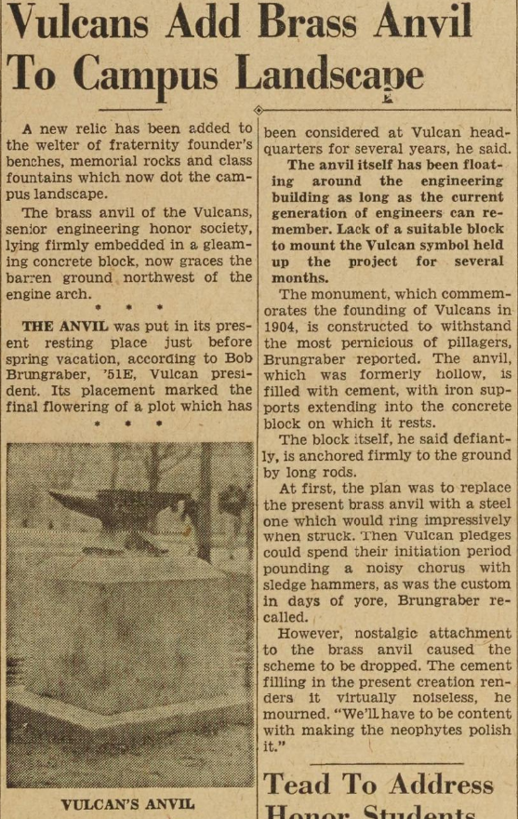
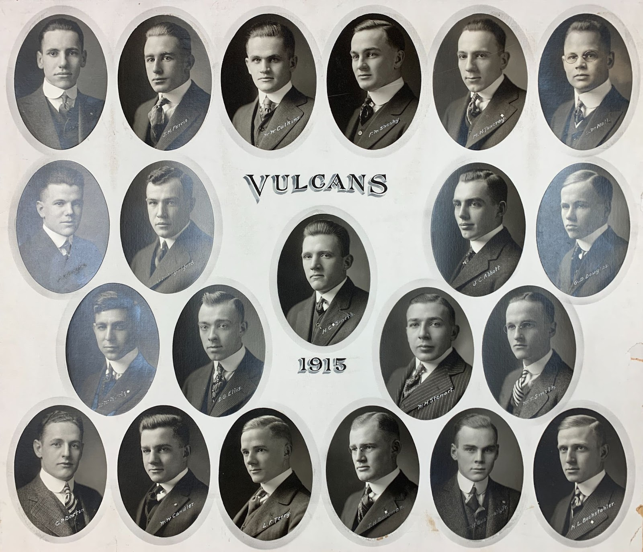
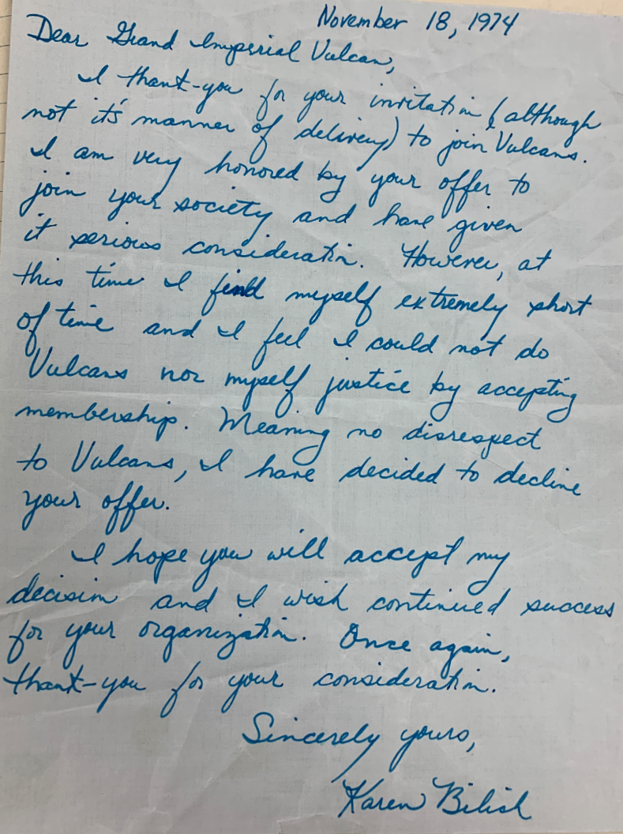
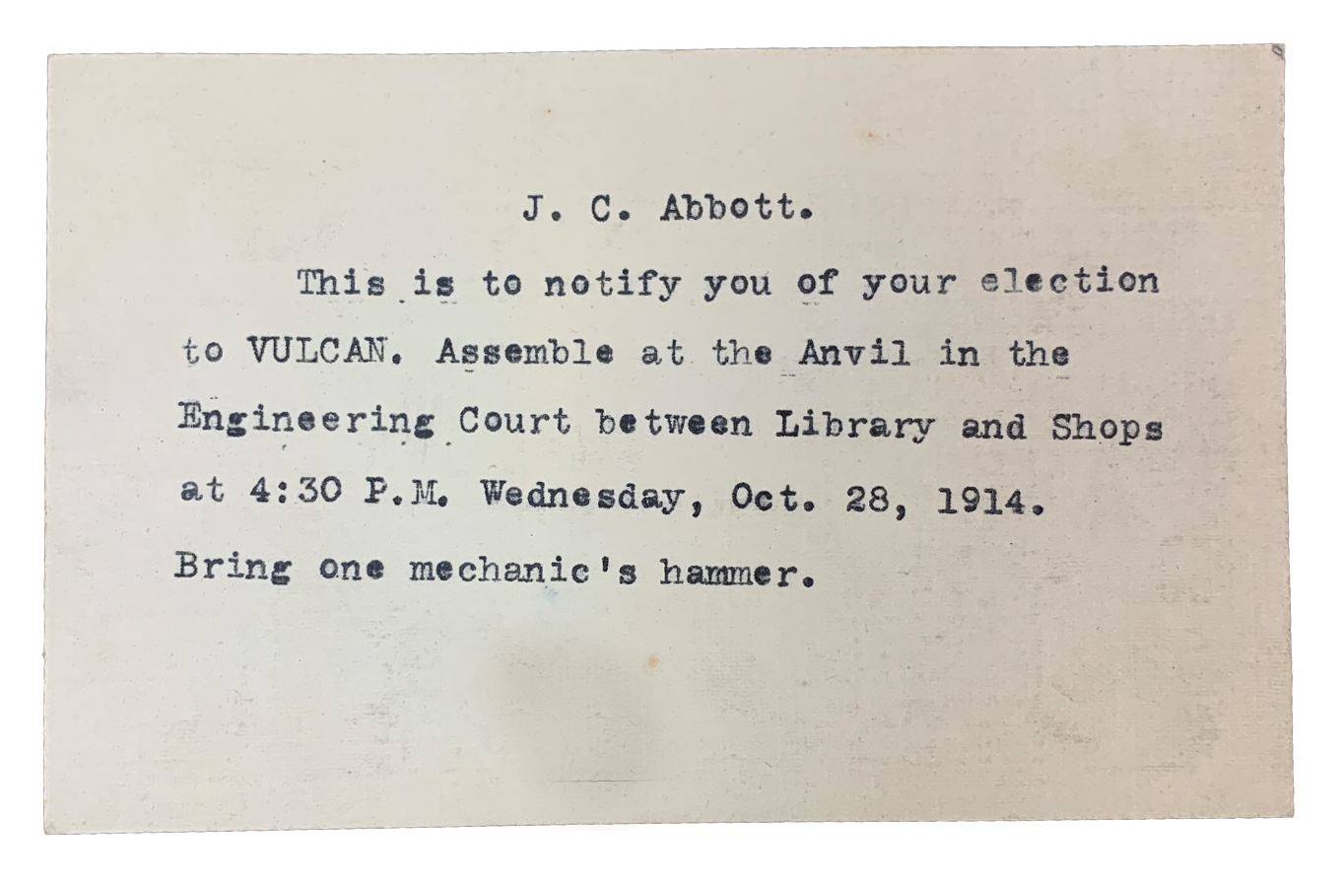
Objectives
Compile and publish the first public record of the Vulcans available to anyone interested in the society’s history
Work to discern current Vulcan members and gather primary accounts on their current activities and their more recent contributions to the College of Engineering
Shine a light on problematic practices of the Vulcans’ past that reflected the College of Engineering and people of color poorly
Provide the Vulcans with a more comprehensive overview of their organization’s history that is unbiased in its portrayal of past traditions and events

Slide 7
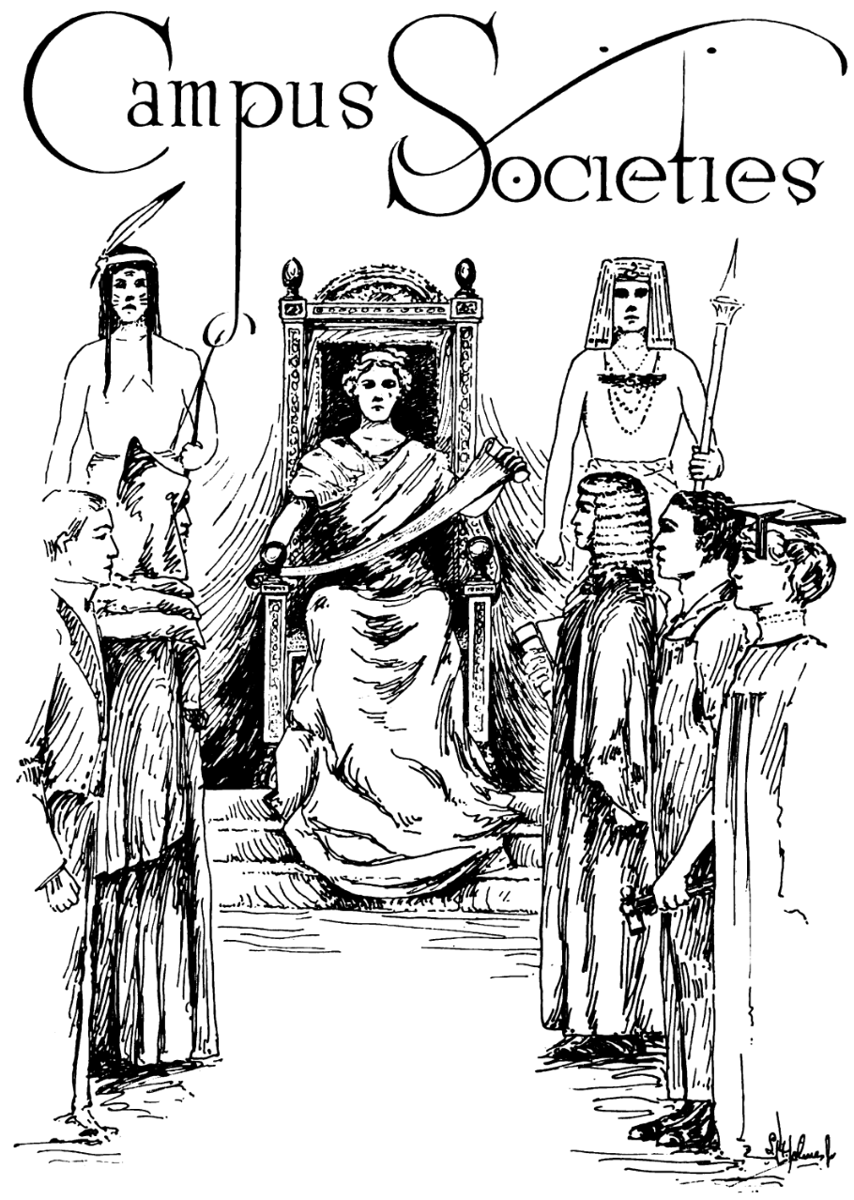
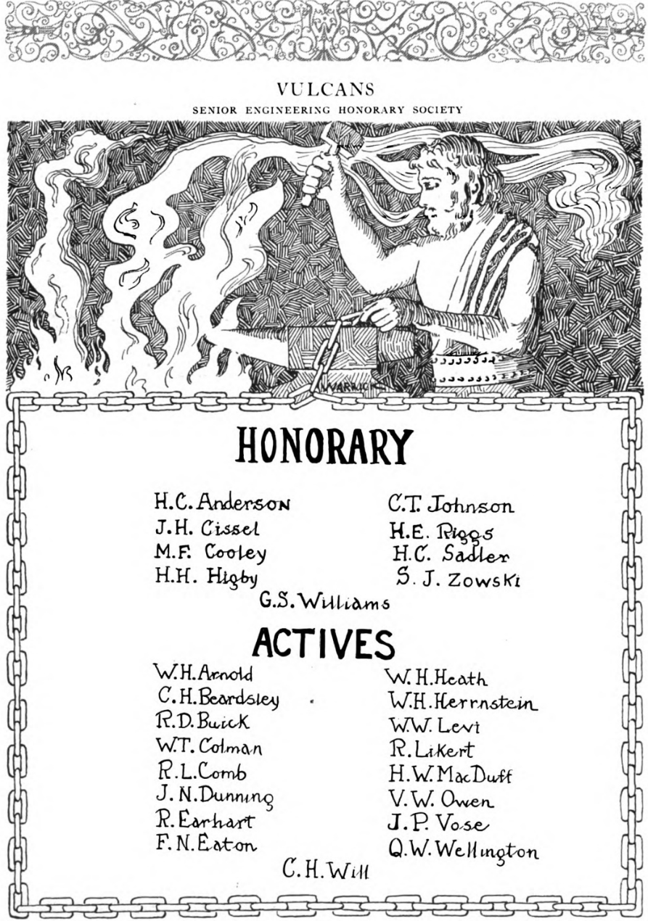
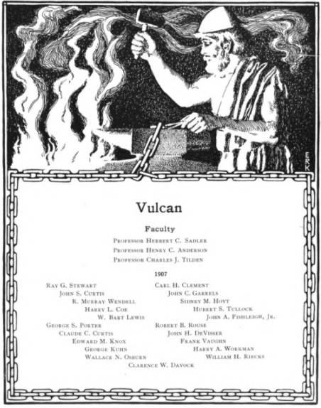
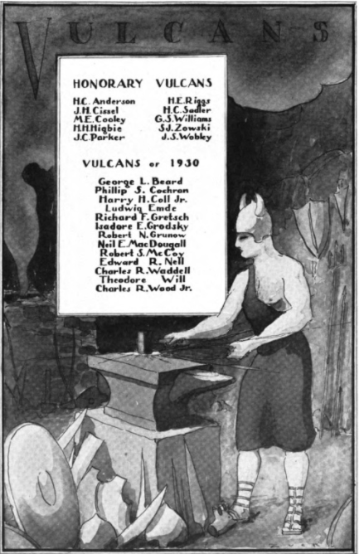
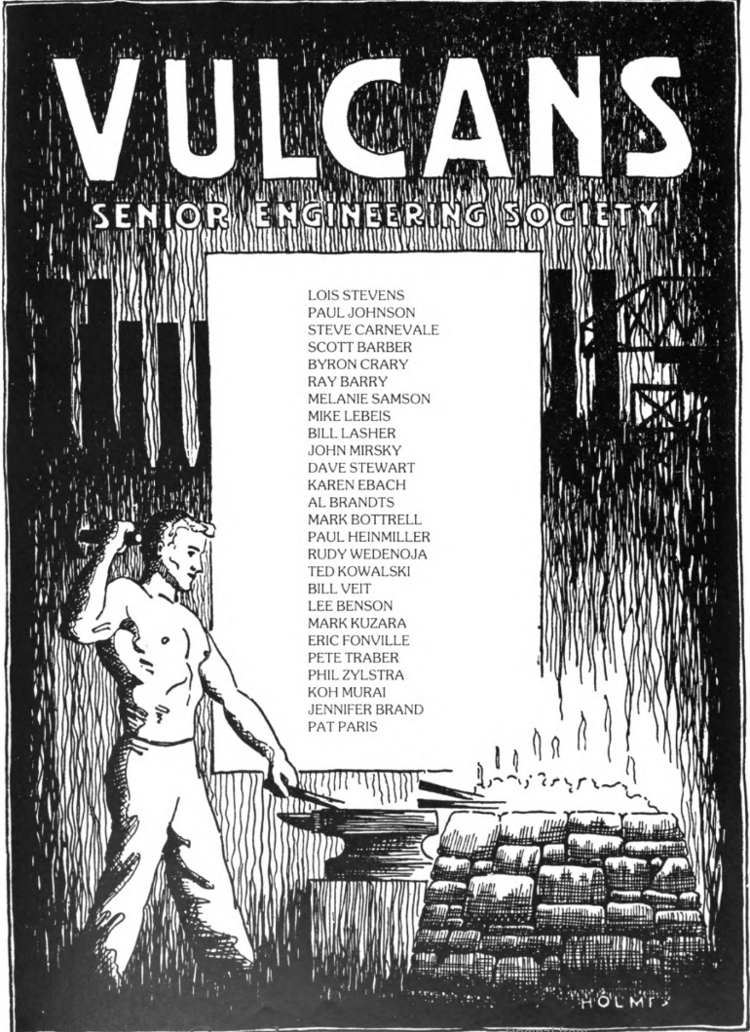
Materials and Methods
Regular trips to the Bentley Historical Library on North Campus were how I collected and found my sources. I used only primary/secondary source documents when constructing my history of the Vulcans. Additionally, I utilized the Michigan Daily online newspaper database to chronical additional “unfavorable” events not recorded by the Vulcans, such as their arrest during the 1934 initiation events.

Slide 8
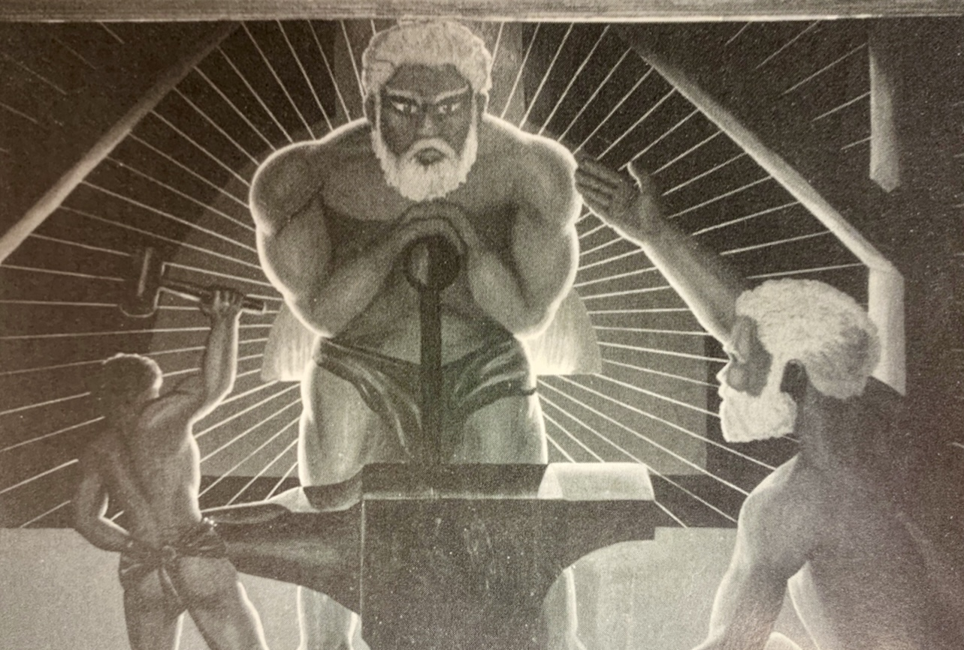
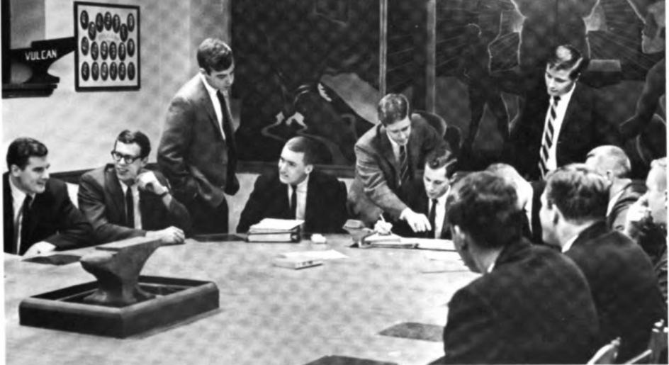
Results
A 54 page document comprising the Vulcans History from 1904-2022 was compiled and reflects both the attitudes of the time when sources were written, alongside modern reflections on the Vulcan’s past.
The Vulcans were instrumental in organizing College of Engineering events, funding community projects, and supporting the University Hospital through donations and entertainment for the sick. The society has generated a variety of initiation rituals that change with the times based on availability to certain venues, and the campus climate towards certain aspects of initiation.

Slide 9
Controversy
The group used to cover themselves in crankcase and ash to imitate the trials of Vulcan, but it gave the group an image of blackface. Vulcan members also would wear pointy hoods during initiation that scared away potential recruits due to the appearance of KKK iconography. Despite the Vulcans best intentions, these among other controversies forced the group to go into secrecy, a period that they still have not come out of. The group was ahead of other societies on campus, inducting its first black member in 1968 and first female member in 1972. They remain the last secret society on campus after the 2021 dissolution of the Order of Angell (formerly Michigamua) and Adara (formerly Phoenix) groups amid similar controversy.

Slide 10
Conclusions
Overall, the Vulcans were founded with the goal of aiding the College of Engineering, and their focus on public service has resulted in many parts of College life that seem standard to students today. They founded the Honor Council, helped raise funds for construction projects on campus, and worked alongside other student groups and Engineering Student Government to host events that benefit and welcome all students. Similar to other societies however, the have a past riddled with controversy and have chosen to plunge into secrecy rather than formally apologize and implement transparency into their dealings.

Slide 11
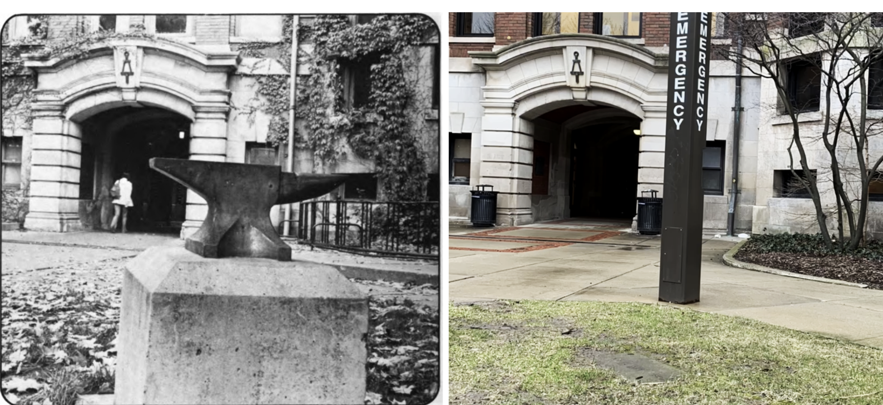
Where are they now?
Other societies that have adopted openness have dissolved completely, so the Vulcans secrecy may also be the success to their longevity.
Today the Vulcans remain an active, yet elusive, part of student life for Michigan Engineering students.

