Slide 1



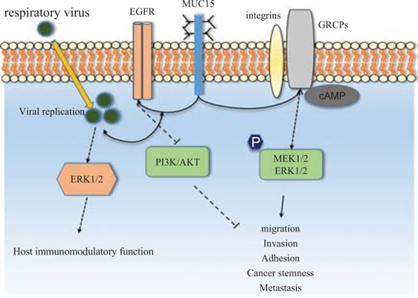
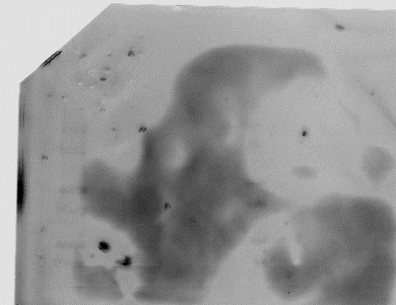
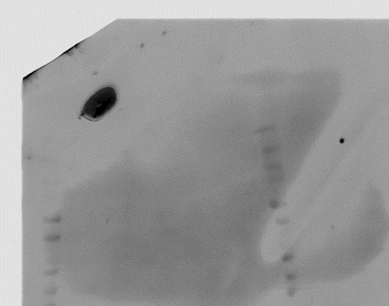
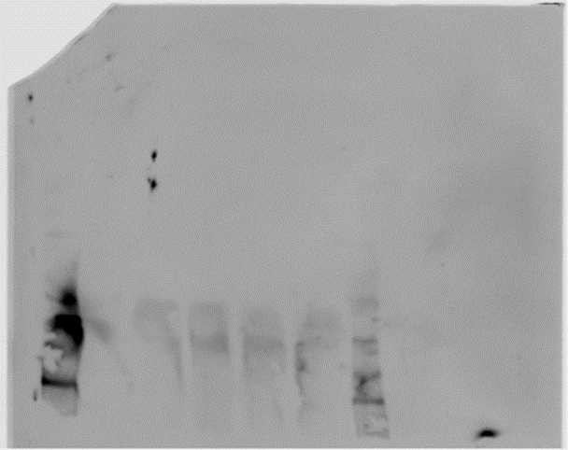
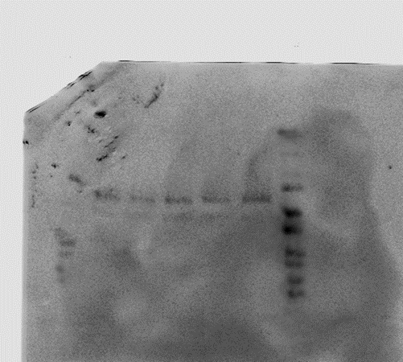
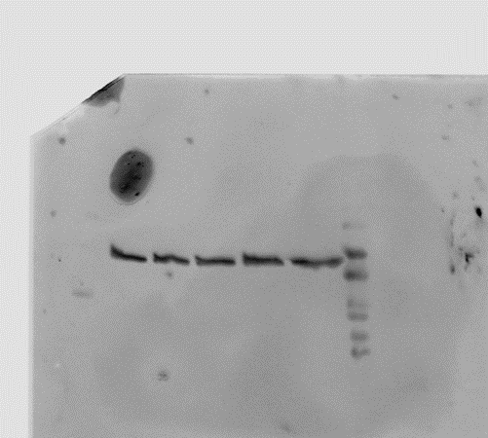
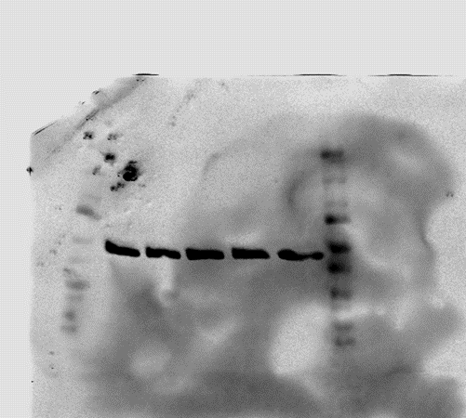

Demonstrating the Link Between MUC15 Expression and Downregulation of PI3K/AKT Signaling
Erin Parlow
Capstone Advisor: Dr. Geeta Mehta
Poster ID: 3549405
Background
Methods
Challenges + Conclusions
Ovarian Cancer
Western Blot Protein Analysis on Five Cell Lines
Challenges:
Variability in results with consistent western blot protocol
Cell contamination issues that could have affected expression patterns
Blotchiness or poor resolution on Western Blots
Western Blots take several days to complete and analyze
Conclusions:
Higher mg (> 40 mg) of protein and overnight incubation is best for showing expression
Housekeeping genes consistent across cell lines
No noticeable difference in expression of pAKT/AKT across cell lines
Is the fifth most deadly form of cancer for women
Is the most deadly form of cancer in the female reproductive tract
Has poor treatment outcomes and low survival rates [1]
Control
Up Scrambled
Down Scrambled
Var2
696
MUC15 and PI3K/AKT signaling
MUC15 expression has been linked to decreased promotion of the PI3K signaling pathway due to decreased AKT phosphorylation.
In renal cancers this has been shown to decrease metastasis [3].
Baseline MUC15 Expression
Upregulated MUC15
Downregulated MUC15
Genetic Controls
Results
Next Steps
Blotting Issues Experienced
-
Complete repeatable resolved Western Blot with newly acquired cell lies to track expression without possible contamination
Compare AKT/pAKT expression with MUC15 expression
Complete ELiZA studies with sheared media to assess mechanical influences of MUC15 activation
Complete Co-IP columns to track if new dimers form in the presence or absence of MUC15 which promote activity of the signaling cascade
[2]
Previous + Current Lab Work
RNAseq experiments
MUC15 Protein Quantification
Discover Optimal Western Blot Parameters
Blotchiness
Unresolved Data
Unclear separations
Increased Cell Lysate Amount
Refined Technique
Acknowledgements
MUC15 one of 50 underexpressed genes
Do MUC15 expression trends follow expectations?
Assess protein expression levels
Thank you to Dr. Geeta Metha and Eric Horst for supporting my work on this Capstone.
Thank you to the Honors Program for providing community and guidance for the completion of this project.
40 mg
Control
ScrDN
ScrUP
Var2
696
Good resolution
BUT
No intelligible size difference in expression between lines
No relationship demonstrated between AKT/pAKT expression.
Objective
AKT
References
Demonstrate that increased expression of MUC15 surface markers results in a downregulation of the PI3K/AKT signaling pathway via decreased phosphorylation of AKT.
[1] Ovarian cancer statistics: How common is ovarian cancer. American Cancer Society (2022). Available at: https://www.cancer.org/cancer/ovarian-cancer/about/key-statistics.html. (Accessed: 13th April 2022)
[2} Zhang, S. et al. Targeting MUC15 protein in cancer: Molecular mechanisms and therapeutic perspectives. Current Cancer Drug Targets 20, 647–653 (2020).
[3] Yue, Y., Hui, K., Wu, S. et al. MUC15 inhibits cancer metastasis via PI3K/AKT signaling in renal cell carcinoma. Cell Death Dis 11, 336 (2020). https://doi.org/10.1038/s41419-020-2518-9
pAKT
β-actin

