Slide 1


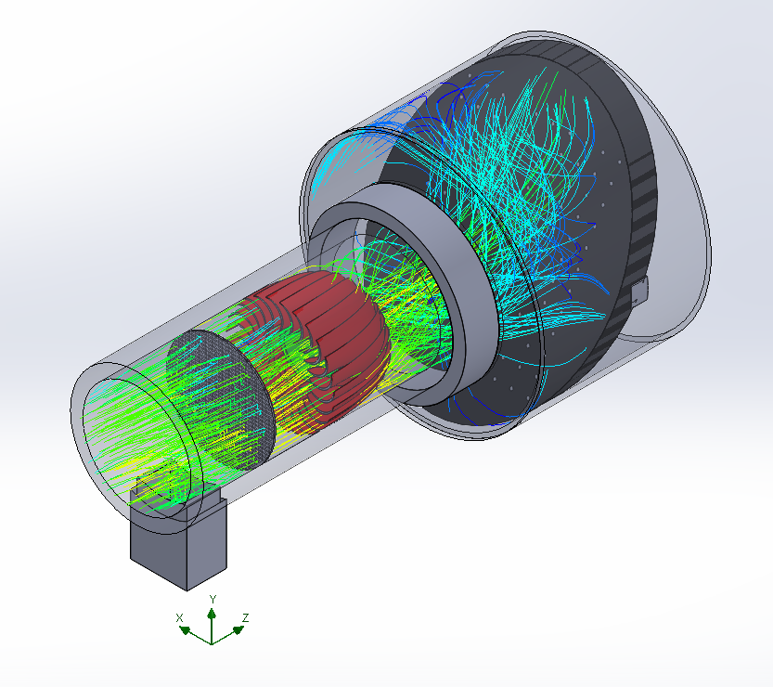
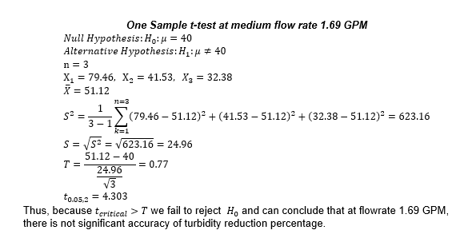
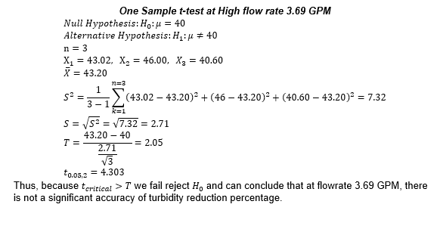
Water Quality Improvement for an Urban World- Quality Water & Contamination Control Unit
Sterling Knight, Aamir Samdani (Honors Capstone), Vanessa Woolley (Honors Capstone) Advisor: Jeremy Bricker
Introduction
Methods
    At a medium flowrate (1.69 gpm) we found the following
Physical Testing Parameters and Set Up
  Physical Testing was conducted on 4/2/2022 in the EWRE flume lab.
  Water with varying initial turbidity was sent through the module. The turbidity of water was measured after treatment
  Turbidity was measured with a secchi disk, then translated to units of NTU using the Penn State college of Agriculture relation of turbidity [NTU] = 24.2d^{1.52.}
  Multiple trials were performed to conduct statistical analysis, varying flowrate.
Water quality is one of the most important factors for human health and wellbeing.
Water quality is an issue of growing importance as cities grow and infrastructure ages.
Climate change has altered both the frequency and intensity of storms.
Sewage overflows (from combined sewage systems and otherwise) resulting from insufficient capacity at treatment plants have been increasing in frequency in some places.
This project started through the Innovation in Action competition of Winter 2021.
Followed the Socially Engaged Design Process
UN Sustainability goals of Life Below Water, Clean Water and Sanitation, Good Health and Wellbeing, Reduced Inequalities, and Industry Innovation and Infrastructure
UV is 99% effective within 6 inches of the UV in 10 seconds.
It is extremely effective and damages the bacteria DNA.
The initial design is shown below.
Trial | Turbidity Reduction Percentage (%)
1 | 79.46
2 | 41.53
3 | 32.38
  Model of Statistical Hypothesis Testing
    Target Condition: Turbidity reduction should be 40%
    Research Question: We want to identify whether or not there is a significant turbidity percentage reduction accuracy at a given water flow rate after water passes through our water treatment solution.
    Rates will be altered (while passing through filter)
    Dependent Variable: Turbidity reduction percentage of water
    One Sample t-test conducted at a significance level of 𝞪 = 0.05. Assume Normal conditions (observations).
    t_{critical} determined from t distribution table.
    At a high flowrate (3.69 gpm) we found the following
Trial | Turbidity Reduction Percentage (%)
1 | 43.02
2 | 46.00
3 | 40.60
Conclusion
Results
    We have demonstrated our design has the capabilities to reduce turbidity by around 40% through our testing.
    However, It was identified in our prototype hypothesis testing that there is no significant accuracy in turbidity reduction percentage at both medium and high flow rates.
    The UV will reduce the bacterial load (from literature).
    Next steps include design improvements and further testing.
    Further testing should enable us to acquire a larger sample size and reduce the data variance.
    Further hypothesis testing with larger and smaller flowrates would better enhance prototype optimization by establishing more accurate thresholds of correlations on the relationship between them.
    Improvements to the design include adding solar, turbine, and scaling up to a full-size module.
    We would also move the outlet lower down to more easily discharge water and reduce stagnation in the body of our design.
Global and Systems Impact
Ethics: Designing a prototype that is environmentally sustainable and conscious of the communities it serves is a crucial objective.
Communities such as Flint, Ann Arbor, and Metro Detroit would greatly benefit from a QWACC solution.
Affordable: Taking into account municipal budgets
No significant technical skill would be required to assemble or install our solution.
Activated Carbon utilized in our QWACC solution is biodegradable and would have zero negative externalities when needing to be replaced and recycled after its effective duration of ~ 36 months.
Acknowledgements
Sincere thanks to all those who have contributed to this project. Special thanks to the following:
Tao Cai
Rosalia Otaduy-Ramirez
Jeremy Bricker (PhD) & Taeksang Kim
Aline Cotel (PhD)
Karen Alofs (PhD) & Kathleen Quebedeaux
University of Michigan Center for Socially Engaged Design with special thanks to Erin Moore
University of Michigan Engineering Honors
Penn State University College of Agricultural Studies
Societal/ Ergonomic Principals to Adhere by
Ensured prototype design would be an appropriate weight and size to prevent ergonomic/musculoskeletal injuries during the assembly process.
Cylindrical prototype shape was determined to be optimal for removing water particulates and be easily handled and installed by workers into a given sewage unit.

