Slide 1

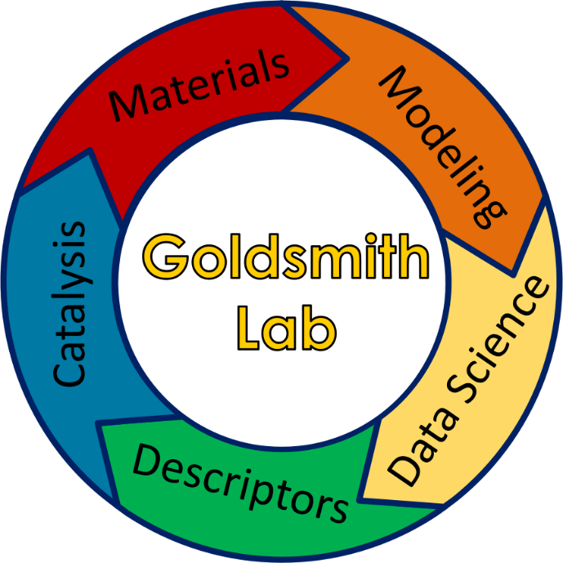

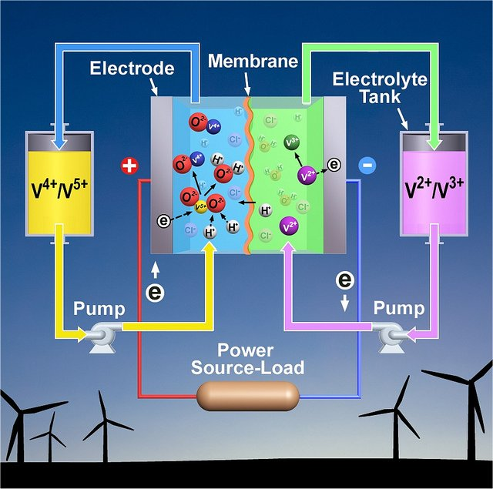
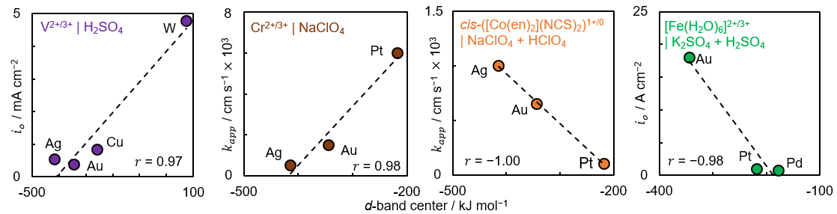
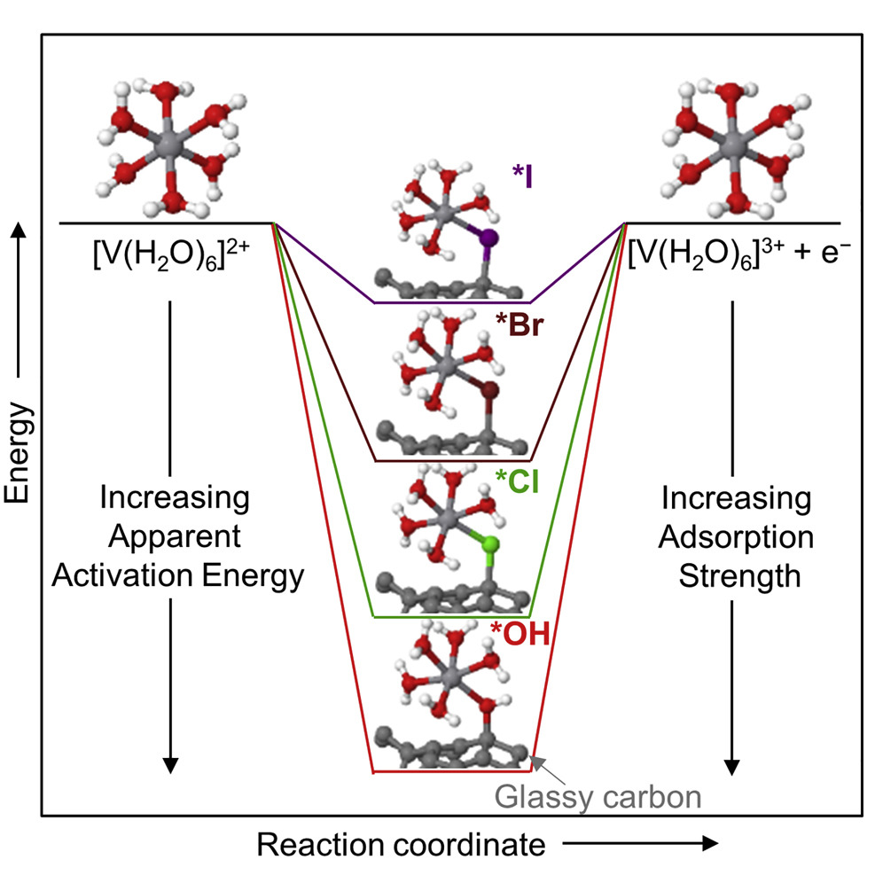
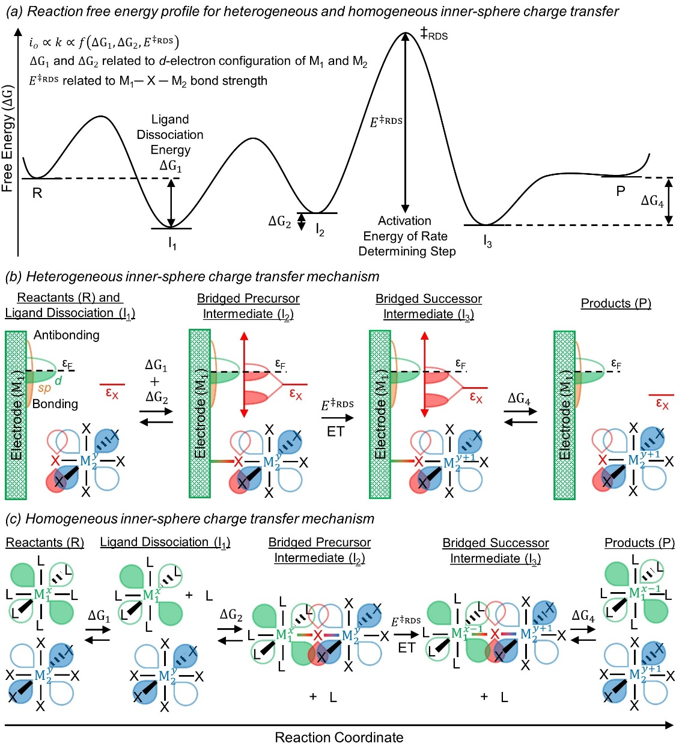
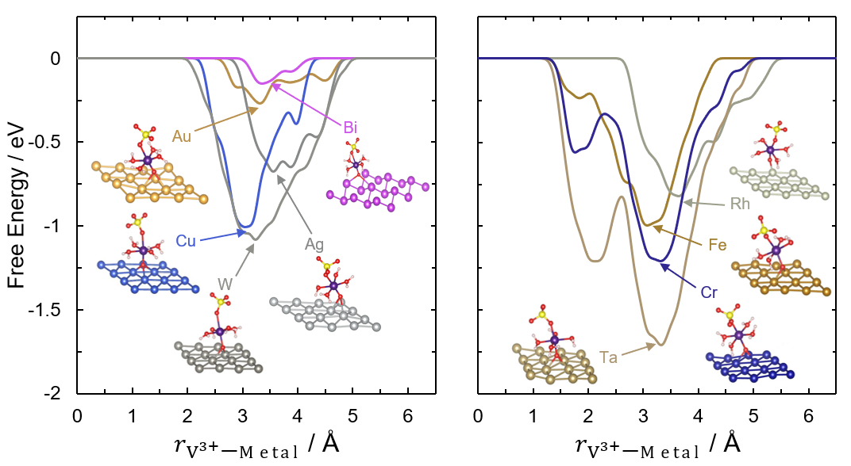
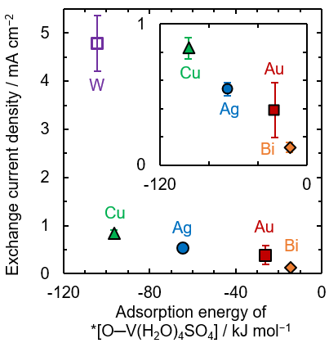
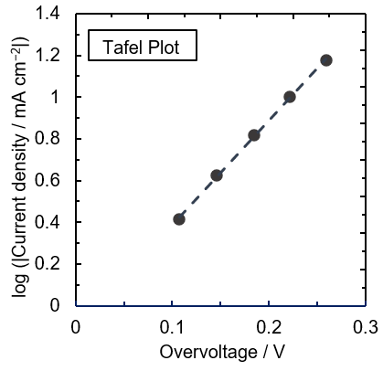
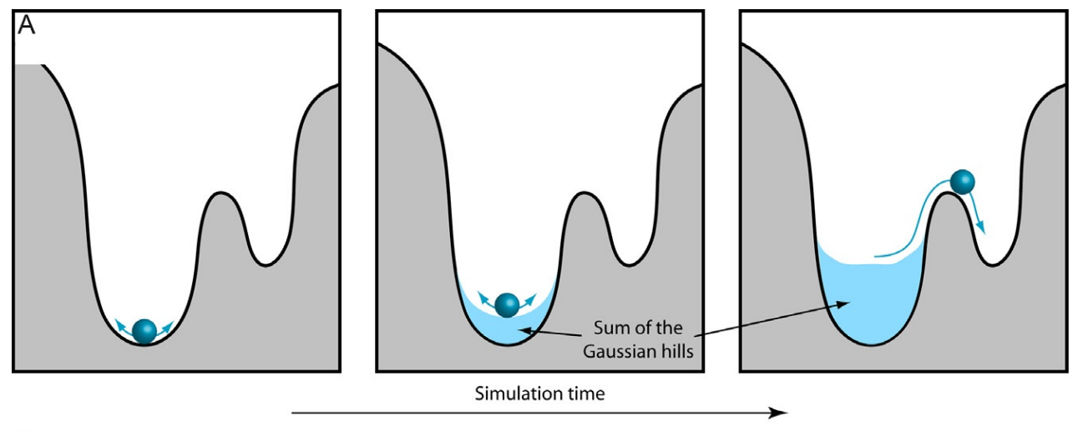
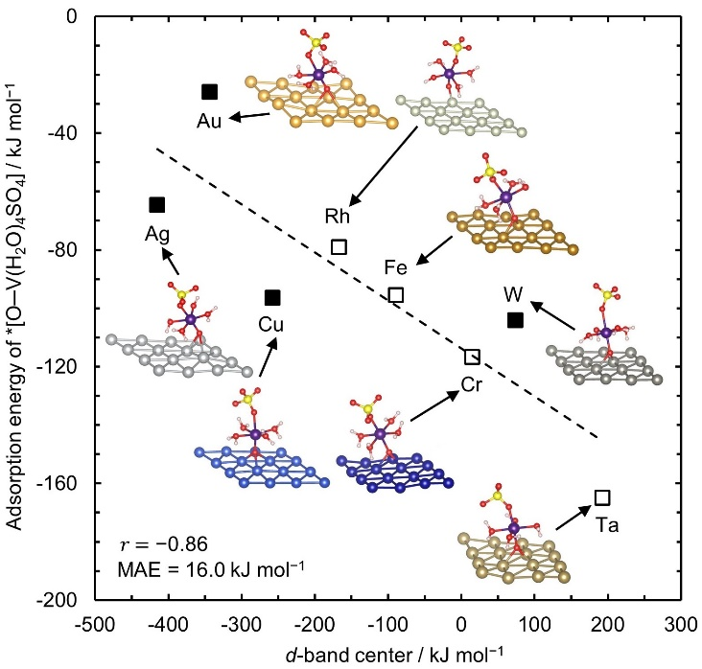
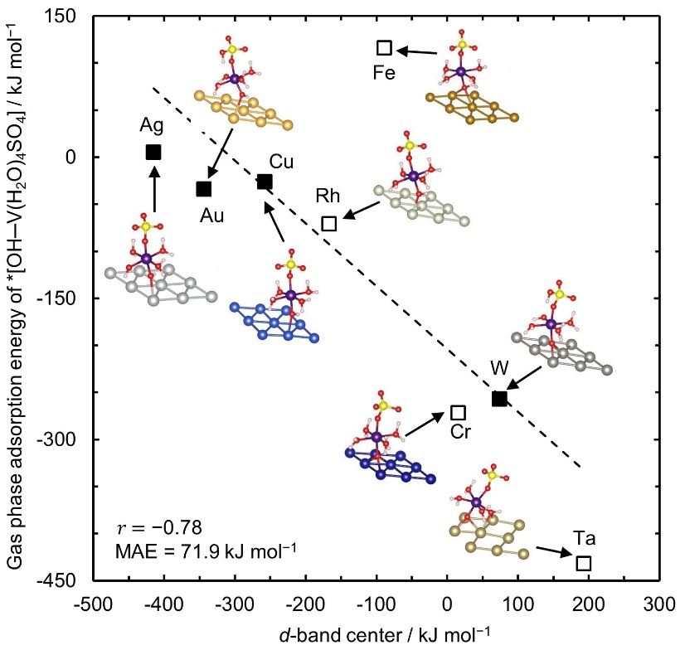
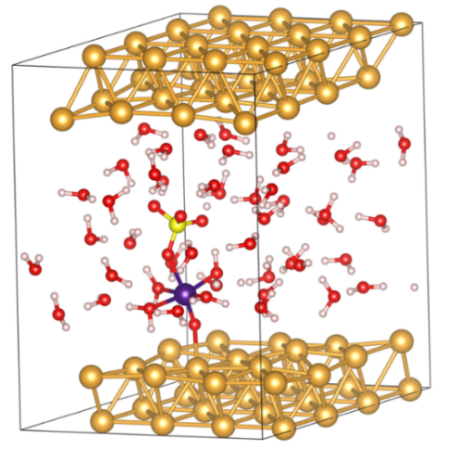
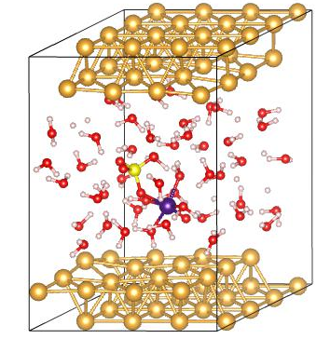
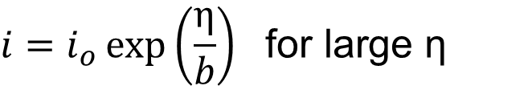
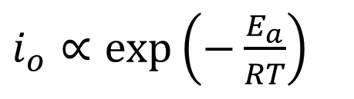
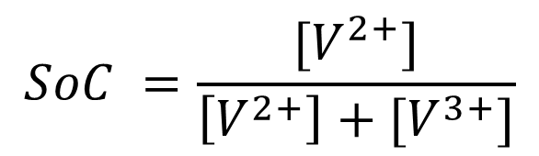
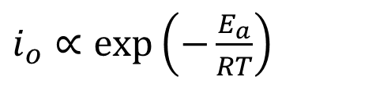
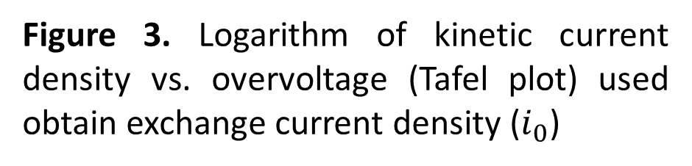
Explaining Kinetic Trends of Inner-sphere Transition Metal Ion Redox Reactions at Electrodes
Harsh Agarwal, Jacob Florian, Daniel Pert (Honors Capstone), Bryan R. Goldsmith, Nirala Singh
Introduction
Results
Results (cont.)
Heterogeneous inner-sphere transition metal-ion charge transfer (CT) reactions involve the formation of a chemical bond between the electrode and the metal ion
They are relevant for electroplating, chemical sensors, corrosion prevention, and redox flow batteries (RFBs) for grid-scale clean energy storage
Widespread commercialization of vanadium RFBs (Figure 1) is limited by slow V²⁺/V³⁺ CT kinetics and low energy efficiency
Simple descriptors for inner-sphere CT kinetics could enable rational design of more active electrocatalysts
Kinetic measurements (Figure 6), microkinetic modelling (Figure 7), and adsorption energy calculations (Figures 8,9) all indicate an inner-sphere mechanism for V²⁺/V³⁺ on metal electrodes
Results indicate CT is the rate-determining step and *[O─V(H₂O)₄SO₄] is the adsorbed intermediate
Kinetics of other heterogenous CT reactions from literature involving transition metal ion redox couples also correlate with d-band center (Figure 10)
(a)
(b)
(c)
(a)
(b)
(c)
(d)
10⁹
10⁷
10⁵
10³
Figure 1. A VFRB converts V³⁺ to V²⁺ during charging and V²⁺ back to V³⁺ during discharging [1]
10
Background
0.1
Figure 10. Correlation between d-band center and kinetics of different inner-sphere redox couples: (a) V²⁺/V³⁺ in H₂SO₄, (b) Cr²⁺/Cr³⁺ in NaClO₄, (c) Co²⁺/Co³⁺ in NaClO₄ + HClO₄, and (d) Fe²⁺/Fe³⁺ in K₂SO₄ + H₂SO₄ (b-d taken from the literature)
Figure 6. (a) Exchange current densities ($i_{o}$) from the Tafel method (b) apparent activation energies ($E_{a}$), and (c) apparent frequency factors as a function of SoC for V²⁺/V³⁺ reaction on Au, Ag, Cu, Bi, W, edge plane pyrolytic graphite (EPPG), and glassy carbon (GC) electrodes
We hypothesize that the d-band center of the electrode affects the adsorption energy of the CT intermediate and therefore acts as a descriptor for heterogenous inner-sphere CT kinetics
The adsorption energy of the proposed intermediate *[X─MX₅] depends on overlap between the d-orbital of the electrode and the p-orbital of the ligand X according to d-band theory (Figure 11)
A lower d-band center results in greater occupancy in the anti-bonding orbitals, leading to weaker adsorption; conversely, a higher d-band center leads to stronger adsorption
Previous work using extended X-ray absorption fine structure (EXAFS) spectroscopy has confirmed the structure of V²⁺ and V³⁺ in perchloric, hydrochloric, and sulfuric acid (Figure 2) [2,3]
V²⁺/V³⁺ CT kinetics on glassy carbon are determined by the energy of the adsorbed intermediate
Based on kinetic measurements, we hypothesize the *[O─V(H₂O)₄SO₄] intermediate occurs on metal surfaces in H₂SO₄, and that the same effect of adsorption energy on CT kinetics holds [4]
The average energy of the d electrons (d-band center) may act as a descriptor for CT kinetics
(a)
(b)
(c)
(a)
3+
(b)
2+
(c)
(d)
(a)
H₂O
H₂O
H₂O
H₂O
H₂O
H₂O
H₂O
H₂O
H₂O
+
H₂O
V
H₂O
H₂O
V
H₂O
H₂O
V
H₂O
H₂O
Cl
SO₄
Figure 7. Predicted trends of (a) exchange current density, (b) apparent activation energy, and (c) apparent frequency factor with SoC assuming electron transfer is the rate determining step
Figure 2. Structure of V³⁺ complex in the presence of (a) perchloric, (b) hydrochloric, and (c) sulfuric acid. Note that an additional chloride may complex with V³⁺ in hydrochloric acid (d) The adsorption energy of the bridged intermediate controls CT kinetics on a glassy carbon electrode
(b)
$$SoC =\frac{[V^{2+}]}{\left[V^{2+}\right]+[V^{3+}]}$$
$i_{o}$ ∝ $\exp\left(−\frac{E_{a}}{RT}\right)$
Methods
(a)
(b)
(c)
Use Tafel method (Figure 3) to find exchange current density and apparent activation energy of V²⁺/V³⁺ reaction on different electrodes as a function of the state of charge (SoC)
Develop a microkinetic model to determine the RDS for V²⁺/V³⁺ based on kinetic measurements
Use DFT calculations to evaluate adsorption energy of *[O─V(H₂O)₄SO₄] intermediate on metals to with varying d-band center (Figure 4,5) to see if correlation exists
Extract kinetic data from literature for other heterogeneous metal-ion CT reactions to test validity of d-band center as kinetic descriptor
Figure 11. (a) Free energy profile for inner-sphere heterogeneous metal ion CT reaction (b) Reaction steps involving transition metals M₁ and M₂ and neutral ligand X. ε_{X} is the electronic energy of the p-orbital of ligand X, and ε_{F} is the electrode Fermi level
Identification of d-band center as kinetic descriptor will enable rational design of alloys or core-shell catalysts with a desired d-band center to maximize inner-sphere CT kinetics
Figure 8. Computed free energy profile of adsorbed vanadium intermediate on metals that are (a) experimentally tested, i.e., Bi, Au, Ag, Cu, and W and (b) not experimentally tested, i.e., Rh, Fe, Cr, and Ta for V²⁺/V³⁺ kinetics (c) Exchange current density as a function of calculated adsorption energies of *[O─V(H₂O)₄SO₄] on Au, Ag, Cu, Bi, and W electrodes for V²⁺/V³⁺ reaction
Conclusions
$i_{o}$ ∝ $\exp\left(−\frac{E_{a}}{RT}\right)$
We demonstrate for the first time that the d-band electronic structure of the electrode is related to the heterogeneous inner-sphere CT kinetics of transition metal ions [7]
We focus on the V²⁺/V³⁺ reaction because the mechanism is not well understood despite its importance in commercialized vanadium-based redox flow batteries for energy storage
W is the most active electrocatalyst reported for the V²⁺/V³⁺ reaction to-date
Our findings extend the applicability of the d-band model, which is ubiquitously used in heterogeneous catalysis, to transition metal ion adsorbates for charge transfer reactions
Higher d-band center leads to stronger binding, as expected from d-band theory
Same trends in both aqueous phase and gas phase, but stronger correlation in aqueous phase
$$i=i_{o}\exp\left(\frac{η}{b}\right) \text{for} \text{large} \text{η}$$
Figure 4. Metadynamics can be described as filling the valleys of the free energy landscape with computational sand. Gaussian “hills” are deposited to bias the system away from values of the collective variable that have been sampled. Image reprinted from ref. 6
(a)
(b)
Acknowledgements
Figure 3. Logarithm of kinetic current density vs. overvoltage (Tafel plot) used obtain exchange current density ($i_{0}$)
(a)
(b)
This research used the resources of the National Energy Research Scientific Computing Center (NERSC), a U.S. Department of Energy Office of Science User Facility operated under Contract No. DE-AC02-05CH11231 using NERSC award BES-ERCAP0022175
References
Figure 5. Simulation cell used to evaluate adsorption energy of *[O─V(H₂O)₄SO₄] on Au(111) using metadynamics (a) before desorption and (b) after desorption
[1] Upgrading the Vanadium Redox Battery, Pacific Northwest National Laboratory.
[2] H. Agarwal, J. Florian, B.R. Goldsmith, N. Singh, ACS Energy Lett. 4 (2019) 2368–2377.
[3] H. Agarwal, J. Florian, B.R. Goldsmith, N. Singh, Cell Rep. Phys. Sci. 2 (2021) 100307.
[4] J. Florian, H. Agarwal, N. Singh, B. R. Goldsmith, Chem. Sci., 12 (2021) 12704–12710.
[5] Pérez-Jiménez, A. I.; Lyu, D.; Lu, Z.; Liu, G.; Ren, B. Chem. Sci., 11 (2020), 4563–4577.
[6] F. Musiani, A. Giorgetti, Int’l Rev. of Cell and Molecular Biology, (2017), 49–77.
[7] H. Agarwal, J. Florian, D. Pert, B.R. Goldsmith, N. Singh, ACS Catal. (2023) 2223–2233.
Figure 9. Adsorption energy of *[O─V(H₂O)₄SO₄] calculated with (a) metadynamics simulations with explicit solvent and (b) static gas-phase calculations shown against the d-band center

