Slide 1

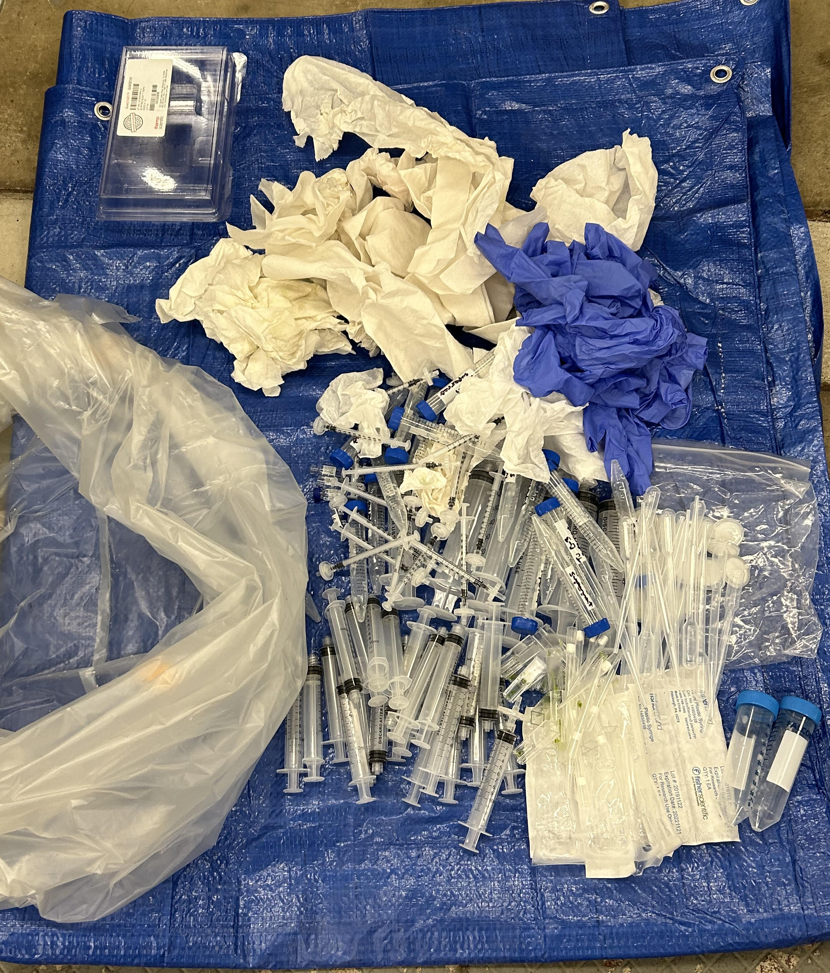
Waste Characterization and Reduction for the ChE 460 Laboratory Course
By Ava Haase (Honors Capstone)
Introduction
Piloted Protocol Modifications
Conclusion
Waste reduction is a major component of sustainability and one of many strategies to combat the effects of climate change. As a UM Chemical Engineering student, I have witnessed laboratory waste generation at the university level in both my chemistry and chemical engineering courses first-hand. These experiences have inspired me to investigate ways in which learning laboratory spaces can reduce their solid and liquid waste, while minimizing hazardous material usage.
I had the pleasure of working with Department of Chemical Engineering (ChE) laboratory faculty and staff by utilizing the ChE 460 course to collect data. This course consists of multiple different experiments, which are collectively motivated by the demand for efficient biofuel production. The scope of this project will consist of both the Photobioreactor (PBR) and Transesterification Reaction (Reactor) experiments as they produce waste consistently in larger amounts than the other experiments [1, 2]. Both PBR and Reactor are active Monday-Thursday of the lab week. To determine impacts of implementation, recommendations were presented to students in the form of a Management of Change (MOC) that indicates an approved deviation from the Standard Operating Procedure (SOP) [3].
This project is not only meant to impact the ChE 460 course, but the broader scope of laboratory spaces at the university and beyond. In addition to collecting quantitative data through waste audits, I have gathered qualitative data through virtual interviews. These conversations aided the creation of recommendations for waste reduction and have provided a space for waste reduction and diversion awareness.
Upon evaluating the waste generated in the first two weeks of lab audits, I generated a list of recommendations for both experiments to take into consideration as they began their third week of experimentation. These recommendations were formatted into an MOC to student users for them to be treated as modifications to their SOP or protocol.
A significant amount of waste reduction was proved possible in both the photobioreactor and transesterification reactor experiments. The PBR teams made additional effort during the week 3 to reuse the glass centrifuge tubes and cuvettes as much as possible. The Reactor teams minimized the number of 1mL syringes used to take samples, one team reducing the amount used from 28 to 4 for just one lab day. Additionally, Reactor teams reduced solvent usage by half. There could be even further improvement if other Reactor teams displayed similar performances. Overall, this project’s implementation reduced the amount of waste generated (lb) weekly by 51% and 23% for PBR and Reactor, respectively. The changes in lab have resulted in a total savings of at least $200 per semester for both experiments combined.
PHOTOBIOREACTOR
Keep using the same 60 mL syringes and do not dispose of them, unless they break. The Monday team is responsible for keeping the syringes screwed on the PBR for the remaining days.
Use reusable 10 mL glass centrifuge tubes when performing a serial dilution. This may not be possible with samples containing supernatants that need the use of a syringe. The 10mL syringes are too wide to fit into the 10mL glass centrifuge tubes.
Use the same pipet tip/syringe for dilutions of the same PBR tube when performing a serial dilution. For example, use 1 pipet tip using a micropipette for all dilutions for PBR tube 3. Do not use the same pipet across tubes to prevent contamination in your samples.
Determine if cuvettes could be rinsed with ethanol and reused upon completion of measuring absorbance. After disposing of the diluted algae from the cuvette, carefully examine it for scratches and rinse with ethanol. Place reused cuvettes in the appropriate labeled container.
Eliminate the usage of tape on your sample tubes. Sharpies can be used to write your sample ID directly on the tube.
2/22/2023 PBR Solid Waste Audit
TRANSESTERIFICATION REACTOR
As I interacted with faculty, staff, and students from the university and beyond, I recognized the importance of waste awareness in our community. This project provides another opportunity for conversation around waste and strategies for reduction. Through external interviews, I have interacted with colleges and lab spaces that gave me insight on not only waste reduction, but also waste diversion. Providing the means for individuals to properly dispose of their waste can manipulate the waste stream amounts relative to each other, however, an even more difficult hurdle to overcome for waste reduction is the individual’s behavior. More research shall be done to determine strategies and solutions for this issue.
Minimize the usage of tape on vials. One group from Week 2 proved it possible to write directly on the vial with Sharpie.
Use the same 1mL syringe to pull samples. This should be done by quickly pulling samples up and down into the syringe three times to “rinse” the syringe before pulling the sample.
Use less solvent to clean the reactor. Try using ½ the volume of IPA/Methanol for cleaning the reactor vessel. To do this, use 150mL compared to the alternative 300mL for cleaning.
Methods
Results
Future Considerations
ChE 460 operates in three rotations, the first two consisting of in-person laboratory experiments and the last consisting of scaling-up the experiments commercially in an asynchronous format. A three-week waste audit was completed for the duration of rotation two. Table 1 gives a breakdown of actions completed by week of rotation two.
Items in both general and hazardous waste were counted, characterized, and sorted daily. Hazardous waste buckets (solid waste) and jugs (liquid waste) were weighed using a bathroom scale with a precision of 0.1 lb. It is important to keep in mind that this scale may not be as accurate for smaller measurements. Table 2 provides a list of the items characterized that are utilized by both the PBR and Reactor experiments.
PHOTOBIOREACTOR
Compiled below are recommendations for long-term waste reduction in a lab setting. This list was generated as a culmination of ideas that proved sustainable in the ChE 460 lab course and those that deserve consideration in the future in correspondence with the 12 Principles of Green Chemistry [3].
Table 1. Audit Schedule Breakdown
$8.40 savings
0.811 lb
Utilize reusable glassware and replace disposable plastic items with reusable alternatives when possible.
Maximize the use out of disposable materials before disposal.*
Use non-sterile options for syringes and filters if possible. Sterile items require additional packaging that is sent to waste.*
Minimize the usage of solvent and other liquid hazardous waste. Determine if smaller amounts can give you the same outcome.
Minimize tape usage. Some tubes are manufactured with designated labeling spaces.
Make available a recycling bin for waste as applicable. Many audited items were re-sorted into a recycling bin, as necessary.
Set clear guidelines about the amount of each material that can be used in lab and train staff, as necessary. User behavior is a significant contributor to waste generation.
Perform waste audits! Visualizing generated lab waste creates a sense of action and accountability, as well as promotes further improvements for waste reduction.
*Be careful to avoid contamination in biological processes. Be mindful of safe practices in the lab (safety comes first).
Goal: 40% reduction in waste across College of Engineering
Week | Actions Completed
Week 1 | Daily Audit
Week 2 | Daily Audit, MOC Creation
Week 3 | MOC Implementation
Table 2. Disposable Waste Materials Used by Experiments
Item | Price | Weight (lb) | Experiment Use
Paper Towel | $ 0.02 | 0.0052 | Both
Nitrile Glove | $ 0.06 | 0.0088 | Both
Transfer Pipet | $ 0.05 | 0.0033 | PBR
1mL Pipet Tip | $ 0.06 | 0.0015 | Both
200μL Pipet Tip | $ 0.05 | 0.0008 | Both
10mL Serological Pipet | $ 0.12 | 0.0182 | PBR
60mL Syringe | $ 0.49 | 0.0742 | PBR
10mL Syringe | $ 0.12 | 0.0185 | PBR
1mL Syringe | $ 0.12 | 0.0051 | Both
1mL Cuvette | $ 0.07 | 0.0044 | PBR
0.45μm Filter | $ 0.10 | 0.0024 | PBR
0.2μm Sterile Filter | $ 1.93 | 0.0138 | PBR
Kimwipe | $ 0.01 | 0.0010 | PBR
15mL Conical Tube | $ 0.14 | 0.0151 | PBR
50mL Conical Tube | $ 0.14 | 0.0281 | PBR
2mL Capped Glass Vial | $ 0.48 | 0.0058 | Both
4mL Capped Glass Vial | $ 0.71 | 0.0122 | Reactor
Methanol | $ 1.51 | 1.0 | Reactor
Isopropyl Alcohol (IPA) | $ 4.94 | 1.0 | Reactor
TRANSESTERIFICATION REACTOR
(on an experimental trial basis)
References
[1] ChE 460 Instructional Staff, Algal Growth in a Photobioreactor. University of Michigan Chemical Engineering, 2023.
https://umich.instructure.com/courses/567228/pages/7-dot-1-bioethanol-module
[2] ChE 460 Instructional Staff, Transesterification of Soybean Oil to Biodiesel Fuel. University of Michigan Chemical Engineering, 2023.
https://umich.instructure.com/courses/567228/pages/7-dot-3-reactor-module
[3] “12 principles of Green Chemistry,” American Chemical Society, 2023. [Online]. Available: https://www.acs.org/greenchemistry/principles/12-principles-of-green-chemistry.html. [Accessed: 15-Mar-2023].
$2.02 savings
(per trial)
0.518 lb
(per trial)
Acknowledgements
Calculations for PBR
Items were categorized by pipets, syringes, cuvettes, filters, paper towels, gloves, and miscellaneous (additional disposable items). To account for different objectives given to each lab day for PBR, waste amounts were averaged on a weekly basis. The average of both week 1 and 2 is compared to week 3 to demonstrate the impact of the implemented MOC.
Calculations for Reactor
Items were categorized by pipets, syringes, paper towels, gloves, and vials. Solvent usage is also accounted for when considering the reduced cost and weight of waste. All liquid reactor waste is assumed to consist of Methanol and IPA at a 2:1 ratio. The results are given on an experimental trial basis to account for the difference in amount of trials/day.
Thank you to the following individuals for their involvement in this project. All faculty, staff, and students supported me in pursuing a project of which I am passionate about. They have also provided a wealth of knowledge and expertise for guidance.
Honors Capstone Advisor
Dr. Chris Barr, Chemical Engineering Department Instructional Lab Supervisor
Additional Acknowledgements
Dr. Saadet Albayrak-Guralp, ChE 460 Instructor
Abagail Jeavons, Chemical Engineering Department Lab Coordinator
Dr. Sara Soderstrom, Associate Professor of Organizational Studies
Honors & Engagement Programs Faculty and Staff
Given that there are two in-person rotations every semester, each consisting of three weeks, the PBR experiment has a total savings potential of about $200, and a total waste reduction potential of about 20 lb per semester. Similarly, given an average of 12 experimental trials per week, the Reactor experiment has a total savings potential of about $150, and a total waste reduction potential of roughly 40 lb per semester.
Assumptions: (1) Solvent waste generated in a 2:1 mass ratio of MeOH to IPA. (2) PBR users used 0.45um filters for all nitrate/glycerol measurements. (3) All MeOH used is from 20L container at $1.5/lb.

