Slide 1


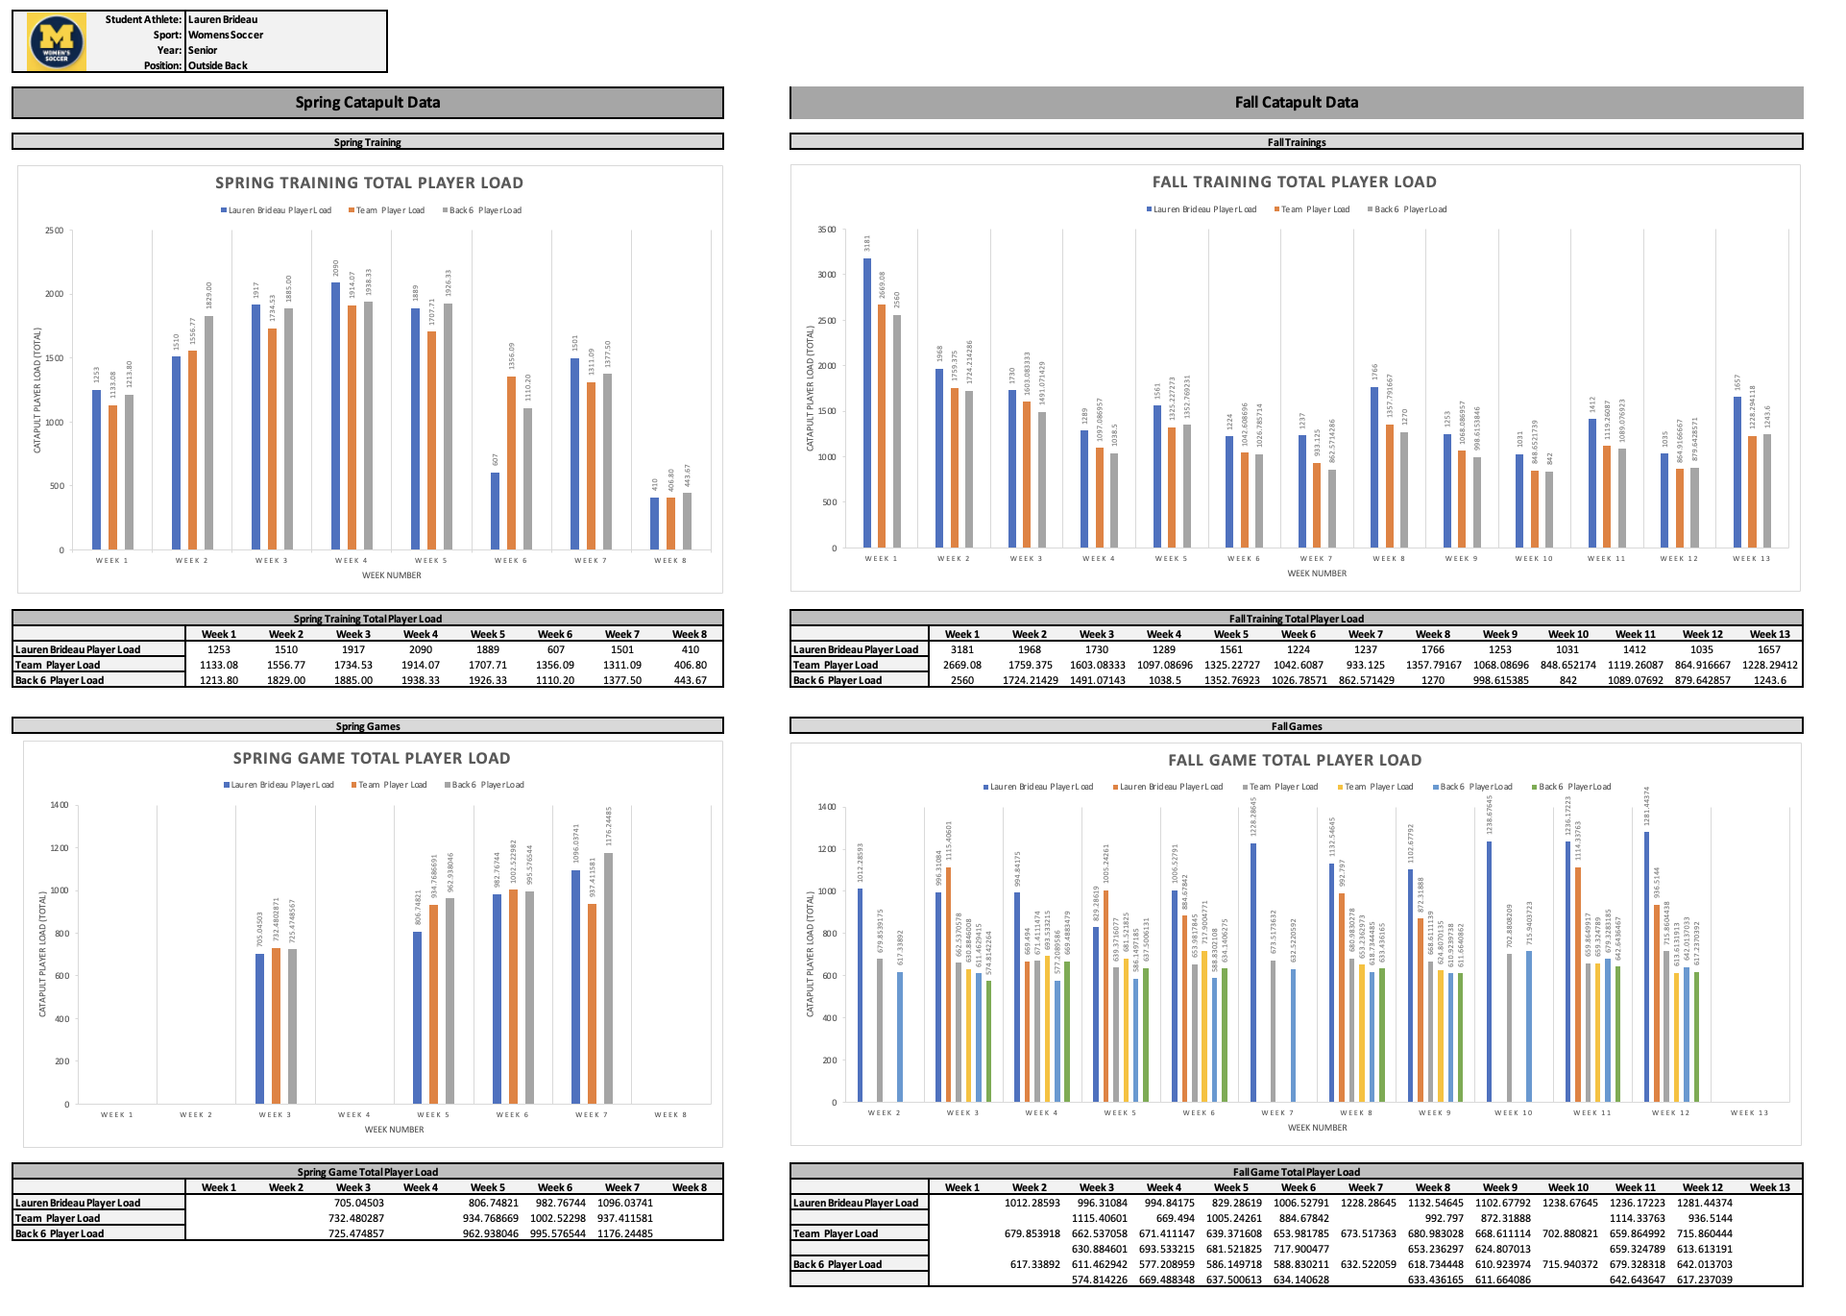
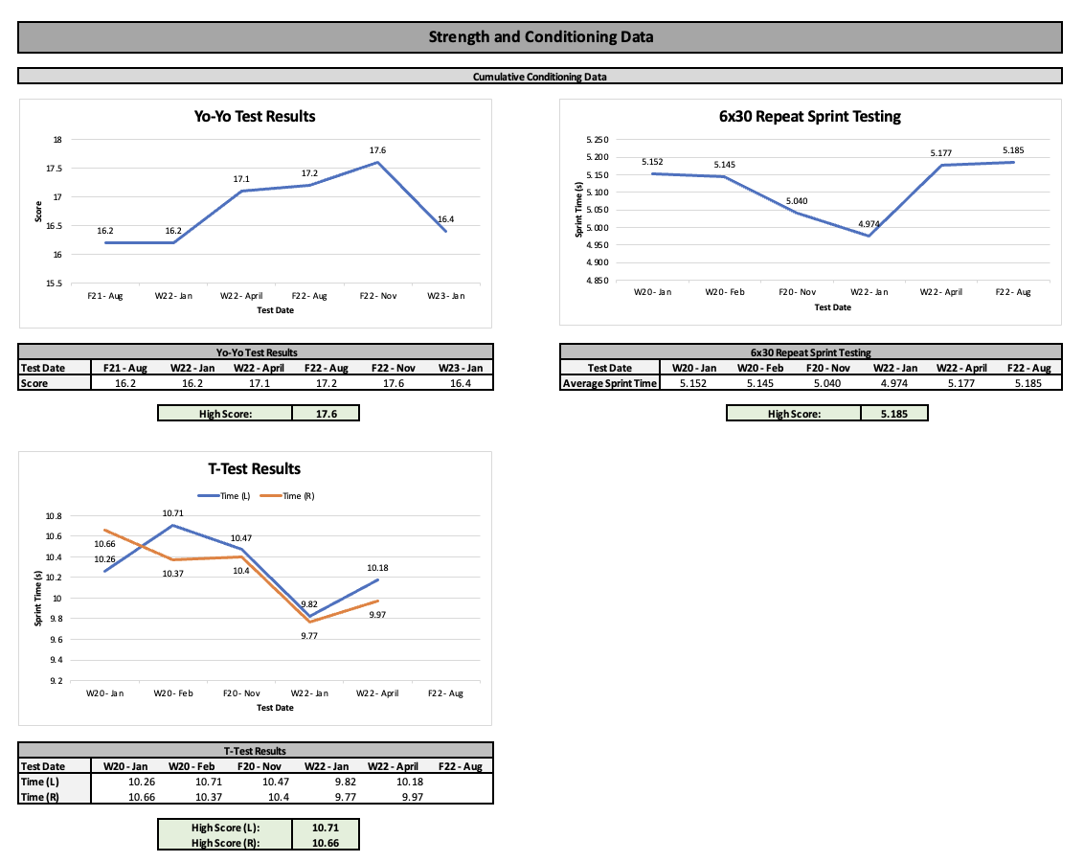
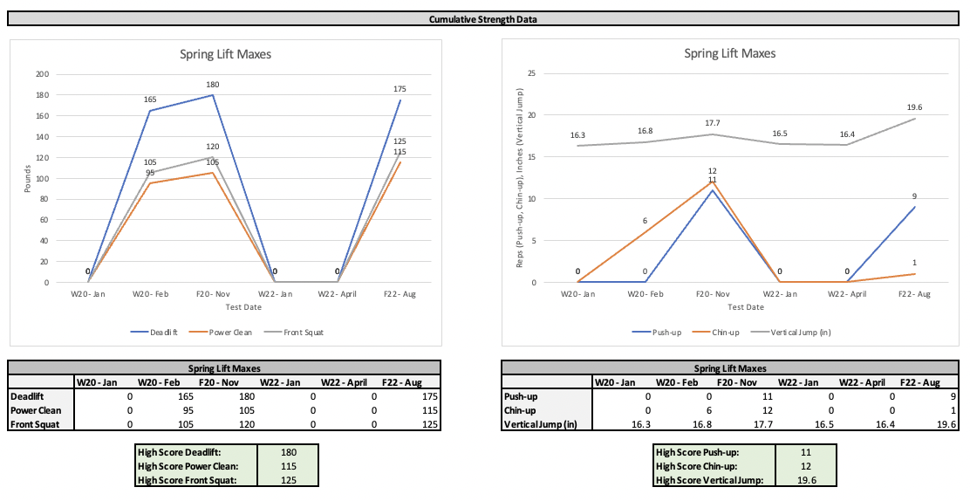
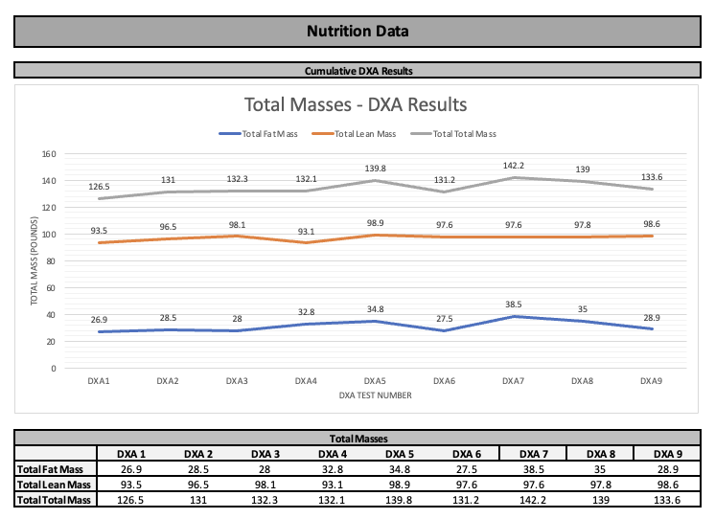
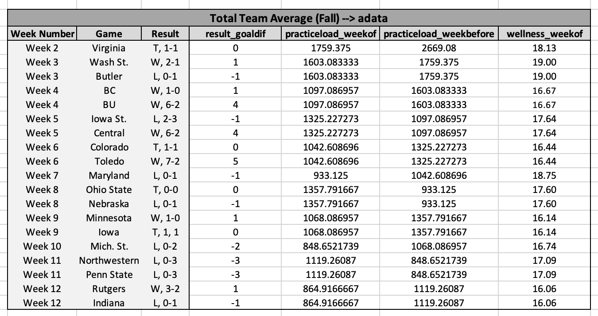
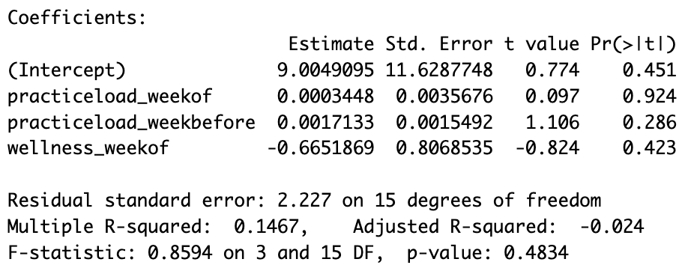
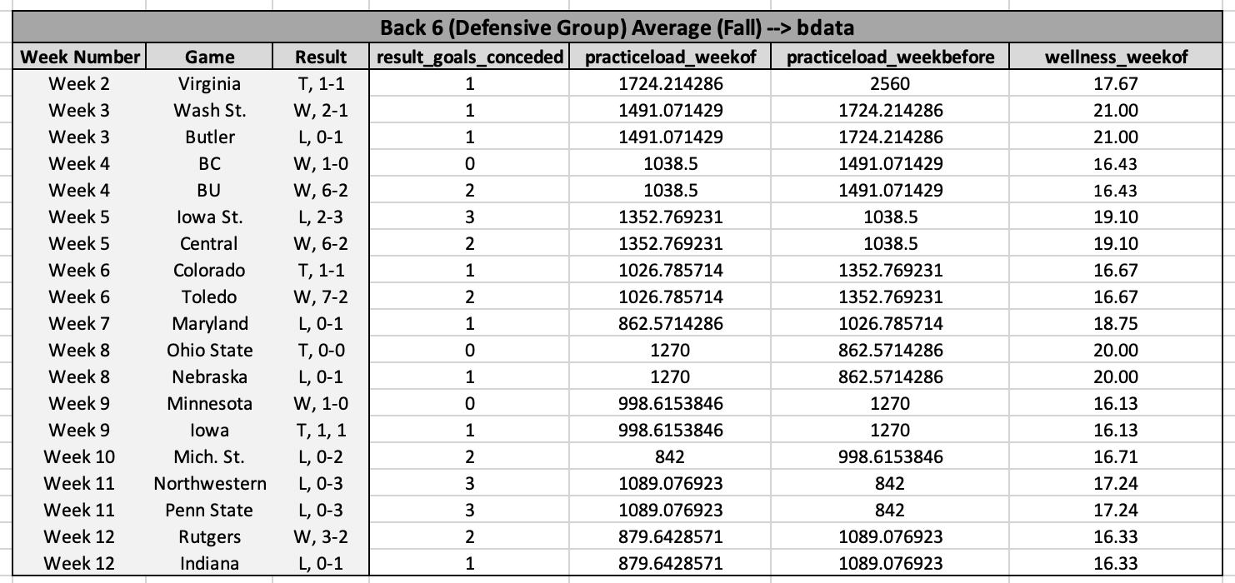
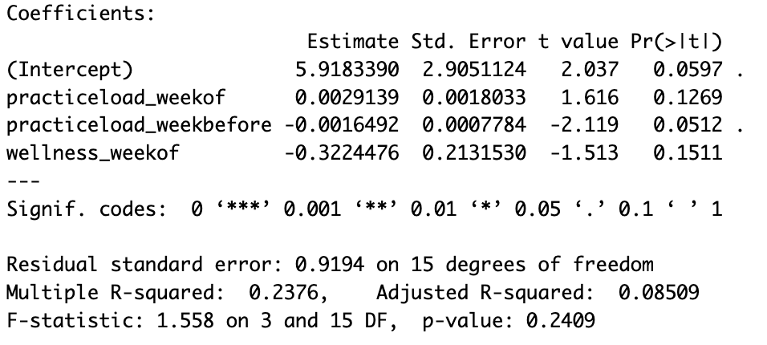

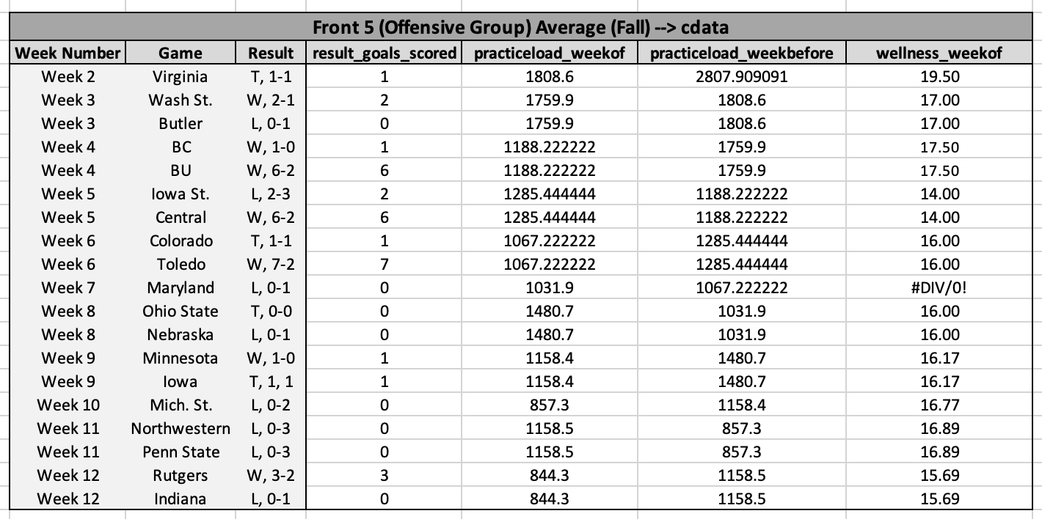
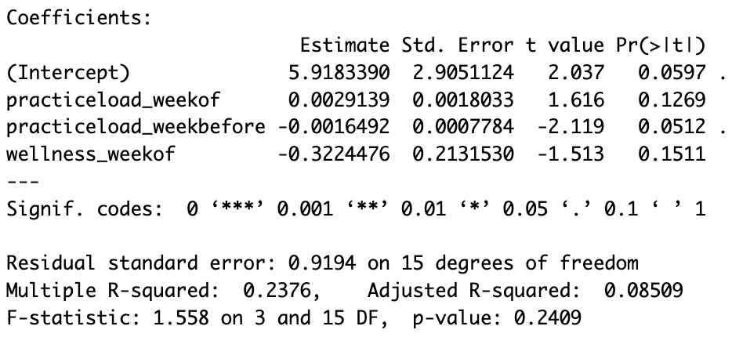
Creating Comprehensive Player Profiles for D1 Athletes at the University of Michigan
Lauren Brideau (Honors Capstone), Raed Al Kontar (Faculty Advisor)
Department of Industrial and Operations Engineering, University of Michigan
Introduction
Example Player Profile
Results and Discussion
The University of Michigan Athletic Department, specifically the staff working with the women’s soccer team, has collected data via testing measures, survey responses, and tracking devices for several years. As of recent, this data has been used to monitor week to week “player load” to dictate practice rigor, limit overuse injuries, and keep as many players as fresh as possible as the season progresses. Unless requested, players don’t get access to their data. With proper analysis, however, the information and trends that this data holds could greatly benefit each individual in respect to their year-to-year/season-to-season development. Even more so, this data can be utilized by the coaching staff to help address player progress in the periodic individual meetings in which they complete every couple of months.
As a former member of the Michigan Women’s Soccer team, and as a regular in the Athletic Training Room, I had the opportunity to work with my athletic trainer to give this undervalued data a purpose, and to give my teammates a quantitative path towards development. My trainer had a vision of creating ”Player Profiles” for each member of the team that will carry with them throughout their college career. With his vision I was able to create a template player profile base on my captured data for myself. Furthermore, with the assistance of Professor Raed Al Kontar, I was able to provide an additional deliverable for the coaching staff. I ran regression analysis on various metrics to determine weather or not said metrics had an impact on overall team performance during games.
Results from Regression Analysis Models, Put Into Words:
Following the running of multiple regression analyses, there is no significant association between:
The team’s average player load the week leading up to a game and the goal differential of the game
The team’s average player load the week before the week leading up to a game and the goal differential of the game
The team’s average wellness data results week leading up to a game and the goal differential of the game
The back six’s average player load the week leading up to a game and the number of goals conceded during the game
The back six’s average player load the week before the week leading up to a game and the number of goals conceded during the game
The back six’s average wellness data results the week leading up to a game and the number of goals conceded during the game
The front five’s average player load the week leading up to a game and the number of goals scored during the game
The front five’s average player load the week before the week leading up to a game and the number of goals scored during the game
The front five’s average wellness data results the week leading up to a game and the number of goals scored during the game
Potential Shortcomings That Could Have Yielded the Above Results:
Although regression analysis suggests there is no significance between the three different types of results and each of the independent variables, some shortcomings within the datasets that could have impacted these results include the following:
Insufficient quantity of data – only measured data points from one season, including just 19 games, perhaps there wasn’t enough data to find an appropriate association.
“Total Player Load” is the improper metric to measure “player performance”, perhaps there are other metrics that more accurately encapsulate how a player performs during a given match instead of how “hard” they worked.
Averaging team data doesn’t give an accurate picture – although soccer is a team sport, there are always certain individuals on a team whose individual performance has a greater impact on the result of the game than the team’s overall performance (ex: a top-goal scorer having a dry spell, the starting goalkeeper having a broken leg and not being able to play in a game against a top opponent).
Goals and Deliverables
Project Goals:
Leverage currently available data and create a template “player profile” using my personal historic data over the past 4 years.
  Utilize this template profile for all University of Michigan women’s soccer players by the program's coaches and trainers.
Organize and structure data from various sources in such a way that makes it (1) easier to input new data each season and (2) easy to create profiles for each current member of the team based off the template model.
Reach conclusions via statistical analysis and regression modeling that can be given to the coaching staff to help improve game results.
Be able to translate the template idea of the player profile for the “Michigan Women’s Soccer Team” to any team in the athletic department who wishes to do the same.
Project Deliverables:
A “Master Data Sheet” which includes a row for each player’s data (consistent amongst all data) including the following
  Weekly total and average catapult data for spring and fall trainings and games from this calendar year for each player, positional group, and team as a whole
  Weekly wellness survey results from the fall season
  Cumulative strength and conditioning testing data
  Cumulative body scan data
  Cumulative injury prevention screening data
Regression analysis results from the following Independent Variables: Total practice load of the week of the game, total practice load of the week before the game, wellness survey results of the week of the game
  Result: Goal Differential, Entire team
  Result: Goals Conceded, Back 6
  Result: Goals Scored, Front 5
Conclusions and Future Work
The Player Profile: Intended Impact
Each current member of the women’s soccer team will receive both the comprehensive and “cover sheet” version of their player profiles to discuss with the coaching staff, strength and conditioning trainers, athletic trainers, and performance nutritionists as they meet with said staff members to analyze their performance. Access to such profiles will allow them to see their growth, or lack thereof, over the course of their time at the university, and will give them a general idea of where they stand relative to the team as a whole and others in their position. This will open the floor for data-driven discussions, and it will allow for players to take ownership of their own growth as a division one soccer player in the realms of trainings, injury prevention, proper diet, speed, conditioning, and strength, hopefully allowing the team as a whole to reach their full potential.
The Player Profile: What’s Next?
Ideally, this player profile template I have created acts as a working document, extending beyond the timeline of this project. Next steps are to streamlining both the data input process, as well as coding the profile so it can auto-populate with data for each member of team, instead of having to manually create everything. Additional information can also be added to the profile, as staff members see fit, or upon player request. Once this step is complete, extending the coded template to other departments/teams within the athletics department so that they can modify it, and make it their own to yield similar results with their team would be the final step in this process.
Takeaways from the Regression Modeling:
Although the regression models that were run using the provided data did not demonstrate any significant association amongst the variables, the data I received for this project was only a small portion of the data available. The data used for this project was selected to achieve a macroscopic summary that would be of most benefit to the players, though evidently not the best data to use to explain results of games. There is further data available spanning other metrics that could impact game results and be beneficial to investigate such as:
Player pass competition percentage
Turnovers in the final third, middle third, and defensive third
Set piece conversion
Number of set pieces conceded
Time goals were scored within the run of play
Approach to Data Collection
Regression Analysis and Results Using R-Studio
All data used for these player profiles was already in the hands of a member of the Michigan Women’s Soccer Team’s staff. The following data was obtained via communication with different departments through athletics:
Spring and fall catapult data (totals and averages), including metrics such as:
  Player load, player load per minute, high speed efforts, high speed distance, sprint distance, etc.
Strength and conditioning test results), including metrics such as:
  Lift test max data, repeat spring testing, fitness testing, agility testing
Injury prevention screening), including metrics such as:
  Imbalances between left and right, imbalances between front and posterior muscle groups
Weekly wellness survey results), including metrics such as:
  Hours of sleep, fatigue rating, muscle soreness rating, stress level rating, etc.
Body composition scan results (DXA) ), including metrics such as:
  Total lean mass, total fat mass, total mass
It was then important to consolidate the data into strictly what would be beneficial as metrics for players and coaching staff to have at their disposal in these profiles. In Excel, each data category (listed above) got its own sheet, and each member of the soccer team received a designated row which stayed consistent across each all sheets. For more granular, day-to-day data, week averages were taken. For data including a single result, such as the result of a test, the test date was included to highlight player change over time. After the completion of each sheet, and each player within each sheet, I was able to manipulate all data for one single player (myself in this scenario) into tables displaying the metrics listed above. Each data type, test type, or season got its own table, which resulted in a master sheet for a single player holding all their granular data for that season (catapult)/their career test results to date. Then, for each data type, team and group (back six, front 5) averages were taken for comparison purposes, helping to yield the ”cover sheet” for each player profile (pictured to the right). Various graphs were created in order to visually display player performance over time (competition and growth with themselves) and where they stand on average in comparison to the rest of the team and their positional group. This specific sheet will be of particular importance in end-of-year coaches' meetings, as both the player and the coaches will be able to provide quantitative measurements to back up their claims.
Data Frames Loaded Into R for Regression Analysis:
Hypothesis: Data from Catapult (total player load the week of a game and the week before a game) and Wellness Survey data (total wellness score) were the only metrics that potentially had a significant impact on the result of a given game.
Results from Regression Analysis in R:
After running a linear regression model for each of the data frames, we observe the following outputs from each data frame:
P-value/F-statistic
Adjusted R-squared
Coefficient Values
What These Results Mean in Relation to Our Models:
P-value:
The p-value highlights the association between our input variables and the output (goals). Any p-value under 0.05 is considered significant, meaning that we have enough evidence that the coefficient is not zero, and the coefficient does in fact add some value to the model. In the three models tested, all P-values were above 0.05, thus the coefficients were insignificant, and did not have statistical power to explain the outcome.
T-value:
The t-statistic is the coefficient divided by the standard error – thus a t-value is large if the coefficient is larger than the standard error (relatively). Larger t-values suggest a higher likelihood or non-zero coefficient values, which for each of our regression models, isn’t the case as the t-values are all close to zero.
Adjusted R-Squared Value:
Used for multiple linear regression models and tells us the percentage or variation of the dependent variable (results) that the independent variables are explaining. Or, more simplistically, it shows how well the model is fitting the data. Each of our models' regressions outputted a very small adjusted r-squared value, suggesting not much of the model is explained well by the data from the data frames
Coefficient Values:
Coefficient values are obtained through the least squares method. The coefficients best explain the data under the linear regression assumptions. Coefficients close to zero suggest little/no relationship between the input variables and the output
F-Statistic and p-value
For a model to contain significant coefficient values and to reject the null hypothesis that all coefficient values are equal to zero, ideally the regression yields a large F-statistic value and hence a small p-value. However, for all three regressions run, the F-statistic is small, suggesting the null hypothesis is not rejected, and all coefficients are equal to zero. This is supported by each p-value also being greater than 0.05, suggesting the coefficients’ insignificance to the overall model.
Acknowledgements
Thank you to the University of Michigan Athletics Department for giving me the opportunity to work on such a project, grant me access to data, and open the door for future applications for this player profile project.
This work could not have been made possible without the contribution and assistance from the following members of the University of Michigan Women’s Soccer Team Staff:
Carter Pallett – Athletic medicine
Kate Smith – Strength and Conditioning
Jacob Kromberg – Director of Operations
Caroline Mandel – Performance Nutrition
Jen Klein – Head Coach

