Slide 1


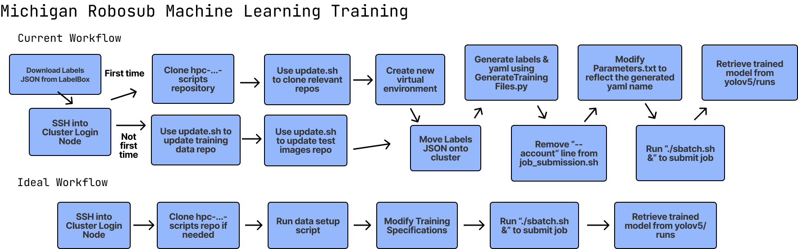
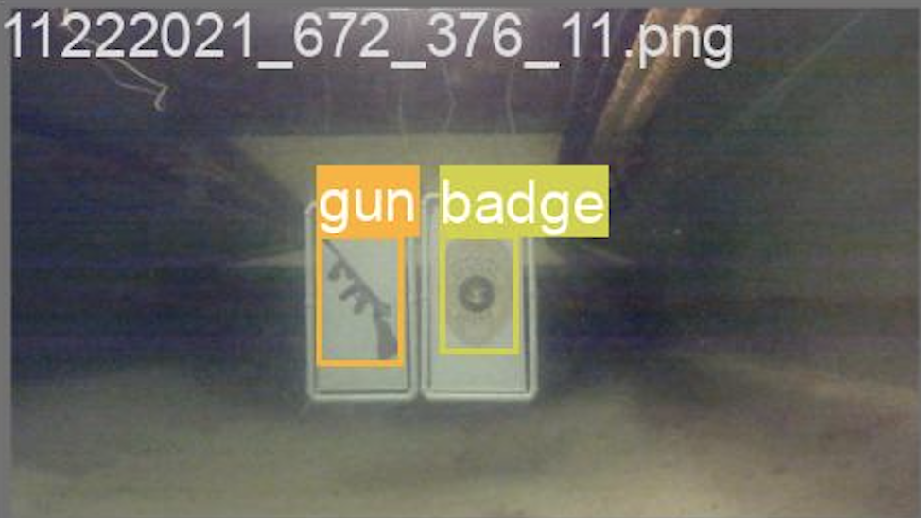
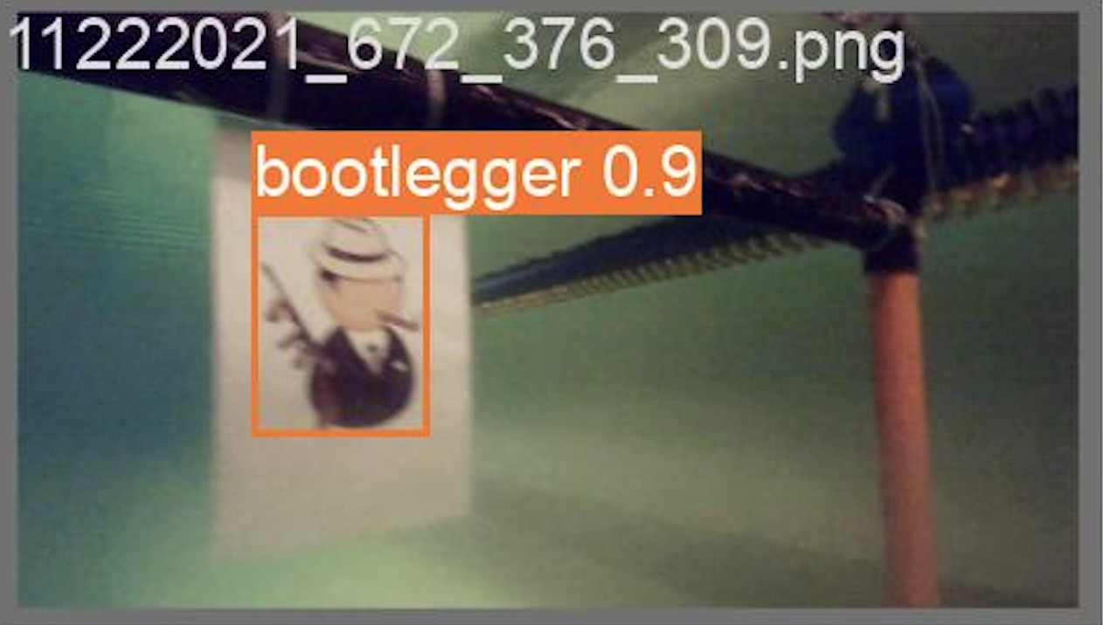
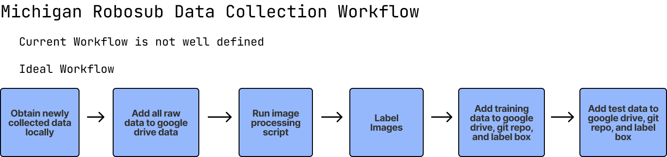
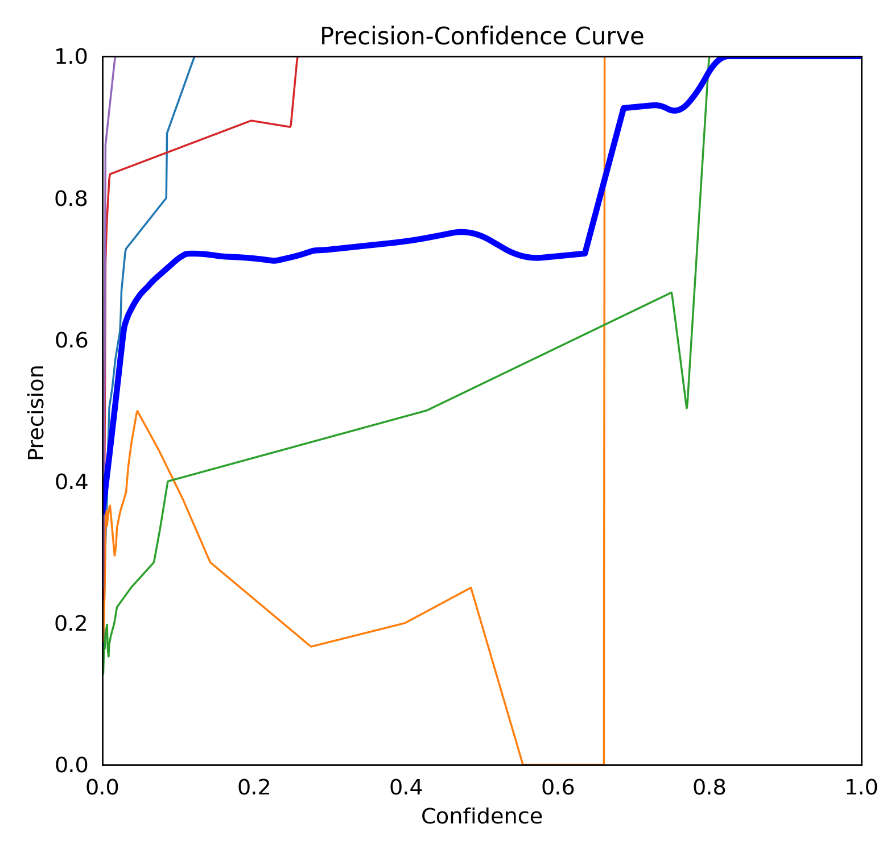
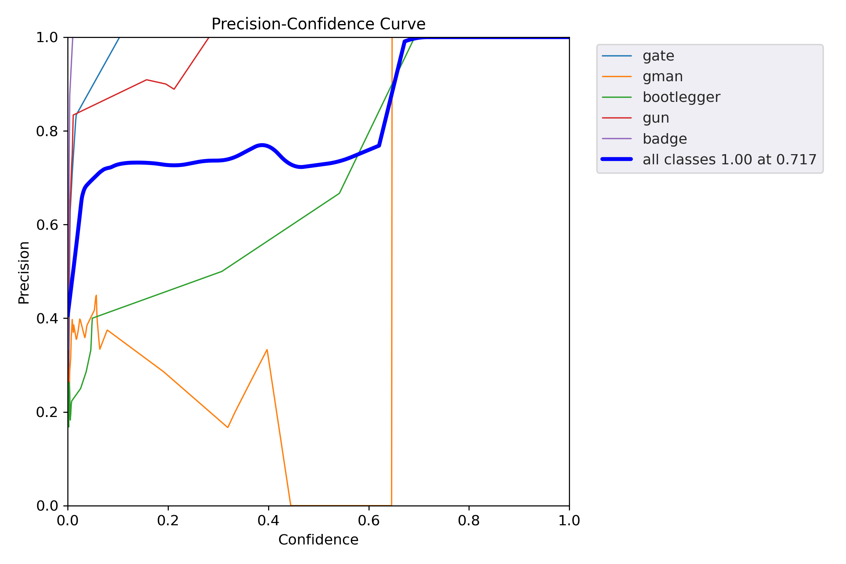
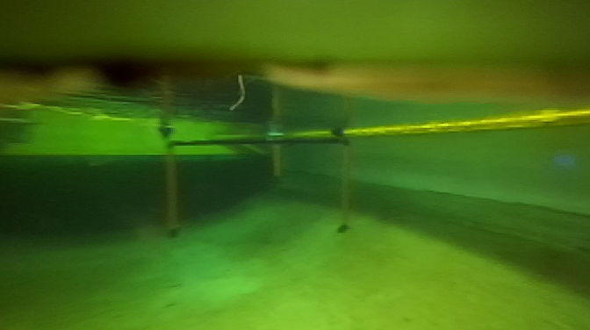
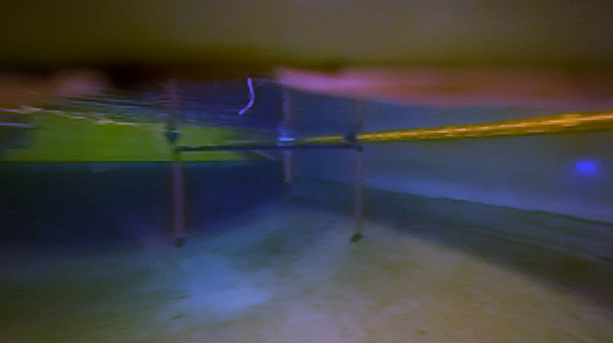
Underwater Object Detection Overhaul:
Infrastructure and Generalizability
Andrew Huston (Honors Capstone), Katie Skinner
Motivation
methods
results
The Michigan Robosub Student Project Team develops an underwater autonomous submarine to complete a variety of tasks in an international competition. The submarine uses a camera and machine learning to detect objects needed to complete these tasks. These objects can be things like buoys or gates. Since the underwater environments we run in are not always consistent, sometimes the machine learning model struggles to accurately recognize these objects.
Pipeline Overhauls:
In order to rework the ML Training and Data Collection pipelines, I used the method of workflow mapping. This allowed me to fully see what the current steps were, and where the process needed to be.
Based on 10 trials of both the pre- and post- overhaul machine learning training workflows, we can see the changes have reduced the amount of prep time by 74.2%.
 | Average Training Prep Time
Pre-Overhaul | 6 minutes, 23 seconds
Post-Overhaul | 1 minute, 39 seconds
The following precision-confidence curves from running the trained models on our test set show that the gray-world algorithm color correction does not significantly increase the performance of the model. The jagged nature of the charts also suggests the need for a more robust test set, which the new data collection pipeline should help with as time goes on.
Machine learning detection of various images needed for competition tasks
The team’s machine learning infrastructure needed to be overhauled. In the previous system, there was a very complex process of generating labels and running commands on a remote computer, which I have now streamlined. The process of collecting and labeling new images to train on had to be improved as well. We also needed a new evaluation metric for our models, as there was no data-backed way to say one model performs better than another. Finally, I researched and experimented with how to increase our model’s performance in a range of environments. These experiments utilize the new training infrastructure.
From here, I was able to create or adjust scripts accordingly so team members would be able to perform the desired actions with just a few simple commands.
Model Evaluation:
I researched the built-in features of the code we use to train our model to see if there was an easy way to get data about the performance of our model. We use YoloV5 to train our model, and I found we could simply run the following command to evaluate our test set.
python3 val.py --data $DATA --task test
Model trained on unaltered images
Model trained on color corrected images
objectives
Model Generalizability:
After a bit of research, I decided to run an experiment by applying a gray-world color correction algorithm to our training data. This will help reduce the effect of extreme colors on the model and may help it generalize better to different environments.
conclusions
Overhaul the model training pipeline
Overhaul the data collection pipeline
Update documentation for using these pipelines
Determine method for model evaluation
Experiment with color correction to improve model generalizability
The changes made to the machine learning training pipeline and data collection pipeline give the Robosub team the flexibility to train new models quickly in the presence of new data. Additionally, the framework set up can be used to find methods of making the model even more generalizable. Overall, this project has greatly increased the team’s potential for success in the yearly competition.
No color correction
Gray-world algorithm applied

