Slide 1
Federated Learning for Classification of COVID-19 Severity based on Chest X-Rays
Matthew Beaubien, advised by Dr. Lubomir Hadjiiski and Dr. Heang-Ping Chan

Slide 2
Motivation
How do we train on a lot of data without sharing it?
What kind of model should we use?
Why do we want to classify severity?

Slide 3
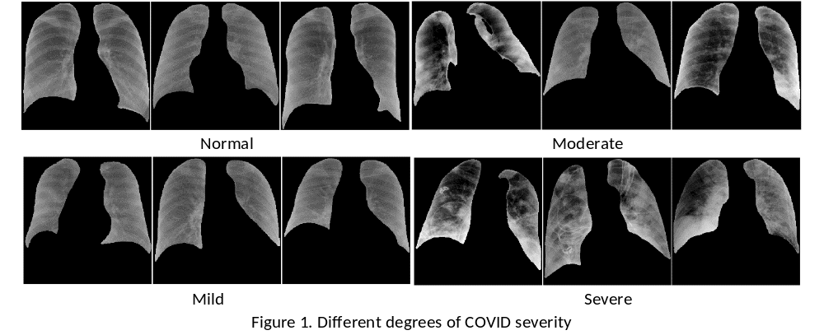
Chest X-Rays of Patients with Different Levels of COVID Severity
Moderate and Severe look very similar

Slide 4
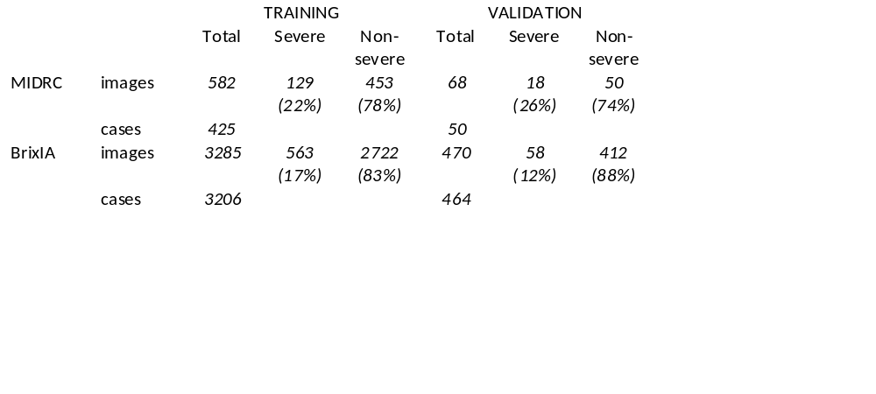
Dataset Sourcing and Splits

Slide 5
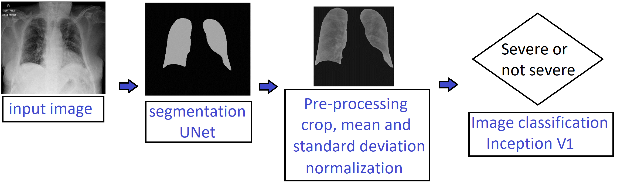
Image Preprocessing Before Training

Slide 6
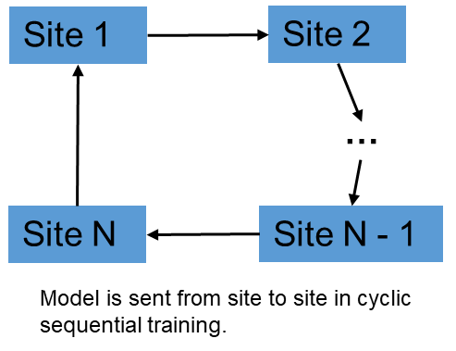
Cyclic Sequential Training

Slide 7
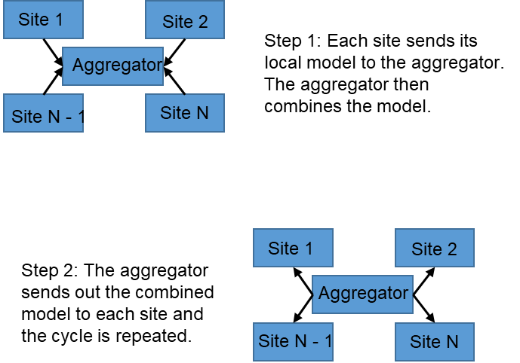
Cyclic Ensemble Training

Slide 8
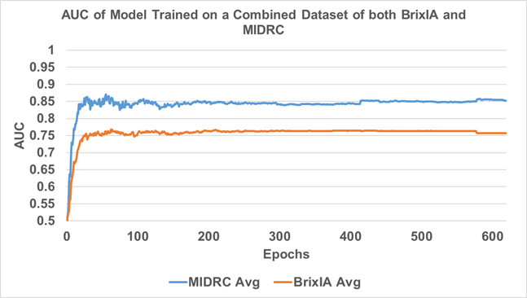
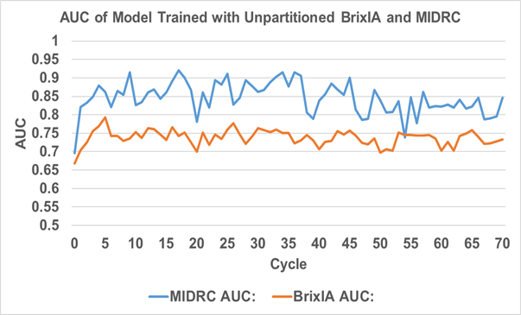
Results

Slide 9

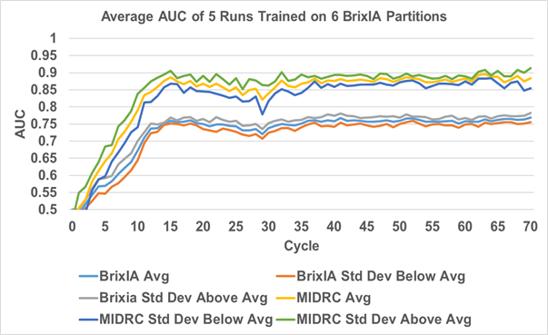
Results

Slide 10

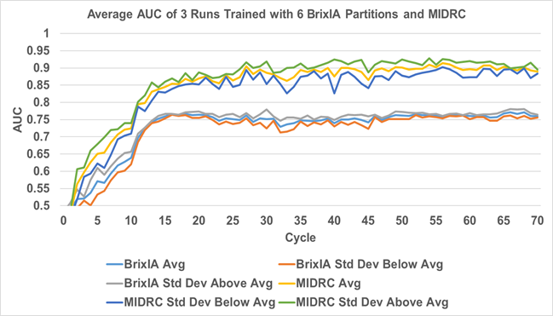
Results

Slide 11

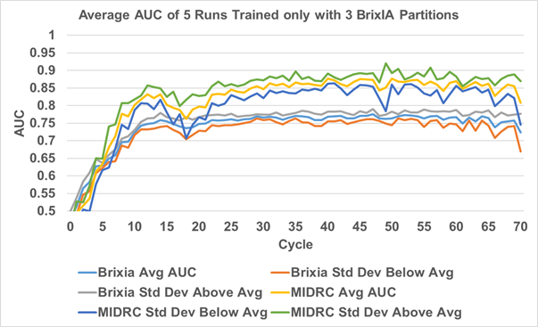
Results

Slide 12

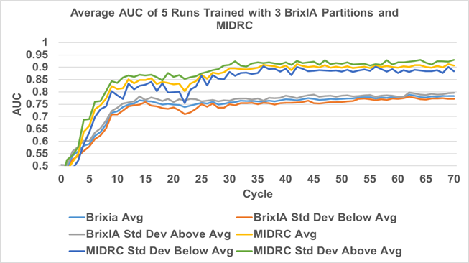
Results

Slide 13
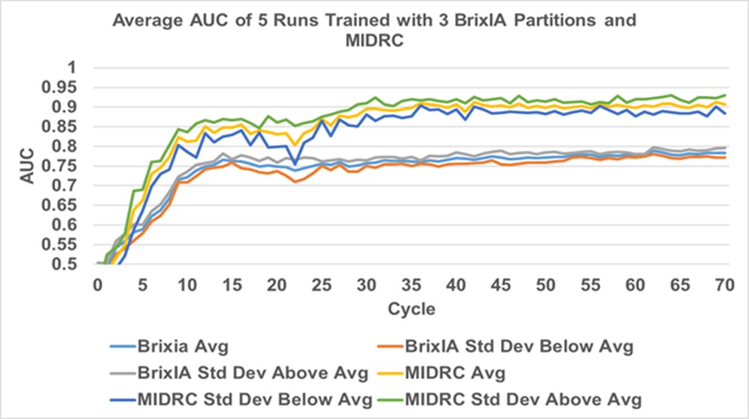
Results

Slide 14
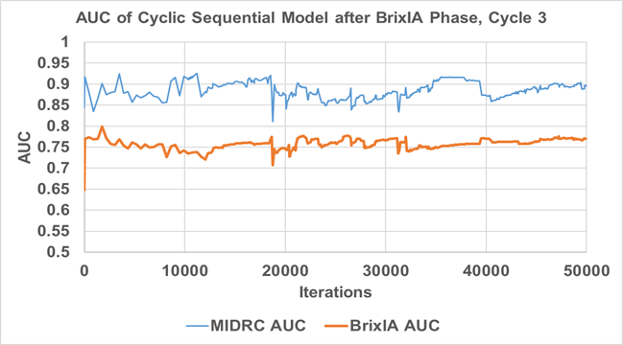
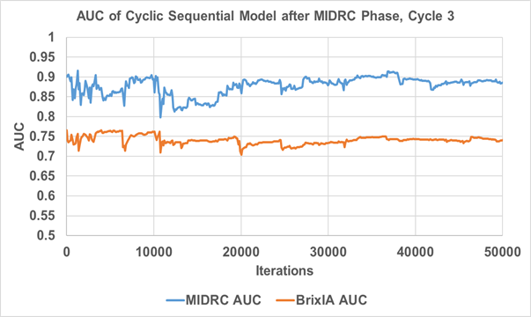
Results

Slide 15
Conclusion
Using Federated Learning, we can train models that perform as well or better than the baseline.
The presence of multiple sites results in a more accurate model.
Ensemble learning does not seem to “forget” in the same way that sequential learning can.
Artificially splitting up the bigger dataset resulted in a much more accurate model.

