Slide 1




Targeting human exosomes via bispecific antibody platform
Kaitlyn Pierpont, Boya Zhang, Sachith Vidanapathirana, Colin Greineder
Notes:
Thank you to the meeting organizers for giving me the opportunity to present this afternoon. My name is Kaitlyn Pierpont and I’m a fourth year Biomedical Engineering undergraduate student at the University of Michigan and this is my third year working in the lab of Colin Greineder in the Emergency Medicine and Pharmacology departments. I’m very excited to share the work we’ve been doing on targeted delivery of human exosomes.

Slide 2
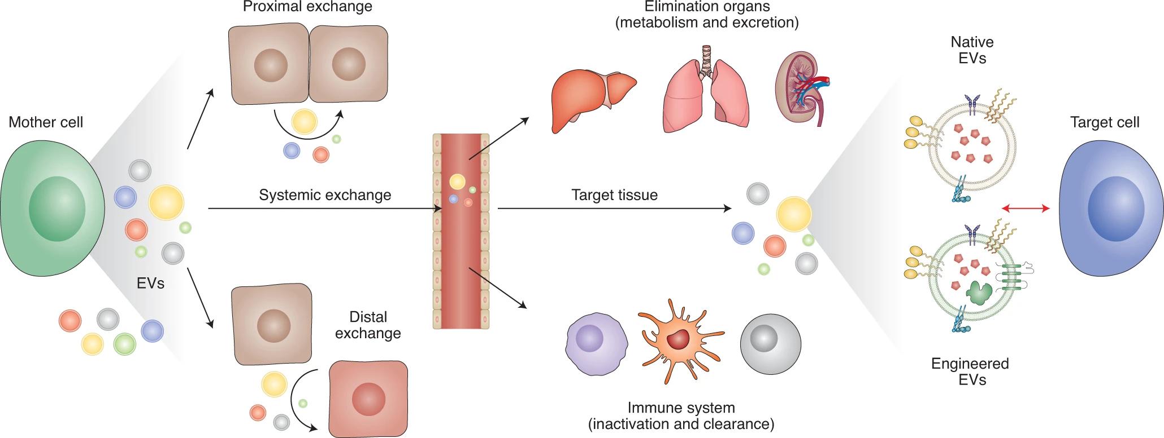



Exosomes are nature’s messengers
Herrmann, I.K., et al.. Nat. Nanotechnol. (2021).
Notes:
As you may be aware, exosomes are small phospholipid membrane bound nanovesicles that are derived from live cells.
They have been identified as key mediators in intercellular communication over short distances for juxtacrine and paracrine signaling, and there is also robust evidence that they can circulate systemically for endocrine signaling. **CLICK**
Exosomes possess an innate ability to deliver their molecular cargo across biological barriers and evade lysosomal degradation. For these reasons, exosomes have been investigated as potential drug nanocarriers.

Slide 3
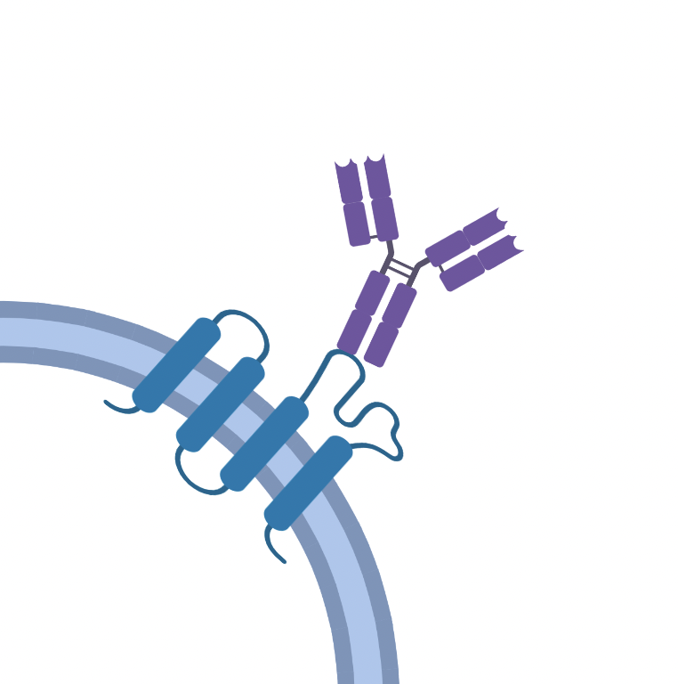

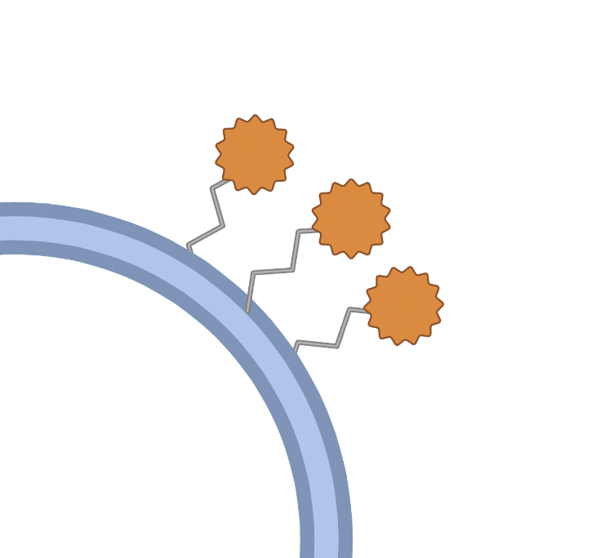



Engineering exosomes as drug carriers
Genetic Engineering
Chemical Conjugation
Our Solution
Requires genetic modification of parental cells
May alter exosome structure
Requires reproducible chemistry
Notes:
Though some speculate that exosomes may have a degree of natural tropism, there is little evidence to suggest that they can accomplish effective cell or organ specific delivery. Therefore, it would be beneficial to reduce off-target delivery by engineering exosomes to present affinity ligands.
This can be achieved
by genetically engineering the parent cell line to display affinity ligands fused to extracellular domains of common exosome surface proteins;
However, this method requires access to the parent cell line and eliminates potential for stem-cell derived exosomes.
Chemical conjugation to the exosome surface is another common method used to deliver exosomes,
but these methods may alter the exosome structure and require highly reproducible chemistry to achieve consistent surface modification.
To address the limitations of these existing engineering strategies, our solution uses an affinity-based coating of bispecific antibodies.

Slide 4
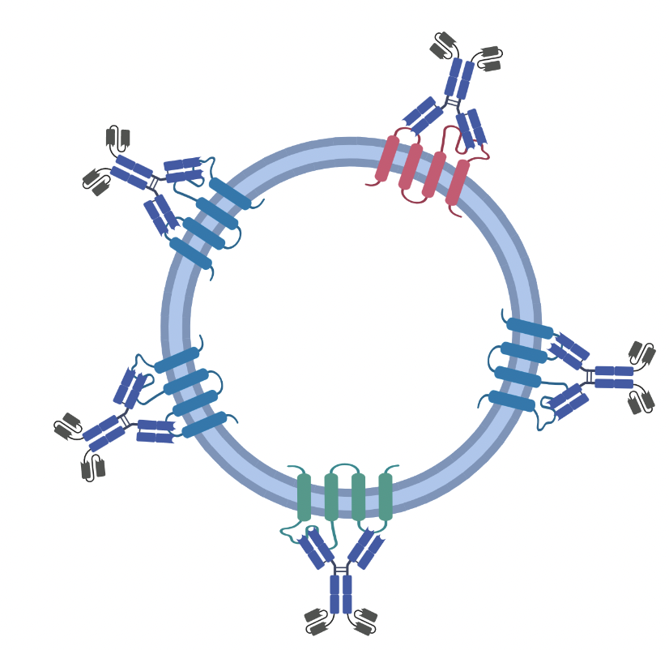
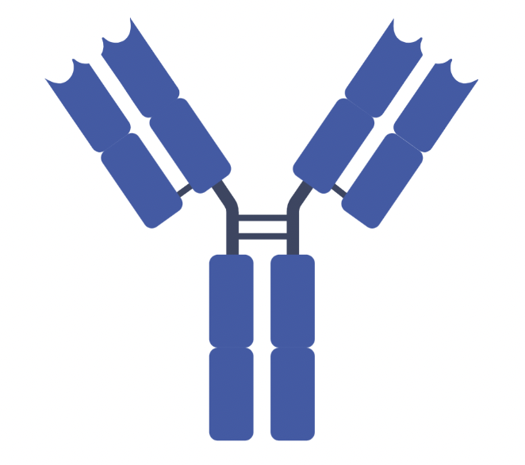

Exosome Targeting Antibodies (ExTAbs)
Anti-CD63 IgG
CD63
CD9
CD81
+ 2 affinity ligands
Notes:
Affinity coating with bispecific antibodies, or ExTAbs, offers a reproducible, versatile method of exosome decoration. Bispecific antibodies allow us to capture exosomes on one end while maintaining affinity to target cells on the other.
As a proof of principle exosome target, we chose to bind CD63, a tetraspanin commonly used as a marker for exosomes. This platform could be adapted for other exosome markers such as **CLICK** CD81 or **CLICK** CD9.
Our bispecific antibodies, or ExTAbs, are comprised of an anti-CD63 IgG with an affinity ligand fused to the C-terminus of each heavy chain resulting in 2 affinity ligands per antibody. These affinity ligands can be swapped to target various cell and tissue types.
For proof of concept, we chose to target the vascular endothelium due to its accessibility from the bloodstream. The endothelial targets we chose are PECAM-1 or CD31, and ICAM-1 or CD54. Therefore, our ExTAbs have affinity to CD63 on one end and affinity to PECAM or ICAM on the other.

Slide 5
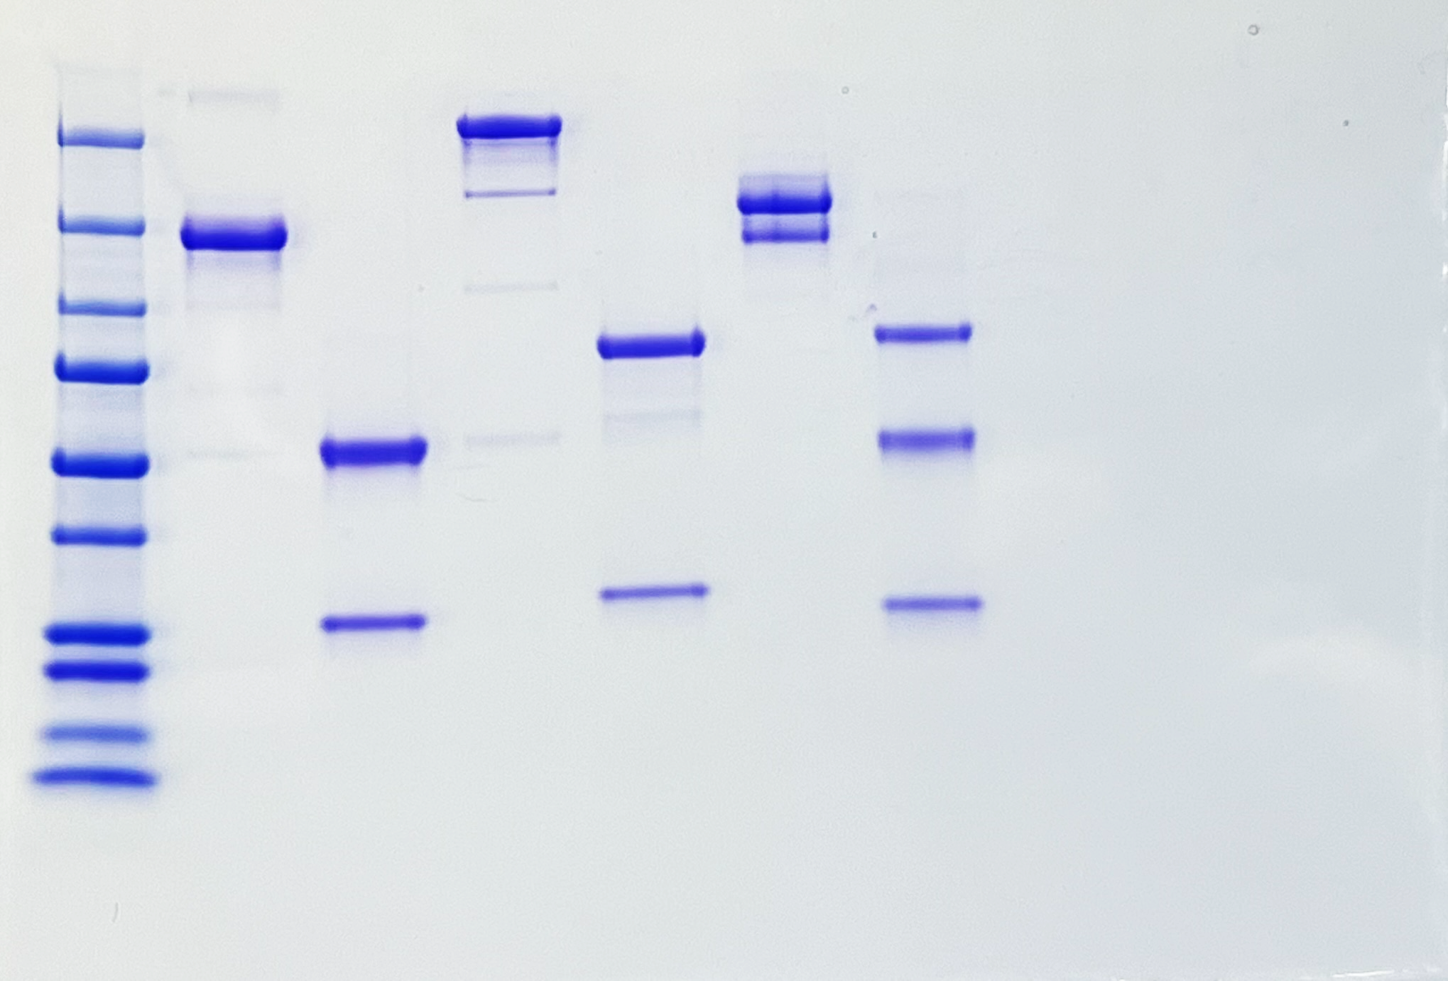


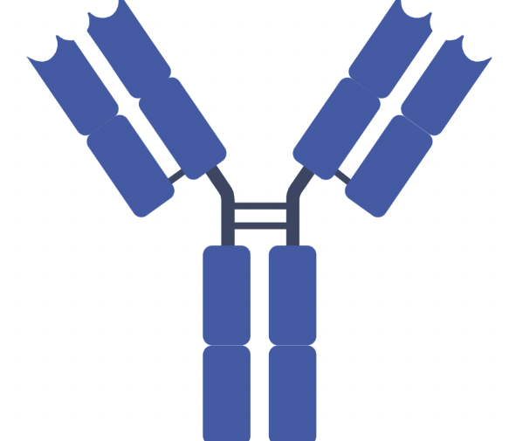



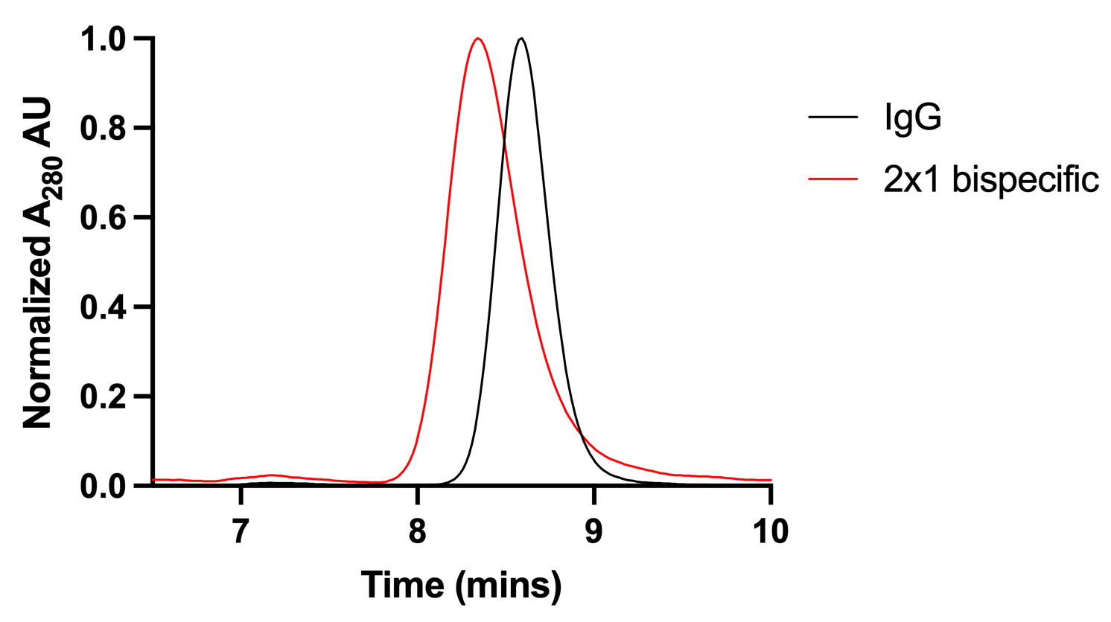
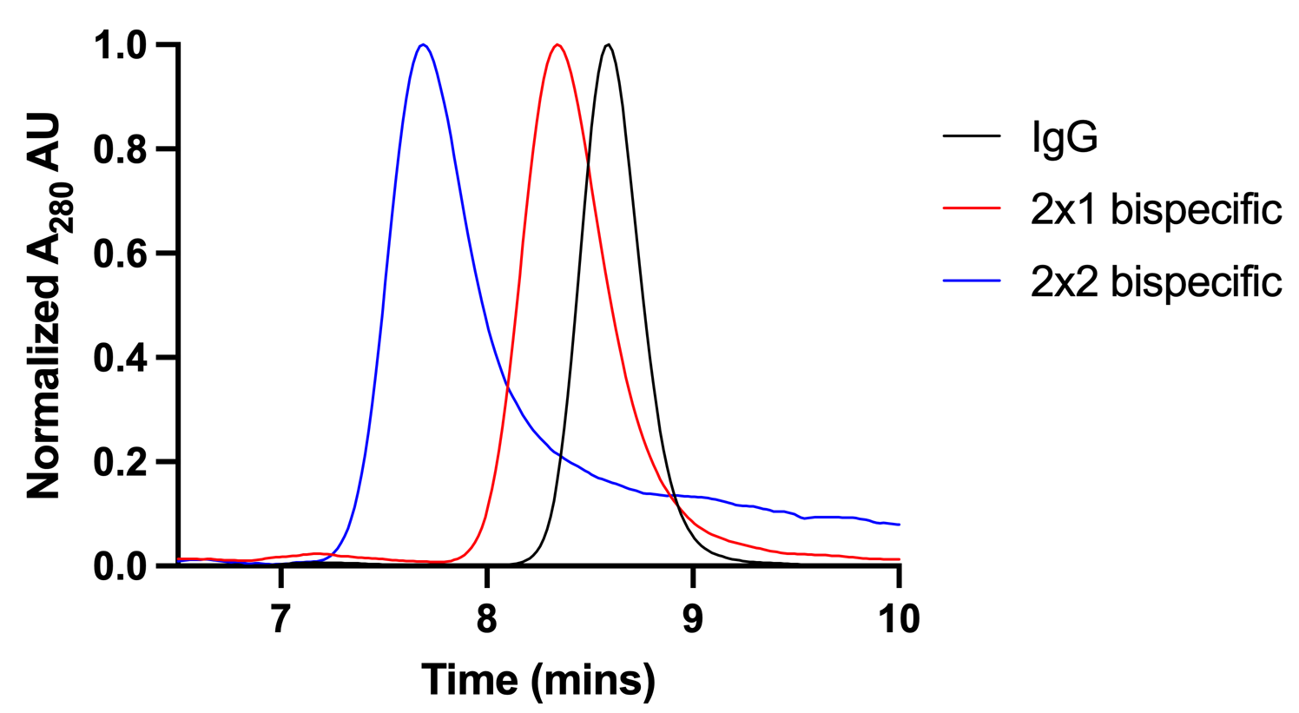
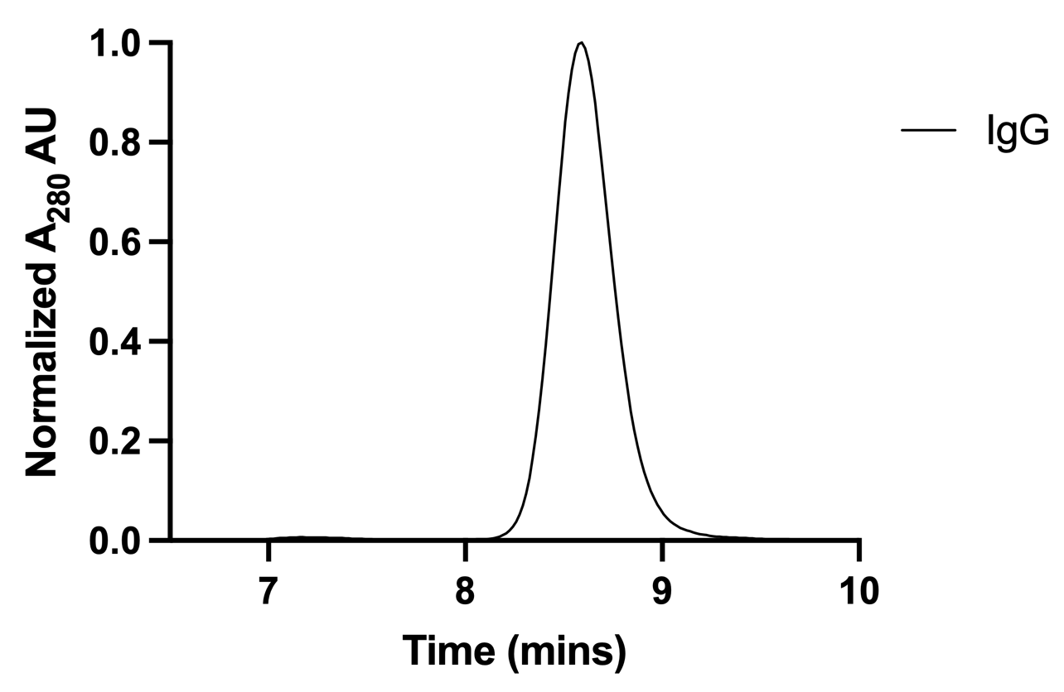
ExTAb structure and characterization
V_{L}
V_{H}
IgG
2:1
2:2
Protein Ladder
NR
R
scFv
Notes:
For background on our ExTAb structure, an IgG consists of 2 heavy chains, shown in blue, and 2 light chains, shown in green.
The very top parts of the heavy and light chains are referred to as the variable heavy and variable light domains, or VH and VL. These are the domains that determine unique antibody affinities.
To change this IgG into a bispecific antibody , we can fuse an affinity ligand known as an scFv to the heavy chain. **CLICK**
An scFv is made of a VH and a VL joined by a flexible linker. Now the heavy chains are no longer identical, causing the bispecific to run in 3 bands on a gel. The addition of the scFv also increases the overall size of the protein, leading to decreased retention time on HPLC. This bispecific has 2 binding arms at the top and one scFv on the other end, making it a 2 by 1 bispecific. **CLICK**
Our ExTAbs are 2 by 2 bispecifics, meaning that they are bivalent for both targets. We achieve this by adding another scFv so that each heavy chain has a fused affinity ligand. Now the heavy chains are once again identical as seen on the gel and the retention time on HPLC decreases even further.

Slide 6

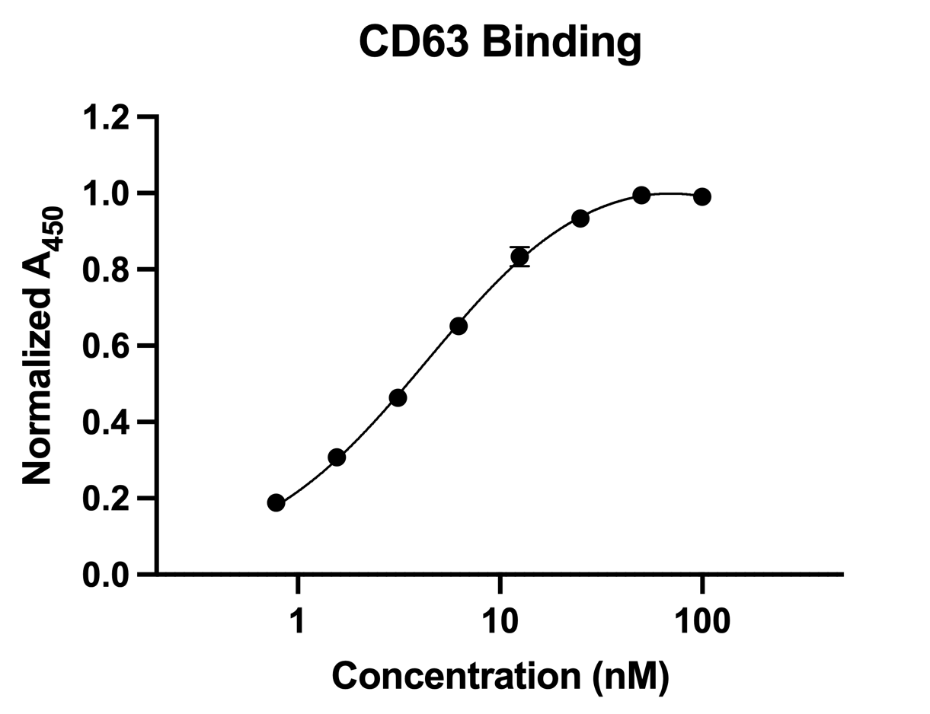
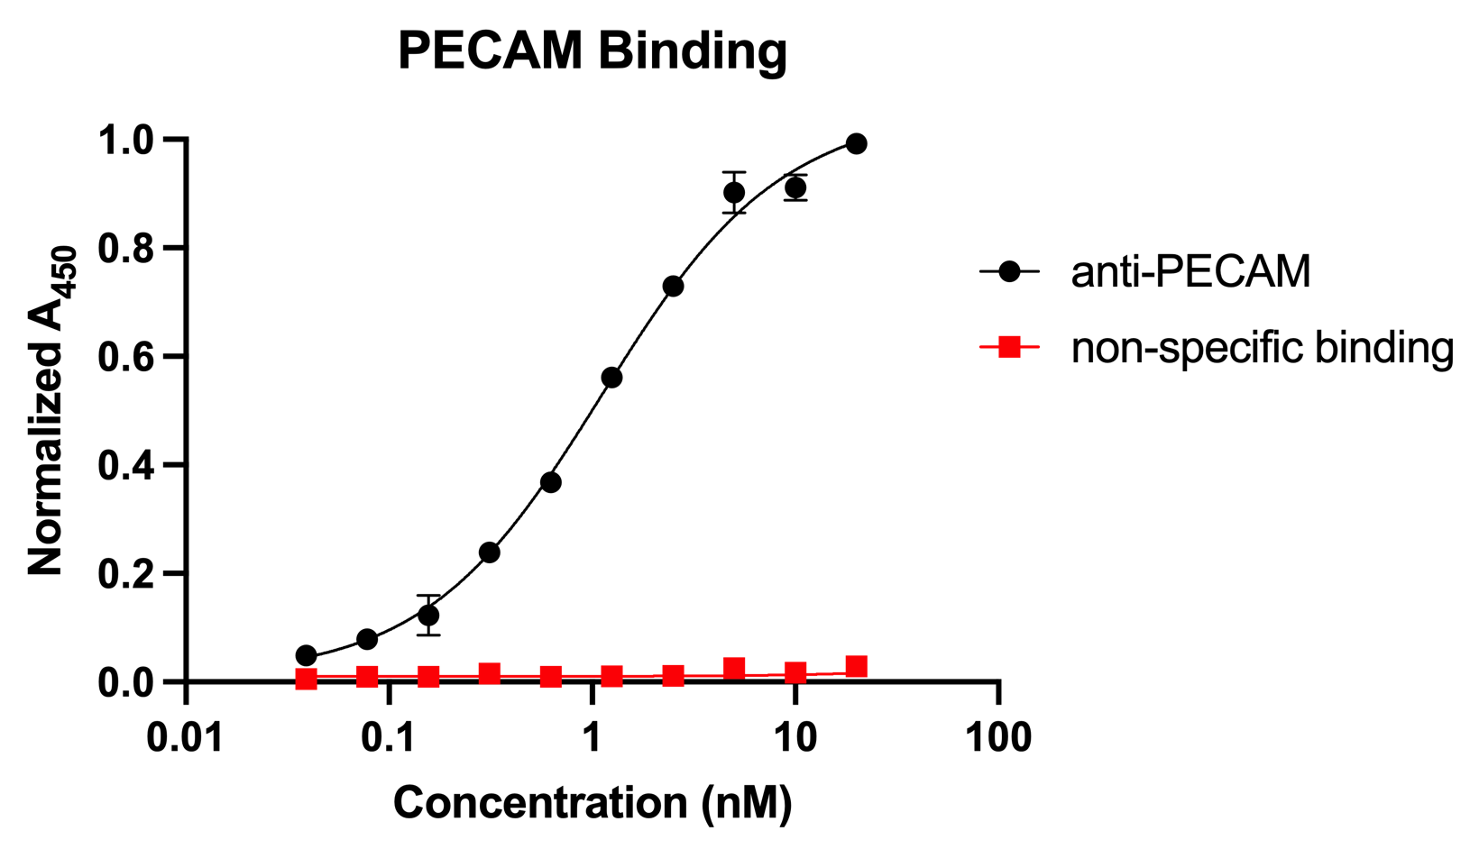
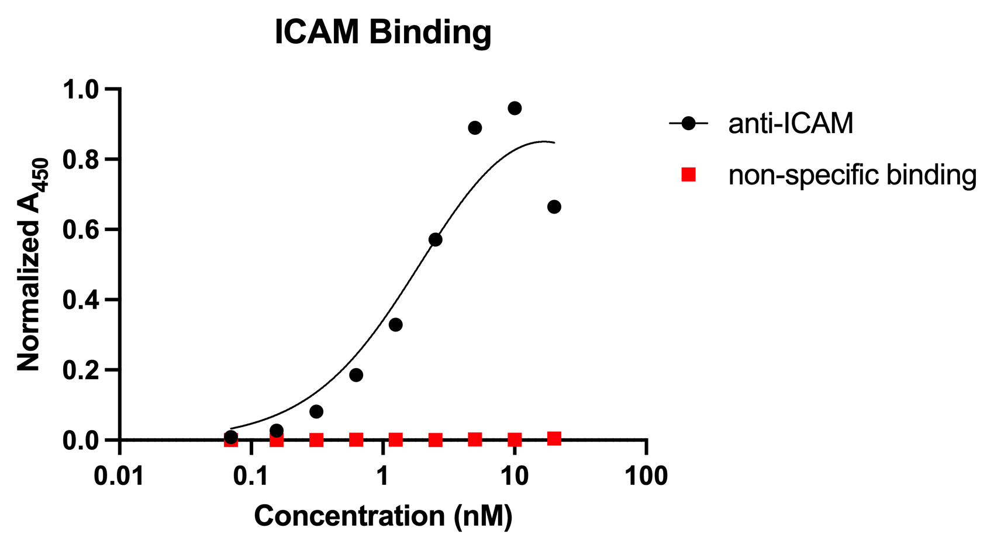
ExTAb structure and characterization
K_{d} = 4.4 nM
K_{d} = 2.1 nM
K_{d} = 1.1 nM
Notes:
Once we successfully designed and expressed our 2 by 2 ExTAbs, we confirmed binding affinities on both ends by ELISA.
IgG end of the antibody displayed high affinity for CD63 with a Kd of 4.4 nM
The scFv ends of anti-PECAM and anti-ICAM ExTAbs also showed high affinities with Kds of 1.1 and 2.1 nM respectively

Slide 7
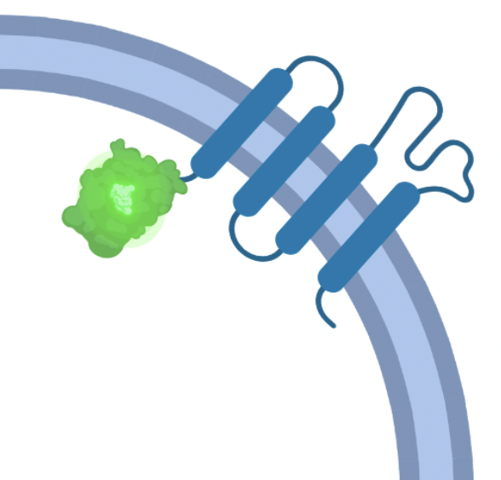
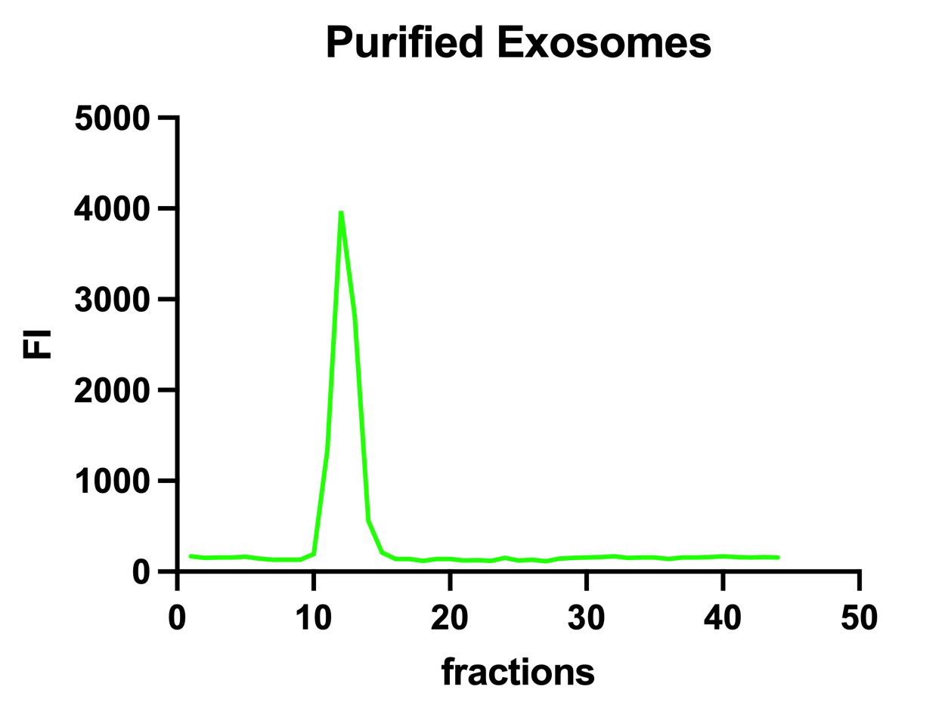
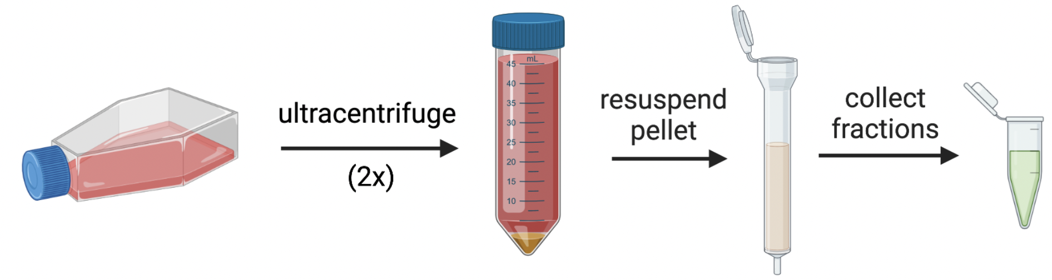

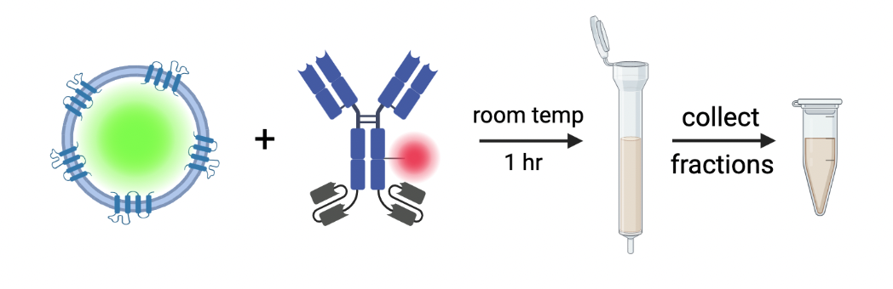
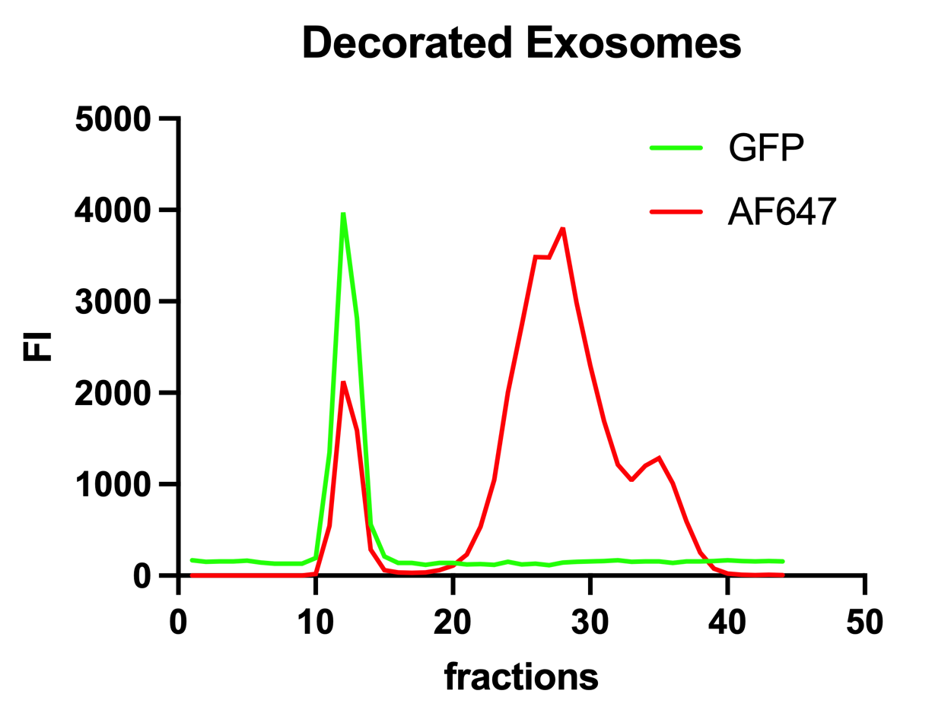
Exosome purification and decoration
CD63-GFP exosomes
Notes:
After characterizing our ExTAbs, we wanted to see if we could use them to decorate the exosome surface.
To facilitate this process, we engineered the exosome parent cell line to express a CD63-GFP fusion protein, so that we could use GFP as a fluorescent marker for the exosomes.
They were purified from cell culture through ultracentrifugation and size exclusion chromatography. Fractions containing exosomes were identified by GFP fluorescence as you can see in this fluorescence plot.
Surface decoration was achieved by incubating the exosomes with AF647 labeled ExTAbs for 1 hour at room temperature before undergoing size exclusion to separate free antibody seen in the rightmost AF647 peak here. We again only take fractions containing GFP.
The efficiency of antibody decoration is highly dependent on CD63 copy number, as expected.

Slide 8
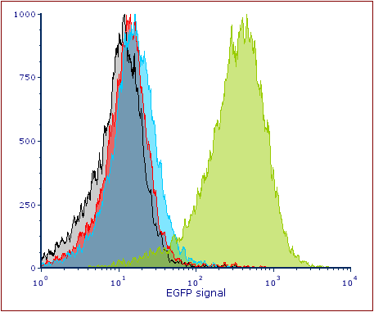
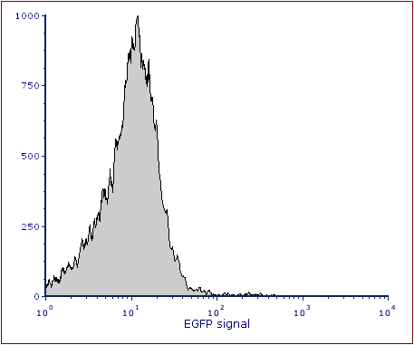
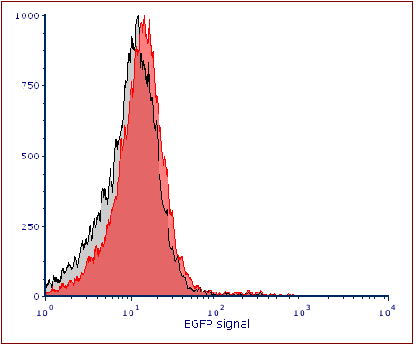
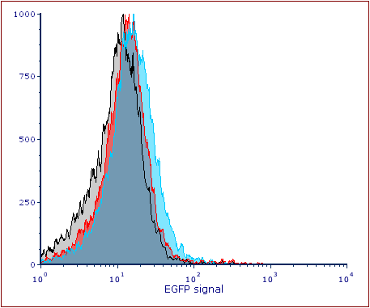
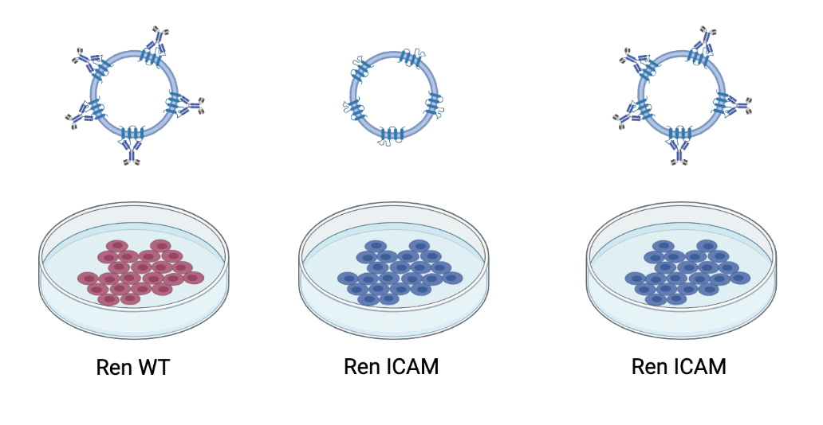
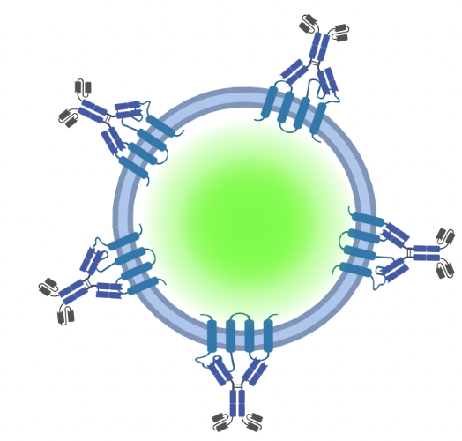
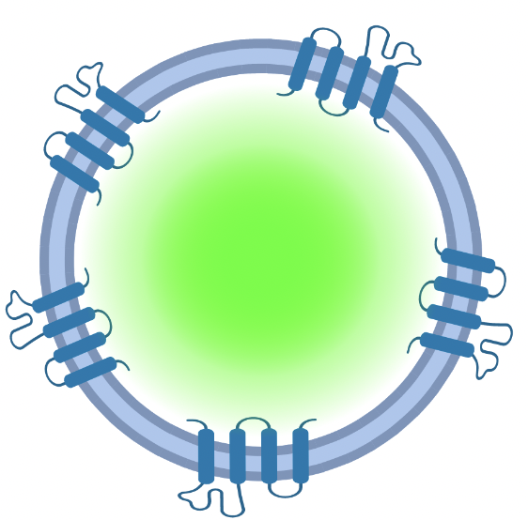
Verification of exosome delivery
Wildtype
ICAM expressing
ICAM expressing
Cell only
Targeted exosomes + wildtype cells
Untargeted exosomes + ICAM cells
Targeted exosomes + ICAM cells
Notes:
Now that we know that we can decorate the exosomes, we want to determine if this strategy will increase exosome delivery to target cells in vitro.
To do this, we incubated exosomes with model ICAM positive and negative cells and compared flow cytometry results to model cells alone on flow cytometry, shown here on this plot.
Targeted exosomes with ICAM negative cells and untargeted exosomes with ICAM positive cells served as controls and showed very little difference in delivery when compared to cells alone.
But when targeted exosomes were incubated with ICAM positive cells, a significant increase in GFP fluorescence can be observed in the model cells.
It is important to note that since this model cell line was engineered to express ICAM, it may not reflect natural ICAM expression.

Slide 9
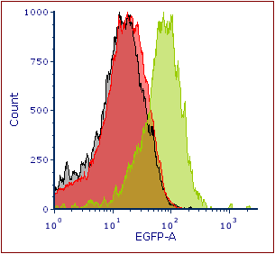
Verification of exosome delivery
cell only
Mouse endothelial cells (bEND3)
Cell only
Untargeted exosomes + cells
Targeted exosomes + cells
Notes:
To address this issue, we next verified exosome delivery to actual endothelial cells. These cells express PECAM-1 naturally and therefore, we tested our PECAM targeted exosomes.
Similarly to our in vitro ICAM delivery experiment, our negative control of untargeted exosomes showed no increase in GFP uptake; however, our targeted exosomes resulted in increased GFP fluorescence within the endothelial cells, as seen on this plot once again.

Slide 10
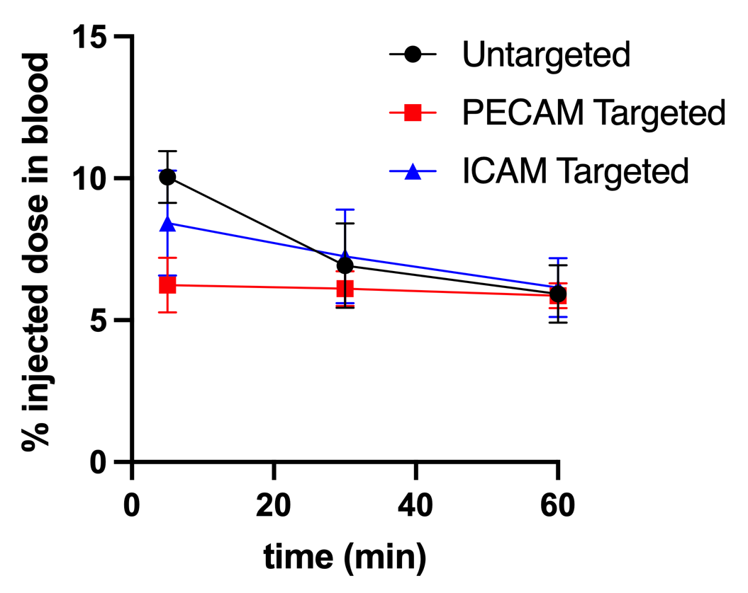
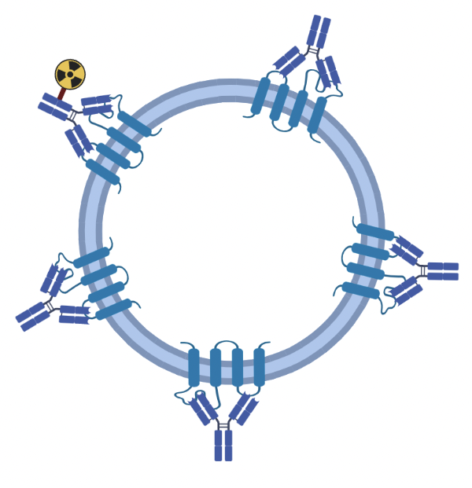
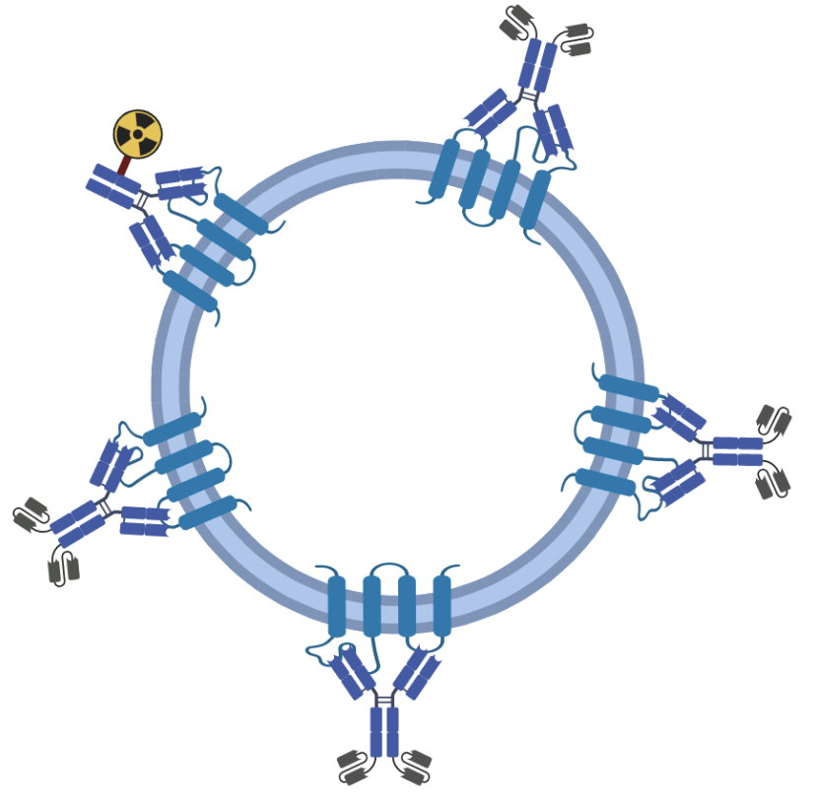
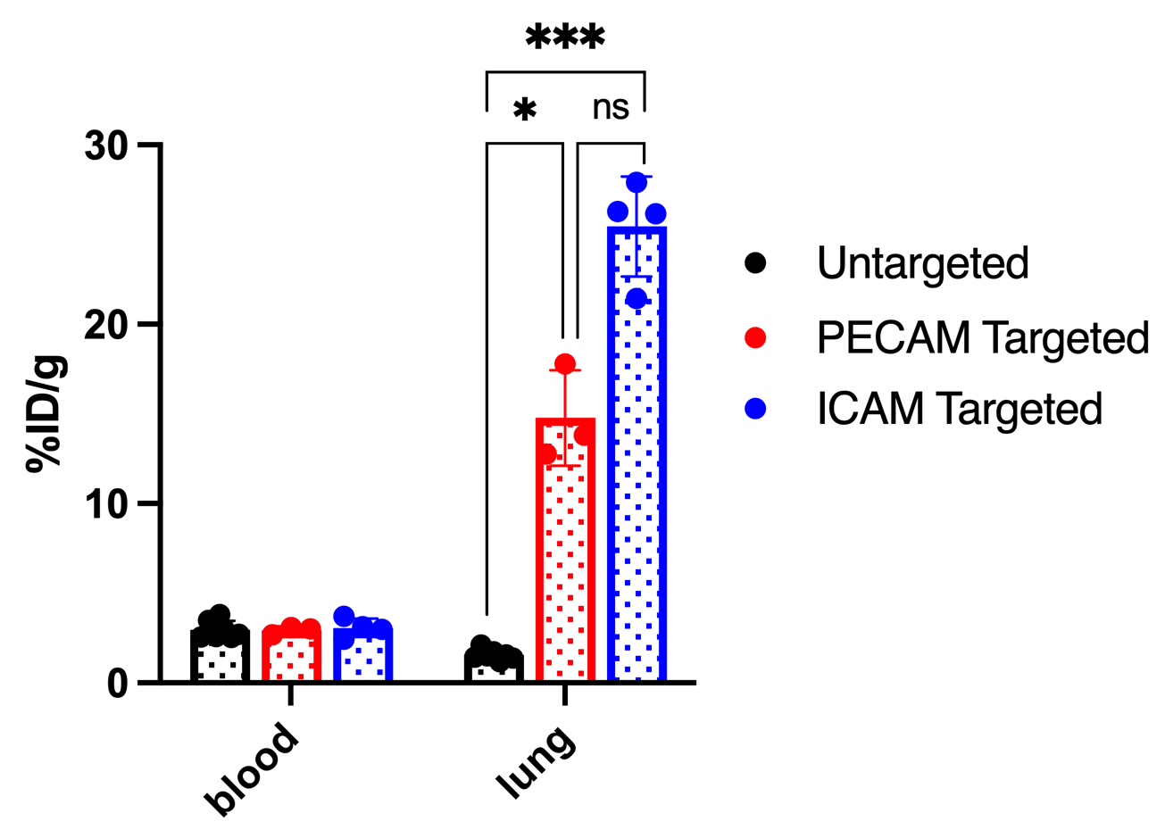
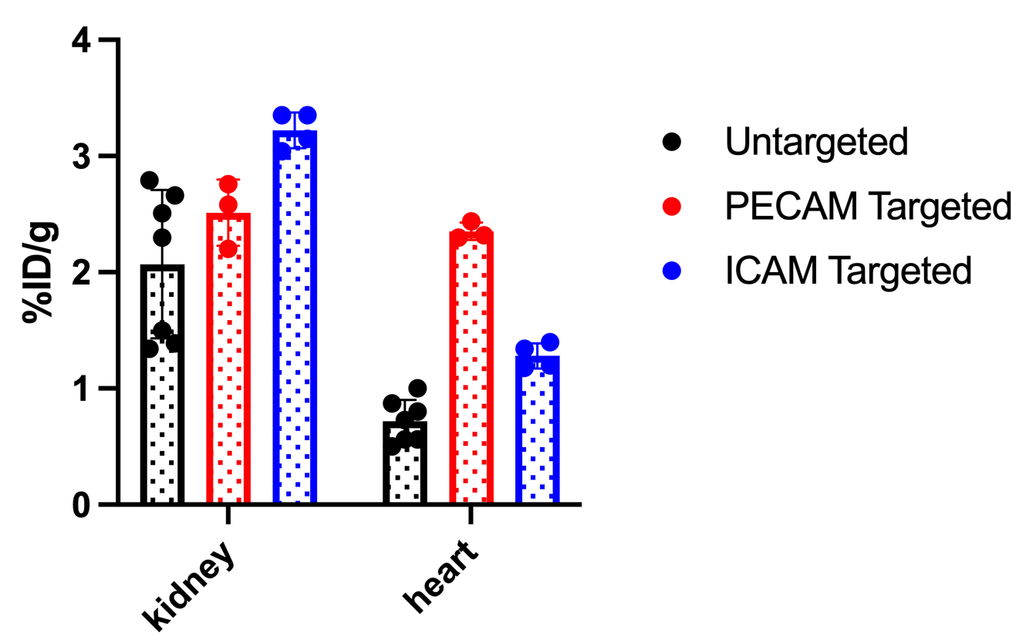
In vivo specificity for vasculature
Untargeted exosome
Targeted exosome
I 125
I 125
Notes:
Now that we had seen increased delivery in vitro, we tested if our method could increase delivery in vivo as well.
For in vivo study, we dosed mice with I-125 labeled untargeted and targeted exosomes. Blood was drawn at 5, 30, and 60 minutes and it was observed that the exosomes cleared very quickly from the bloodstream, as expected.
Organs were harvested at the 60-minute time point as well, and the percent of injected dose in each organ was measured.
Exosomes had significantly increased uptake in the lung, a highly vascularized organ, when compared to exosomes in the blood. ICAM targeting resulted in slightly higher uptake than PECAM in the lung.
In addition, we see an increase in exosome delivery in the kidney and heart, which are also endothelial-rich organs. PECAM and ICAM show different

Slide 11
Future Directions
Acknowledgements
Verify cell-specific delivery
Boya Zhang
Michaela Dodd
Layne Bond
Xinye Wang
Jae Bucknor
Sachith Vidanapathirana
Colin Greineder
Deliver functional cargo
Explore other targets by swapping affinity ligands
Notes:
Going forward, we intend on verifying specific delivery on a cellular level instead of the organ level
We are also in the process of evaluating if our ExTAb coated exosomes can delivery functional molecular cargo to target cells
And we look forward to exploring other target cells and organs for this versatile platform
Thank you

Slide 12
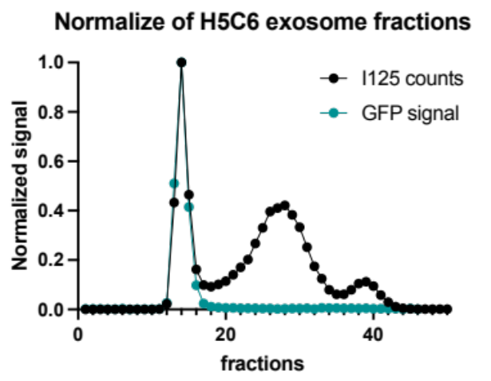
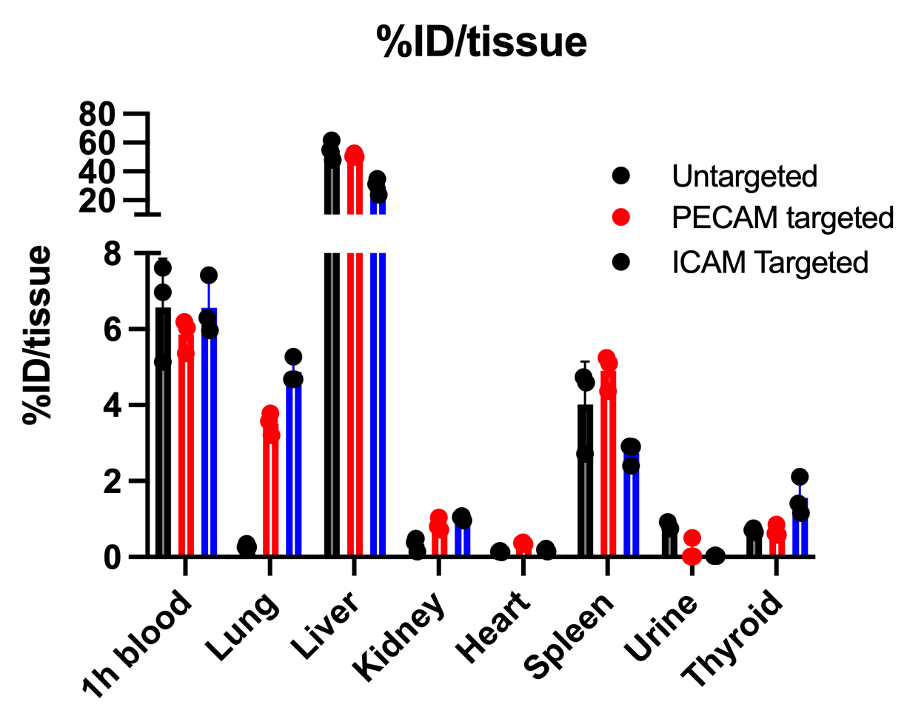
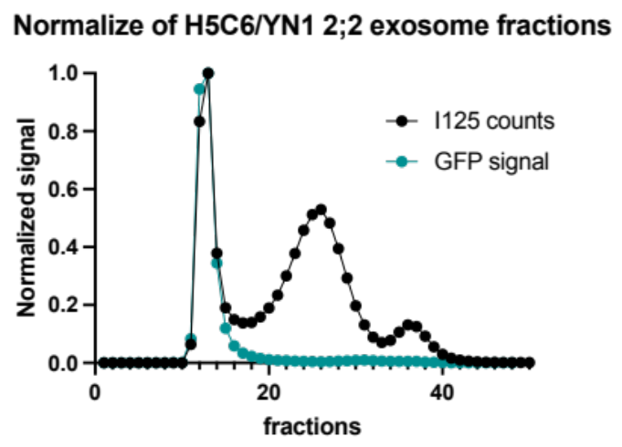
Untargeted exosome:
I 125
Targeted exosome:
I 125

