Slide 1
Common Barriers to Replicability and Retrieval in Systematic Review Search Strategies
Whitney A Townsend, MLIS
Patricia F Anderson, MILS
Emily C Ginier, MLIS
Mark P MacEachern, MLIS
Kate M Saylor, MSI
Judith E Smith, MSLIS
Taubman Health Sciences Library, University of Michigan

Slide 2


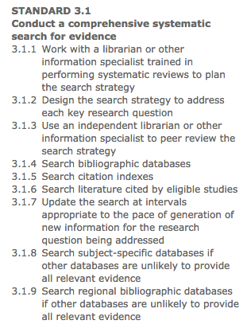
Background
Rethlefsen ML, Farrell AM, Osterhaus Trzasko LC, Brigham TJ. Librarian co-authors correlated with higher quality reported search strategies in general internal medicine systematic reviews. J Clin Epidemiol. 2015 Jun;68(6):617-26. doi: 10.1016/j.jclinepi.2014.11.025.
Koffel JB. Use of recommended search strategies in systematic reviews and the impact of librarian involvement: a cross-sectional survey of recent authors. PLoS One. 2015 May 4;10(5):e0125931. doi: 10.1371/journal.pone.0125931.
Meert D, Torabi N, Costella J. Impact of librarians on reporting of the literature searching component of pediatric systematic reviews. J Med Libr Assoc. 2016 Oct;104(4):267-277.
Koffel JB, Rethlefsen ML. Reproducibility of Search Strategies Is Poor in Systematic Reviews Published in High-Impact Pediatrics, Cardiology and Surgery Journals: A Cross-Sectional Study. PLoS One. 2016 Sep 26;11(9):e0163309. doi: 10.1371/journal.pone.0163309.
Townsend WA, Anderson PF, Ginier EC, MacEachern MP, Saylor KM, Shipman BL, Smith JE. A competency framework for librarians involved in systematic reviews. J Med Libr Assoc. 2017 Jul;105(3):268-275. doi: 10.5195/jmla.2017.189. Epub 2017 Jul 1.
Notes:
We’ve hit the point where librarian integration in systematic reviews is recommended by major standards; the value of our involvement is backed up by research, and we’ve developed competencies for librarian involvement in systematic reviews. While our searches are generally better than those of team members without specific information training, many librarians are seeking out training opportunities to further develop their search skills.

Slide 3
Background
Systematic Reviews: Opportunities for Librarians
  Funded with Federal funds from the National Library of Medicine, National Institutes of Health, Department of Health and Human Services, under Contract HHSN-276-2011-00005-C with the University of Illinois at Chicago.
  Flipped Classroom Model: 2 weeks online asynchronous followed by 2 day in-person
  Data from 4 cohorts of 20-25 each spread over 1 calendar year
  IRB exempt
Notes:
At the University of Michigan, we have offered a hybrid online/in-person workshop for librarians since 2013 for a total of 10 cohort sessions. Participants submit assignments for online modules, take part in online discussion boards, and submit draft search strategies. Today I’m going to talk about some of our findings from 4 cohorts worth of participant workshop data related to these draft search strategies.

Slide 4
Our Question
What are the most common barriers to replicability and retrieval that we should target in systematic review instruction?
Notes:
As we worked to continually improve our course and instruction, and gathered search data, we asked ourselves a question:

Slide 5
The Methods
Participants provided with a case scenario:
  Standardized topic with clear population and intervention concept blocks (based on a published SR with 10 included studies)
  Researcher requests:
    Limit search to the last 10 years
    Limit search to Human studies
    Particular outcomes of interest
  Three sentinel articles that fit inclusion criteria (3 of the 10 included studies from the published SR)
Notes:
To identify some of the most common challenges in systematic searches, participants completed a capstone search assignment.

Slide 6
The Methods
Participants provided with a case scenario:
  Standardized topic with clear population and intervention concept blocks (based on a published SR with 10 included studies)
  Researcher requests:
    Limit search to the last 10 years
    Limit search to Human studies
    Particular outcomes of interest
  Three sentinel articles that fit inclusion criteria (3 of the 10 included studies from the published SR)

Slide 7
The Methods
Participants provided with a case scenario:
  Standardized topic with clear population and intervention concept blocks (based on a published SR with 10 included studies)
  Researcher requests:
    Limit search to the last 10 years
    Limit search to Human studies
    Particular outcomes of interest
  Three sentinel articles that fit inclusion criteria (3 of the 10 included studies from the published SR)

Slide 8
The Methods
Assignment Instructions:
“Create a replicable search strategy using PubMed for the systematic review topic and scenario listed below. Use the information provided at your discretion as you formulate your search; for example, if the research team wants to limit to English language studies but you don’t feel that’s appropriate, you don’t need to do so in your search.”
Submit: Search Strategy, Number of results

Slide 9
The Methods
Instructors reviewed submitted draft strategies for:
  Replicability
  Application of Limits
  Retrieval of 3 sentinel articles provided
  Retrieval of 10 included studies from published SR
    PMIDs for identified articles and missed articles
Notes:
Also stripped out all limits to check retrieval

Slide 10
IMPORTANT!
Good to know (aka limitations):
  Searches are DRAFTS; done in 2 weeks
  Results guide in-person discussions
  Cohort search analysis is used as an instructional exercise
Notes:
Stress that this is used as an instructional exercise; it’s always more impactful to SEE the difference that it is just to hear about it. Instructors present a similar analysis to each cohort to guide in-person discussions and peer review exercises. This is NOT meant to test the educational intervention; it IS an educational intervention.

Slide 11
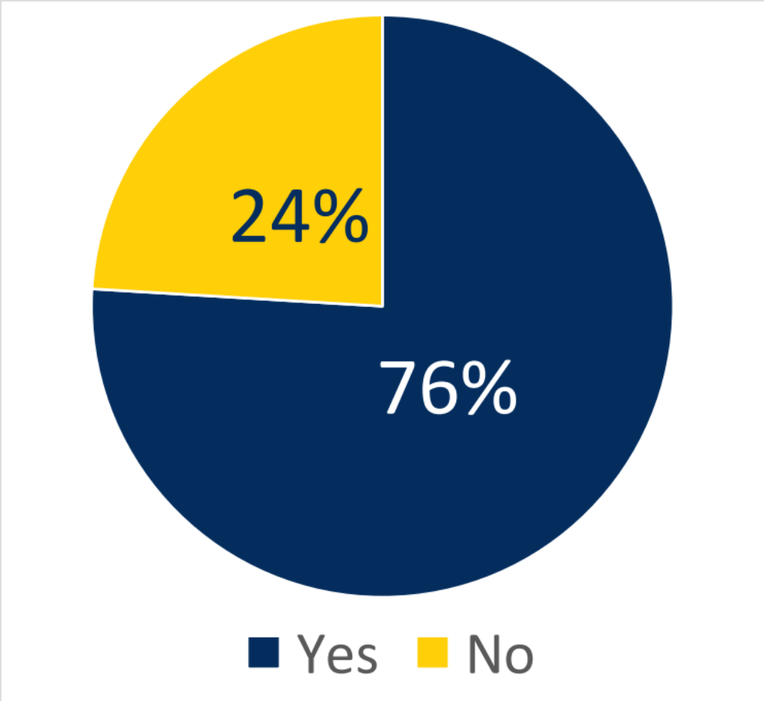
How replicable are strategies?
Replicability
N= 79
Difficult to define
Generous definitions due to draft search status
Multiple reasons for non-replicable strategies
Notes:
Not Replicable:
Obvious spelling/syntax errors
No obvious errors
Unable to conduct a search from information provided

Slide 12
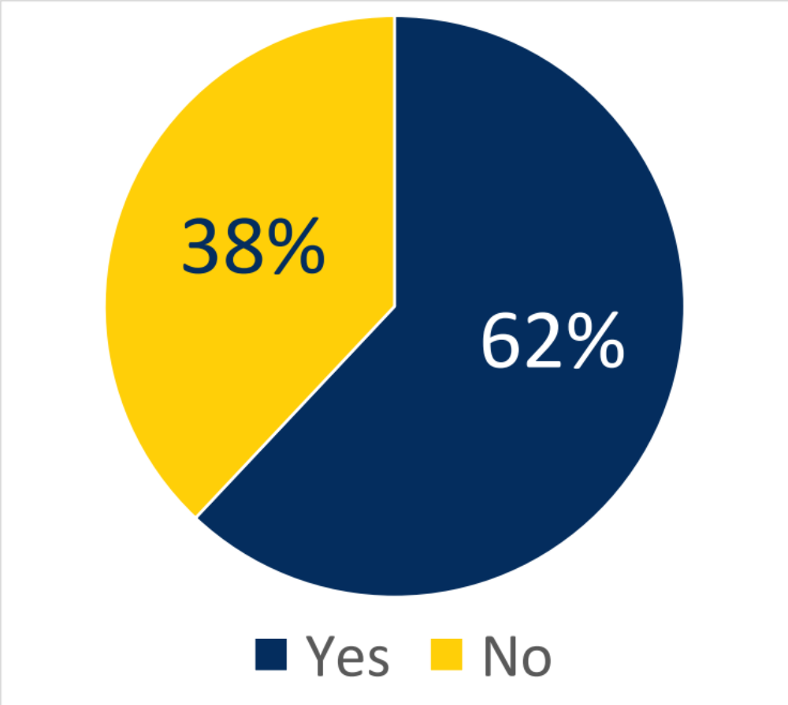
Which limits do searchers apply?
Date limit
10 year limit requested by scenario team
Not required to comply
  “Last 10 years”
  Custom Date range
  Others

Slide 13
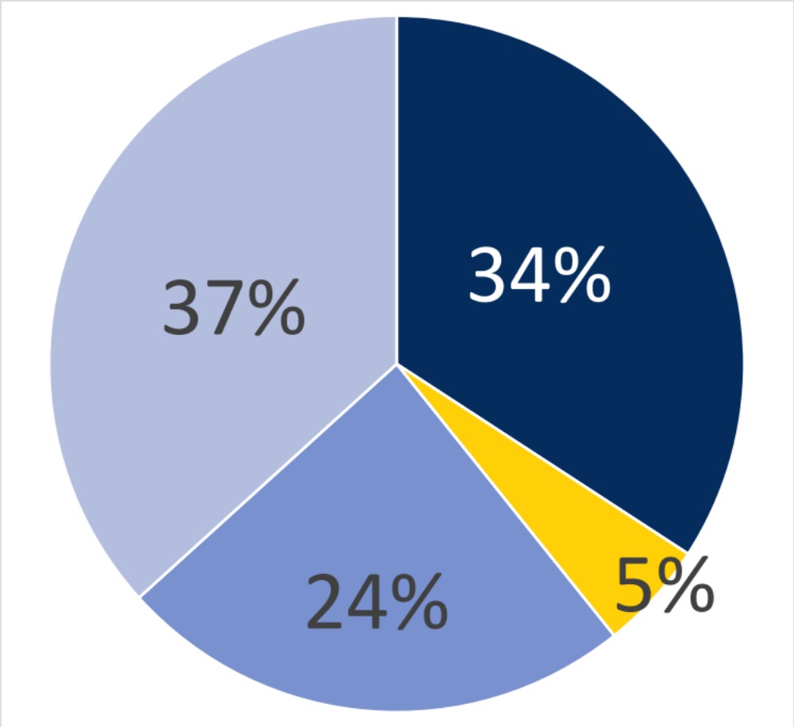
Which limits do searchers apply?
Human Limit
    No
    Other
    Yes - Cochrane Human limit (NOT NOT)
    Yes - Humans[MeSH]

Slide 14
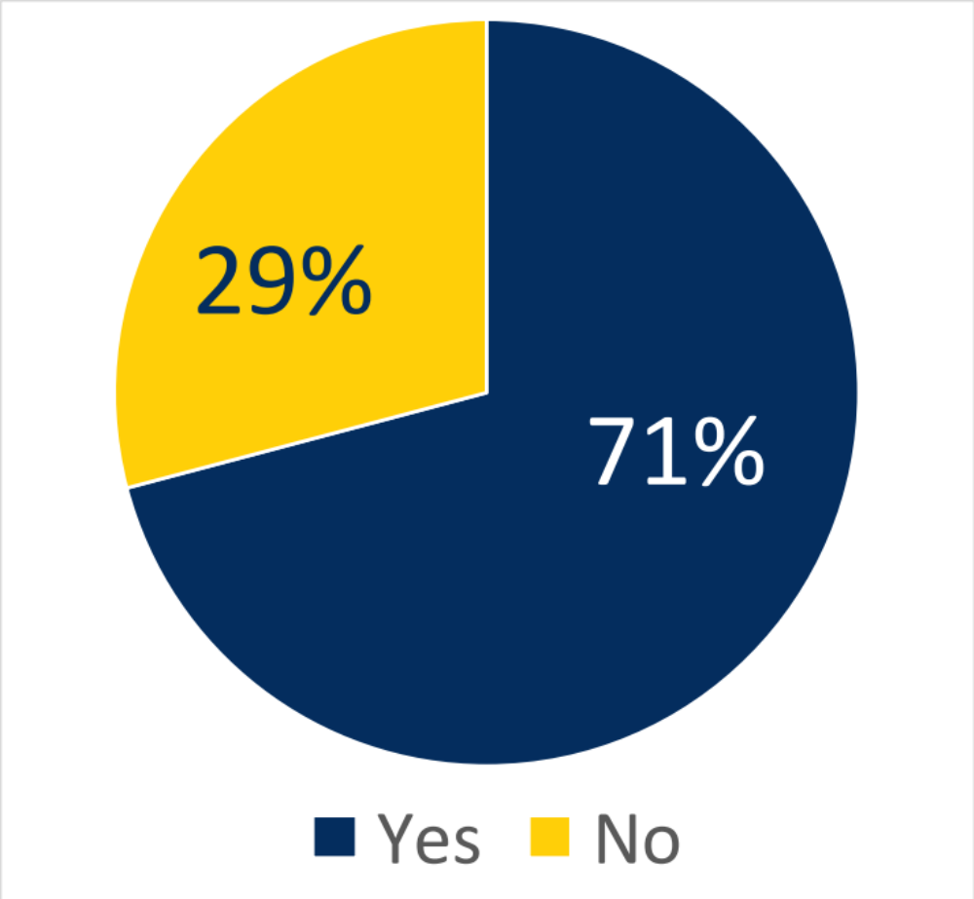
Which limits do searchers apply?
Included outcomes
Highly topic dependent
Not all outcomes are reported in the abstract

Slide 15
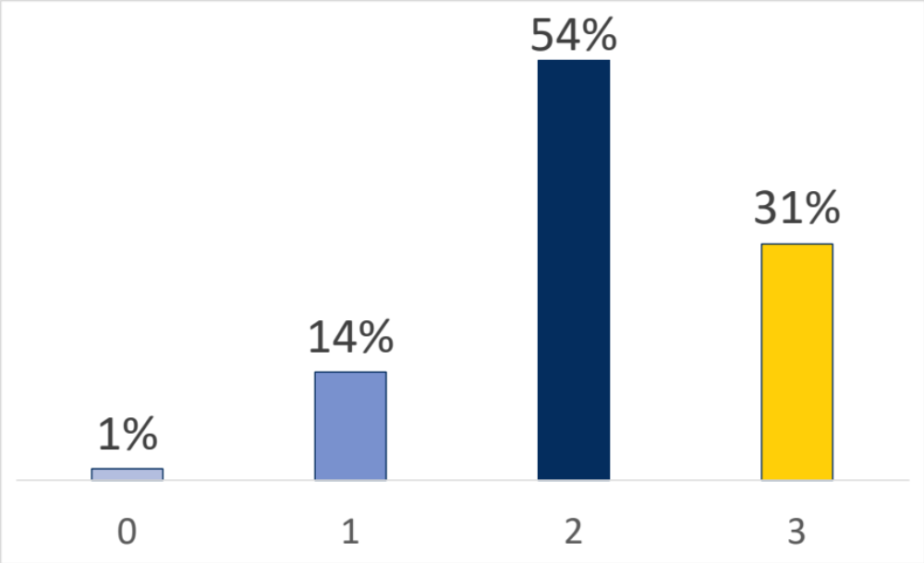
How well are known citations retrieved?
Retrieval of all 3 sentinel articles:
31%
Notes:
Note that N=72 here (7 strategies were completely un-replicable; unable to create a search from information provided. Others in the 24% not replicable, we used the results that we got in our searches)

Slide 16
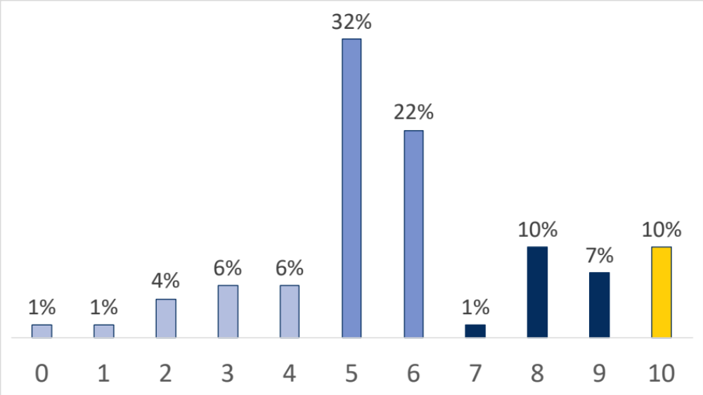
How well are all citations retrieved?
Retrieval of all 10 included studies:
10%

Slide 17
Which papers were most commonly missed?
Missed Citations (PMID) |  | % Participants
7609106 |  | 81%
1773291 |  | 78%
2317671 |  | 71%
16413349 |  | 64%
17850374 |  | 50%
24660833 |  | 28%
18367097 |  | 17%
24989847 |  | 13%
24601996 |  | 7%
27159369 |  | 7%

Slide 18
Why were these papers missed?
Missed Citations (PMID) |  | % Participants
7609106 |  | 81%
1773291 |  | 78%
2317671 |  | 71%
16413349 |  | 64%
17850374 |  | 50%
24660833 |  | 28%
18367097 |  | 17%
24989847 |  | 13%
24601996 |  | 7%
27159369 |  | 7%
Outside of the 10 year date range limit for all cohorts, regardless of limiting technique
Outside of the 10 year date range limit for some cohorts
Notes:
62% limited by date, so even though that didn’t missed 3 articles very consistently. (50% missed is on the cusp depending on cohort and limiting technique). These numbers stayed pretty consistent even when limits were stripped out, so not solely due to date. So let’s look at why.

Slide 19
7609106
Intraoperative blood loss and prognosis in prostate cancer patients undergoing radical retropubic prostatectomy.
Oefelein MG (1995)
To assess more thoroughly the prognostic significance of perioperative transfusions, we examined a previously ignored factor, namely intraoperative blood loss. Univariate and multivariate stepwise regression analysis was performed on results of a 10-year series of 251 consecutive men who underwent radical retropubic prostatectomy for clinically localized carcinoma. Gleason score, operative blood loss and pathological stage were significantly (p &lt; 0.0001) associated with progression-free survival. A risk ratio of 1.08 (95% confidence interval 1.05 to 1.10) was demonstrated for every 100 ml. of operative blood loss. The operative blood loss but not the type (autologous or allogeneic) of blood transfused was significantly related to decreased recurrence-free survival after radical retropubic prostatectomy. This finding implies that the operative events necessitating transfusion are potentially more significant than the immunological effects of the transfusion.
Adult Aged
Blood Loss, Surgical*
Disease-Free Survival
Follow-Up Studies
Humans
Male Middle Aged Multivariate Analysis
Postoperative Complications / epidemiology Prognosis Prostatectomy* Prostatic Neoplasms / mortality Prostatic Neoplasms / surgery*
Regression Analysis
Survival Rate
WHAT HAPPENED?
No transfusion MeSH term or “blood transfusion” phrase
  Transfusions[tw]
  Transfusion[tw]
  Transfus*[tw]
  Transfused[tw]
  “Blood loss”[tw]
  “Blood loss, surgical”[mesh]
Table: Yale MeSH Analyzer
Notes:
Inadequate keyword term generation

Slide 20
1773291
Peri-operative blood transfusion in relation to tumour recurrence and death after surgery for prostatic cancer.
Eickhoff JH (1991)
Several reports have suggested that peri-operative blood transfusion promotes tumour recurrence and death after surgery for cancer. We have studied the effect of transfusion in 156 patients operated on for prostatic cancer. A retrospective review was made of the clinical, histopathological and transfusion data in their hospital records. Sixty patients received blood transfusions and 96 did not. The 5-year prostatic cancer specific survival rate was 0.56 in the transfused patients and 0.69 in the non-transfused group. The transfused patients had a higher prevalence of risk factors than did the non-transfused. When the differences in risk factors were accounted for by Cox regression analysis, peri-operative blood transfusion reduced the prostatic cancer death intensity by 36%. The study does not support the hypothesis that blood transfusion promotes recurrence following surgery for prostatic cancer.
Aged Aged, 80 and over
Blood Transfusion / adverse effects*
Humans
Male Middle Aged
Neoplasm Recurrence, Local* / mortality
Prospective Studies Prostate / surgery Prostatic Neoplasms / mortality* Prostatic Neoplasms / surgery
Retrospective Studies Risk Factors
Surgical Procedures, Operative / mortality Survival Rate
WHAT HAPPENED?
No prostatectomy term (MeSH or keyword)
  Prostate/surgery[mesh]
  Prostatic Neoplasms/surgery[mesh]
  Surgical Procedures, Operative[mesh]
  ”prostatic cancer”[tw] AND surgery[tw]
Table: Yale MeSH Analyzer
Notes:
Inadequate keyword term generation

Slide 21
PMID | 2317671
Title | Blood transfusion and survival following surgery for prostatic carcinoma.
Journal Title | The British journal of surgery
Author Year | McClinton S (1990)
Abstract | Blood transfusion in the perioperative period has been reported to have a detrimental effect on survival in many types of cancer. Other studies have failed to confirm this. We have examined retrospectively the records of 246 patients with prostatic carcinoma who underwent transurethral resection of the prostate (TURP) in Aberdeen Royal Infirmary between 1977 and 1982. Bilateral orchiectomy (BLO) was performed in 193 patients. Of these patients, 71 of 246 (29 per cent) received perioperative blood transfusion. After controlling for differences due to a number of variables, transfusion of non-autologous blood was shown to be associated with a significant negative effect on survival. Perioperative transfusion of non-autologous blood should be avoided in patients with malignancy, unless there are clear overriding clinical indications. Prospective trials are needed urgently.
MeSH Headings | Aged
 | Humans
 | Intraoperative Period
 | Male
 | Orchiectomy
 | Prostatectomy Prostatic Neoplasms / mortality Prostatic Neoplasms / pathology Prostatic Neoplasms / surgery*
 | Retrospective Studies
 | Scotland / epidemiology Survival Rate
 | Transfusion Reaction*
WHAT HAPPENED?
Survival the only outcome term (MeSH or keyword)
  Specific outcomes of interest to team are not indicated (although survival is related to all of them!)
Table: Yale MeSH Analyzer
Notes:
Inclusion of outcomes; again, term generation (or leave outcomes off altogether)

Slide 22
Limitations
Draft Searches!
Required to use PubMed
At present, don’t have data on experience levels of participants
Refine definitions of replicable
Small changes to course over time (additional online instruction in searching, form for assignment submission)
This is only one topic; limits have very different effects on retrieval for other topics
Changes in indexing over time affect replicability
Notes:
When we ran these searches at the time of the cohort, versus for analysis now, we got some slightly different results. Let’s take a look at why. (and this raises questions of replicability)

Slide 23



Changes in Indexing
Most frequently missed articles at the time
(after removal of all search limits)
Spring 2017
Spring 2018
Fall 2017

Slide 24
27159369
Perioperative Blood Transfusion as a Significant Predictor of Biochemical Recurrence and Survival after Radical Prostatectomy in Patients with Prostate Cancer.
Kim JK (2016)
There have been conflicting reports regarding the association of perioperative blood transfusion (PBT) with oncologic outcomes including recurrence rates and survival outcomes in prostate cancer. We aimed to evaluate whether perioperative blood transfusion (PBT) affects biochemical recurrence-free survival (BRFS), cancer-specific survival (CSS), and overall survival (OS) following radical prostatectomy (RP) for patients with prostate cancer. A total of 2,713 patients who underwent RP for clinically localized prostate cancer between 1993 and 2014 were retrospectively analyzed. We performed a comparative analysis based on receipt of transfusion (PBT group vs. no-PBT group) and transfusion type (autologous PBT vs. allogeneic PBT). Univariate and multivariate Cox-proportional hazard regression analysis were performed to evaluate variables associated with BRFS, CSS, and OS. The Kaplan-Meier method was used to calculate survival estimates for BRFS, CSS, and OS, and log-rank test was used to conduct comparisons between the groups. The number of patients who received PBT was 440 (16.5%). Among these patients, 350 (79.5%) received allogeneic transfusion and the other 90 (20.5%) received autologous transfusion. In a multivariate analysis, allogeneic PBT was found to be statistically significant predictors of BRFS, CSS, and OS; conversely, autologous PBT was not. The Kaplan-Meier survival analysis showed significantly decreased 5-year BRFS (79.2% vs. 70.1%, log-rank, p = 0.001), CSS (98.5% vs. 96.7%, log-rank, p = 0.012), and OS (95.5% vs. 90.6%, log-rank, p &lt; 0.001) in the allogeneic PBT group compared to the no-allogeneic PBT group. In the autologous PBT group, however, none of these were statistically significant compared to the no-autologous PBT group. We found that allogeneic PBT was significantly associated with decreased BRFS, CSS, and OS. This provides further support for the immunomodulation hypothesis for allogeneic PBT.
From Spring 2017…
Table: Yale MeSH Analyzer

Slide 25
27159369
Perioperative Blood Transfusion as a Significant Predictor of Biochemical Recurrence and Survival after Radical Prostatectomy in Patients with Prostate Cancer.
Kim JK (2016)
There have been conflicting reports regarding the association of perioperative blood transfusion (PBT) with oncologic outcomes including recurrence rates and survival outcomes in prostate cancer. We aimed to evaluate whether perioperative blood transfusion (PBT) affects biochemical recurrence-free survival (BRFS), cancer-specific survival (CSS), and overall survival (OS) following radical prostatectomy (RP) for patients with prostate cancer. A total of 2,713 patients who underwent RP for clinically localized prostate cancer between 1993 and 2014 were retrospectively analyzed. We performed a comparative analysis based on receipt of transfusion (PBT group vs. no-PBT group) and transfusion type (autologous PBT vs. allogeneic PBT). Univariate and multivariate Cox-proportional hazard regression analysis were performed to evaluate variables associated with BRFS, CSS, and OS. The Kaplan-Meier method was used to calculate survival estimates for BRFS, CSS, and OS, and log-rank test was used to conduct comparisons between the groups. The number of patients who received PBT was 440 (16.5%). Among these patients, 350 (79.5%) received allogeneic transfusion and the other 90 (20.5%) received autologous transfusion. In a multivariate analysis, allogeneic PBT was found to be statistically significant predictors of BRFS, CSS, and OS; conversely, autologous PBT was not. The Kaplan-Meier survival analysis showed significantly decreased 5-year BRFS (79.2% vs. 70.1%, log-rank, p = 0.001), CSS (98.5% vs. 96.7%, log-rank, p = 0.012), and OS (95.5% vs. 90.6%, log-rank, p &lt; 0.001) in the allogeneic PBT group compared to the no-allogeneic PBT group. In the autologous PBT group, however, none of these were statistically significant compared to the no-autologous PBT group. We found that allogeneic PBT was significantly associated with decreased BRFS, CSS, and OS. This provides further support for the immunomodulation hypothesis for allogeneic PBT.
WHAT HAPPENED THEN?
No MeSH terms! Hadn’t been indexed yet; keyword only
Table: Yale MeSH Analyzer
Notes:
Adequate keyword terms OR using Cochrane Human limit (instead of Humans[Mesh]) would solve this problem! An issue for MeSH heavy searches.

Slide 26
Changes in Indexing
1773291
Peri-operative blood transfusion in relation to tumour recurrence and death after surgery for prostatic cancer.
Eickhoff JH (1991)
Several reports have suggested that peri-operative blood transfusion promotes tumour recurrence and death after surgery for cancer. We have studied the effect of transfusion in 156 patients operated on for prostatic cancer. A retrospective review was made of the clinical, histopathological and transfusion data in their hospital records. Sixty patients received blood transfusions and 96 did not. The 5-year prostatic cancer specific survival rate was 0.56 in the transfused patients and 0.69 in the non-transfused group. The transfused patients had a higher prevalence of risk factors than did the non-transfused. When the differences in risk factors were accounted for by Cox regression analysis, peri-operative blood transfusion reduced the prostatic cancer death intensity by 36%. The study does not support the hypothesis that blood transfusion promotes recurrence following surgery for prostatic cancer.
Aged Aged, 80 and over
Blood Transfusion / adverse effects*
Humans
Male Middle Aged
Neoplasm Recurrence, Local* / mortality
Prospective Studies Prostate / surgery Prostatic Neoplasms / mortality* Prostatic Neoplasms / surgery
Retrospective Studies Risk Factors
Surgical Procedures, Operative / mortality Survival Rate
PMID | 1773291
Title | Peri-operative blood transfusion in relation to tumour recurrence and death after surgery for prostatic cancer.
Journal Title | British journal of urology
Author Year | Eickhoff JH (1991)
Abstract | Several reports have suggested that peri-operative blood transfusion promotes tumour recurrence and death after surgery for cancer. We have studied the effect of transfusion in 156 patients operated on for prostatic cancer. A retrospective review was made of the clinical, histopathological and transfusion data in their hospital records. Sixty patients received blood transfusions and 96 did not. The 5-year prostatic cancer specific survival rate was 0.56 in the transfused patients and 0.69 in the non-transfused group. The transfused patients had a higher prevalence of risk factors than did the non-transfused. When the differences in risk factors were accounted for by Cox regression analysis, peri-operative blood transfusion reduced the prostatic cancer death intensity by 36%. The study does not support the hypothesis that blood transfusion promotes recurrence following surgery for prostatic cancer.
MeSH Headings | Aged Aged, 80 and over
 | Humans
 | Male Middle Aged
 | Neoplasm Recurrence, Local* / mortality
 | Prospective Studies Prostate / surgery Prostatic Neoplasms / mortality* Prostatic Neoplasms / surgery
 | Retrospective Studies Risk Factors
 | Surgical Procedures, Operative / mortality Survival Rate
 | Transfusion Reaction*
Author Assigned Keywords
Blood Transfusion/
adverse effects
Transfusion Reaction
Spring 2017
Spring 2018
Images: Yale MeSH Analyzer, April 2017 & April 2018

Slide 27
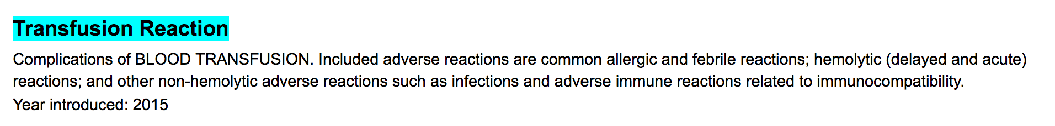
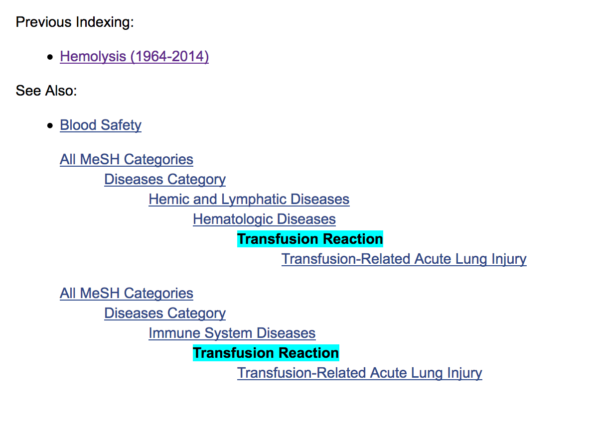
Changes in Indexing

Slide 28
Changes in Indexing: Effects
When searches were re-run in May 2018:
22% of participants added citations to their results
8% of participants lost citations from their results
Notes:
Even if being consistent with dates, field tagging, etc, searches are NOT replicable in true fashion. Only data sets can truly tell us what the team screened for inclusion and exclusion (see Mark’s presentation)
Citations added due to article being indexed
Citations lost due to change from Blood Transfusion/adverse effects to Transfusion Reaction (would be ok with adequate keyword generation if using [tw] field code)

Slide 29
So what does it all mean?
Key areas of educational need:
Adequate term generation
Testing searches and peer review
Best practices for limiting searches
Talking points with teams
PRESS yourself before you wreck yourself!
www.cadth.ca/resources/finding-evidence/press

Slide 30
The Future…
More data, more problems
Effects of specific limits on retrieval
PRESS of Capstone draft searches
Data cleaning and further analysis at RTI

Slide 31
Whitney A Townsend whitneyt@umich.edu
Patricia F Anderson, MILS
Emily C Ginier, MLIS
Mark P MacEachern, MLIS
Kate M Saylor, MSI
Judith E Smith, MSLIS
Notes:
Thank you team, and thank you all workshop participants. We can’t do research without you!!

