Slide 1


“Chromatin Remodeling in
Pediatric High-Grade Gliomas:
Impact of DNA Repair and Genomic Stability”
Maria G. Castro PhD
mariacas@umich.edu
Department of Neurosurgery
Department of Cell and Developmental Biology
University of Michigan Medical School

Slide 2
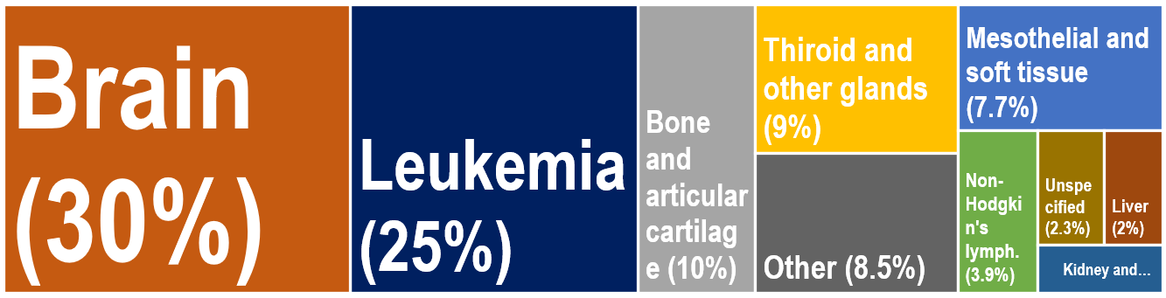
Pediatric High-Grade Gliomas (pHGGs)
Amongst the most aggressive pediatric brain tumors, with long-term survival rates (>5 yr) of 10%–15%
Leading cause of cancer-related death in children and young adults.
Despite surgery and SOC treatment,
pHGGs recur as more aggressive tumors
Are characterized for harboring mutations in genes associated with epigenetic mechanisms
Percent distribution of cancer deaths for children and adolescents in US aged 1–19
Adapted from: Curtin et al, NCHS Data Brief No. 257, September 2016

Slide 3
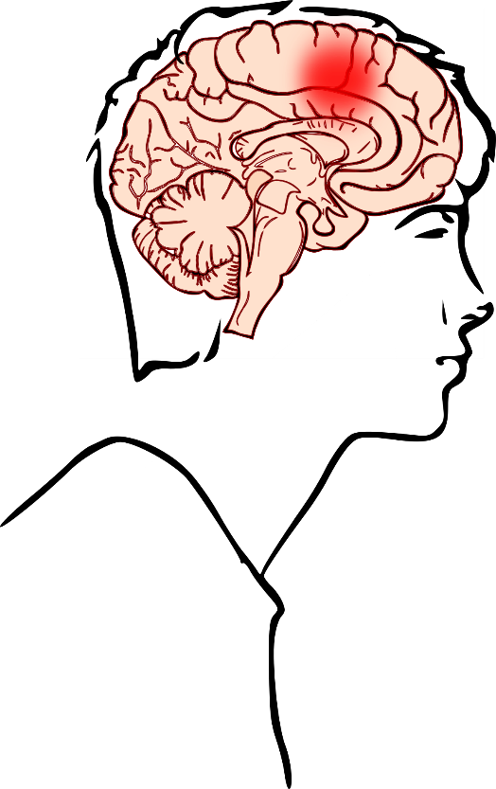
The H3.3-G34R pHGG molecular subgroup
Occurs in adolescents/young adults.
Restricted to the cerebral hemispheres.
Highly associated with P53 and ATRX mutations.
Most tumors encode a mutation in the histone H3.3 (H3F3A): G34 R/V
Our goal: uncover targetable vulnerabilities associated to G34R pHGG

Slide 4
Development of genetically engineered H3.3-G34R pediatric glioma models utilizing the sleeping beauty (SB) transposase system

Slide 5
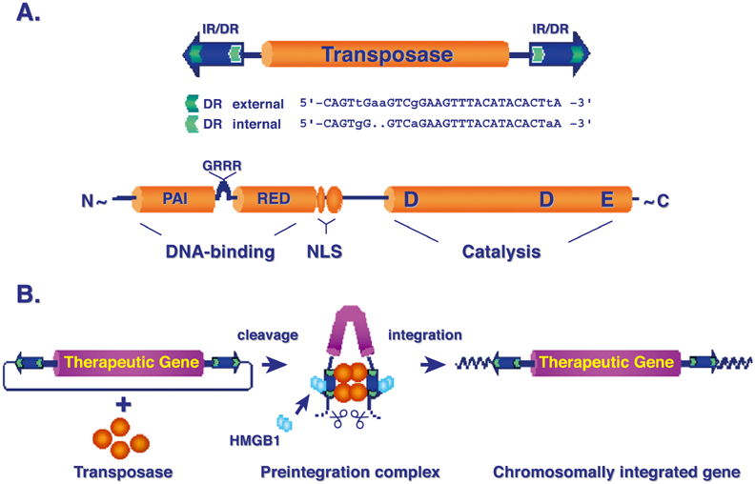
The Sleeping Beauty Transposable Element and its Transposition
Genetic lesion
Genetic lesion
Izsvάk et al., Molecular Therapy. 2004 February; (9): 147-156

Slide 6
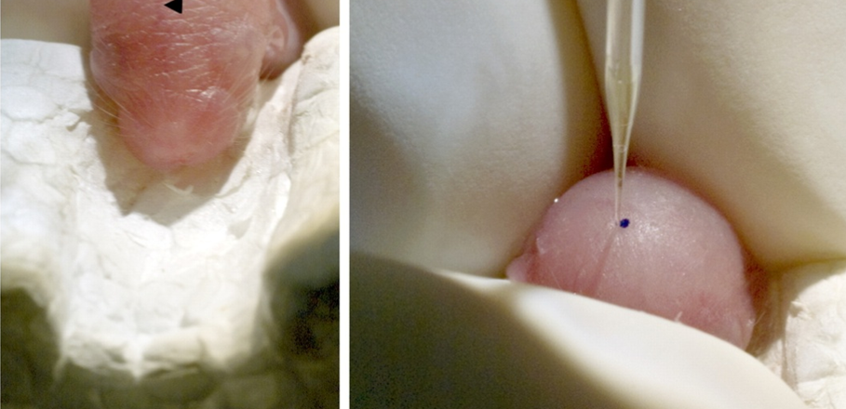
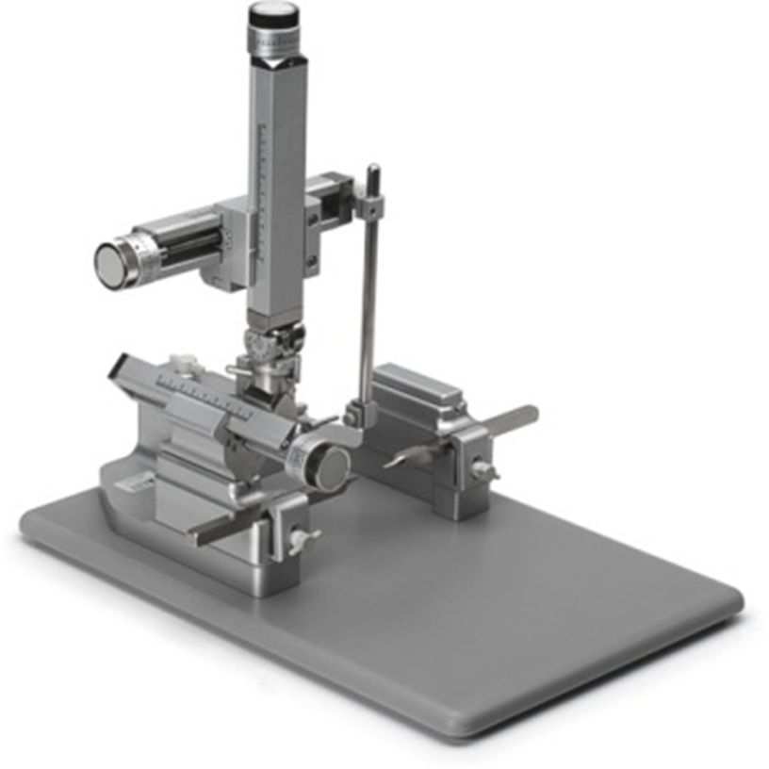
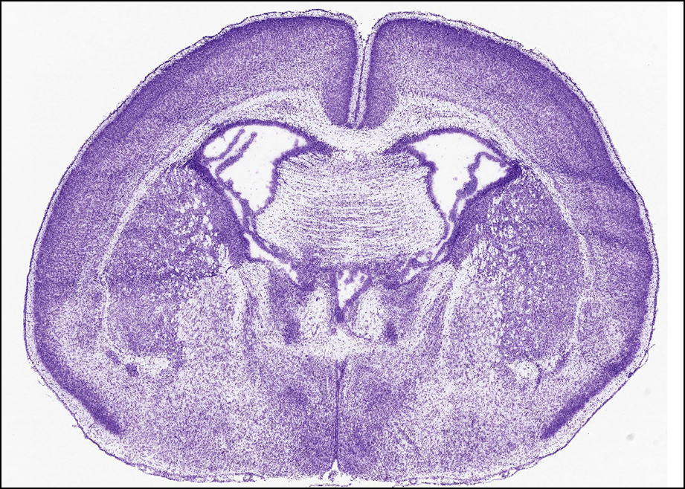
Sleeping Beauty (SB) Transposase-Mediated Brain Tumor Models
Calinescu et al, JOVE 2015

Slide 7
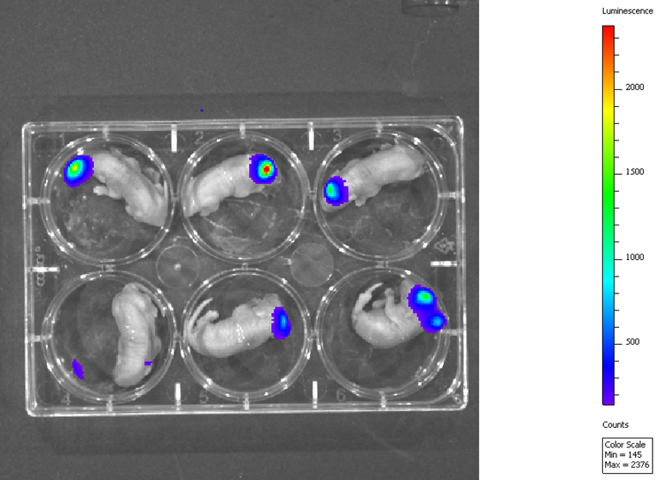
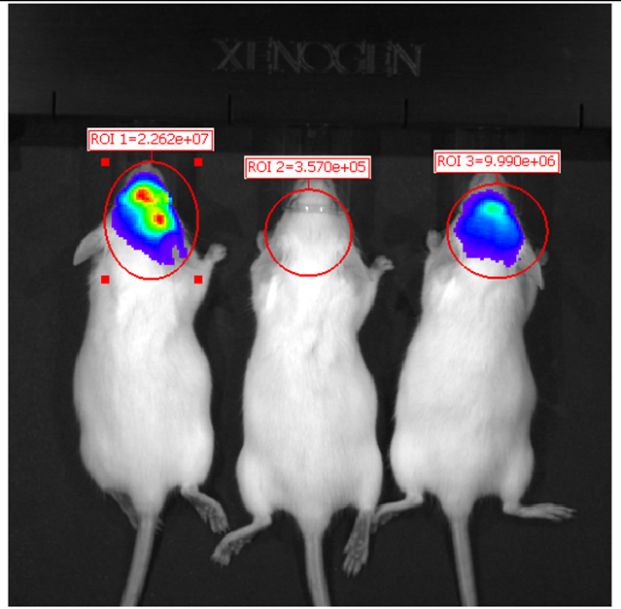
In Vivo Monitoring Sleeping Beauty Transposase Induced GBM
1 day post-injection
35 days post-injection
Calinescu et al, JOVE 2015

Slide 8
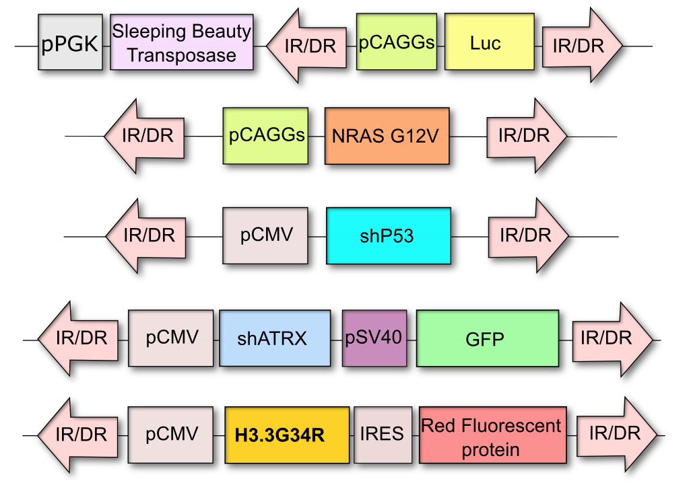
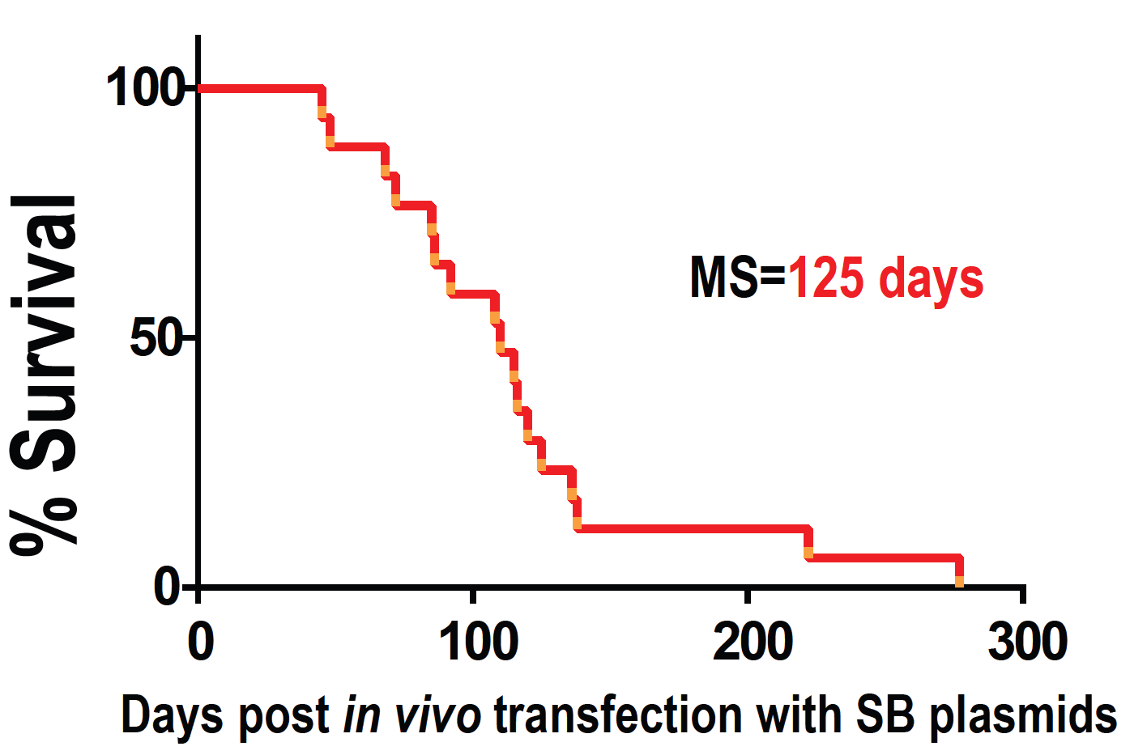
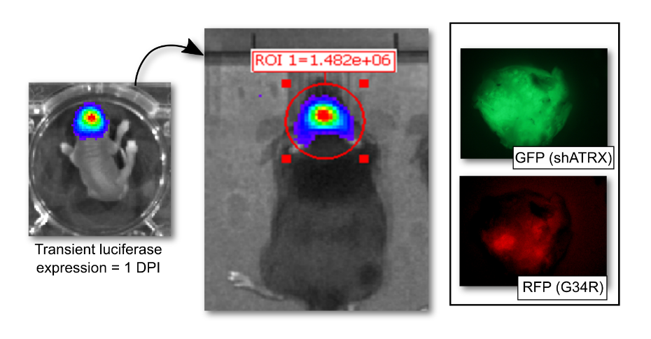

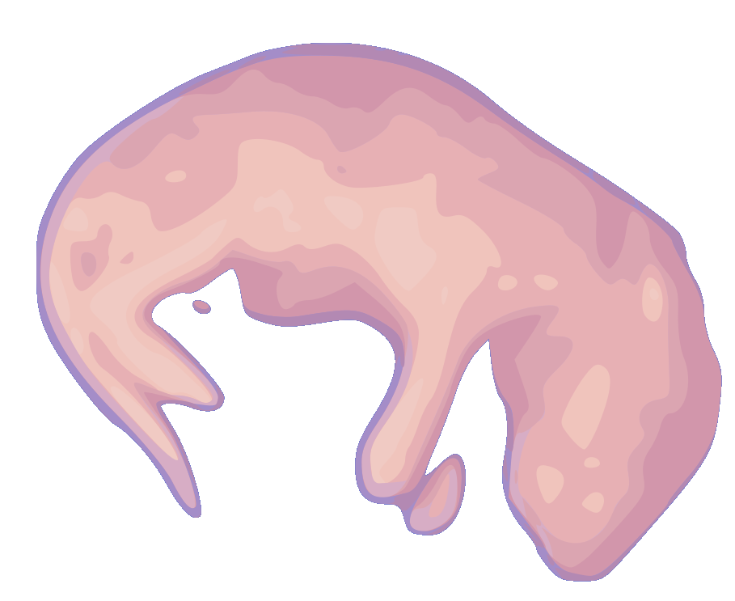

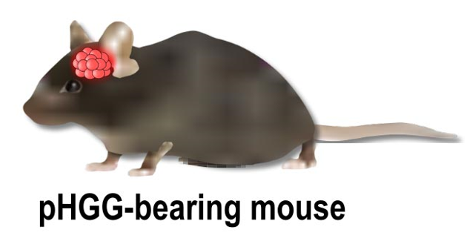
Development of a genetically engineered H3.3-G34R pHGG model
Sleeping beauty transposase system
Primary neurospheres’ culture
Implantable immunocompetent model
Haase S, Banerjee K, Mujeeb A, Lowenstein PR, Castro MG, 2021 (JCI, November 2022)

Slide 9
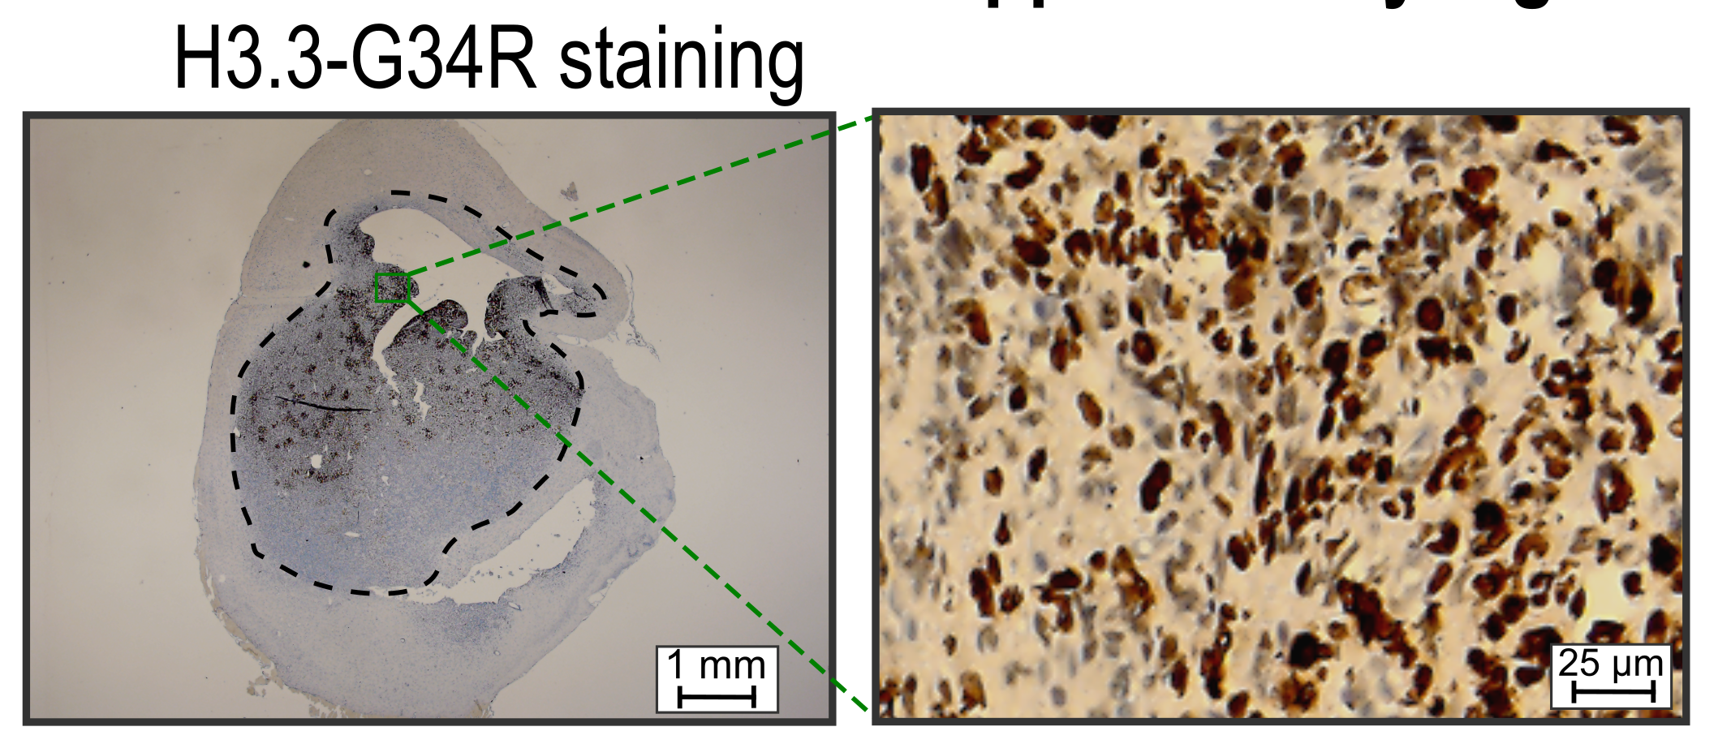
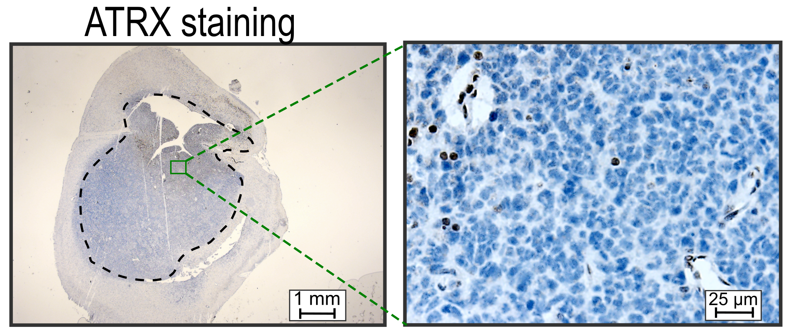
Characterization of the genetically engineered
H3.3-G34R HGG model
Sleeping beauty transposase system
Haase S, Banerjee K, Mujeeb A, Lowenstein PR and Castro MG et al (JCI, November 2022)

Slide 10
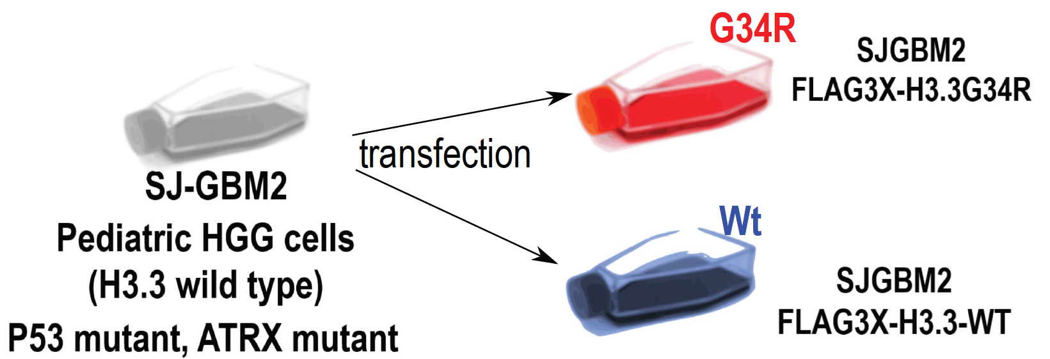
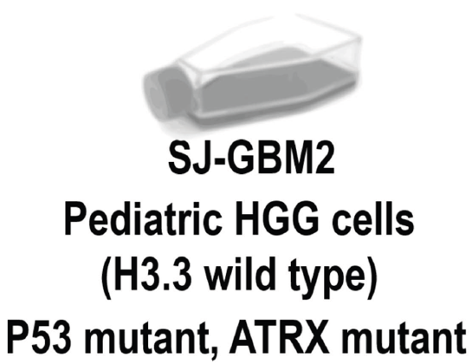
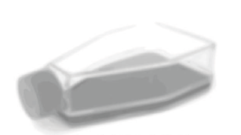

Human pHGG models (H3.3-G34R vs H3.3-Wt)
Genetically engineered isogenic models
Endogenous pHGG human models
Wt
Wt
vs
Midline diffuse glioma
H3.3-Wt
HSJD-GBM-002
Hemispheric pHGG
H3.3-G34R
OPBG-GBM-001
Hemispheric pHGG
H3.3-G34R
Haase S, Banerjee K, Mujeeb A, Castro MG et al (JCI, November 2022)

Slide 11
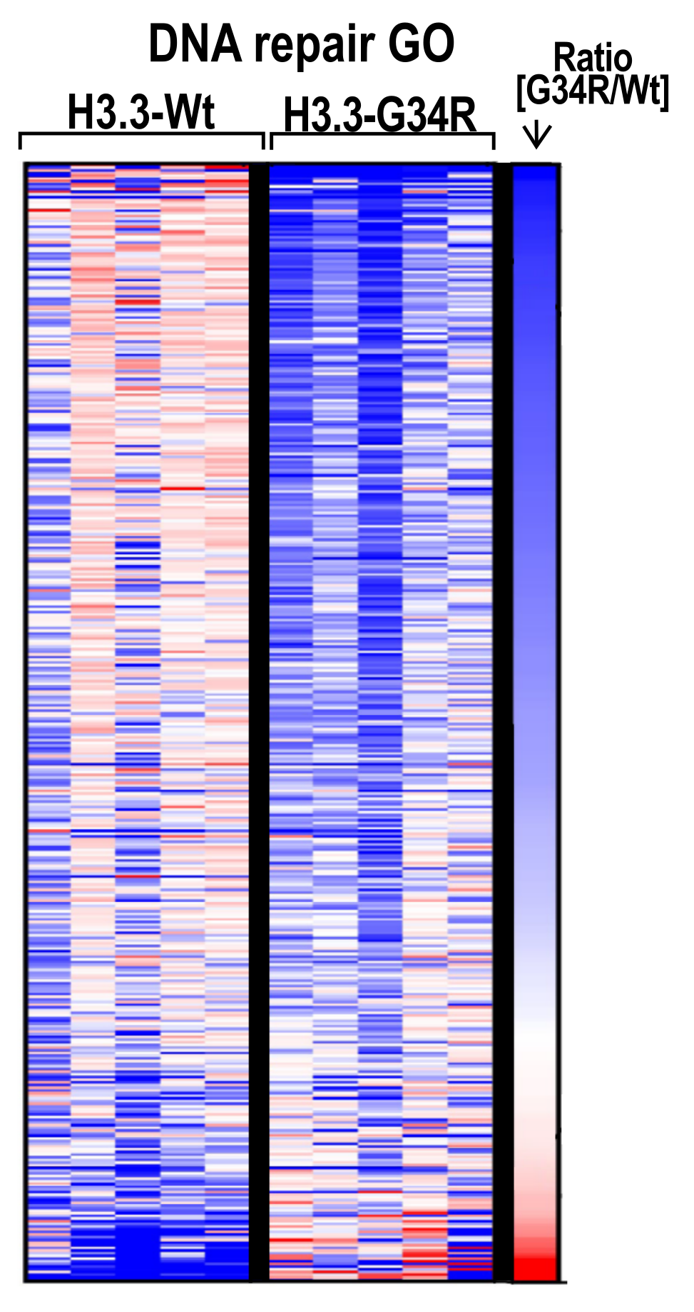
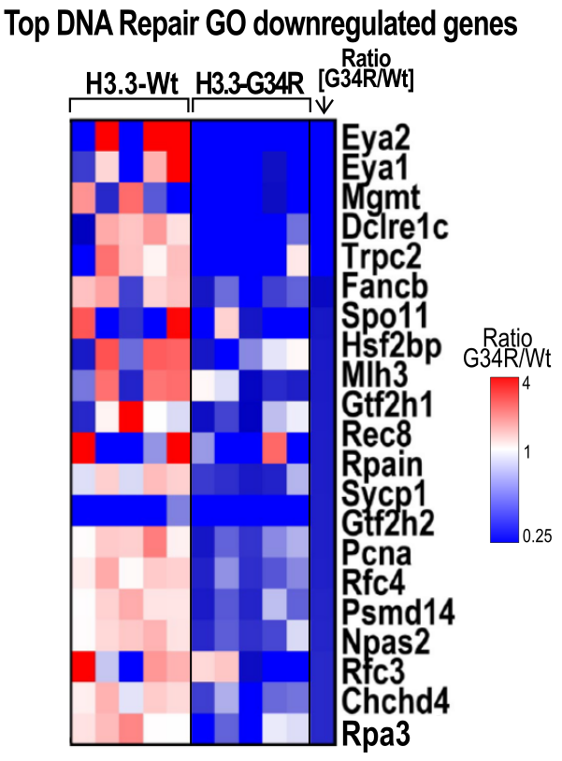
RNA-seq - DNA repair pathways are downregulated in G34-mutant pHGG
Mouse pHGG model (G34R vs Wt)
Haase S, Banerjee K, Mujeeb A, Lowenstein PR and Castro MG et al (JCI, November 2022)

Slide 12
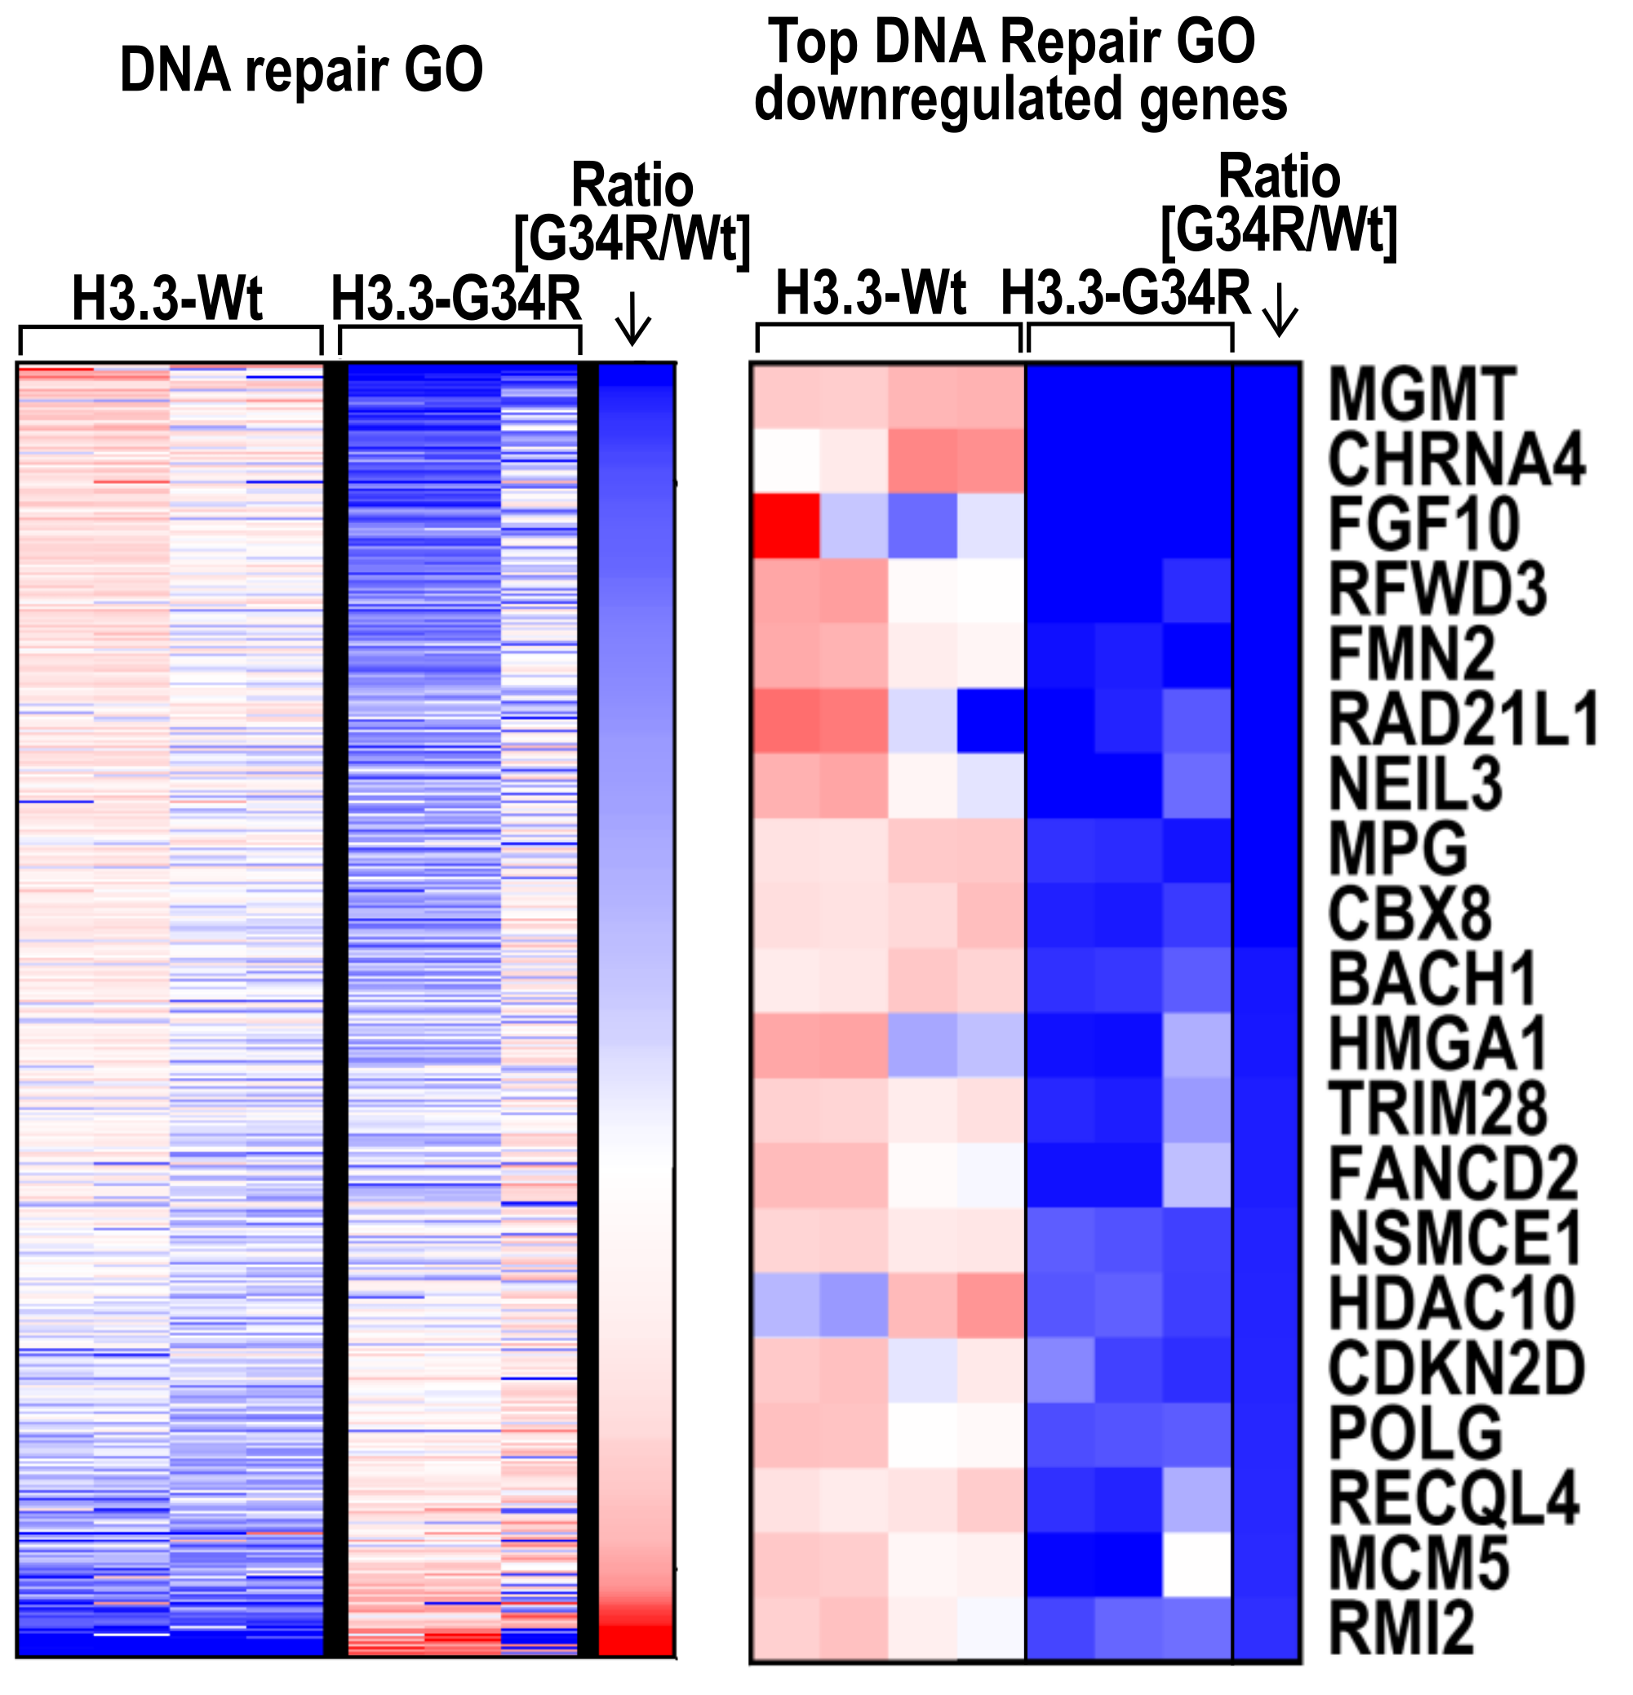
RNA-seq - DNA repair pathways are downregulated in G34-mutant pHGG
Human pHGG model (G34R vs Wt)

Slide 13
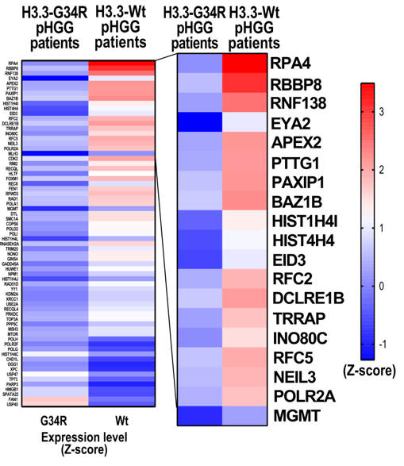
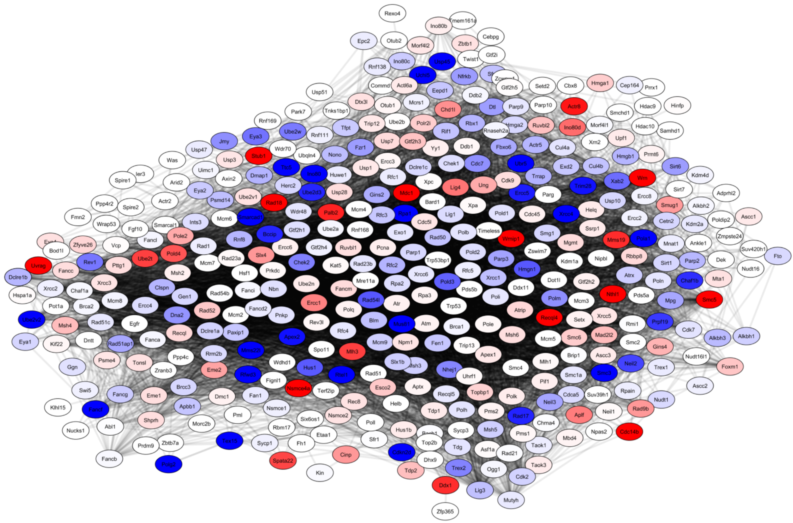
DNA repair pathways are downregulated in G34R pHGG
Transcriptomic analysis of patients’ databases
Haase et al., J Clin Invest. 2022 Sep 20;e154229. doi: 10.1172/JCI154229.

Slide 14
Signaling pathways which mediate DNA repair

Slide 15
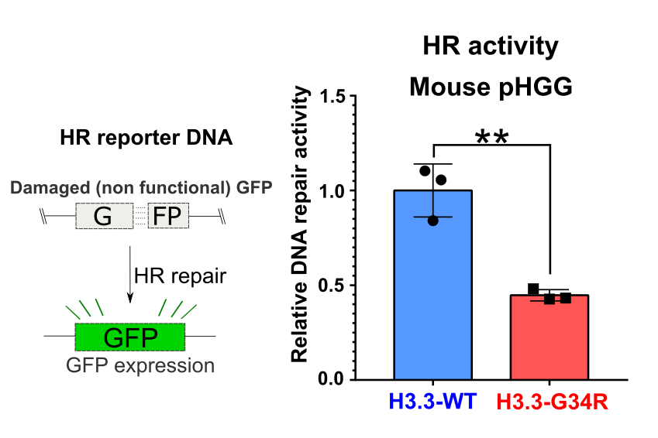
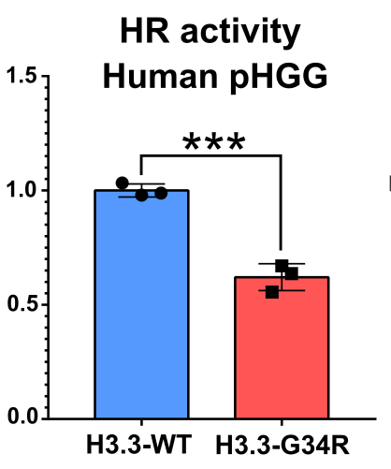
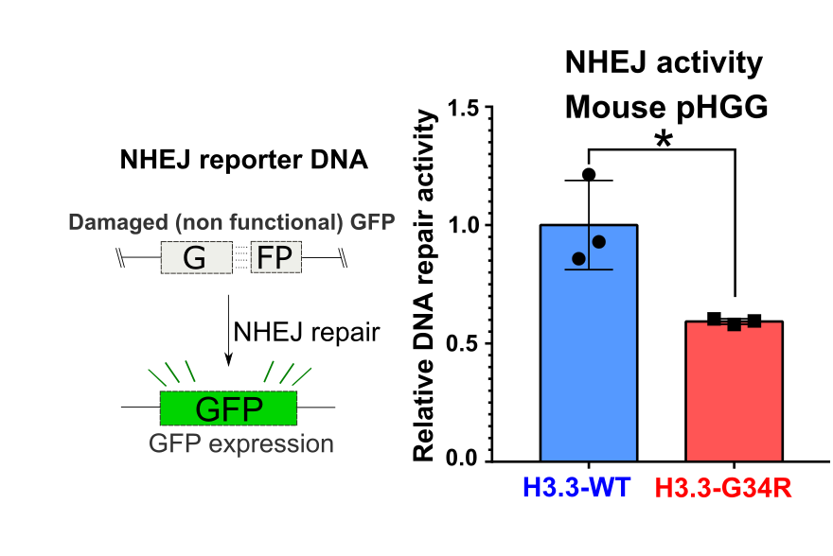
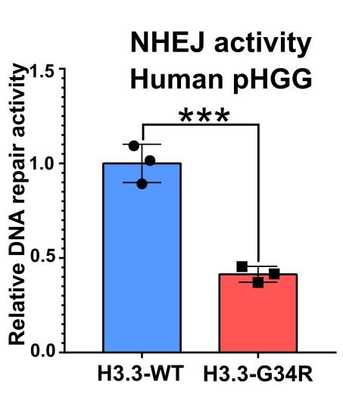
DNA repair activity is downregulated in
Mouse and Human H3.3-G34R pHGG

Slide 16
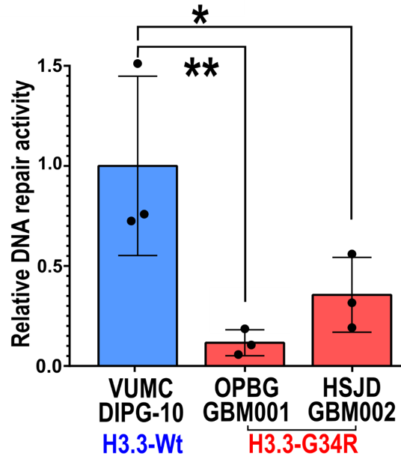
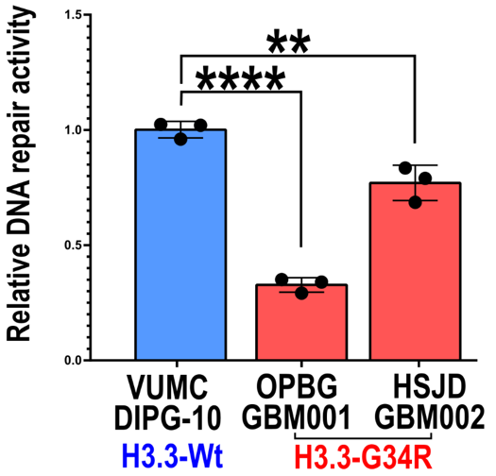
DNA repair activity is downregulated in
patient derived H3.3- G34R pHGG
HR activity Endogenous
H3.3-Wt/mutant human PD cells
NHEJ activity Endogenous
H3.3-Wt/mutant human PD cells

Slide 17
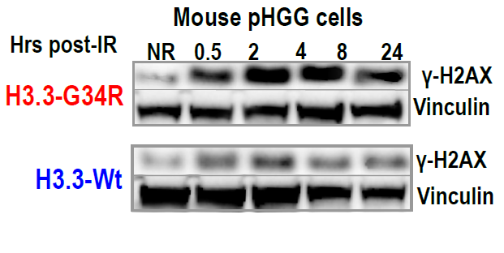
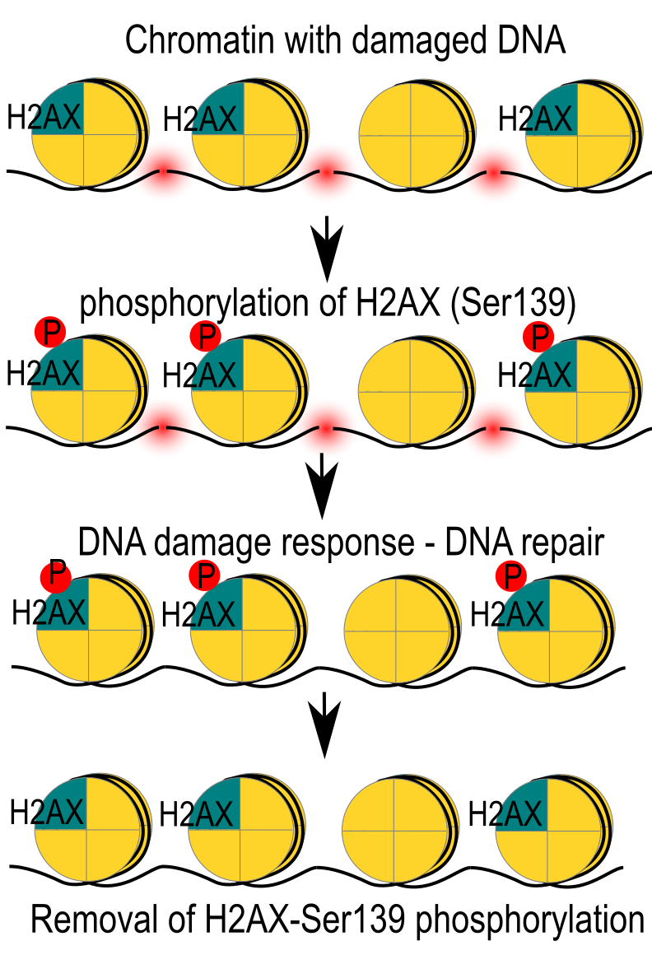
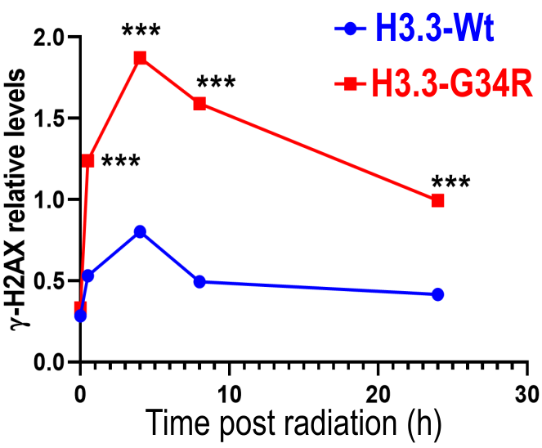
DNA damage response (DDR) is delayed in mouse H3.3-G34R pHGGs
Haase S, Banerjee K, Mujeeb A, Castro MG, et al JCI, November 2022

Slide 18
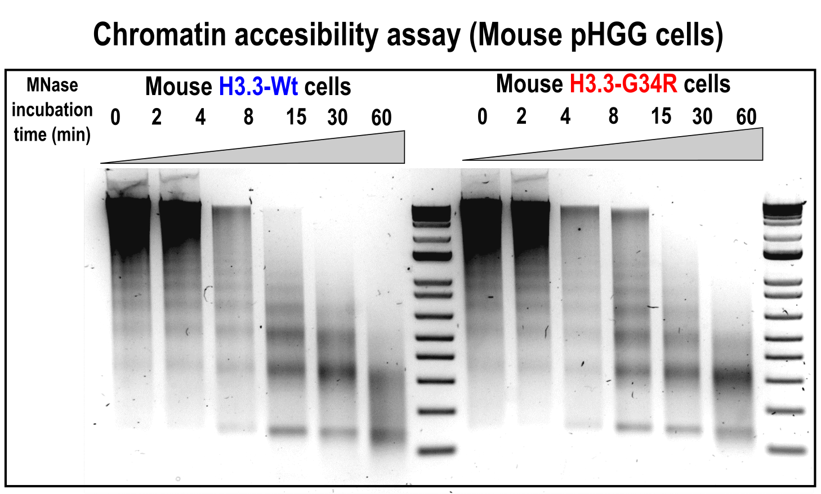
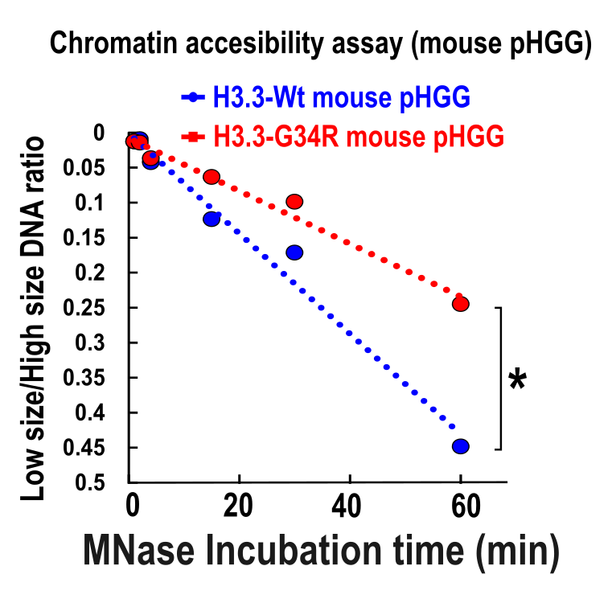
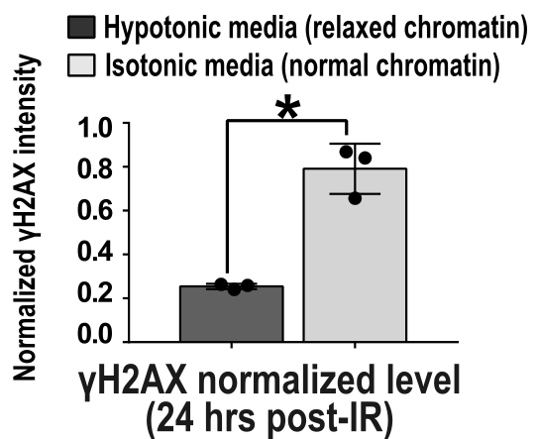
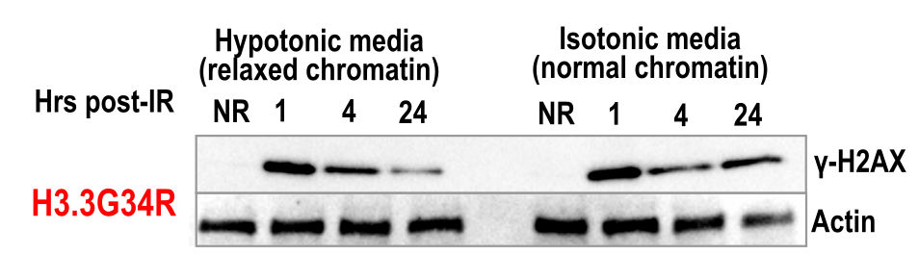
H3.3-G34R expression correlates with increased chromatin compaction and chromatin relaxation improves DNA repair in mouse H3.3-G34R pHGG cells
Haase S, Banerjee K, Mujeeb A, Lowenstein PR and Castro MG et al, JCI, November 2022

Slide 19
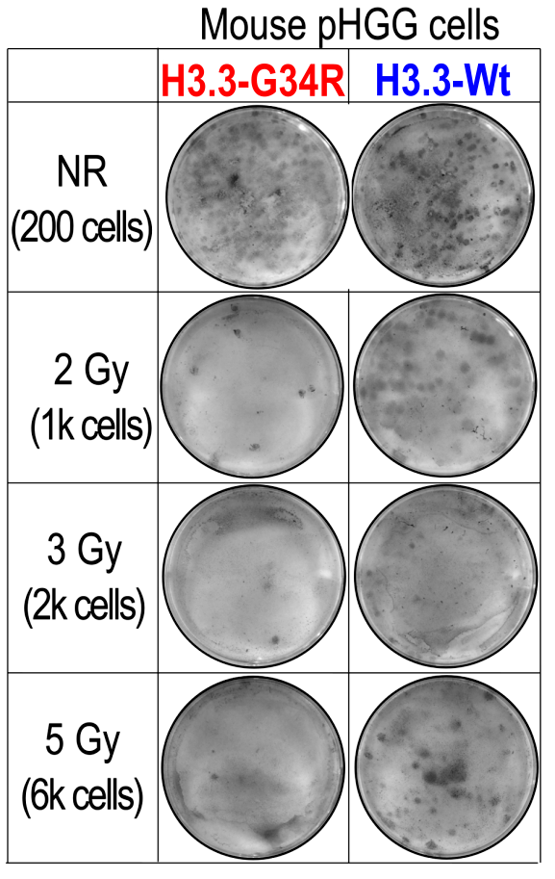

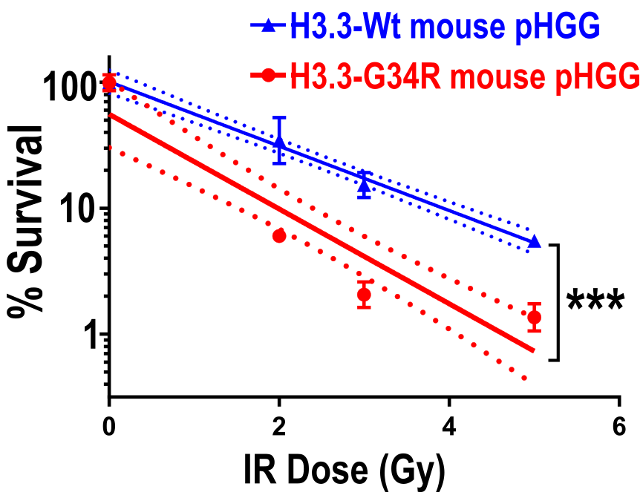
The reduced DNA repair activity correlates with increased susceptibility to ionizing radiation in mouse G34R pHGG
Clonogenic assay
WT
G34R
Radiation (IR)
Plating with pre-determined cell densities
Count number of colonies formed
Haase S, Banerjee K, Mujeeb A, Castro MG et al, JCI, November 2022

Slide 20
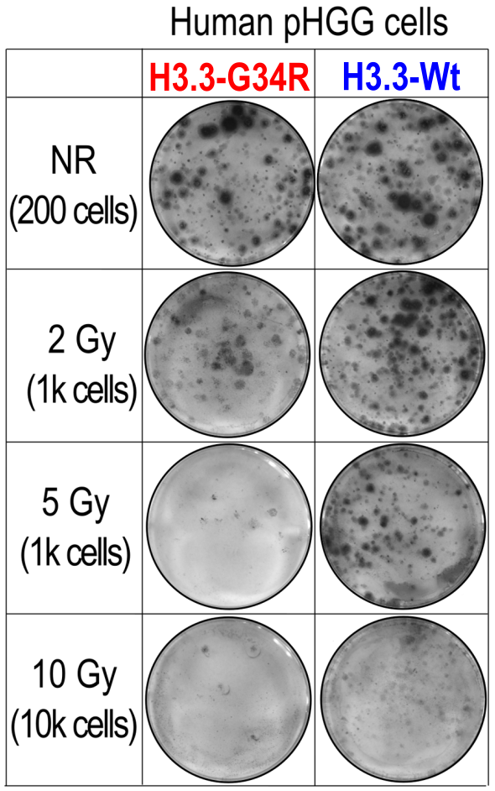
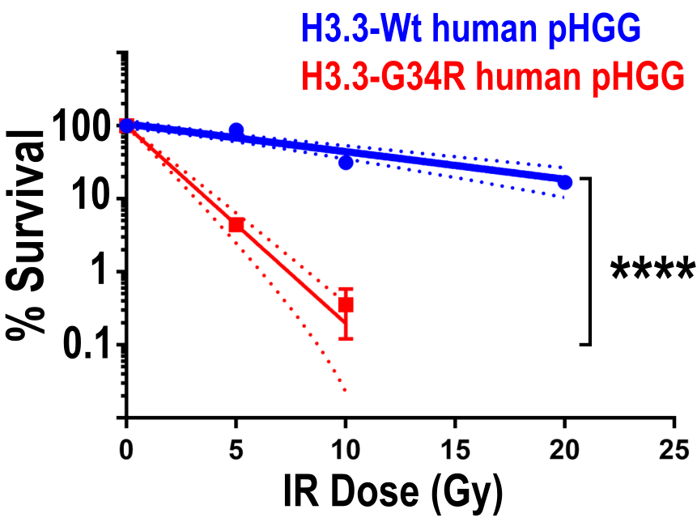
The reduced DNA repair activity correlates with increased susceptibility to ionizing radiation in human G34R pHGG
Clonogenic assay
WT
G34R
Radiation (IR)
Plating with pre-determined cell densities
Count number of colonies formed
Haase S, Banerjee K, Mujeeb A, Lowenstein PR and Castro MG, 2021 (JCI, under revision)

Slide 21
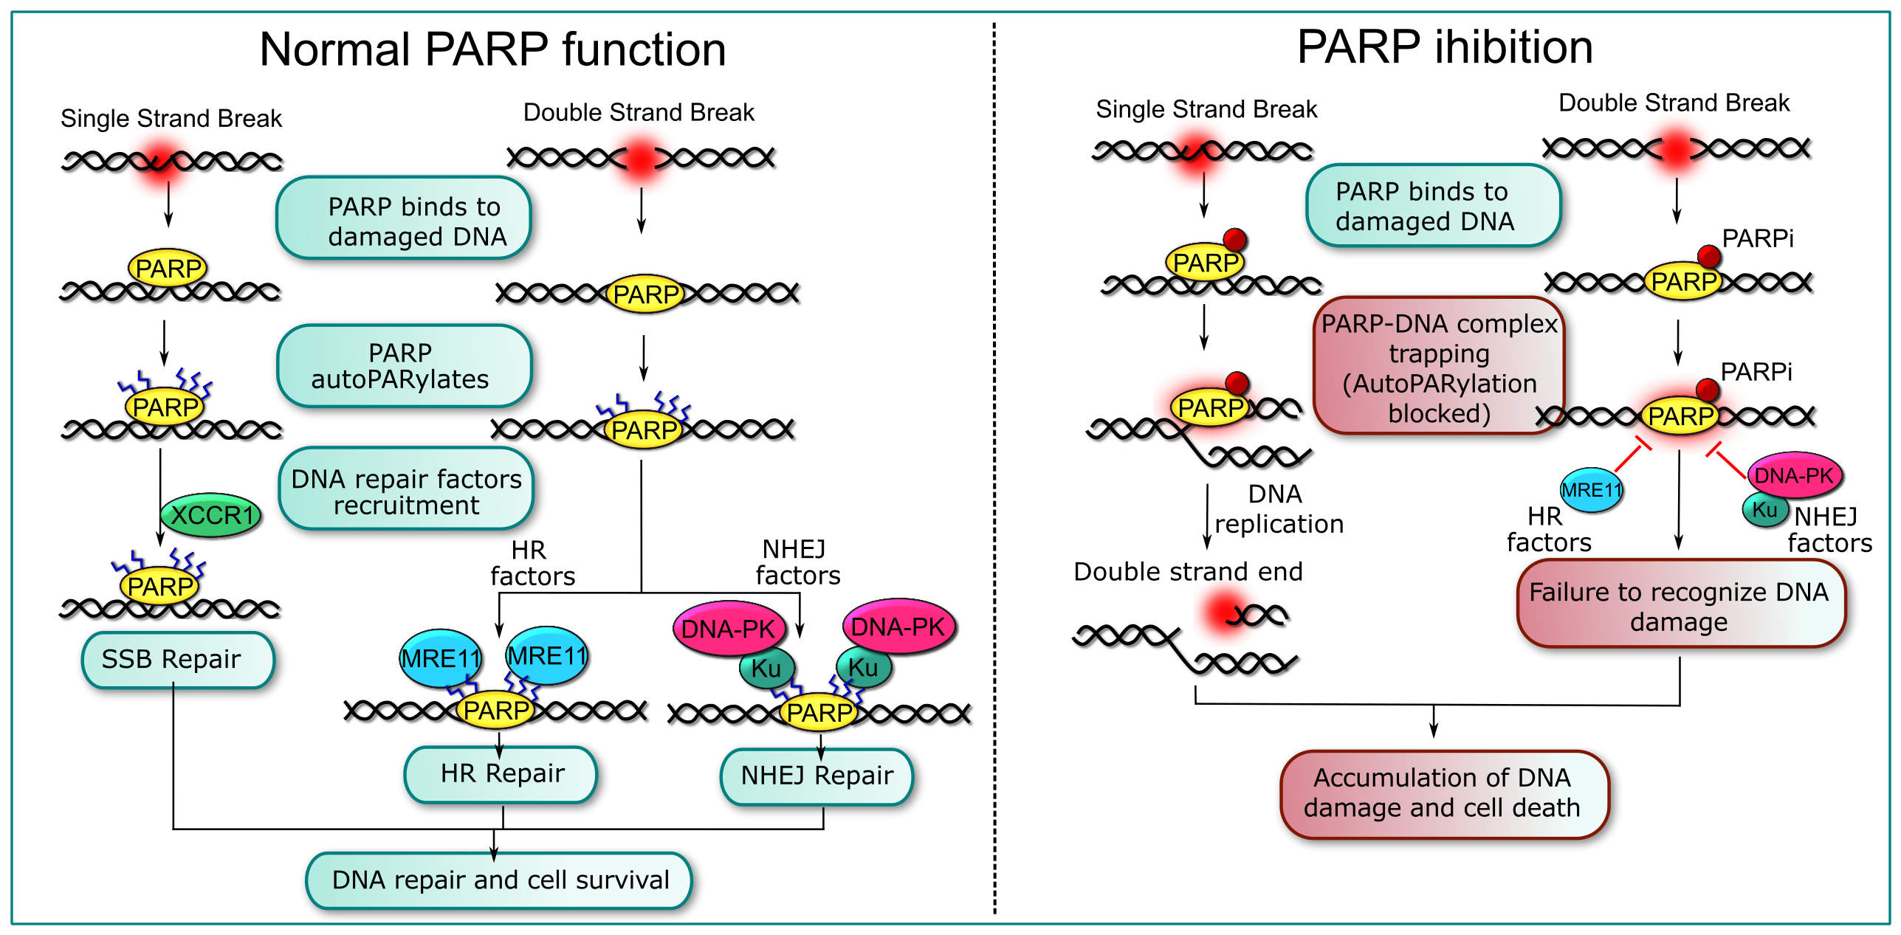
Tumors with DNA repair defects are sensitive to PARP inhibitors

Slide 22
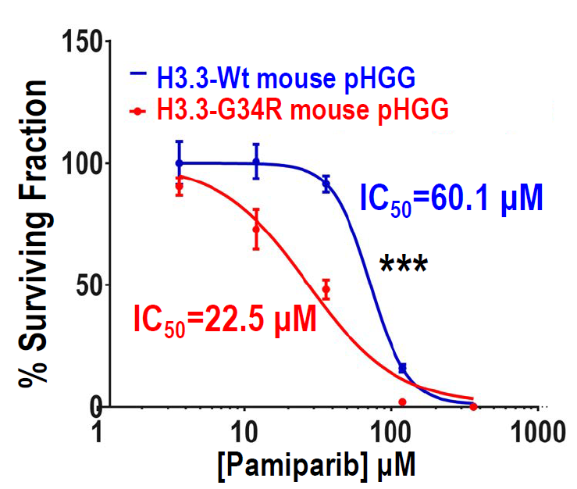
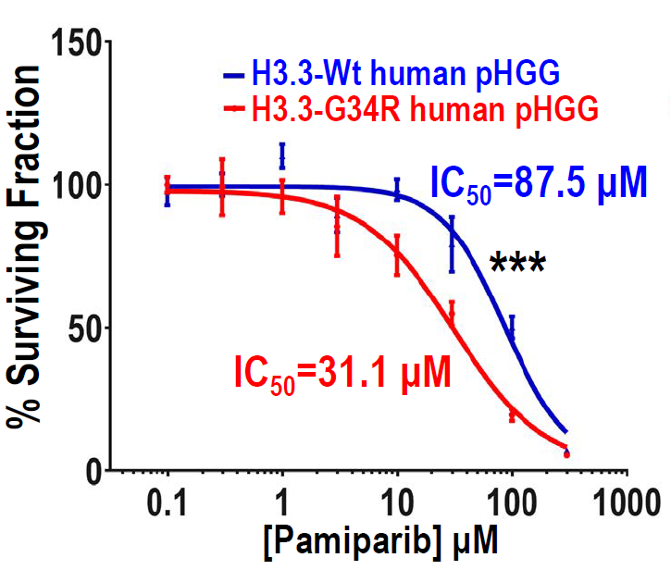
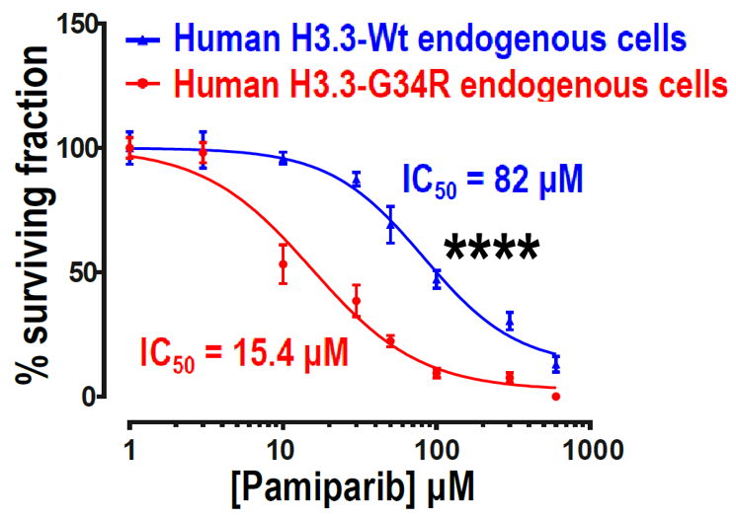
G34-mutant pHGG cells are more susceptible to DNA damage response inhibitors in vitro
Dose response curve, BBB-permeable PARP inhibitor Pamiparib
Haase S, Banerjee K, Mujeeb A, Castro MG et al, JCI, November 2022

Slide 23
DNA repair requires effective cell cycle checkpoint regulation

Slide 24
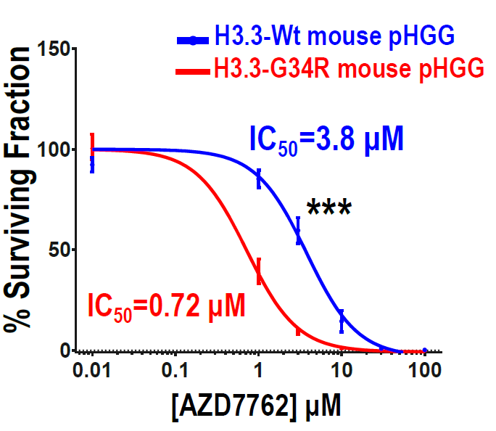
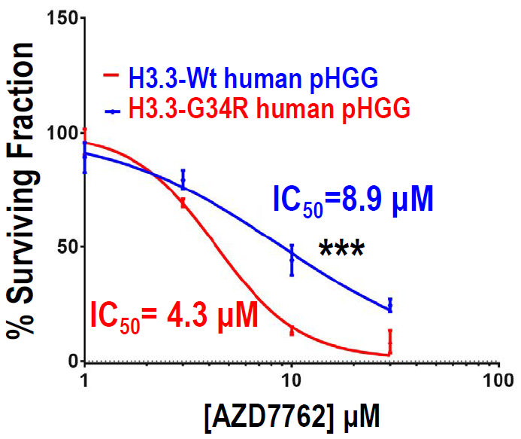
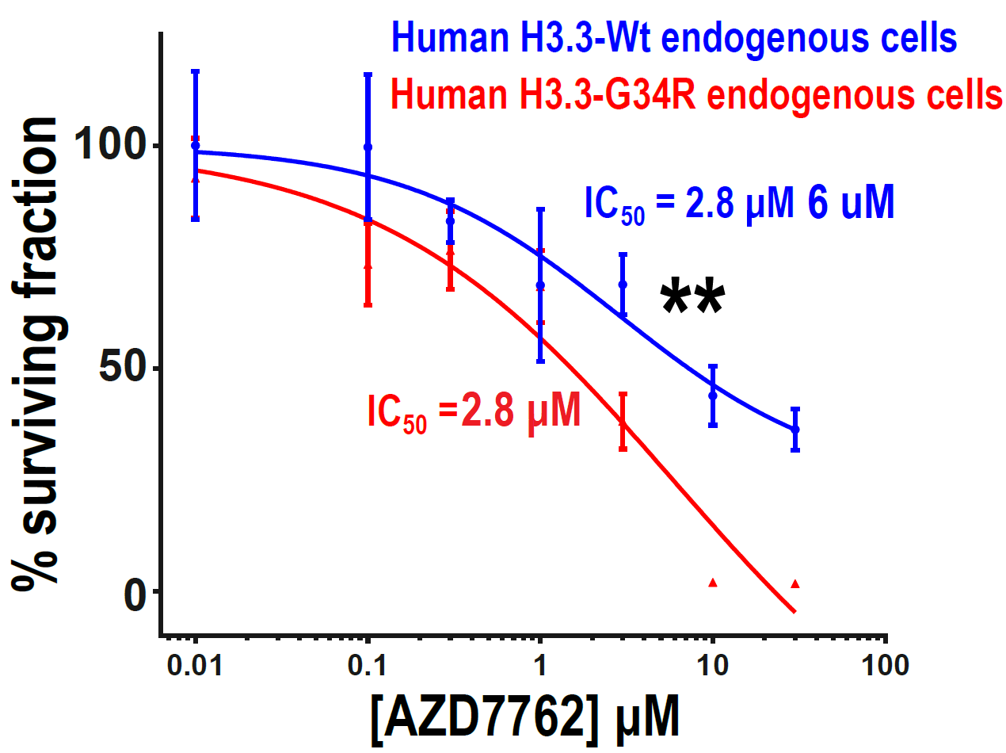
G34-mutant pHGG cells are more susceptible to DNA damage response inhibitors in vitro
Dose response curve, BBB-permeable cell cycle checkpoint 1/2 inhibitor AZD7762
Haase S, Banerjee K, Mujeeb A, Castro MG, 2022 (JCI)

Slide 25
Radiation is SOC for pediatric high grade glioma patients
How will H3.3 G34R mutant
high-grade glioma bearing mice
respond to radiation?

Slide 26
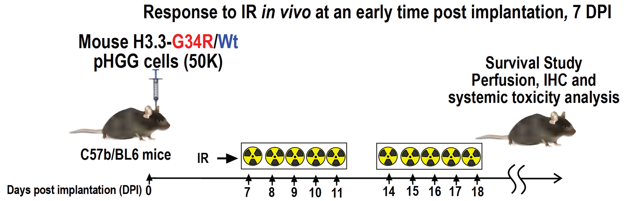
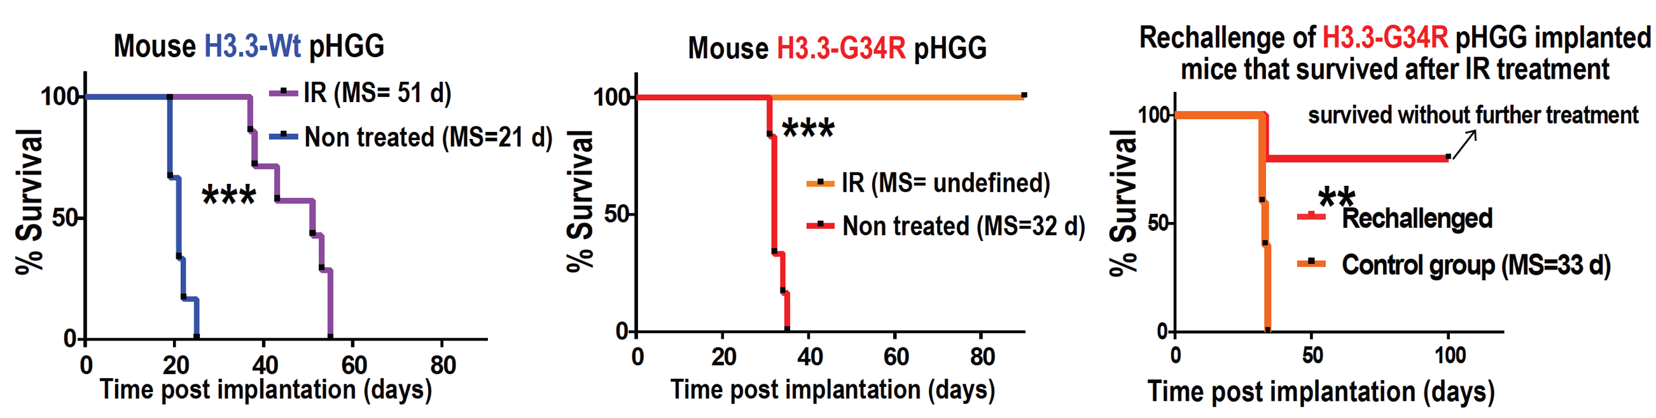
Radiation therapy is more efficient in G34R pHGG
Haase S, Banerjee K, Mujeeb A, Castro MG, 2022 (JCI)

Slide 27
Impact of H3.3-G34R on chromosomal stability?

Slide 28
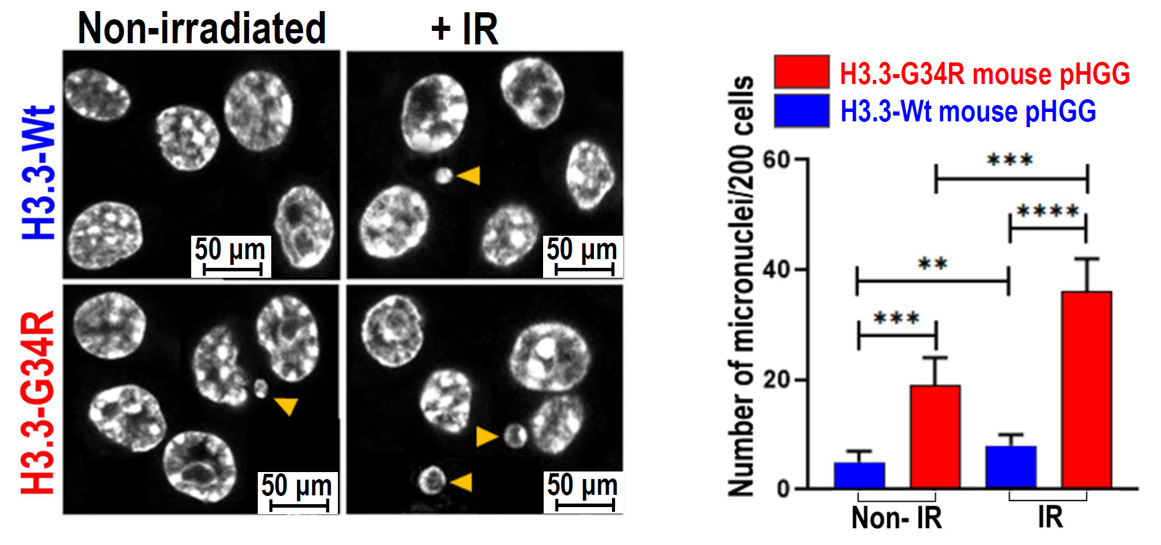
H3.3-G34R pHGG exhibit chromosomal instability
Characterization of micronuclei mouse pHGG
Haase S, Banerjee K, Mujeeb A, Castro MG, 2022 JCI

Slide 29

H3.3-G34R pHGG exhibit chromosomal instability
Haase S, Banerjee K, Mujeeb A, Lowenstein PR and Castro MG, 2021 JCI

Slide 30
How does chromosomal instability and downmodulation of DNA repair in H3.3-G34R pHGG affect the response to immunotherapies?

Slide 31

cGAS-STING pathway activation in H3.3-G34R pHGG

Slide 32


cGAS-STING pathway activation in mouse
and human H3.3-G34R pHGG

Slide 33





The cGAS-STING pathway activation mediates type-I interferon release in G34R pHGG
Haase S, Banerjee K, Mujeeb A, Lowenstein PR, Castro MG, 2022 JCI

Slide 34

G34R-induced cGAS-STING activation mediates Damage-Associated Molecular Patterns (DAMPs) release
Mouse H3.3-G34R
Haase S, Banerjee K, Mujeeb A, Lowenstein PR and Castro MG, 2022 (JCI)

Slide 35
How does Sting pathway activation, in response to DNA damaging therapies, impact anti-tumor immunity in H3.3-G34R pHGG ?

Slide 36



Radiation therapy combined with inhibition of DDR is efficacious in H3.3-G34R pHGGs

Slide 37


Radiation therapy combined with DDRi results
in antitumor immunological memory which
prevents pHGG recurrence
Haase S, Banerjee K, Mujeeb A, Castro MG, 2022 (JCI)

Slide 38


The RT + DDRi treatment efficacy is mediated by adaptive immunity
Haase S, Banerjee K, Mujeeb A, Castro MG, 2022 (JCI)

Slide 39


cGAS-STING stimulation enhances RT + DDRi (Pamiparib) treatment efficacy
Haase S, Banerjee K, Mujeeb A,
Lowenstein PR, Castro MG, 2022 (JCI)

Slide 40

cGAS-STING stimulation enhances RT + DDRi (cell cycle checkpoint inhibitor) efficacy

Slide 41


cGAS-STING inhibition blocks RT + DDRi treatment efficacy
Haase S, Banerjee K, Mujeeb A, Castro MG, 2022 (JCI)

Slide 42
Impact of combining SOC + DDRi with immune checkpoint blockade in H3.3 G34R pediatric HGG

Slide 43


αPD-L1 therapy increases the efficacy of DDRi + RT in G34-mutant pHGG

Slide 44
Conclusion I
DNA repair defects and genomic instability are molecular vulnerabilities of G34-mutant pHGG that can be pharmacologically targeted.
PARP inhibition or cell cycle checkpoint inhibition combined with RT exhibits high efficacy in preclinical models of G34-mutant pHGG.
The RT + DDRi treatments are not efficient in CD8-KO models, indicating a prominent role of the adaptive immune system. This highlights the importance of performing preclinical testing in immunocompetent models.

Slide 45
Conclusion II
G34R/V-mediated genomic instability increases the efficacy of RT and DDRi treatments by inducing cGAS-STING activation, which elicits innate-immune mechanisms.
cGAS-STING pathway activation mediates the extended survival in H3.3-G34R pHGG-bearing mice.
cGAS-STING inhibition blocks the efficacy of RT + DDRi.
STING agonists are promising candidates for G34-mutant HGG.

Slide 46
Conclusion III
The combination of immunotherapies with treatments exploiting DNA repair defects and genomic instability emerge as potential therapies for H3.3-G34R/V HGG.

Slide 47















Radiation therapy
DDR inhibitors
STING agonists

Slide 48

After 6 years, of work, including one year of revisions, this paper was finally accepted for publication in the Journal of Clinical Investigation
Credit for cover art:
Ella Maru Studio https://www.scientific-illustrations.com/

Slide 49








Thank you!
Laboratory of Brain Tumor Biology and Therapeutics
University of Michigan Medical School
Principal Investigators
Maria Castro
Pedro Lowenstein
Research Team
Stephen Carney
Marcus Barissi
Maria Luisa Varela
Emily Brumley
Caitlin Alindogan
Justin Dreyer
Sarah Thompson
Maria B. G Fabiani
Clifford Abel
Lab
Brandon L. McClellan
Faisal Syed
Rohit Thalla
Ali Dabaja
Marta Edwards
Melissa Lay
Santiago Haase
Andrea Comba
Claire Tronrud
Anzar Mujeeb
Kaushik Benerjee
Molly West
Felipe Nuñez
Andrea Comba
Collaborators
Josh Welch
Visweswaran Ravikumar
Carl Koschmann
Ángel M. Carcaboso
Maria Vinci
Arvind Rao
Jennifer S. Yu

Slide 50













THANK YOU! Collaborators and Funding scources
Figueroa
Laboratory
Welch
Laboratory
Venneti
Laboratory
Alan Meeker
Lyssiotis
Laboratory
Costello
Laboratory
Sartor
Laboratory
Gorbunova
Laboratory
Epigenetics
Core
Hambardzumyan
Laboratory
Bioinformatics
Core
Schwendeman Lab
Lahann Lab
Moon Lab
Sequencing
Core

Slide 51
The End
Thank you so much
for your attention!

Slide 53
Slides for questions/discussion
Future directions
Characterizing the cGAS-STING pathway activity in tumor and immune TME cells and their contribution to the DDRi + RT therapy efficacy.
Combining STING-KO mouse models, and STING-KO G34-mutant pHGG cells
Characterizing mechanisms of resistance to the DDRi + RT therapy
Single cell transcriptomic, epigenomics and CyTOF
Mechanisms of tumor adaptation
Sequencing of extrachromosomal circular DNA

Slide 54

Future directions

Slide 55


Analyzing mechanisms of resistance in G34-mutant pHGG
sc-RNAseq

Slide 56


Analyzing mechanisms of resistance in G34-mutant pHGG
Non treated
Resistant
Susceptible

Slide 57




Analyzing mechanisms of resistance in G34-mutant pHGG: immune cells
GSEA: Treated (RT) vs non treated
(CD45+ cell clusters)

Slide 59
Analyzing mechanisms of resistance in G34-mutant pHGG
sc-RNAseq

Slide 60
Analyzing mechanisms of resistance in G34-mutant pHGG
Non treated
Resistant
Susceptible

Slide 61
Analyzing mechanisms of resistance in G34-mutant pHGG: immune cells
GSEA: Treated (RT) vs non treated
(CD45)

Slide 62
In Vivo Monitoring Sleeping Beauty Transposase Induced gliomas
1 day post-injection
35 days post-injection
Calinescu et al, JOVE 2015

Slide 63
DNA repair pathways are downregulated in G34R pHGG
Transcriptomic analysis of patients’ databases
Haase S, Banerjee K, Mujeeb A, Lowenstein PR and Castro MG, 2021 (JCI, under revision)

Slide 64
DNA damage response (DDR) is delayed in H3.3-G34R pHGGs

Slide 65


DNA damage response (DDR) is delayed in human H3.3-G34R pHGGs
Haase S, Banerjee K, Mujeeb A, Castro MG, 2021 (JCI, under revision)

Slide 66




H3.3-G34R expression correlates with increased chromatin compaction and chromatin relaxation improves DNA repair in human H3.3-G34R pHGG cells
Haase S, Banerjee K, Mujeeb A, Lowenstein PR and Castro MG, 2021 (JCI, under revision)

Slide 67





H3.3-G34R pHGG exhibit chromosomal instability
Characterization of micronuclei in human pHGG
Human pHGG
Non-irradiated
+ IR
H3.3-Wt
H3.3-G34R
Haase S, Banerjee K, Mujeeb A, Lowesntein PR and Castro MG, 2021 (JCI, under revision)

Slide 68

G34R-induced cGAS-STING activation mediates Damage-Associated Molecular Patterns (DAMPs) release
Human H.3-G34R
Haase S, Banerjee K, Mujeeb A, Lowesntein PR and Castro MG, 2021 (JCI, under revision)

Slide 69
Radiation therapy combined with DDRi results
in antitumor immunological memory which
prevents pHGG recurrence
Haase S, Banerjee K, Mujeeb A, Castro MG, 2021 (JCI, under revision)

Slide 70
Translational Implications
Use a combination of SOC together with STING pathway activation and immune-stimulatory strategies to enhance therapeutic efficacy in pHGG
Work in progress…

