Slide 1

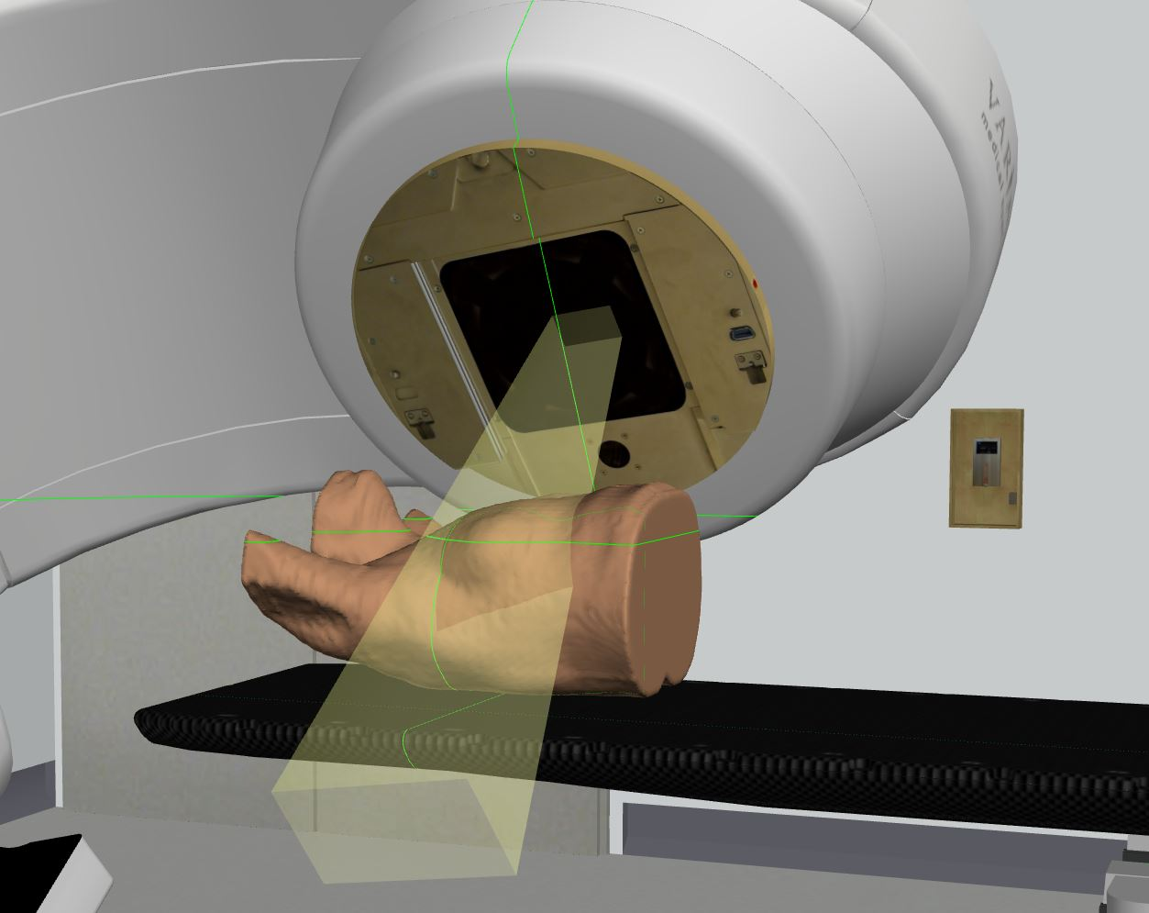
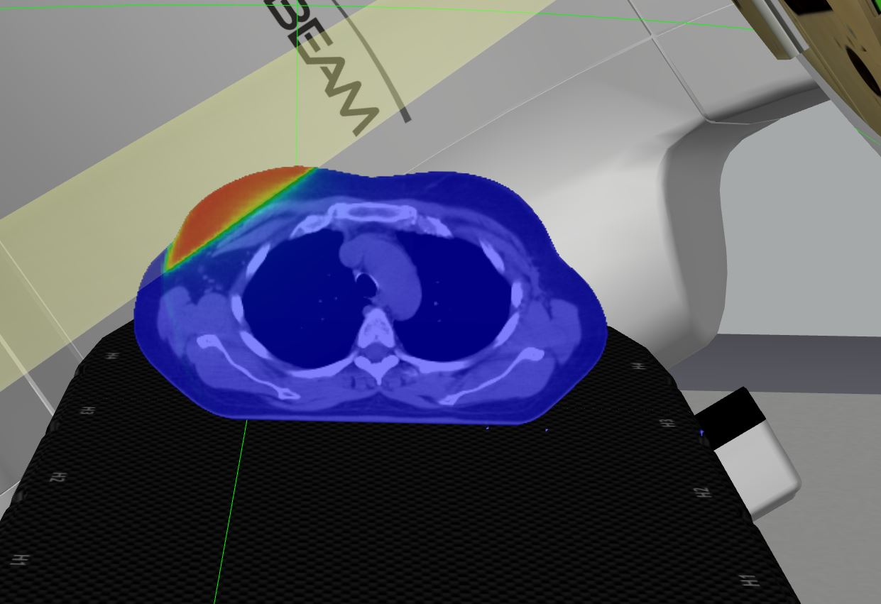
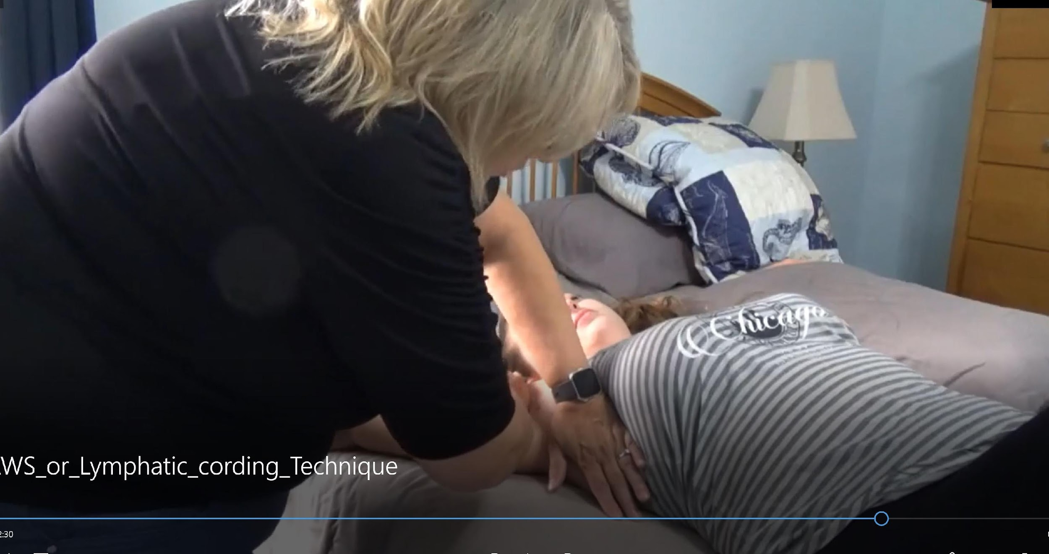
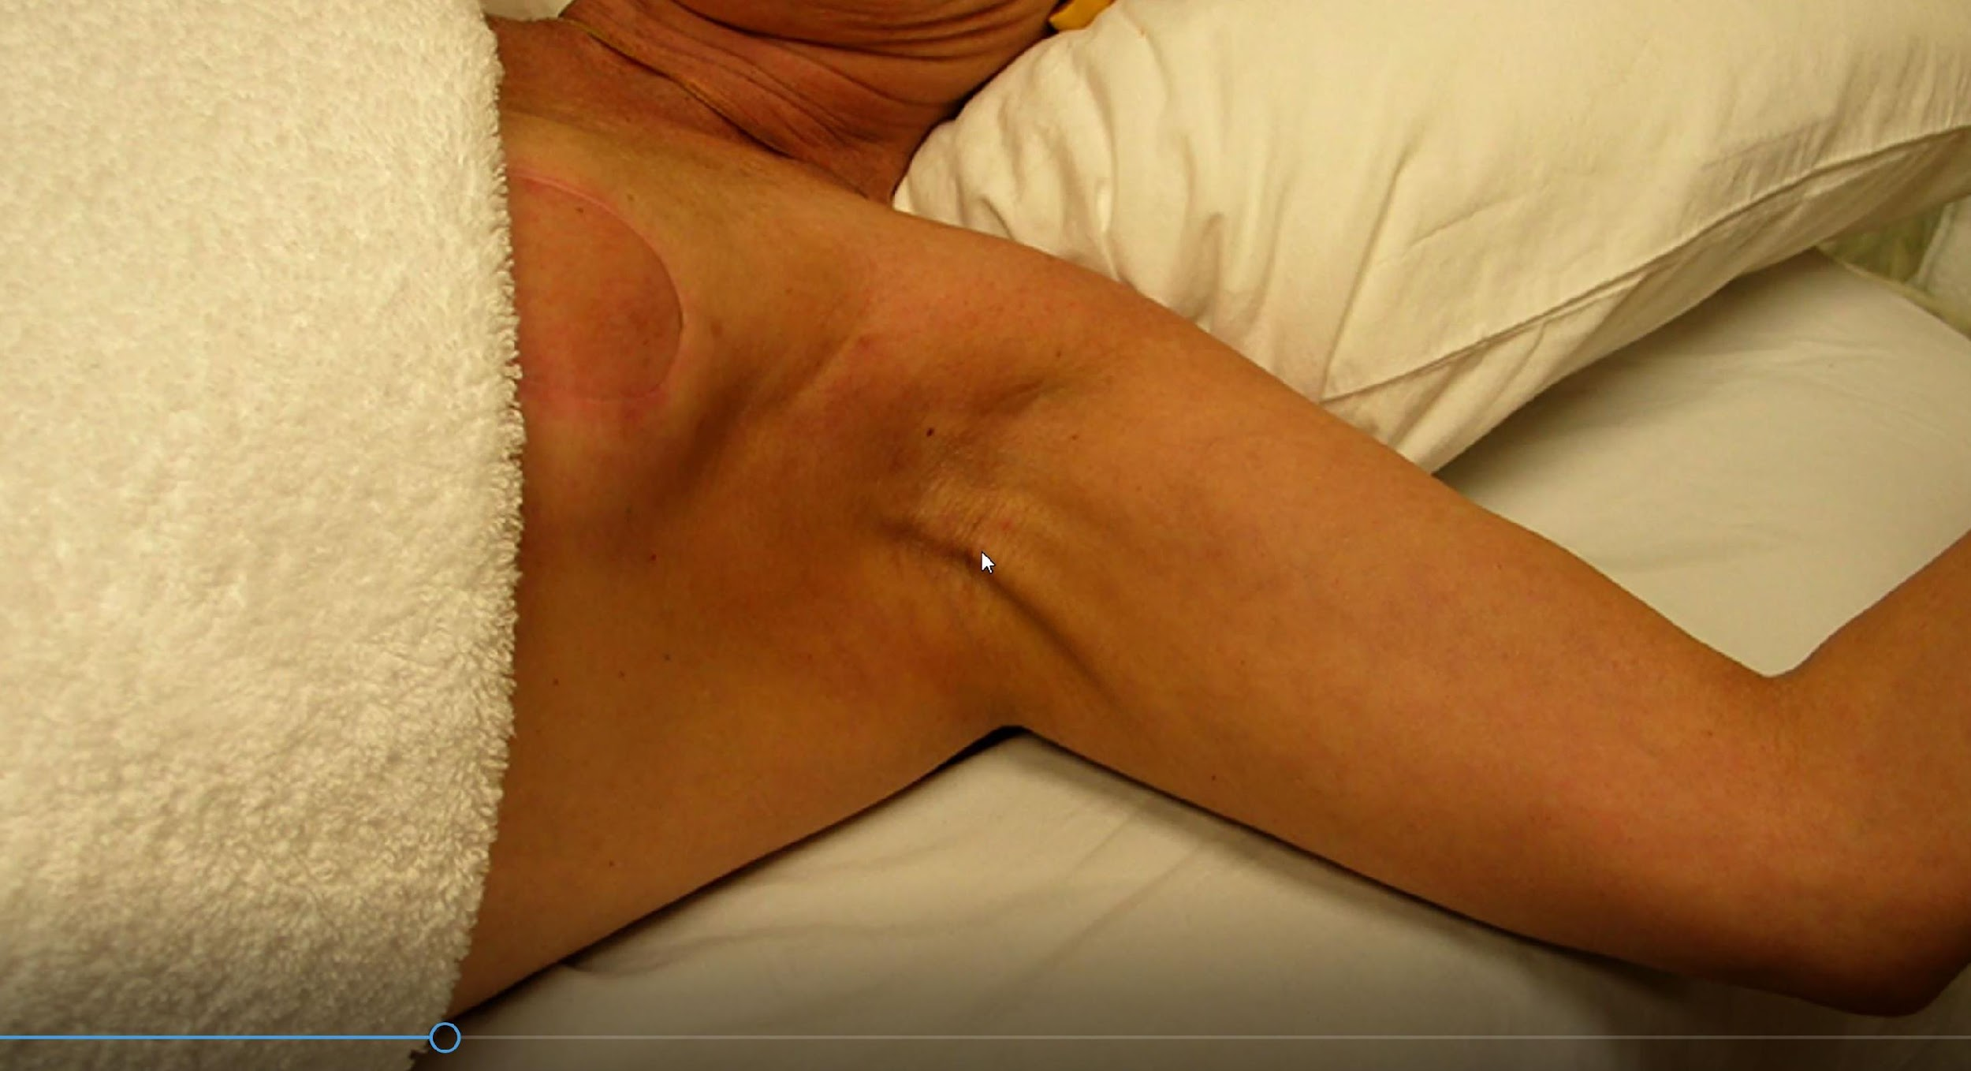

Interprofessional Education Breast Cancer Case-based Learning Activity for Physical Therapy and Radiation Therapy Students
Leslie M. Smith, PT, DPT; Julie Hollenbeck, M.Ed., R.T.(T); Sindhuja Muralidharan, SPT
Background
Results
Breast cancer is the most commonly diagnosed cancer among women¹
Understanding roles and responsibilities (RR) may increase effective team functioning and patient care.²
Radiation therapists and physical therapists care for breast cancer patients.³
Interprofessional educational (IPE) experiences have shown to foster professional growth and improve patient care.^{2,4}
Interprofessional Education Collaborative (IPEC) defined interprofessional collaboration through four core competencies of values/ethics, RR, interprofessional communication, and teams and teamwork.^{5,6}
Only students completing both the pre-IPE and the post-IPE survey were used for further analysis.
Combined pre-IPE and post-IPE surveys included 34 DPT students (57.6%) and 7 RTT students (70.0%).
Roles and Responsibilities | N | Mean Pre-score (SD) | Mean Post-Score (SD) | P-value
Total score (All 10 questions) | 41 | 33.1 (8.4) | 45.0 (4.5) | p < 0.05
Own RR (3 Questions) | 41 | 13.2 (1.7) | 14.1 (1.0) | p < 0.05
Other profession’s RR (7 Questions) | 41 | 19.9 (7.2) | 30.9 (4.5) | p < 0.05
Purpose
The purpose of this IPE experience was
to bring together healthcare students in radiation therapy
and physical therapy programs for a case discussion of the care
and management of a patients with breast cancer and to
enhance their understanding of each other’s RR in that care.
**Significant difference with p value < 0.05 from paired t-test; SD=Standard deviation
Actions, Methods or Interventions
Discussion
Physical therapy (n=59), and radiation therapy students (n=10) participated in a one-hour face to face IPE case review.
Pre-learning included videos of the other profession and recorded demonstrations on how physical therapists manage axillary web syndrome and how radiation therapists treat breast cancer.
This IPE case review included a pre-IPE survey, a face to face case based activity and a post-IPE survey.
During the face to face case students were given one of two cases and questions to foster discussion.
Each question on the survey was developed from each of the ten roles and responsibilities sub-competencies.⁶
The students were asked to rate their knowledge of one’s own RR and of the other profession participating using a Likert scale (Strongly Disagree=0 to Strongly Agree=5).
Understanding other health care providers RR may improve patient care.
This type of activity can assist in improving the IPEC competencies for future healthcare providers.
Research will continue to test the validity of the pre-IPE and post-IPE survey tool.
Conclusion
A one-hour IPE with guided case discussion can
allow students to share experiences, that can improve
the understanding of each others roles and responsibilities
in the treatment of breast cancer patients.
Pre-learning Professional Demonstrations
References
DeSantis CE, Ma J, Gaudet MM, et al. Breast cancer statistics, 2019. CA: A Cancer Journal for Clinicians. 2019;69(6):438-451. doi:10.3322/caac.21583
Hudson CC, Gauvin S, Tabanfar R, Poffenroth AM, Lee JS, O’Riordan AL. Promotion of role clarification in the Health Care Team Challenge. Journal of Interprofessional Care. 2017;31(3):401-403. doi:10.1080/13561820.2016.1258393
Doherty D, Lahrman M, Linn S, Drouin JS. Prevalence of Functional Deficits and Rehabilitation Needs Among Individuals Receiving Radiation Therapy for Cancer: A Descriptive Study. Rehabilitation Oncology. 2013;31(4):23-31. doi:10.1097/01893697-201331040-00005
Furr S, Lane SH, Martin D, Brackney DE. Understanding roles in health care through interprofessional educational experiences. British Journal of Nursing. 2020;29(6):364-372. doi:10.12968/bjon.2020.29.6.364
Brashers V, Haizlip J, Owen JA. The ASPIRE Model: Grounding the IPEC core competencies for interprofessional collaborative practice within a foundational framework. Journal of Interprofessional Care. 2020;34(1):128-132. doi:10.1080/13561820.2019.1624513
Interprofessional Education Collaborative. (2016) Core competencies for interprofessional collaborative practice: 2016 update. Accessed March 2, 2022. https://ipec.memberclicks.net/assets/2016-Update.pdf

