Slide 1
The intersection of Notch and BMP signaling during human osteoblast differentiation
Yadav Wagley
(Hankenson Laboratory)

Slide 2
Bones…uniquely shaped elements that are spread throughout the body
Provide structural framework, protect internal organs and mineral storage
1
Allow locomotion
2
Hematopoiesis
3

Slide 3
Constituents of bone
Cellular constituents-Chondrocytes, Osteoblasts and Osteoclasts
Common mesenchymal progenitor for chondrocytes and osteoblasts
Osteoclasts come from myelomonocytic lineage
Acellular constituents-Matrix consisting of collagen fibers, hydroxylapatite

Slide 4
Bone development starts during embryogenesis and continues after birth
Intramembranous Ossification
Endochondral ossification

Slide 5
Proliferation
Condensation
Patterning/
Remodelling

Slide 6
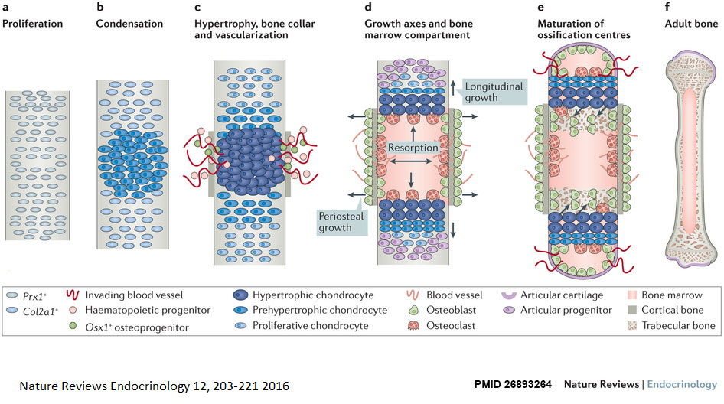
Endochondral ossification

Slide 7
Worldwide, 1 in 3 women over age 50 will experience osteoporotic fractures, as will 1 in 5 men aged over 50
With increasing life expectancy, combined lifetime risk for all fracture coming to clinical attention is ~40%, equivalent to the risk of cardiovascular disease
Long bone non-union rates ~12%
Direct annual medical costs ~$1T

Slide 8
Bone disorders
FRACTURE
Osteoporosis
Osteogenesis imperfecta
Osteopenia
Arthritis
Hyperparathyroidism
Osteopetrosis
Paget’s disease
Craniosynostosis
Bone Metastases
Rickets
……
……
Osteomyelitis

Slide 9
Bone Regeneration Strategies
Autologous Bone Grafts and Scaffolds
Recombinant Proteins that helps in bone formation

Slide 10
CD34
CD19
CD45
CD14
CD90
CD79a
CD73
CD105
MSCs
CD11b
HLA-DR
CD44
CD166
Self-Renew
Osteoblast
Chondrocyte
Adipocyte

Slide 11
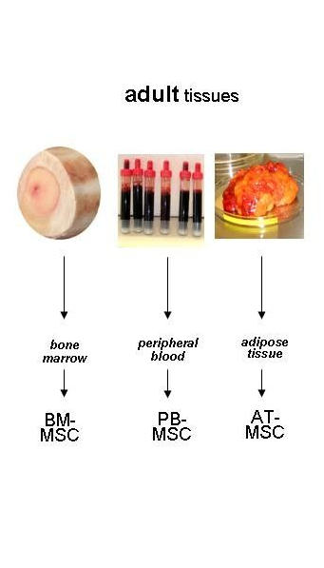
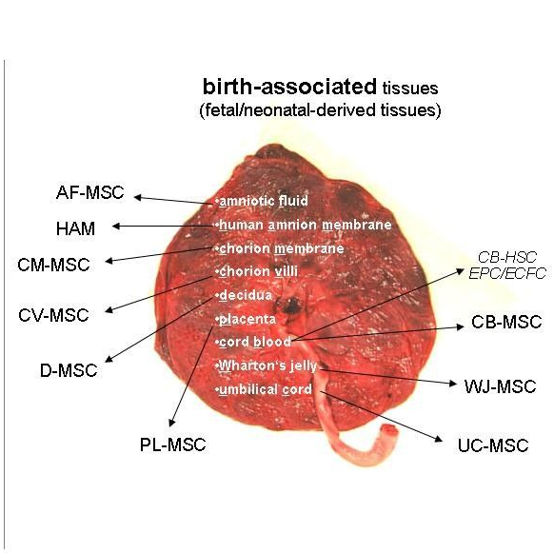

Sources of MSCs
Hass, Cell Communication and Signaling (2011), 9:12

Slide 12
Sox9
Col2
Col2
Ihh
Runx2
ColX
ALP
Sox9
Condensed
Mesenchyme
Proliferating
Chondrocyte
Prehypertrophic
Chondrocyte
Hypertrophic
Chondrocyte
IGF/FGF
BMP
Hedgehog
Notch
Parathyroid Hormone
WNT signaling
Msx1
Msx2
Notch
Runx2
MSC
Osteochondro-
progenitor
Preosteoblast
Early osteoblast
Late osteoblast
Osteoblast
Osteocyte
Runx2
ALP
Runx2
ALP
Osx
Col1
ALP
Osx
BSP
OCN
OPN
DMP
SOST

Slide 13
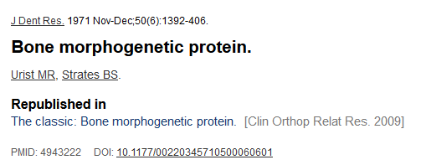
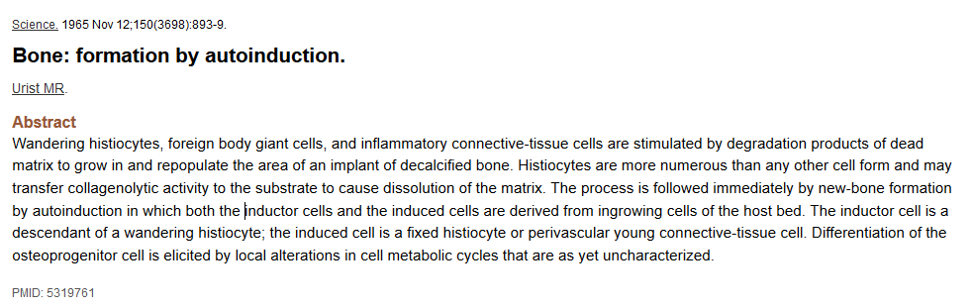


BMPs are the first known robust inducers of bone

Slide 14
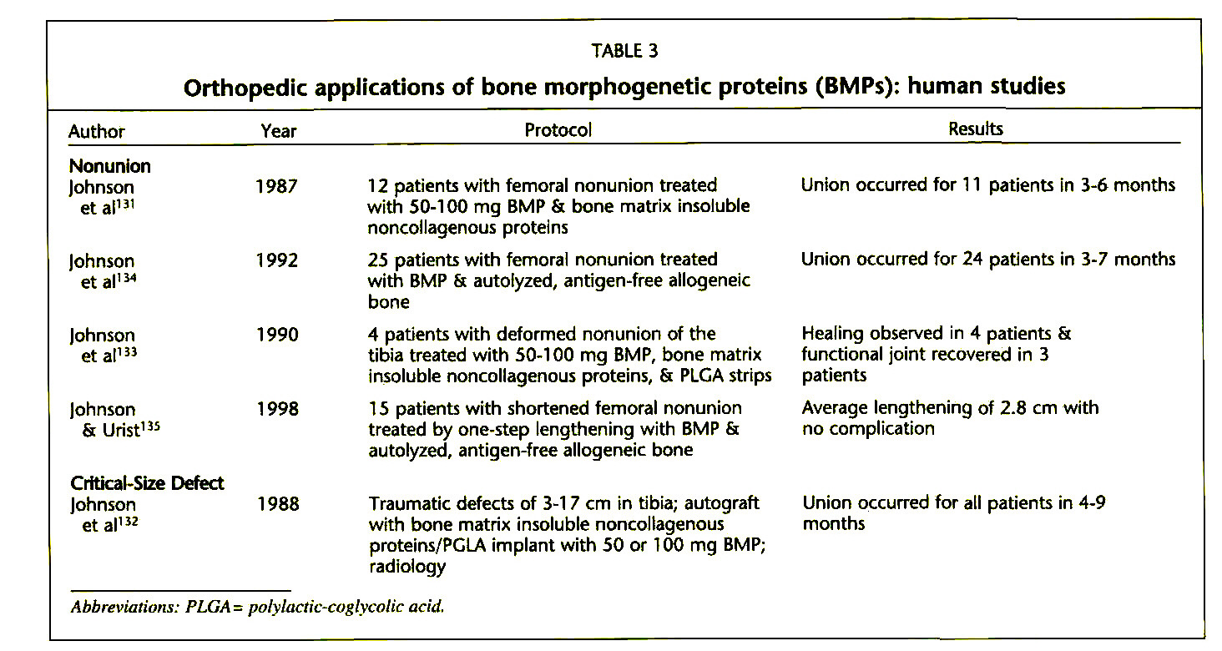
Croteau, Orthopedics (1999); 22(7):686-695

Slide 15
pleiotropic effects of BMPs
Now comprises a group of more than 20 proteins that are indicated in development and function of many cell types
Wang, Genes and Diseases (2014); 1:87-105

Slide 16
Classical BMP signaling pathway involves Runx2 and Osterix as critical mediators
BMP
BMP
BMPRs
P
P
TAK1
P
P
Smad 1/5/8
Smad 1/5/8
P
Smad6/7
Smad4
MKK3/6
P
Smad 1/5/8
Smad4
p38
P
Id-1
Id-2
Dlx5
P
Osx
P
Smad 1/5/8
Smad4
Runx2
SBE
P
MSC
Preosteoblast
Osteoblast

Slide 17
Recombinant BMPs in clinics…
INFUSE® = rhBMP-2/Absorbable collagen sponge
The INFUSE® Bone Graft/Medtronic Interbody Fusion Device is indicated for spinal fusion procedures in skeletally mature patients with degenerative disc disease (DDD) at one level from L2-S1, who may also have up to Grade I spondylolisthesis or Grade 1 retrolisthesis at the involved level.
http://www.infusebonegraft.com/healthcare-providers/spine-surgery/important-safety-information/index.htm
OP-1/BMP-7
OP-1 Putty and OP-1 Implant are currently approved in the United States under Humanitarian Device Exemptions (HDE) for revision posterolateral lumbar spine fusion and for the treatment of long bone nonunion fractures, respectively.
http://www.stryker.com/cn/products/Orthobiologicals/Osteoinductive/OP-1/index.htm

Slide 18
The challenges…
No significant improvement compared with autologous bone grafting versus BMP7 in tibial nonunion
In a closed tibial diaphyseal fracture models, rhBMP-2 did not shorten the time to fracture union and conflicting results surround its usage for spinal fusion efficacy and safety
The search for better bone regenerating agent continues…
Einhorm. (2015): Nat. Rev. Rheumatol. 11, 45-54

Slide 19
Are other BMPs potent and consistent inducers of osteoblast differentiation?
Hankenson Laboratory reported BMP6 as a potent inducer of Osteoblast differentiation about a decade ago

Slide 20
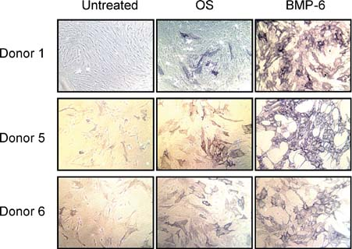
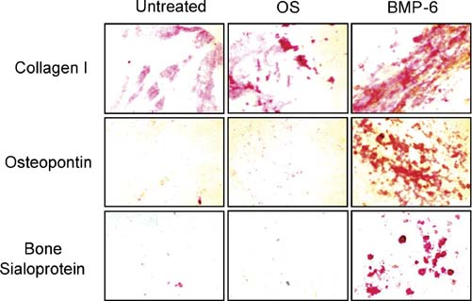
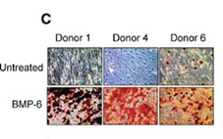

The Hankenson laboratory was first to report BMP6 as a potent and consistent inducer of osteoblast differentiation of hMSCs.
12 days (Alkaline phosphatase)
21 days (ECM proteins)
Alizarin Red S
Von Kossa
Friedman, JCB (2005): 98(3): 538-554)

Slide 21
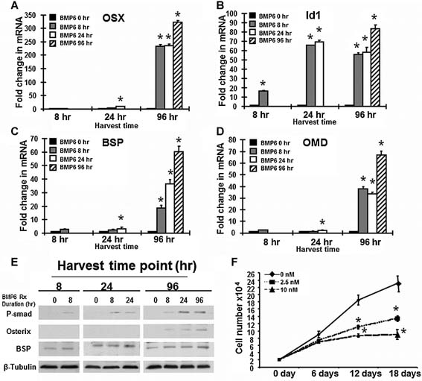
The transcription factor Osterix (SP7) regulates BMP6- induced human osteoblast differentiation
Id1 is a canonical BMPR-target gene
Zhu, JCP (2012): 227(6): 226-2685)

Slide 22
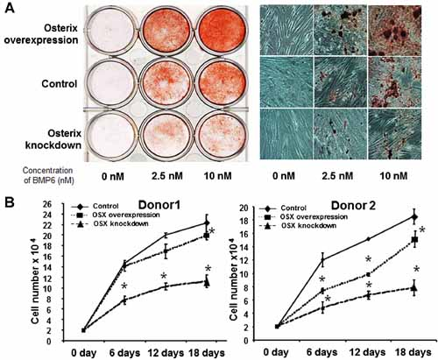
The transcription factor Osterix (SP7) regulates BMP6- induced human osteoblast differentiation
p38
Dlx5
Osx
Smad 1/5/8
Smad4
Runx2
SBE
MSC
Preosteoblast
Osteoblast
Zhu, JCP (2012): 227(6): 226-2685)

Slide 23
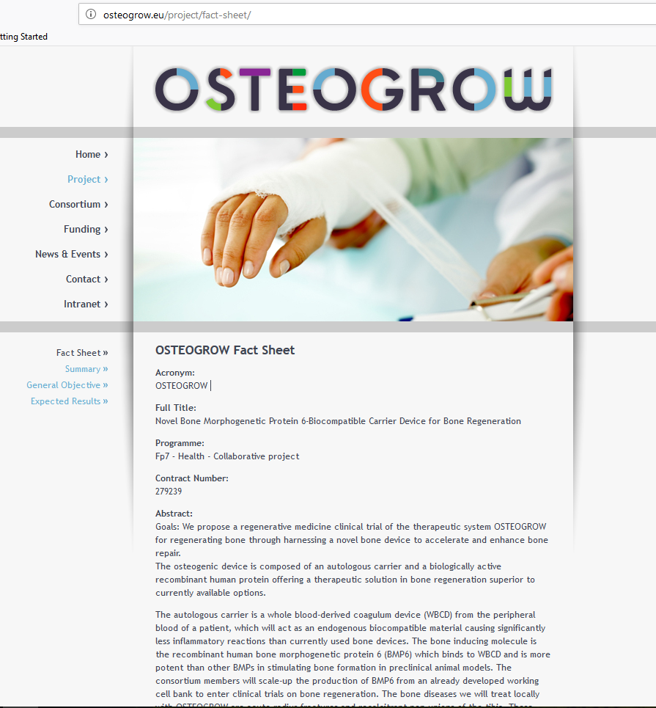

OSTEOGROW = Novel Bone Morphogenetic Protein 6-Biocompatible Carrier Device for Bone Regeneration
The autologous carrier is a whole blood-derived coagulum device (WBCD) from the peripheral blood of a patient, which will act as an endogenous biocompatible material causing significantly less inflammatory reactions than currently used bone devices.
http://osteogrow.eu/project/fact-sheet/
acute radius fractures and recalcitrant non-unions of the tibia

Slide 24

Agenda @bone_healing:
There is much to learn about the MSC differentiation mechanism …
Are there additional regulatory mechanisms that determine MSC fate during osteoblast differentiation in addition to the canonical BMP/SMAD pathway?
How does the osteoblastic differentiation program initiated by BMP intersect with other signaling pathways, such as Notch?
BMP6
Ub
Jagged/
Delta
BMP2
NICD
BMP7

Slide 25
CD36
CD34
CD19
CD11b
CD45
CD166
CD90
CD105
CD19
CD34
CD14
CD90
CD45
CD73
MSCs
CD105
CD79a
CD44
CD11b
HLA-DR
CD166

Slide 26
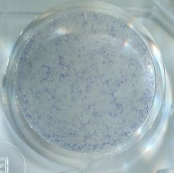
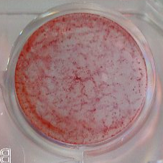
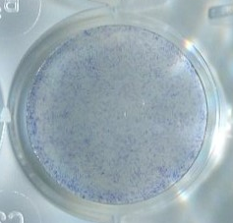
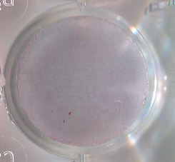
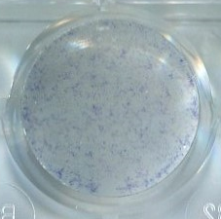
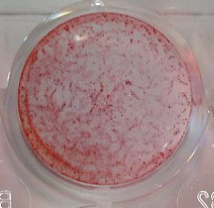
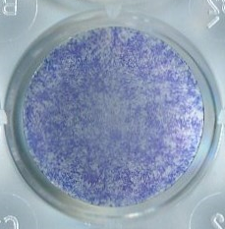
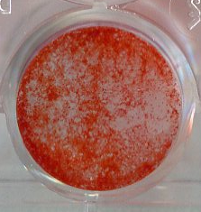
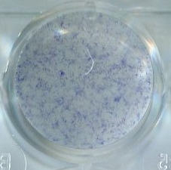
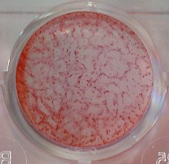
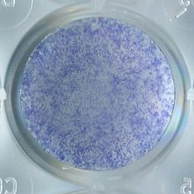
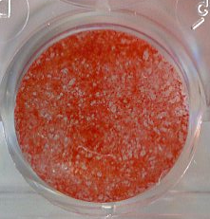
Osteogenic Differentiation with BMPs
Donor to Donor variability
Preparation methods and culture conditions
hMSCs
24h
Serum- free osteopermissive media
Tissue culture plates
Serum- containing osteopermissive media
BMP
BMP
96h
8-12 days
96h
8-12 days
-
-
-
-
BMP6
BMP6
BMP6
BMP6
BMP2
BMP2
BMP2
BMP2

Slide 27
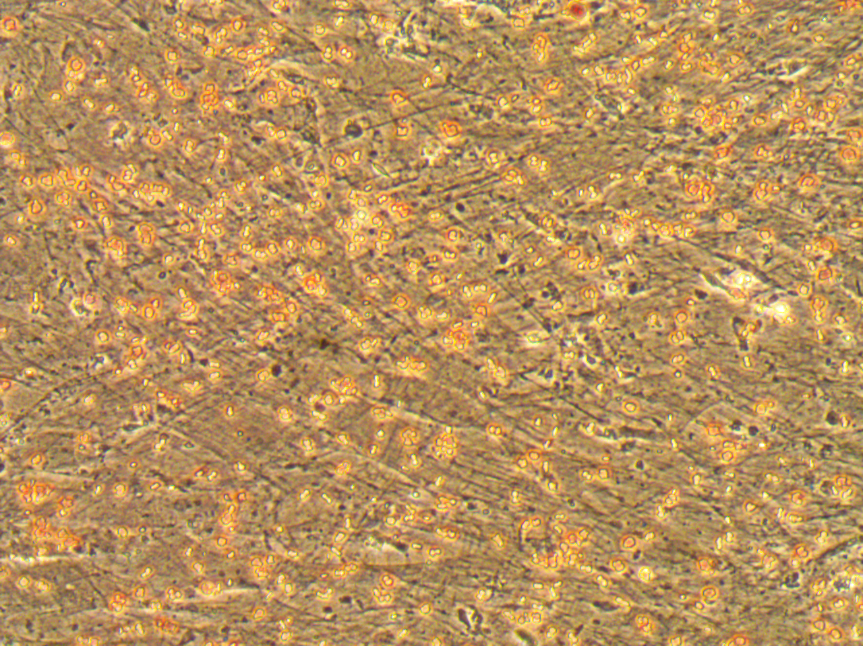
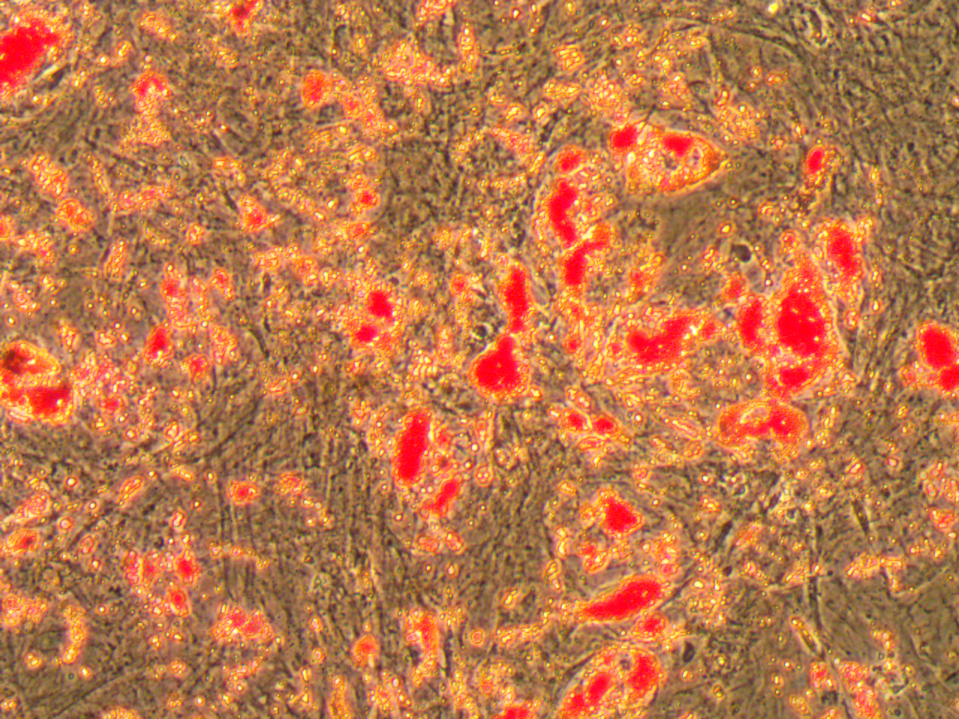
Adipogenic Differentiation of the donor lines used in this study
Uninduced
Adipogenic
Condition 1
Condition 2

Slide 28
Back to Osteogenic differentiation with BMPs

Slide 29

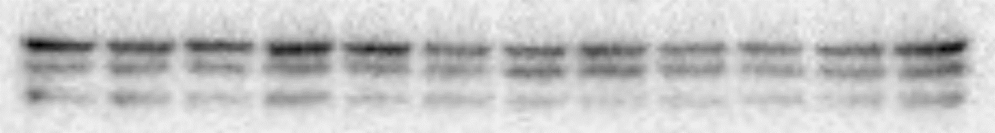
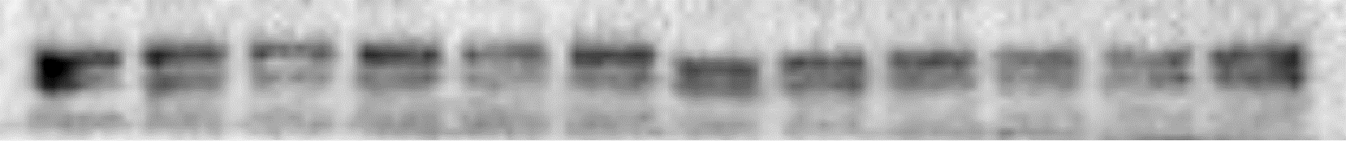
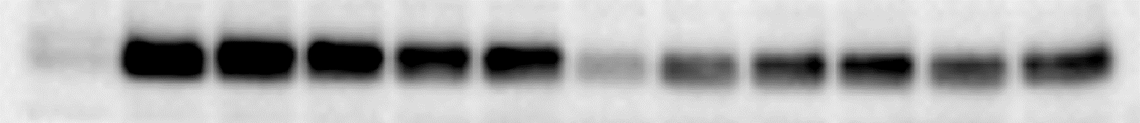
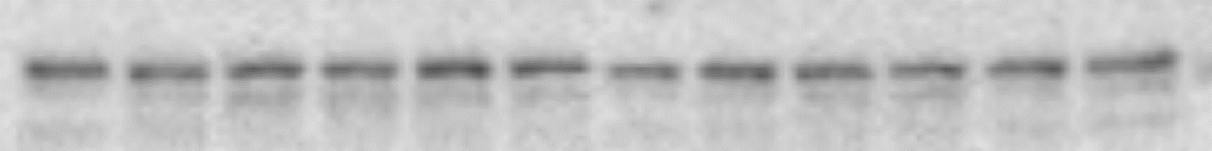
Osteogenic transcription factors increase in serum-free conditions
- FBS
+ FBS
0
8
24
48
72
96
0
8
24
48
72
96
: BMP6 (h)
P-SMAD 1/5/9
Runx2
Osterix
Dlx5
SMAD5
- FBS
+ FBS
0
0.25
0.5
1
2
4
0
0.25
0.5
1
2
4
: BMP6 (h)
P-SMAD 1/5/9
SMAD5

Slide 30
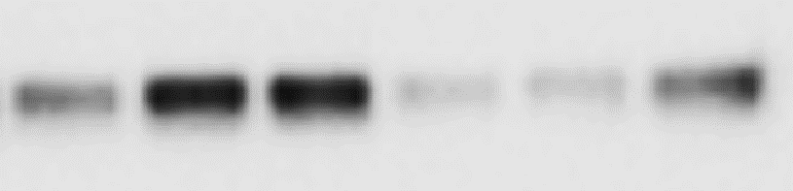
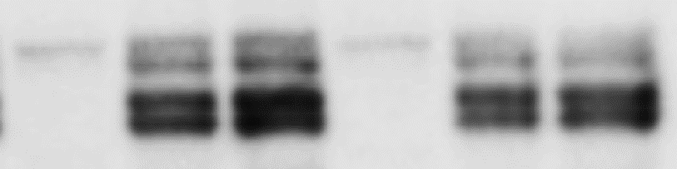
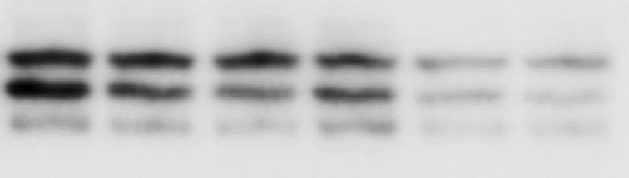
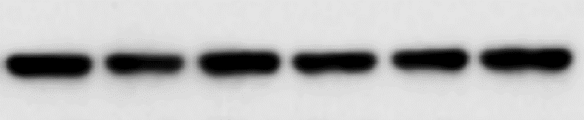
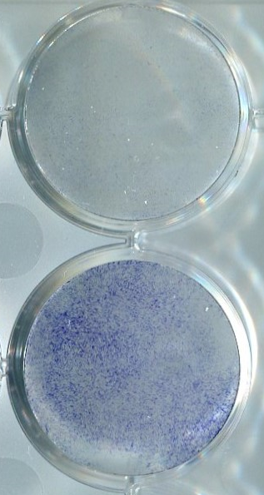
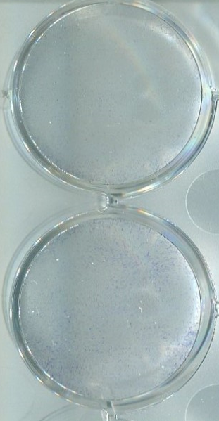
Runx2 is required for BMP induced alkaline phosphatase expression in response to BMP
-
48
72
-
48
72
: BMP-6 (h)
Runx2
Osterix
Dlx5
p38 MAPK
Dlx5
Osx
siRNA:
Control
Runx2
Smad 1/5/8
SBE
Smad4
Runx2
- BMP2
MSC
Preosteoblast
Osteoblast
+ BMP2

Slide 31
Canonical SMAD pathway activation is not sufficient to induce osteoblastic differentiation of hMSCs
Serum withdrawal enhances human osteoblast differentiation by increasing expression of osteoblast lineage specific transcription factors

Slide 32
BMP
BMP
BMPRs
P
P
TAK1
P
P
MAPK pathways
Smad 1/5/8
Smad 1/5/8
P
Smad6/7
Smad4
MKK3/6
ERK
JNK
p38
P
Smad 1/5/8
Smad4
p38
P
Id-1
Id-2
Dlx5
P
Osx
P
Smad 1/5/8
Smad4
Runx2
SBE
P
MSC
Preosteoblast
Osteoblast

Slide 33


Stimulus
Growth Factors, GPCR, Mitogens, Stress, Inflammatory cytokines
A-raf, B-raf
C-raf, MOS
Tpl2
MLK3, TAK,
DLK
MEKK1,4
MLK3, ASK1
MEKK2, 3
Tpl2
MAPKKK
MEK1/2
MKK3/6
MKK4/7
MEK5
MAPKK
ERK1/2
p38 MAPK
(α/β/γ/δ)
SAPK/
JNK1,2,3
ERK5/BMK1
MAPK
Outcome
Growth, Differentiation, Development,
Inflammation, Apoptosis etc.
Adapted from:
http://www.cellsignal.com/contents/science-cst-pathways/map-kinase-signaling-resources/science-pathways-mapk

Slide 34
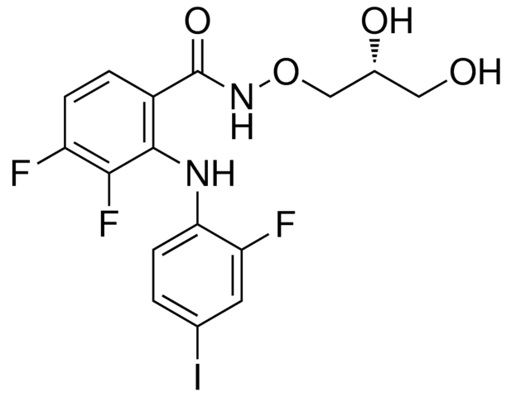
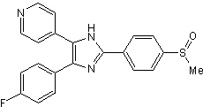
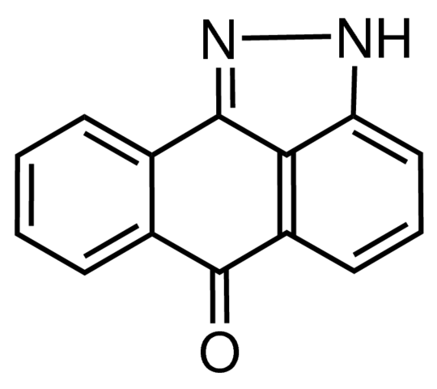
SB203580 (SB)
PD 0325901 (PD)
SP600125 (SP)
p38 MAPK inhibitor
MEK1/MEK2 inhibitor
To block ERK pathway
JNK inhibitor

Slide 35
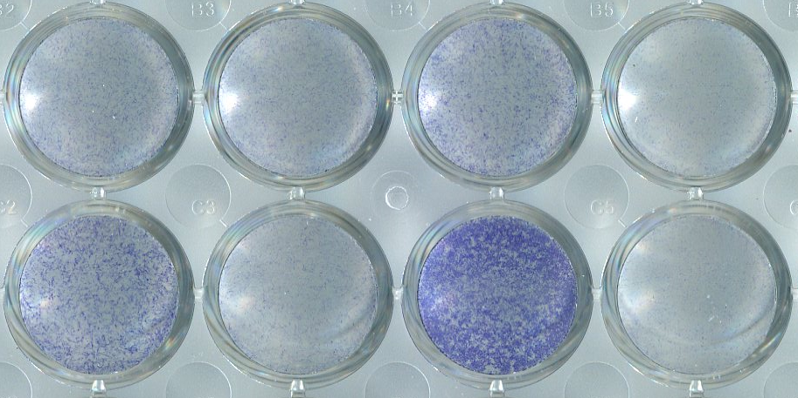

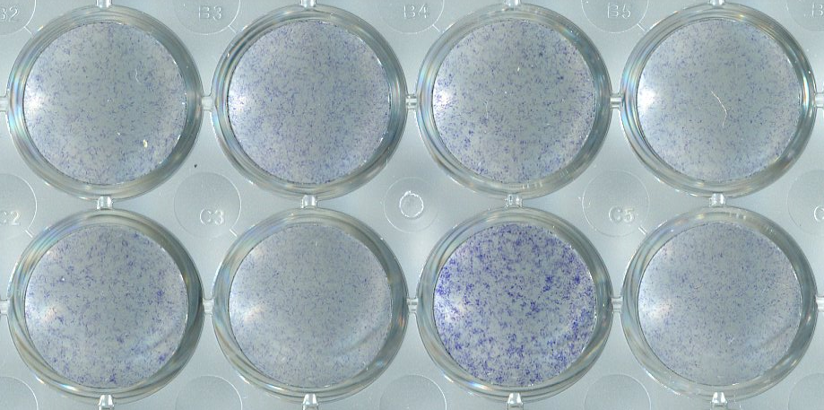
p38 MAPK and JNK signaling are required for hMSC osteoblast differentiation; ERK signal is inhibitory
p38 MAPK inhibitor-SB
MEK inhibitor-PD
JNK inhibitor-SP
DMSO
]
(-) BMP6
Serum Free Condition
(+) BMP6
]
(-) BMP6
16.5% FBS
(+) BMP6
PD0325901 (1 μM) -MEK1
SB203580 (5 μM) - p38 MAPK
SP600125 (5 μM) -JNK

Slide 36
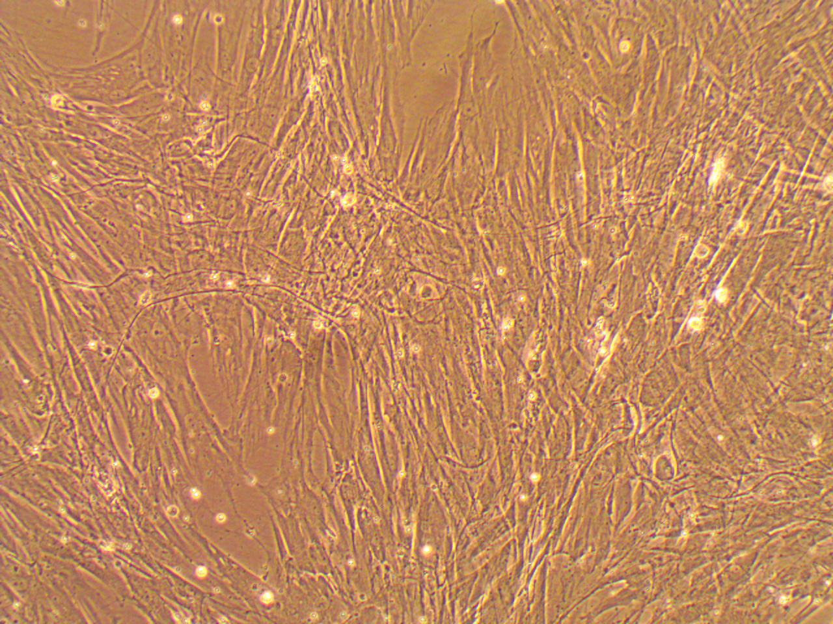
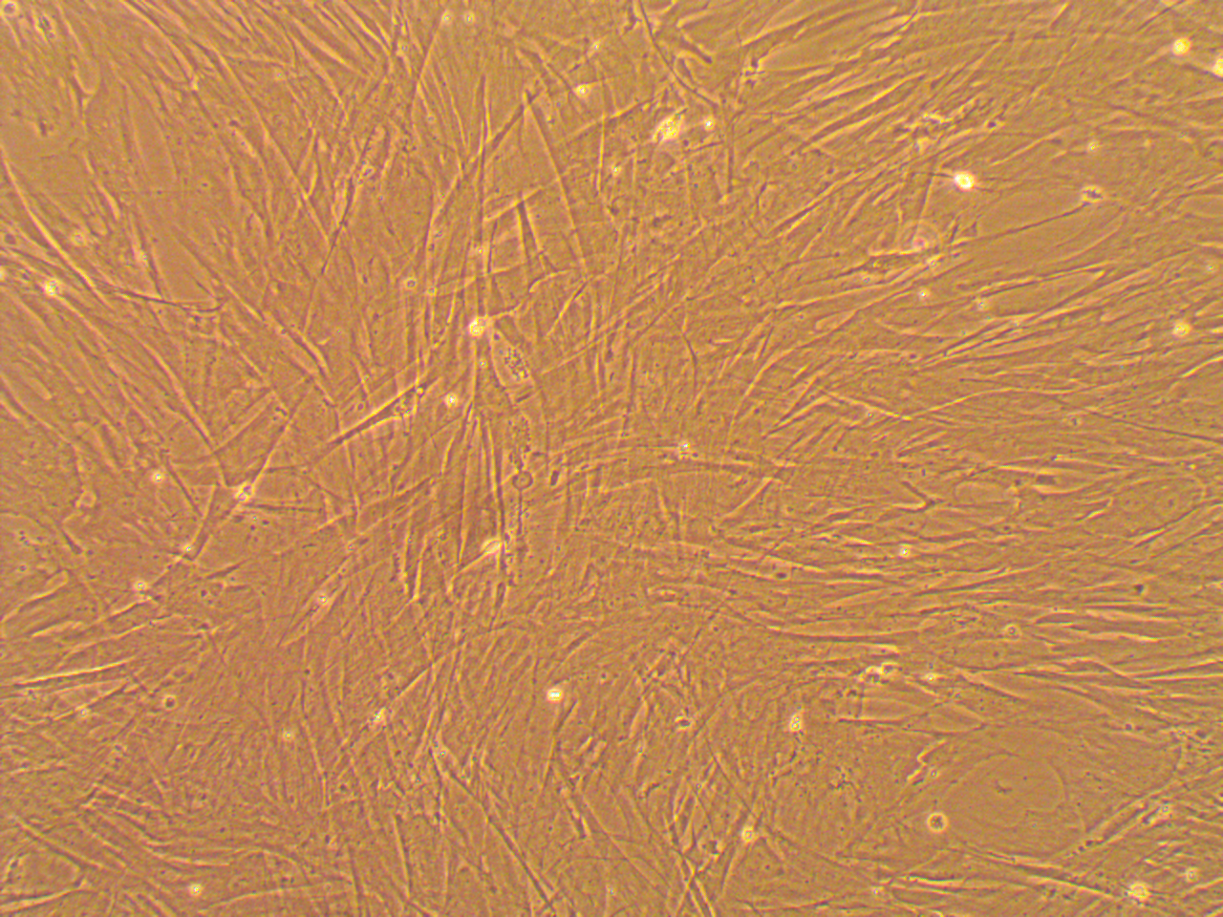
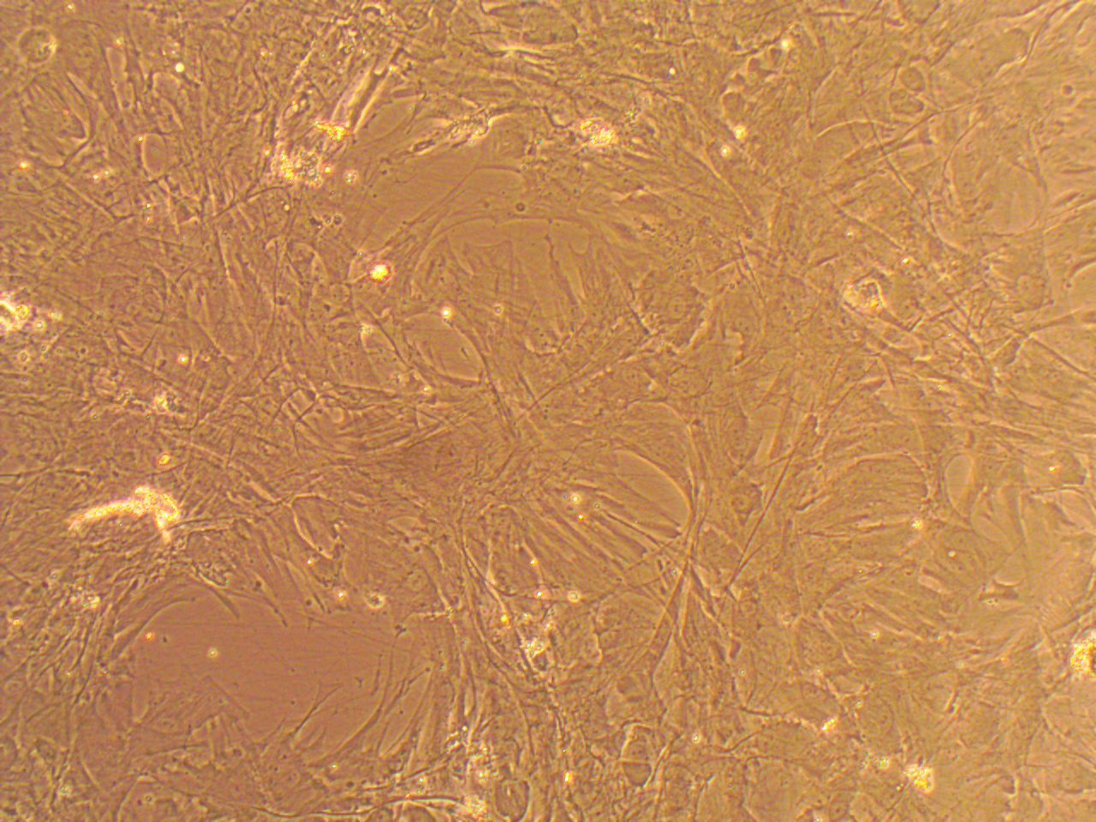
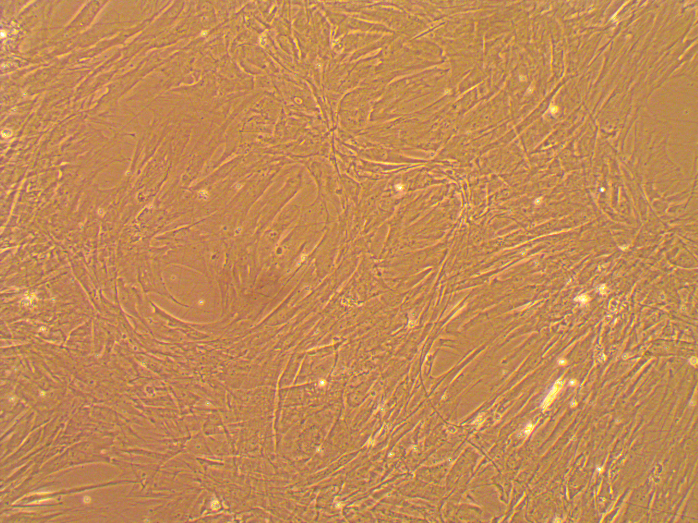
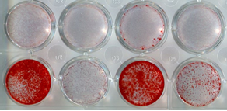
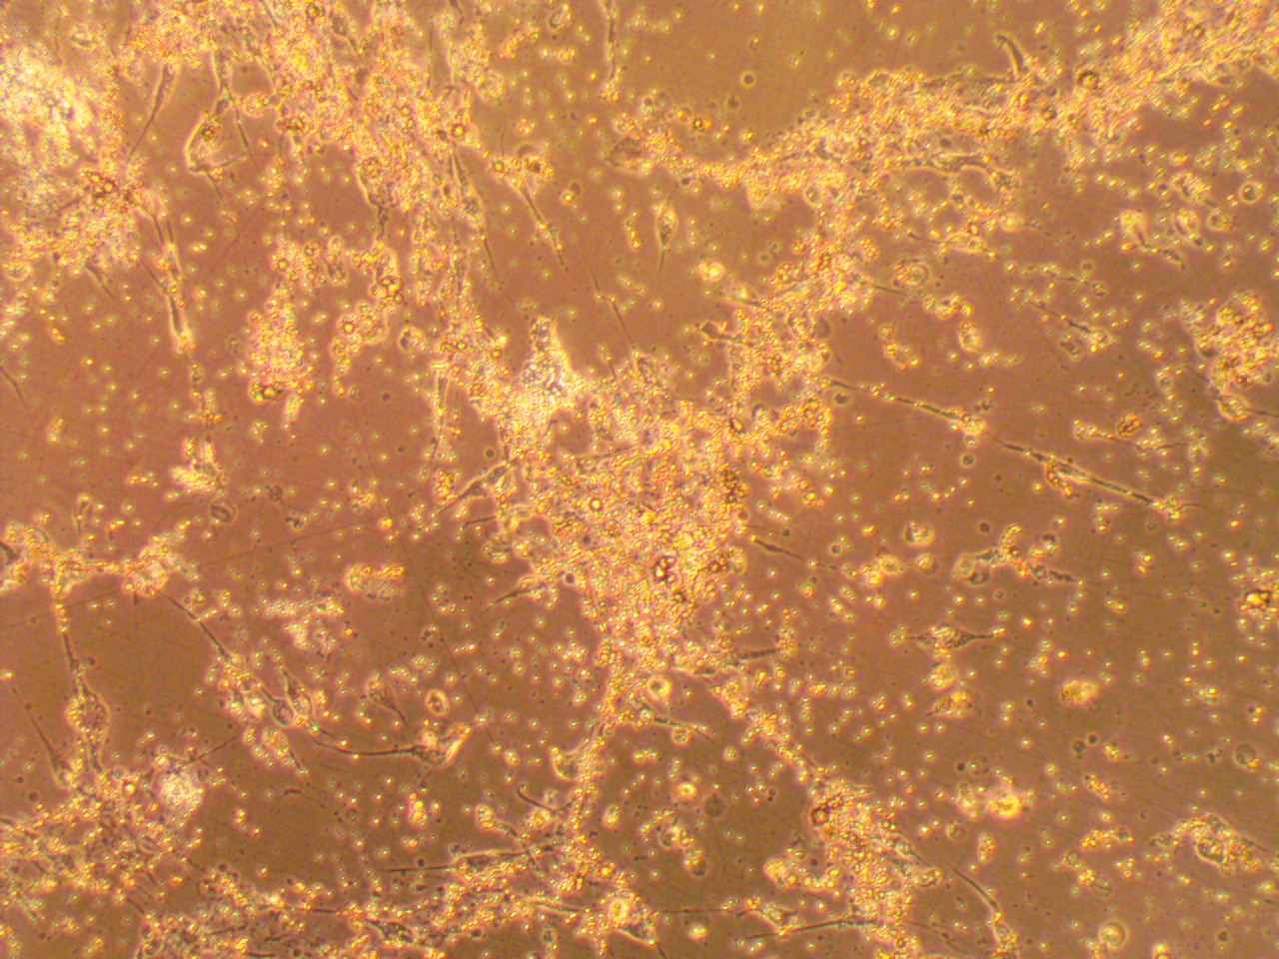
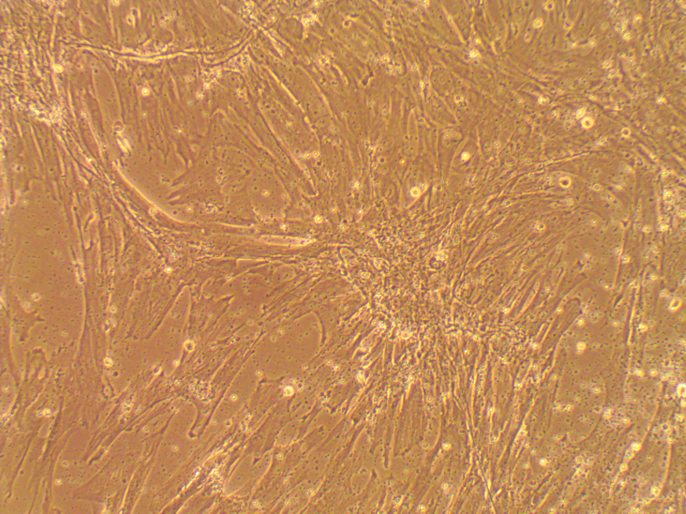
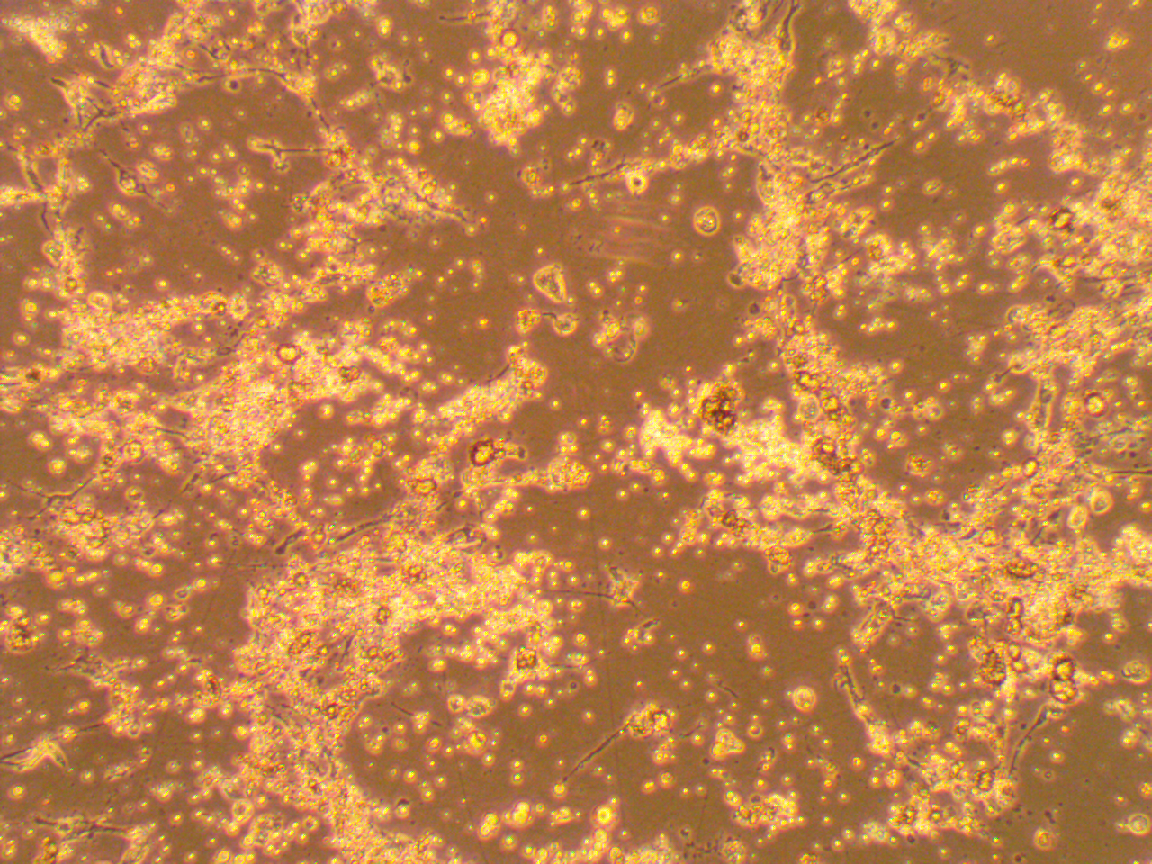
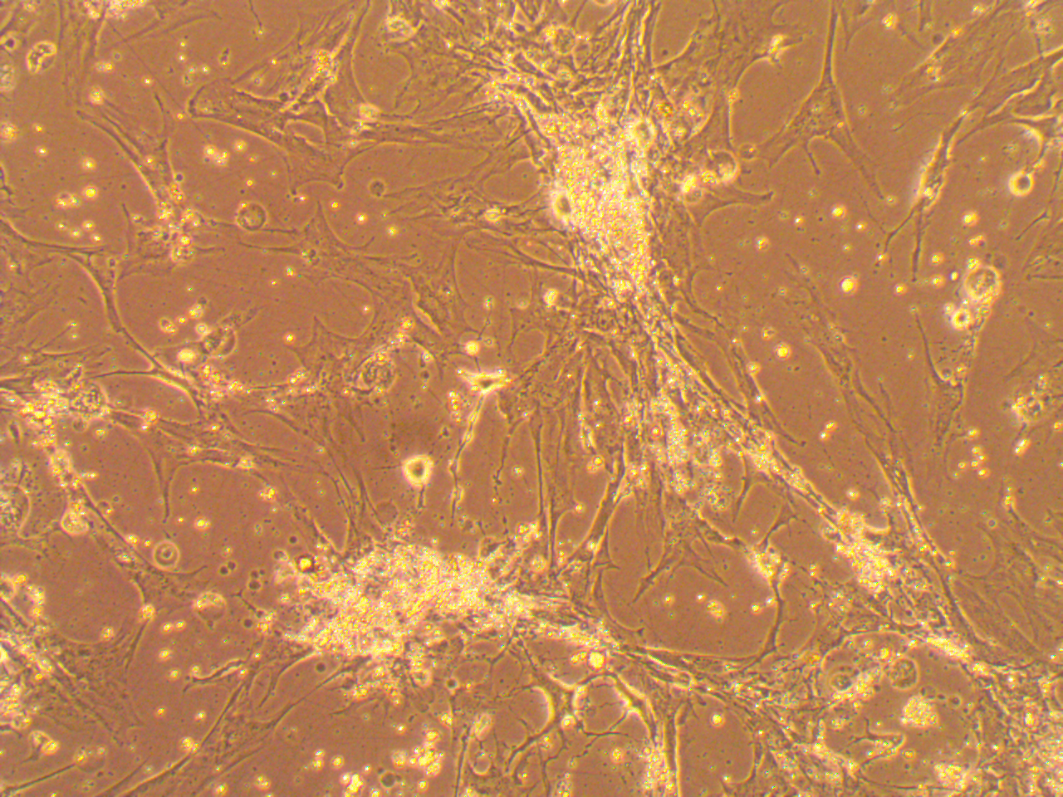
DMSO
p38 MAPK inhibitor-SB
MEK inhibitor-PD
JNK inhibitor-SP
(-) BMP6
]
(-) BMP6
Serum Free condition
(+) BMP6
(+) BMP6

Slide 37










BMP stimulation doesn’t appear to have a significant effect on MAPK phosphorylation
-
0.25
0.5
1
2
4
8
24
48
72
96
: BMP-6 (h)
P-SMAD 1/5/9
SMAD5
P-p38 MAPK
p38 MAPK
P-ERK 1/2
ERK 1/2
P-JNK
JNK
Osterix
GAPDH

Slide 38
Blocking either p38 or JNK pathway reduced ALP and Osterix, but did not appear to impact Runx2 expression or Id1

Slide 39







Blocking both p38 or JNK pathway reduced protein expression levels of Osterix
p38 MAPK inhibitor
p38 MAPK inhibitor
MEK inhibitor
MEK inhibitor
JNK inhibitor
JNK inhibitor
-
+
+
+
+
-
-
-
: BMP6 (200ng/ml)-72h
P-SMAD 1/5/9
Runx2
Osterix
Dlx5
P-ERK
ERK
GAPDH
PD0325901 (1 μM) -MEK1
SB203580 (5 μM) - p38 MAPK
SP600125 (10 μM) -JNK

Slide 40
BMP
BMP
BMPRs
ERK
JNK
p38
P
P
ERK
Id-1
Id-2
P
To osteoblast differentiation
Dlx5
Osx
JNK
?
ERK
? feedback inhibition
P
Smad 1/5/8
Smad4
Runx2
SBE
P
p38
and
JNK
MSC
Preosteoblast

Slide 41
Notch regulation of hMSC differentiation

Slide 42

To lysosomal degradation
To endosomal resorting
Neur or Mib
Ub
Ub
Ligand Expressing Cell
Nicastrin
Presenilin
APH-1
PEN-2
A
Receptor Expressing Cell
ADAM/TACE
G-secretase
complex
B
FBXW7
KDM5A
CtBP1
HDAC
HAT
CIR
MAML
SMRT
SHARP
KDM5A
SKIP
CSL/
RBPj
SKIP
CSL/
RBPj

Slide 43


Human skeletal developmental defects caused by Notch pathway mutations
DLL3, LFNG, HES7, MESP2 mutations: spondylocostal dysostosis
Notch2 mutations: Hajdu–Cheney syndrome
Jag1/Notch2 mutations: Alagille syndrome
GAD-BFC.ORG
KRANTZ, ET AL. (1997) J MED GENET

Slide 44


Notch ligands are upregulated during intramembranous bone healing
TIME
n=8-12
Youngstrom, NPJ Regen Med(2017): 2:32

Slide 45



RBPjk knockout in skeletal progenitors results in fracture nonunion
PRX1-Cre targets early progenitors.
WANG, ET AL. (2016) JCI

Slide 46

Jagged-1 drives 37% more bone volume than control.
Youngstrom, NPJ Regen Med(2017): 2:32

Slide 47

Jagged-1 does not induce the hypertrophic phenotype of BMP-2
Youngstrom, NPJ Regen Med(2017): 2:32

Slide 48



Jag1 promotes osteoblast differentiation in vitro
ZHU, ET AL. (2013) STEM CELLS
DISHOWITZ, ET AL. (2013) PLOS ONE

Slide 49


PKC delta is required for Jagged-1 induction of hMSCs

Slide 50


Similar to BMP regulated differentiation, JNK pathway is required for Jagged-1 mediated alkaline phosphatase expression
p38 MAPK inhibitor-SB
MEK inhibitor-PD
JNK inhibitor-SP
DMSO
p38 MAPK inhibitor-SB
(-) Jag1
MEK inhibitor-PD
JNK inhibitor-SP
FBS
OPM
DMSO
(+) Jag1
(-) BMP6
(+) BMP6
(-) Jag1
SERUM FREE
OPM
(+) Jag1
PD0325901 (1 μM) -MEK1
SB203580 (5 μM) - p38 MAPK
SP600125 (10 μM) -JNK

Slide 51
BMP MODULATION of NOTCH
OR
NOTCH Modulation of BMP

Slide 52
Does Jag1 regulate BMP expression or expression of BMP receptors?
 | CONTROL-1 | JAG-1 | CONTROL-2 | BMP-2
BMP1 | 70.43 | 130.328 | 89.17 | 62.19
BMP2 | 1.13 | 1.11 | 1.08 | 1.63
BMP4 | 1.05 | 1.03 | 1.77 | 7.16
BMP6 | 1.20 | 1.13 | 1.67 | 1.43
BMP7 | 1.07 | 1.10 | 1.17 | 1.18
BMPR1A | 11.76 | 13.69 | 14.83 | 17.00
BMPR1B | 1.18 | 1.49 | 1.47 | 1.16
BMPR2 | 10.12 | 11.58 | 11.94 | 17.19
Although BMP1 is implicated in bone and cartilage development, it is a metalloprotease and not a TGFβ superfamily member

Slide 53
Both Notch and BMP signaling increases Jag1, but not other ligands

Slide 54
Both Notch and BMP signaling increases Notch3 significantly

Slide 55

















Notch3 protein levels increases by Jag-1 and BMP6 stimulation
Jagged-1
BMP-6
24h
48h
72h
96h
PBS
Jag1
PBS
Jag1
PBS
Jag1
PBS
Jag1
-
0.25
0.5
1
2
4
8
24
48
72
96
(h)
ALP
ALP
Notch1 (val 1744)
Notch1 (val 1744)
Notch2 (NTM)
Notch2 (NTM)
Notch3 (NTM)
Notch 3 (NTM)
RBPj
Runx2
Runx2
Osterix
Osterix
Dlx5
Dlx5
GAPDH
GAPDH
Notch2 (NTM)
Long exposure

Slide 56



Notch2 and 3 proteins are affected by p38 MAPK and JNK
p38 MAPK inhibitor
p38 MAPK inhibitor
MEK inhibitor
MEK inhibitor
JNK inhibitor
JNK inhibitor
-
+
+
+
+
-
-
-
: BMP6 72h
p38 MAPK inhibitor-SB
MEK inhibitor-PD
P-SMAD 1/5/9
JNK inhibitor-SP
DMSO
Runx2
(-) BMP6
Osterix
Dlx5
(+) BMP6
P-ERK
ERK
(-) BMP6
GAPDH
Notch 2 (NTM)
(+) BMP6
Notch 3 (FL)
Notch 3 (NTM)

Slide 57

γ-secretase inhibition reduces alkaline phosphatase expression induced by BMPs
DAPT
+
DMSO
DAPT
BMP
BMP
BMP6
BMP2

Slide 58
γ-secretase inhibition reduces BMP mediated Jag1 and Notch3 expression, but does not impact Osterix and Runx2
DMSO
BMP
BMP
-
DMSO
BMP
BMP
-
DMSO
BMP
BMP
-
DAPT
DAPT
DAPT
DMSO
BMP
BMP
-
DMSO
BMP
BMP
-
DMSO
BMP
BMP
-
DAPT
DAPT
DAPT

Slide 59


γ-secretase inhibition impairs BMP- mediated mineralization of hMSCs
p38 MAPK inhibitor-SB
MEK inhibitor-PD
JNK inhibitor-SP
DMSO
DAPT
(-) BMP6
(+) BMP6
(-) BMP2
(+) BMP2

Slide 60


Jagged1 is essential for osteoblast development during maxillary ossification
Hill. et al., Bone 2015; 62: 10-21

Slide 61


Jagged-1 neutralizing antibody on Alkaline phosphatase expression induced by BMPs
Readout at 72h
Readout at 96h
@Jag1 (µg/ml)
@Jag1 (µg/ml)
DMSO
1
5
10
DAPT
DMSO
1
5
10
DAPT
-
-
BMP2
BMP2
BMP6
BMP6
DAPT and @Jag1 antibodies were added 6h post BMP stimulation in these experiments

Slide 62
BMP regulation of Jagged-1 transsignaling in hMSCs
Immobilized
Jagged1
BMP
Ub
BMP
BMP
BMP
BMPRs
Notch 2
Notch 2
BMPRs
P
P
P
P
Ub
Jagged1
JNK
P
Canonical signaling
Canonical signaling
Jagged1
Osx
Ub
Notch 3
Runx2
Osx
Runx2
Self-sustained signaling
p38
JNK
P
P

Slide 63
Follow up…
What is the requirement for Osterix and Runx2 in Jag1 mediated osteoblast differentiation?
Is Jagged1 required for BMP mediated osteoblast mineralization
How is Jagged-1 expression regulated in hMSCs?
Does BMP signaling regulate Notch signaling through Runx2 transcriptional regulation?
Is Notch3 upregulation required for BMP-mediated effects?

Slide 64





Kurt. D. Hankenson
Troy L. Mitchell
Daniel W. Youngstrom
Robert L. Zondervan
Rafael Senos Dos Santos
Kannan Karuppaiah

