Slide 1

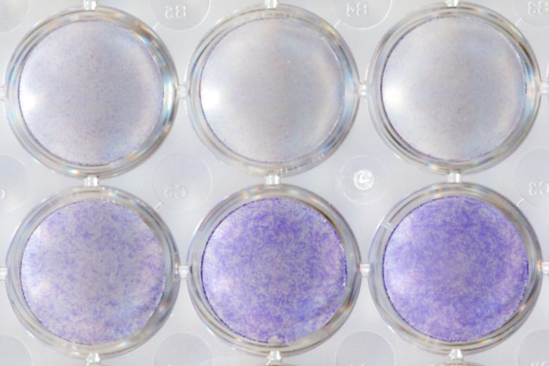
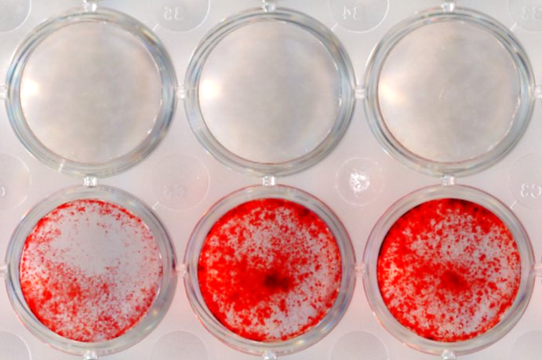
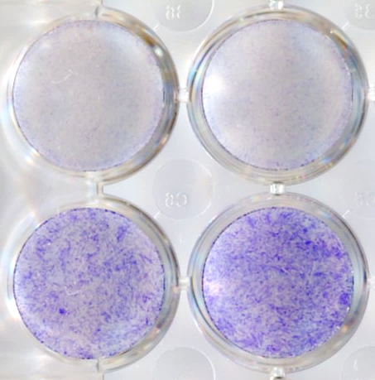
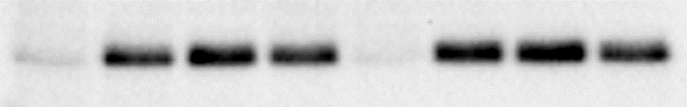


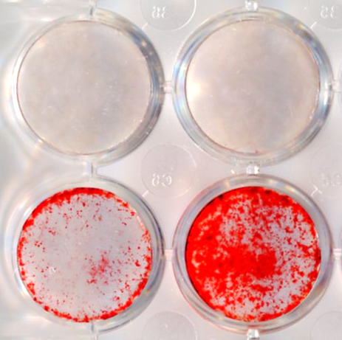

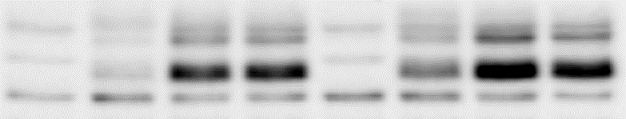
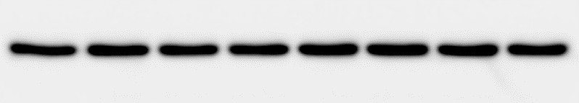

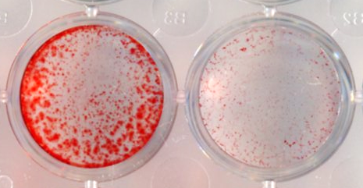
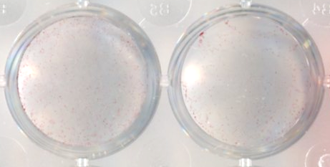
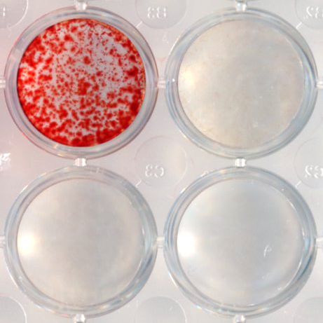
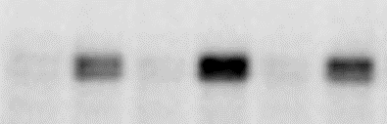
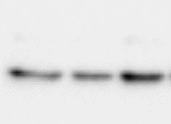
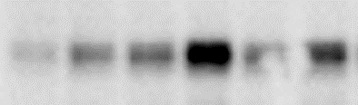
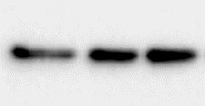
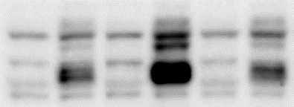
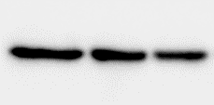
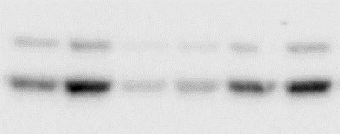
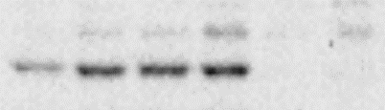
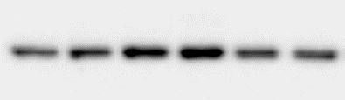
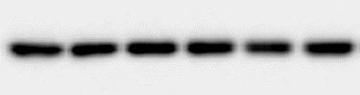
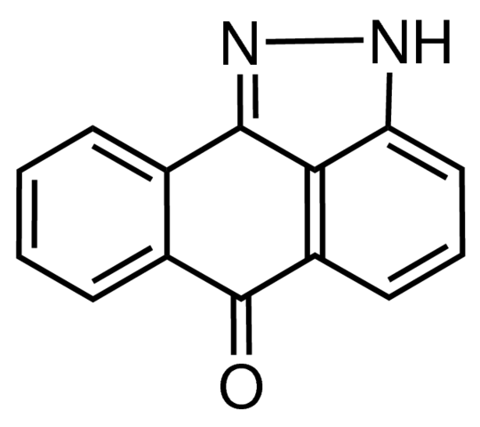
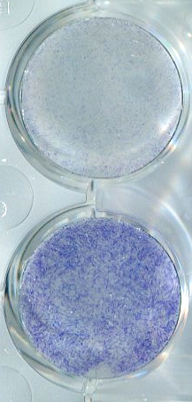
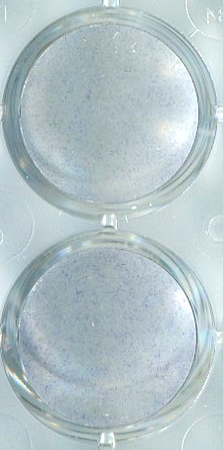
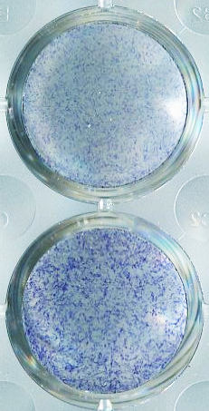
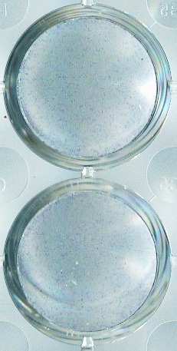
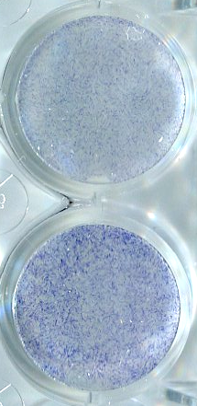
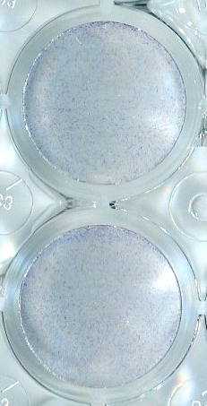
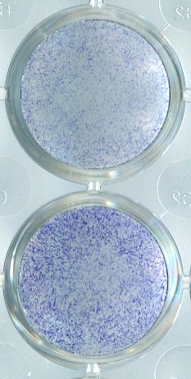
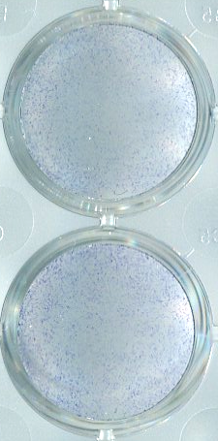
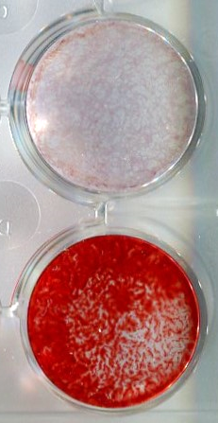
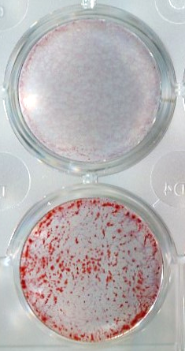
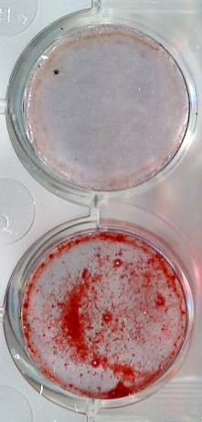
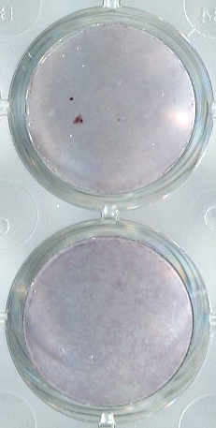
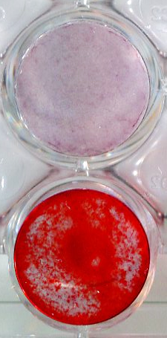
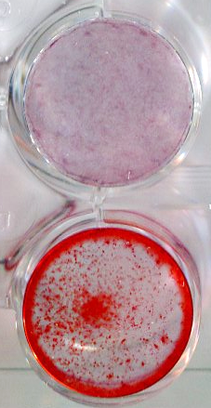
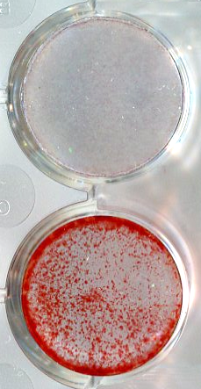
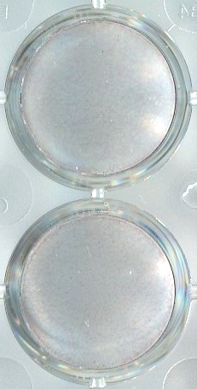


c-JUN N-terminal kinase (JNK) isoform 2 Augments Human Osteoblast Differentiation by Integrating Bone Morphogenetic Protein Signaling and Canonical Notch Signaling
Yadav Wagley¹, Benjamin Graham and Kurt D. Hankenson¹
University of Michigan
Orthopaedic Surgery
¹Department of Orthopaedic Surgery, Orthopaedic Research Laboratories, University of Michigan Medical School, Ann Arbor, MI 48109.
Email: ywagley@med.umich.edu; kdhank@umich.edu
Introduction
2. JNK2, but not JNK1 activity is required for hMSC osteoblast differentiation
5. JAGGED1 (JAG1) knock-down abrogates BMP-mediated human osteoblast differentiation without significantly altering BMP/SMAD signaling
The c-Jun N-terminal kinases (JNK) are evolutionary conserved regulators of proliferation, differentiation and cell death responses.
The three isoforms of JNK, JNK1, JNK2 and JNK3, are encoded by three distinct genes MAPK8, MAPK9 and MAPK10, respectively. Although the expression of JNK3 is limited to brain, heart and testes, JNK1 and JNK2 isoforms are ubiquitously expressed throughout the body, including in musculoskeletal tissues¹.
In vivo studies show that Jnk1^{-/-} mice display severe osteopenia due to impaired bone formation, whereas Jnk2^{-/-} mice display a mild osteopenia only evident in long bones. In vitro, Jnk1^{-/-} osteoblasts display a selective defect in the late stages of osteoblast differentiation with impaired mineralization activity².
However, the isoform specific roles of JNK1 and JNK2 in human osteoblast differentiation are lesser known.
A
3
B
siRNA
C
siRNA
A
siRNA
B
JAG1
C
2
control
JNK1
JNK2
control
JNK1
JNK2
control
JAG1
5
*
fpkm
(-)
(-)
(-)
4
control siRNA
JAG1 siRNA
3
1
Relative expression
BMP2
BMP2
2
*
-
24
48
72
24
48
72
: BMP2(h)
0
BMP2
1
P-SMAD1/5/9
MAPK8
MAPK9
MAPK10
Alk Phos (4 days)
Alizarin red S (10 days)
Alk Phos (4 days)
0
-
+
-
+
:BMP2
JAG1
C
MAPK8 (JNK1)
D
MAPK9 (JNK2)
E
MAPK10 (JNK3)
siRNA
control
JAG1
:siRNA
NOTCH1 (ICD)
2.5
2.5
2.5
control
JAG1
2.5
JAG2
RUNX2
1.5
1.5
1.5
2.0
Osterix
(-)
1.5
Relative expression
0.5
0.5
0.5
1.0
GAPDH
Relative expression
*
Relative expression
Relative expression
*
*
BMP2
0.5
1.0
1.0
*
1.0
0
-
+
-
+
:BMP2
0.5
0.5
0.5
Alizarin red S (10 days)
control
JAG1
:siRNA
Objective
0
-
+
-
+
-
+
:BMP2
0
-
+
-
+
-
+
:BMP2
0
-
+
-
+
-
+
:BMP2
Figure 5. (A) Alkaline phosphatase expression (top image) and extracellular calcium deposition (bottom image) was histochemically determined in hMSC after JAG1 knockdown. A representative result of four independent donor lines is shown. (B) JAG1 (top) and JAG2 (bottom) mRNA expression level was determined from siRNA transfected cells stimulated with BMP2 for 3 days. *, p<0.05 compared to control siRNA transfected samples with no BMP2. (C) Immunoblot detection shows comparable expression of phospho-SMAD1/5/9, RUNX2 and Osterix protein expression whereas JAG1 and NOTCH1 intracellular domain (ICD) are reduced in cells after JAG1 knockdown.
control
JNK1
JNK2
control
JNK1
JNK2
control
JNK1
JNK2
    To evaluate specific contribution of JNK1 and JNK2 during bone morphogenetic protein (BMP)-mediated osteoblast differentiation of human bone-marrow derived mesenchymal stem/progenitor cells (hMSC).
siRNA
siRNA
siRNA
Figure 2. (A) fpkm values for each JNK isoform obtained after RNA sequencing of three independent hMSC donor lines is shown. (B) Alkaline phosphatase expression and (C) extracellular calcium deposition was histochemically determined in hMSC after JNK1 and JNK2 knockdown. A representative result of four independent donor lines is shown. (C-E) Expression levels of (C) MAPK8 (JNK1), (D) MAPK9 (JNK2), and (E) MAPK10 (JNK3) was determined in four independent hMSC donor lines after JNK1 and JNK2 knock-down. Each colored dot across the histograms represents a unique hMSC donor line *, p<0.05 compared to control siRNA without BMP2 (200ng/ml) stimulation.
6. JNK2-deficient immortalized hMSC fail to produce extracellular calcium deposition in response to BMP2
Methods
3. While JNK2 knock-down minimally affects RUNX2 and Osterix proteins, JNK1 knock-down enhances their expression
A
Immortalized hMSC
B
JNK2 KO
clone A
C
JNK2 KO
clone B
70,000 hMSC were seeded onto each well of a 12-well plate using hMSC maintenance media and the next day transfected with siRNAs using DharmaFECT1 transfection reagent (Dharmacon Inc.) following manufacturer’s instructions. siRNA transfected cells were allowed to recover for 2 days and stimulated with 200ng/ml BMP2 using serum-free osteopermisive media.
Gene expression and immunoblot analysis were performed using cells stimulated with BMP2 for 3 days. Alkaline phosphatase expression was determined on day 4 after BMP2 stimulation. Some cells received fresh osteopermissive media on the 4th and 8th day after initial BMP stimulation, and the accumulation of extracellular calcium was determined on day 10 using Alizarin red S staining.
JNK2 KO
clone A
control
JNK2 KO
clone B
control
control
control siRNA
JNK1 siRNA
JNK2 siRNA
JNK2
-
+
-
+
-
+
:BMP2
JNK1
P-SMAD 1/5/9
P38 MAPK
RUNX2
GAPDH
Alizarin red S (12 days)
Alizarin red S (12 days)
Osterix
Figure 6. (A) hTERT immortalized hMSC expressing Cas9 were genomically edited with non-targeting guide or JNK2 synthetic guides. Two subclones were established using JNK2 targeted cells. Total cell lysates from non-targeted control and knockout (KO) clones were evaluated for JNK2 knock-out by immunoblot analysis. The expression of JNK1 and p38 MAPK was determined for specificity of genome editing. GAPDH was evaluated as internal control. (B-C) Immortalized control cells as in (A) and JNK knock-out clones were stimulated with BMP2, and the deposition of extracellular calcium was histochemically determined after 12 days. Results are representative of two independent experiments.
JNK1
JNK2
p38 MAPK
GAPDH
Summary and Discussion
Figure 3. Total cell lysates from JNK1 and JNK2 siRNA transfected hMSC donor line were prepared after three days of BMP2 stimulation. Protein levels of phosphorylated SMAD 1/5/9, RUNX2 and Osterix were determined to show BMP receptor signaling and its downstream effects on pro-osteoblastic transcription factors. The levels of JNK1, JNK2 and p38 MAPK were determined to demonstrate knock-down efficiency and specificity of each siRNA. The levels of GAPDH was determined to show equivalent protein loading across samples. A representative result of two independent donor line is shown.
    Pharmacological inhibition of JNK disrupts BMP-mediated hMSC osteoblast differentiation.
    JNK1 knock-down minimally affects alkaline phosphatase expression and extracellular calcium deposition but enhances BMP-mediated expression of RUNX2 and Osterix protein levels. On the other hand, JNK2 knock-down minimally affects canonical BMP/SMAD signaling but impairs hMSC osteoblast differentiation.
    JNK2 functions downstream of canonical BMP/SMAD signaling to increase expression of canonical Notch ligand JAG1 and Notch target genes HES1 and NOTCH3.
    Direct JAG1 knock-down of hMSC disrupts hMSC osteoblast differentiation but does not affect canonical BMP/SMAD signaling.
    On-going studies will continue to understand the JNK2 mediated integration of BMP/SMAD signaling and canonical Notch Signaling.
Results
4. BMP-dependent Notch ligand JAG1 expression and downstream target genes HES1 and NOTCH3 are altered in JNK2 silenced cells.
1. Pharmacological Inhibition of JNK impairs BMP-mediated human osteoblast differentiation
A
B
Donor 1
Donor 2
C
Donor 1
Donor 2
A
8
JAG1
B
4
HES1
C
8
NOTCH3
(-)
DMSO
SP
(-)
DMSO
SP
(-)
DMSO
SP
(-)
DMSO
SP
6
3
6
Relative expression level
Relative expression level
4
BMP6
BMP6
BMP2
BMP2
4
2
Relative expression level
SP600125 (SP)
(-)
(-)
(-)
(-)
2
1
2
JNK1, -2 and -3 inhibitor
BMP6
BMP6
BMP2
BMP2
0
-
+
-
+
-
+
:BMP2
0
-
+
-
+
-
+
:BMP2
0
-
+
-
+
-
+
:BMP2
-
control
JNK1
JNK2
control
JNK1
JNK2
control
JNK1
JNK2
Figure 1. (A) SP600125 (SP), anthra[1,9-cd]pyrazol-6(2H)-one, a pharmacological inhibitor of JNK1, 2, and 3 is depicted. (B-C) Alkaline phosphatase expression (top, 4 days) and extracellular calcium deposition (bottom, 10 days) was determined in two independent hMSC donor lines stimulated with BMP6 (200ng/ml) (B) and BMP2 (200ng/ml) (C) in presence or absence of 5μM SP600125.
siRNA
siRNA
siRNA
References: 1. Zeke A, Misheva M, Remenyi A et al., MMBR 80(3):793-835 2016
2. Xu R, Zhang C, Shin DY et al., JBMR 32(9):1811-1815 (2017)
Figure 4. Expression levels of (A) JAG1 (B) HES1, and (C) NOTCH3 were determined in four independent hMSC donor lines after JNK1 and JNK2 knock-down. Each colored dot across the histograms represents a unique hMSC donor line *, p<0.05 compared to control siRNA without BMP2 (200ng/ml) stimulation.
Orthopaedic Research Laboratories
Acknowledgments: Human bone-marrow derived MSC used in this study were isolated and characterized at the Institute of Regenerative Medicine, Texas A&M. Support for this study was provided by National Institutes of Health through grants 1R01HD100406-01A1, R01AG072705-1 and R01-AR055607-10.
: ywagley@med.umich.edu;
kdhank@umich.edu

