Slide 1

Building and Maintaining a
Trusted Digital Repository
Jared Lyle
Metadata & Preservation “Deep Dive” Webinar series for ICPSR staff
16 September 2021
Notes:
Did you know there are international standards and guidelines that provide blueprints for building and maintaining a trusted digital repository -- i.e., a repository “whose mission is to provide reliable, long-term access to managed digital resources to its designated community, now and in the future?”
Since 2006, ICPSR has measured itself against these standards for digital repositories, including most recently becoming CoreTrustSeal certified. Come learn about:
What are the standards, and where can you find them?
How following these standards benefits staff and funders, especially when ICPSR is building new infrastructure and workflows?
In what ways does ICPSR comply with these standards?
What more can ICPSR do to better adhere to these standards?.

Slide 2
This Webinar is part of a monthly series of virtual learning sessions for staff by the Metadata & Preservation unit. The series will provide a “deep dive” into the steps taken and the standards used by ICPSR to make data Findable, Accessible, Interoperable, and Reusable (FAIR) -- both today and over time.
For more details about the series: https://bit.ly/icpsr-fair-deep-dive

Slide 3

“We have accomplished an enormous amount over [the past 18 months], taking on new projects to support different parts of the research community, developing new processes and technologies, adding a new organizational unit, and increasing the size of our staff by nearly 50%.”
-Maggie Levenstein in the ICPSR Weekly Announcements, September 13, 2021
Notes:
Why are we holding these deep dive Webinars? A couple main reasons that are underscored by this quote from the recent ICPSR Weekly Announcements: 1) ICPSR has increased in staff size by 50% in just the last 18 months. That’s not counting the new staff added in the 3-5 years before the pandemic. We have lots of new people not familiar with digital repository practices. 2) ICPSR is developing new processes and technologies, including for what looks like will be a huge infrastructure project. It’s important we follow good practices when updating or building new infrastructure.

Slide 4
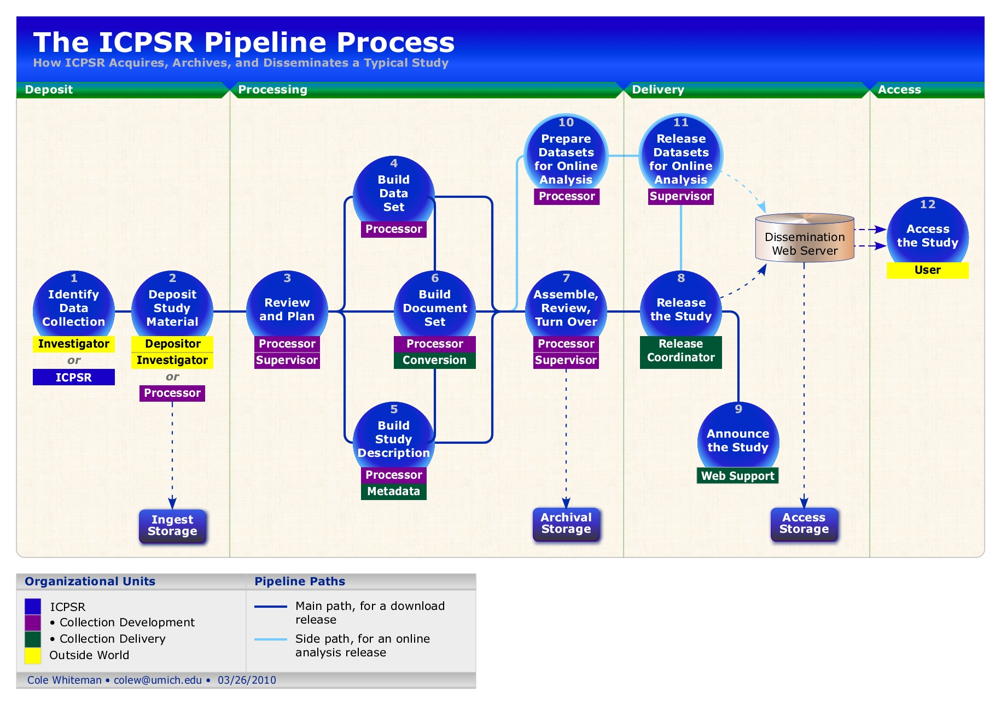
Notes:
The goal of the Metadata & Preservation unit is to set and enforce standards and manage unique products that increase data discovery and reuse -- both now and into the future.
While we’ll use these deep dives to discuss the details of our work, for instance metadata review or Bibliography additions, we also want to use these Webinars to discuss metadata and preservation more generally.
Everyone -- and I mean everyone -- at ICPSR is involved in activities to make our data discoverable and re-usable. This spans from the project managers and curators who are intricately involved with enhancing and describing our data collections, to CNS and Product Owners maintaining and building infrastructure, to BCD, Administration, and Marketing & Communications ensuring we have necessary funding and support to keep our repository operating. Having an informed staff ensures we continue to produce high quality products.

Slide 5
October 21 - Metadata: Why and How We Use It to Create FAIR Data
November 18 - Metadata: Data Documentation Initiative (DDI-Codebook)
December 9 - Bibliography of Data-related Literature
January 20 - Digital Preservation
March 3 - Doing More with Metadata: Documenting Variable Comparability using DDI-Lifecycle
April 14 - Doing More with Metadata: Other Standards
May 19 - DataCite: More Than Just DOIs
For more details about the series: https://bit.ly/icpsr-fair-deep-dive
Notes:
Future deep dives include….

Slide 6
Outcomes: Building and Maintaining a
Trusted Digital Repository
What is a “Trustworthy Repository” (and why does it matter)?
What are the standards used to build and assess a Trusted Repository, and where can you find them?
How following these standards benefits staff and funders, especially when ICPSR is building new infrastructure and workflows?
In what ways does ICPSR comply with these standards?
What more can ICPSR do to better adhere to these standards?
Notes:
Outcomes for this presentation about Building and Maintaining a Trusted Digital Repository.

Slide 7
What is a
“Trustworthy Repository”
(and why does it matter)?

Slide 8
Digital material is fragile and requires proper care and feeding:
“Digital information lasts forever or five years, whichever comes first”.
-Jeff Rothenberg
Notes:
Digital content can be much more fragile.

Slide 9
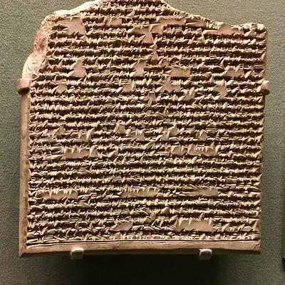
https://flic.kr/p/RDGaX2
Notes:
Whereas physical materials are incredibly durable, like this cuneiform tablet that is many hundreds of years old.
Photo: CC BY 2.0 DEED

Slide 10
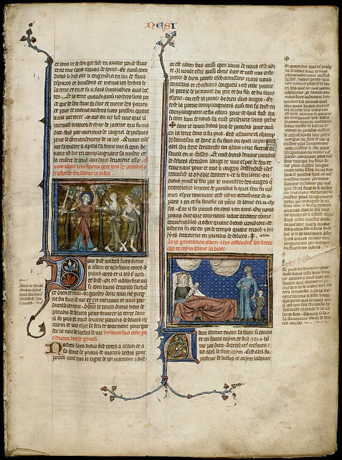
https://flic.kr/p/gJNrKt
Notes:
Or this vellum page that can last for hundreds of years without much intervention.
Photo: CC BY-NC-SA 2.0 DEED

Slide 11
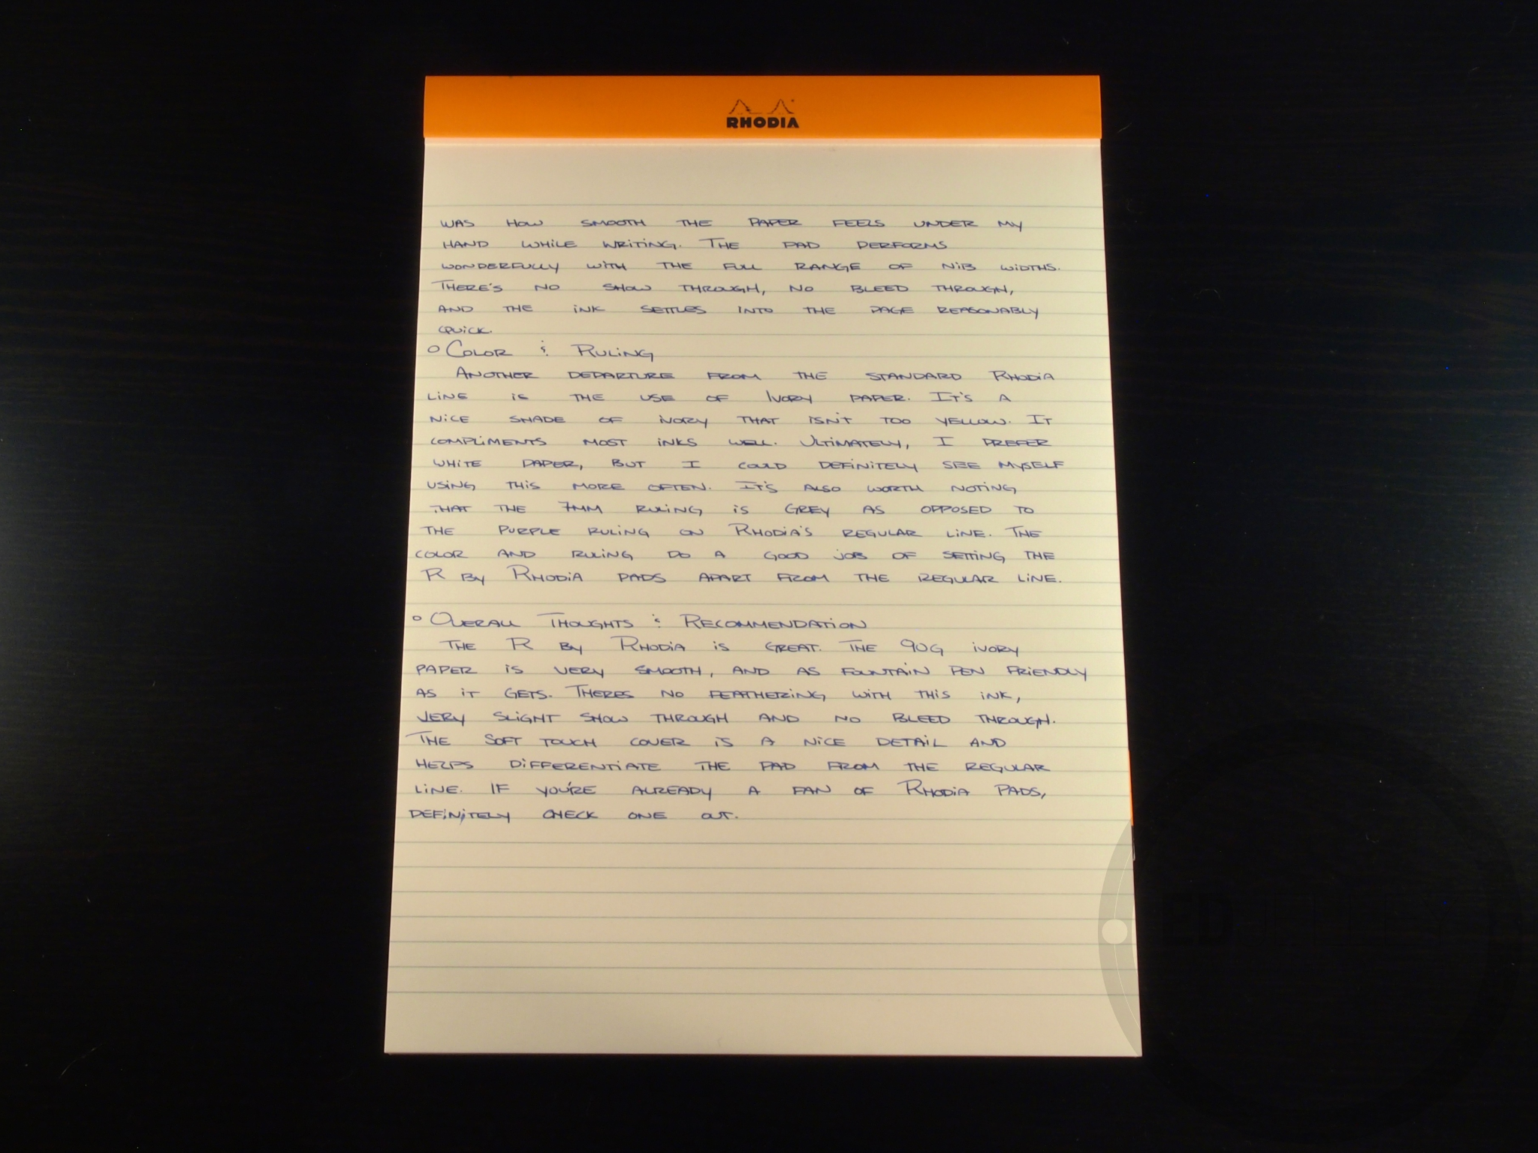
https://edjelley.files.wordpress.com/2013/02/r-by-rhodia-no-18-stationery-review-6.jpg
Notes:
Or even the cheap paper we use today will last for decades. You pretty much only need to keep it dry. Otherwise, just stick it in a box and forget about it!

Slide 12
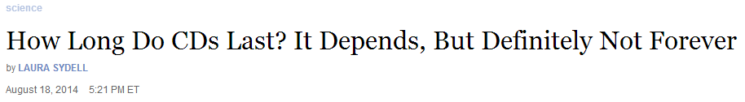
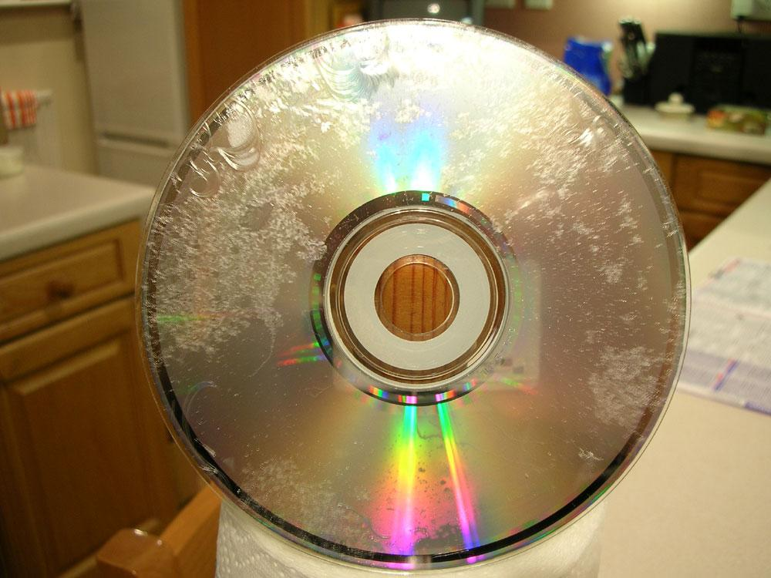
http://www.npr.org/blogs/alltechconsidered/2014/08/18/340716269/how-long-do-cds-last-it-depends-but-definitely-not-forever
http://img140.imageshack.us/img140/9180/atomheartmotherub2.jpg
Notes:
Bits rot or the physical media deteriorate or fail.
This is a variant of what's called "CD rot," Youket explains. In this case. it's what's called "bronzing." The outer coating of the CD erodes, leaving a silver layer exposed. And when you leave silver exposed, it tarnishes.
"Everyone always wants to know the answer to the same question, 'How long do CDs last? What's the average age?' " Youket says. But "there is no average, because there is no average disc.“
These days, the Library of Congress is starting to archive material on servers, which France acknowledges could pose an entirely different set of still-unknown problems in the future.

Slide 13

Notes:
Formats change. These are data in old EBCDIC format.

Slide 14
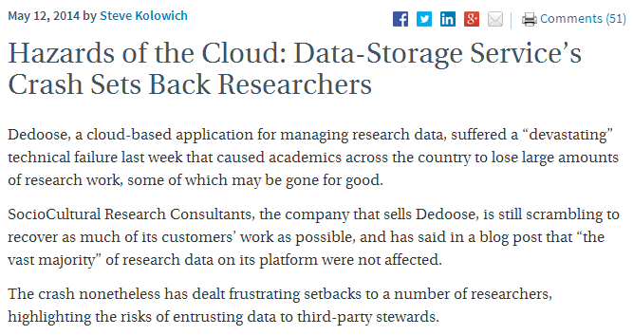
http://chronicle.com/blogs/wiredcampus/hazards-of-the-cloud-data-storage-services-crash-sets-back-researchers/52571
Notes:
Services crash...

Slide 15
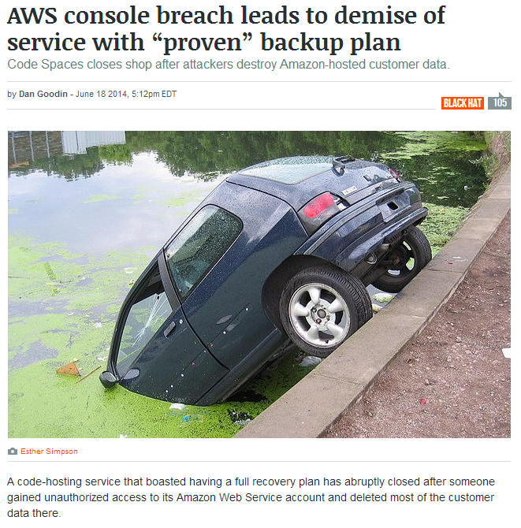
http://arstechnica.com/security/2014/06/aws-console-breach-leads-to-demise-of-service-with-proven-backup-plan/#p3
Notes:
...are hacked...

Slide 16
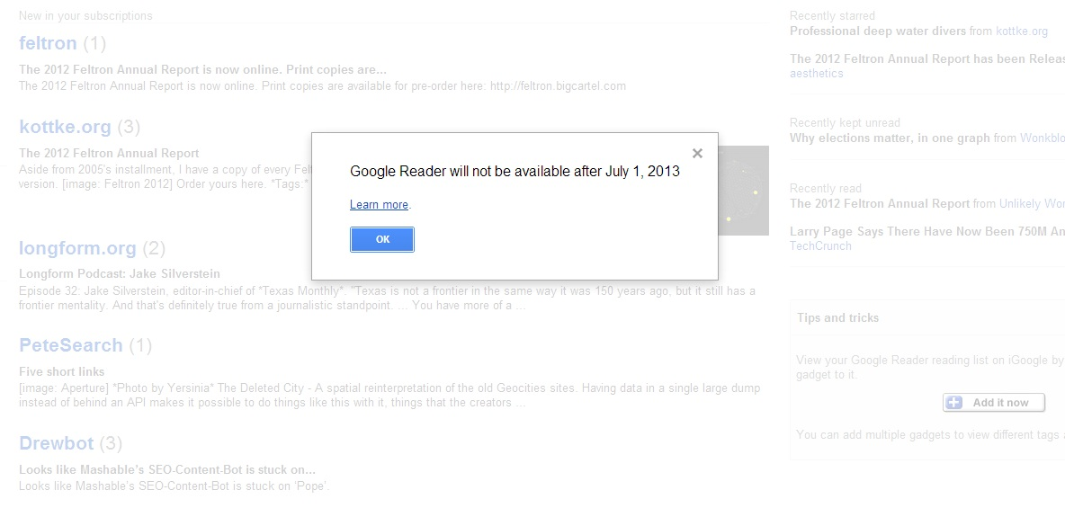
Notes:
...go out of business (like many of Google’s services) or fail.

Slide 17
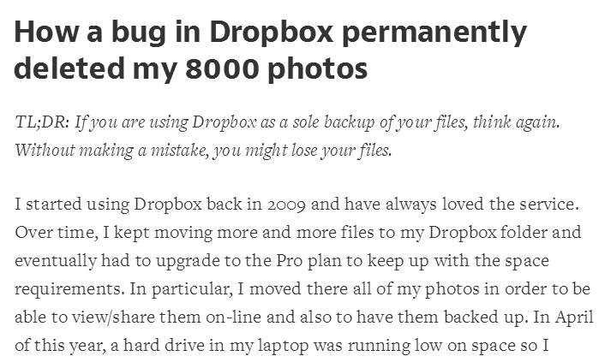
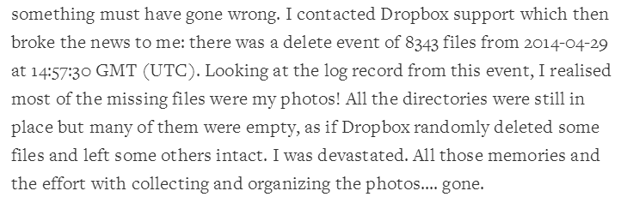
https://medium.com/@jan.curn/how-bug-in-dropbox-permanently-deleted-my-8000-photos-cb7dcf13647b
Notes:
And there’s always bugs and human error to blame.

Slide 18
Digital Preservation “Threats” include:
Media failure
Hardware failure
Software failure
Communications errors
Failure of network services
Media & hardware obsolescence
Software obsolescence
Operator error
Natural disaster
External attack
Internal attack
Economic failure
Organizational failure
Source: Rosenthal et al., 2005
http://www.dlib.org/dlib/november05/rosenthal/11rosenthal.html
Notes:
The digital preservation threats are legion...

Slide 19
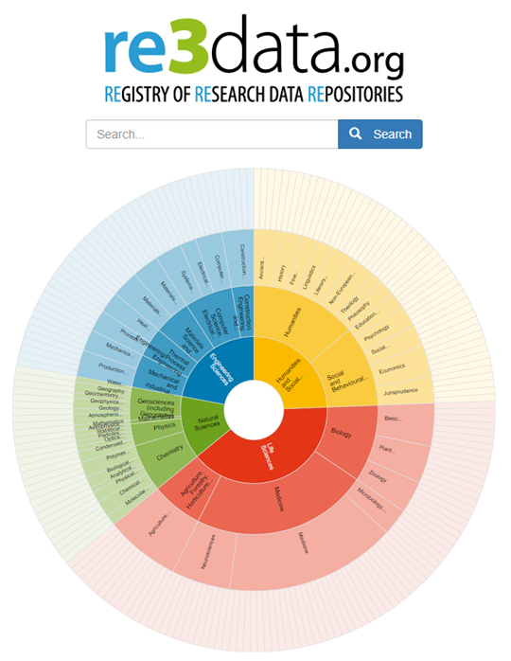
Notes:
To manage those fragile digital data, many digital repositories have been created. This chart, from re3data.org, a registry of repositories, catalogs the large number of digital repositories (2,739 data repositories in its catalog). While this is impressive, the true number of repositories is likely much larger.

Slide 20
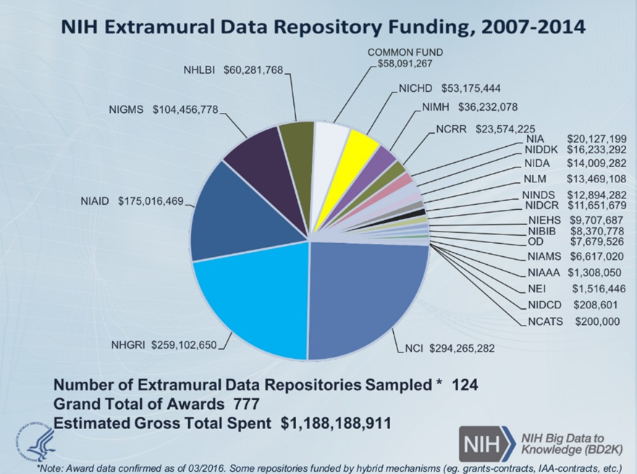
https://www.slideshare.net/pebourne/data-science-bd2k-update-for-nih
Notes:
Funders have invested a huge amount in data repositories! From 2007-2014, NIH spent ~$1.2Bn extramurally on maintaining data archives.
Presented to the Advisory Committee to the U.S. National Institutes of Health Director by the Associate Director for Data Science on June 10, 2016, this graph shows that from 2007-2014, NIH spent ~$1.2Bn extramurally on maintaining data archives. Funders invest a huge amount in data repositories! Ensuring that investment is managed by a trustworthy repository is important.
(Only 12% of data described in published papers is in recognized archives – 88% is dark data)
https://www.slideshare.net/pebourne/data-science-bd2k-update-for-nih

Slide 21
Forever!
Guaranteed!
We promise!
Notes:
Many repositories claim they will store data for the long term, using terms like these.
But can we trust what they say? Can we trust but also verify?
“Claims of trustworthiness are easy to make but are thus far difficult to justify or objectively prove.” (TRAC)

Slide 22
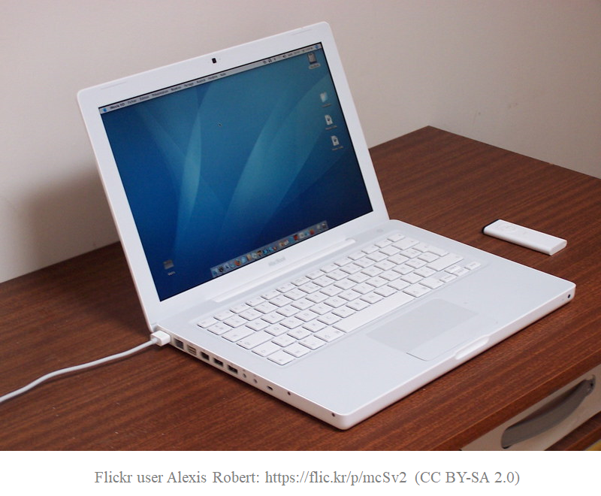
Notes:
With digital repositories, it’s more difficult to assess trustworthiness, especially since so many aspects are “behind the screen”, remote, and can’t be seen.
“Since digital information is less tangible and much more mutable than other materials, trust and reliability may be more difficult to prove. “
https://www.oclc.org/content/dam/research/activities/trustedrep/repositories.pdf

Slide 23
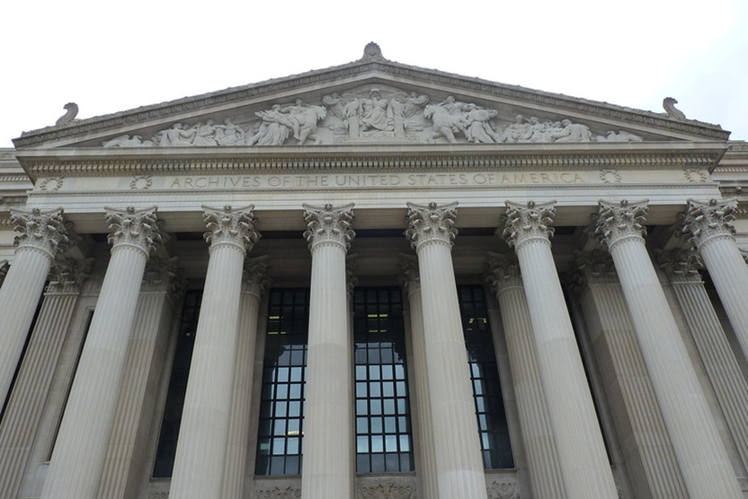
Notes:
Whereas with physical items, you could more readily assess the trustworthiness. An archive was physically impressive and imposing. Donors could judge and readily assess the building’s physical security and environment, the shelving, containers, the size and expertise of staff.
Source: Society of American Archivists Trends in Archives Practice series, Module 8, “Becoming a Trusted Digital Repository”, Bruce Ambacher
https://flic.kr/p/8RVLek
[Unlike with physical Trust underpins much of why we use services in society, but the evaluation of the trustworthiness of repositories changed with the transition to digital. ]

Slide 24
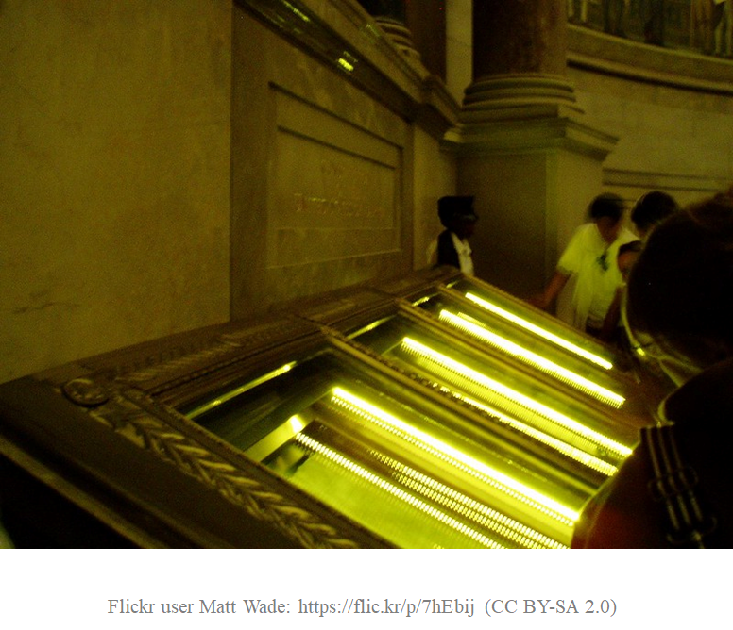
Notes:
If you visit the National Archives in Washington, D.C., for instance, the original Charters of Freedom are protected by armed guards, metal detectors, security cameras, thick glass, huge doors, and secure vaults.

Slide 25

How do you judge if a repository is “Trustworthy”?
Post your answer in the chat box.

Slide 26
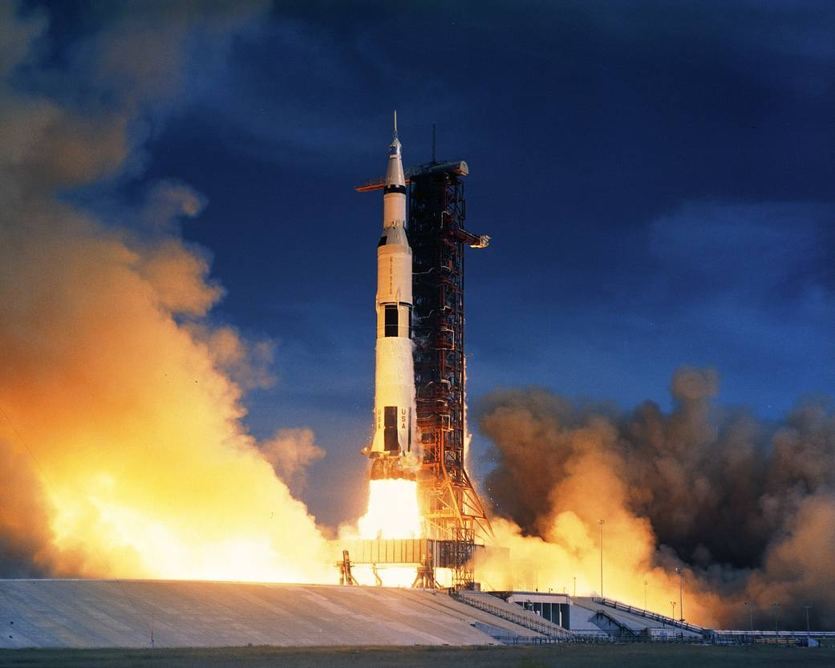
https://www.nasa.gov/centers/marshall/history/images/this-week-in-nasa-history-apollo-15-launches-july-26-1971.html
Notes:
It turns out this question of what makes a repository trustworthy is decades old.

Slide 27
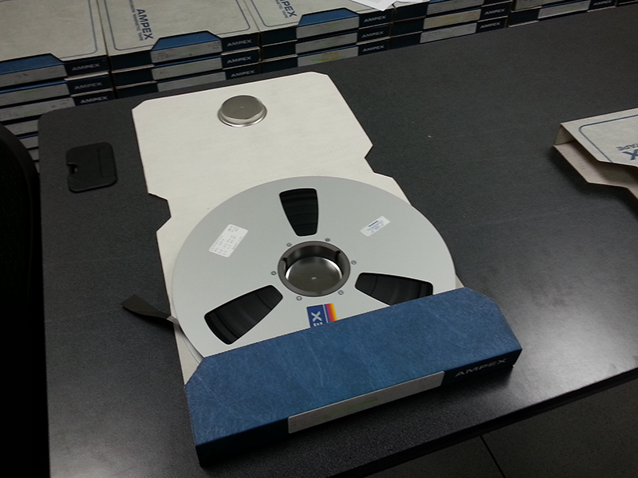
https://landsat.gsfc.nasa.gov/article/imaging-past
Notes:
National space agencies -- including NASA --had grappled with digital preservation issues since its founding and led an effort in the 90s to define shared concepts and terminology associated with digital preservation, the basic functions of a digital archiving system, and the important attributes of the digital information objects towards which preservation efforts would be directed.
See: Lavoie’s OAIS: Introductory Guide (2nd Edition)
https://www.dpconline.org/docs/technology-watch-reports/1359-dpctw14-02/file

Slide 28
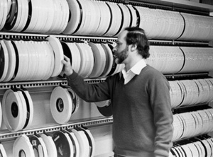
https://www.icpsr.umich.edu/web/pages/about/history/eighties.html
Notes:
Libraries and data archives had grappled with similar issues...

Slide 29
“A trusted digital repository is one whose mission is to provide reliable, long-term access to managed digital resources to its Designated Community, now and in the future….A trustworthy digital repository will understand threats to and risks within its systems.”
Audit and Certification of Trustworthy Digital Repositories
https://public.ccsds.org/pubs/652x0m1.pdf
Notes:
See also -Trusted Digital Repositories: Attributes and Responsibilities
https://www.oclc.org/content/dam/research/activities/trustedrep/repositories.pdf
The digital preservation community eventually defined what a trusted digital repository should be doing to preserve and provide access to digital resources, as well as how to test if a repository was compliant.
You can think about these resources much like building codes and inspections. The specifics of the technology or policy details may vary, but all repositories should follow similar good practices.

Slide 30
What are the standards used to build and assess a
Trusted Repository?
Where can you find them?

Slide 31
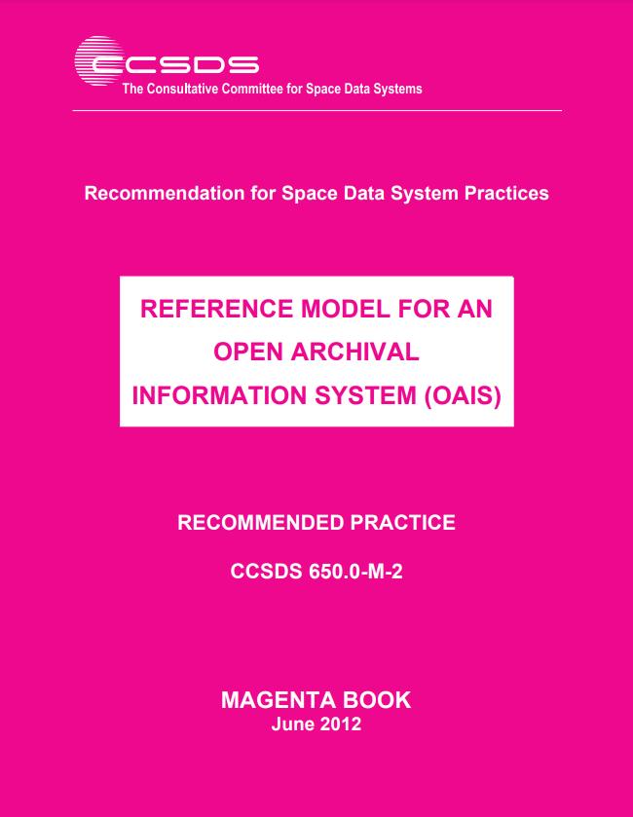
https://public.ccsds.org/pubs/650x0m2.pdf
Notes:
The first important resource created by the community was the Open Archival Information System (OAIS) Reference Model. It is a conceptual framework rather than a blueprint for concrete implementation. A key element in the design of OAIS is its flexibility and level of abstraction: it makes no assumptions about how the concepts and models in OAIS are to be implemented, and imposes no requirements concerning the technologies used to support the implementations. OAIS also provides common language.
The OAIS reference model was approved in January 2002 as ISO International Standard 14721; a revised and updated version was published in 2012 as ISO Standard 14721:2012.
Source: https://www.dpconline.org/docs/technology-watch-reports/1359-dpctw14-02/file

Slide 32
OAIS Mandatory Responsibilities
Negotiate for and accept appropriate information from information producers;
Obtain sufficient control of the information in order to meet long-term preservation objectives;
Determine the scope of the archive’s user community;
Ensure that the preserved information is independently understandable to the user community, in the sense that the information can be understood by users without the assistance of the information producer;
Notes:
Source: https://www.dpconline.org/docs/technology-watch-reports/1359-dpctw14-02/file

Slide 33
OAIS Mandatory Responsibilities
Follow documented policies and procedures to ensure the information is preserved against all reasonable contingencies, and that there are no ad hoc deletions.
Make the preserved information available to the user community, and enable dissemination of authenticated copies of the preserved information in its original form, or in a form traceable to the original.
Notes:
Source: https://www.dpconline.org/docs/technology-watch-reports/1359-dpctw14-02/file

Slide 34
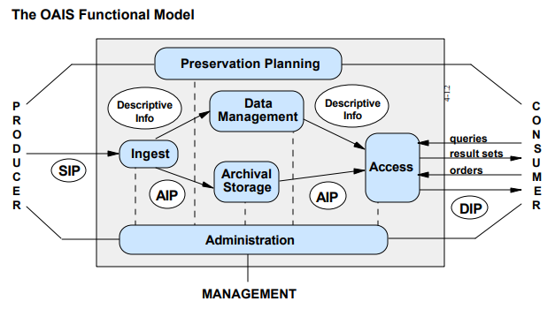
OAIS Functional Model
https://www.oclc.org/content/dam/research/activities/trustedrep/repositories.pdf
Notes:
The reference model identifies and describes the core set of mechanisms with which an OAIS-type archive meets its primary mission of preserving information over the long term and making it available to the Designated Community (i.e., the subset of Consumers expected to independently understand the archived information in the form in which it is preserved and made available by the OAIS.).
These mechanisms are summarized by the OAIS functional model, which defines six high-level services, or functional entities, that collectively define the OAIS’s preservation and access operations: Ingest, Archival Storage, Data Management, Preservation Planning, Access, and Administration. Operating alongside these six functional entities are Common Services, which consist of basic computing and networking resources. An OAIS-type archive will implement each of the six functional entities, along with Common Services, in the course of building a complete archival system.
The OAIS information model is built around the concept of an information package, which consists of the object that is the focus of preservation, along with metadata necessary to support its long-term preservation, access, and understandability, bound into a single logical package. There are three important variants of the information package concept: the Submission Information Package (SIP), the Archival Information Package (AIP), and the Dissemination Information Package (DIP).
Source: https://www.dpconline.org/docs/technology-watch-reports/1359-dpctw14-02/file

Slide 35
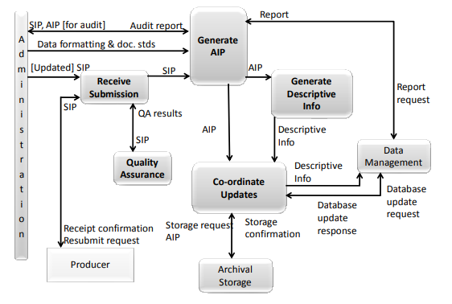
Ingest functions

Slide 36
Example: “Receive Submission”
appropriate storage capability or devices to receive a SIP from the Producer
legal transfer of custody for the Content Information in the SIP
may require that special access controls be placed on the contents.
provides a confirmation of receipt of a SIP to the Producer
may include a request to resubmit a SIP in the case of errors resulting from the SIP submission.

Slide 37
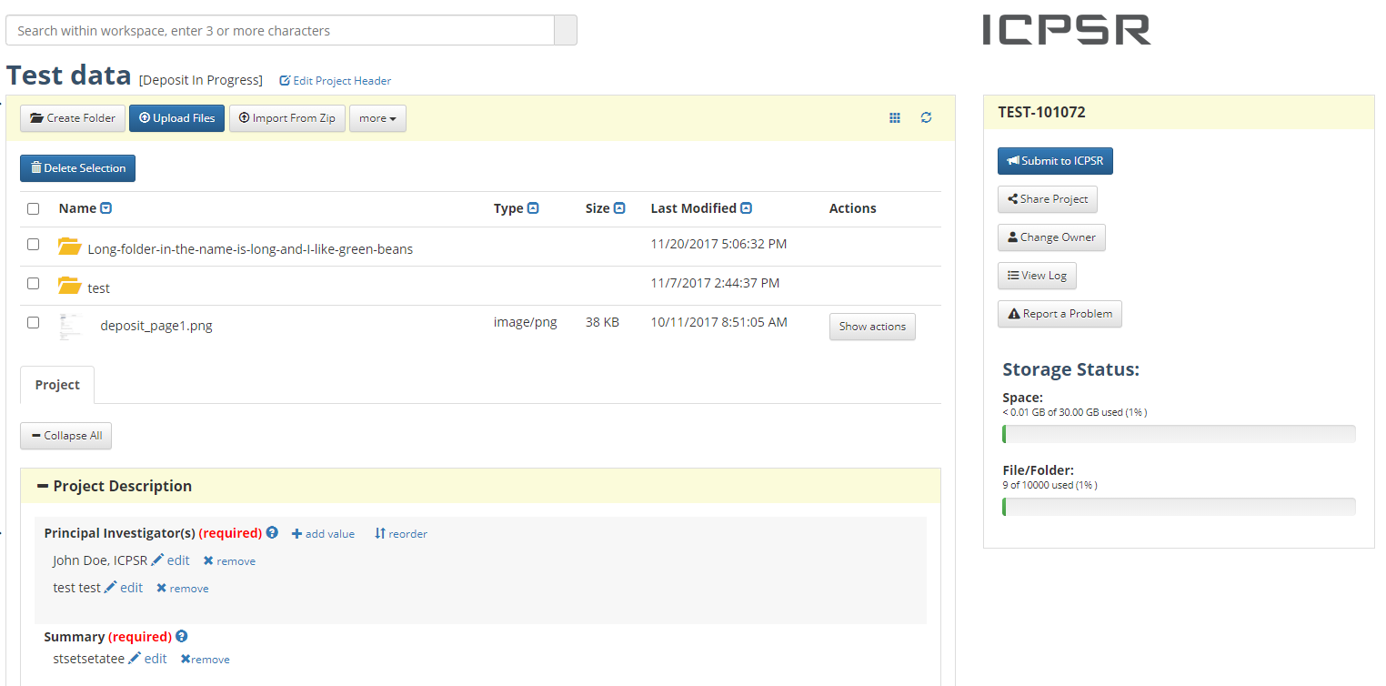
Notes:
Here is ICPSR’s implementation of a portion of the Receive Submission component of the Ingest function.

Slide 38
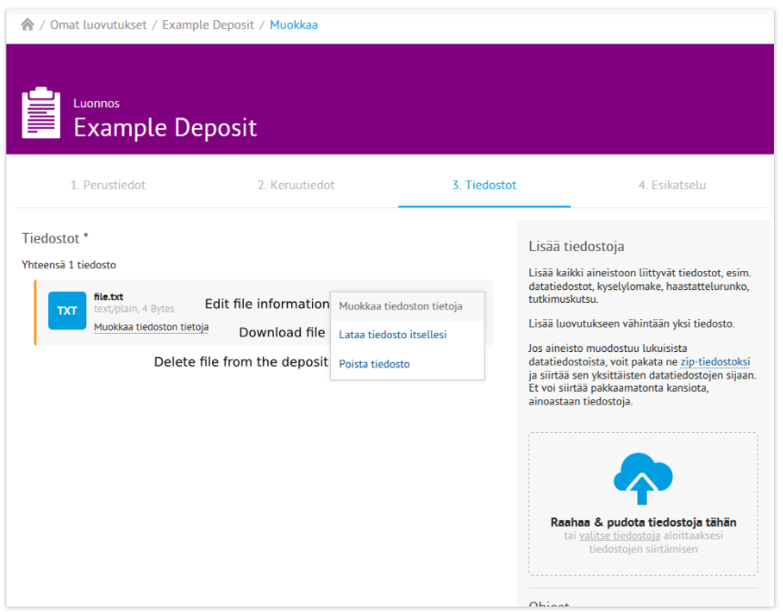
Notes:
Here is the Finnish Social Science Data Archive’s implementation of a portion of the Receive Submission component of the Ingest function.

Slide 39

“[Me right now] reading OAIS for the first time…”
https://twitter.com/anarchivist/status/890309866069270529
Notes:
The OAIS Reference Model can seem dense and overly abstract when first read, but it’s a wonderful foundation for building trusted repositories. I love this GIF showing this person’s ‘aha’ moment after seeing the OAIS Reference Model for the first time.
OAIS provides a conceptual framework rather than a blueprint for concrete implementation: it makes no assumptions about how the concepts and models in OAIS are to be implemented, and imposes no requirements concerning the technologies used to support the implementations.
OAIS also provides common language.

Slide 40
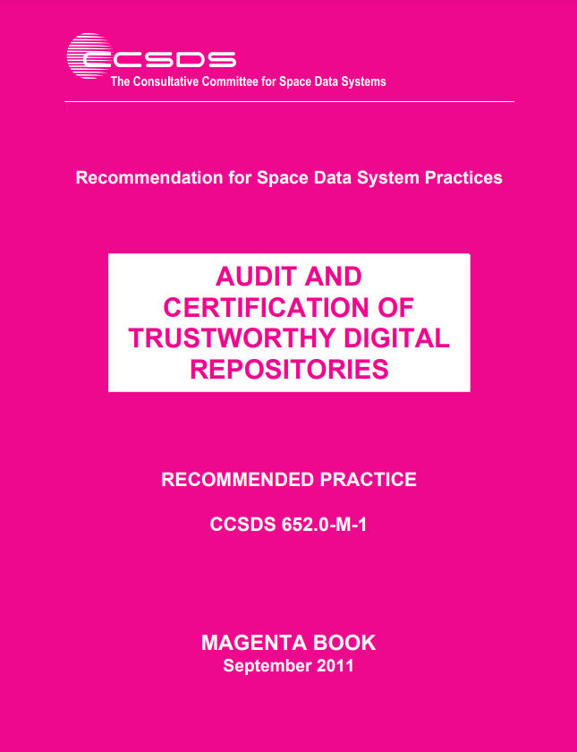
https://public.ccsds.org/pubs/652x0m1.pdf
Notes:
The second important document created by the digital preservation community was the Audit and Certification of Trustworthy Digital Repositories.
‘Trusted’ or trustworthy organizations could not simply identify themselves. Long before it became an approved standard in 2002, many in the cultural heritage community had adopted OAIS as a model to better understand what would be needed from digital preservation systems. Institutions began to declare themselves ‘OAIS-compliant’ to underscore the trustworthiness of their digital repositories. However, there was no established understanding of ‘OAIS-compliance’ beyond being able to apply OAIS terminology to describe their archive, despite there being a compliance section in OAIS which specifies the need to support the model of information and fulfilling the mandatory responsibilities.
Audit and Certification of Trustworthy Digital Repositories was eventually published as an ISO standard (ISO 16363).
Source: https://public.ccsds.org/pubs/652x0m1.pdf
[The OAIS Reference Model contained a roadmap which included the need for a certification standard.]

Slide 41
Audit and Certification sections
Organizational Infrastructure
  Governance, staffing, policies, finances, etc.
Digital Object Management
  Access, integrity, process, preservation, etc.
Infrastructure and Security Risk Management
  System design, security, etc.
Notes:
ISO 16363 provides the normative metrics against which a digital repository may be judged. Over 100 sections provide detailed metrics for assessing a digital repository, grouped as follows:
• covers Organizational Infrastructure;
• covers Digital Object Management;
• covers Infrastructure and Security Risk Management.

Slide 42
4.1.5 The repository shall have an ingest process which verifies each SIP for completeness and correctness.
Supporting Text
This is necessary in order to detect and correct errors in the SIP when created and potential transmission errors between the depositor and the repository.
Notes:
Remember the OAIS guidance about Ingest, specifically the Receive Submission component? In ISO 16363, there are specific sections that let a repository demonstrate compliance.
Here, we look at how the repository verifies completeness and correctness. There’s supporting text clarifying why this is important.

Slide 43
Examples of Ways the Repository Can Demonstrate It Is Meeting This Requirement
Appropriate Preservation Policy and Preservation Implementation Plan documents and system log files from system(s) performing ingest procedure(s); logs or registers of files received during the transfer and ingest process; documentation of standard operating procedures, detailed procedures, and/or workflows; format registries; definitions of completeness and correctness.
Notes:
And examples of ways the repository can demonstrate it is meeting this requirement.

Slide 44
Discussion
Information collected during the ingest process must be compared with information from some other source to verify the correctness of the data transfer and ingest process….This allows the repository to demonstrate that its preserved objects have completely and correctly copied what it intended to copy from the SIPs….One thing that a repository might want to do is check for network drop out or other corruption during the transmission process.
Notes:
There’s also a discussion section that provides practical useful guidance.

Slide 45
Using OAIS and ISO 16363 as references,
what more can ICPSR do to verify
each deposit (SIP) for
completeness and correctness?
Post your answer in the chat box.

Slide 46
Benefits to ICPSR’s stakeholders

Slide 47
Benefits
Improves processes and procedures
Measures against a community standard, especially cross-disciplinary
Uncovers internal knowledge not documented
Great learning experience

Slide 48
Benefits continued
Difficult to quantify
  Trust of stakeholders
  Transparency
  Teaching opportunity for staff
  Use of community standards and alignment across domains
Leadership dimension also important

Slide 49
In what ways does ICPSR comply with these standards?
What more can ICPSR do to better adhere to these standards?

Slide 50
ICPSR Digital Preservation Policy Framework
ICPSR is committed to developing its digital preservation policies, repository, and strategies in accordance with the Open Archival Information System (OAIS) Reference Model (2012).
ICPSR is committed to an ongoing self-assessment and improvement process that aligns policies and practice at ICPSR with the Trustworthy Repositories Audit and Certification (TRAC) requirements that were revised and incorporated into the ISO/DIS 16363 (CCSDS 652-R-1).
https://www.icpsr.umich.edu/web/pages/datamanagement/preservation/policies/dpp-framework.html

Slide 51
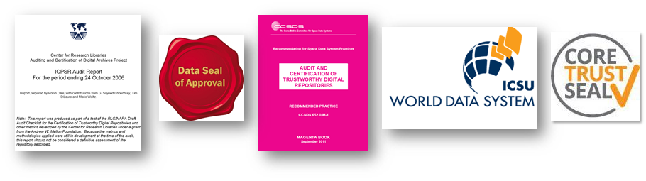
ICPSR Assessment Experience
2005-2006 CRL test audit (TRAC checklist)
2010-2012 TRAC/ISO 16363 self-assessment
2009-2010 Data Seal of Approval certification
2013 Data Seal of Approval (update)
2013 World Data System certification
2018-2019 CoreTrustSeal
https://www.icpsr.umich.edu/web/pages/datamanagement/preservation/trust.html

Slide 52

CoreTrustSeal, 2018-2019

Slide 53
CoreTrustSeal
Developed by the DSA-WDS Partnership Working Group on Repository Audit and Certification, a Working Group of the Research Data Alliance

Slide 54
Requirements
16 criteria (guidelines):
  Organizational Infrastructure (6)
  Digital Object Management (8)
  Technology (2)

Slide 55
Organizational Infrastructure
…has an explicit mission to provide access to and preserve data in its domain
…maintains all applicable licenses covering data access and use and monitors compliance
…has a continuity plan to ensure ongoing access to and preservation of its holdings
…ensures, to the extent possible, that data are created, curated, accessed, and used in compliance with disciplinary and ethical norms

Slide 56
Organizational Infrastructure
…has adequate funding and sufficient numbers of qualified staff managed through a clear system of governance to effectively carry out the mission
…adopts mechanism(s) to secure ongoing expert guidance and feedback (either in-house, or external, including scientific guidance, if relevant)

Slide 57
Digital Object Management
…guarantees the integrity and authenticity of the data
…accepts data and metadata based on defined criteria to ensure relevance and understandability for data users
…applies documented processes and procedures in managing archival storage of the data
…assumes responsibility for long-term preservation and manages this function in a planned and documented way

Slide 58
Digital Object Management
…has appropriate expertise to address technical data and metadata quality and ensures that sufficient information is available for end users to make quality-related evaluations
Archiving takes place according to defined workflows from ingest to dissemination
…enables users to discover the data and refer to them in a persistent way through proper citation
…enables reuse of the data over time, ensuring that appropriate metadata are available to support the understanding and use of the data

Slide 59
Technology
…functions on well-supported operating systems and other core infrastructural software and is using hardware and software technologies appropriate to the services it provides to its Designated Community
The technical infrastructure of the repository provides for protection of the facility and its data, products, services, and users

Slide 60
Certification report: https://www.coretrustseal.org/wp-content/uploads/2019/08/Inter-university-Consortium-for-Political-and-Social-Research.pdf

Slide 61
Audit Findings
Positive reviews overall, but…
Succession plans needed
  Reinforced work on succession planning – integrated into Data-PASS partnership agreement
Acquisition of preservation rights from depositors
  Changed deposit process to be explicit about ICPSR’s right to preserve content
Need for more process and procedural documentation related to preservation
  Created policies, including Digital Preservation Policy Framework, Access Policy Framework, and Disaster Plan
  Recognized need to make policies more public – e.g., static and linkable Terms of Use (previously only dynamic)
Machine-room issues noted

Slide 62
What more can ICPSR do to better adhere to standards?
Post your answer in the chat box.

Slide 63
What more can we do?
Fine tuning:
  Making older versions of collections available
  File-level persistent identifiers and citations
Notes:
Examples of FSD’s full compliance: • mission statement exists • collection policy exists • preservation policies exists • short and long term business planning in place • appropriate deposit agreements exist • minimum information requirements specified • minimum descriptive information captured Examples of FSD’s non-compliance: • no formal succession plan • no commitment to regular self-assessment or external certification • no documented process for testing for an understanding of the AIP Content Information • no systematic analysis of security risk factors
https://iassistquarterly.com/public/pdfs/iqvol_39_2_kleemola.pdf

Slide 64
Acknowledgements
Mary Vardigan, Archivist Emerita, ICPSR
Nancy McGovern, Director of Digital Preservation, MIT Libraries
Margaret Hedstrom, UM School of Information
Bryan Beecher, Former CNS Director
  http://techaticpsr.blogspot.com/search/label/trac

Slide 65
Thank You!
lyle@umich.edu

Slide 66
Extra slides...

Slide 67
Anthea Seles, TNA presents ‘OAIS: its limitations and (how) can they be fixed,’ 4th May 2016
https://vimeo.com/165416927

Slide 68
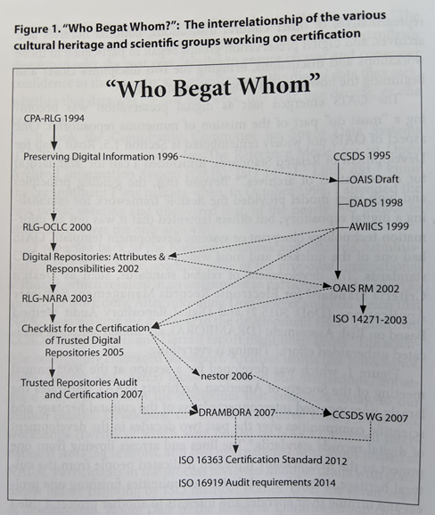
Bruce Ambacher, Society of American Archivists Trends in Archives Practice series, Module 8, “Becoming a Trusted Digital Repository”, page xvi
Notes:
This figure was developed for a session at the 2008 annual meeting of the Society of American Archivists (SAA). It shows the development of digital records standards across multiple communities.

Slide 69
Example of CoreTrustSeal Evidence – R5
Guideline Text: R5. The repository has adequate funding and sufficient numbers of qualified staff managed through a clear system of governance to effectively carry out the mission

Slide 70
Example of Evidence – R5
Guidance: The range and depth of expertise of both the organization and its staff, including any relevant affiliations (e.g., national or international bodies), is appropriate to the mission.

Slide 71
ICPSR Response: R5 (one part)
A 12-person Council whose members are elected by the ICPSR membership provides guidance and oversight to ICPSR. Members serve four-year terms, and six new members are elected every two years. The Council acts on administrative, budgetary, and organizational issues on behalf of all the members of ICPSR. [6]
ICPSR’s staff of over 100 perform a variety of functions to support ICPSR’s archival and training missions. The staff include data curators and managers, librarians, Web developers, communications specialists, user support specialists, administrative staff, and a small team of researchers, as well as software developers, programmers, system administrators, and desktop support specialists. Staff have expertise in digital archiving, data preservation, usability testing, Section 508 review for ADA Section 8 compliance, DOI registration, web traffic analytics, search engine optimization, storage and dissemination of sensitive data, restricted-use data agreements, and researcher credentialing. All staff are required to complete ongoing training related to data security and disclosure risk. [7]

Slide 72
ICPSR Response: R5 (references)
References:
[1] ICPSR Web site, About the Organization: https://www.icpsr.umich.edu/icpsrweb/content/about/index.html (accessed 2018-10-04)
[2] ICPSR 2016-2017 Annual Report, Financial Reports: https://www.icpsr.umich.edu/files/ICPSR/about/annualreport/2016-2017.pdf (accessed 2018-11-08)
[3] ICPSR Web site, Thematic Data Collections: https://www.icpsr.umich.edu/icpsrweb/content/about/thematic-collections.html (accessed 2018-10-04)
[4] ICPSR Web site, List of Member Institutions and Subscribers: https://www.icpsr.umich.edu/icpsrweb/membership/administration/institutions (accessed 2018-11-06)
…

