Slide 1
Deep Dive into the ICPSR Bibliography of Data-related Literature
Elizabeth Moss, MSLIS
ICPSR Staff Webinar
Metadata & Preservation
Deep Dive Series
December 9, 2021
Notes:
Hi, My name is Elizabeth Moss. I manage the ICPSR Bibliography of Data-related Literature and the staff who work on it. Welcome to this fourth presentation in the Metadata and Preservation unit’s deep dive series.
The main purpose of my talk today is to get you familiar with the Bibliography. Originally funded by the National Science Foundation to be built, the ICPSR Bibliography of Data-related Literature is a continually-updated, searchable database that provides curated two-way links between data archived at ICPSR and thousands of published and unpublished works resulting from analyses of those data.
I assume many of you are fairly new to ICPSR, and you may not have had much interaction with it.

Slide 2
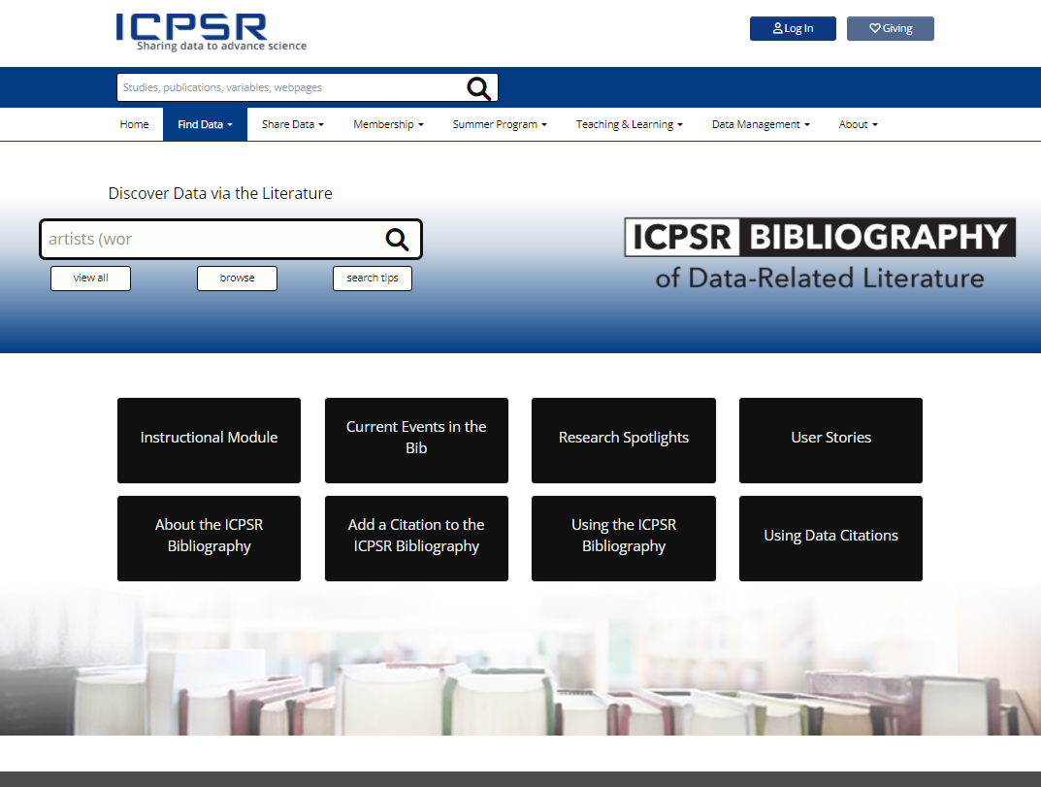
https://www.icpsr.umich.edu/web/pages/ICPSR/citations/
Notes:
Before getting started, I wanted to point out the Bibliography portal. Not only can you start a search of the Bibliography here, but you can get to all the public-facing informational documents and resources. Get to it from the Find Data pull down menu.

Slide 3
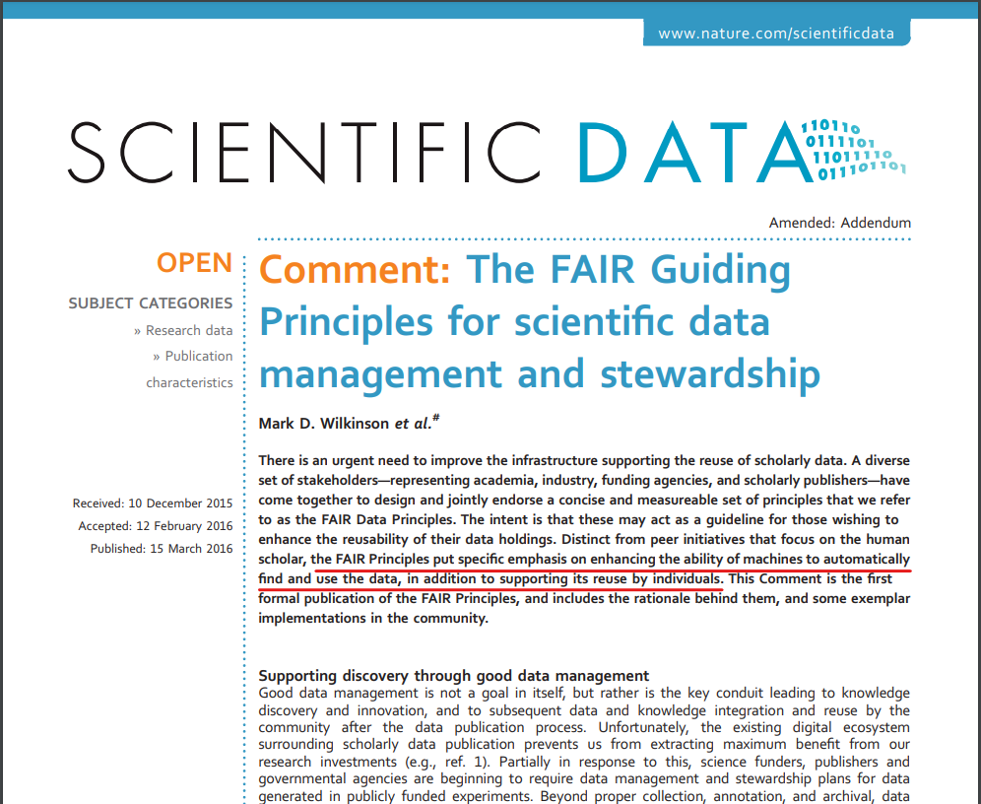
https://doi.org/10.1038/sdata.2016.18
Notes:
One goal of the Deep Dive series is to showcase how we help make ICPSR data comply with the community standard of making research data FAIR: That is: findable, accessible, interoperable, and reusable.
You can think of data-related publications as specialized metadata that enables site visitors to discover, or FIND, ICPSR data. And, actually, as we search for data-related publications, the Bibliography staff takes advantage of the work the rest of the unit and the organization does to enhance our metadata to make our data FINDABLE. So, ICPSR’s compliance with FAIR principles is especially helpful to us. I’ll come back to this a little later in the presentation. This is simply an article by most of the main players who created the FAIR principles, which you may want to check out. Note underlined in red [READ]

Slide 4
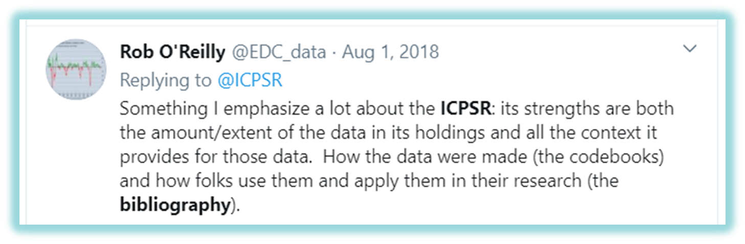
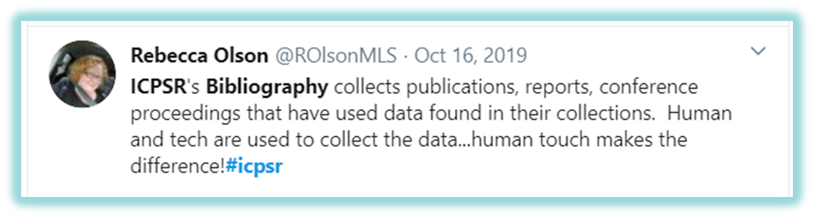
Notes:
These two tweets together describe the Bibliography in a nutshell--what it does and how.
THe first tweet makes it clear that providing links between studies and publications is an enhancement to the metadata, giving people the full picture of how data are applied in their research.
And the second tweet underscores that the Bibliography is curated by humans, and that is appreciated.

Slide 5
Deep Dive Right In
Original vision
What we built
How we populate it
Who at ICPSR helps
How it benefits projects
How it benefits users
Detecting data use
Work with the MICA Project
Future directions
Your questions
Notes:
So, I’m going to cover these basic themes today. [READ list]

Slide 6
Original Vision, ca. 1999
Create an online database containing works that reference ICPSR data.
Create mechanisms for collecting, organizing, and displaying citations.
Enhance ICPSR’s study descriptions with the addition of a comprehensive list of publications related to each dataset.
Create a systematic plan to gather citations on an ongoing basis.
https://www.icpsr.umich.edu/web/pages/ICPSR/citations/
Notes:
Here was the original vision for the Bibliography back in 1999 when the NSF grant was written. And in 2000 it was built. There were four basic components to create.
So, what did we come up with?
The first one: [READ RED TEXT]

Slide 7
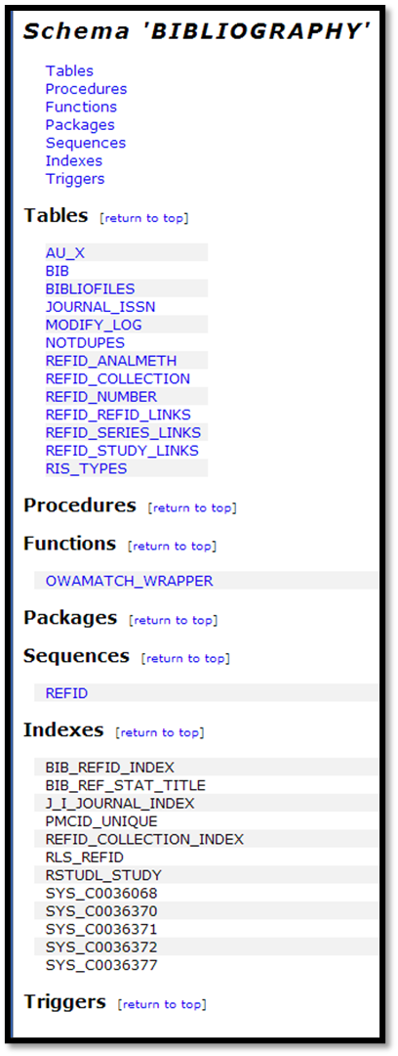
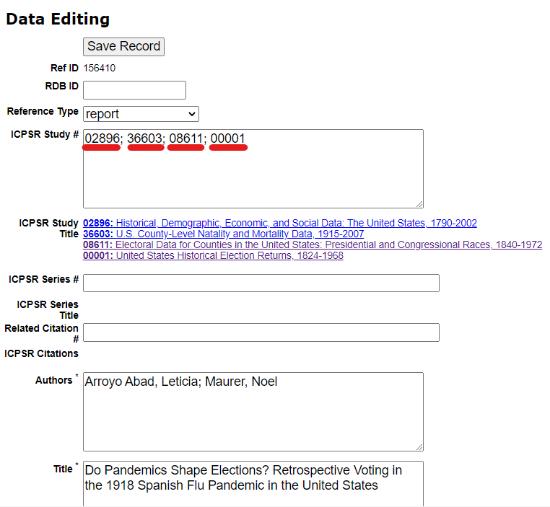
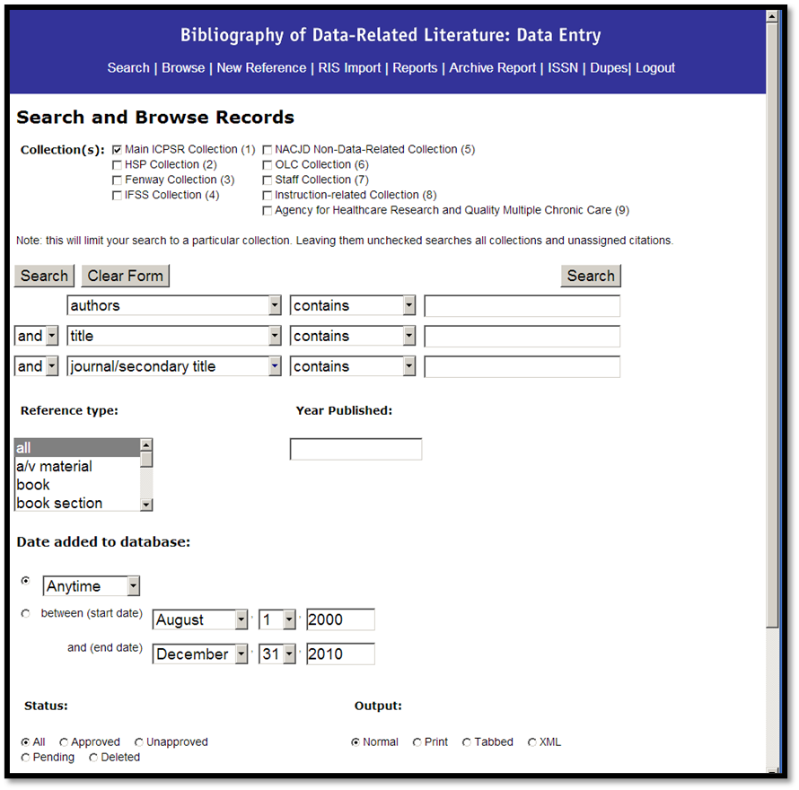
Notes:
CNS built a separate Oracle database to store citation records, with programmed links to the main TDB schema that holds the study metadata. [CLICK]
And a Perl-based administrative interface so we can add and edit those citation records. [CLICK]
In each citation record we have a field that allows us populate it with the ICPSR study numbers that correspond with the data being analyzed in the publication. This record has been curated and hard coded to link to those four studies when they display on ICPSR’s websites.

Slide 8
ICPSR Bibliography: Original Vision, ca. 1999
Create an online database containing works that reference ICPSR data.
Create mechanisms for collecting, organizing, and displaying citations.
Enhance ICPSR’s study descriptions with the addition of a comprehensive list of publications related to each dataset.
Create a systematic plan to gather citations on an ongoing basis.
https://www.icpsr.umich.edu/web/pages/ICPSR/citations/
Notes:
The second task was to [READ RED TEXT]
So that Oracle database of citation records that CNS built also is a searchable database, for the public, with the same user interface as the other searches on the ICPSR websites.
Scripts display the contents of the Bibliography database in search results, making the Bibliography a discovery tool to search for and find data of interest, after having been linked to it from a publication. Let’s just do that for a minute. [GO TO FIND DATA TAB].
The big database of linkages is usually called the ICPSR Bibliography of Data-related Literature. Or the Bibliography.
But the search results tab and the tab on the study home page are both called Data-related Publications.
It was thought that the full name would not fit on the tab, and that the public would be less confused by the term “publications” than the more general term, “literature.”
So, think of the of it as the specific list of publications that appear in those tabs, pulled for display from the big searchable pool of literature in the Bibliography database.

Slide 9
ICPSR Bibliography: Original Vision, ca. 1999
Create an online database containing works that reference ICPSR data.
Create mechanisms for collecting, organizing, and displaying citations.
Enhance ICPSR’s study descriptions with the addition of a comprehensive list of publications related to each dataset.
Create a systematic plan to gather citations on an ongoing basis.
https://www.icpsr.umich.edu/web/pages/ICPSR/citations/
Notes:
Remember those hard-coded study numbers in the citation record? [GO TO TABS]
They enable scripts to compile lists of publications on the study home pages, and on the series home pages. Each time that page opens, scripts look in the Bibliography’s database to compile and display all of the citations with this study number hard coded in its record.

Slide 10
ICPSR Bibliography: Original Vision, ca. 1999
Create an online database containing works that reference ICPSR data.
Create mechanisms for collecting, organizing, and displaying citations.
Enhance ICPSR’s study descriptions with the addition of a comprehensive list of publications related to each dataset.
Create a systematic plan to gather citations on an ongoing basis.
https://www.icpsr.umich.edu/web/pages/ICPSR/citations/
Notes:
So the mechanism for adding, curating, storing, and displaying the Bibliography and its contents is complete.
But #4 is something we continue to perfect. [READ RED]

Slide 11
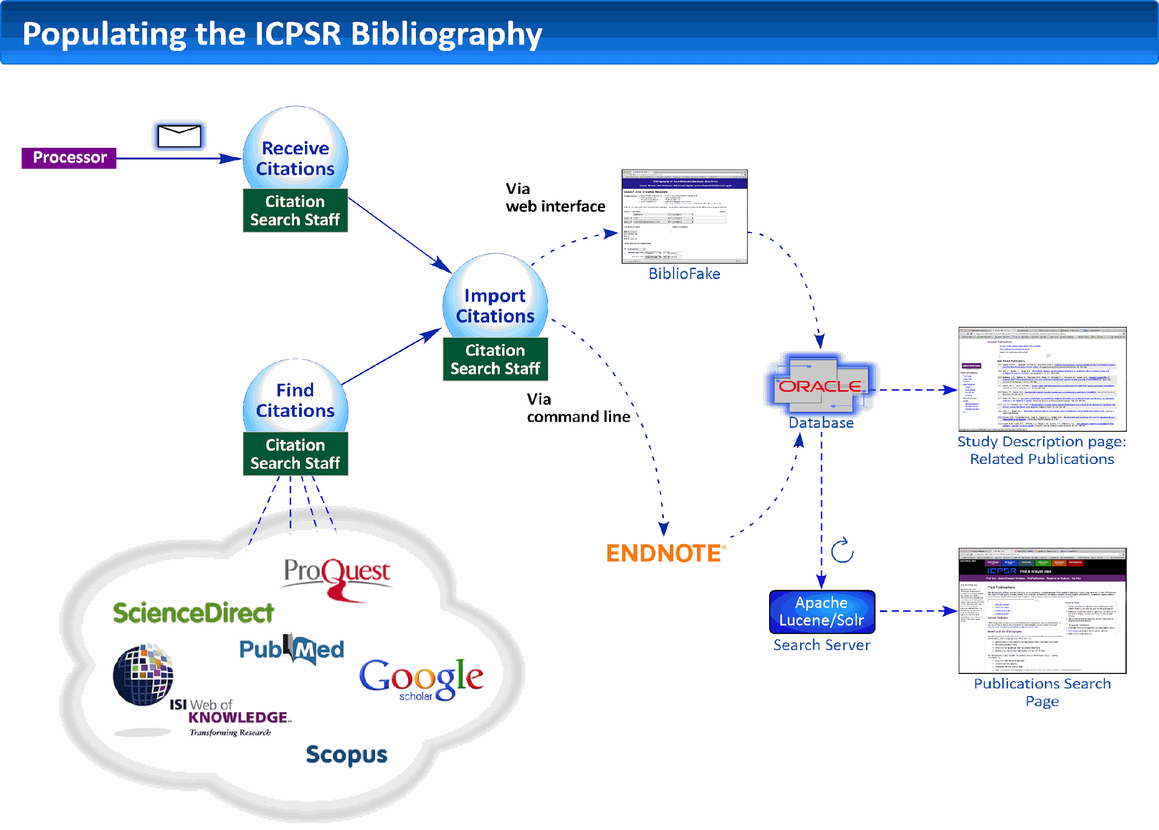
Data Depositor/ Data curator
Secondary- use authors
Restricted data users
Research teams
Curation Staff/ Other
Data Depositor/ PM/ Data curator
Secondary- use authors
Restricted data users
Research teams
Bibliography Staff
Bibliography Staff
Bibliography Staff
Citation Search Staff
Search and set up query alerts
Harvest alerts into the future
Add citation record to database and link with study/series #s
Keep track of hundreds of alerts
Check grey literature sites
Bibliography Staff
Search and set up query alerts
Harvest alerts into the future
Add citation record to database and link with study/series numbers
Keep track of hundreds of alerts
Check grey literature sites
Notes:
This is a diagram of the current way in which we gather citations.
It’s a picture of what I just described of the original vision. On the left of this diagram, you can see the blue box indicates we get some publications submitted by both PIs and secondary users. Here are some examples:
[NEXT THREE SLIDES]

Slide 12
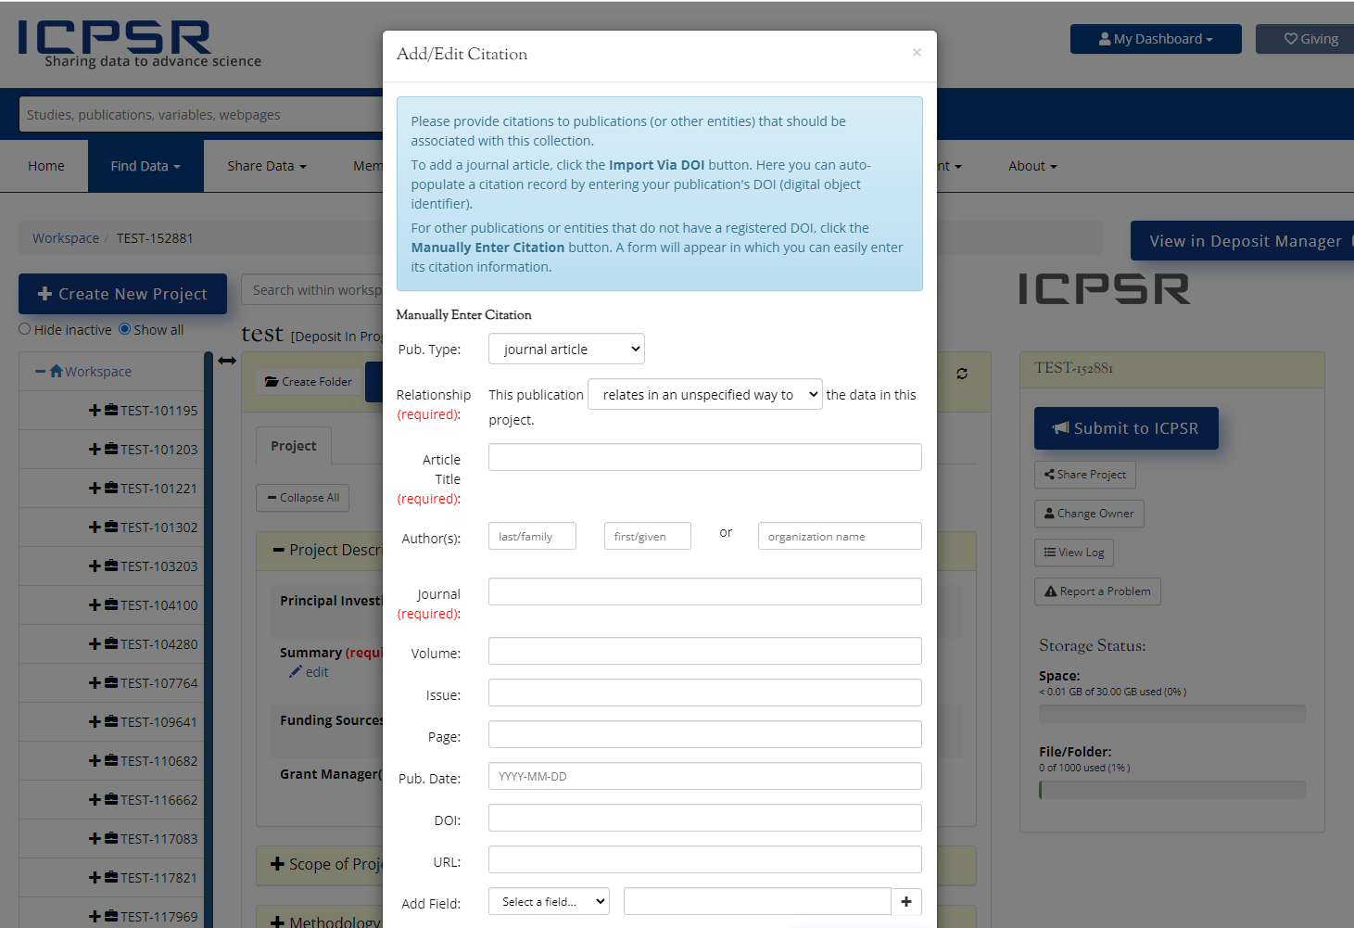
Notes:
You may be aware of this modal in the Deposit Form, where depositors can upload publications.

Slide 13
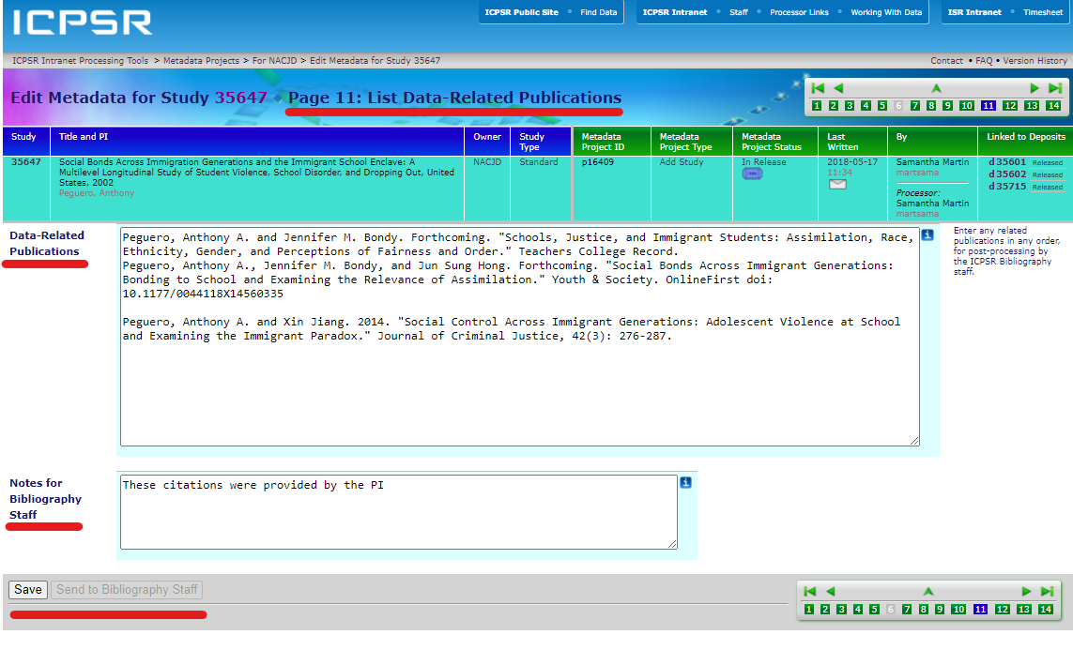
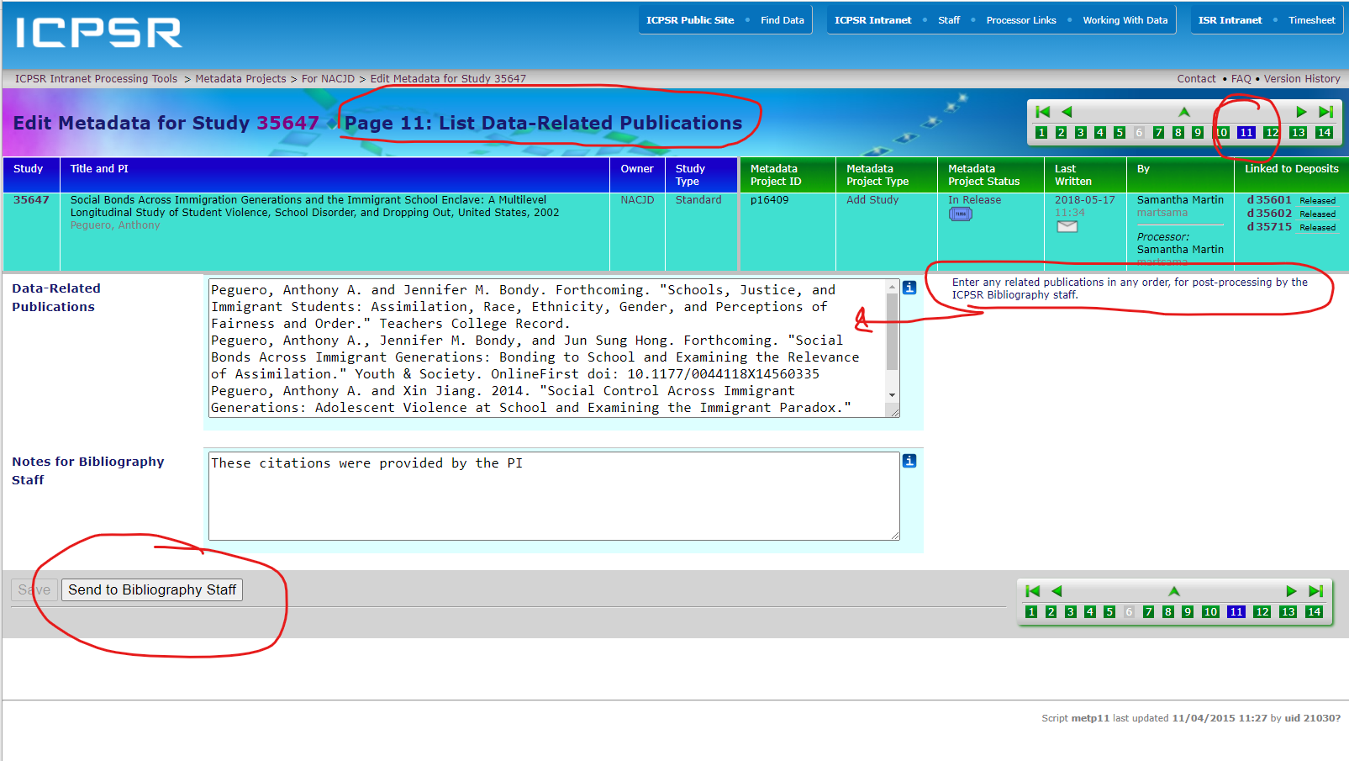
Notes:
This is Step 11 in the Metadata Editor. Curators actually have to push the Send to Bibliography Staff button, and it will email the publications to us to verify and add to the database.

Slide 14
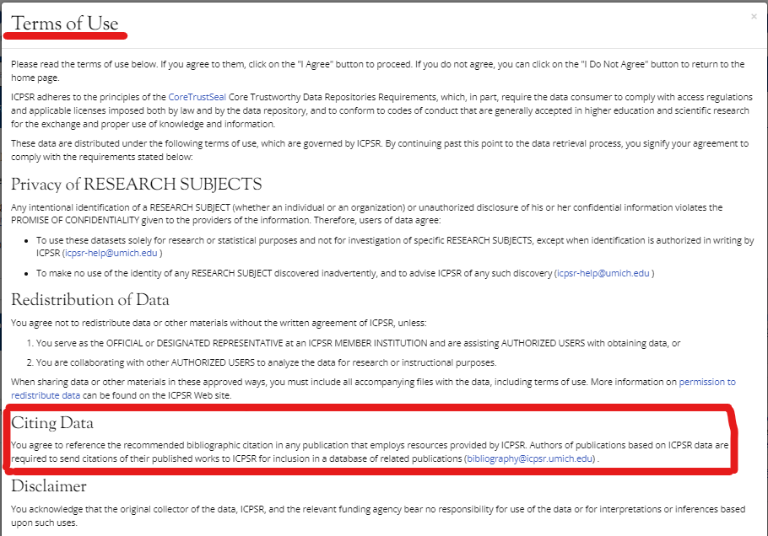
Notes:
And you may be aware that when you download data, you get a Terms of Use agreement that includes a requirement to cite the data and to send us any works you publish based on data from ICPSR. So we occasionally receive those in the Bibliography email.

Slide 15
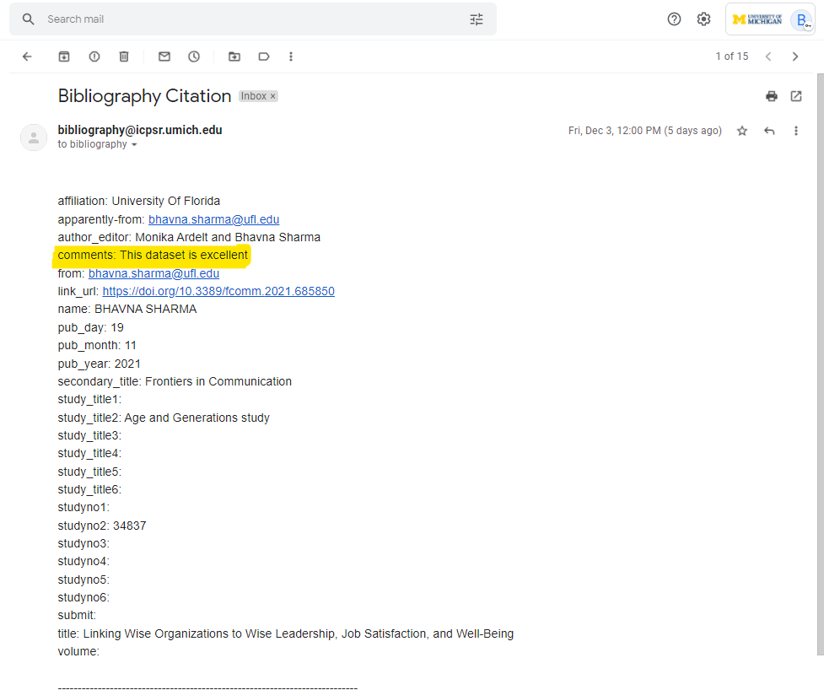
Notes:
Here’s a recent example. I wanted to include it, due to this author’s comment. She says: This dataset is excellent.

Slide 16
Data Depositor/ Data curator
Secondary- use authors
Restricted data users
Research teams
Curation Staff/Other
Data Depositor/ PM/ Data curator
Secondary- use authors
Restricted data users
Research teams
Bibliography Staff
Bibliography Staff
Bibliography Staff
Citation Search Staff
Search and set up query alerts
Harvest alerts into the future
Add citation record to database and link with study/series #s
Keep track of hundreds of alerts
Check grey literature sites
Bibliography Staff
Search and set up query alerts
Harvest alerts into the future
Add citation record to database and link with study/series numbers
Keep track of hundreds of alerts
Check grey literature sites
Notes:
That said, the majority of items in the Bibliography are found by the Bibliography staff, searching those literature sources you see in the cloud on the lower left. In the blue box to the right, it describes their main tasks. [READ TASKS and SHOW ON DIAGRAM]
This is a different kind of curation workflow than the study curation workflow, of course. In this case, the citation metadata are collected, curated with links to studies and series, and with other administrative data, and stored in citation recorda in our Oracle database.
Regardless of where we get the citations, the method for systematically gathering data-related publications populating the collection is manual, but evolving.

Slide 17
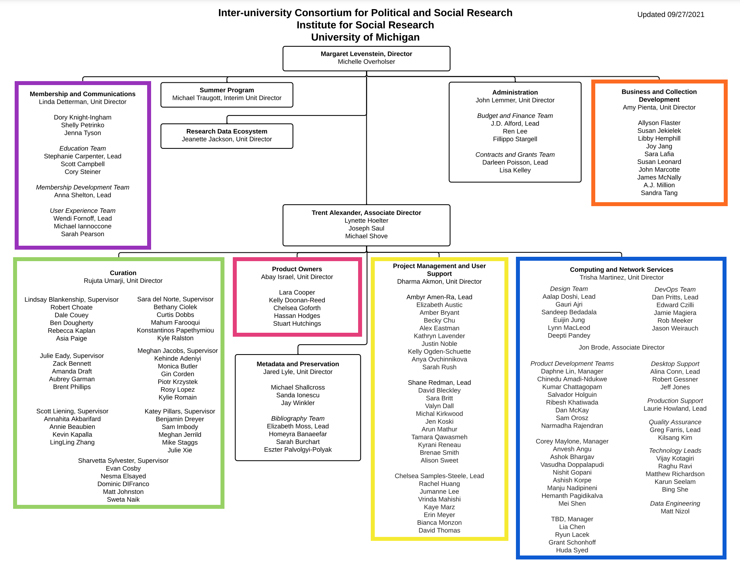
Notes:
In the previous diagram, I mentioned a few ICPSR groups involved with the Bibliography. Let’s just make sure we cover all of you, using the org chart to talk about each unit.
First, in the dark red box I want to acknowledge each of the three other Bibliography team members in the Metadata and Preservation unit. [Sarah Burchart, Eszter Palvolgyi-Polyak, and Homeyra Banaeefar]. They all search for, verify, curate, and collect thousands of publications each year. Each Bibliography team member has a portfolio of studies, associated with the funding project or projects, that they consider their own. They become quite expert at learning how the studies in their portfolios are referred to in the literature. And they create other resources using the Bibliography, which I’ll point to in a moment.
I have already mentioned that Curators, in the bottom left in the green box, occasionally receive deposited publications. We count on Curators pushing sending those to us.
In the Yellow box, the Project Managers play a large role in communicating to us their project’s searching priorities, clarifying particularly thorny collections, or letting us know when or if they will be acquiring the next wave or year of a series.

Slide 18
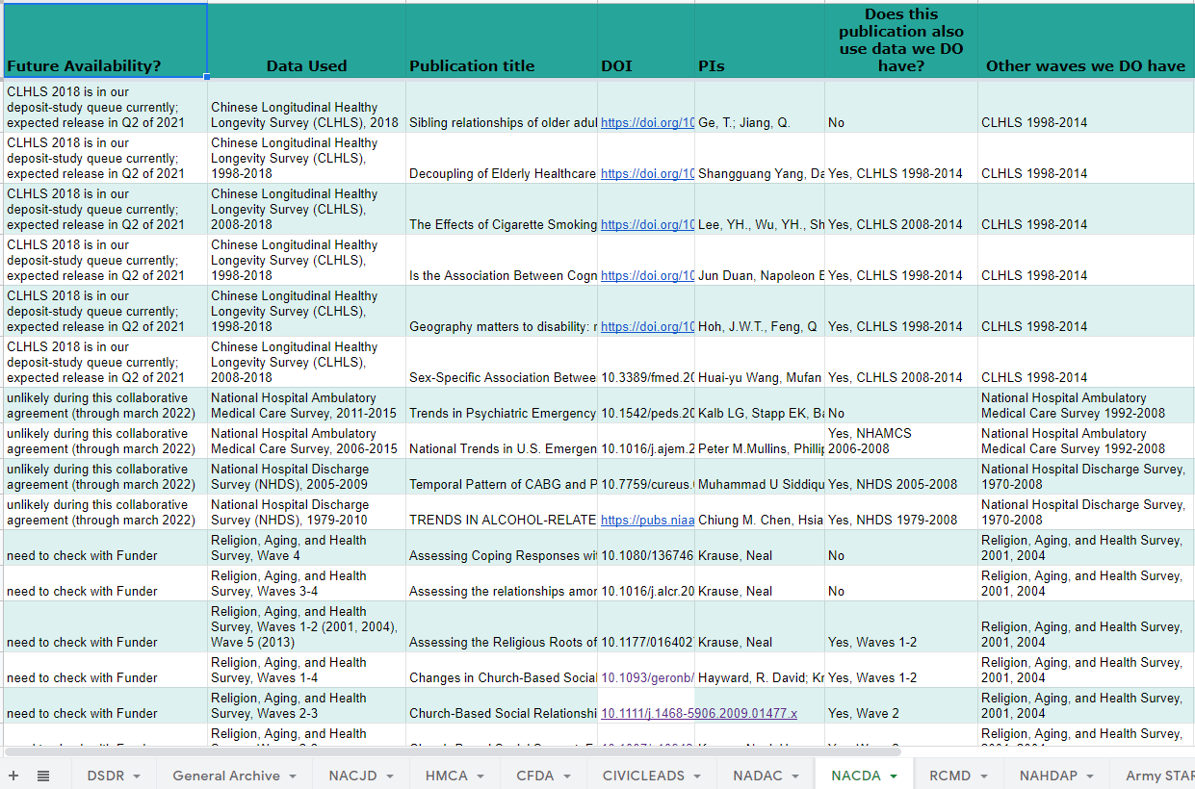
Notes:
Bib staff in the course of searching the literature for data use, often find publications that use some waves we don’t yet have. Instead of just throwing the fish back in the pond, they keep them in this spreadsheet, and we ask the Project Managers to update the first column, as you see her, letting us know if we can expect to see the new data. It really impacts our work. {POINT TO COLUMNS.]

Slide 19
Notes:
Returning to the org chart, the two blue boxes represent the Product Owners and CNS.
CNS built the database 20 years ago, and provide support. And Product Owners help facilitate that. The hope is that Legacy Bibliofake will be replaced by something more less clunky, perhaps built on the MCC model using DM3. Improvements to data entry efficiency, all the way to integrating API streams are on the agenda for the Bibliography.
MarComm, up on the left, has been a continuous support. They put out social media like this, that I wasn’t even aware of, to promote the Bibliography.

Slide 20
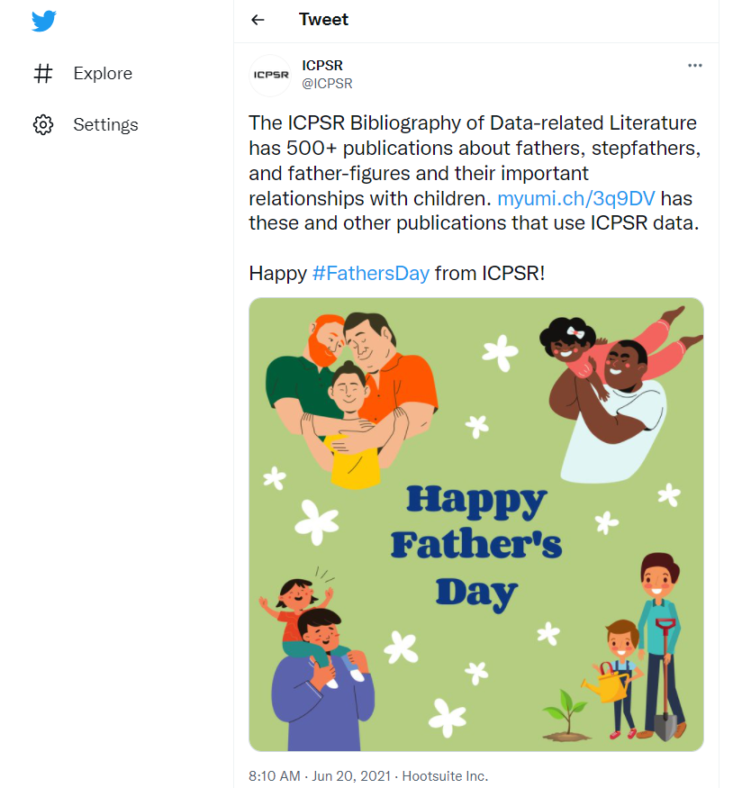

Slide 21
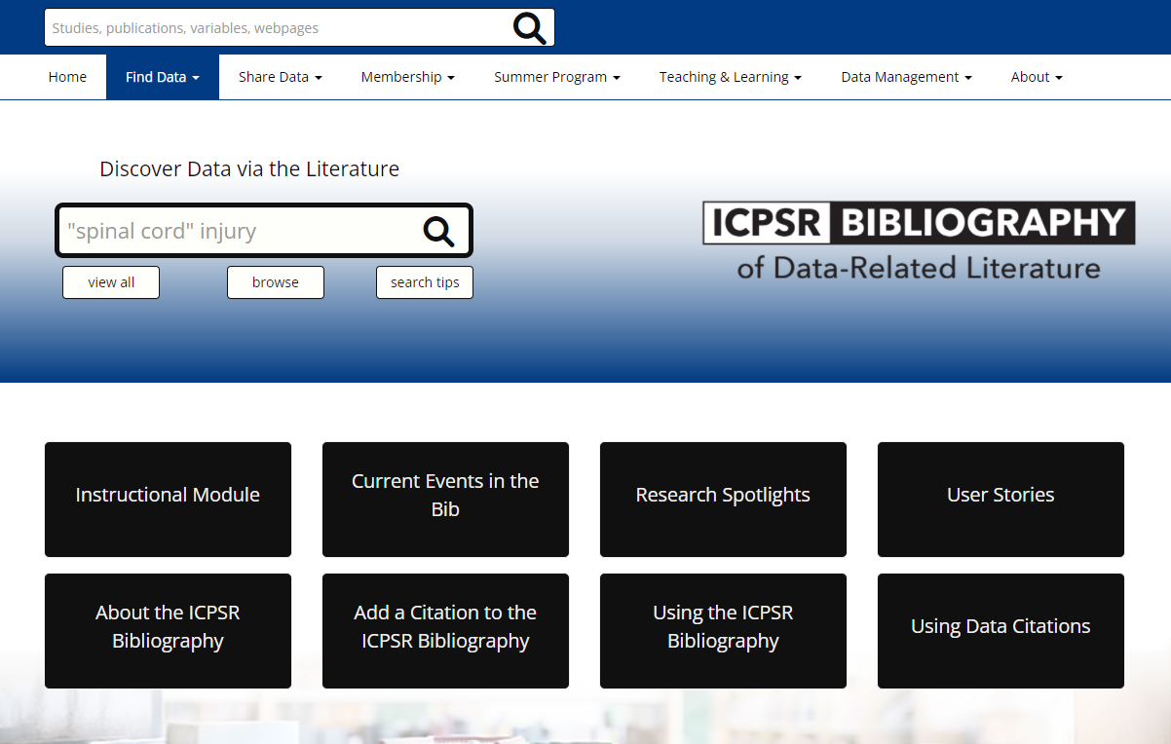
Notes:
And Webteam recently updated the Bibliography portal, which we expanded with more content. We interacted with just about everyone in MarComm during the past year to promote the Bibliography and celebrate its 20th anniversary.

Slide 22
Notes:
Others on the org chart in admin and on Trent’s team lend valuable support to us when asked. Finally, in orange, BCD has been crucial to the Bibliography, as they have prioritized funding for staffing.

Slide 23
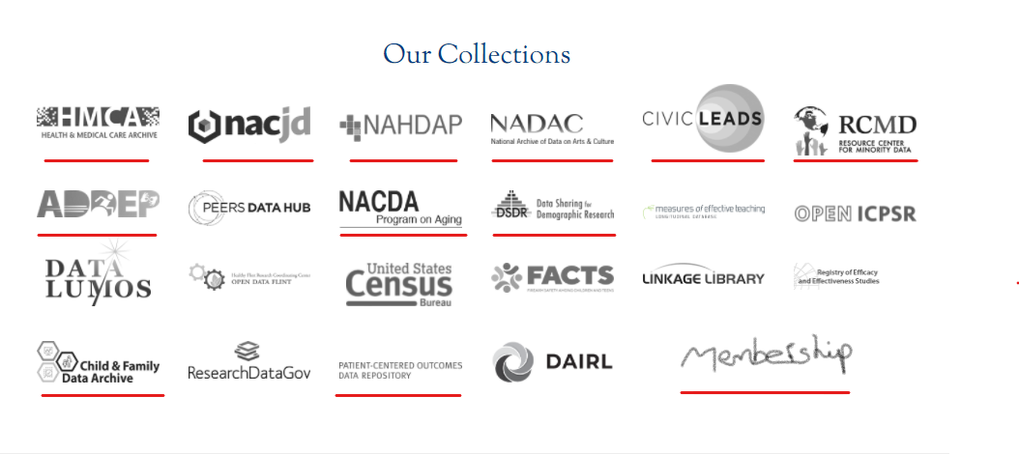
Notes:
The NSF grant ended back in 2001. The Bibliography is now supported by most of the curated data projects at ICPSR and by Membership. Our funders are underlined in red here, but a few funders, like PATH Study don’t appear here.
In the past four years, because funding for more staff has occurred, the growth of the Bibliography has really accelerated. We are about to have collected 100,000 citations and hope you will join us in the Atrium on Monday at 1pm, if you’re in the building. We’ll be celebrating that milestone with cake.

Slide 24
  Instructors, students, and researchers can:
    Use as option for the data hesitant--librarians and students
    Avoid duplicating published analyses
    See cross-disciplinary implications and potential uses of data, which were unconsidered when collected
    Learn about methodological issues, some of which are covered solely in the published literature
    Replicate analyses
Notes:
Okay, so we built the Bibliography and everybody helps. So who uses it? And how can it help your project?
The Bibliography is great for data hesitant students, or even librarians who may not be expert in analysis software. You can still help guide data hesitant students to data via the literature about the data.
And you’re probably familiar with reasons you would do a lit review of the data as a student or researcher.

Slide 25
  Non-analysts can:
    Find summary statistics in research briefs, executive summaries, and reports for use in grants, news articles, and other publications
    Share important findings with those outside academia

Slide 26
  PIs and funders can:
    Monitor how shared data are used and cited, and correct authors who don’t comply with restricted use agreements or terms of use
    Track the impact of their investment in data creation and data sharing
    Supply evidence of the value of their data when applying for further funding
Notes:
READ SLIDE
Okay, so what else do we offer projects and funders?

Slide 27
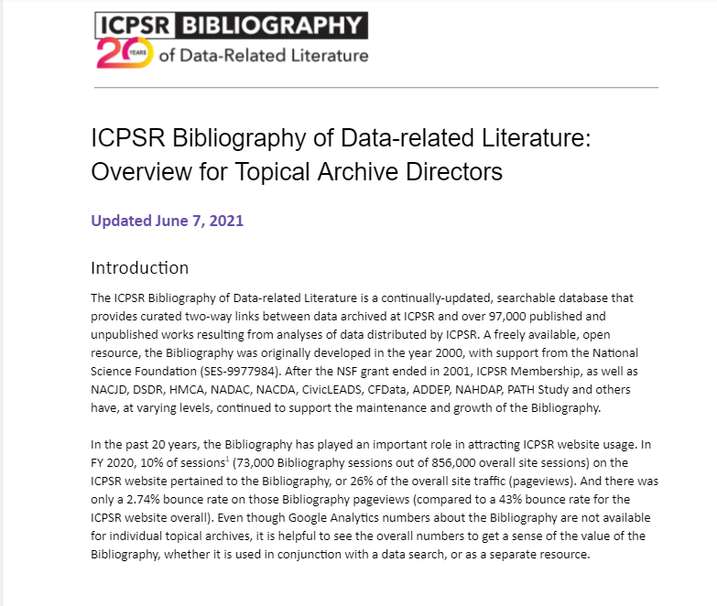
Notes:
I’ve posted several documents describing the Bibliography, including this one for BCD, which points to benefits that funders may respond to. It’s on the M & P drupal page.
https://drupal.icpsr.umich.edu/node/1181

Slide 28
Discovery Tool
Linking scholarly literature promotes data sharing by helping our website users discover data via the related literature. There is a main Bibliography search portal on the ICPSR website, but each topical archive has the option of including a customized search and browse UI on their individual websites.
Data Literature Review
Since data-literature links are not easy to compile, topical archives can provide a valuable service: providing analyses together with the data underlying them, all from the study’s home page. From there, site users can link to a given publication as well as any other ICPSR datasets that were also used in the publication. Using the list of related publications as a type of literature review is helpful when considering whether to download files or seeing how other researchers used the data.
Funders Understand Citations as an Impact Measure
Individual topical archives report to their funders the number of publications associated with their data, showing evidence of impact and reuse that is not abstract. The funder can see that data were not only downloaded, but utilized to advance scientific understanding.
Users Get a Shortcut to Restricted Data Content
For users considering going through the process of applying for access to restricted data, seeing the variables used in a PI or agency report helps them see what is available in data that they could not easily examine before committing to a use agreement.
Ready-made Content for Promoting Data in Social Media and Study Home Pages
In social media, topical archives have posted an author’s visualizations, with links back to the article and the data. The Bibliography provides archive staff with a source for choosing publications in which their data are used in trending research areas or current news, by important authors, or in high-impact journals.
Notes:
This is taken from the text of that document.

Slide 29
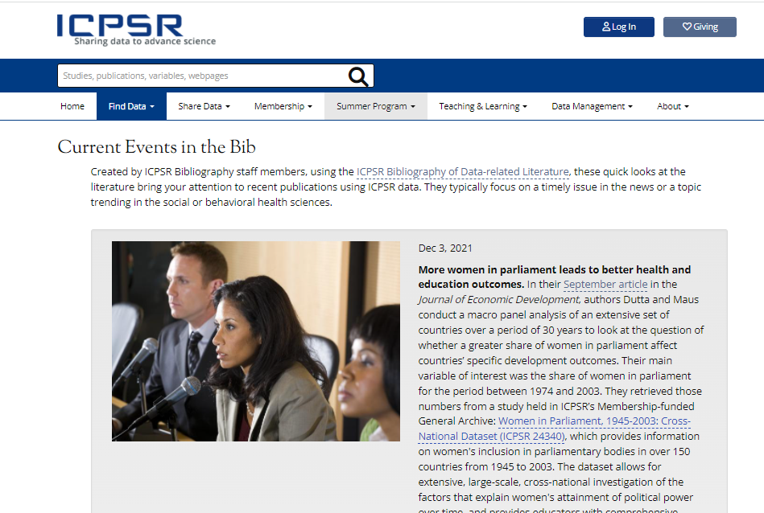
Notes:
That document also describes new content and instructional resources that the Bibliography team creates using the literature we collect every day.
As you’ll recall, our original vision was to provide a searchable database so people could discover data and compile lists of the publications associated with a study.
We are now adding some offerings that take advantage of the Bibliography collection, also to encourage data discovery. We’ve begun to add resources created about and directly from the citations database. https://www.icpsr.umich.edu/web/pages/ICPSR/citations/
This is a screenshot of a recent Current Events in the Bib entry. I post a new one weekly to highlight how a given study or studies are being used in a recent publication, often about current topics in the news or the social science literature.

Slide 30
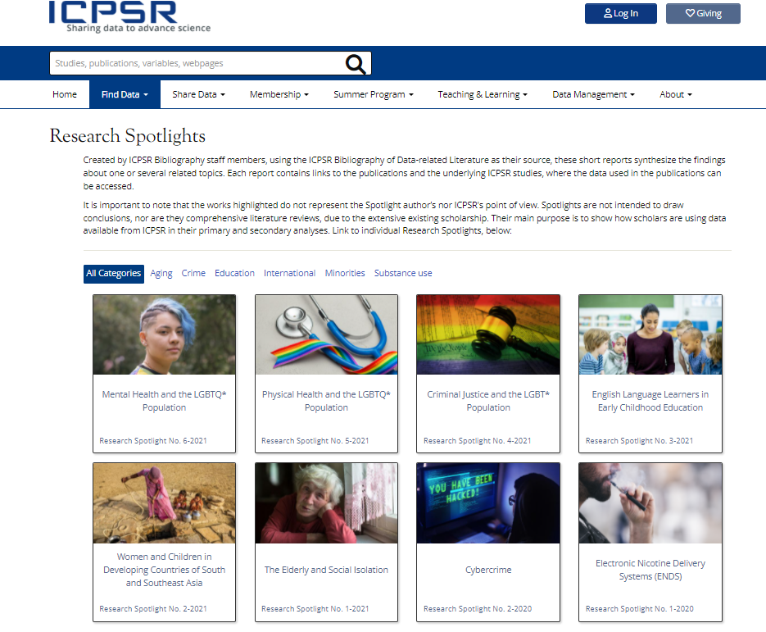
Notes:
The Bibliography staff creates Research Spotlights that are short data/lit reviews around the topics they see in the literature. These often discuss several studies in one topical archive, making these ideal to link to for the benefit of a project’s audience. Here’s an example of how DSDR has featured some relevant Research Spotlights on the TransPop site
[OPEN TAB]

Slide 31
Detecting data use
Notes:
If you’ll recall, I mentioned in the beginning that because we make our data FINDABLE, it helps ICPSR as an organization, and specifically the Bibliography team, track down uses of data.

Slide 32
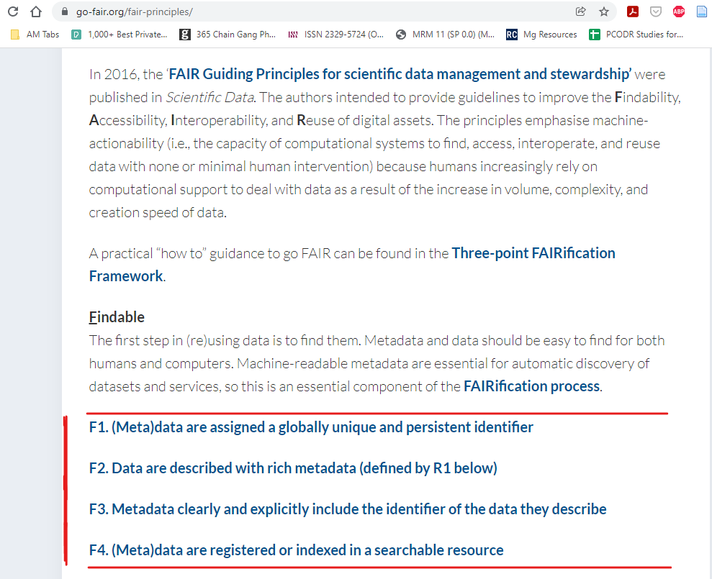
Notes:
[Read under FIndable, then:]
F1 We take advantage of the fact that ICPSR studies have a unique, persistent identifier that authors can use to cite with. This is the digital object identifier registered for each study.
F2 And because data are described with rich metadata, we, the Bibliography staff often consult it to understand whether a publication actually used our data. This is necessary when authors don’t cite it clearly, using the DOI. We also are power users of the series page. Finding an informally cited use of a study that is part of a series means you need to have a menu of all the possible studies in that series to choose from.
F3 We provide our DOIs with our metadata
F4 Our metadata are indexed in the sources we look in for related publications, so we can find cited references that way, e.g., in Google Scholar.

Slide 33
“. . . librarians collecting citation metrics may have to read an entire article to determine the exact data set used, and even then, some ambiguity may remain . . .”
Vannan, S., Downs, R.R., Meier, W., Wilson, B.E. and Gerasimov, I.V. 2020. "Data Sets Are Foundational to Research. Why Don’t We Cite Them?" EOS. November 16, 2020. https://doi.org/10.1029/2020EO151665
Notes:
That said, this article Data Sets Are Foundational to Research. Why Don’t We Cite Them? is a great summary of the issues that data repositories face when trying to track data use. I could quote many parts of it, but this one seems quite relevant to our experience.
READ QUOTE
And that is because of these data centers encounter the same problems we do when trying to track data use efficiently. There is still not enough uptake of data citation. People do not cite with specificity, they don’t use the references list for data citation, not to mention the DOI provided. Even when they do cite with a DOI, we still find we need to verify they were used correctly. I will get to that in a moment.

Slide 34
Collection criteria
The ICPSR Bibliography of Data-related Literature contains citations of data-related literature—that is, publications, papers, presentations, Web pages, or other information objects that meet at least one of the following criteria:
Contain analysis of data archived by ICPSR (including publications by the original principal investigator as well as articles containing secondary analysis). These analyses can include the use of the original PI data, data disseminated in printed form or on the ICPSR Web site, or where the exact source cannot be determined from the publication, as long as the data have been archived by ICPSR.
Contain discussion, critique, or extension of another’s data analysis of a kind that would have required the author to work with the original raw data.
Contain discussion, critique, or extension of another’s data analysis, which might lead a reader to consult the original raw data.
Contain discussion or critique of the data source in general, such as caveats on the use of a particular study that contain more than the simple statement that the data are problematic.
Quote the data in charts that are newly compiled by the author (i.e. not charts reproduced from the PI’s publication of the data).
If the publication does not use (manipulate or analyze) the data, but refers to hypotheses which the data were used to establish or critique, it should be included only if the references to the data are extensive and can be distinguished from the references to the original publication. For example, a review article that discusses a study from the point of view of data quality or study design would be included. One that discusses only the logic of its conclusions, or makes only a passing mention of a study, would not be included.
Contain discussion or critique of the data collection process, study design, or methodology.
Note: Since some datasets are available from multiple archives or data providers and we cannot always verify that the source of the data used was ICPSR, ICPSR need not be the actual source of the data used in the publication to qualify for inclusion in the Bibliography.
Notes:
I should mention our collection criteria. We use pretty strict guidelines when adding pubs the Bibliography.
We follow a list of 7 collection criteria.
In short, if the author manipulated or analyzed the data, or the methodology was critiqued or discussed extensively, we collect it.
If data were mentioned in passing, we don’t. We also don’t generally collect use of measures or questions from survey instruments.

Slide 35
8. Did author use something in a series, but didn’t say which specific study? Collect for series.
1. Is this already in the Bibliography? If no . . .
2. Were the data formally cited in the references? If no . . .
3. Where does query string appear in text? (tables, footnotes, methods, supplement, acknowledgements, grant number?)
7. Was any year/wave /phase clearly analyzed but not cited in the references? Add those.
Heuristic to Evaluate Data Use in Publications
6. Collect citation and associate with study numbers from ICPSR catalog.
4. If a good “hit” (data analyzed) – 5. If a bad “hit” (just mentioned or pub cited)— 5a.
If 5. Does ICPSR catalog have same years, waves, panel, sample?
If 5a, find cited pubs & check for #1--#5.
Notes:
This represents that manual effort referred to in the previous slide. Our Bibliography staff make a series of judgments based on our collection criteria, and on our experience with the way that authors in the social and behavioral sciences tend to refer to data. We can’t just depend on the references list. We have to read through the whole paper, using a lot of inside knowledge to try to link a publication to the data analyzed in it. [READ THROUGH HEURISTIC]

Slide 36
Because of informal data citation
We must create queries using the study name and other metadata.
Imprecise by nature, these queries can bring back what we consider to be bad hits.
Distinguishing data mentioned in passing from actual data use must be done with human judgment.
Since most data are not explicitly cited, it can be unclear where they got the data, what year/wave/sample they used, etc.
Bad hits=time wasted.
Notes:
This is kind of a review of what we just saw. [READ SLIDE]
And even when people cite using the DOI, oftentimes they are citing “uses” of data or data adjacent items in ways that do not meet our collection criteria.

Slide 37
Since 2019, when we began tracking it, slightly less than a third of the of the publications collected in the Bibliography explicitly cited ICPSR. Even fewer used a DOI.
Notes:
[READ SLIDE]
BUT
Limiting our collection to only those publications in which ICPSR DOIs were included or people explicitly stated they got the data from ICPSR, would mean most publications in which data were used would go unlinked and uncounted, and not be available in the Bibliography.
SO
We do collect informally cited data. We do our best detective work on the back end because authors do not clearly cite data on the front end.

Slide 38
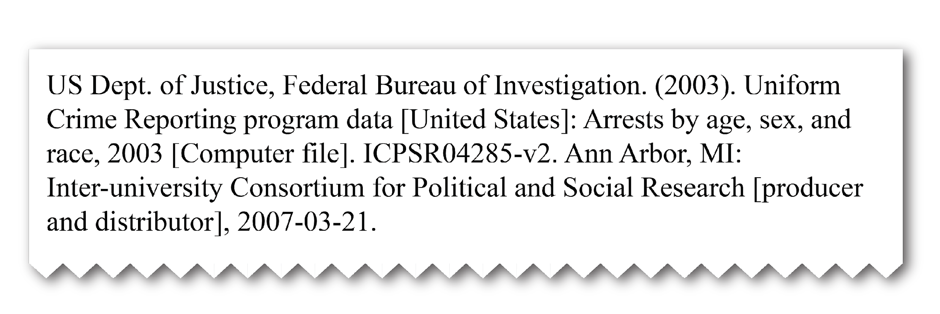
Almost complete
Data are formally cited in the references, but the PID is not included, which would have enabled machine-actionable detection and linking.
Moss, E., & Lyle, J. (2018). Opaque data citation: Actual citation practice and its implication for tracking data use. Poster presented at the 11th Research Data Alliance (RDA) Plenary, Berlin, Germany. https://deepblue.lib.umich.edu/handle/2027.42/142393
Notes:
Here are some examples of real world citing practice. Jared Lyle and I presented at two conferences in the past few years about the categories of informal data citation that we currently encounter in the social and behavioral science literature. These are all real snippets from the literature.

Slide 39
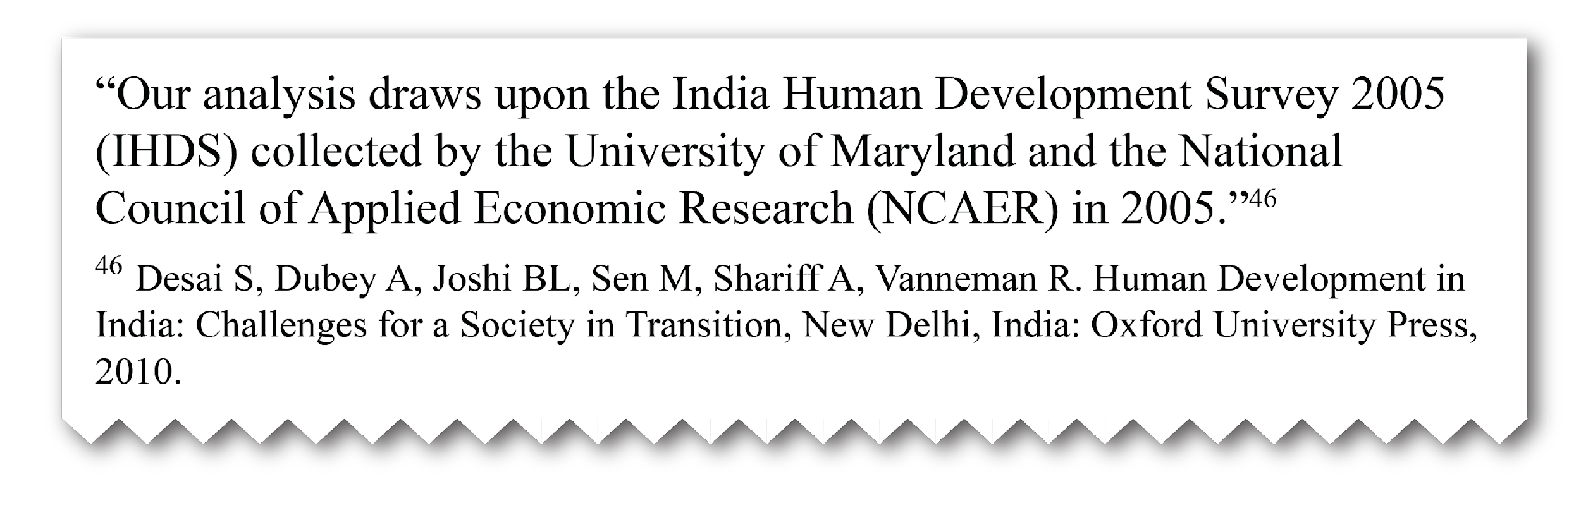
Indirect
A title and year of the data are mentioned in the methods, so it is clear data were used and even named, but no formal reference is made to the data or where they may be accessed. Often, the reference provided is to another publication and not directly to the data.

Slide 40
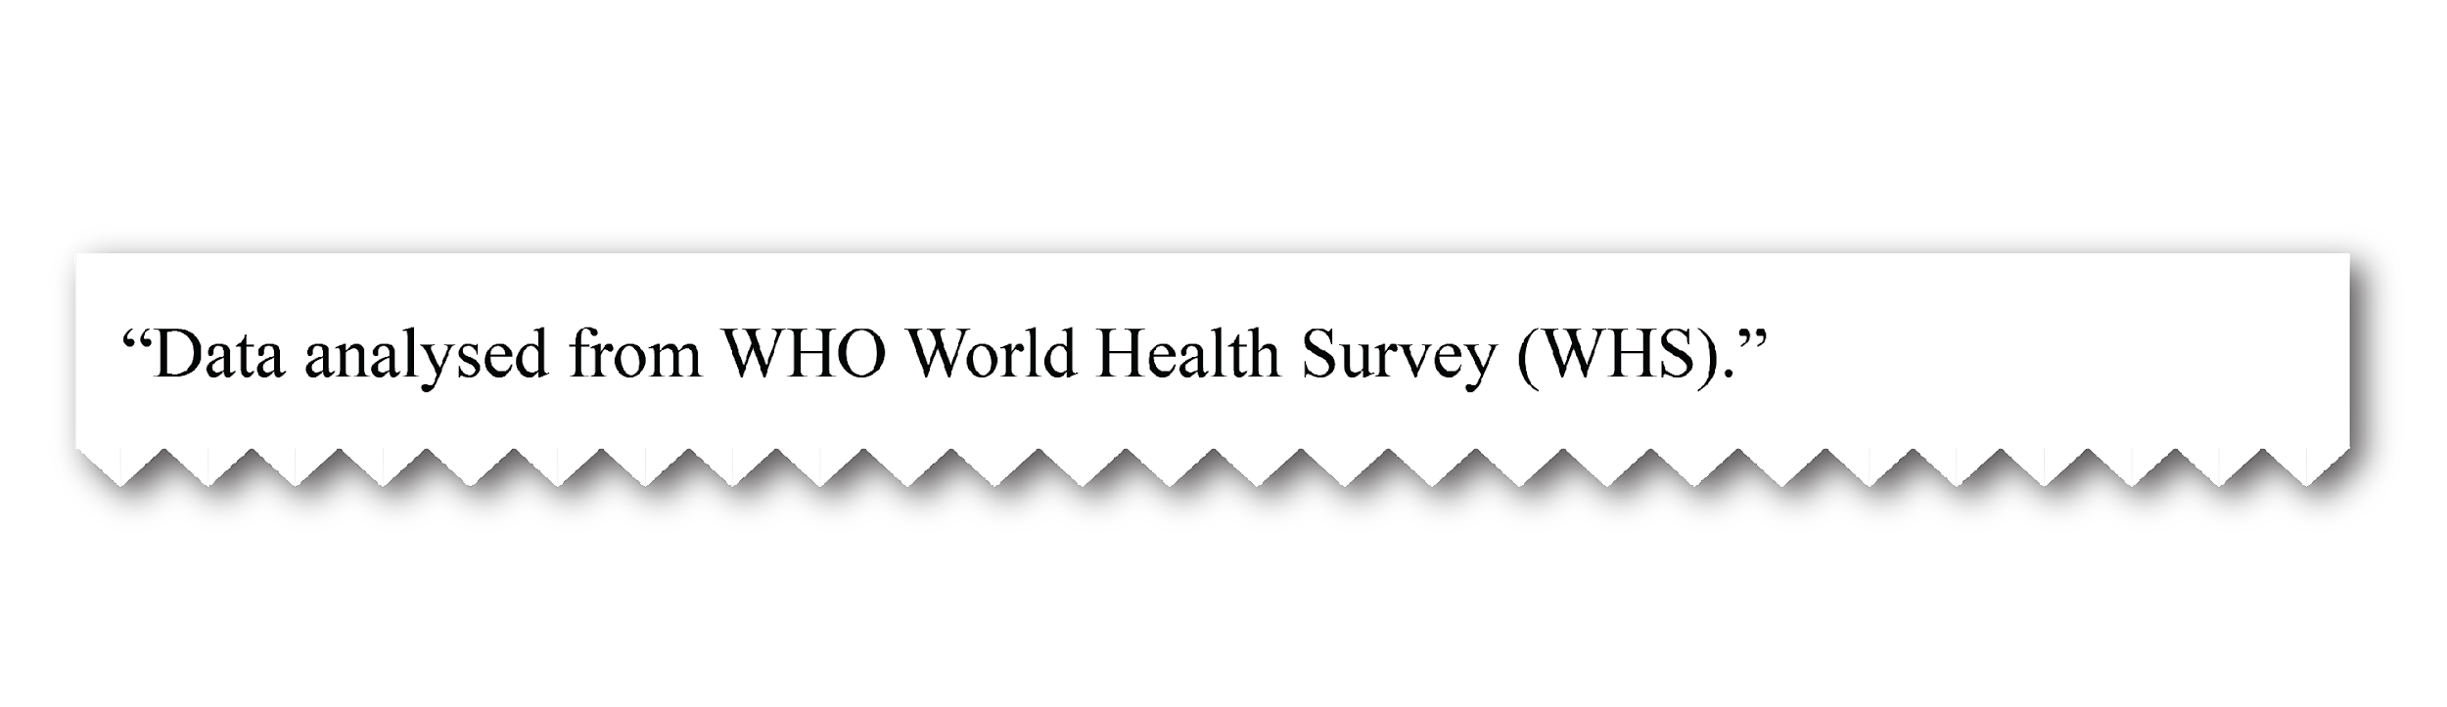

Mismatched
You see it in the literature this way:
Title used when archived:
When the data are archived, the title may differ from the title used in publications prior to archiving.

Slide 41

Barely there
Authors may mention the name of a data collection, and may even provide the specific years analyzed. But they do not include the PID provided by the archive, let alone the version number. Not enough information is provided to know exactly where the author got the data.

Slide 42
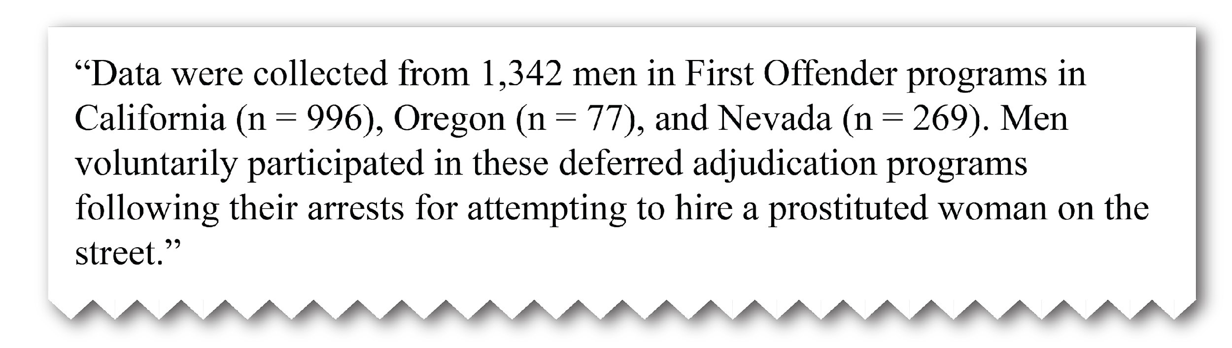
Vaguely described by necessity
The investigator writes about her own data well before having a citation and registered PID.
Or, sometimes, in sensitive areas of research, authors tend to say as little as possible about identifying characteristics of the data, even in broad terms.

Slide 43
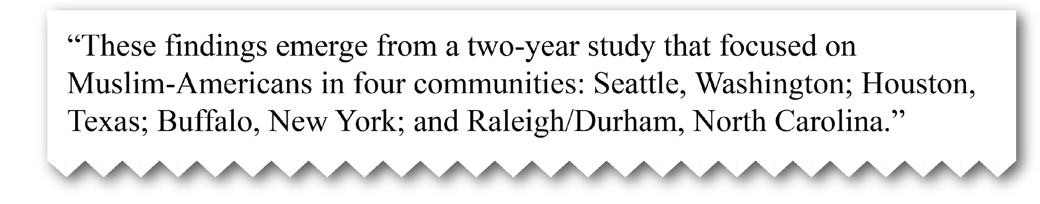
Deducible with inside information
In some cases, even though no formal citation is used, an informed reader may know where the data were mandated to be deposited.
In other cases, authors acknowledge assistance from a repository. Or, only a staff member with knowledge of some aspect of the data would be aware of an identifying characteristic.

Slide 44
The MICA Project Dives In

Slide 45
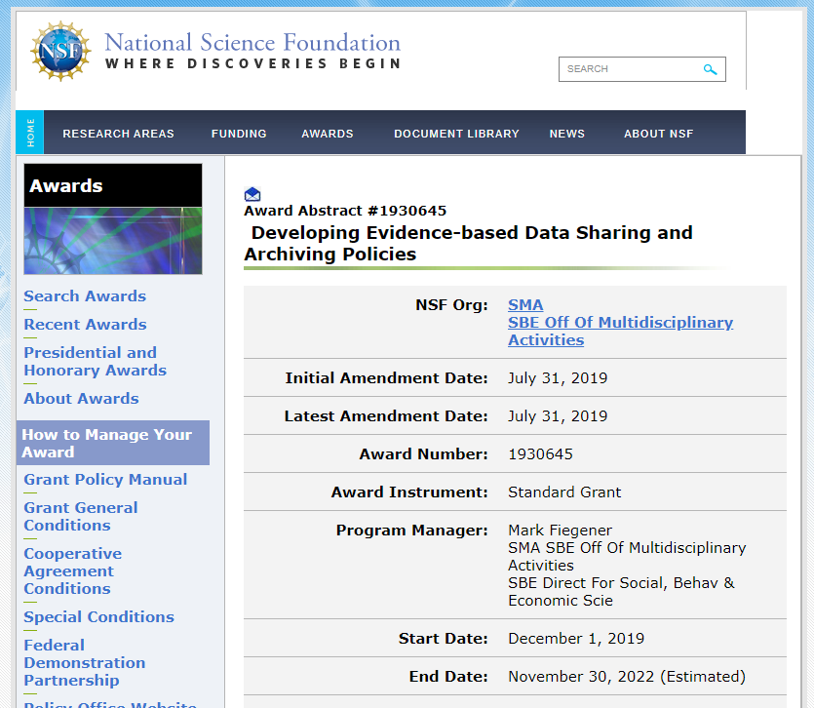
Notes:
This NSF-funded project, also known as Measuring the Impact of Curatorial Actions (MICA) is an active grant at ICPSR, investigating ways to measure the impact of curating data. Sara Lafia, Libby Hemphill, David Bleckley, Leo Fan, and others are working on the aspect of the project attempting to enlarge the Bibliography collection and at the same time make it less skewed (since collecting for it has been done by unequally, depending on what studies were funded to have Bibliography work done).
They want to bring more computing power to the Bibliography population process. They want to automate the discovery of more related publications via APIs and then create a recommender algorithm to funnel only the most likely candidates for human curation. But to do that, they need to tackle informal data citation by teaching an algorithm to recognize datasets and dataset use in the text.

Slide 46
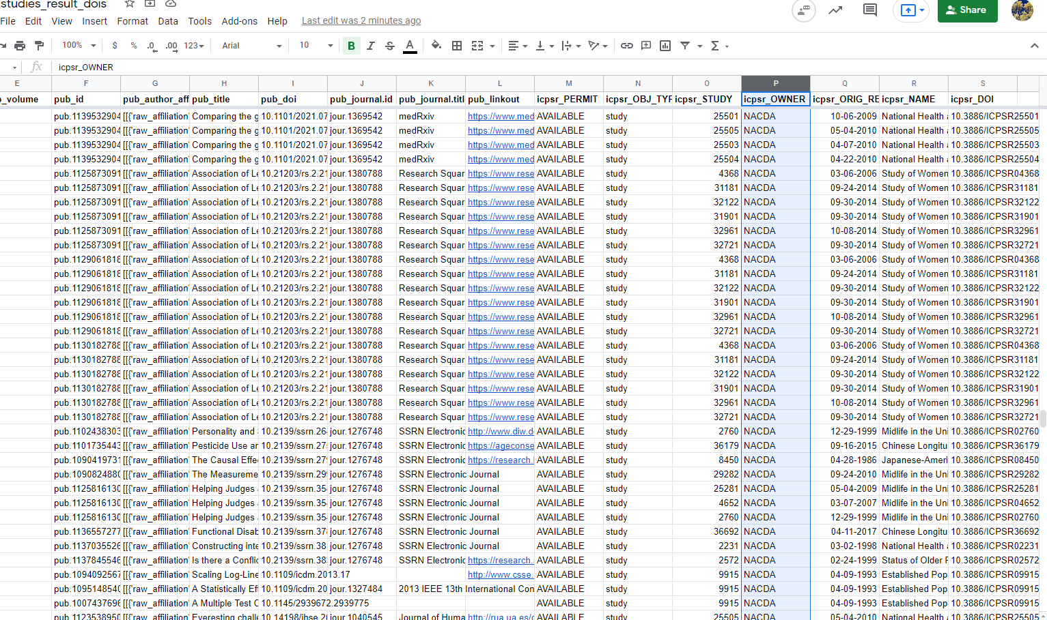
Publications Using Data We Do Not Yet Distribute
(This material is based upon work supported by the National Science Foundation under grant 1930645.)
Notes:
A preliminary goal was to set up API pulls from literature databases to try to populate the Bibliography by sending large-scale queries for all 11,000 plus studies. Starting with Dimensions Plus, a large multidisciplinary database with over 69 million publications available for full text search.
Here is an example of Dimensions API output, based only on DOI hits, at this early stage. The Bibliography team evaluated each of these (we are still evaluating the largest group) to determine if these publications citing DOIs from ICPSR were actually collectible.
I will show you our results in a moment, but I wanted to point out that ideally, after the MICA funding is gone, we could retain and integrate API streams from outside publisher platforms into ICPSR’s workflow so that the Bibliography team could do periodic pulls.

Slide 47
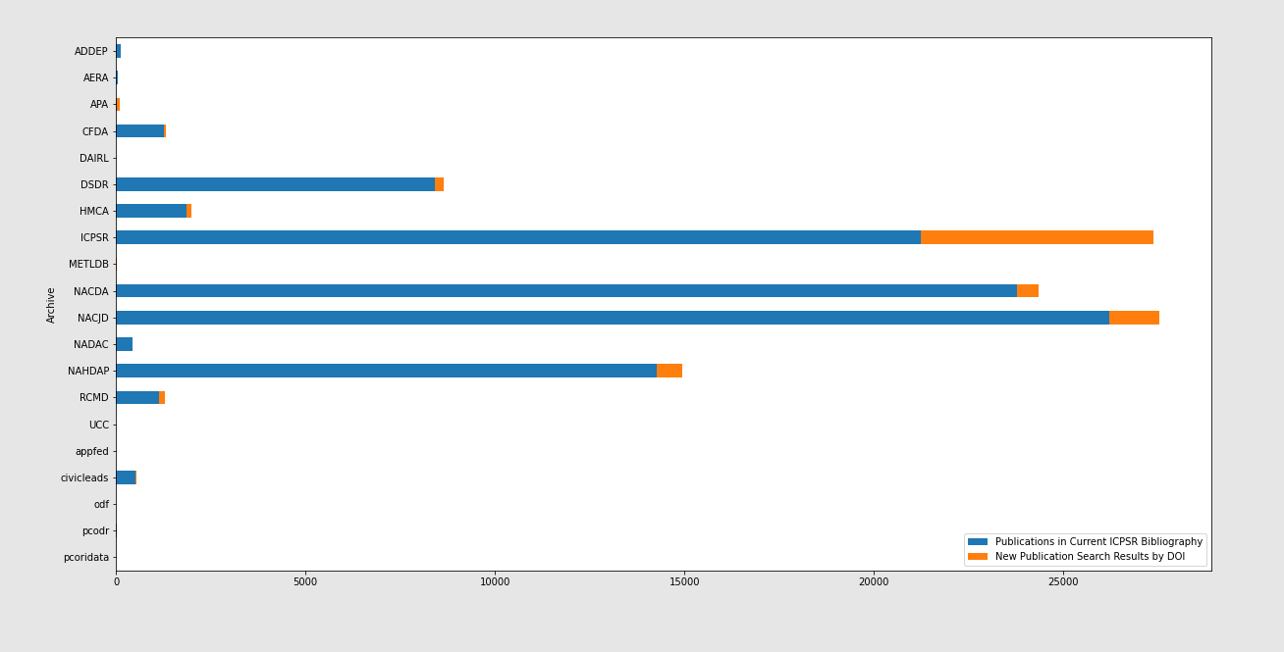
DOI Query Results, by Owning Archive
(This material is based upon work supported by the National Science Foundation under grant 1930645.)
Notes:
Sara Lafia prepared this chart by owning archive. In blue, you can see that the DOI query brought back many publications that we had already collected. But the orange sections are publications we did not have.
The Bibliography team checked to see if these are from sources we don’t regularly scan, if these were rejected because they didn’t meet our collection criteria, if they were simply studies we hadn’t searched for yet, or if the DOIs were incorrectly used.
1.

Slide 48
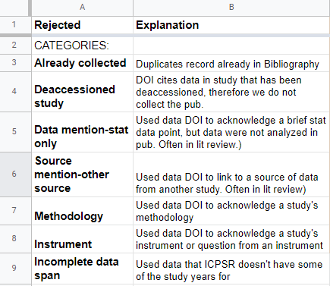
Notes:
Because there were a large number of publications that we determined were not collectible, we divided the rejections into categories:
[READ]

Slide 49
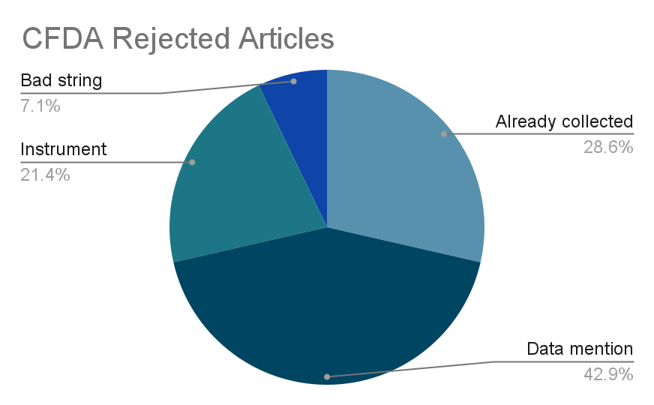
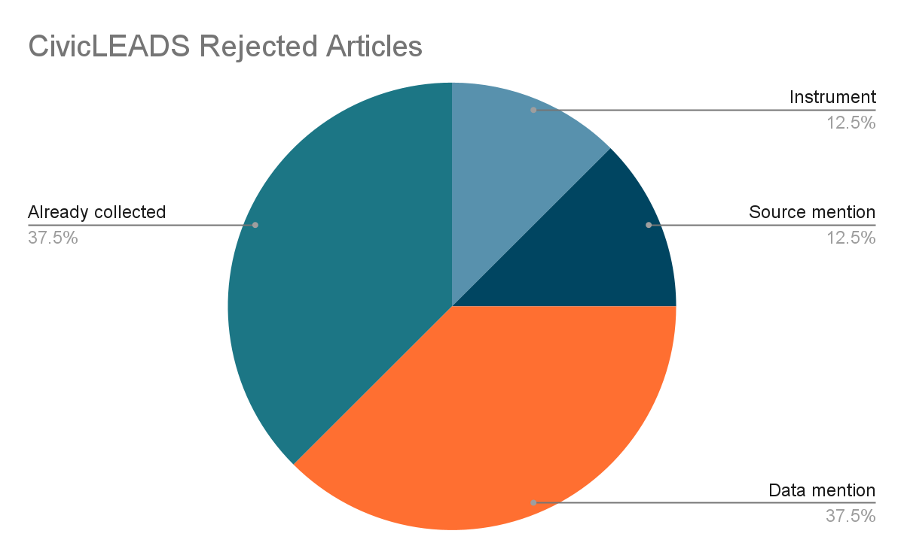
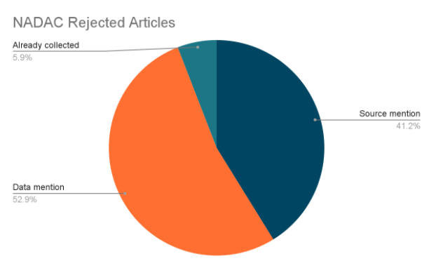
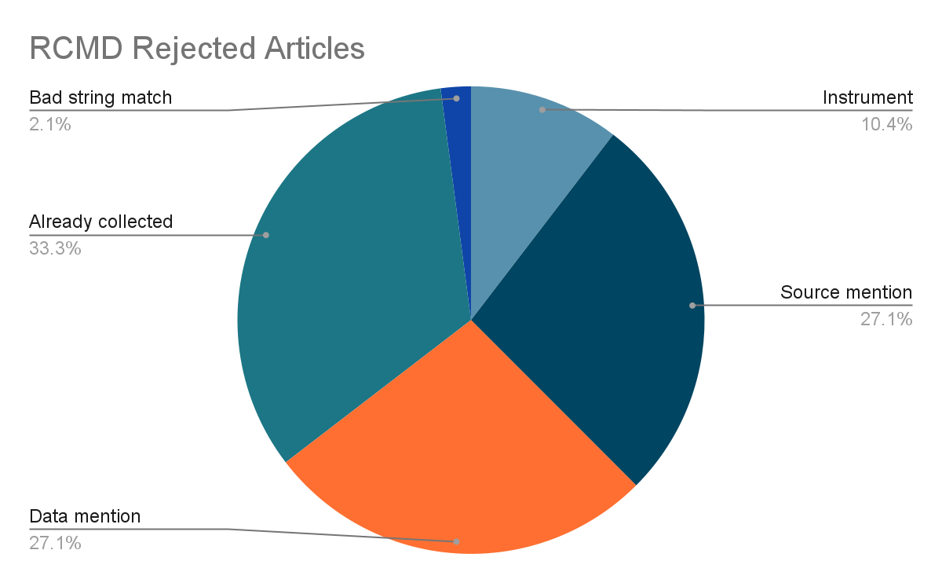
Notes:
I’ve put the archives with the smaller collections on one page, and the larger collections on the next slide.
At this stage, it is interesting to note the proportion of rejections due to citing mentions or instruments or another source not analyzed.

Slide 50
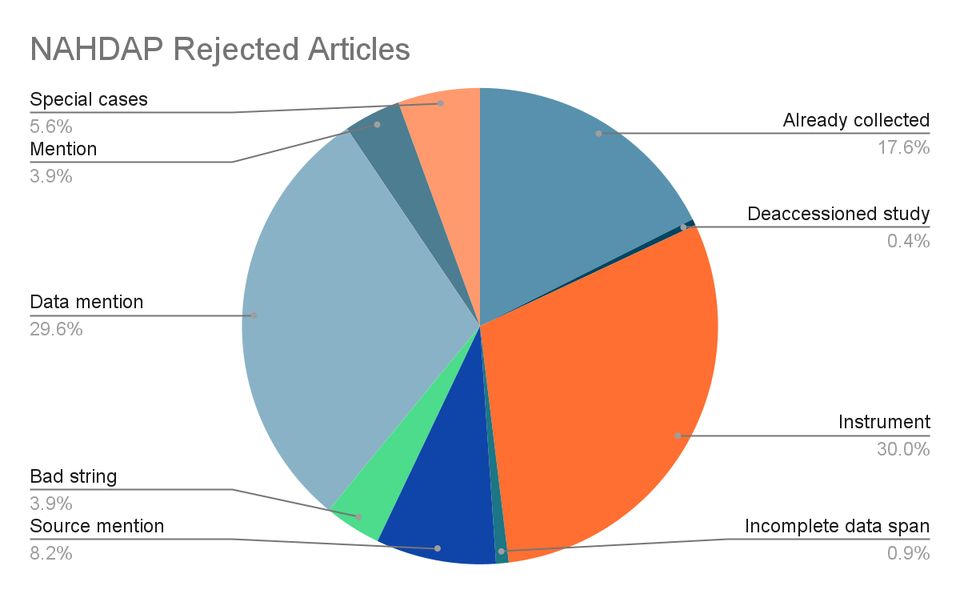
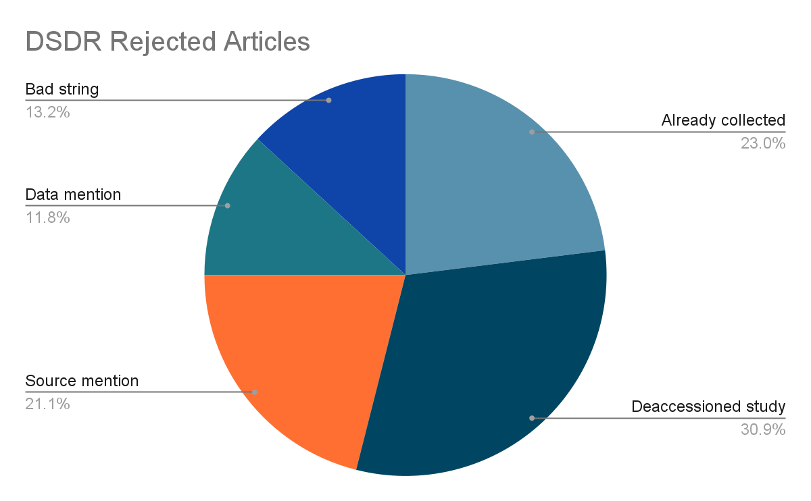
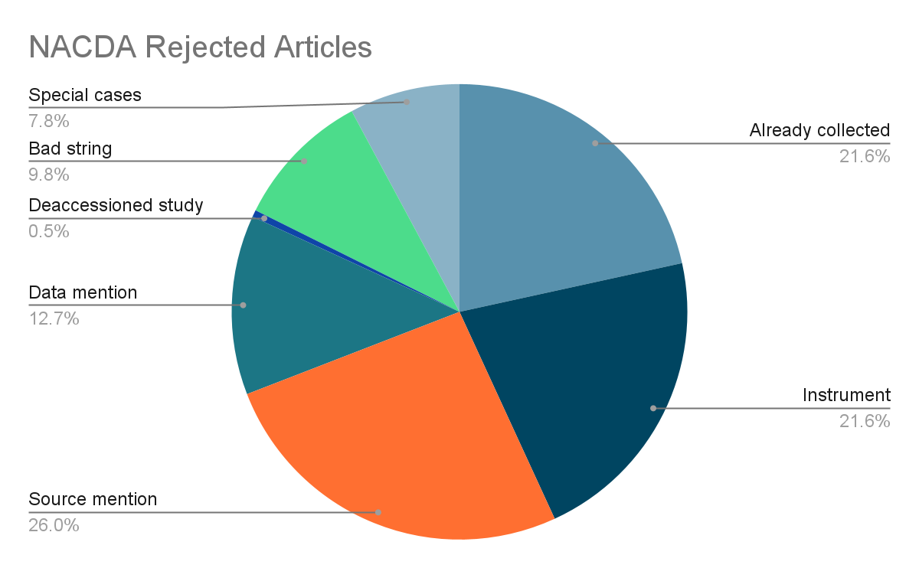
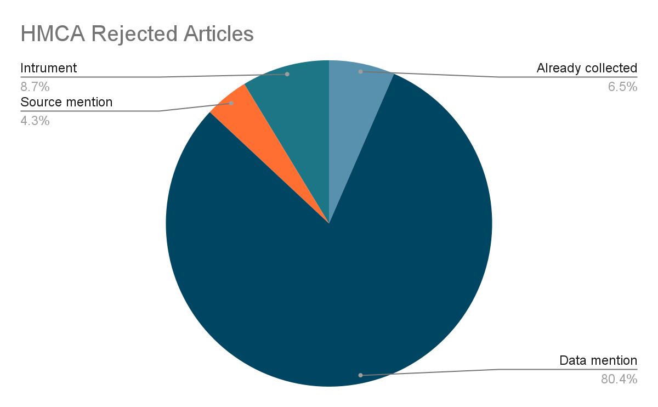
Notes:
This was just an interesting experiment, and when we are finished evaluating the largest result set--those using data from the general archive, we may be able to draw some conclusions about gaps in data citation options.
Sara has already run a second, larger query in Dimensions Plus for exact references to all 11,656 ICPSR Study Names, Study DOIs, and Study Numbers. We included the search terms “ICPSR”, “Inter-university Consortium for Political and Social Research”, or “Interuniversity Consortium for Political and Social Research”. Bibliography team will soon begin combing through those, and we hope to find many to collect and not too many that do not meet our collection criteria.

Slide 51
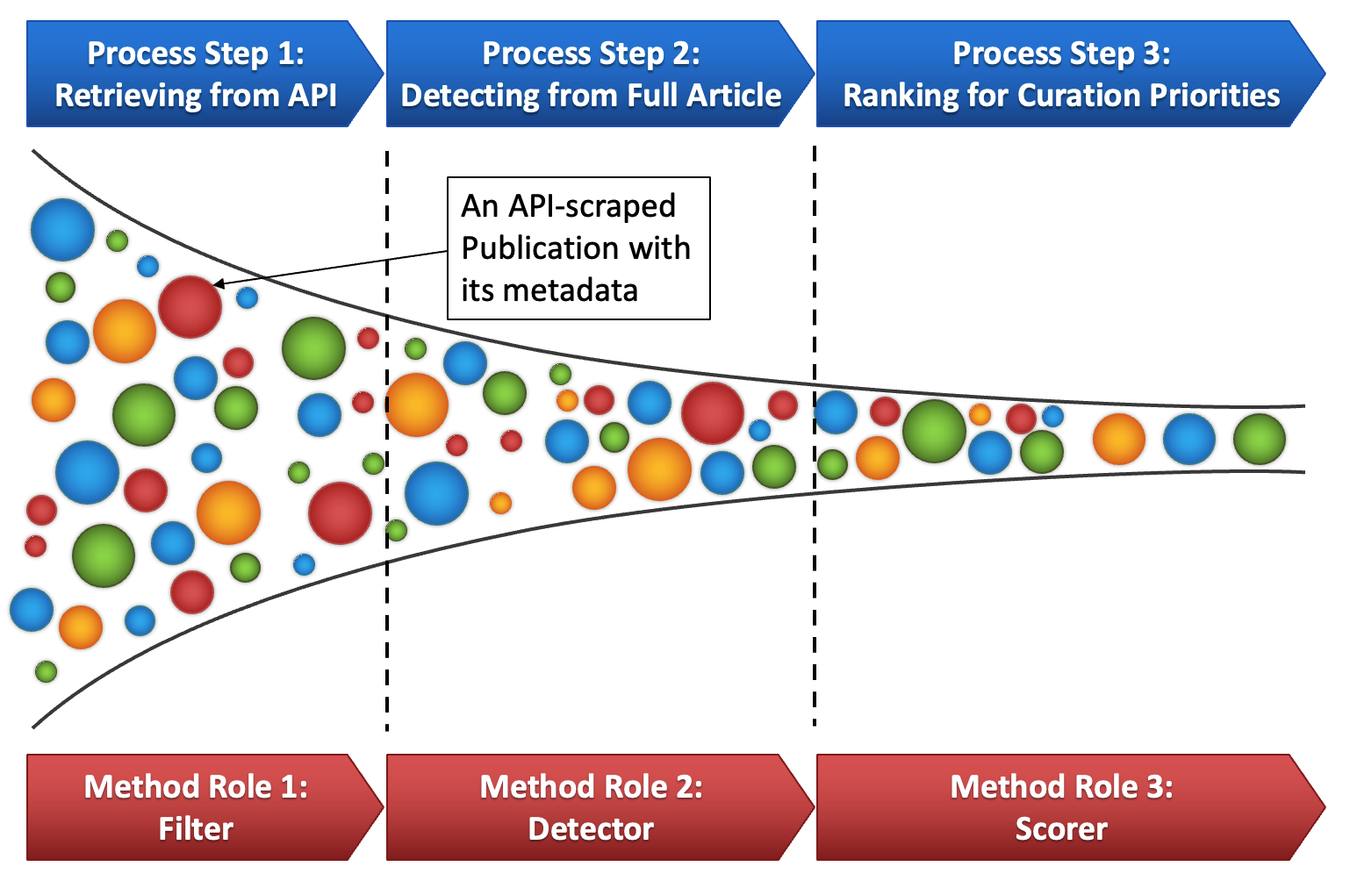
(This material is based upon work supported by the National Science Foundation under grant 1930645.)
Notes:
And Leo Fan, a doctoral student at the School of Information, is building this Funnel Process of Data Citation Detection for ICPSR studies. We input the query results from the Dimensions API, i.e. the returned publications (and their metadata) as the candidate citations of ICPSR studies. Then, the Funnel Process will 1) filter the candidates by semantic similarity, 2) detect evidence of citations in candidates (and filtering out those candidates with no detectable evidence), and 3) rank the candidates to indicate their possibility of being a True citation. This Funnel Process can suggest curation priorities for the ICPSR team. He is currently fine tuning this model and will be presentin

Slide 52
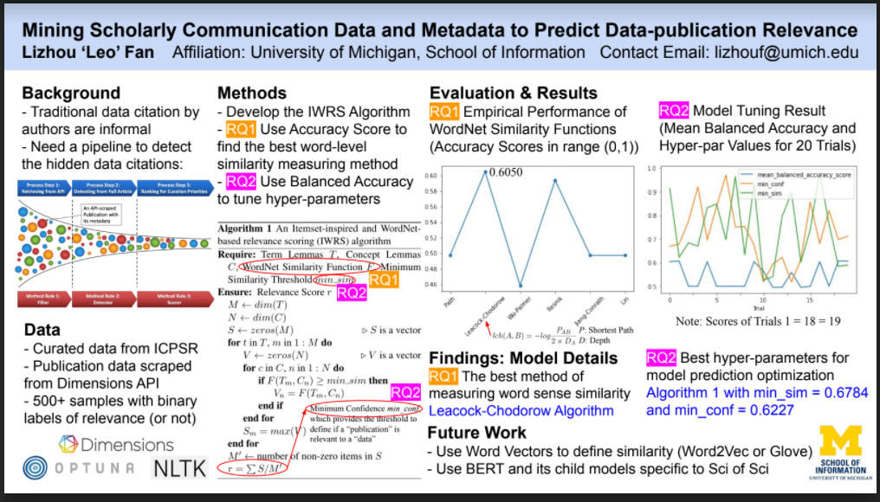
(This material is based upon work supported by the National Science Foundation under grant 1930645.)

Slide 53
Future Directions
Integrate regular, automated pulls via publisher services
Curated and non-curated DOI query results display on ICPSR site
Integrate selector algorithm to help harvest thousands of query results (either from APIs or from existing email alerts)
Take advantage of file-level citation when it becomes available at ICPSR, so people have options for citing data files and questionnaires, for instance
Better, smarter, integrated UI for capturing and curating data citation metadata

Slide 54
Thanks for joining.

