Slide 1
Digital Preservation and ICPSR
ICPSR Metadata & Preservation "Deep Dive" Series
Mike Shallcross
Associate Archivist
January 20, 2022
shallcro@umich.edu

Slide 2
Agenda
Why is digital preservation important?
What is digital preservation?
  Open Archival Information System Reference Model (ISO standard)
  Elements of a Digital Preservation Program
  Assessing Digital Preservation Practices
Digital Preservation at ICPSR

Slide 3

What’s the Deal with Digital Preservation?
Or, why is digital preservation important?

Slide 4
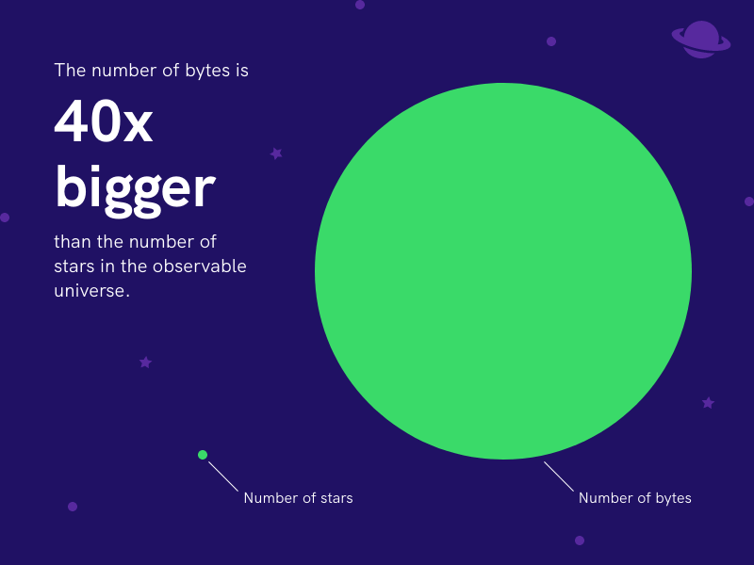
There’s a lot of data out there...
The World Economic Forum estimated that as of 2020, there were 44 zettabytes of data in the world (1 ZB = 1 billion TB!).
Every day, the world generates:
  500 million tweets
  294 billion emails
  4 PB of Facebook data
  4 TB of data from each connected car
  65 billion WhatsApp messages
https://piktochart.com/blog/data-visualization-statistics/

Slide 5
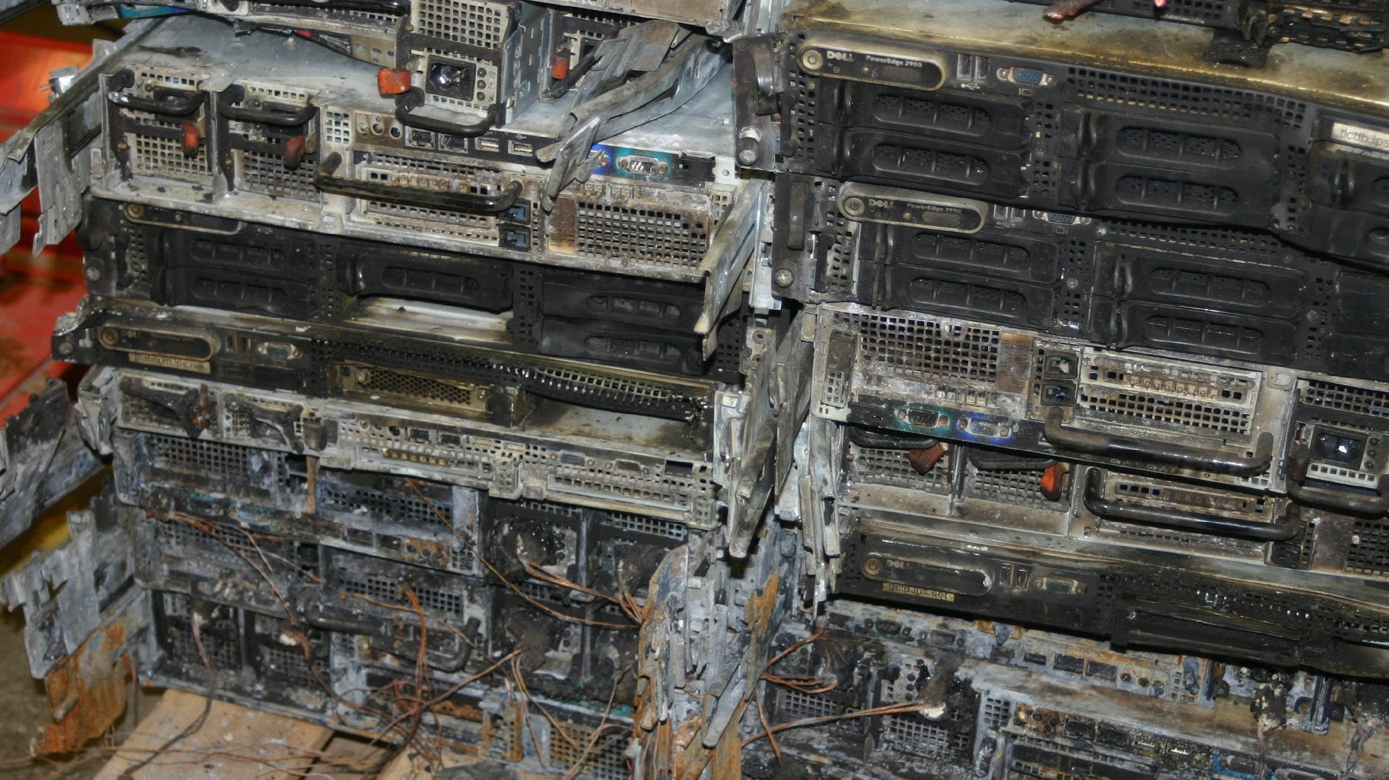
All that data is great–until something happens…
https://memegenerator.net/img/images/15181933.jpg

Slide 6
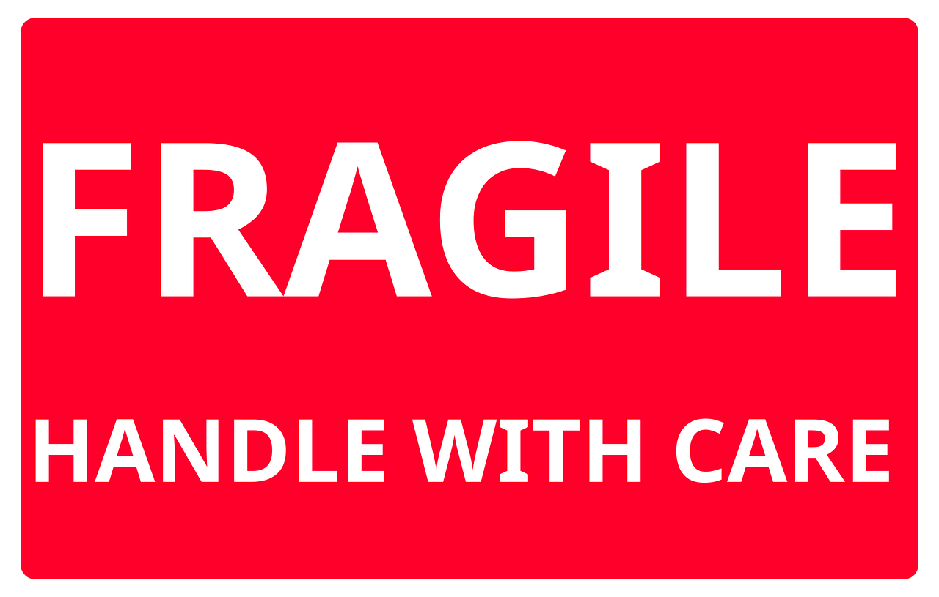
Data are Actually Pretty Fragile!
The scale and diversity of digital content can exacerbate a wide range of potential issues:
  Software dependencies
  Disk drive crashes
  Data corruption or loss
  Insufficient metadata
https://pixabay.com/images/id-4910491/

Slide 7

Vint Cerf: a new “Digital Dark Age”?
“We are nonchalantly throwing all of our data into what could become an information black hole without realizing it. We digitize things because we think we will preserve them, but what we don’t understand is that unless we take other steps, those digital versions may not be any better, and may even be worse, than the artifacts that we digitized.”
https://www.theguardian.com/technology/2015/feb/13/google-boss-warns-forgotten-century-email-photos-vint-cerf

Slide 8
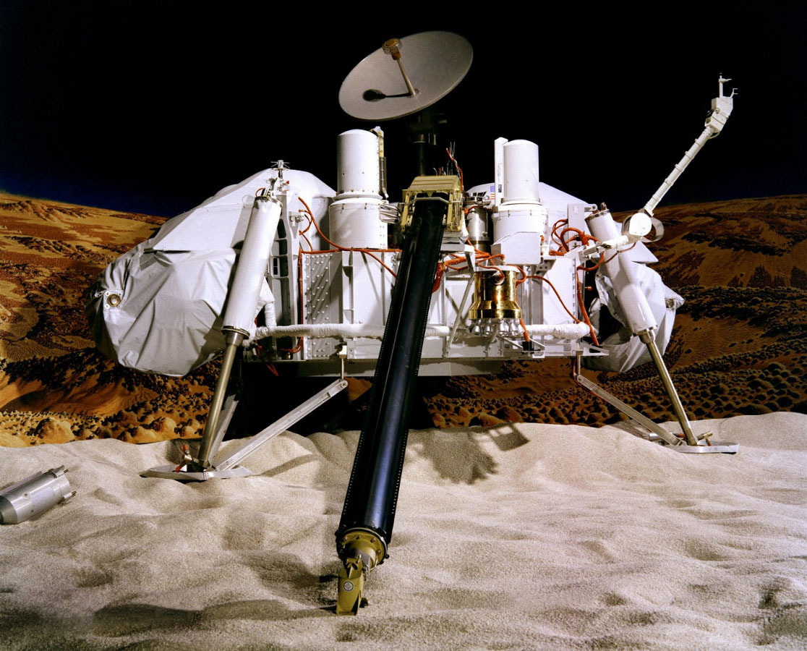
NASA Viking Missions to Mars
1970s Viking missions to Mars generated huge amounts of data.
Approx. 20% has been lost.
Original data tapes deteriorated—could not be read.
Recovery involved manual entry from print outs!
http://proxy.lib.umich.edu/login?url=https://search.ebscohost.com/login.aspx?direct=true&db=bth&AN=460160&site=ehost-live&scope=site

Slide 9
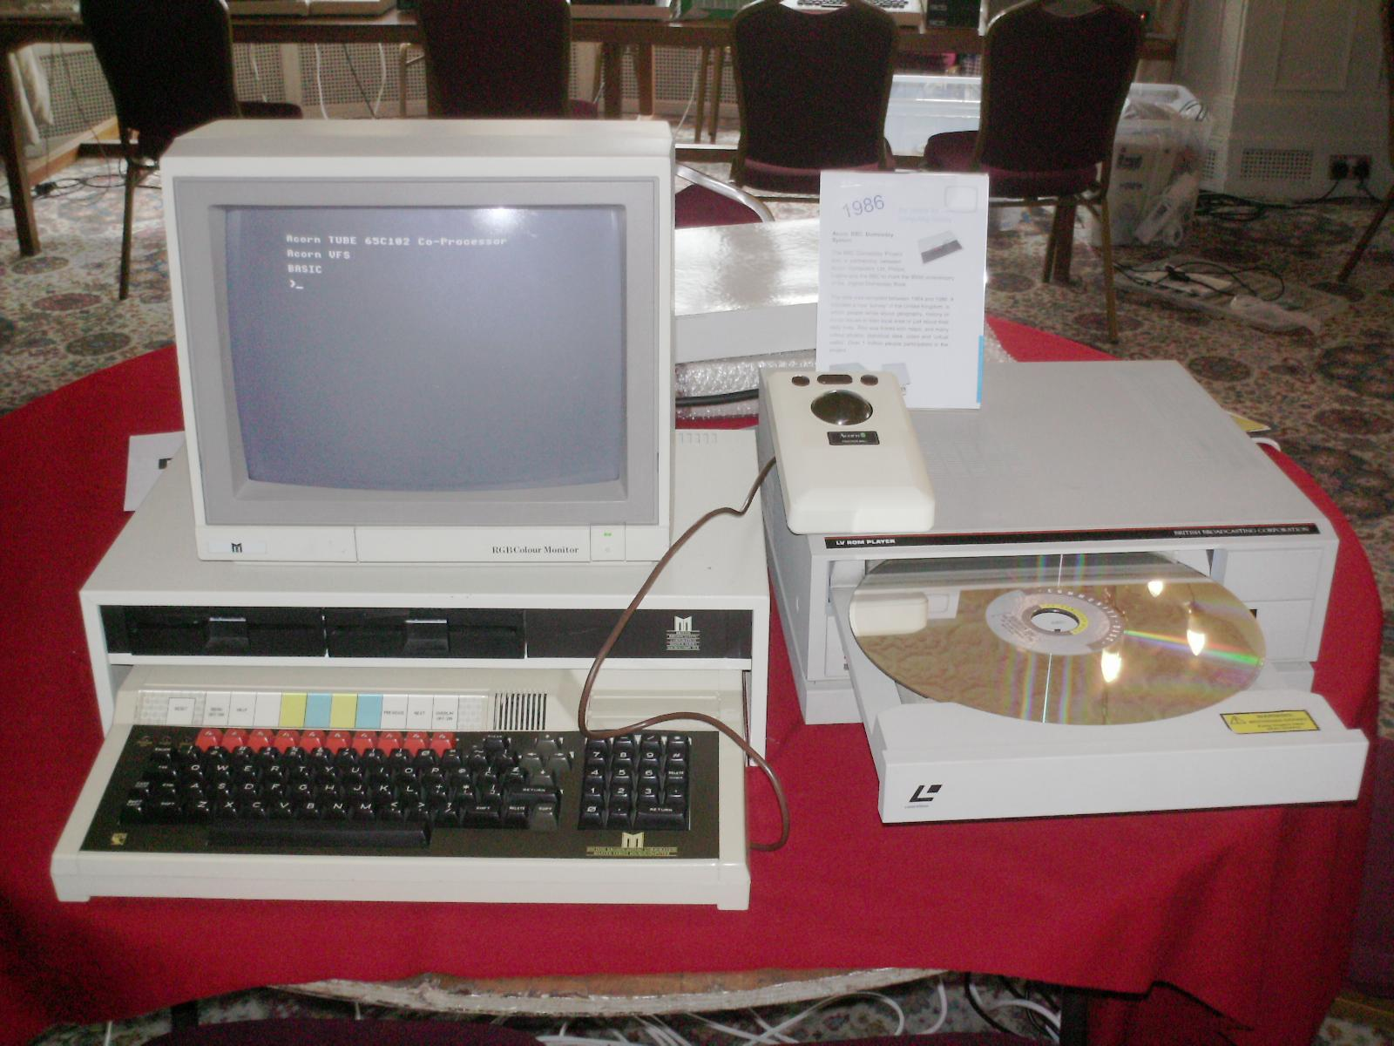
Digital Domesday Book (1984-1986)
BBC and partners created a “digital Domesday Book” for the 900th anniversary of the original.
By 2000, the digital version was unusable due to software and hardware obsolescence.
2004: new version was reverse-engineered...
https://www.historyofinformation.com/detail.php?id=1661

Slide 10
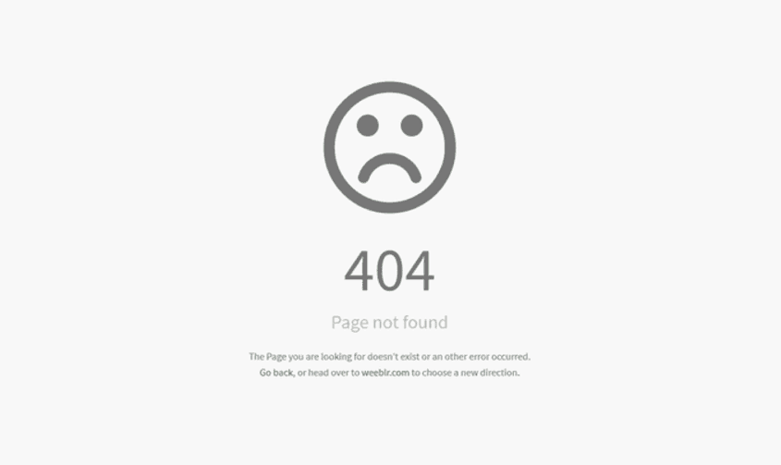
Ephemerality of Online Resources
Harvard Law School examined:
  553,693 New York Times articles (1996-2019)
  Articles contained 2,283,445 URLs to external content
Findings:
  53% of articles had at least one bad URL
  25% of all URLs were completely inaccessible (404 error)
  13% of URLs pointed to different content
“What the ephemerality of the Web means for your hyperlinks” Columbia Journalism Review (5/21/21)

Slide 11
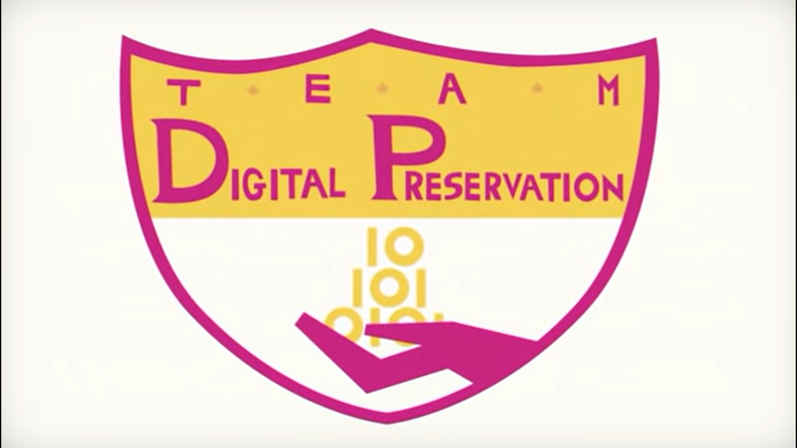
To the Rescue!
https://www.youtube.com/watch?v=pbBa6Oam7-w

Slide 12
What is Digital Preservation?

Slide 13
Digital Preservation Defined
“Digital preservation is the active management of digital content over time to ensure ongoing access.” (Library of Congress)
“Digital Preservation refers to the series of managed activities necessary to ensure continued access to digital materials for as long as necessary.” (Digital Preservation Coalition)
“Digital preservation combines policies, strategies and actions that ensure access to digital content over time.” (Association for Library Collections and Technical Services)
Notes:
Key Points:
Active and engaged
Sustainable (ongoing; no end point)
Focused on access and use
Content agnostic
Implicit: need to scale, with ever-growing collections

Slide 14
“Digital Preservation” Key Takeaways
Digital preservation is (pro-) active (not passive or reactive!)
Digital preservation is ongoing: no such thing as “completed” or “done.”
Access is the primary goal (and evidence of) digital preservation!
Digital preservation encompasses all digital content (and associated metadata)
  Web content, databases, images, Office files, PDFs, datasets, etc.

Slide 15
OAIS: Foundation of Digital Preservation

Slide 16
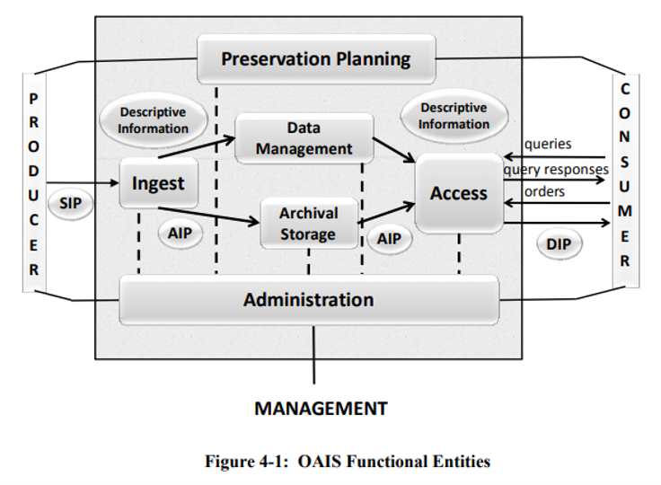
Open Archival Information System (OAIS) Reference Model
“An OAIS is an Archive, consisting of an organization, which may be part of a larger organization, of people and systems that has accepted the responsibility to preserve information and make it available for a Designated Community.”
https://public.ccsds.org/pubs/650x0m2.pdf

Slide 17
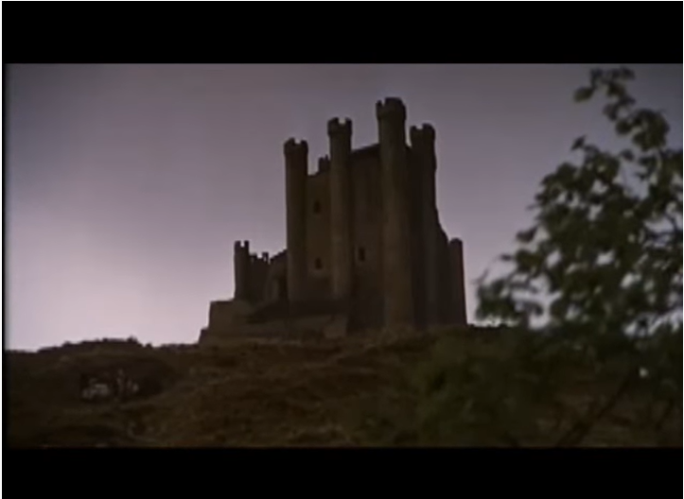
OAIS: It’s Only a Model
Provides a framework but not implementation guidelines
Defines core functions of an archive:
  Ingest
  Archival storage
  Data management
  Access
  Preservation planning
  Administration
Camelot! (It’s only a model)
Monty Python and the Holy Grail - https://www.youtube.com/watch?v=m3dZl3yfGpc

Slide 18
OAIS: It’s Only a Model
Provides a framework but not implementation guidelines
Defines core functions of an archive:
  Ingest
  Archival storage
  Data management
  Access
  Preservation planning
  Administration
https://public.ccsds.org/pubs/650x0m2.pdf

Slide 19
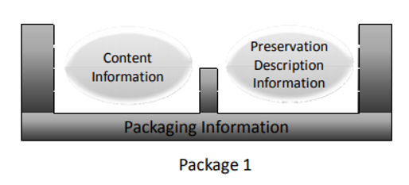
OAIS Information Model
An “Information Package” consists of:
  Content Information (the data)
  Preservation Description Information (metadata)
Types of Information Packages:
  Submission Information Package (SIP): transferred by Producer
  Archival Information Package (AIP): generated by Archives; may include additional metadata as well as normalized version of content
  Dissemination Information Package (DIP): provided to users
https://public.ccsds.org/pubs/650x0m2.pdf

Slide 20
Elements of a Digital Preservation Program

Slide 21
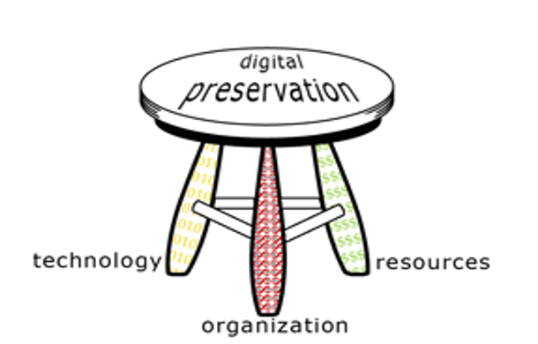
Key Components of a Digital Preservation Program
Organization: policies, procedures, and staff
Resources: $$$$$
Technology: software, hardware, storage
https://dpworkshop.org/dpm-eng/conclusion.html
Notes:
Organizational Infrastructure includes the policies, procedures, practices, people—the elements that any programmatic area needs to thrive, but specialized to address digital preservation requirements. It addresses this key development question:
What are the requirements and parameters for the organization's digital preservation program?
Technological Infrastructure consists of the requisite equipment, software, hardware, a secure environment, and skills to establish and maintain the digital preservation program. It anticipates and responds wisely to changing technology. It addresses this key development question:
How will the organization meet defined digital preservation requirements?
Resources Framework addresses the requisite startup, ongoing, and contingency funding to enable and sustain the digital preservation program. It addresses this key development question:
What resources will it take to develop and maintain the organization’s digital preservation program?

Slide 22
Organizational Readiness
Mandate: why preserve content? (hint: designated community!!)
Advocacy and education around:
  Benefits
  Costs
  Responsibilities
Collecting policy: what kinds of materials will be acquired?
Staffing: “No One Cooks the Bacon Alone” – it’s a team effort!

Slide 23
How to Preserve? High-Level Steps
Evaluate resources and assets:
  What are unique needs of users and content?
  What tools and resources are available?
  What strategies are sustainable?
Threat assessment and risk mitigation
Establish a preservation policy: what strategies will you employ to maintain access for the long-term?
Audit and assessment: are preservation actions successful?

Slide 24
Threat Assessment and Risk Mitigation
Threats:
  User error or neglect
  Malicious attack
  Infrastructure failure
  Technical obsolescence (formats, software, hardware)
  Financial distress
  Loss of staff (with institutional knowledge and skills)
  Disaster scenarios
Risks:
  Content is unavailable.
  Content is corrupted or lost.
  Content is complete but cannot be rendered with available software.
  Content is complete but metadata issues prevent discovery, reuse, or interpretation.
  Content is not trusted as authentic or reliable due to undocumented acquisition or changes over time.

Slide 25
Essential Digital Preservation Strategies
Basic strategies:
  Intellectual control: inventory and core metadata
  Bitstream preservation: maintain sequence of bits in their original state
    Checksum calculation, documentation, and verification (fixity)
    Example (MD5): a05d0ea2d2ba9abd8a75d7e184644ed2 test-file.txt
  Data replication (at least 2 copies in separate locations) and regular storage replacement
More advanced strategies:
  File format identification (e.g., with PRONOM format registry and DROID utility)
  Technical metadata extraction (e.g., with Apache Tika, MediaInfo, Exiftool, etc.)
  Sensitive data detection (e.g., with bulk_extractor, Spirion, etc.)
  Documenting preservation actions (e.g., with PREMIS schema)

Slide 26
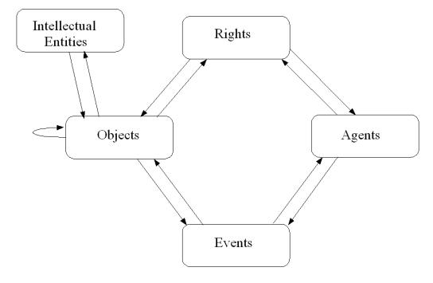
PREMIS: PREservation Metadata Implementation Strategies
http://www.loc.gov/standards/premis/

Slide 27
Sample PREMIS (HathiTrust)
<PREMIS:event>
<PREMIS:eventIdentifier>
<PREMIS:eventIdentifierValue>fixity check1</PREMIS:eventIdentifierValue>
</PREMIS:eventIdentifier>
<PREMIS:eventType>fixity check</PREMIS:eventType>
<PREMIS:eventDateTime>2009-06-26T06:35:11</PREMIS:eventDateTime>
<PREMIS:eventOutcomeInformation>
<PREMIS:eventOutcomeDetail>pass</PREMIS:eventOutcomeDetail>
</PREMIS:eventOutcomeInformation>
<PREMIS:linkingAgentIdentifier>
<PREMIS:linkingAgentIdentifierType>AgentID</PREMIS:linkingAgentIdentifierType>
<PREMIS:linkingAgentIdentifierValue>UM</PREMIS:linkingAgentIdentifierValue>
</PREMIS:linkingAgentIdentifier>
</PREMIS:event>
(Type of event)
(Timestamp for event)
(Event outcome)
(Agent that performed event)

Slide 28
Beyond Bit-Level Preservation
Migration:
  Maintain access to information by converting from original file format (and bit sequence) to a more accessible and/or sustainable format
  Original file is usually maintained alongside preservation copy
Emulation:
  Reproduce the behavior of hardware and/or software in a different technological environment
  See: Emulation-as-a-Service-Infrastructure project (EaaSI) at Yale
Advanced tools: bundle microservice workflows with storage management
  Archivematica
  Preservica

Slide 29
Characteristics of Successful Preservation
Utility: data are accessible and usable
Authenticity: data are what they claim to be
Integrity: data are stable and do not change unexpectedly
Security: data do not pose risks for users (or the repository)
Scalability: solutions can accommodate growing collections
Sustainability: solutions are appropriate for local resources
Transparency: stakeholders understand roles, responsibilities and procedures
All of which promotes trust in the data and institution!
Notes:
Utility: preservation is for use.
If content is not used, should we keep it?
If we can’t provide usable copies or support use, should we keep it?
Accessibility...
Authenticity: the digital content is what it claims to be
Integrity: the digital content has not changed unexpectedly: it remains the same
Security
Data is safe (backup/redundancy; disaster recovery; the bits remain the same)
Users are safe (viruses/malware)
Institution is safe (risk management related to rights, donor agreements, access requirements)
Sustainability
The data is accessible and usable over time
The institution has sufficient resources, staffing, and expertise to manage and provide access to data
Community: (you go faster alone but farther together)
Tools
Standards (metadata, file formats)
Best practices

Slide 30
Assessing Digital Preservation Practices

Slide 31
NDSA Levels of Preservation
Organized into five functional areas:
  Storage
  Integrity
  Control (information security)
  Metadata
  Content
Progressive levels; lower ones reflect most immediate needs or are prerequisites for higher ones:
  Level 1: Know your content (most basic)
  Level 2: Protect your content
  Level 3: Monitor your content
  Level 4: Sustain your content (most advanced)

Slide 32
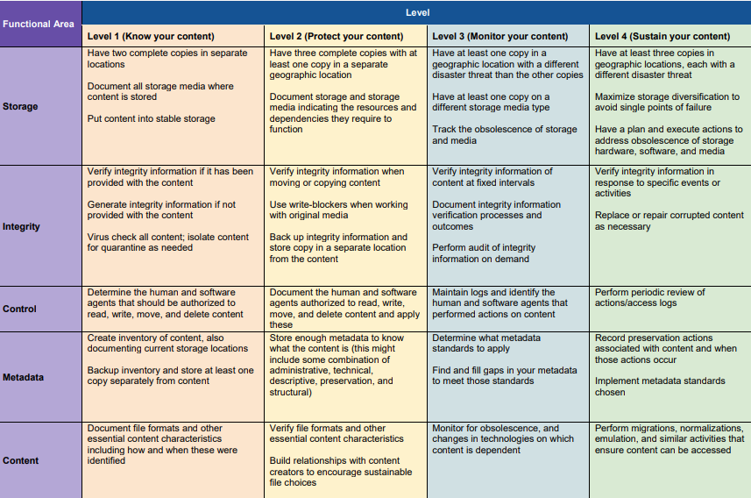

Slide 33
ISO 16363: Trustworthy Digital Repositories
Based on Trustworthy Repositories Audit & Certification: Criteria and Checklist (TRAC; 2011)
Provides evaluation criteria in three areas:
  Organizational infrastructure
  Digital object management
  Infrastructure and security risk
Requires thorough documentation of policies and procedures.
May be used for self-audit or ISO-endorsed accreditation.

Slide 34

CoreTrustSeal
An international, community based, non-governmental, and non-profit organization launched in 2017.
Defines 16 core requirements for Trustworthy Data Repositories.
Offers core level certification for Trustworthy Data Repositories holding data for long-term preservation.

Slide 35
Digital Preservation at ICPSR

Slide 36
ICPSR Digital Preservation Policy Framework
Highest level digital preservation policy document at ICPSR; reflects the goals defined in the ICPSR Strategic Plan.
Makes explicit ICPSR's commitment to preserving the digital assets in its collections.
Informed by the OCLC-RLG report Trusted Digital Repositories: Attributes and Responsibilities (2002):
  OAIS compliance
  Administrative responsibility
  Organizational viability
  Financial sustainability
  Technological and procedural suitability
  Systems security
  Procedural accountability

Slide 37
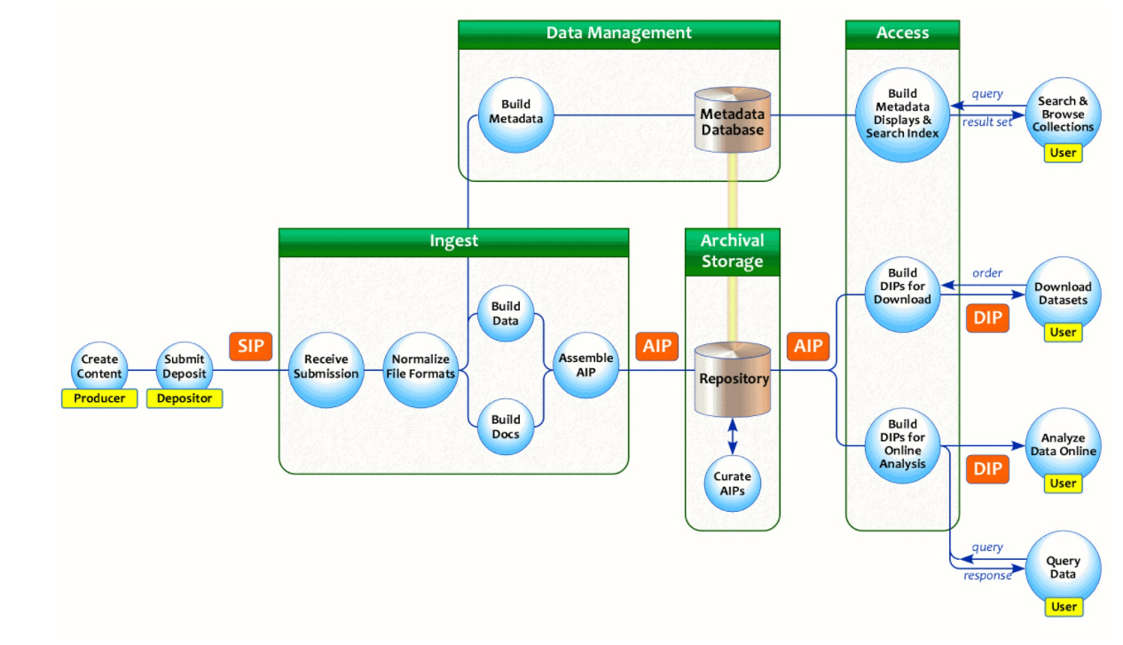
1. OAIS Compliance
https://www.icpsr.umich.edu/web/pages/datamanagement/lifecycle/oais.html

Slide 38
2. Administrative Responsibility
ICPSR was established in 1962 as a data archive within the Institute for Social Research at the University of Michigan.
ICPSR has had a fundamental commitment to and successful track record of acquiring and ensuring long-term access to digital assets.
ICPSR’s mandate for digital preservation reflects:
  Scholarly mission of ISR and UM
  Service to member organizations
  Contractual obligations and grants

Slide 39
3. Organizational Viability
The digital preservation function is integrated into the operations and planning of ICPSR and throughout the digital content lifecycle:
  Project Managers: Identify data suitable for acquisition; ensure all data are included in deposits; prepare metadata.
  Curation: Normalize and clean data; document provenance and preservation actions; create metadata and processing history files.
  CNS: Maintain IT infrastructure that ingests, stores, manages, and provides access to files.
  Summer Program: Provide training in data stewardship and use.
  Metadata & Preservation: Maintain and develop preservation policies and strategies; develop metadata standards to ensure long-term use of data.
  BCD/Membership: Find funding to support long-term preservation.
  Administration: Allocate resources and facilitate collaboration to keep repository running.

Slide 40
4. Financial Sustainability
A portion of ICPSR’s membership support is allocated to digital preservation services.
External research funding extends ICPSR’s digital preservation scope and capabilities.
ICPSR has long-standing and emerging partnerships with other organizations for digital preservation cooperation and collaboration.

Slide 41
5. Technological and Procedural Suitability
ICPSR has adopted normalization and migration as its primary digital preservation strategies (in addition to data clean up and metadata creation).
  Normalization produces a standardized set of file formats to manage and preserve: ASCII for text, or TIFF for images.
  Migration converts digital content to current file formats as software and related technology evolve and copies digital content from older to newer storage media as part of a systematic program.
Both original deposit materials and normalized versions are included in Archival Information Packages.
ICPSR maintains five copies of content on site and across the US in multiple technologies.

Slide 42
6. System Security
Regular maintenance and upgrades to system infrastructure.
Secure workspaces for content curation.
Active use of checksums to ensure file integrity from receipt onward.
Periodic reviews and audits of its digital content in archival storage.
Policies and tools for user access to restricted data.

Slide 43
7. Procedural Accountability
Demonstrated commitment to assessments and transparency:
  Test case for Trusted Repositories Audit & Certification (TRAC) in 2006.
  One of the first six data repositories to earn the Data Seal of Approval in 2011.
  Earned the World Data System certification in 2013.
  Undertook TRAC/ISO 16363 self-assessment from 2010-2013.
  Certified by the CoreTrustSeal Board in 2019.
Regular reviews of digital preservation policy framework.

Slide 44
What’s Next?
Research Data Ecosystem (RDE) will include:
  New content types such as video and social media data
  DM3 data model and new metadata schema and standards
  New tools and platforms
Opportunity to:
  Develop new preservation strategies and workflows.
  Expand the range of collected technical and preservation metadata.
  Enhance our ability to reuse this metadata for preservation and access.

