Slide 1

Doing More with Metadata:
Documenting Variable Comparability using DDI-Lifecycle
M&P Deep Dive
Sanda Ionescu
Metadata Specialist
ICPSR
Notes:
Good afternoon! My name is Sanda Ionescu and today, I will be discussing documenting variable comparability using DDI-Lifecycle, a newer development line of the DDI metadata suite of products, featuring added support for grouping items, information reuse, and documenting variable comparability across studies or series of studies.

Slide 2
DDI-Codebook for single studies
Closely follows the “sequential” structure and content organization of a traditional print codebook
Main sections:
Document description
  Self-referencing information about the DDI instance at hand. For internal use (archival-specific), not publicly displayed
Study description
  General information about a study. Mirrors the introductory part of a codebook, describing study scope, coverage, methodology, related publications, etc.
File description
  Physical characteristics of data file(s) – name, format, structure, dimensions.
Data description
  Detailed description of each variable, including variable groups if applicable
Other (study-related) materials
  References or contains materials used in the production of the study or useful in the analysis of the data
Notes:
In November, I presented a deep dive staff Webinar on DDI-Codebook metadata, which is used to document single studies. ICPSR uses DDI-Codebook extensively to document our curated collections. DDI is simple to understand and use, and it’s built into the core tools ICPSR curation staff use to curate our studies.

Slide 3
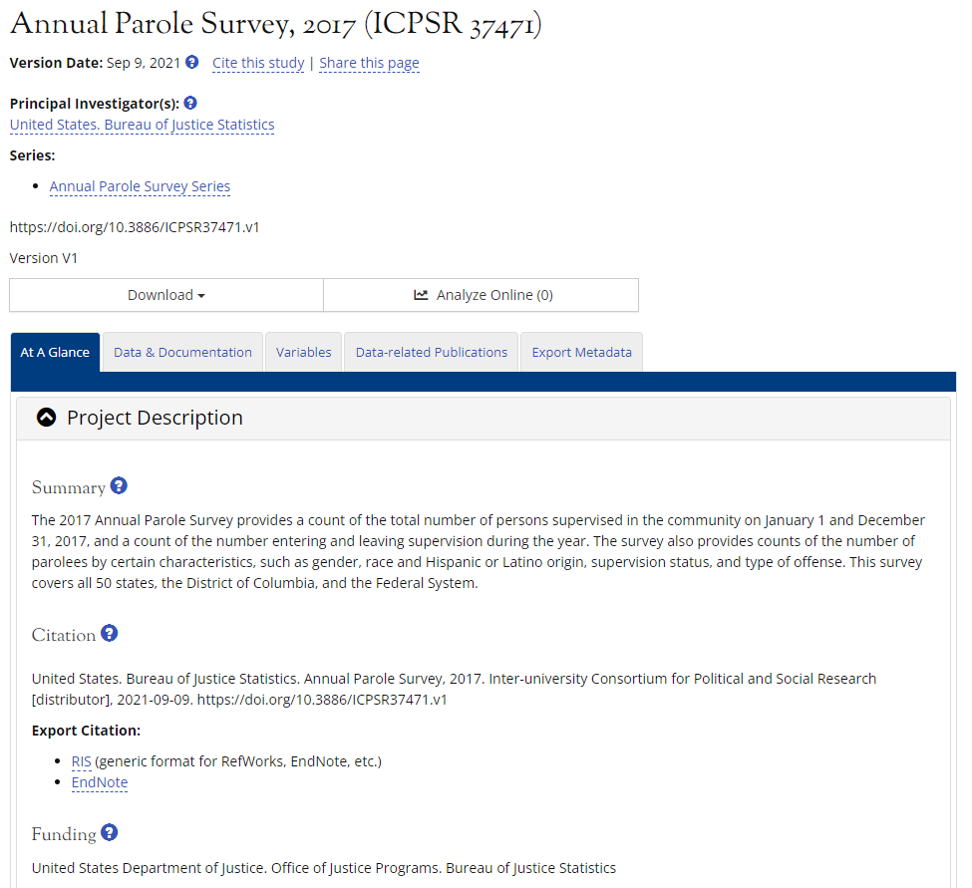
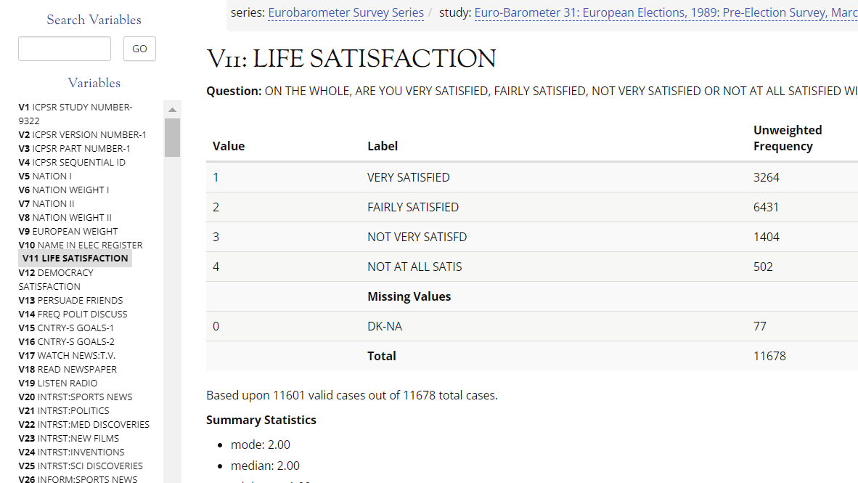
DDI-Codebook at ICPSR
DDI-C for Metadata Records
DDI-C for Variable Descriptions
Notes:
DDI lets us mark up our study- and variable-level metadata so users can find, understand, and re-use our data collections.

Slide 4
DDI-Lifecycle for longitudinal data
DDI-L adds metadata value for variable comparison and harmonization
  Allows grouping and linking comparable items
Series: National Social Life, Health, and Aging Project (NSHAP)
NSHAP Wave 1
2005-2006
NSHAP Wave 2
2010-2011
NSHAP Wave 3
2015-106
Wave 4 …
Variables
…….
ATTEND
SOCIAL
FAMRELY
FAMOPEN
SAMEBED
HEALTH
……..
Variables
…….
ATTEND
SOCIAL
FAMRELY2
FAMOPEN2
SAMEBED2
……..
Variables
….....
ATTEND
SOCIAL
FAMRELY2
FAMOPEN2
SAMEBED3
………

Slide 5
DDI-Lifecycle for longitudinal data
Documents
  Variable comparability
  Degree of comparability
Example: variables FAMOPEN and FAMOPEN2
  Question: How often can you open up to members of your family if you need to talk about your worries?
Wave 1: FAMOPEN
0 if volunteered – no family
hardly ever (or never)
some of the time
often
Wave 2: FAMOPEN2
0 never
hardly ever or rarely
some of the time
often
if volunteered – no family
Wave 3: FAMOPEN2
0 never
hardly ever or rarely
some of the time
often
if volunteered – no family
Notes:
Example of a question that was asked in all 3 waves
The wording of the question was exactly the same
But the response categories were changed from W1 to the next 2 waves

Slide 6
DDI-Lifecycle for longitudinal data
Traditional crosswalk: suggests comparability
  All comparable items entered on the same row
Wave 1 | Wave 2 | Wave 3
VOLUNTEER | VOLUNTEER | VOLUNTEER
SONS | SONS
FAMOPEN | FAMOPEN2 | FAMOPEN2
SAMEBED | SAMEBED2 | SAMEBED3
 | BREAKBONE | BREAKBONE3
Notes:
In a traditional crosswalk, all comparable items will be entered on the same row in a table format,
irrespective of whether they are identical or there are differences among them

Slide 7
DDI-Lifecycle for longitudinal data
DDI-L variable cascade uses the variables’ physical representation to suggest degree of comparability:
Concept: How often can R open up to family
Representation A:
0 if volunteered – no family
hardly ever (or never)
some of the time
often
Representation B:
0 never
hardly ever or rarely
some of the time
often
if volunteered – no family
W1: FAMOPEN
W2: FAMOPEN2
W3: FAMOPEN2
Data harmonization needed
Are directly comparable
Notes:
In DDI-L the variable cascade goes one step further, to suggest not only comparability,
but also the degree to which items may be comparable.
Example: one concept measured in two different ways – which means it has two different types of representation, suggesting the need for a different treatment of the data for comparison purposes.
While the variables from w2 and w3 are directly comparable because they have the same representation, the data need to be harmonized before we can compare them to the w1 variable which has a different representation

Slide 8
DDI-Lifecycle for longitudinal data
  DDI-L crosswalk: a cascading structure
Conceptual Var. Group | Conceptual Variable | Represented Variable | Instance Variable W1 | Instance Variable W2 | Instance Variable W3
Support from Family and Friends | C_FAMOPEN
 |  | R_FAMOPEN | FAMOPEN
 |  | R_FAMOPEN2 |  | FAMOPEN2 | FAMOPEN2
Notes:
A DDI-L type of crosswalk will differ from a traditional one in that it will not necessarily place all of the comparable variables on a single row in a table, but will rather use a cascading structure, which also indicates the degree to which they are comparable.

Slide 9
DDI Deep Dive – DDI-Lifecycle
Outline
DDI-Lifecycle: a product of the DDI Alliance
  New features, new functionality
Modular design
  Modules and schemes
  The variable “explosion”
The variable cascade
  Variable comparison across datasets
DDI-Lifecycle tools
  The Colectica suite
DDI-Lifecycle projects at ICPSR
  Cross-wave comparison – the NSHAP* longitudinal series
  Cross-series comparison – the NSHAP-NHATS* concordance
*NSHAP – The National Social Life, Health and Aging Project
*NHATS – The National Health and Aging Trends Study

Slide 10
DDI-Lifecycle – A product of the DDI Alliance
The Data Documentation Initiative (DDI) - a metadata standard for documenting data from the social, economic, and behavioral sciences
  Expressed in XML (eXtensible Markup Language)
  Two development lines:
    DDI-Codebook (DDI-C) – V 1.0 to V 2.5, V 2.6 in development
    DDI-Lifecycle (DDI-L) – V 3.0 to V 3.3
Both DDI products can be used successfully, for different purposes
  DDI-Codebook
    Study descriptions
    Individual, stand-alone studies/datasets
  DDI-Lifecyle
    In-depth documentation of longitudinal/time-series data
    Variable comparison across datasets

Slide 11
DDI-Lifecycle: Advantages
  Supports the reuse of information
  Supports the creation of metadata registries (e.g., concept/question/variable banks)
  Allows flexibility in organizing information
  Supports grouping related studies and comparing variables across datasets

Slide 12
DDI-Lifecycle – Modular design
DDI-C is conceived as a single file, with a sequential structure.
  Single instance includes study-level metadata, file descriptions, individual variable descriptions and related resources
DDI-L has a modular architecture, mirroring a database structure and type of relationships
  Items of the same “type” are bundled together and their relationships are realized through cross-referencing.
  This type of structure supports the reuse of information - a valuable new feature of DDI-L

Slide 13
DDI-Lifecycle - Modular design
Building blocks of the modular structure
  Modules
  Schemes
Modules
  Document different aspects, or stages in the life cycle of a study
  Can live independently (they have their own schemas) or they may be connected to one another
  Modeled as a multi-branched hierarchy

Slide 14
DDI-L modular design
Modules
DDI Instance
Study Unit
Group
Resource Package
Conceptual
Components
Data
Collection
Archive
Study
Unit
Subgroup
Study
Unit
(Sub)group
Organizations
Study
Unit
Subgroup

Slide 15
DDI-L modular design
Schemes
Schemes
  Collections of sibling “objects”, including the traditional components of a variable description: variable names and labels, questions, concepts, universes, values, value labels…
  Can live semi-independently (need a higher level wrapper) or in-line within modules

Slide 16
DDI-L modular design
Schemes
Schemes (within modules):
Study Unit
Data
Collection
Logical
Product
Physical Data
Product
Variable Scheme
(Variable names and labels)
Code List Scheme
(Codes/Values)
Category Scheme
(Value Labels)
References
References

Slide 17
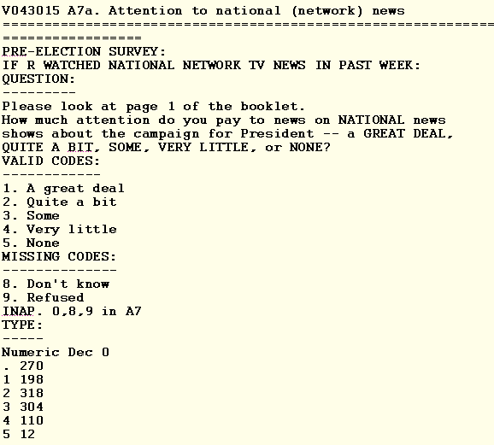
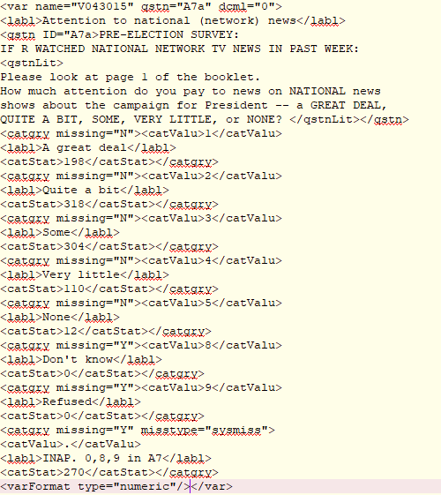
Variable markup in DDI-C (V043015, ANES 2004 – ICPSR 4245)
Print codebook :
DDI 2.5:

Slide 18
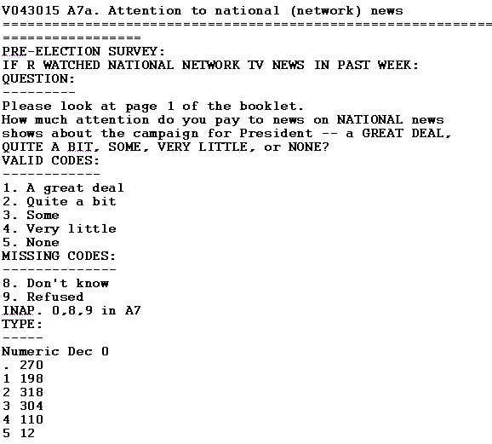
Variable markup in DDI-L
Modular structure: the variable explosion
Logical Product:
Variable Scheme
Conceptual Component:
Concept Scheme
Data Collection:
Question Scheme
Logical Product:
Code Scheme
Conceptual Component:
Universe Scheme
Logical Product:
Category Scheme
Physical Instance:
Statistics

Slide 19
DDI-Lifecycle: Modular design
More complex
More challenging to implement
Precludes manual editing
Significant advantages:
  Supports the reuse of information
  Supports the creation of metadata registries (eg., concept/question/variable banks)
  Allows flexibility in organizing the DDI Instance
  Supports grouping related studies and comparing variables across datasets
Notes:
Need for tools

Slide 20
DDI-Lifecycle – The variable cascade
The variable cascade – new feature in DDI-L
  Supports variable comparison across datasets (studies, series of studies)
  Useful in documenting longitudinal and time-series data
(Instance) variables are the actual variables in the dataset(s)
Conceptual Variable
Documents the “concept” measured
Includes the question asked or a description of the variable
Represented Variable
Adds the variable’s physical representation
Represented Variable
Adds the variable’s physical representation
(Instance) Variable
Adds summary statistics and category frequencies
(Instance) Variable
Adds summary statistics and category frequencies
(Instance) Variable
Adds summary statistics and category frequencies

Slide 21
DDI-Lifecycle: The variable cascade
Example: variables FAMOPEN and FAMOPEN2 from NSHAP (ICPSR#36873)
Same concept, different representations
Question: How often can you open up to members of your family if you need to talk about your worries?
Concept: How often can R open up to family?
Wave 1: FAMOPEN
0 if volunteered – no family
hardly ever (or never)
some of the time
often
Wave 2: FAMOPEN2
0 never
hardly ever or rarely
some of the time
often
if volunteered – no family
Wave 3: FAMOPEN2
0 never
hardly ever or rarely
some of the time
often
if volunteered – no family
Data harmonization needed
Directly comparable

Slide 22
DDI-Lifecycle: The variable cascade
By making a distinction between different (physical) representations, the variable cascade documents both comparability and degree of comparability
Conceptual Variable
CONCEPT_FAMOPEN
(common question/concept)
Represented Variable
REPR_FAMOPEN
(Wave 1 – values 0-3 and value labels)
Represented Variable
REPR_FAMOPEN2
(Waves 2-3 – values 0-4 and value labels)
(Instance) Variable
FAMOPEN (Wave 1 -
Includes frequencies)
(Instance) Variable
FAMOPEN2 (Wave 2 -Includes frequencies)
(Instance) Variable
FAMOPEN2 (Wave 3 –
Includes frequencies)

Slide 23
DDI-Lifecycle: The variable cascade
(Instance) variables are “real” variables
  They document actual data points in a data set
Conceptual variables and represented variable are theoretical constructs
  Created by the person(s) who are producing the metadata
  Result from an in-depth evaluation of all (instance) variable pairs
  Represent value added content in the documentation

Slide 24
Working with DDI-Lifecycle: Tools
The Colectica suite
  Colectica Designer
    DDI-L editor
    Multiple formats converter
      Imports a variety of machine-readable formats
        Data and metadata in statistical formats (SAS, SPSS, Stata, Excel, and CSV)
        Machine-readable survey instruments/questionnaires (Blaise, CASES, IBM SPSS Data Collection / SPSS Dimensions, QueXML, REDCap
        Other structured/machine-readable metadata resources (code lists, metadata spreadsheets, DDI-C and DDI-L)
      Exports both DDI-C and DDI-L
      Can serve as a DDI-C to DDI-L converter

Slide 25
Working with DDI-Lifecycle: Tools
The Colectica suite
Colectica Repository
  A centralized storage system for managing data resources, enabling collaborative workflows, providing automatic version control
Colectica Portal
  Web application for data and metadata publication and discovery
  Supports metadata browsing and searching
  Interactive display of cross-study variable comparison information, based on the DDI-L variable cascade

Slide 26
DDI-Lifecycle at ICPSR: The NSHAP project
Fall of 2018: ICPSR’s National Archive of Computerized Data on Aging (NACDA) acquired a Colectica repository and portal to host future DDI-L projects
Pilot project, January-March 2019
  Create, and display DDI-L documentation for the National Social Life, Health, and Aging Project (NSHAP) – core data, waves 1-3
  Served as proof of concept for extending the use of DDI-L to other NACDA studies
NSHAP Waves 1-3 already processed, archived and disseminated following ICPSR standards
      Clean, verified data and documentation, including DDI 2.5 variable descriptions enhanced with question text and variable groups
      Served as starting point for our DDI-L project

Slide 27
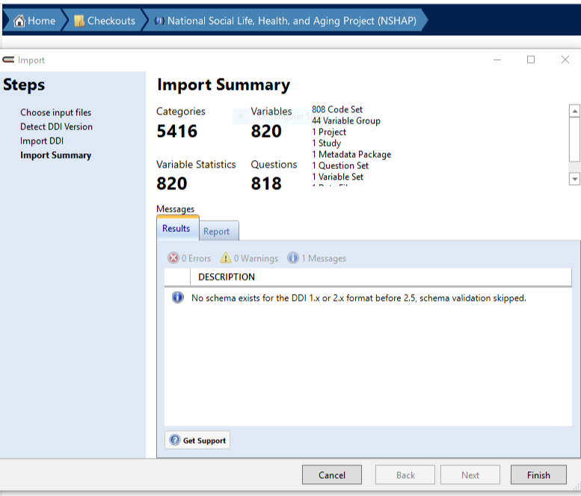
Creating DDI-L for the NSHAP series
Steps to DDI 3.2:
1. Import pre-existing DDI 2.5 for individual waves into Colectica Designer:
Imported fields:
Variable groups
Variable name
Variable label
Summary statistics
Values
Value labels
Category statistics
Missing data information
Question text
(Descriptive text)
Variable notes, if present in DDI-C, are *not* imported (they are not part of the variable description in DDI-L)

Slide 28
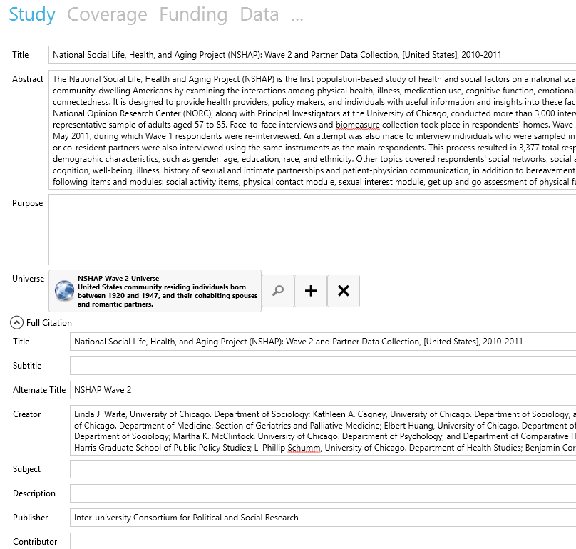
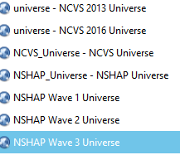
Creating DDI-L for the NSHAP series
2. Complete study description fields in Colectica Designer
- Easy and convenient editing
- Entries follow the DDI-L structure
- Allows content reuse:
Searches pre-existing metadata created in the Designer
Saves new content and makes it available for future reuse

Slide 29
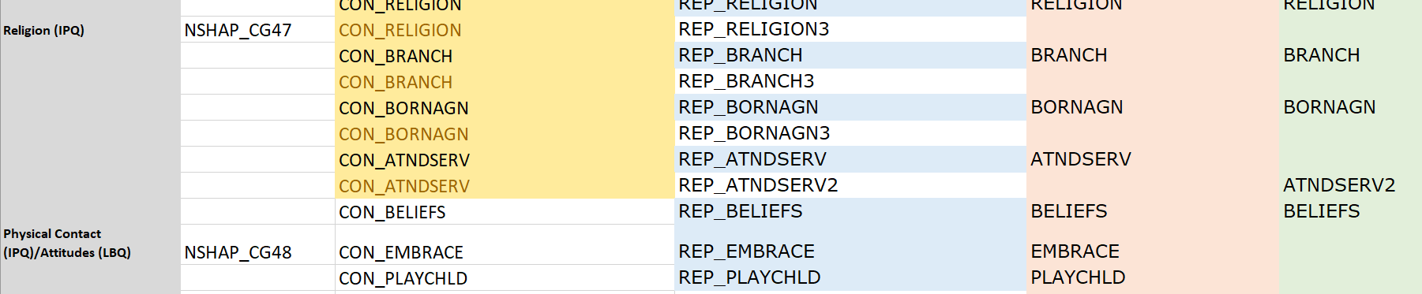
Creating DDI-L for the NSHAP series
3. Document comparability across waves in a format compliant with the DDI-L variable cascade
  Compare variable lists (from SPSS setups) to identify which questions were repeated, and in which wave(s)
  Identify changes in variables representation across waves
  Create represented variables as appropriate
  Create conceptual variables to link comparable represented variables
  Create conceptual variable groups to assist in browsing by topic
  Crosswalk created in Excel format

Slide 30
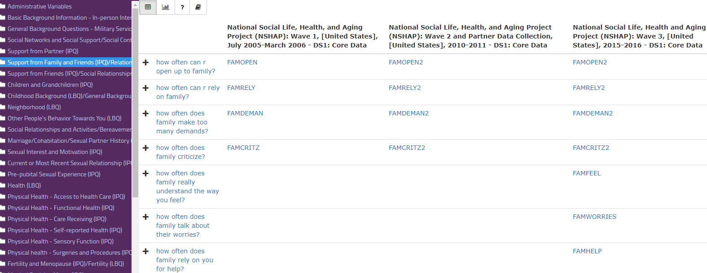
Creating DDI-L for the NSHAP Series
NSHAP Waves 1-3 now publicly available on the portal
  “Browse by concept” view and initial crosswalk view

Slide 31
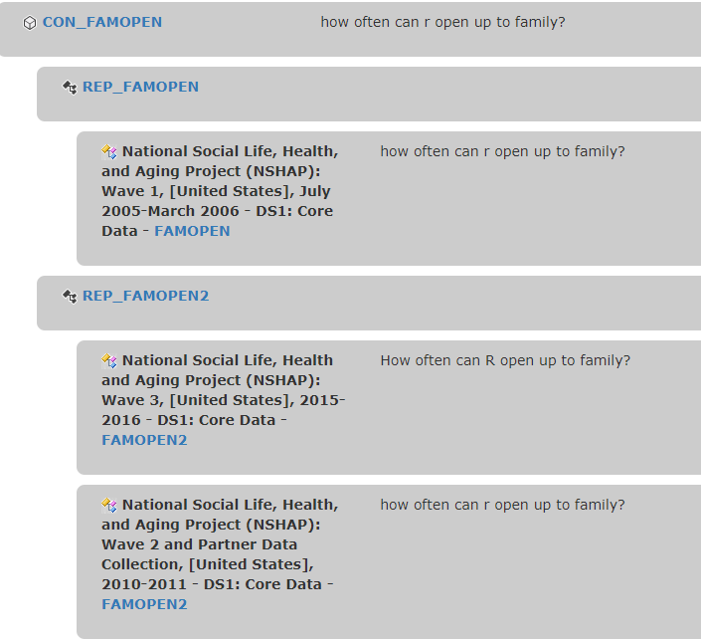
Creating DDI-L for the NSHAP Series
Correspondence Tree

Slide 32
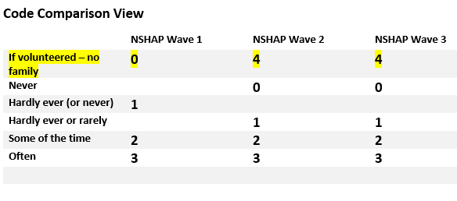
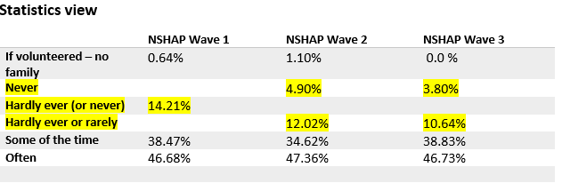
Creating DDI-L for the NSHAP Series
The three types of concordance views are also available from the individual variable description page

Slide 33
DDI-L metadata for cross-series concordances
The NSHAP-NHATS crosswalk
Steps
  Starting point: DDI-L documentation for each individual series, including variable cascades
    Comparable variables from each series are already linked by a common conceptual variable
  Challenge: find comparability among variables from 11 individual waves (3 from NSHAP and 8 from NHATS)
    DDI-enabled solution:
    Examine, and find matches between conceptual variables from each series
    Create new, unifying concept (DDI conceptual variable) that links the conceptual variables from the individual series
      Project-created and assigned
      Allows pulling together all of the comparable (instance) variables from the individual waves.

Slide 34
DDI-L metadata for cross-series concordances
Matching DDI-L concepts to compare across series
Cross-series conceptual variable
HYPERTENSION
NSHAP Conceptual Variable
EVER HAD HYPERTENSION
NHATS Conceptual Variable
HAS HIGH BLOOD PRESSURE
NSHAP Represented Variable
HYPERTENSION
NHATS Represented Variable
High BP
NSHAP
Wave 1
Hypertension
NSHAP
Wave 2
Hypertension
NSHAP
Wave 3
Hypertension
NHATS
Wave 1
High BP
NHATS
Wave 2
High BP
NHATS
Wave 3
High BP
NHATS
Wave 8
High BP
…

Slide 35
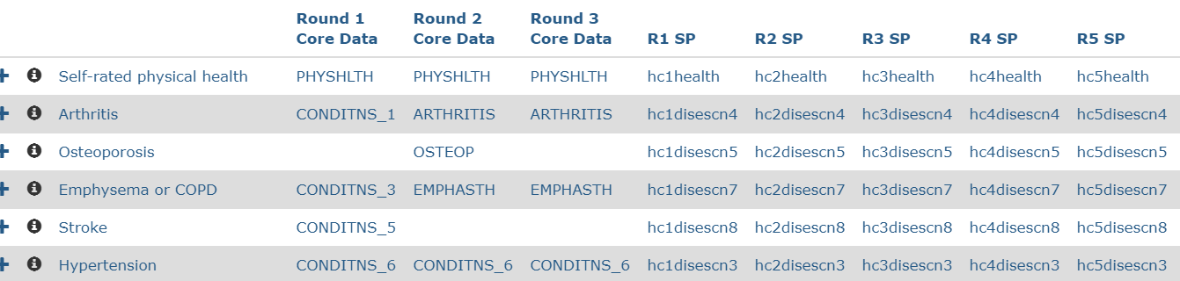
DDI-L metadata for cross-series concordances
NSHAP Variables
NHATS Variables
Series-specific conceptual and represented variables and comparison views available when selecting the common concept

Slide 36
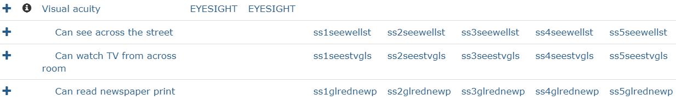
DDI-L metadata for cross-series concordances
Four types of variable comparability
  Directly comparable
  Need harmonization
  Related concepts
  One-to-many or many-to-one matches
    Example:
NSHAP
NHATS

Slide 37
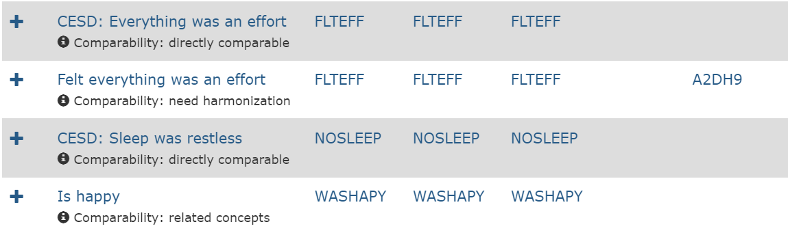
DDI-L metadata for cross-series concordances
In the cross-series crosswalks, the type of comparability is displayed on the Colectica Portal for each set of comparable variables
inches

Slide 38
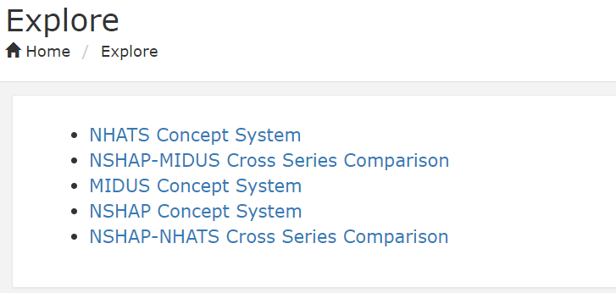
DDI-Lifecycle projects on the Colectica Portal
        Upcoming: The Irish Longitudinal Study on Ageing (TILDA),
        waves 1-3

Slide 39

Questions?
Comments?
                Thank you!

