Slide 1
Doing More with Metadata:
Other Standards
ICPSR Metadata & Preservation “Deep Dive”
April 14, 2022
Mike Shallcross, jay winkler, Jared Lyle
(with support from Sanda Ionescu)
Notes:
While ICPSR makes heavy use of DDI metadata, we also use other metadata standards, including MARC, Dublin Core, and Schema.org. In this ICPSR staff Webinar, we will discuss other metadata standards that are available, their benefits and drawbacks, how ICPSR uses some of them in current work, and how ICPSR can (and should) use other standards in current and developing work.

Slide 2
M&P Deep Dives
This Webinar is part of a monthly series of virtual learning sessions for staff by the Metadata & Preservation unit.
The series will provide a “deep dive” into the steps taken and the standards used by ICPSR to make data Findable, Accessible, Interoperable, and Reusable (FAIR) -- both today and over time.
For more details about the series: https://bit.ly/icpsr-fair-deep-dive

Slide 3
Agenda
Introduction to Metadata Standards
Overview of the ICPSR Metadata Landscape
ICPSR’s Use of Metadata Standards
Future Work with Metadata Standards

Slide 4
Introduction to Metadata Standards

Slide 5
What are Metadata?
“Data about data”
“Information which describes significant aspects of a resource” (Digital Preservation Coalition Glossary)
“Information about data that promotes discovery, structures data objects, and supports the administration and preservation of records” (SAA Dictionary of Archives Terminology)

Slide 6
Data Without Metadata
01000001 01101110 00100000 01101001 01101110 01110100 01100101 01110010 01101110 01100001 01110100 01101001 01101111 01101110 01100001 01101100 00100000 01100011 01101111 01101110 01110011 01101111 01110010 01110100 01101001 01110101 01101101 00100000 01101111 01100110 00100000 01101101 01101111 01101100 00100000 01000001 01101110 00100000 01101001 01101110 01110100 01100101 01110010 01101110 01100001 01110100 01101001 01101111 01101110 01100001 01101100 00100000 01100011 01101111 01101110 01110011 01000001 01101110 00100000 01101001 01101110 01110100 01100101 01110010 01101110 01100001 01110100 01101001 01101111 01101110 01100001 01101100 00100000 01100011 01101111 01101110 01110011

Slide 7
Categories of Metadata
Descriptive metadata: facilitate resource identification and exploration
Administrative metadata: support resource management
  Rights metadata: address issues around access and use
  Technical metadata: information required to render and display content
  Preservation metadata: ensure ongoing access and trust in content
Structural metadata: relate components of complex objects

Slide 8
The Added Value of Metadata
Internal Users (ICPSR)
Manage
Provide (and limit) access
Relate content
Preserve
External Users (Researchers)
Find and discover
Evaluate and select
Access and use
Cite and share

Slide 9
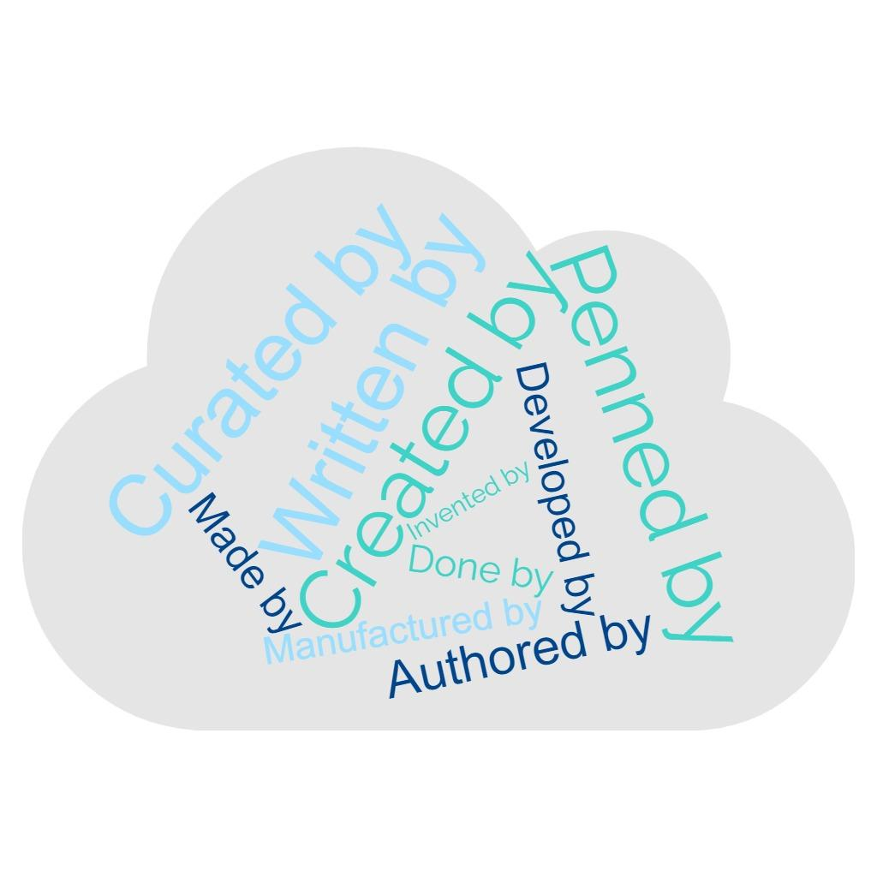
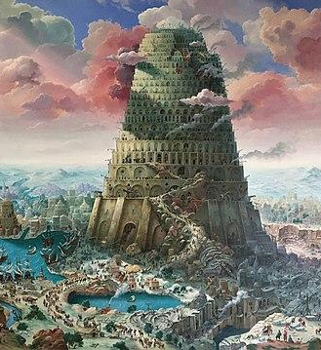
So, How Do You Speak “Metadata”?
Александр Михальчук, CC BY-SA 4.0 <https://creativecommons.org/licenses/by-sa/4.0>, via Wikimedia Commons

Slide 10
Metadata Standards: Consensus and Consistency
High level documents that establish a common way of structuring and understanding information (with principles and guidelines)
Developed by experts, recognized by authoritative bodies (e.g., ISO or W3C), and maintained over time by a stable institutional ‘home’
Types:
  Data structure standards (schema): identify the categories of information (“elements”) that can be used in a metadata record
  Data value standards: provide controlled vocabularies, authorities, and other sources of standardized terms and names used to create metadata
  Data content standards: establish guidelines for how to input information into records
  Data exchange standards: define how metadata should be structured for sharing (e.g., XML, JSON, RDF)
Notes:
“Standards enable information to be appropriately compared with predictable outcomes.” Green, A. E., & Humphrey, C. (2014). Building the DDI. IASSIST Quarterly, 37(1-4), 36. https://doi.org/10.29173/iq500
Even though a 2011 survey of 1,329 scientists about data sharing showed “over 78% of survey respondents either use no metadata or a local home grown metadata approach,” data repositories understand and value metadata standards. See: Tenopir C, Allard S, Douglass K, Aydinoglu AU, Wu L, et al. (2011) Data Sharing by Scientists: Practices and Perceptions. PLOS ONE 6(6): e21101. https://doi.org/10.1371/journal.pone.0021101

Slide 11
Benefits of Metadata Standards
FAIR: Findable, Accessible, Interoperable, Reusable
Shared understanding of what specific pieces of information are supposed to mean
Developed via input from all stakeholders: depositors, archives, users
  Especially useful for emerging data types.
Interoperability: metadata can be shared between institutions and systems
Structure: allows metadata to be “consumed” (and used!) by computers (as well as humans)

Slide 12
Overview of the ICPSR Metadata Landscape

Slide 13
Review: Data Documentation Initiative (DDI)
Built to provide a structured framework for describing social science surveys, but has since grown to include a broad range of data types
  Basic descriptive content for variables, files, source material, and study level information.
  Supports discovery, preservation, and the informed use of data
  Makes data independently understandable and re-usable
Created through an NSF-funded project initiated and led by ICPSR (2000)
  “An international effort with inclusive involvement across research, survey, and data professional organizations, representing the interests of data producers, archives, distributors, and end-users”
  Latest version of DDI-Codebook released in 2012
  Latest version of DDI-Lifecycle released in 2020
Rapidly adopted by a large number of projects and users: Consortium of European Social Science Data Archives (CESSDA), the International Household Survey Network (IHSN), and repositories in 80+ countries
Notes:
See: Green, A. E., & Humphrey, C. (2014). Building the DDI. IASSIST Quarterly, 37(1-4), 36. https://doi.org/10.29173/iq500
The charge to the original DDI committee “made it clear that this was to be an international effort with inclusive involvement across research, survey, and data professional organizations, representing the interests of data producers, archives, distributors, and end-users of social science data.”
“Documentation…describe[s] the content, quality, and features of a dataset, which in turn provides an indication of its fitness for use.”
Data structure and content standard:
https://ddialliance.org/Specification/DDI-Codebook/2.5/XMLSchema/field_level_documentation.html
Defines metadata elements and provides guidance on data entry
Data value standards (examples):
Consortium of European Social Science Data Archives (CESSDA) Vocabularies
ISO 8601 date standard (i.e., YYYY-MM-DD)
Data exchange standard: XML (https://www.w3.org/XML/)

Slide 14
Other Metadata Standards Employed by ICPSR
Data Catalog Vocabulary (DCAT)
DataCite Metadata Schema
Data Tag Suite (DATS)
Dublin Core
MARCXML
schema.org

Slide 15
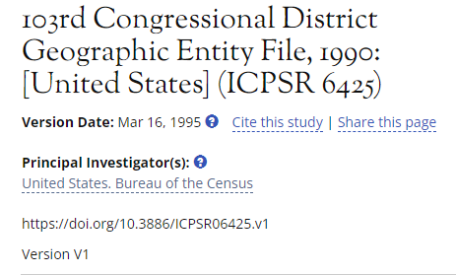
Why All These Standards?
Study home pages provide users with relevant metadata…
BUT:
Labels are not universally applied
  Large font = “title”?
Labels may not be universally understood
  What’s a “principal investigator”?
Simple text is not machine-readable, which is important for:
  Search engines
  Computational analysis and parsing of metadata
  System interoperability and data sharing
Different users and platforms require different metadata standards: no “one size fits all” solution

Slide 16
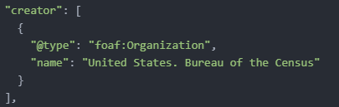

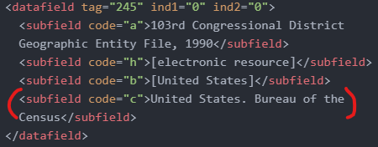
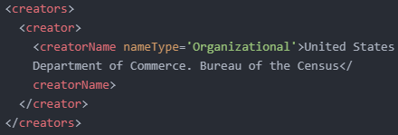
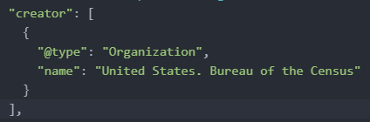
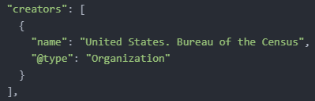
DCAT
Dublin Core
MARCXML
DataCite
schema.org
DATS

Slide 17
Data Catalog Vocabulary (DCAT)
Developed in 2010 at Digital Enterprise Research Institute (NUI Galway); taken over by W3C in 2012; currently in v3
DCAT-US: profile developed for US Govt. by Project Open Data (2013); used in https://data.gov
Designed to “facilitate interoperability between data catalogs published on the Web” and “increase the discoverability of datasets and data services”
Allows hierarchical description of:
  Dataset: “a collection of data, published or curated by a single agent”
  Distribution: a specific, accessible instance of a dataset (e.g., downloadable files)
Increasingly widespread use, but must rely on other standards (e.g., DDI) to described the data themselves

Slide 18
DataCite Metadata Schema
DataCite: non-profit, member organization founded in 2009; current DOI registrar for ICPSR.
  Vision statement: “Connecting research, identifying knowledge”
DataCite Metadata Schema developed ca. 2010; currently in v4.4
“Generic to the broadest range of research datasets, rather than customized to the needs of any particular discipline”
“Primarily supports the citation and discovery of data”
“Not intended to supplant or replace the discipline- or community-specific metadata that fully describes the data and is vital for understanding and reuse” (i.e., no

Slide 19
Data Tag Suite (DATS)
Developed ca. 2015 by the “biomedical and healthCAre Data Discovery Index Ecosystem” (bioCADDIE) project (with funding from NIH)
Intended to describe datasets being ingested in DataMed discovery interface (prototype developed for the bioCADDIE project)
Developed for life sciences research, but generic: applicable to and extendable for any type of dataset
Current level of support and implementation is unclear

Slide 20
Dublin Core
Developed in 1995 (OCLC and and NCSA workshop in Dublin, OH)
A “lingua franca”:
  Mature, recognized by numerous standardization bodies (ISO, ANSI, NISO, IETF, etc.)
  Widely supported across platforms with crosswalks (or “mappings”) to many other standards
v1.1: 15 “core” elements (creator, title, description); expanded to 55 in 2012 (“DCMI Metadata Terms”)
"Broad and generic, being usable for describing a wide range of resources"
Main strengths are in discovery and expressing rights and relations; not suited to describe the data themselves

Slide 21
MARCXML
Developed by the Library of Congress with OCLC and RLG in 2002 to bring structured MARC catalog data into XML
Promotes interoperability with MARC data format and other metadata standards (via crosswalks)
Used in Online Public Access Catalogs (OPACs), such as Library of Congress Catalog and OCLC Worldcat: facilitates discovery of ICPSR data collections alongside related materials in library systems
Some support for describing GIS data, but less so for other research data

Slide 22
schema.org
Launched in 2011 by Google, Microsoft, Yahoo, & Yandex (currently in v12)
Structured data embedded in the source code of web pages
  Machine-readable
  Provides richer context to make online content more discoverable and understandable
Provides a vocabulary (e.g., “elements”) and content guidelines to improve accuracy and reduce ambiguity of search results and content interactions
ICPSR uses JSON-LD (“linked data”) to present schema.org metadata on study home pages

Slide 23
ICPSR’s Use of Metadata Standards

Slide 24
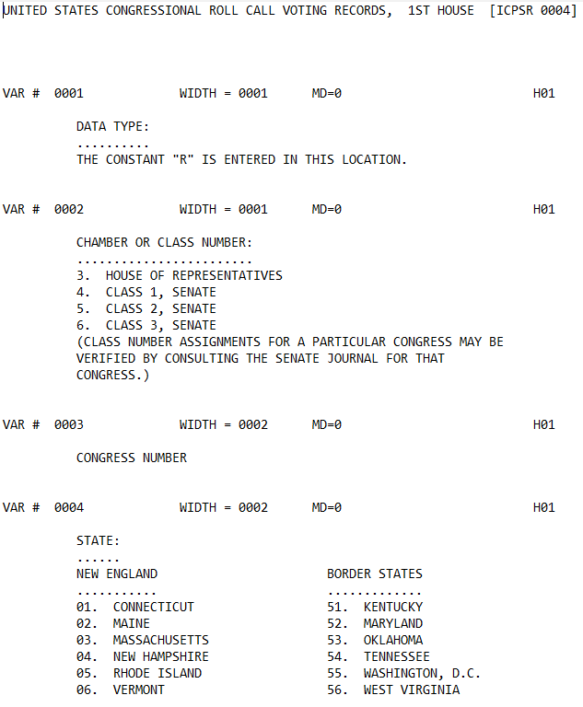
Inter-university Consortium for Political and Social Research, and Congressional Quarterly, Inc. United States Congressional Roll Call Voting Records, 1789-1998. Inter-university Consortium for Political and Social Research [distributor], 2010-05-06. https://doi.org/10.3886/ICPSR00004.v3
Notes:
Prior to the 80s, “documenting research data was treated primarily as a publication process. This information was assembled into a printed report, which was commonly referred to as a codebook. These volumes often contained sections dedicated to a technical description of the study and method of data collection, a detailed listing of the variables, their codes, and their layout in a data file, a copy of the data collection instrument, and any other contextual information providing background to the data.”
“...ICPSR Study Description “Template” Manual. “Every new or revised ICPSR study requires a study description which is written by the staff member who processes or evaluates the study. These descriptions follow a strict format, called a template, which insures that standard information is recorded for each study. The template consists of named fields into which the staff person enters appropriate information about the study. Completed templates ultimately reside in an online SPIRES database.”
Source: Green, A. E., & Humphrey, C. (2014). Building the DDI. IASSIST Quarterly, 37(1-4), 36. https://doi.org/10.29173/iq500

Slide 25
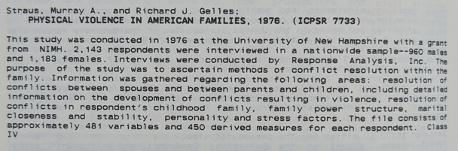
Source: ICPSR Guide to Resources and Services 1980-1981
Notes:
ICPSR published printed catalogs based on the standardized study descriptions.
Source: Green, A. E., & Humphrey, C. (2014). Building the DDI. IASSIST Quarterly, 37(1-4), 36. https://doi.org/10.29173/iq500

Slide 26
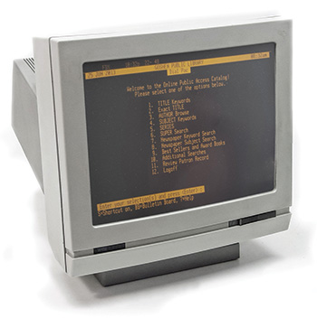
https://americanlibrariesmagazine.org/2016/01/04/cataloging-evolves/
Notes:
In the late 1970’s, a group of university libraries began producing their own electronic MARC catalogue records for study level discovery of research data.
In the 1980’s, the ICPSR began circulating to others study-level MARC records of their data holdings.
OCLC, a nonprofit cooperative organization "that provides shared technology services, original research, and community programs for its membership and the library community at large, became a distributor of MARC records for ICPSR study holdings.
Source: Green, A. E., & Humphrey, C. (2014). Building the DDI. IASSIST Quarterly, 37(1-4), 36. https://doi.org/10.29173/iq500

Slide 27
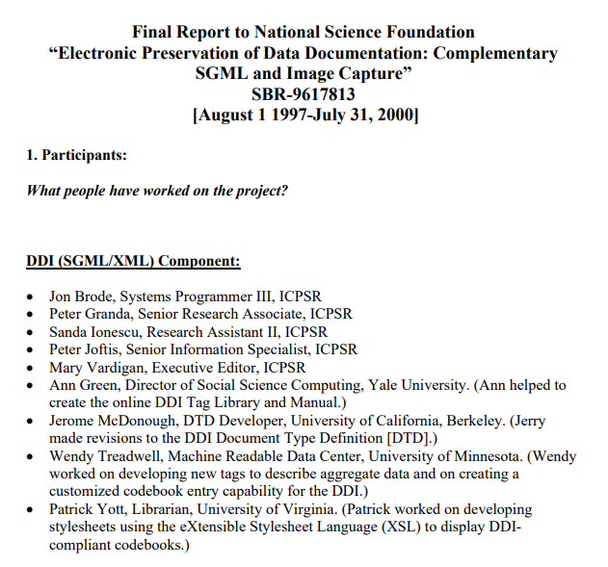
https://ddialliance.org/sites/default/files/final.pdf
Notes:
In the mid-1990s, a group of data professionals, led by ICPSR, met at IASSIST to create a data description to best describe social science data. They “incorporate[d] the concepts and parts of traditional printed codebooks and also to build compatibility with computer-generated data collection and documentation processes.”
The original DDI committee “made it clear that this was to be an international effort with inclusive involvement across research, survey, and data professional organizations, representing the interests of data producers, archives, distributors, and end-users of social science data.”
They knew what good documentation was. Intellectual components of DDI were developed from a common core of elements, from:
Codebooks
Study descriptions from data archives
Bibliographic records establishing identity (including Sue Dodd, a pioneer in cataloging machine readable data files)
Statistical analysis metadata
Source: Ann Green, 2014 NADDI, “Committing to Data Quality (Keynote address). http://summit.sfu.ca/item/13955
Source: Green, A. E., & Humphrey, C. (2014). Building the DDI. IASSIST Quarterly, 37(1-4), 36. https://doi.org/10.29173/iq500

Slide 28
Cataloging, Citation, and Encoding Guidelines
Cataloging Machine Readable Data Files, Sue Dodd
MARC-MRDF: the work of the American Library Association Sub-Committee on Rules for Machine-Readable Data Files.
Dublin Core: OCLC/NCSA Metadata Workshop, Online Computer Library Center
TEI: Text Encoding Initiative DTD for SGML
EAD: Encoded Archival Description DTD for SGML
Notes:
They based their work on existing cataloging, citation, and encoding guidelines, including these.
Source: Green, A. E., & Humphrey, C. (2014). Building the DDI. IASSIST Quarterly, 37(1-4), 36. https://doi.org/10.29173/iq500

Slide 29
DDI outcomes
Improved search precision.
Improved finding aids for resource discovery.
Improved interoperability.
Ability to produce multiple products from a single source.
Ability to display information in several ways from a single source.
Improved consistency and completeness of documentation.
Facilitation of the job of intelligent agents.
https://ddialliance.org/sites/default/files/final.pdf
Notes:
https://ddialliance.org/sites/default/files/final.pdf
In developing a specification for the content, transport, presentation, and preservation of social science metadata, the DDI project has contributed to the conduct of social science research and archiving in the following ways:
Improved search precision. Because elements of a codebook can be tagged separately for content using this XML application, detailed, field-specific searches are possible. This enables a user to search, for example, all question text for specific terms or to search the sampling field across studies.
Improved finding aids for resource discovery. Because the DDI provides “header” information describing the marked-up document itself, locating DDI-compliant documents is expedited.
Improved interoperability. We provide a mapping from DDI elements to Dublin Core elements to aid further in the metadata standardization effort. Our intention is to add a crosswalk to other standards such as GILS and MARC.
Ability to produce multiple products from a single source. Marked up codebooks can be used to create bibliographic citations, full study descriptions, setups for statistical packages, etc.
Ability to display information in several ways from a single source. Using stylesheets, an XML codebook can be transformed to display in different presentation formats.
Improved consistency and completeness of documentation. Markup provides a way to standardize metadata and to ensure that codebooks meet accepted guidelines for content. The DDI effort should help to encourage data producers to provide in their documentation all of the information necessary for users to determine whether a given study meets their research needs and to perform accurate analyses. While the DDI Committee decided not to specify many elements as required, it did develop a list of elements that are highly recommended for inclusion in codebooks.
Facilitation of the job of intelligent agents. The DDI metadata provides a structured schema that can be employed by systems for data extraction and analysis, such as FERRET (Federal Electronic Research and Review Extraction Tool, developed by the Census Bureau), SDA (Survey Documentation and Analysis, developed by UCBerkeley), NESSTAR, VDC (Virtual Data Center, under development at Harvard), etc. It also provides the potential to pull together information from separate systems.

Slide 30
Review: ICPSR’s Core Study Metadata Based on DDI
ICPSR uses DDI as our core metadata framework to describe our curated studies (see previous deep dives about DDI-Codebook and DDI-Lifecycle)
Study-level metadata are DDI-compliant
  All or most curated study fields map seamlessly to DDI 2.5 tags
Variable-level metadata are also DDI-compliant
  Generated through Hermes in an automated way
    Archived
    SOLR indexed for searching
    Converted to PDF to generate Codebook frequencies section
    Reusable information parsed and saved in DB format
Notes:
Content limited to
Variable metadata generated through SPSS
Question text (no subfields)
Variable level notes
We have a new variable schema for RDE. This will extend support for additional DDI-Codebook elements.

Slide 31
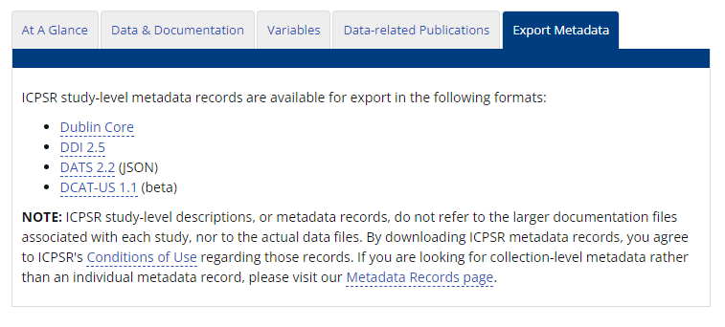
Metadata Source: “Export Metadata” Tab
Dublin Core
DDI Codebook
DATS
DCAT

Slide 32
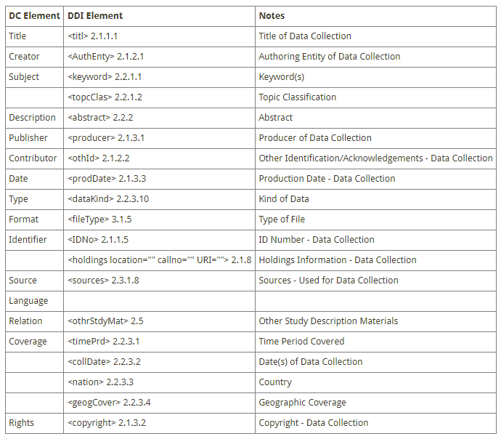
Mapping to Dublin Core
https://ddialliance.org/resources/ddi-profiles/dc
Notes:
Most elements within the Dublin Core element set map directly to elements in the DDI Version 2 Codebook DTD.

Slide 33
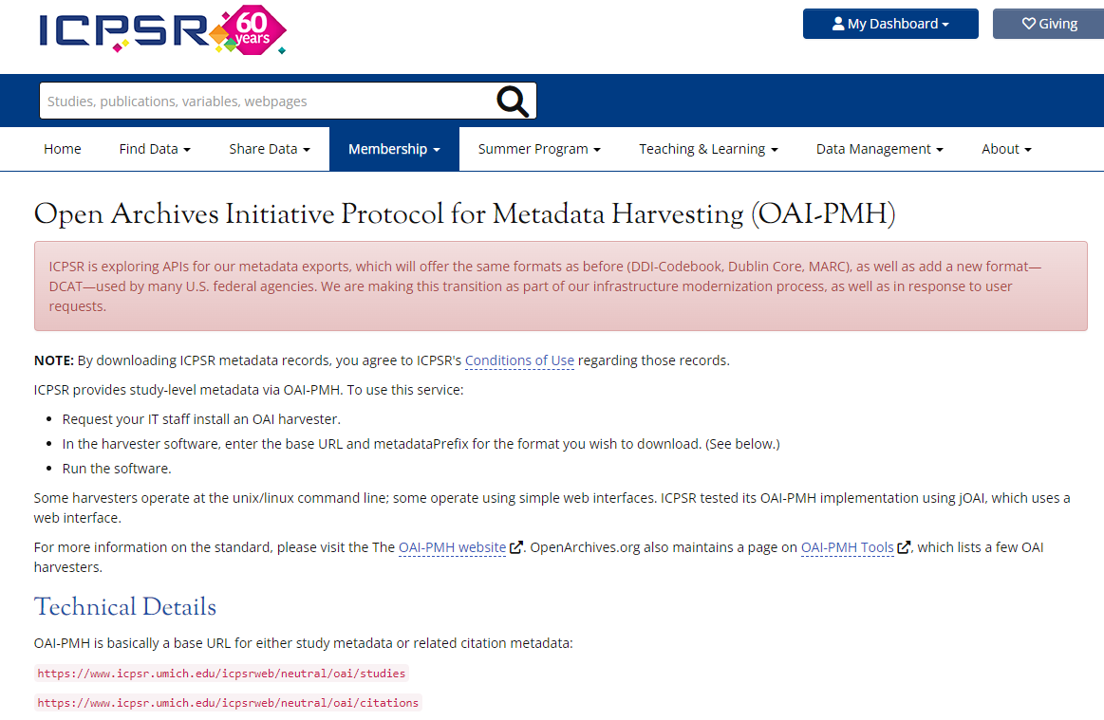
Metadata Source: Open Archives Initiative Protocol for Metadata Harvesting (OAI-PMH)
Protocol developed for harvesting metadata
Client-server architecture
Uses HTTP requests; returns XML records
ICPSR supports:
  Dublin Core
  MARCXML
  DDI 2.5 (Codebook)
  DDI 2.5 with data-related publications

Slide 34
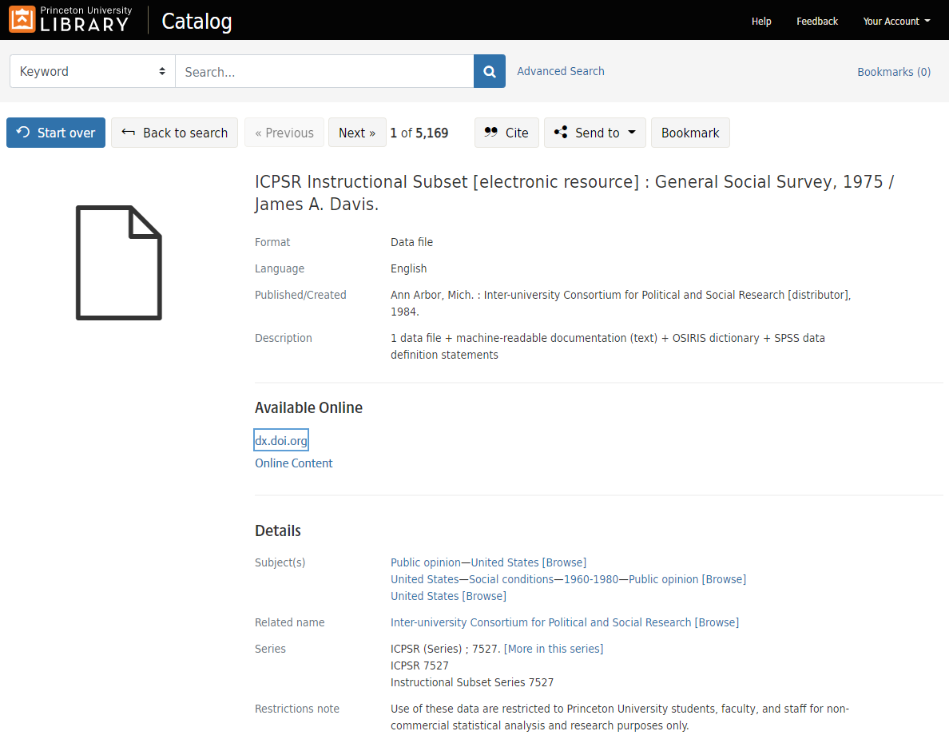

Slide 35
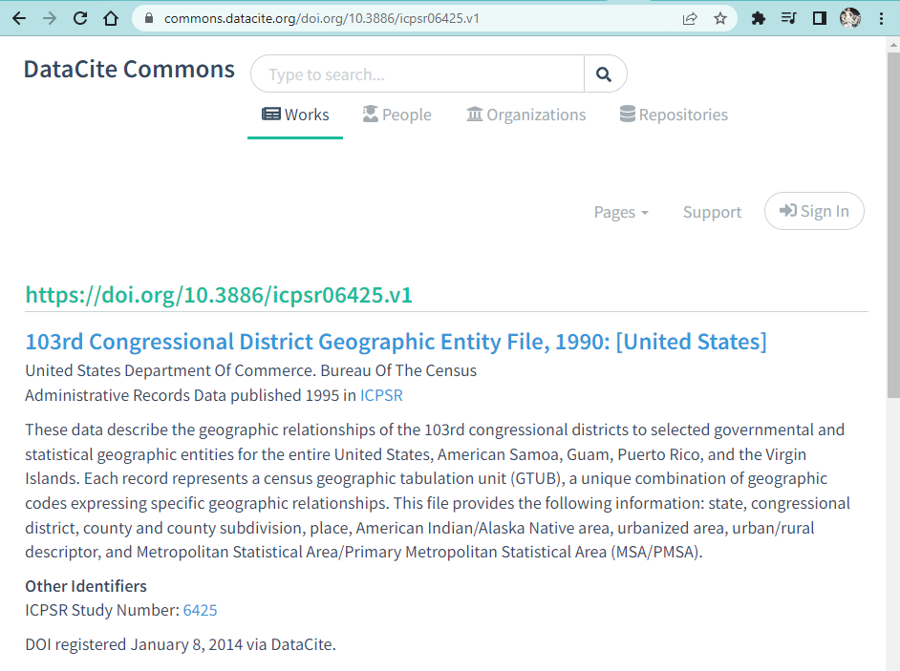
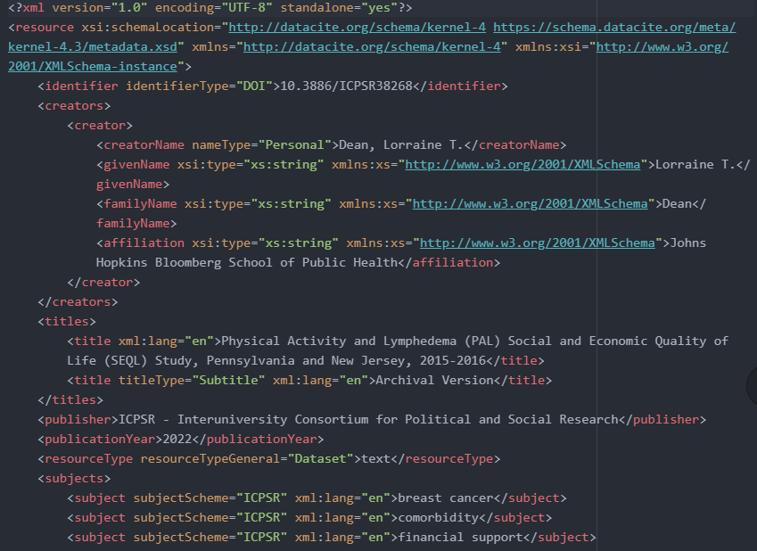
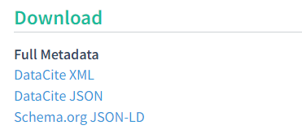
Metadata Source: DataCite Commons
ICPSR produces DataCite XML
DataCite metadata is searchable on the Commons and available for download

Slide 36
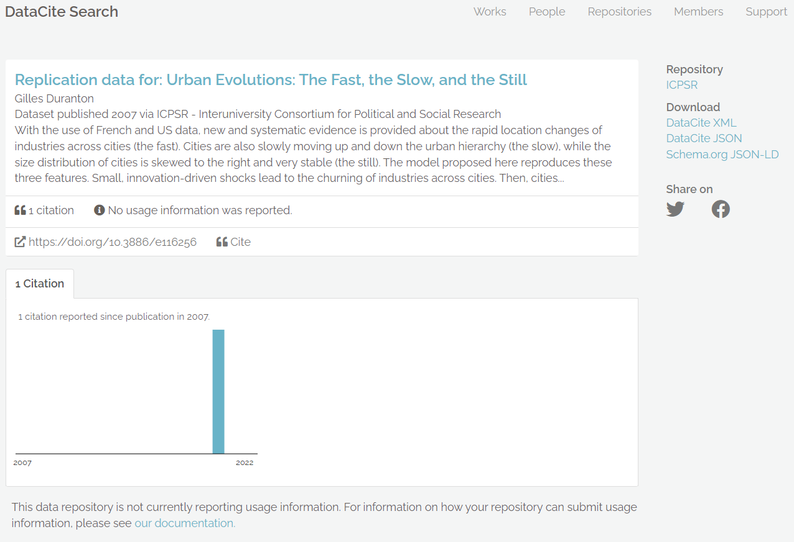

Slide 37
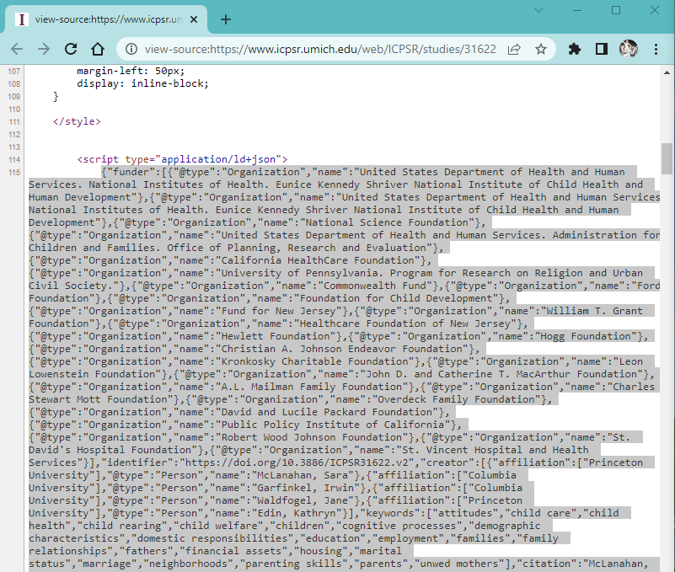
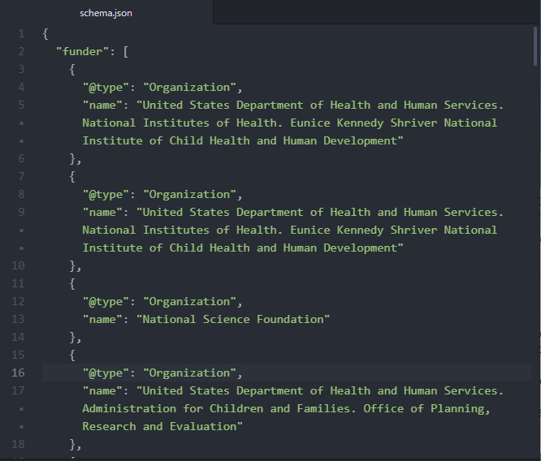
Metadata Source: Study Home Page HTML (schema.org)

Slide 38
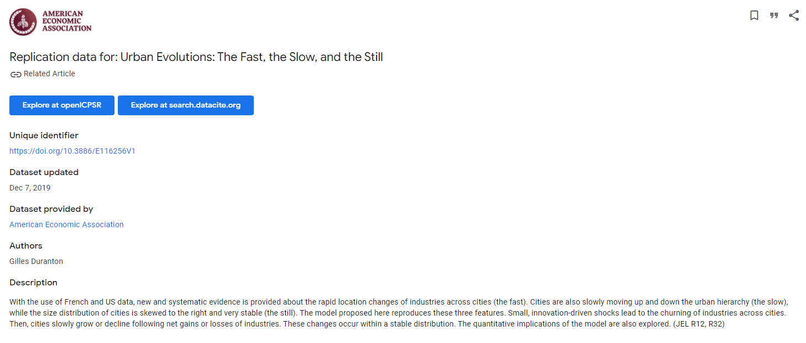

Slide 39
Future Work with Metadata Standards

Slide 40
Future Work
Evaluate “FAIRness” of current exports and enhance as necessary
Improve internal documentation
Involvement in DataCite
Defining Core and Extended Metadata for All Objects

Slide 41
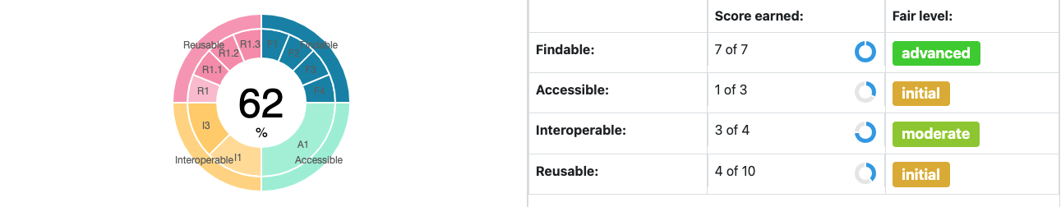
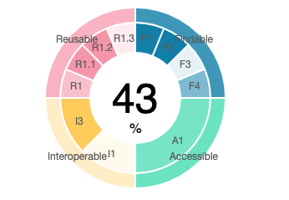
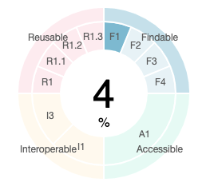
1a. Evaluate “FAIRness”
www.f-uji.net
GESIS
Roper
Notes:
https://search.gesis.org/research_data/ZA7604?doi=10.4232/1.13733
https://ropercenter.cornell.edu/ipoll/study/31119369

Slide 42
1b. Enhance Exports
Make sure as many fields are represented in each export
Support new formats
What do our users want?

Slide 43
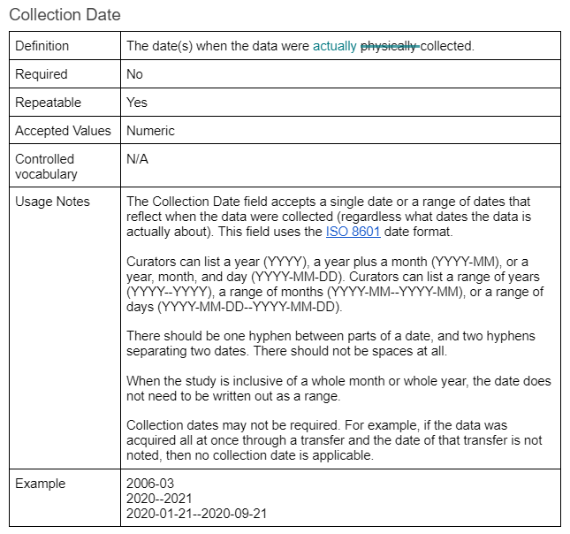
2. Improve External Documentation
Notes:
How can we help our users help us?

Slide 44
3. Involvement in DataCite
Metadata Working Group
DataCite standards informing future work
Talk to you in May!

Slide 45
4. Defining Core and Extended Metadata for All Objects
ICPSR is rapidly expanding the range and type of objects that we archive and catalog:
  MCC includes reports, publications, and other knowledge products
  Research Data Ecosystem (RDE) will develop tools for video and social media data
We must use standards–including new ones!–to enable information to be appropriately compared with predictable outcomes.
  Use DDI for the core descriptive metadata elements
  Include descriptive and technical metadata extensions for new data formats and research disciplines
Notes:
“Standards enable information to be appropriately compared with predictable outcomes.”
Source: Green, A. E., & Humphrey, C. (2014). Building the DDI. IASSIST Quarterly, 37(1-4), 36. https://doi.org/10.29173/iq500

Slide 46
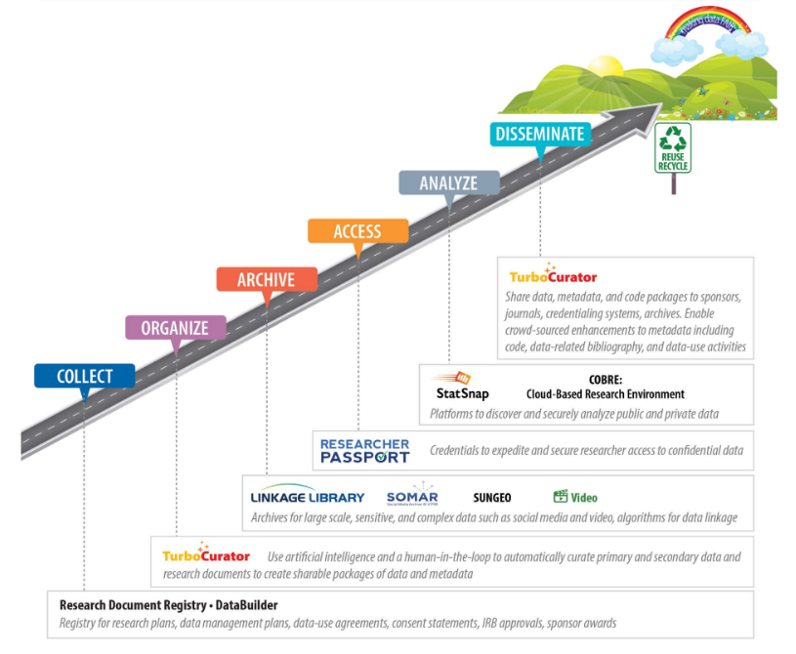
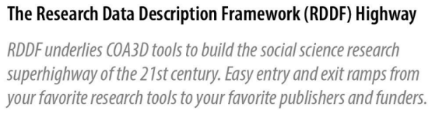
Metadata Undergird the RDE Project
*RDDF is a new ICPSR metadata schema / data model

Slide 47
RDE Metadata Schema: Scope (Jan. 2022)
CNS and Metadata & Preservation project (with input from varied stakeholders)
Define a conceptual data model for ICPSR metadata and business information, which will include :
  “Entities” that we need to store information about (e.g., people, studies, variables, etc.)
  Unique identifiers to reference those entities
  Properties of those entities (e.g., ‘title’, ‘study time period’, ‘data type” for a study)
  Relationships between entities
  Rules for how information will be entered (accepted values, mandatoriness, repeatability, etc.)
Ensure the new data model’s flexibility by allowing for the creation of:
  Profiles: constrain or limit the data added to given entity
  Extensions: allow for additional entities or properties
Out of scope: the physical data model (i.e., how and where the metadata is stored)

Slide 48

“Things not Strings”: Entities are Objects
Current practice: a “person” is a string of text associated with a field name:
RDE Metadata Schema: a “person” is a conceptual object that
  Has associated properties like “name” and “research discipline”
  Has relationships with other objects (e.g., affiliations with organizations and contributions to products)
  May be referenced by a unique identifier (URI) to access properties and relationships from a variety of contexts

Slide 49
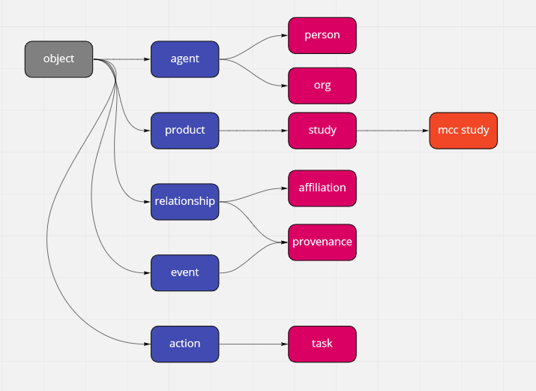
Draft Taxonomy of “Entities” in RDE Metadata Schema

Slide 50
Phase One: People and Organizations
Schema must allow us to document how people and orgs make contributions to data collections, publications, and other knowledge products
  Roles such as PI, funder, distributor, etc.
Information about the same people and orgs is also used for:
  ICPSR membership.
  MyData accounts.
  Summer Program (students and faculty).
  Collection development contacts.
Goal: develop flexible schemas to support these varied uses and avoid data silos or redundancies

Slide 51
Person and Organization Schemas
Common to both:
  Names
  Contact points (phone, email, addresses)
  Alternate identifiers (ORCID, ROR, GLEIF, etc.)
Person-specific examples:
  Research discipline
  Restricted data applications
  Important relationships: institutional affiliation and contributions to products (e.g., PI role)
Organization-specific examples:
  “Parent” organization
  Classifications (public vs. private vs. non-profit, academic vs. nonacademic, etc.)

Slide 52
Next Phase: Schema for Video Data
Video Data team currently documenting user needs and requirements, which will inform schema development
Establish general metadata schema for studies and extend for video data
  Current study metadata: broadly applicable to video studies, with some extensions (e.g., ‘genre’)
Biggest needs are around file-level schema; video will require:
  Technical metadata: frame rate, image size, color profile, duration, etc.
  Structural metadata: relations between and among videos in a dataset
  Provenance metadata: source and production of content as well as data lineage from deposit onward
  Rights

Slide 53
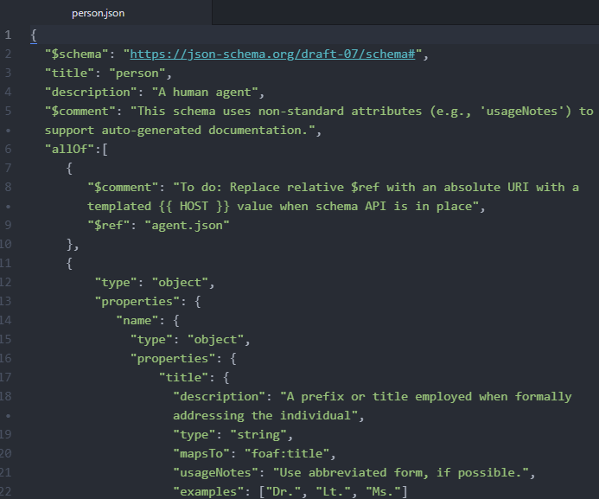
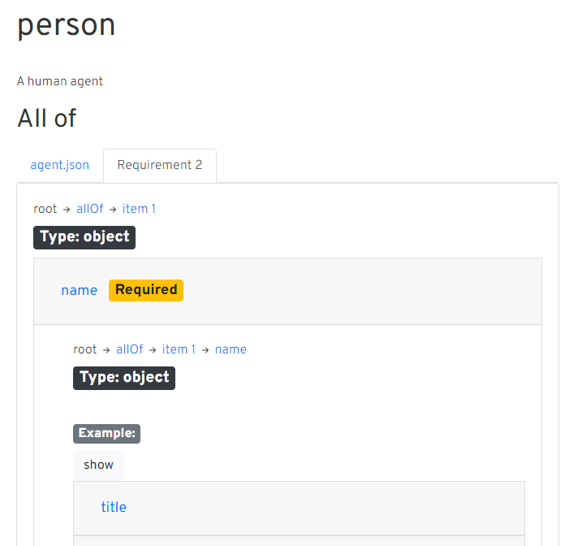
Schema Documentation
Raw JSON Schema
Human-Readable HTML

Slide 54
Thank you!
Questions?

Slide 55
[Extra Slides…]

Slide 56
Standards Make Metadata More Understandable
<creator>Jane Doe</creator>
(Dublin Core)

Slide 57
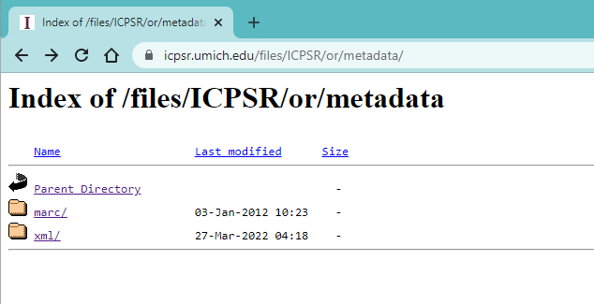
Metadata Source: Batch Download
DDI 2.5
MARC
MARCXML

Slide 58
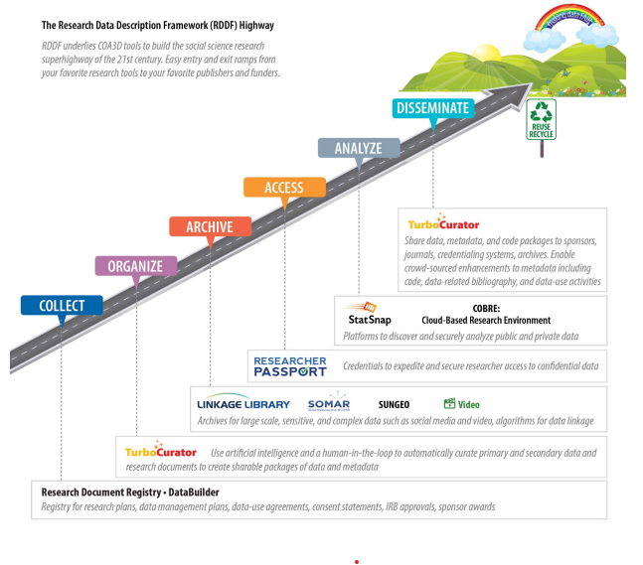
Metadata Undergirds RDE Infrastructure

