Slide 1

DataCite: More Than Just DOIs
jay winkler, Mike Shallcross, and Jared Lyle
ICPSR Metadata & Preservation “Deep Dive”
May 12, 2022

Slide 2
Overview
DOI basics
ICPSR’s relationship to DataCite
DataCite metadata schema
Other DataCite activities
Doing more with DataCite

Slide 3
DOI Basics

Slide 4

Web pages don’t last long, including the URLs
https://www.sproutfund.org/logos/100-days.png
Notes:
The average life of a web page is 100 days, [Brewster] Kahle [founder of the Internet Archive] said…, and “most of the best of the web is already off the web.”
Source: https://www.vox.com/2017/3/1/14771148/internet-archive-brewster-kahle-preservation-net-neutrality-donald-trump-recode-podcast

Slide 5
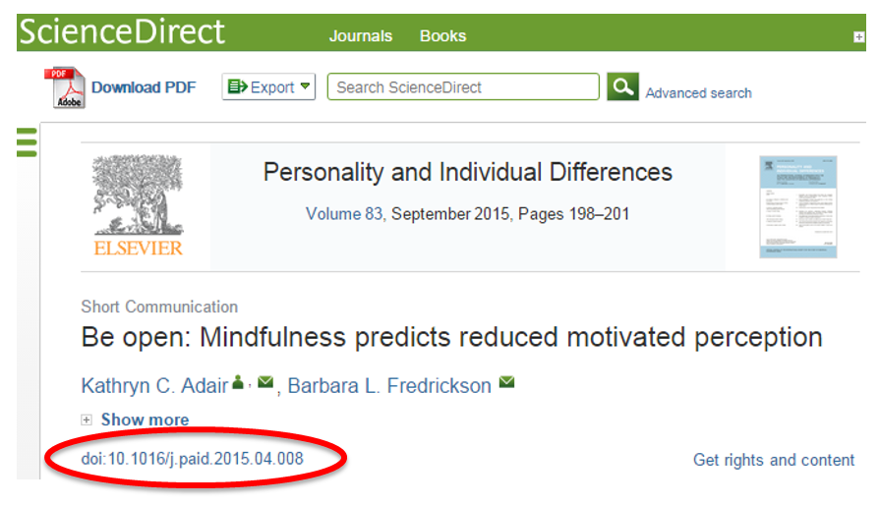
DOIs to the rescue!
https://library.concordia.ca/help/citing/sharing-links.php?guid=doi

Slide 6
DOI Benefits
Persistent - the citation remains the same, even if the web changes
Accurate - you know you’re getting the exact data
Unique - there’s one and only one citation

Slide 7
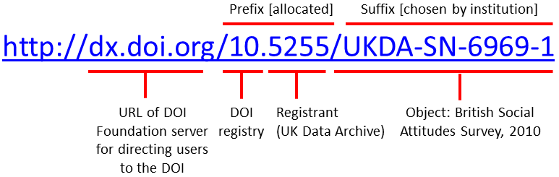
What is a DOI?
https://blogs.lse.ac.uk/impactofsocialsciences/2015/04/23/digital-object-identifiers-stability-for-citations/
Standard ICPSR format: https://doi.org/10.3886/ICPSR06425.v1
“Opaque” format: https://doi.org/10.3886/70z7-0j44

Slide 8

History of DOIs at the ICPSR
ICPSR began adding DOIs to study metadata in 2008. Initially, ICPSR registered DOIs through CrossRef, an official DOI Registration Agency used primarily by publishers.
From the June 2008 Council minutes: “Council members pointed out that because DOIs have mainly been used in traditional publishing, ICPSR is breaking new ground in using DOIs for data and this is a leadership area for us.”
https://www.icpsr.umich.edu/files/ICPSR/org/governance/minutes/2008-06.pdf
Notes:
“Staff have been investigating Digital Object Identifiers (DOIs) in connection with the Child Care Project and the ICPSR Bibliography of Data-Related Literature. DOIs come out of the commercial publishing world, and they have some properties that are advantageous for ICPSR: specifically, they would ensure that data resources are cited accurately and uniquely and that they can be found at persistent locations. In terms of the ICPSR Bibliography, having DOIs would also streamline the process of connecting users to the full text of publications cited in the Bibliography.”
https://www.icpsr.umich.edu/files/ICPSR/org/governance/minutes/2008-06.pdf

Slide 9
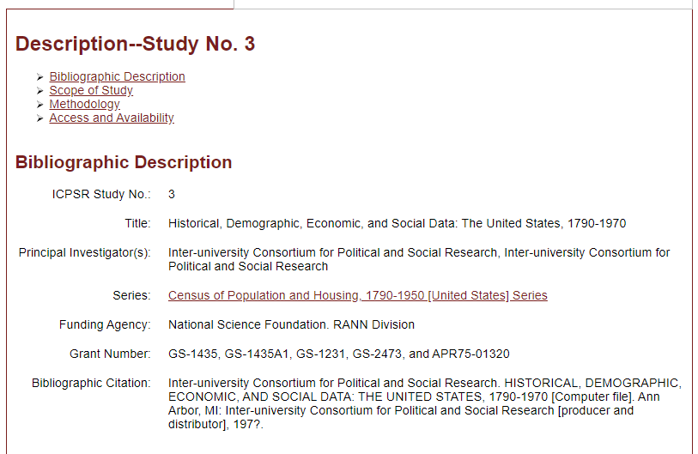
ICPSR study home page before DOIs
https://web.archive.org/web/20051111220903/http://webapp.icpsr.umich.edu/cocoon/ICPSR-STUDY/00003.xml

Slide 10
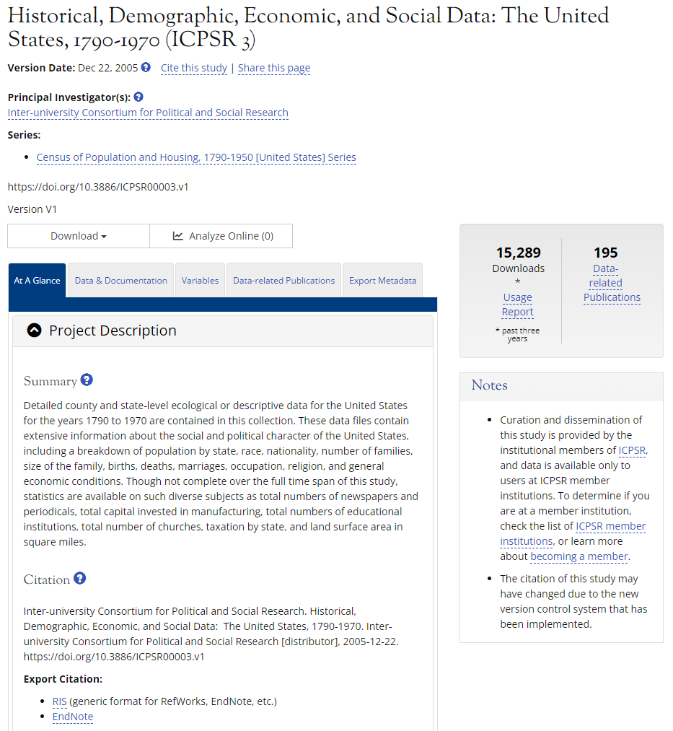
ICPSR study home page after DOIs
https://www.icpsr.umich.edu/web/ICPSR/studies/3

Slide 11
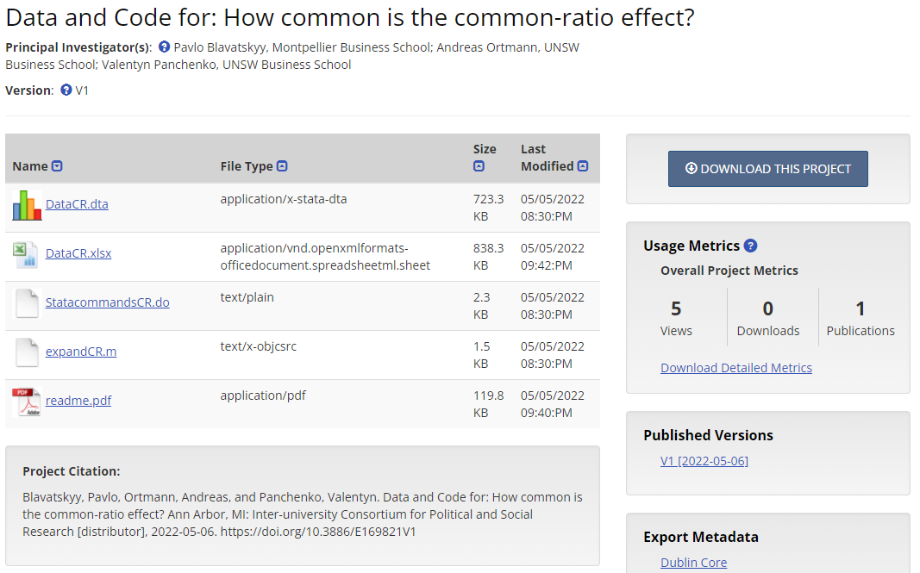
openICPSR project home page
https://doi.org/10.3886/E169821V1

Slide 12
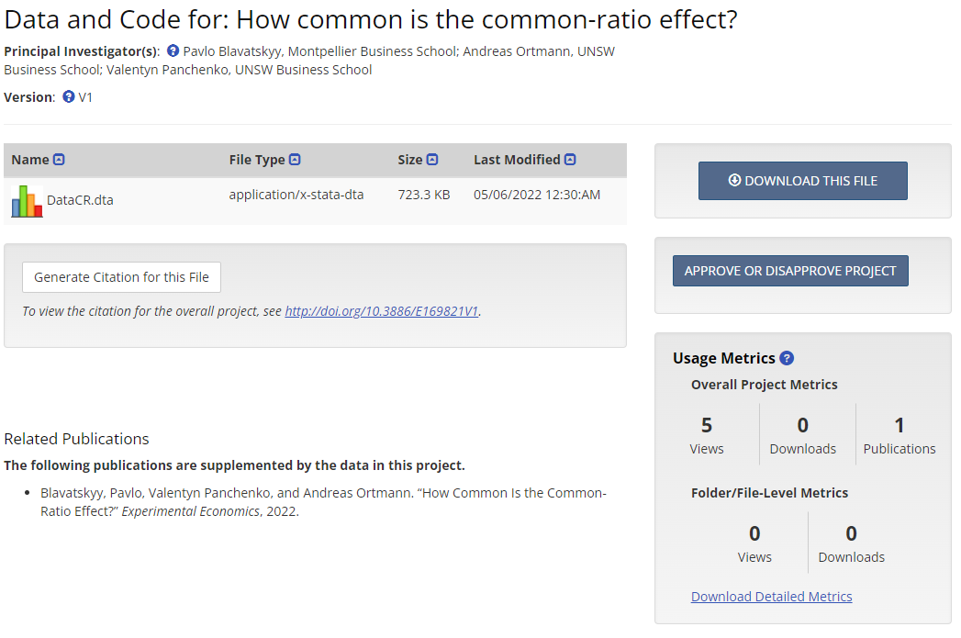
Including on-demand citations (pre-request)
https://www.openicpsr.org/openicpsr/project/169821/version/V1/view?path=/openicpsr/169821/fcr:versions/V1/DataCR.dta&type=file

Slide 13
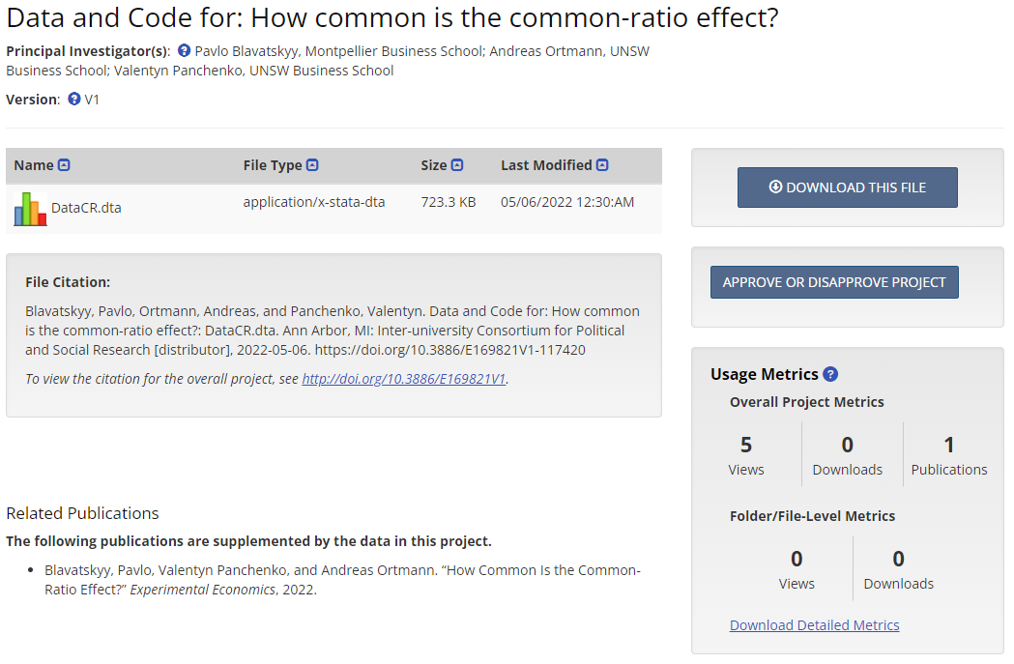
Including on-demand citations (post-request)
https://doi.org/10.3886/E169821V1-117420

Slide 14
DOI Contractual Obligations
You are required to maintain a "tombstone" page for objects that are no longer available.
Save for rare cases, you will not be allowed to delete DOIs.
You are required to fix broken links with X business days.
You are required to keep your metadata reasonably up-to-date.
Source: “Implementing DOIs at ICPSR” by Matthew Richardson
Notes:
You are required to maintain a "tombstone" page for objects that are no longer available. If an object has to be taken down, you will still maintain a web page for that object that provides basic metadata and a note that the object is no longer available from your website. You might also want to include information on why it's no longer available, when it was taken down, and who to contact for more information (i.e., who now owns the object and asked you to take it down).
Save for rare cases, you will not be allowed to delete DOIs. Though the registration agencies will forgive the infrequent coding error that might erroneously create a DOI, they will not entertain requests for many or frequent deletions. Assume that it's not really an option.
You are required to fix broken links with X business days. If a link breaks, you are required to update the DOI metadata with a working URL within X business days, with X determined by your DOI registration agency. Some agencies will facilitate this by running their own broken link reports and emailing you when a problem occurs.
You are required to keep your metadata reasonably up-to-date. Because DOI metadata is used by some citation applications and used for federated searching, you need to keep your DOI metadata up-to-date. If the title of an object changes, you should re-submit the metadata to your DOI registration agency, even if neither the DOI nor the URL changed.

Slide 15
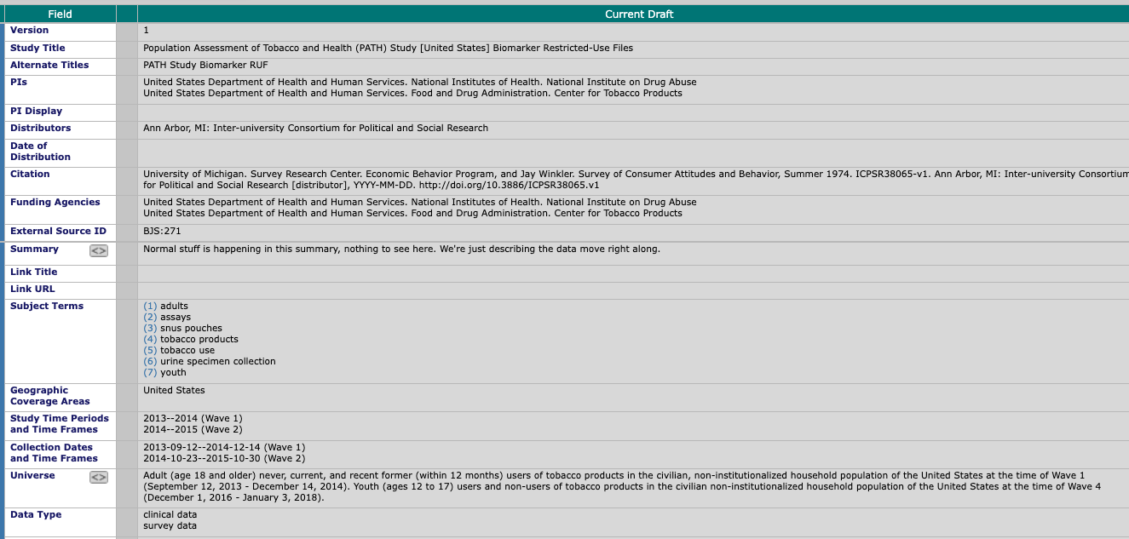
Process of Registering DOIs

Slide 16
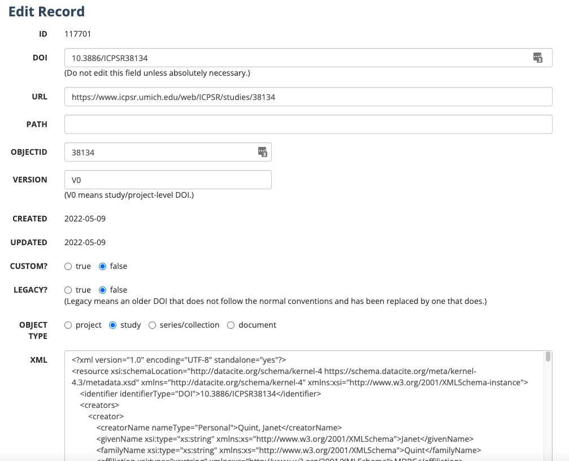
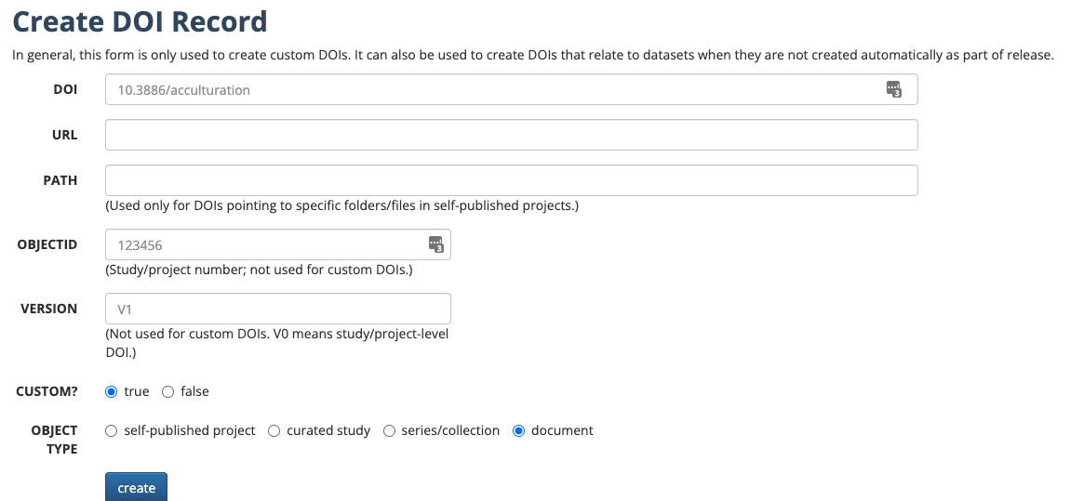
DOI Admin Tool

Slide 17
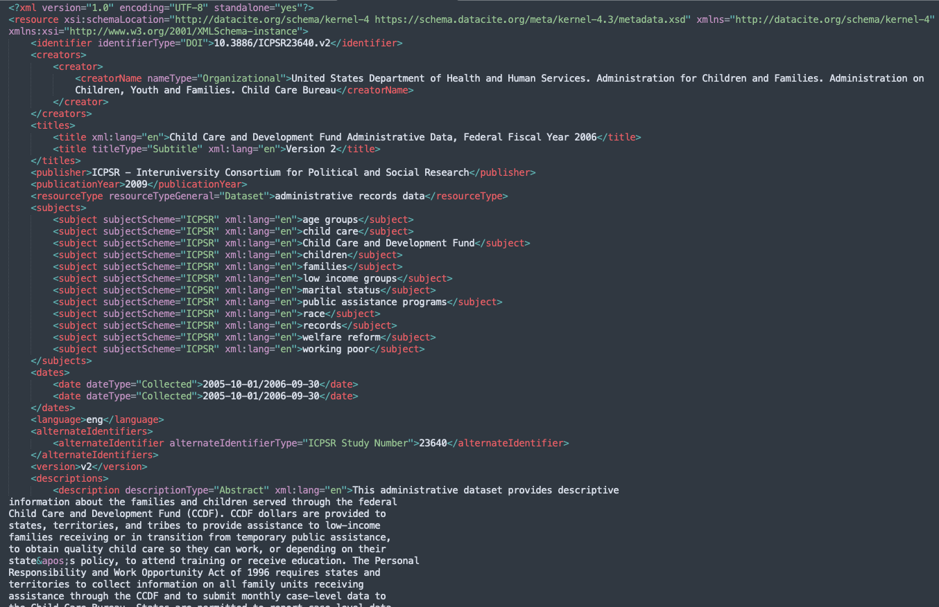
XML

Slide 18
Uses of the Admin Tool
Checking on DOI Registration Errors
Fixing Errors in DOI XML
Fixing Citations
Mass-updating URLs by archive as necessary
Adding new custom DOIs

Slide 19
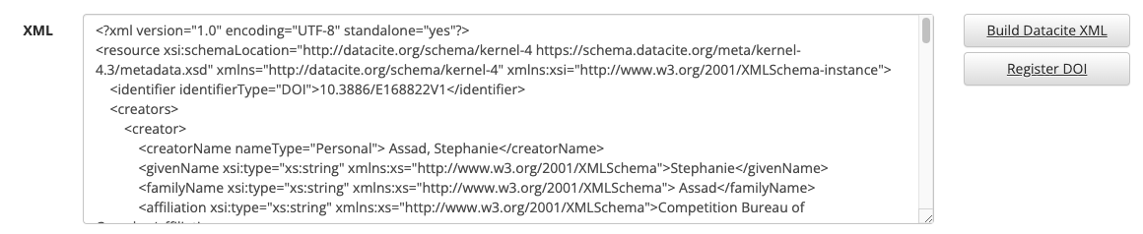
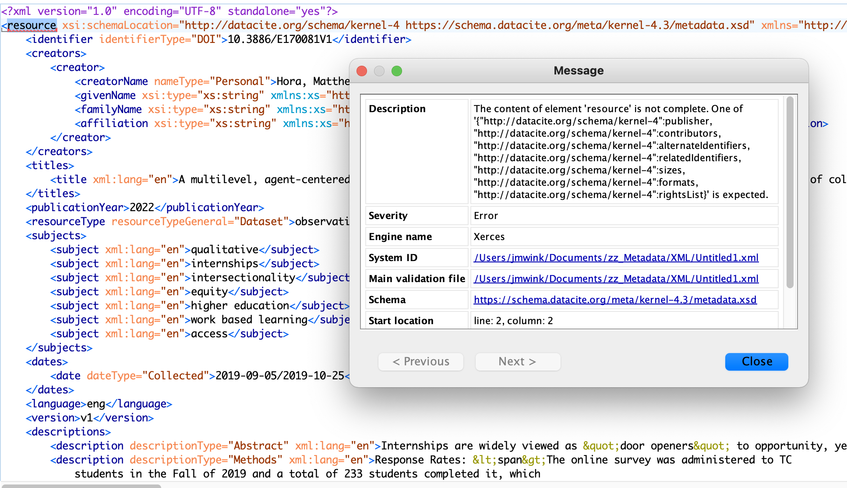
Updating and Administering DOIs

Slide 20
ICPSR’s Relationship to DataCite

Slide 21
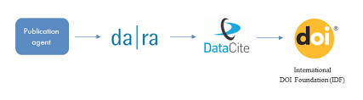
Transition to DataCite - first via da|ra
2013 - ICPSR switched DOI registration agencies from Crossref to DataCite since DataCite was focused on data citation. At the time, DataCite did not provide DOI registration services to other organizations. Instead, they encouraged national libraries to act as allocating agencies on behalf of other like-minded organizations. ICPSR selected da|ra as our allocating agency given da|ra’s aligned social science metadata and mission.

Slide 22
Transition to DataCite - switch to Direct Member
2021 - DataCite changed its membership and fee model, which made it possible to register DOIs directly through DataCite rather than using an allocating agency like da|ra. ICPSR decided to switch DOI registration so it is directly from DataCite.
Notes:
“The new DataCite Membership and Fees Model”: https://blog.datacite.org/the-new-datacite-membership-and-fees-model/

Slide 23
Transition to DataCite - benefits of Direct Membership
ICPSR strongly appreciated the DOI registration service da|ra provided, but the switch to Direct Membership in DataCite offered several advantages, including:
Use of the latest version of the DataCite schema
Preventing irregularities of our metadata in service providers’ displays
Direct access to DataCite governance and product direction
Notes:
DataCite is an influential and leading data services organization on an international level. Additionally, direct DataCite membership offers the ability to influence their new value-added services like DataCite Commons, a discovery service that enables simple data searches while also showing the connections between content with DOIs and people, research organizations, and funders (i.e., the PID Graph). DataCite offers similar DOI registration services as da|ra, with some enhancements (e.g., using the latest metadata schema) along with exciting new technology and leadership opportunities.
In terms of ICPSR goals, we desire to standardize relationship types in submitted metadata to improve and standardize related publications displayed in DataCite Commons and in Event Data outputs.

Slide 24
The DataCite Metadata Schema

Slide 25
What is a metadata schema?
“A metadata schema (or metadata standard) establishes and defines data elements and the rules for using those elements to describe a resource.” (Atla)
Provides a common language that is primarily computer readable but also allows humans to communicate about how and why they are representing within the schema.

Slide 26
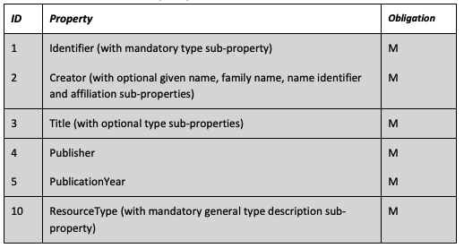
The DataCite Metadata Schema
“It is… intended to be generic to the broadest range of research datasets, rather than customized to the needs of any particular discipline.”
The DataCite Metadata Schema provides the elements to describe a wide array of research products that one may produce a DOI for.

Slide 27
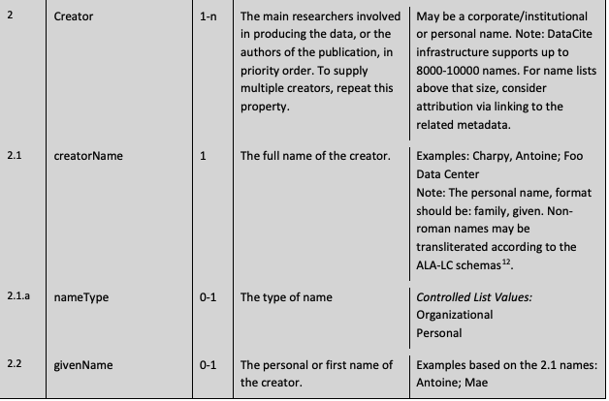
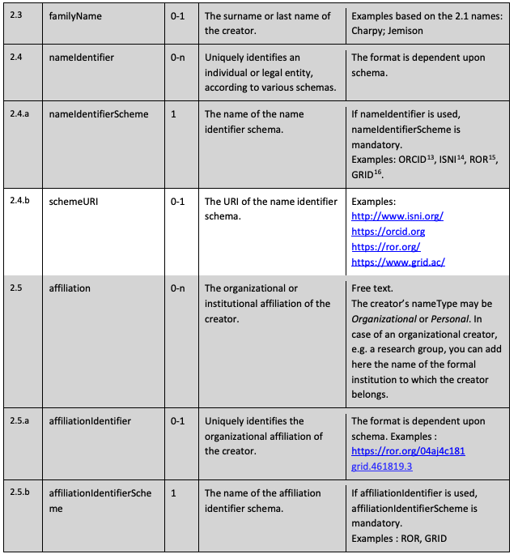

Slide 28
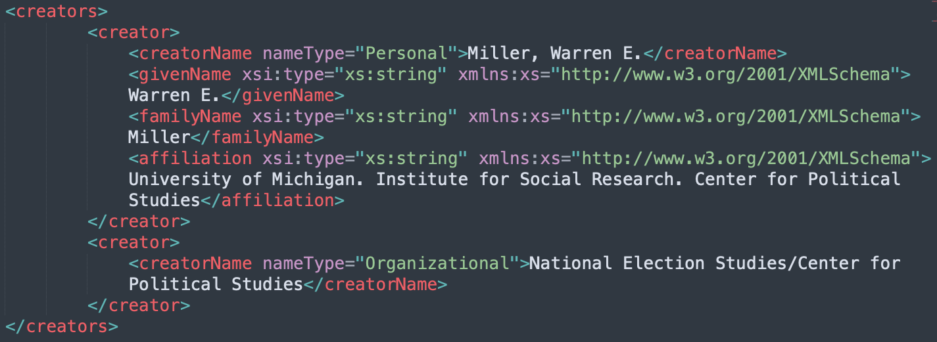
Personal name with givenName, familyName, and Affiliation Elements
Organizational name with just the creatorName element.

Slide 29
What changed in the transition?
Began sending Alt Titles
Better labeling of individual datasets within a study
Various small code efficiencies
Fewer options for describing the different methods fields
Less specific restrictions information
Less specific date information

Slide 30
Other DataCite Activities

Slide 31
DataCite’s Non-DOI Activities
DataCite Commons
Event Data
Community Functions
  Working Groups
    Metadata Working Group
    Services and Technology Steering Group
    Community Engagement Steering Group
  Community Calls

Slide 32
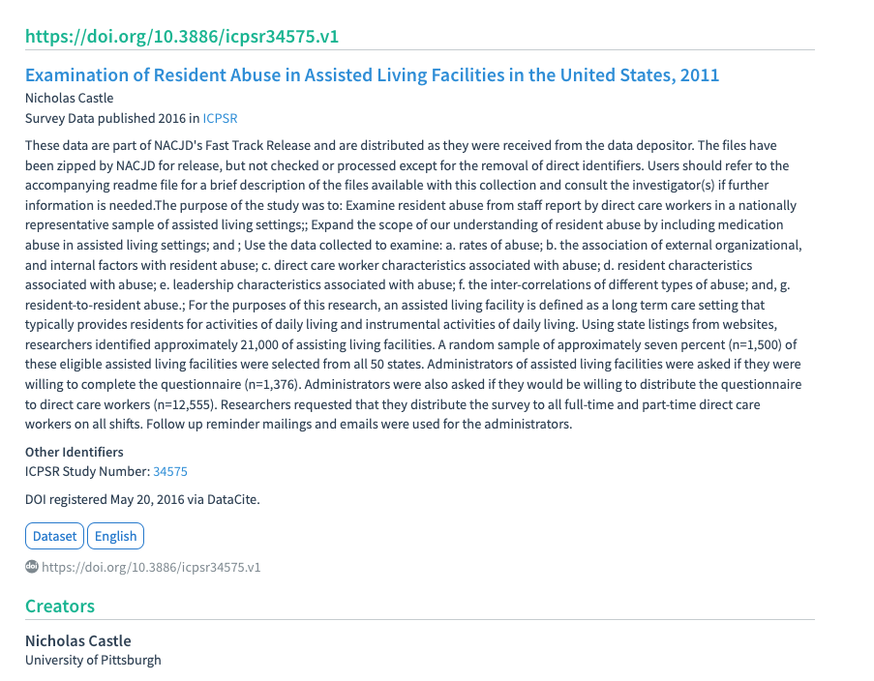
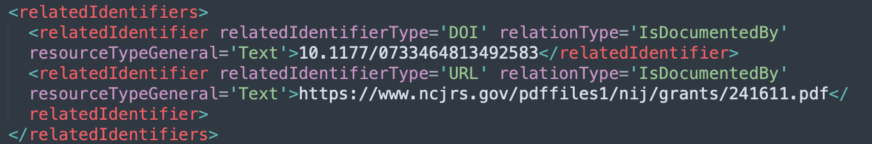
DataCite Commons
Our study metadata in DataCite Commons
Automated relatedIdentifier field in DataCite XML export shows that DataCite found that this paper cited our study.

Slide 33
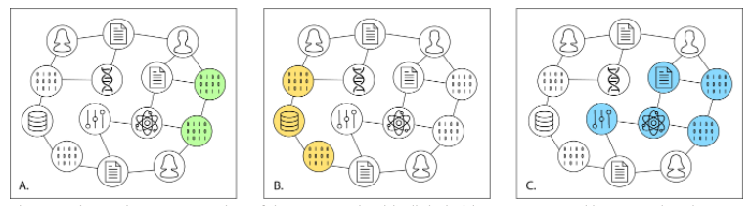
Event Data
DataCite built an event data API, so that users can query their service to see when someone registers a DOI for an object that cites the user's DOI. It is a quick way to retrieve a list of objects that cite your publication/dataset.
Notes:
Source: “Implementing DOIs at ICPSR”, by Matthew Richardson

Slide 34
DataCite Steering Committees
Steering Groups provide opportunities for broad community participation
Services and Technology Steering Group:
  Provides expertise and advice on DataCite’s product and technology development.
  Coordinates with other DataCite groups so that product and technology are aligned with DataCite’s community engagement efforts.
Community and Engagement Steering Group:
  Monitors community needs and provides feedback on DataCite’s priorities and services
  Recommends strategies to communicate about DataCite’s services, features, and plans
  Helps build relationships, cultivate discussions and promote collaboration among the DataCite community (including community calls)
Notes:
DataCite is a community driven organization and it’s two steering Groups provide opportunities for broad community participation. These groups help to set organizational priorities and identify strategies related to sustainability planning, services, and outreach.
The Services and Technology Steering Group (STSG) is responsible for providing expertise and advice on DataCite’s product and technology development. The group is suggesting and reviewing product and technology solutions to evaluate their impact and effectiveness. The STSG aligns its work with that CESG so that product and technology are aligned with DataCite’s community engagement efforts.
The Community and Engagement Steering Group identifies outreach needs for the DataCite community, including current and potential DataCite members as well as the broader research community. This includes: monitoring and assessing community needs and providing feedback on DataCite’s priorities and services; recommending strategies and tools to communicate about DataCite’s services, features, and plans; helping to build relationships, cultivate discussions and promote collaboration among the DataCite community; and involvement in DataCite’s annual meetings. The Community and Engagement Steering Group also works with several regional Expert Groups to ensure that unique needs and issues from around the world are identified and addressed.
Both Steering Groups coordinate their activities so that product and technology development and implementation are aligned with DataCite’s community engagement efforts

Slide 35
DataCite Metadata Working Group
Purpose:
  Develop and maintain the DataCite Metadata Schema
  Align schema with community standards (e.g., DOI, ORCID, Dublin Core, etc.)
Structure:
  Overseen by DataCite Board; consults with DataCite member organizations
  Two co-chairs; 10-16 members
Activities:
  Provide guidance on the use of the DataCite Metadata Schema
  Track emerging trends and best practices in the metadata community
  Respond to metadata schema suggestions and change requests
  Monthly meetings; additional sub-group meetings to address schema requests
Notes:
The purpose of the Metadata Working Group is to develop and maintain the DataCite Metadata Schema and align it with other community standards such as Digital Object Identifiers, the ORCID identifier schema, and metadata standards such as Dublin Core.
The Working Group is overseen by the DataCite Board but frequently consults with and gains feedback from DataCite Member organizations.
There are two co-chairs for the working group and it has a target membership of 10 to 16 individuals, with 15 people currently serving.
The working group’s activities generally fall into three areas: it
Provides guidance on the use of the DataCite Metadata Schema, which includes responding to questions on DataCite forums and email lists
Tracks emerging trends and best practices in the metadata community and considers their implications for the schema
Responsd to metadata schema change requests

Slide 36
DataCite Metadata Schema Change Process
Users suggest a change or addition to the DataCite Metadata Schema (via email, forums, meetings, etc.).
Proposed schema changes are added to the DataCite Roadmap for community feedback.
Quarterly proposal validation sessions (“Open Hours”): requests are presented with use cases, potential solutions, and related documentation.
If sufficient community support, requests are taken up by a Metadata WG subgroup for further discussion, review and identification of potential outcomes (to be approved by entire WG).
Notes:
There are essentially 4 steps to the metadata schema change process.
First, members of the user community suggest a change or addition to the DataCite Metadata Schema via email, forums, or meetings, etc.
Next, proposed schema changes are added to the DataCite Roadmap for community feedback.
After this, the stakeholders who submitted the request present information at a DataCite “Open Hours” session, which is a quarterly proposal validation session where schema requests are shared along with with use cases, potential solutions, and related documentation.
Finally, if there is sufficient community support coming out of the Open Hours meeting, the schema request will be assigned to a Metadata WG subgroup for further discussion, review, and identification of potential outcomes that are then approved by the entire working group.

Slide 37
Schema Change Request Outcomes
No action is taken on request.
New best practice recommendations (e.g., change to schema documentation or guidelines, but no change to the schema iteself)
Establish new schema mapping (e.g., change how an existing metadata field is interpreted or introduce a new mapping to an external standard)
Modify or introduce new schema field or attribute (results )
Notes:
Metadata schema change requests typically end with one of four outcomes.
First, no action may be taken on the request. This outcome may result from a number of factors, including a lack of relevance to the broader community or technical challenges in implementing the change or making it compatible with existing metadata records.
Next, the request may lead to new best practice recommendations. In this scenario, there may be changes to the schema documentation and associated guidelines, but the schema itself is untouched.
A third outcome is the establishment of a new schema mapping. This might result in a change to how an existing metadata field is interpreted or might introduce a new mapping to an external standard.
Finally, the request may lead to a modification of the metadata schema or the introduction of a new field or attribute.

Slide 38
Doing More with DataCite

Slide 39

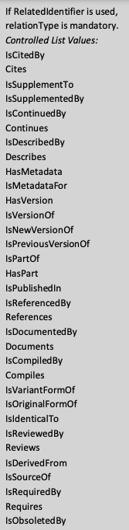
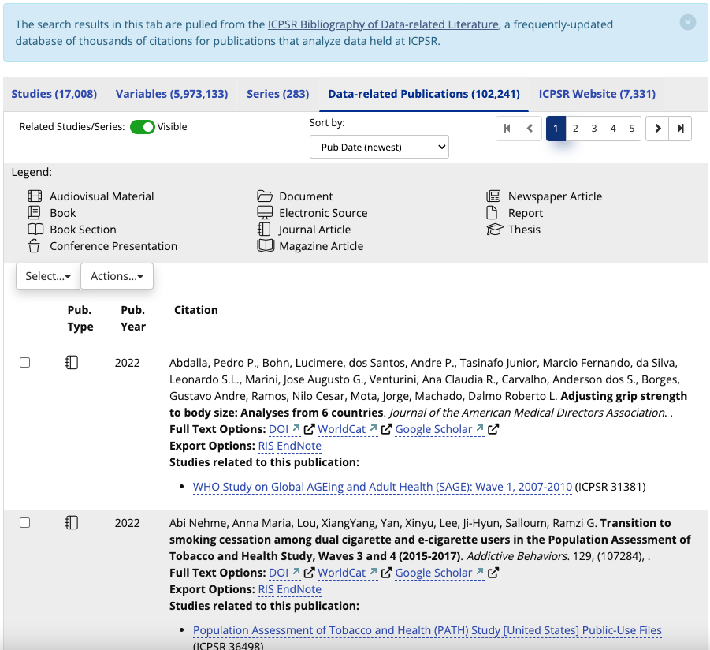
Relationship Types

Slide 40


Unique Identifiers
ICPSR
https://ror.org/02q7mkh03
Margaret Levenstein
https://orcid.org/
0000-0002-9641-2725

Slide 41
DM3/RDE Schema Goals and DataCite Opportunities
ICPSR Metadata Goals | DataCite Opportunity
Better represent intellectual and structural relationships between studies, datasets, and data-related publications | New “relatedItem” field and associated conventions for describing relations (as of v4.4, March 2021)
Expand use of alternate identifiers (e.g., ORCID, ROR, etc.) for agents and products | PID Graph: establishes connections between different entities within the research landscape
Extend metadata practices to encompass diverse formats and disciplines (video, social media, GIS, etc.) | DataCite metadata change request process
Notes:
As part of the RDE initiative, ICPSR is developing a new data model and metadata schema based on the DM3 infrastructure used with the Millennium Challenge Corporation and Research Data dot Gov platforms. Some key objectives of this work align with the goals that jay just mentioned, and so I’d like to call out some of the ways in which our participation in the DataCite community and use of the DataCite Metadata Schema will contribute to this work.
First, as we seek to Better represent intellectual and structural relationships between studies, datasets, and data-related publications, we will be able to use the DataCite schema’s “relatedItem” field and associated conventions for describing relations that were introduced in March 2021 as part of the schema’s version 4.4.
Second, as we seek to expand our use of alternate identifiers such as ORCID and ROR, we will benefit from DataCite’s PID (or persistent identifier) graph, an API driven tool that helps facilitate data discovery by establishing connections between different entities within the research landscape.
Third, as we seek to extend our metadata practices to encompass diverse dataset formats such as video, social media, and GIS, we can take advantage of the DataCite metadata change request process to introduce new fields into the DataCite schema and broaden the reach and impact of our local practices.

Slide 42
Thank you!
Questions?

