Slide 1

NACDA Webinar for MCUAAAR's HBCU Partners
Using NACDA and ICPSR Resources
March 2024
NACDA Director Dr. James McNally
NACDA Data Project Manager Kathryn Lavender

Slide 2
Plan for Today
Introduce NACDA, ICPSR, and secondary data
Search the NACDA site and identify possible datasets
Review the Metadata
Obtain the data
Cite the Data
Other resources

Slide 3
NACDA’s Role in Supporting HBCU Research
As an HBCU member, you have the same access to all NACDA resources as enjoyed by other educational institutes.
NACDA is funded by the National Institute on Aging and represents a public good open to all interested individuals and organizations.
Like many broad research classifications, the access of individual HBCUs to resources and infrastructure can vary.
We are happy to discuss individual and organizational needs and work for solutions to maximize the use of NACDA and ICPSR resources for research development, teaching, and grant writing.
You can contact us at any time after this presentation with questions.

Slide 4
Types of Data for Research Analysis
Primary Data represent information which you or people you collaborate with directly design, collect and administer to address a specific topic of interest.
Secondary Data are collected and processed without your direct control but used by you to address a specific research interest or project. Secondary data can also be data you or people you collaborate with directly design, collected but used for research that is independent from its original intent.

Slide 5
Why Use Secondary Data?
Efficiency- The collection of primary data, both qualitative and quantitative is time consuming and expensive. Good secondary data should come in a format that facilitates research.
Variety- The quantity of secondary data has growth tremendously. Many if not most research questions can be explored with some existing data set.
Theory Testing- Secondary data allows for the controlled testing of research framework and theories in a manner that allows for replication and validation of results.
Generalizability- Because the best secondary data takes advantage of sampling distributions it allows for results to be generalized to a broader population than many qualitative studies. It allows for the testing of small study results on a broader population.

Slide 6
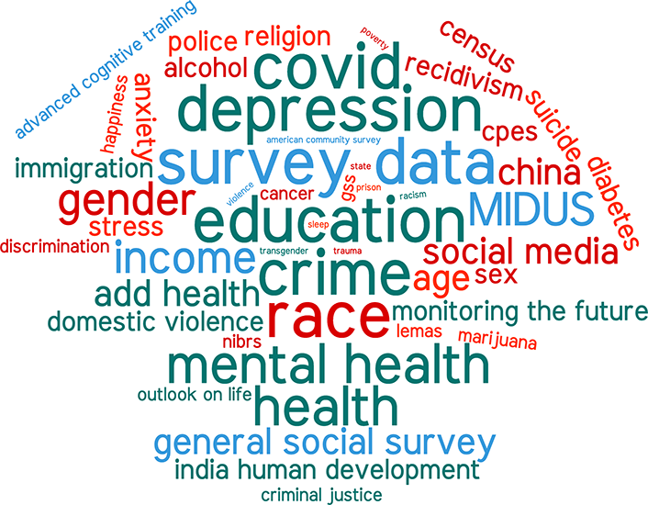
Potential Research Topics
Mental health and relationships
Physical decline in aging and depression
Education and income
Substance abuse
Neighborhoods and community engagement

Slide 7
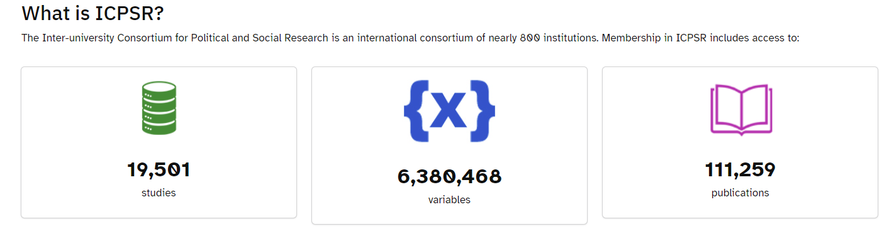
What is ICPSR?

Slide 8

ICPSR is a Social Science Data Archive
The Inter-university Consortium for Political and Social Research
Comprised of several different units and projects
Funded by a variety of sources
Mostly public-use data, some restricted data
Data are available for download from study pages at no cost to data users
Data are cleaned, organized, managed, converted to multiple formats, and preserved for long term use
Adheres to FAIR principles (findable, accessible, interoperable, reusable)
Part of the Institute for Social Research, at the University of Michigan
https://www.icpsr.umich.edu/

Slide 9
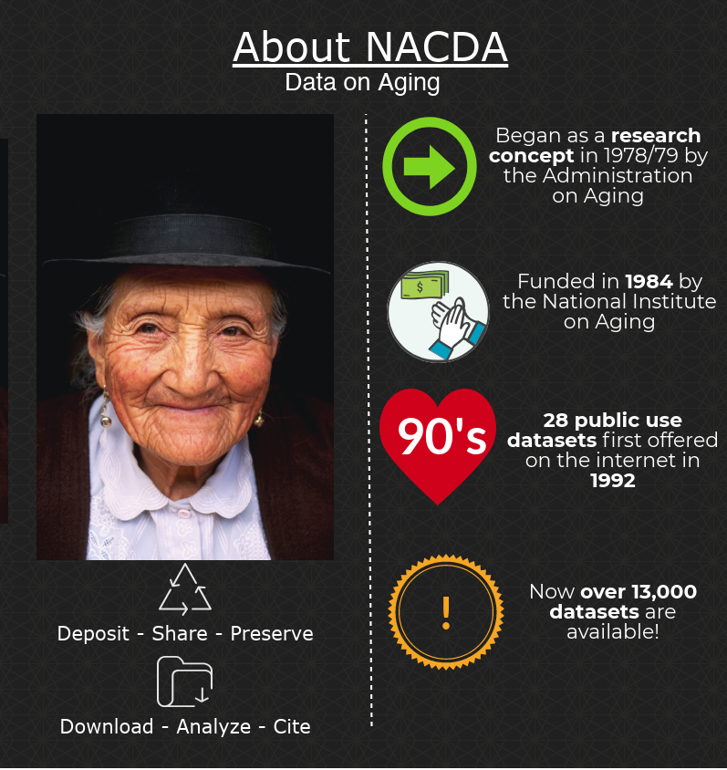
National Archive of Computerized
Data on Aging
More than 40 years of experience
Part of ICPSR
Funded by the National Institute on Aging (NIA)
Free to use
Mostly quantitative data
nacda-aging.org

Slide 10
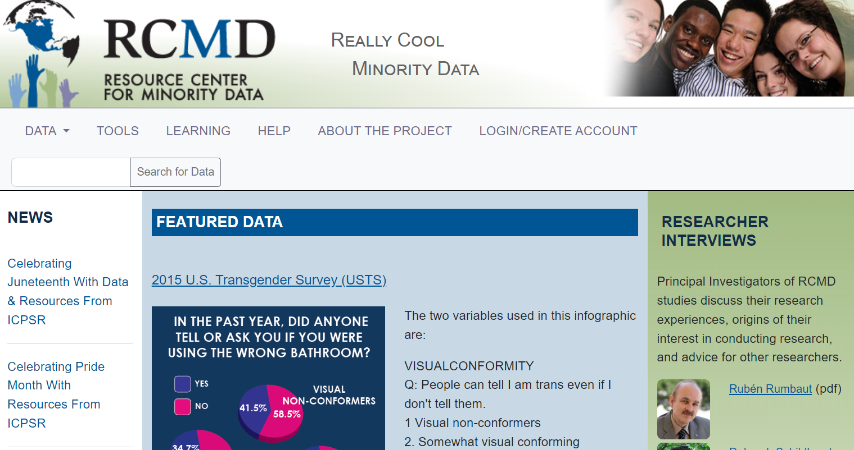
Sister Archive of Interest - RCMD
Resource Center for Minority Data

Slide 11

Do You Have Access to ICPSR Resources
Yes!
Member access
Federally-funded archives
Self-published data resources
*If you have navigated ICPSR’s site, or another ICPSR archive, you can navigate the others seamlessly – they provide consistent data products.

Slide 12
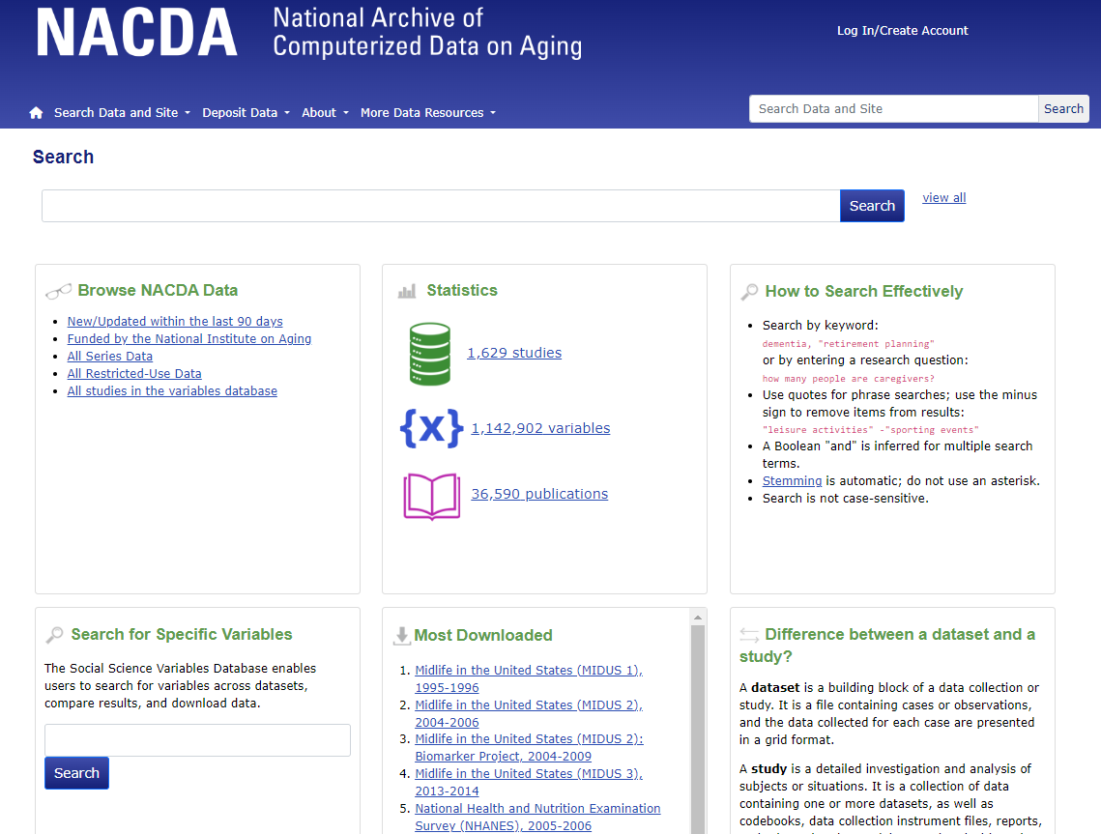
Search for Data Resources
Search by:
  Keyword
  Phrase
  PI name
  Related Publication
  Acronym
  Study title
  Variable
  And more!

Slide 13
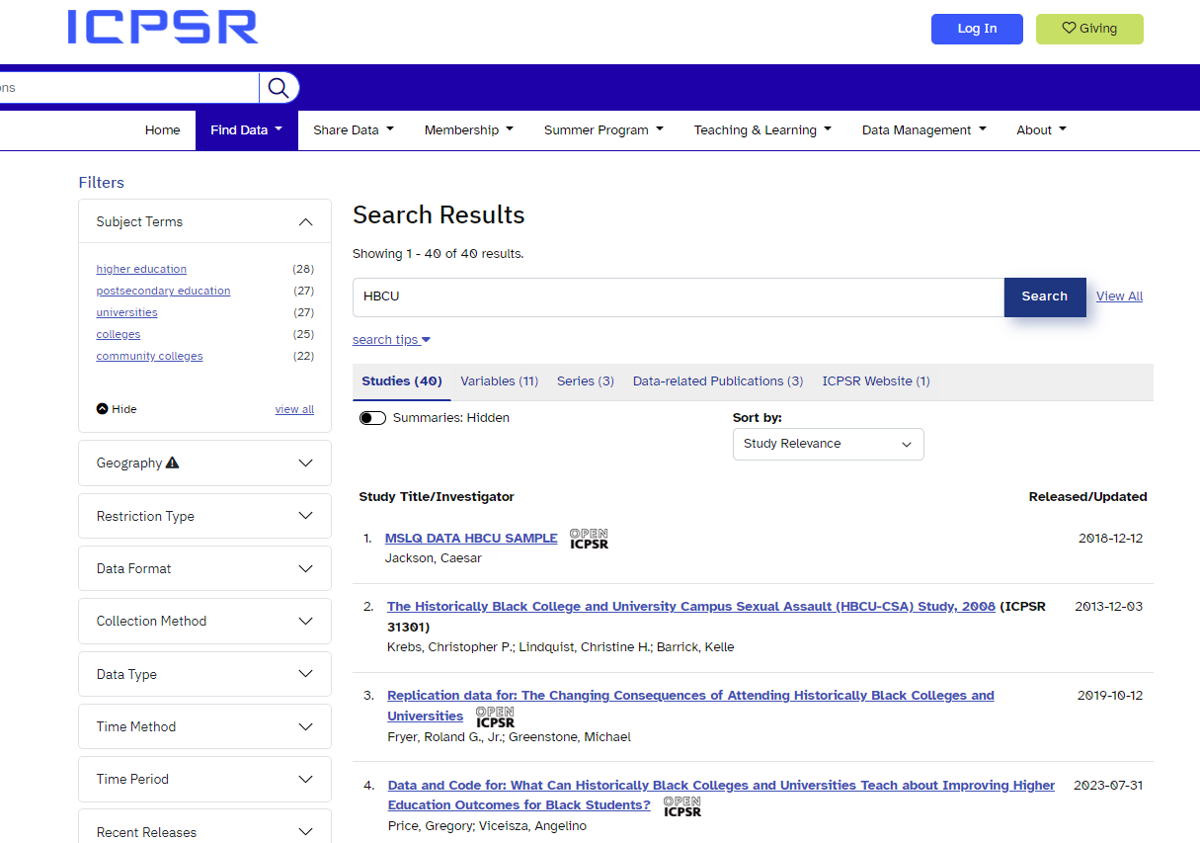
Search Results – Default by Study

Slide 14
Metadata – What Makes Search Possible
Metadata is the key to data. Some examples:
Collection level metadata
  Study title
  PI
  Description/Abstract
  Subject terms
  Collection dates
  Sampling
  Universe
  Data type
Variable level metadata
  Variable name
  Variable label
  Value labels
  Missing designations
  Question text
  Variable concepts

Slide 15
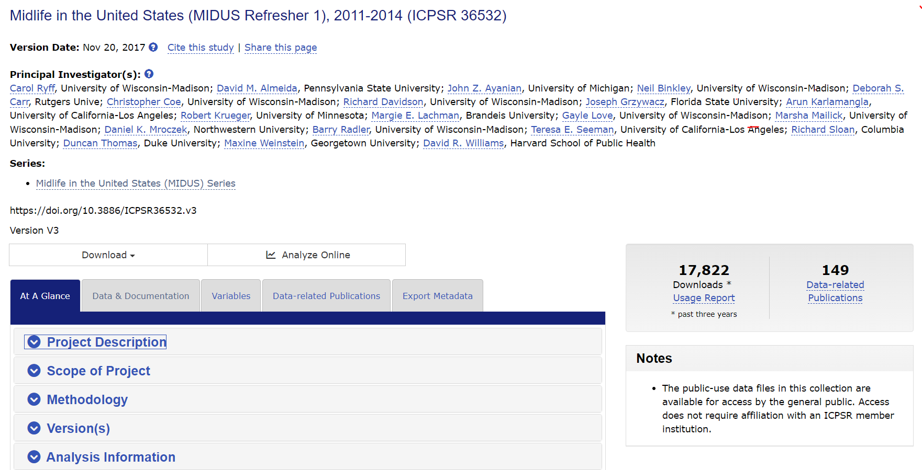
Collection Level Metadata (Study Pages)

Slide 16
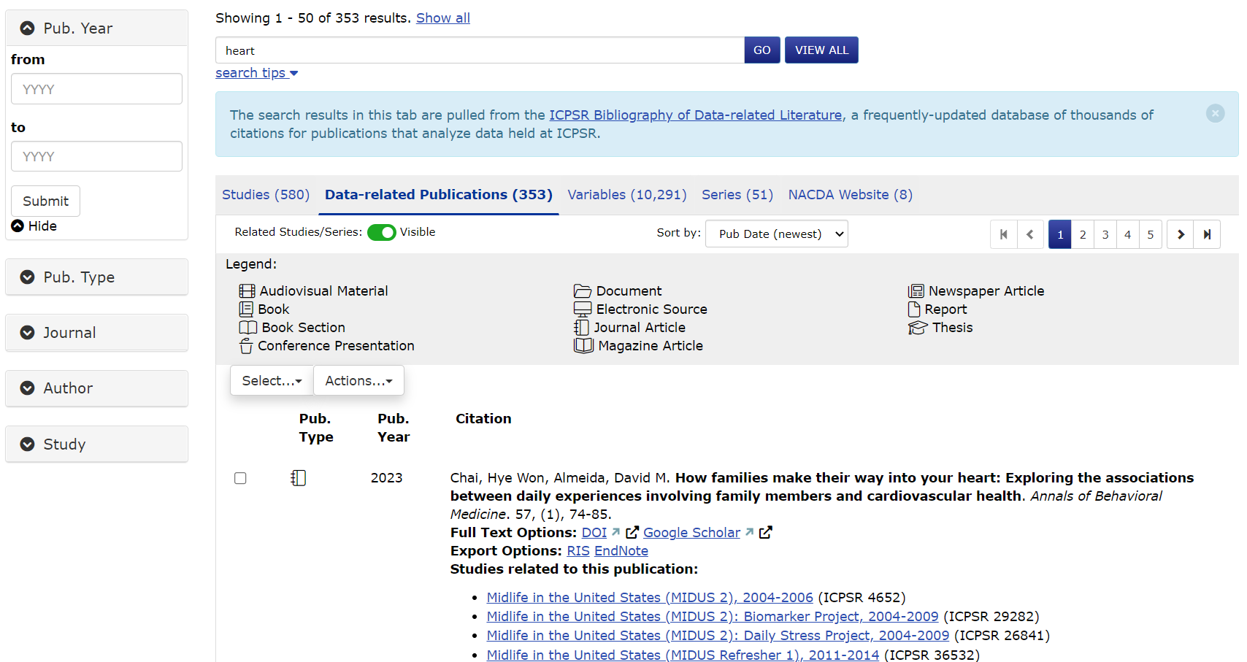
Related Publications

Slide 17
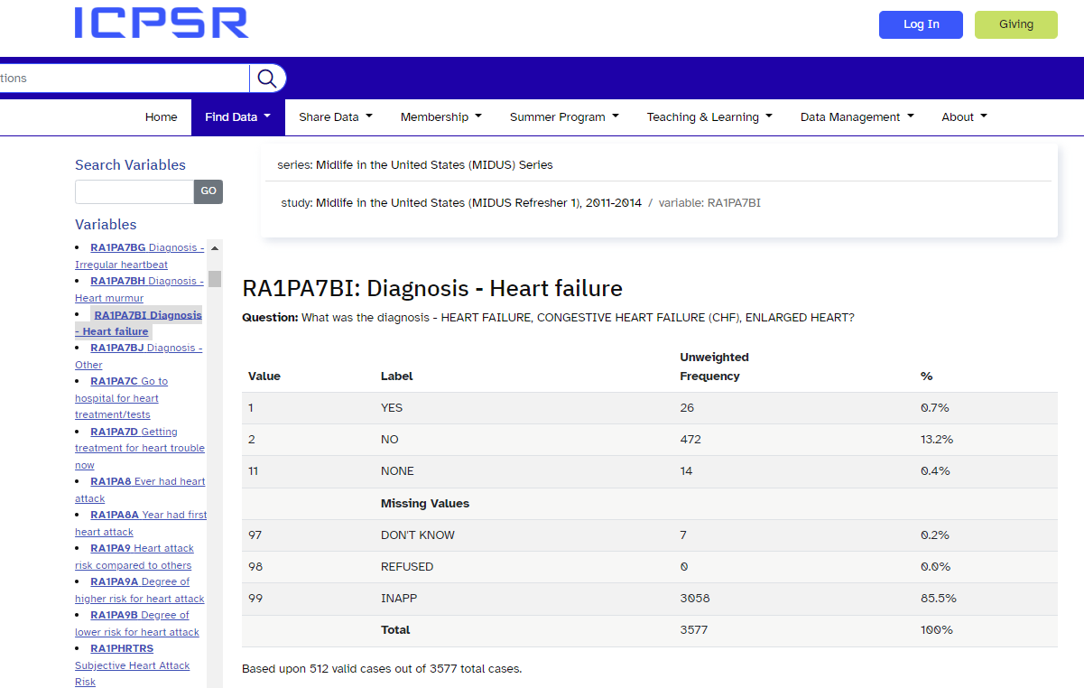
Variable Level Metadata

Slide 18
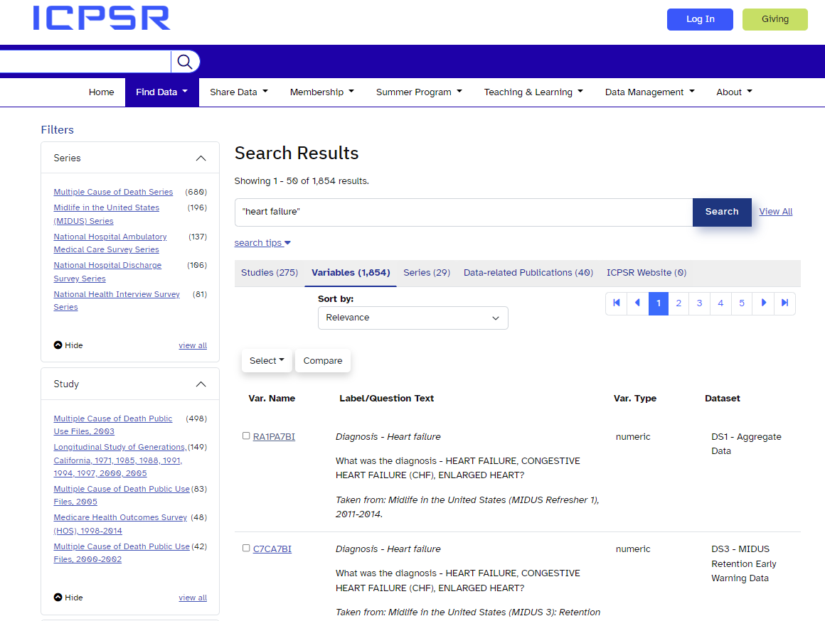
Variable Search

Slide 19
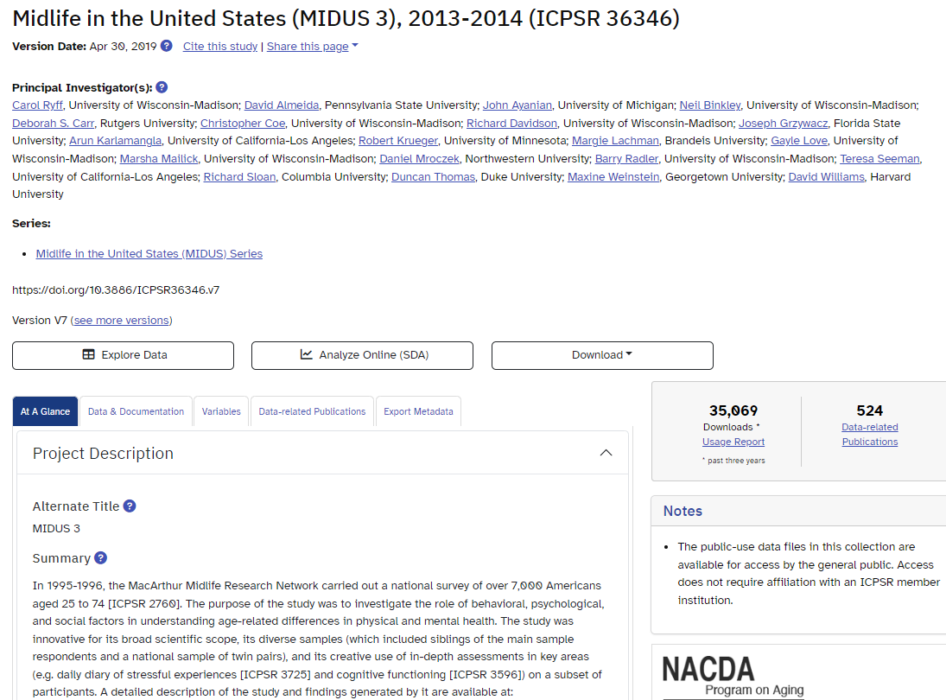
How to Download From the Study Page

Slide 20
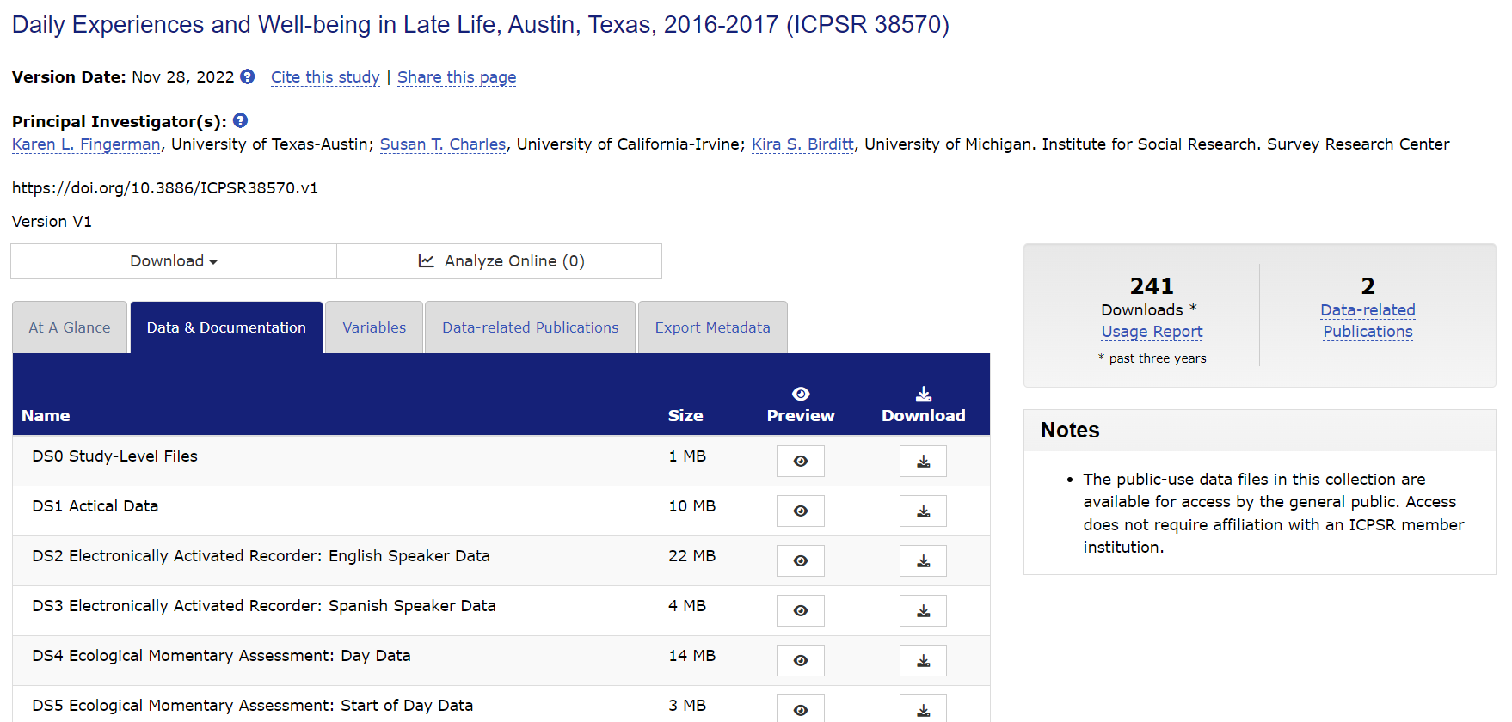
How to Download – Data and Doc Tab

Slide 21
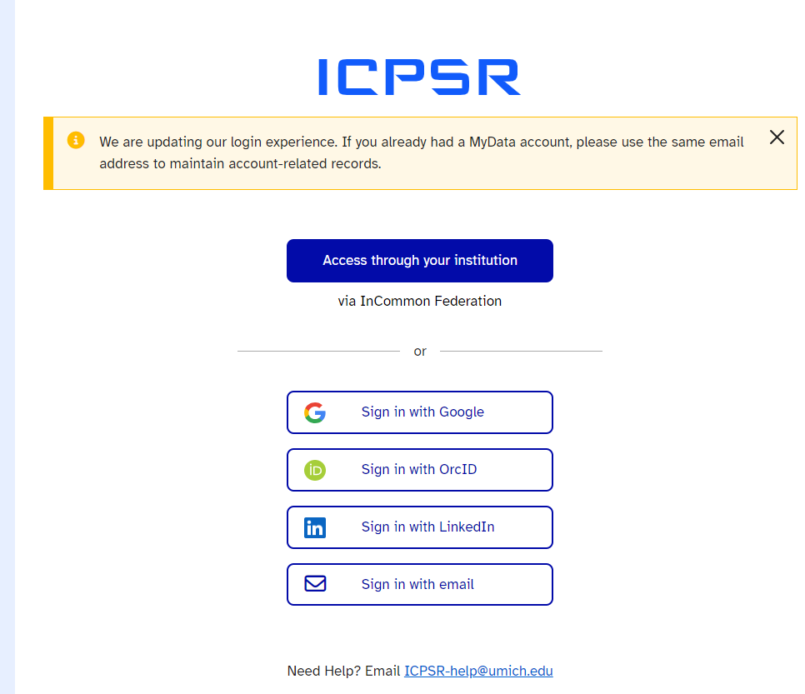
You Must Be Logged Into Your ICPSR Account to Download Data (Researcher Passport)
It’s free
Very little info is needed
We do not spam you or sell your data

Slide 22
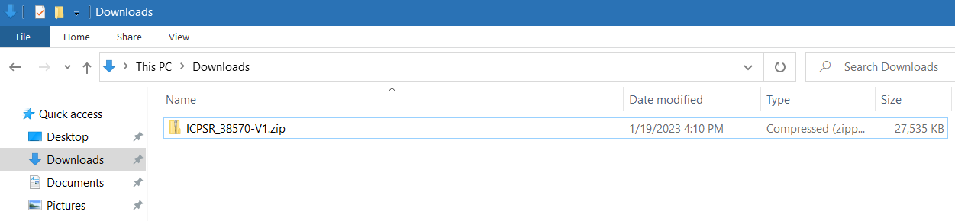
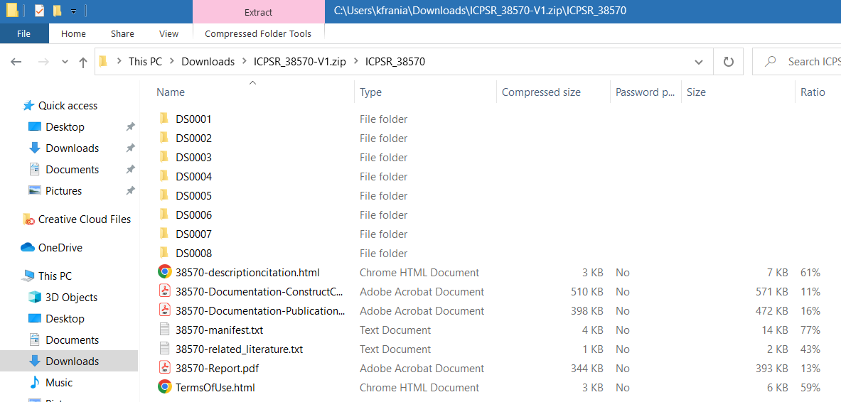
What the Download Looks Like

Slide 23
ICPSR Data and Documentation File Formats
SPSS
Stata
SAS
R
ASCII + Setup
PDF
Excel
Plain Text
*These are ICPSR’s standard for quantitative data.

Slide 24
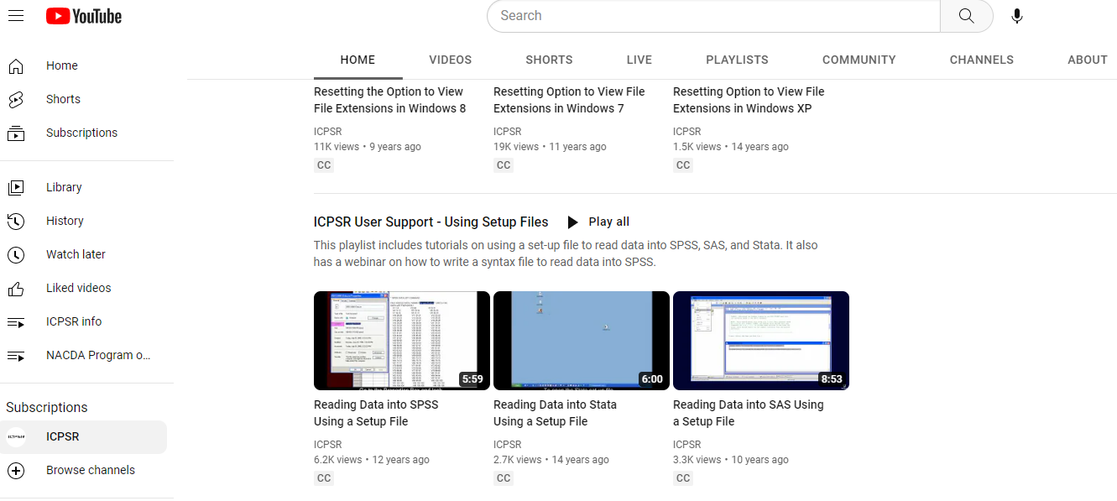
Reading ASCII Data

Slide 25
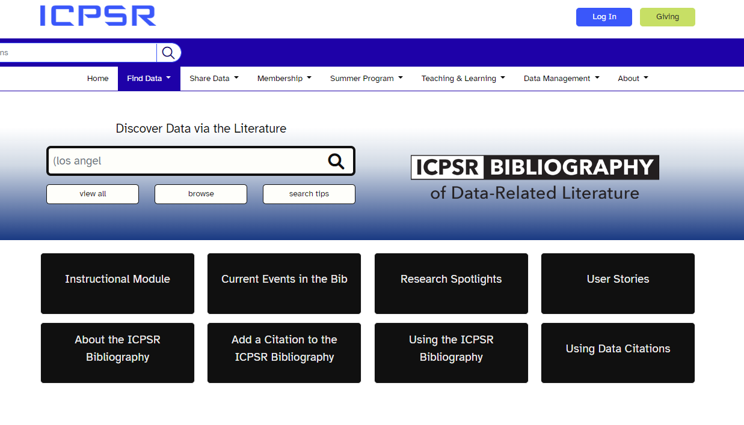
Search From Related Publications
Notes:
ICPSR has more than 100k related publications!

Slide 26
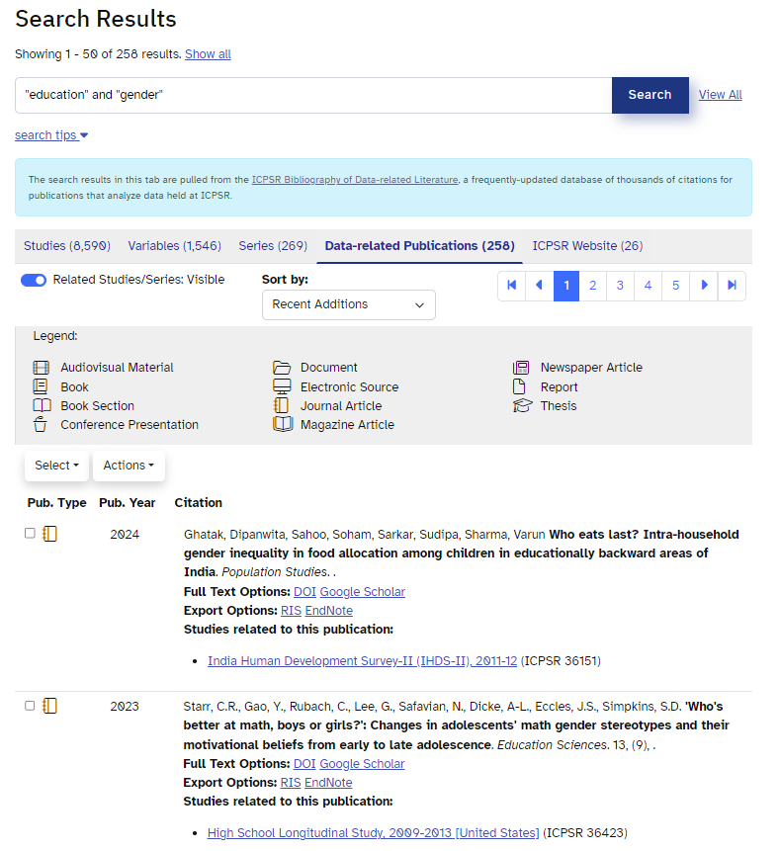
Example Search Starting with Related Pubs
Sort searches by date, title, author, and more
Results include the study/data referenced in the publication

Slide 27
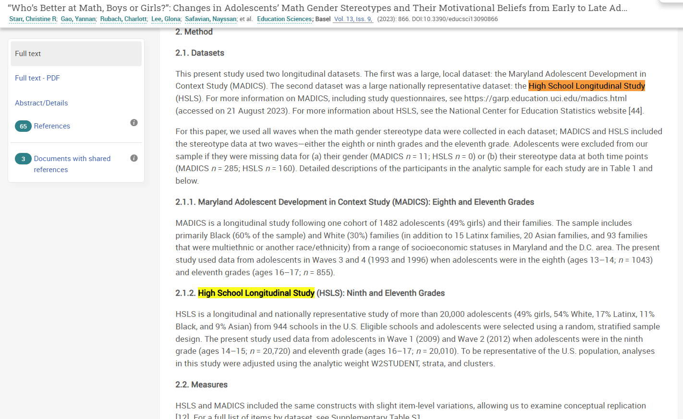
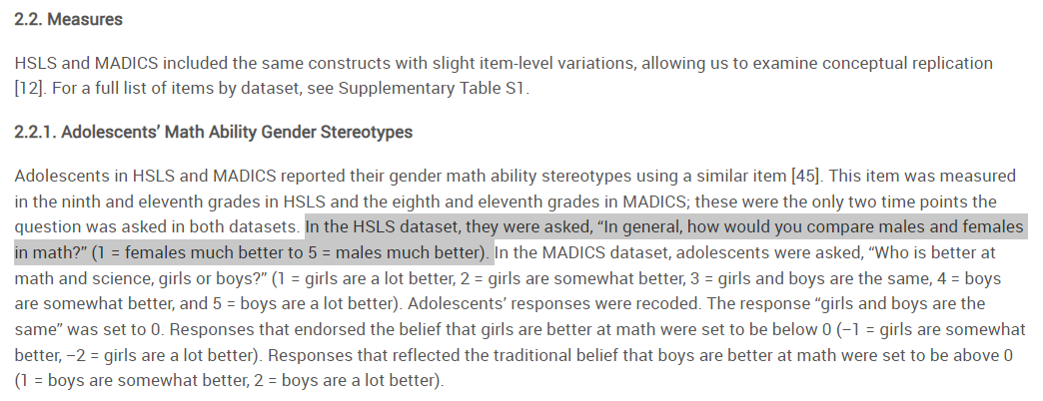
Review and Read the Publication

Slide 28
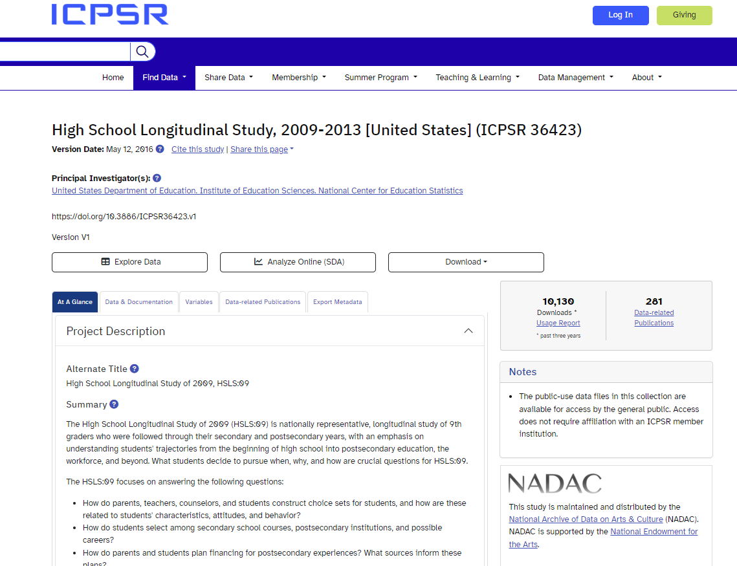
From the Study Page, Go to the Study

Slide 29
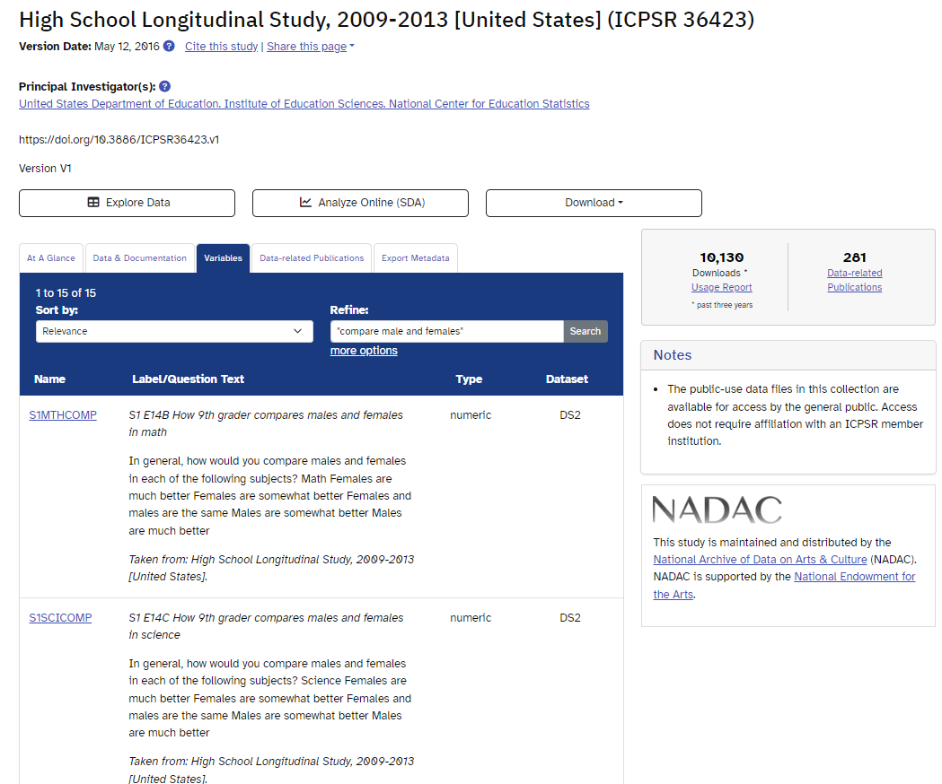
Searching a Study at the Variable Level
Type in a search term – using the related publication we found, search for “compare males and females”
The study page results will display any related variables and note which study and dataset they can be found within.
Once you locate the variable you want you can go to the study page and download the files you need.

Slide 30
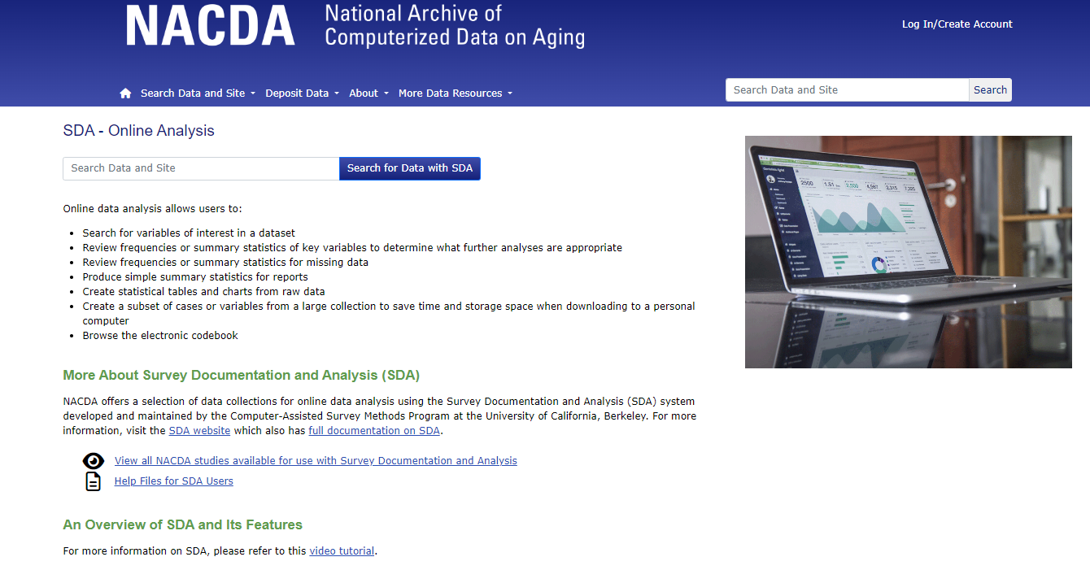
SDA – Online Analysis – No Software Needed!
Notes:
Not all studies have SDA.

Slide 31
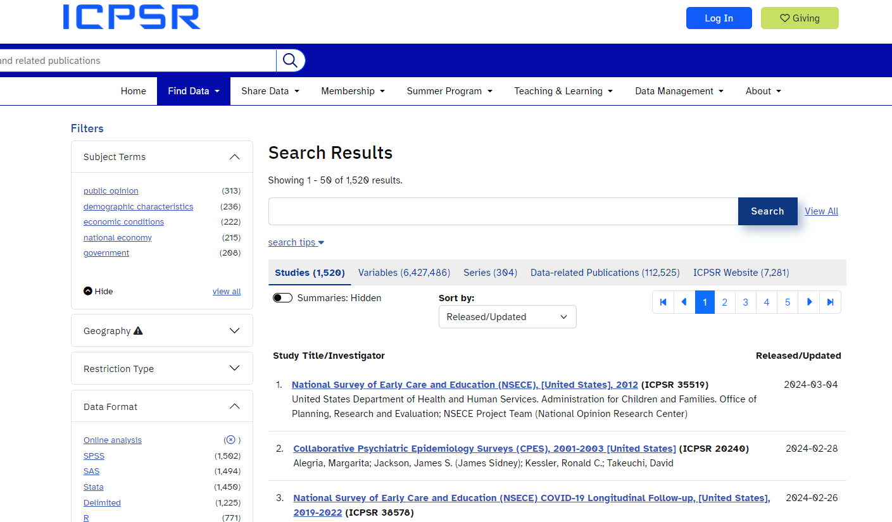
Search Studies with SDA
Notes:
Use the preset filter. You need to be logged in to use SDA.

Slide 32
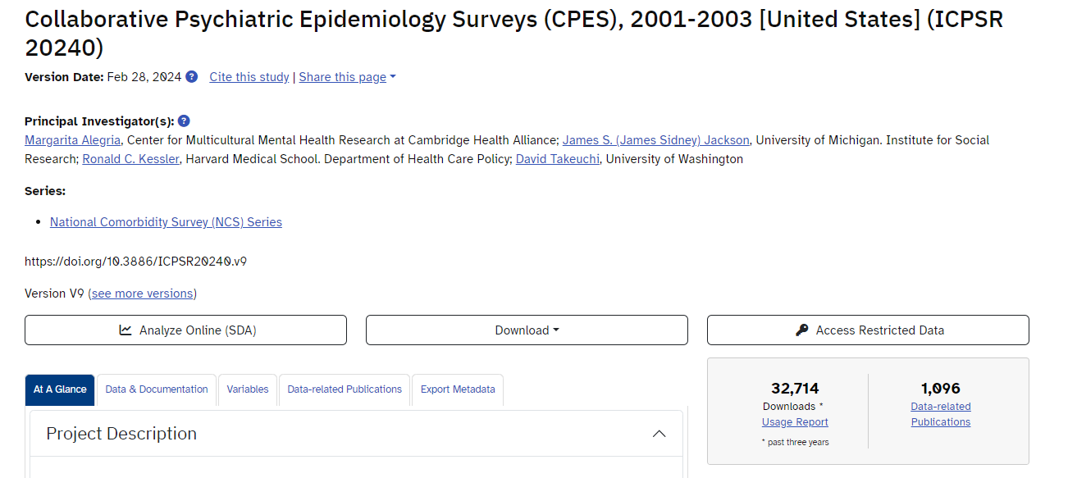
SDA from Study Pages

Slide 33
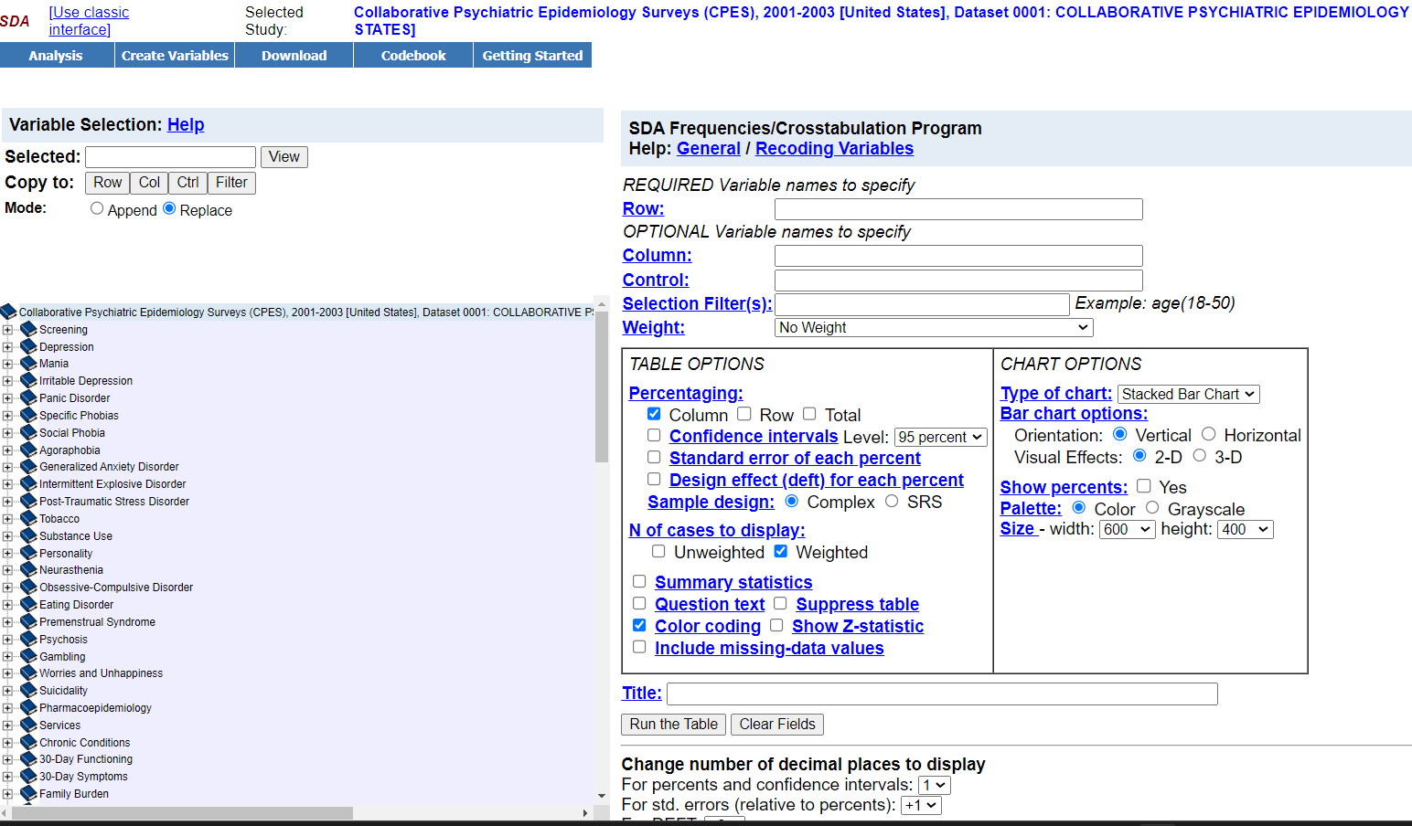
SDA - Example

Slide 34
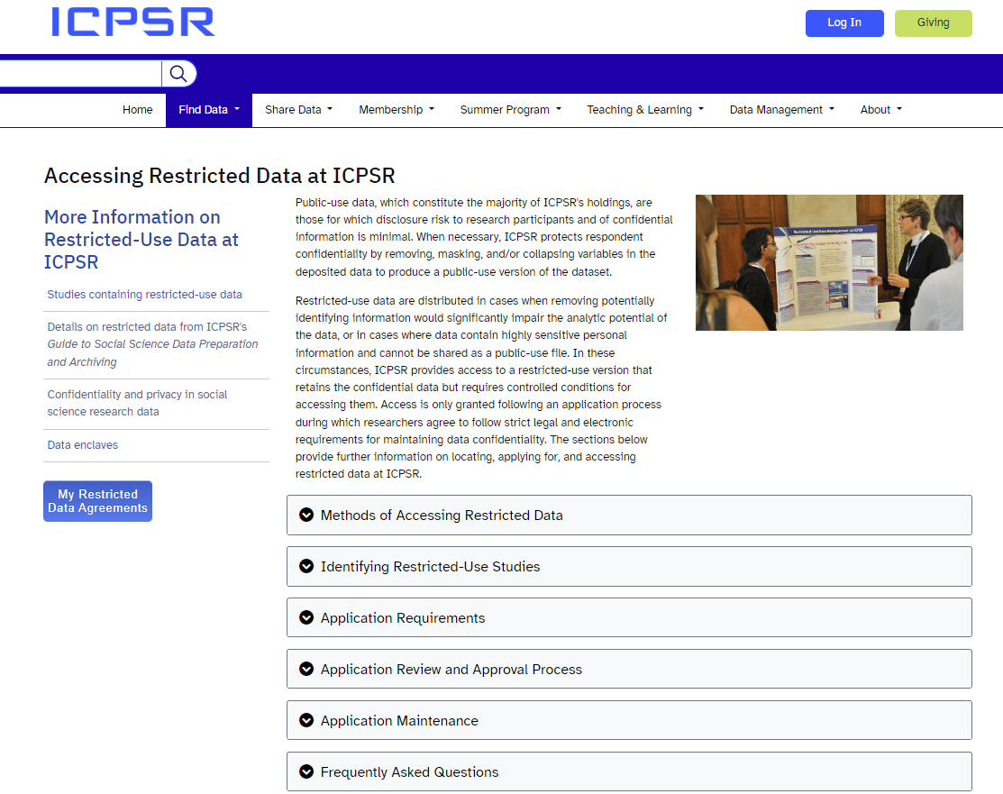
Accessing Restricted Data

Slide 35
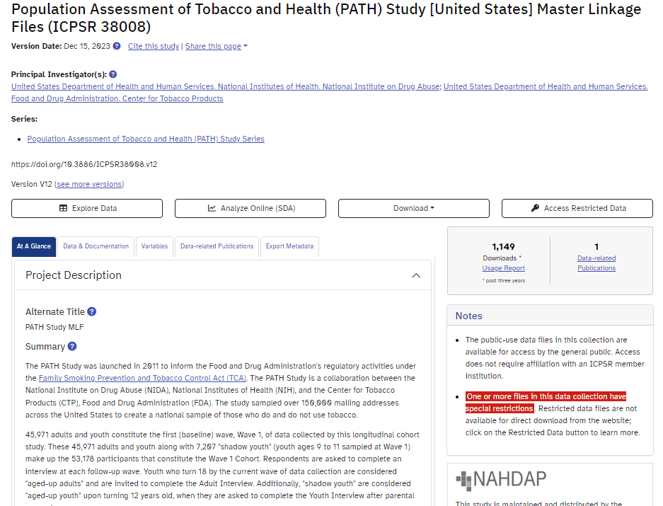
Identifying Restricted-Use Studies
Most of ICPSR’s data are publicly available, however, some studies require additional clearance to ensure ethical research use by secondary data users.

Slide 36
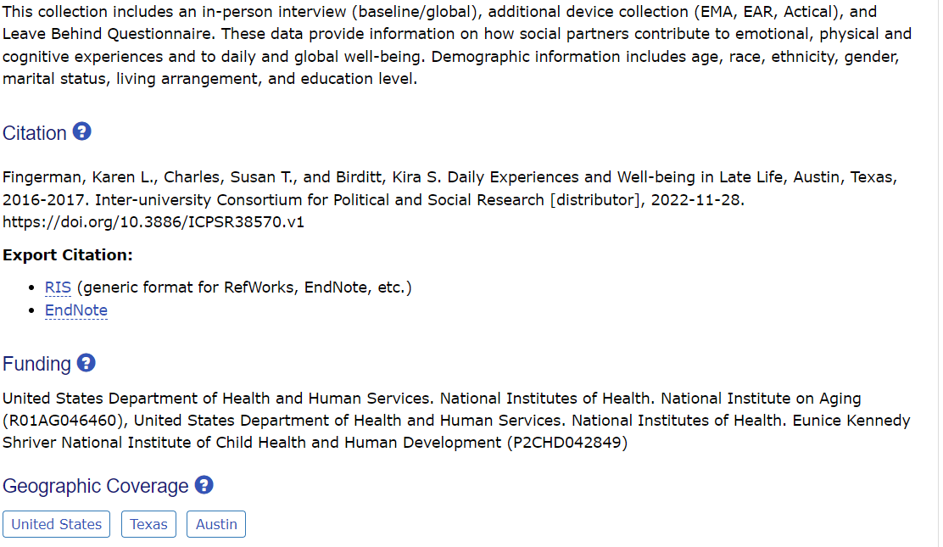
How to Cite the Data
Refer to the Study Homepage – At a Glance section - Citation

Slide 37
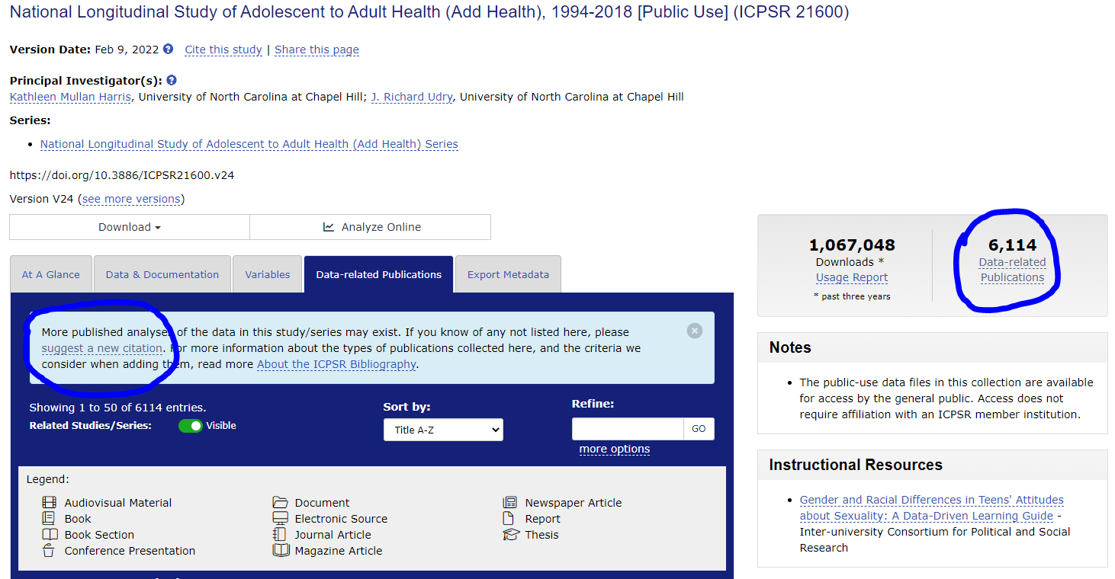
Have You Used ICPSR Data?
Submit Your Citation to Us!
Email us using
icpsr-nacda@umich.edu OR use our ICPSR citation submission form that provides the citation directly to our bibliography team.
Your publication will be linked to the data you used and become part of our bibliography database!
You can also find the option to suggest a citation from any study page – data-related publications tab.

Slide 38
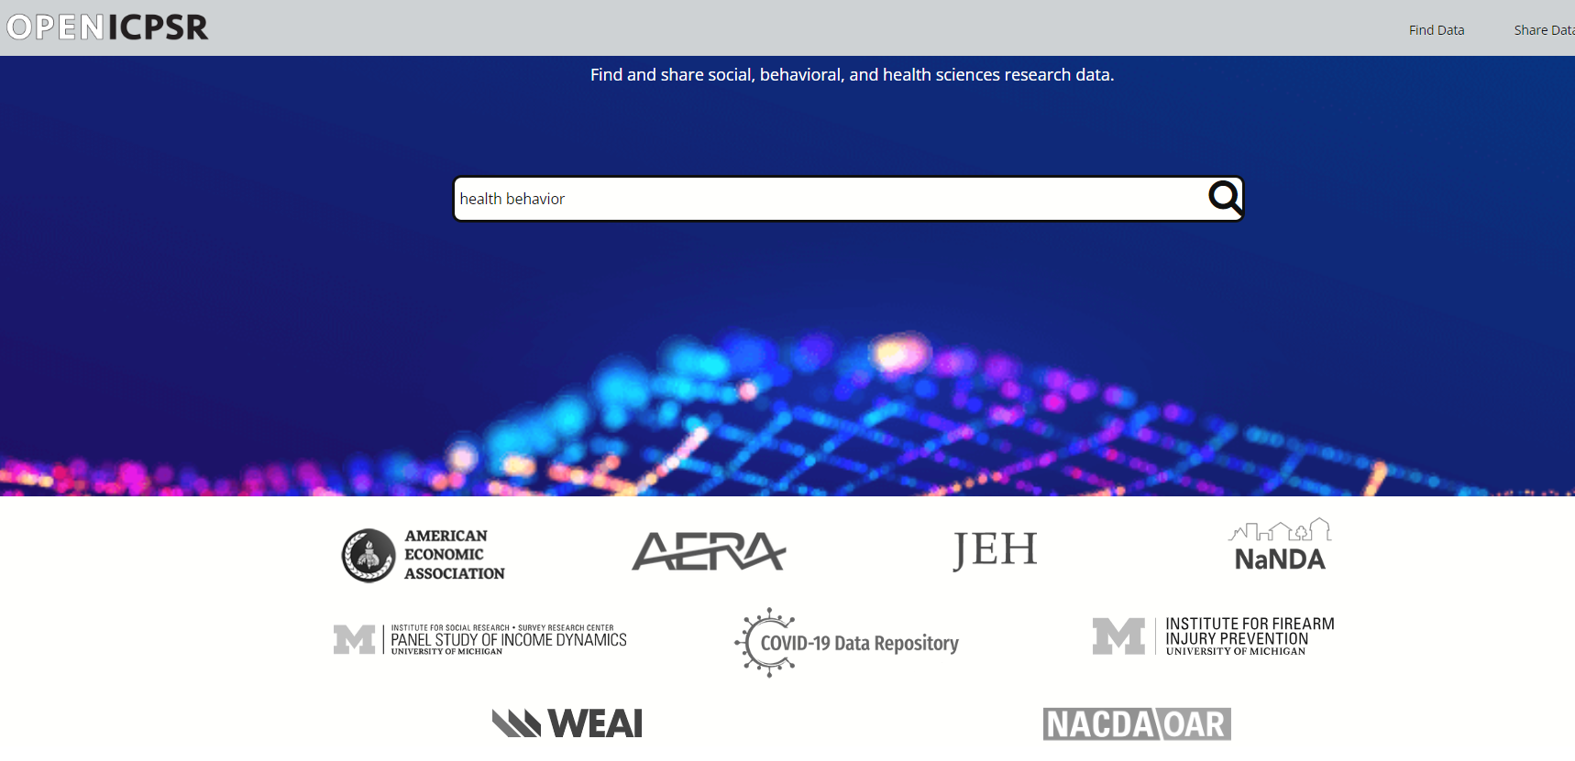
Share your Syntax and Research - OpenICPSR

Slide 39
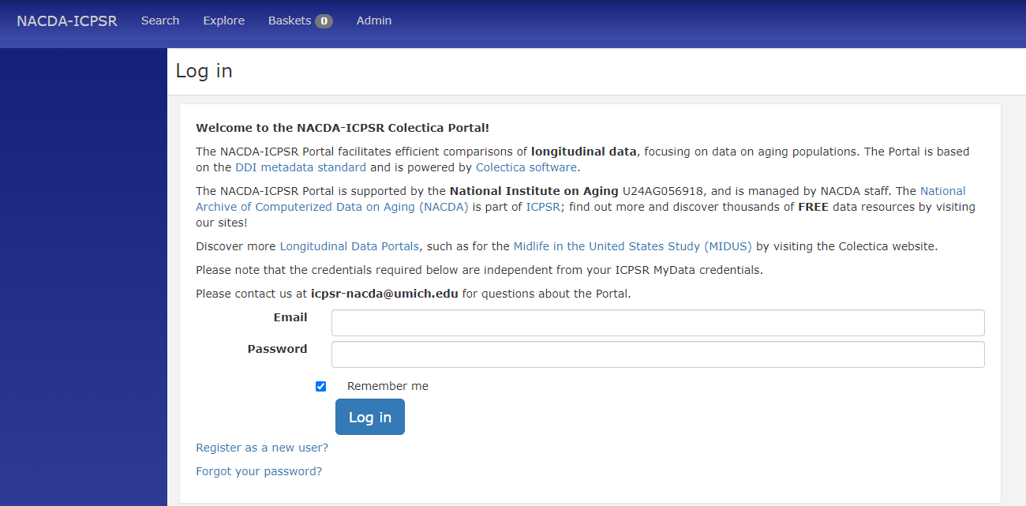
Another Way to Discover Data –
NACDA Colectica Portal
Your login credentials for the portal are not the same as your MyData login credentials (unless you make them that way).

Slide 40
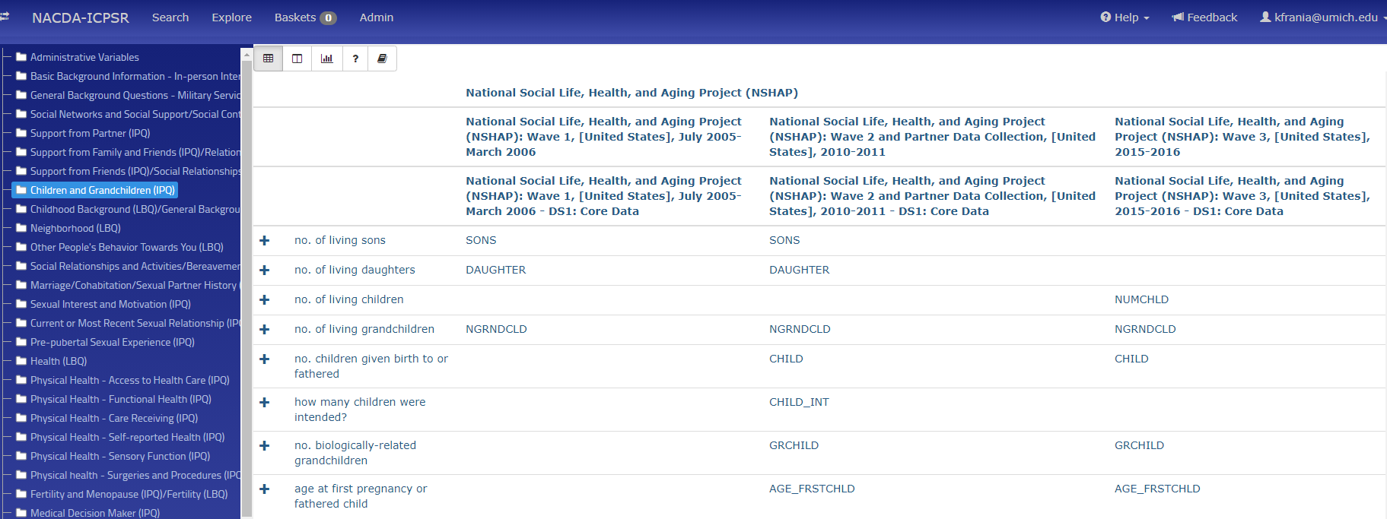
Colectica Portal – Explore

Slide 41
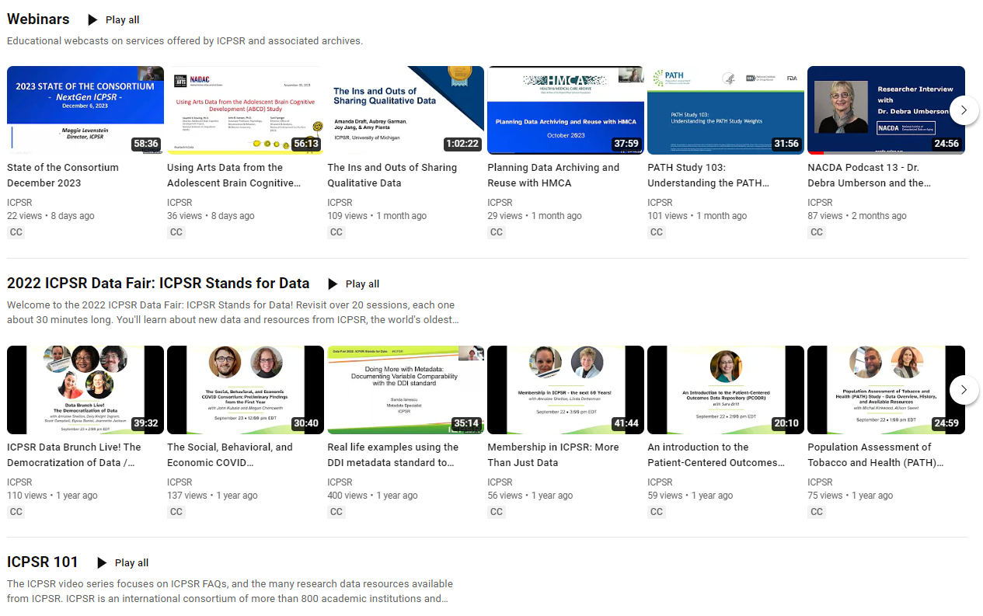
YouTube Resources

Slide 42
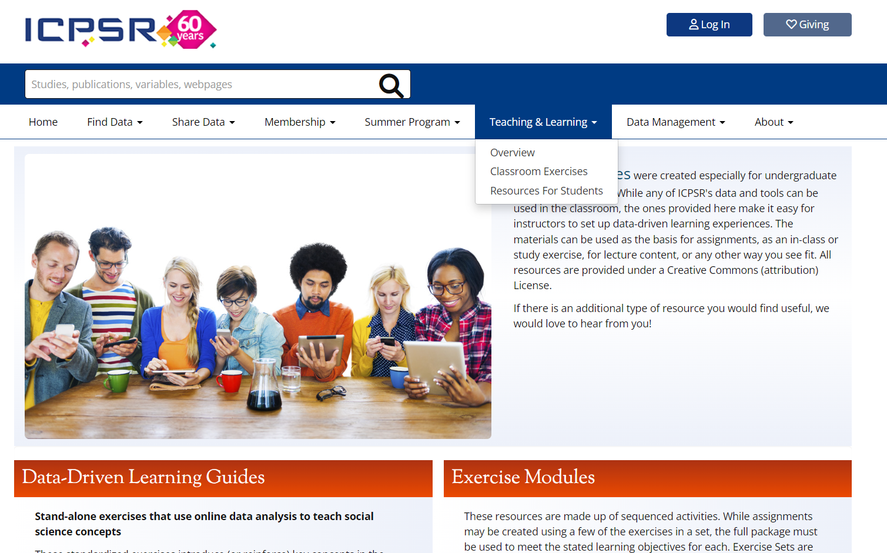
ICPSR Instructional Resources

Slide 43

Data User Support
icpsr-help@umich.edu
-Data questions
-Data access
-Other concerns
Email us anytime.

Slide 44

Upcoming Events
Booths at upcoming April MPRA, AERA, and PAA Conferences
-Check ICPSR’s News and Events page for more!

Slide 45
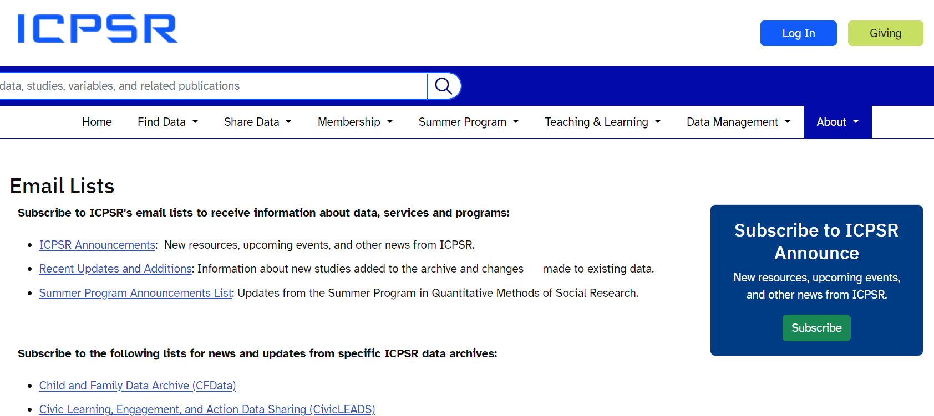
Newsletters
Visit the ICPSR site to sign up for newsletters from ICPSR and other ICPSR projects

Slide 46

Other Data Resources
HRS
NHATS
Gateway to Global Aging
ROPER Center
GESIS
CESSDA
CDC
Not a data center but a good resource: IASSIST

Slide 47
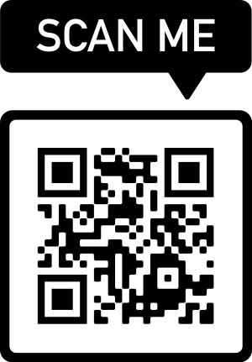
Thank You!
Scan this QR Code to get to our LinkTree:
NACDA website
NACDA Colectica Portal
YouTube playlist
Newsletter signup
NIH data sharing resources

