Slide 1
Doing More with Metadata:
Documenting Variable Comparability with the DDI standard
Sanda Ionescu
Metadata Specialist
ICPSR

Slide 2
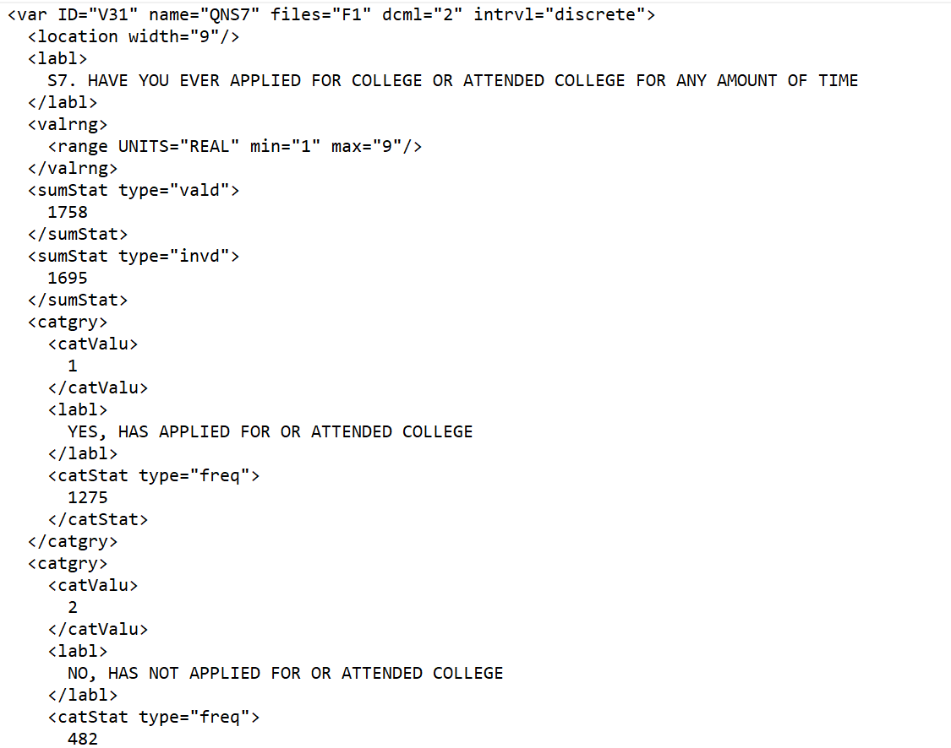

DDI – a metadata standard for the social sciences
The Data Documentation Initiative (DDI) – a metadata standard specifically designed for describing data from the social, political, and behavioral sciences
Standardized metadata
  Structured in a consistent, predictable way
  Machine-actionable: software may be programmed to take a variety of actions on its content
    Interactive display
    Filtered searches
  Is shareable and interoperable
    Not system-dependent
Makes data FAIR - Findable, Accessible, Interoperable and Reusable

Slide 3
Why DDI?
DDI is the best metadata choice for data archives
  Other well-known and widely-used metadata standards
    DCAT (Data Catalog Vocabulary)
    DC (Dublin Core)
    Schema.org
  Describe datasets as objects and their relationships
  DDI also describes data points (variables) as objects, with their:
    Physical characteristics
    Meaningful content
    Relationships
DDI is widely used by data archives around the world
  Use of the same standard facilitates metadata sharing and reuse

Slide 4
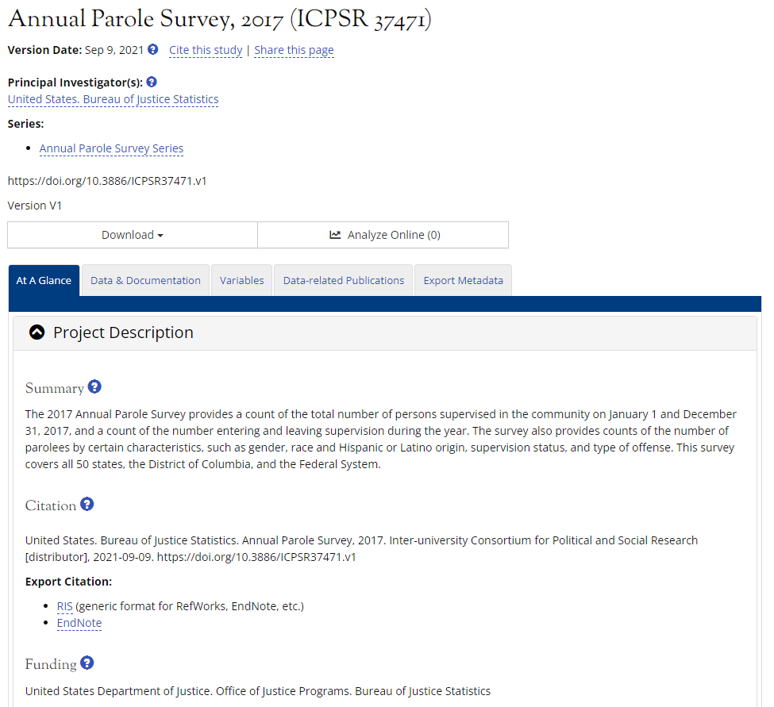
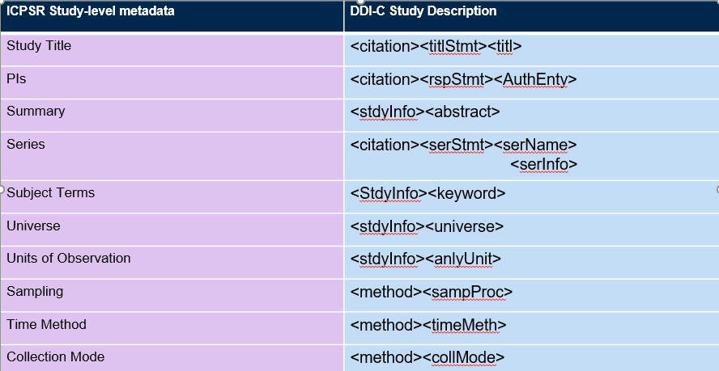
DDI at ICPSR
ICPSR’s metadata is fully aligned to DDI
  ICPSR study descriptions are based on DDI fields

Slide 5
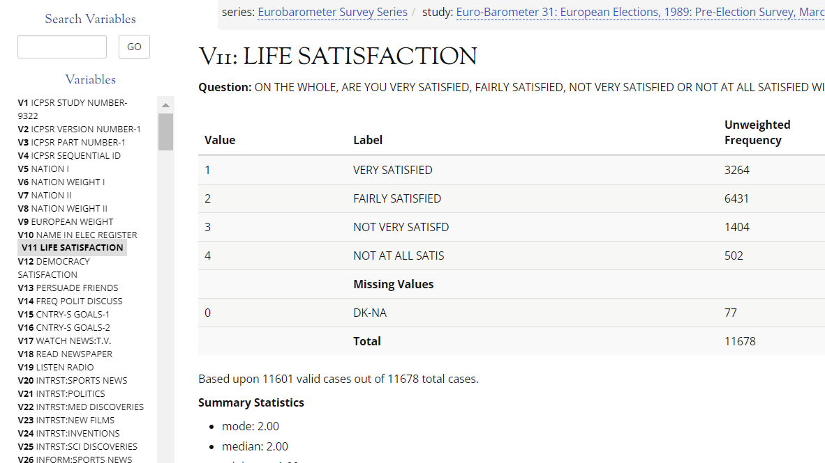
DDI at ICPSR
ICPSR’s variable descriptions are also expressed in DDI
Generated in an automated way by our processing systems
All of our curated studies have individual variable descriptions in DDI and are included in the public variable search

Slide 6
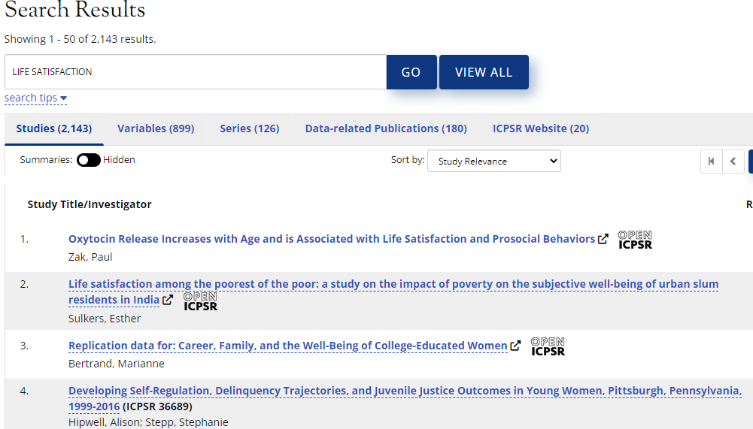
DDI at ICPSR
DDI-structured metadata supports enhanced data discovery and evaluation
The keyword search on ICPSR’s home page brings up all of the metadata products that may be dealing with a specific topic
  Studies
  Variables
  Series, etc.

Slide 7
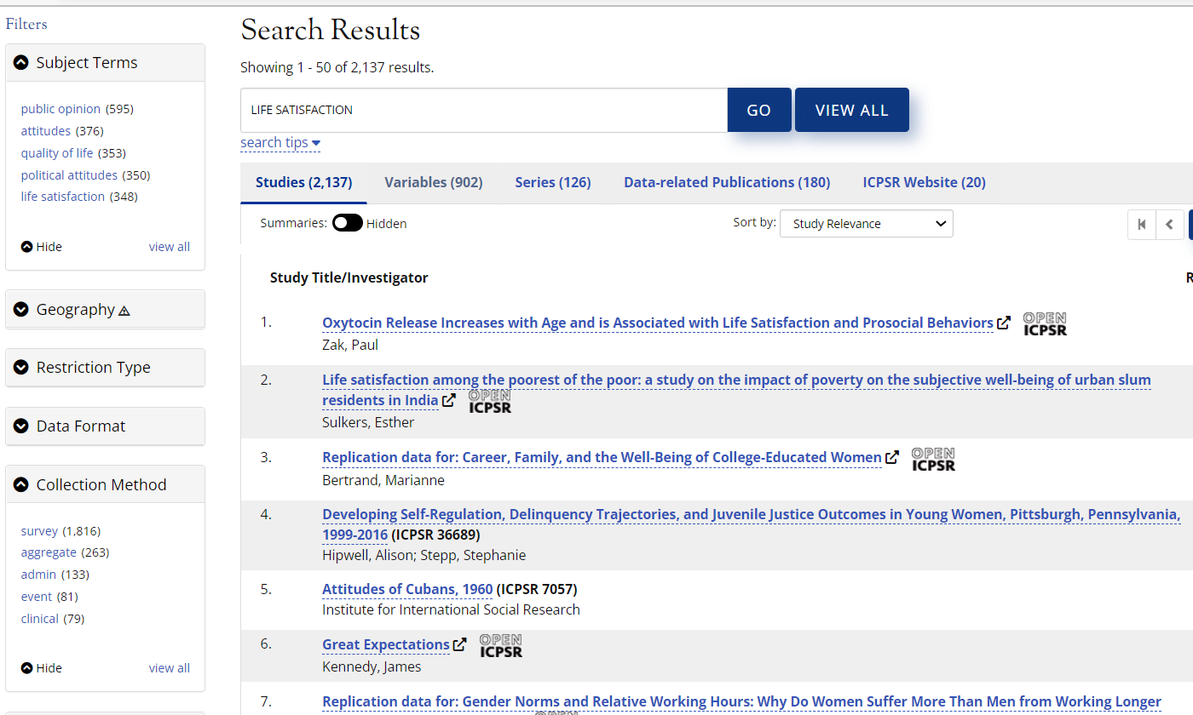
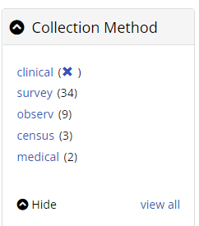
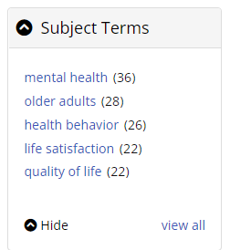
Study-level DDI at ICPSR
At study level the search results may be refined using filters created from the DDI fields included in the DDI study description
Multiple filters, with interactive coverage, may be selected

Slide 8
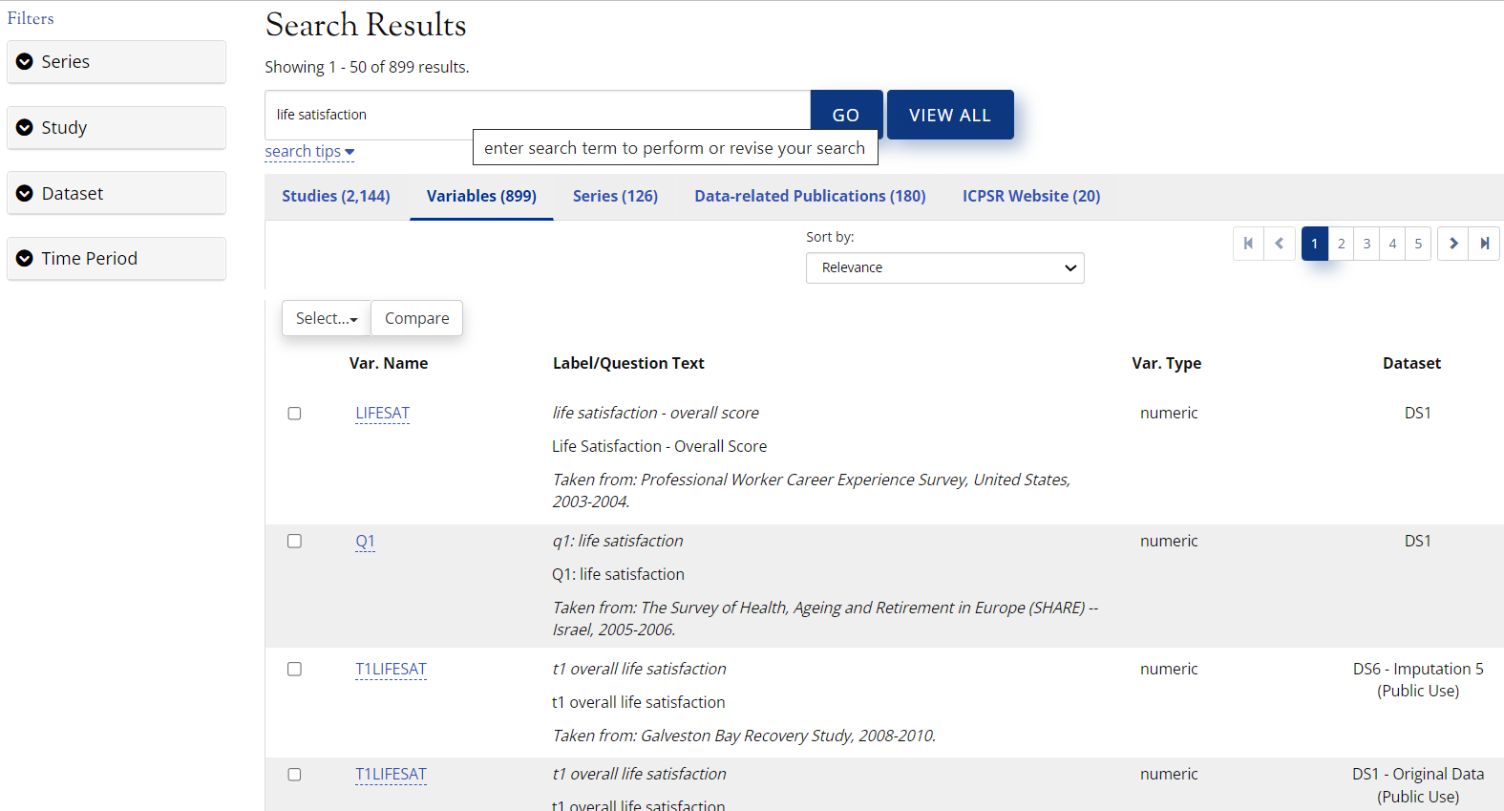
DDI variable descriptions at ICPSR
The interactive study codebook, powered by DDI tagging of variable metadata:
Detailed individual variable description
Variable in dataset context
Variable search within dataset
Facilitates data discovery and evaluation for secondary analysis
Best suited to support research projects looking at how concepts are measured and if, or how they correlate with other concepts at the same point in time (within the same dataset)
Keyword variables search:

Slide 9
DDI at ICPSR
Different perspective on data analysis: longitudinal, or time-series data users
  Interested in studying how ideas, perceptions, opinions or populations change over time
    Identify, and compare measures of the same concept taken at different points in time
    Identify differences in answer categories or answer coding to be resolved/harmonized for statistical analysis

Slide 10
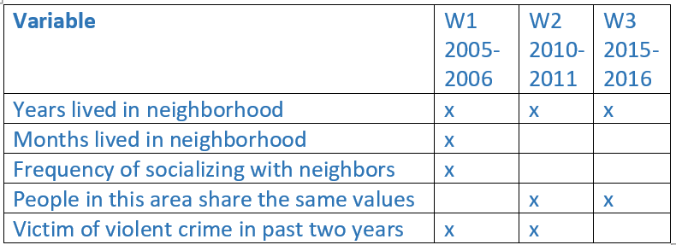
DDI at ICPSR
Variable crosswalks:
Favorite tool for longitudinal data users
Easily identify
  Questions that were repeated over time to measure the same concept
  Specific time points when the same concept was measured
Useful, but the information is not complete
Questions asked and response categories still need to be discovered and assessed for comparison and harmonization

Slide 11
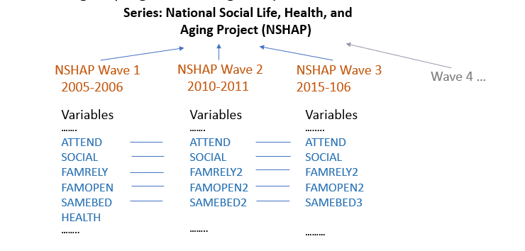
DDI for longitudinal data at ICPSR
DDI-Lifecycle
A newer development line of the DDI metadata standard
Offers an elegant, accurate and comprehensive solution for documenting variable comparability across datasets
DDI-Lifecycle allows grouping
and linking comparable items
  Series
  Studies
  Variables

Slide 12
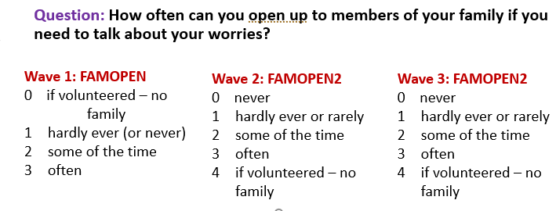
DDI for longitudinal data at ICPSR
DDI documents
  Variable comparability
  Degree of comparability
Example: variables FAMOPEN and FAMOPEN2 from the NSHAP longitudinal study
Traditional crosswalk:
Wave 1 | Wave 2 | Wave 3
VOLUNTEER | VOLUNTEER | VOLUNTEER
SONS | SONS
FAMOPEN | FAMOPEN2 | FAMOPEN2
SAMEBED | SAMEBED2 | SAMEBED3
 | BREAKBONE | BREAKBONE3

Slide 13
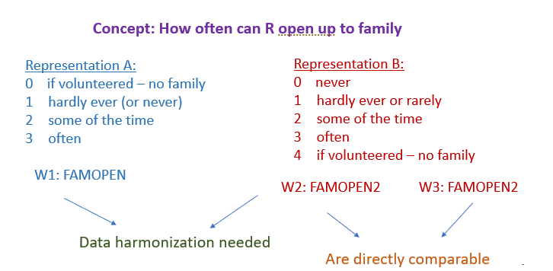
DDI for longitudinal data at ICPSR
The Variable Cascade
  DDI-L structure
  Uses the variables’ physical representation to suggest degree of comparability

Slide 14
DDI for longitudinal data at ICPSR
The Variable Cascade – the DDI structure that describes, and links
  Dataset variables across waves
  Concept measured
  Specific physical representation
Comparison-relevant information
  Saved in the archival-friendly DDI document
  May be retrieved in the future
  Can be used, and re-used by different systems/applications
The DDI can be manipulated to provide multiple functionality for data users
    Collection-wide keyword searches
      Filtered by item type
      Filtered by specific description field
    Interactive comparison views
    Selected variables downloads
    Customized codebooks

Slide 15
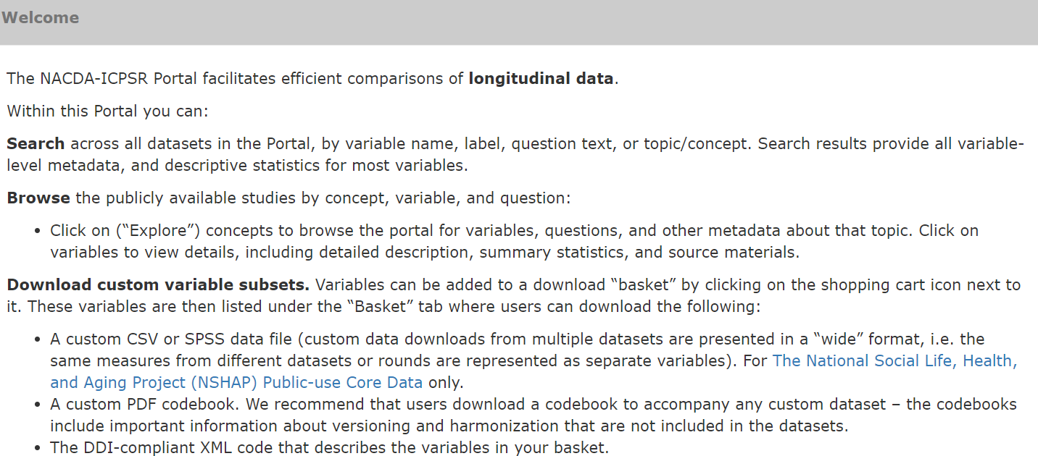
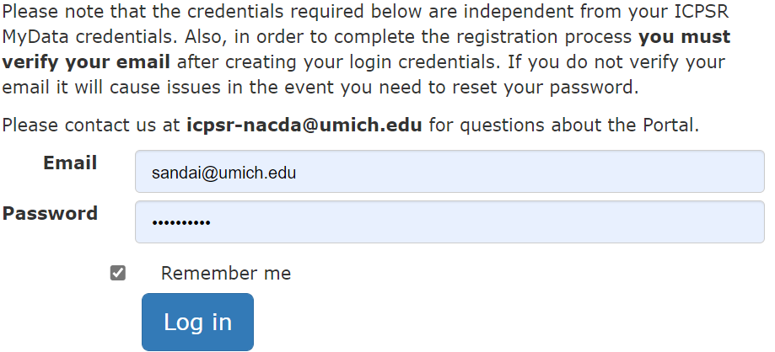
DDI for longitudinal data comparison at ICPSR
ICPSR projects using DDI for longitudinal data
  Started as exploratory projects in 2019
  Supported by NIA grants awarded to our Aging Archive (NACDA)
  Using Colectica software
    Colectica Designer for DDI creation
    Colectica Portal for Web presentation
    https://harmonize.icpsr.umich.edu

Slide 16
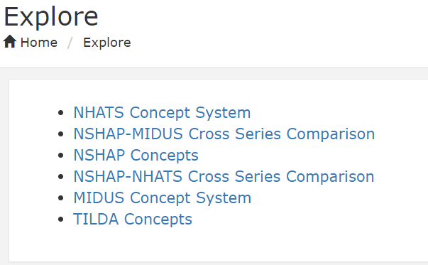
DDI for longitudinal data comparison at ICPSR
ICPSR projects using DDI for longitudinal data
  Two types of projects:
    Single series, cross-wave comparison
      The National Social Life, Health and Aging Project (NSHAP)
      The Irish Longitudinal Study on Ageing (TILDA)
      Health and Aging in Africa: A Longitudinal Study of an
      INDEPTH Community in South Africa (HAALSI) – forthcoming
    Cross-series concordances
      NSHAP – NHATS (National Health and Aging Trends Study)
      NSHAP – MIDUS (Midlife in the United States)
    Single-series DDI metadata for the NHATS and MIDUS studies were shared with us by their creators
    ICPSR reused these metadata to create new, added-value documentation for cross-series variable comparison

Slide 17
DDI for cross-wave variable comparison:
The NSHAP longitudinal study
The National Social Life, Health, and Aging Project (NSHAP)
Conducted by NORC (National Opinion Research Center), and a team of investigators at the University of Chicago
Longitudinal study of community-dwelling older people, aged 57 - 85 at the time of recruitment
Study of health and social factors
  Examines the interaction among physical health and illness, use of medication, emotional health, cognitive and sensory function, social connectedness, sex life, and quality of relationships
Core data, public version available for access through the ICPSR-NACDA Colectica portal
  3 rounds of data between 2005-2016
  COVID-19 substudy, 2020-2021

Slide 18
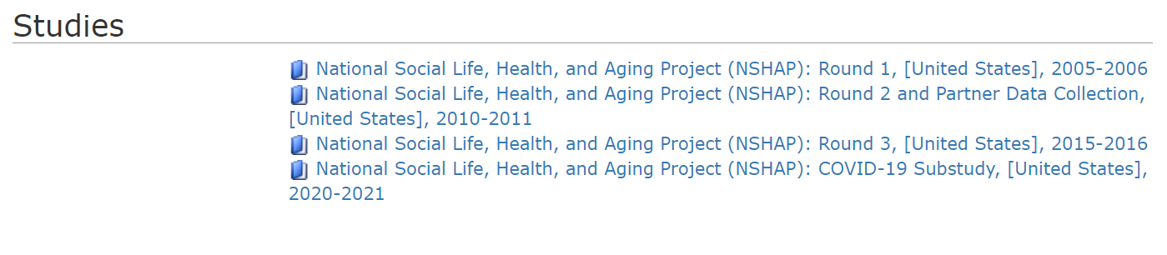
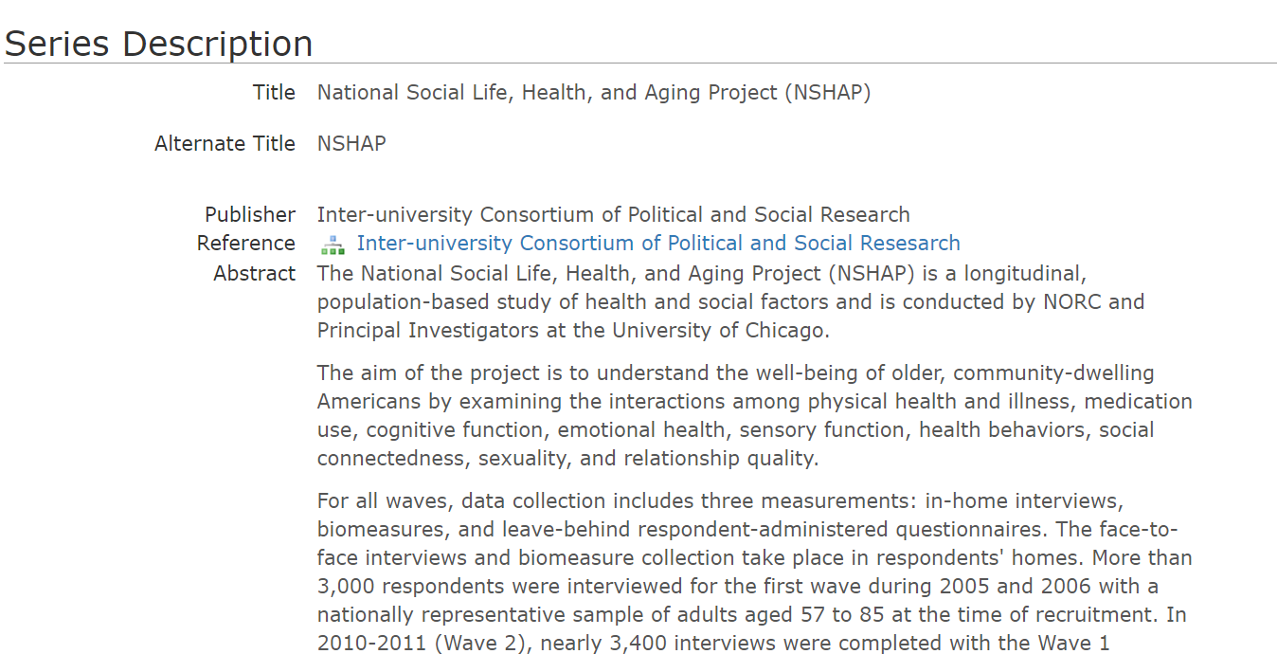
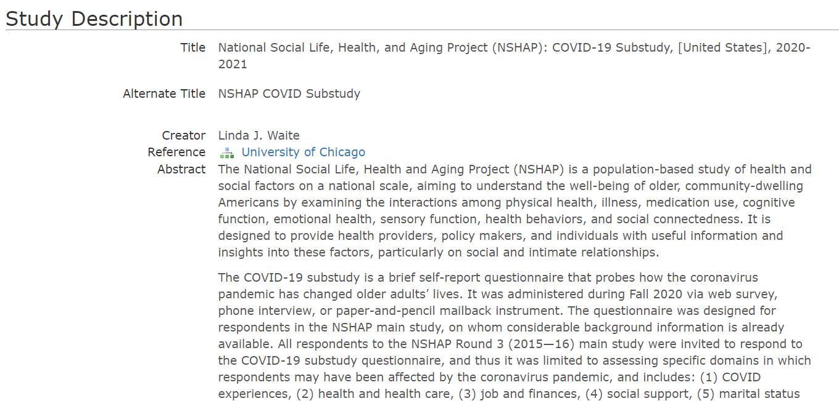
DDI for cross-wave variable comparison
ICPSR-NACDA Colectica Portal:
Complete series, study, and variable-level documentation

Slide 19
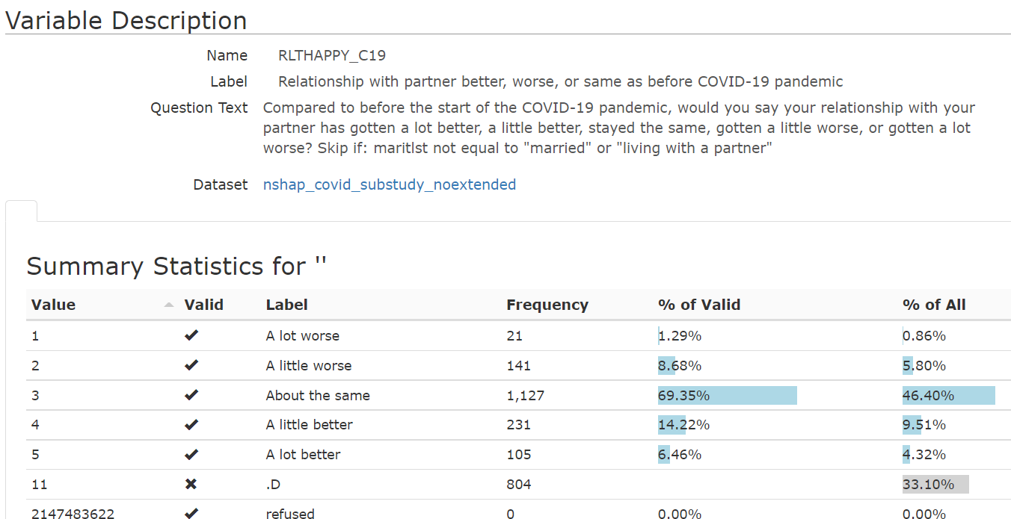
DDI for cross-wave variable comparison
ICPSR-NACDA Colectica Portal
Complete individual variable descriptions

Slide 20
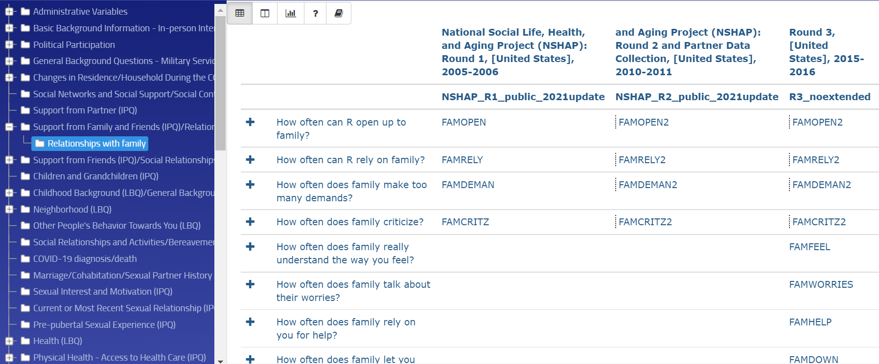
DDI for cross-wave variable comparison
Variable comparison information
Explore by concept – initial crosswalk view

Slide 21
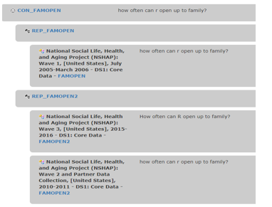
DDI for cross-wave variable comparison
The Correspondence Tree:
  Different physical representations indicate the need for data harmonization

Slide 22
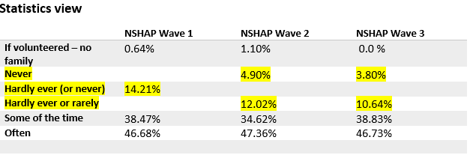
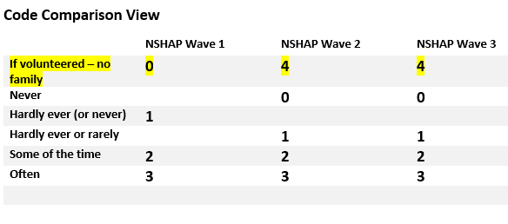
DDI for cross-wave variable comparison
The three types of concordance views are also available from the individual variable description page

Slide 23
DDI for longitudinal data at ICPSR
Comparison information is value-added documentation created by our Metadata team
  Identify, and flag comparable variables in a series
  Discover and document differences in the variables’ physical representation
  Create unique concepts/conceptual variables to link comparable items
  Create topical groups and subgroups to assist in data discovery
DDI encoding facilitates optimal processing and presentation of the enhanced metadata content

Slide 24
DDI for cross-series comparison
The NSHAP-NHATS concordance
Starting point: DDI-L documentation for each individual series, including variable cascades
  Comparable variables from each series are already linked by a unique common concept (conceptual variable)
Challenge: find comparability among variables from 11 individual waves (3 from NSHAP and 8 from NHATS)
    DDI-enabled solution:
    Examine, and find matches between conceptual variables from each series
    Create new, unifying concept (DDI conceptual variable) that links the conceptual variables from the individual series
      Project-created and assigned
      Allows pulling together all of the comparable (instance) variables from the individual waves.

Slide 25
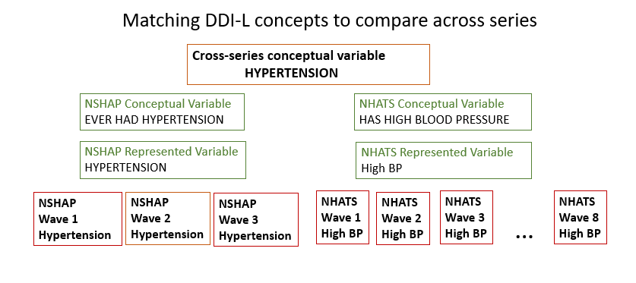
DDI for cross-series comparison
The NSHAP-NHATS concordance

Slide 26
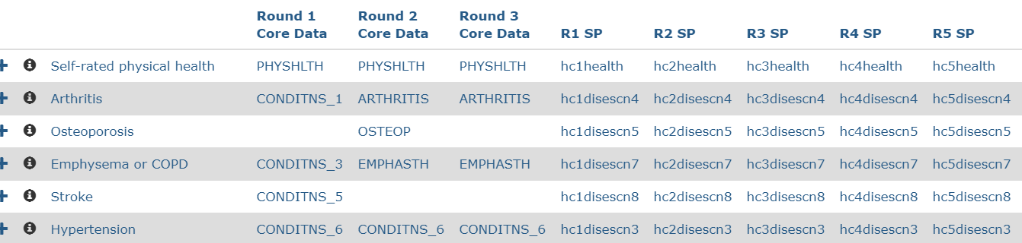
DDI for cross-series comparison
The NSHAP-NHATS concordance
NSHAP Variables
NHATS Variables
Series-specific concepts, physical representations and comparison views available when selecting the common concept

Slide 27

DDI for cross-series comparison
Four types of variable comparability
  Directly comparable
  Need harmonization
  Related concepts
  One-to-many or many-to-one matches
    Example:
NSHAP
NHATS

Slide 28
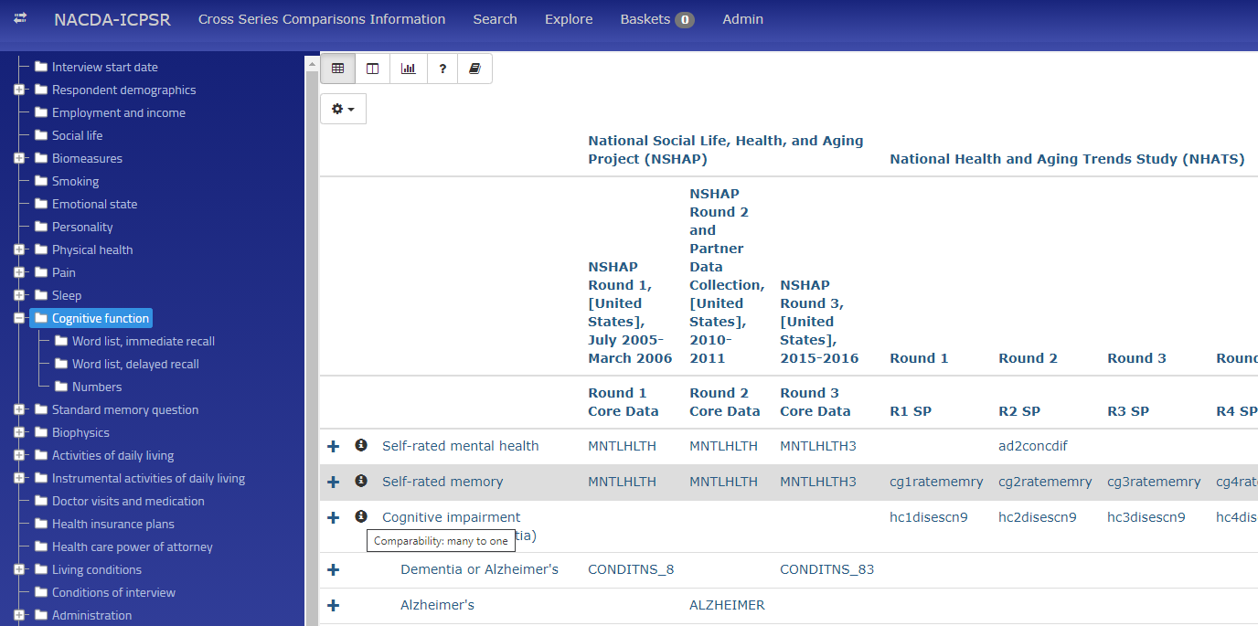
DDI for cross-series comparison

Slide 29
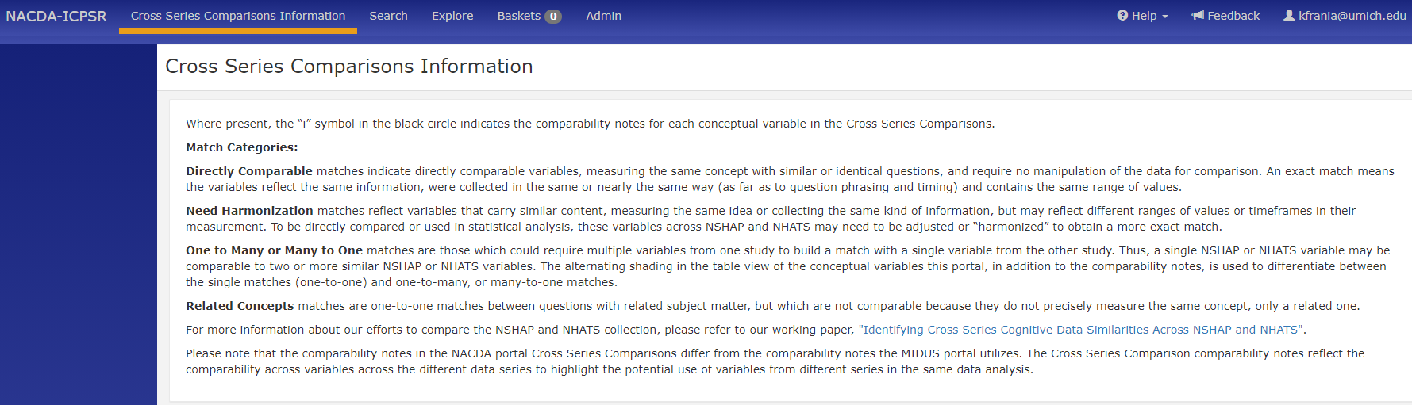
Cross-series comparability types defined on the NACDA Colectica Portal

Slide 30

Questions?
Comments?
                Thank you!

