Slide 1

Aging Data:
The National Archive of Computerized Data on Aging
AGEN Conference, March 2024
NACDA Director Dr. James W McNally
NACDA Data Project Manager Kathryn Lavender

Slide 2

NACDA Team
Dr. McNally is Director of the NACDA Program on Aging, a data archive containing over 1,500 studies related to health and the aging lifecourse. He holds a Ph.D. in Demography and Sociology from Brown University. His research focuses primarily on issues of family support and health among the aged, both in the U.S. and internationally. He does methodological research on the repair of deficient data. Most recently, he has been studying the impacts of heterogeneity on health outcomes among elderly U.S. Asian/Pacific Islander populations.
Kathryn Lavender is the data project manager for NACDA. She is involved with day-to-day operations including data deposits, restricted-use data agreements, data user requests, as well as long term planning of NACDA activities in the research community. Kathryn has 15 years of experience relate to data management activities.

Slide 3
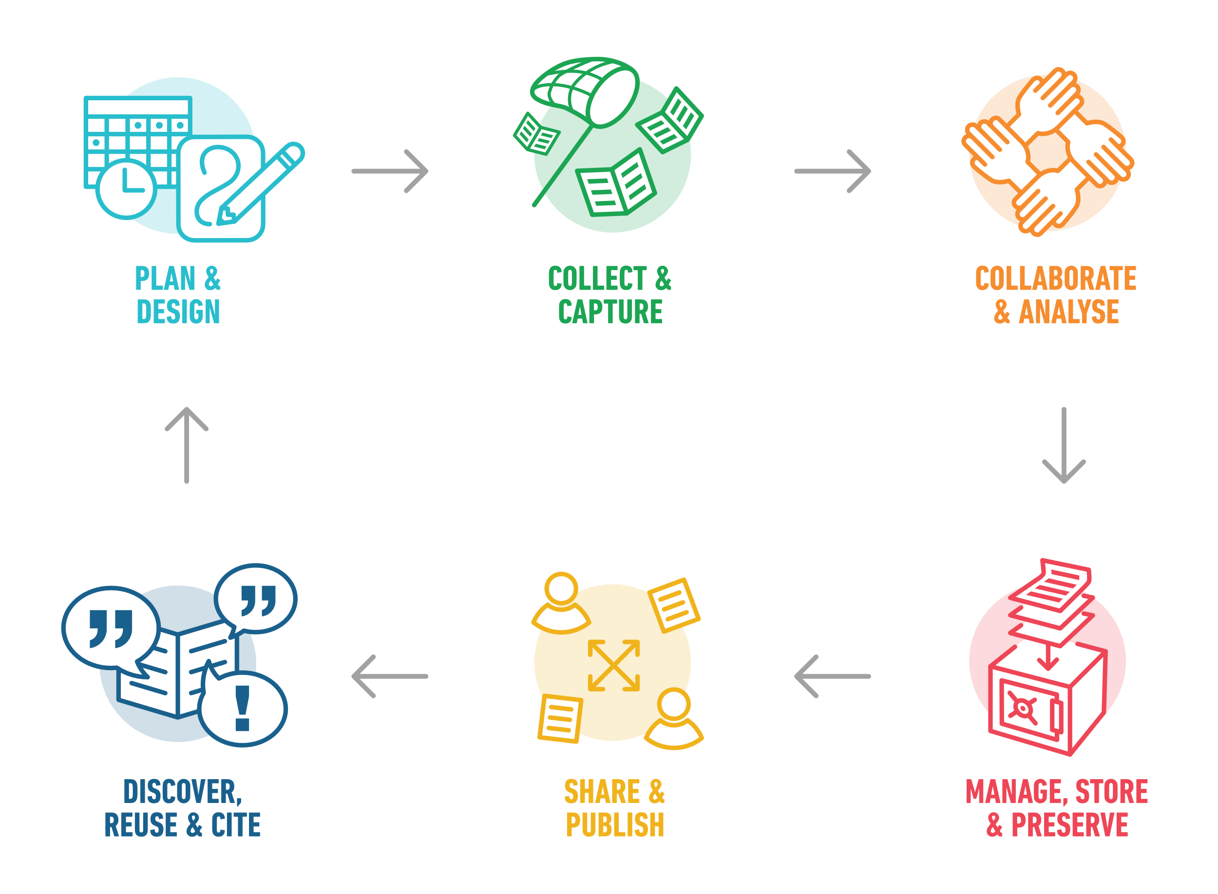
Preparing for Your Project: Research Lifecycle

Slide 4
Types of Data for Research Analysis
Primary Data represent information which you or people you collaborate with directly design, collect and administer to address a specific topic of interest.
Secondary Data are collected and processed without your direct control but used by you to address a specific research interest or project. Secondary data can also be data you or people you collaborate with directly design, collected but used for research that is independent from its original intent.

Slide 5
Why Use Secondary Data?
Efficiency- The collection of primary data, both qualitative and quantitative is time consuming and expensive. Good secondary data should come in a format that facilitates research.
Variety- The quantity of secondary data has growth tremendously. Many if not most research questions can be explored with some existing data set.
Theory Testing- Secondary data allows for the controlled testing of research framework and theories in a manner that allows for replication and validation of results.
Generalizability- Because the best secondary data takes advantage of sampling distributions it allows for results to be generalized to a broader population than many qualitative studies. It allows for the testing of small study results on a broader population.

Slide 6


Potential Research Topics
Mental health and relationships
Physical decline in aging and depression
Education, income, and retirement
Caregiving and care-receiving
Neighborhoods and community support systems

Slide 7
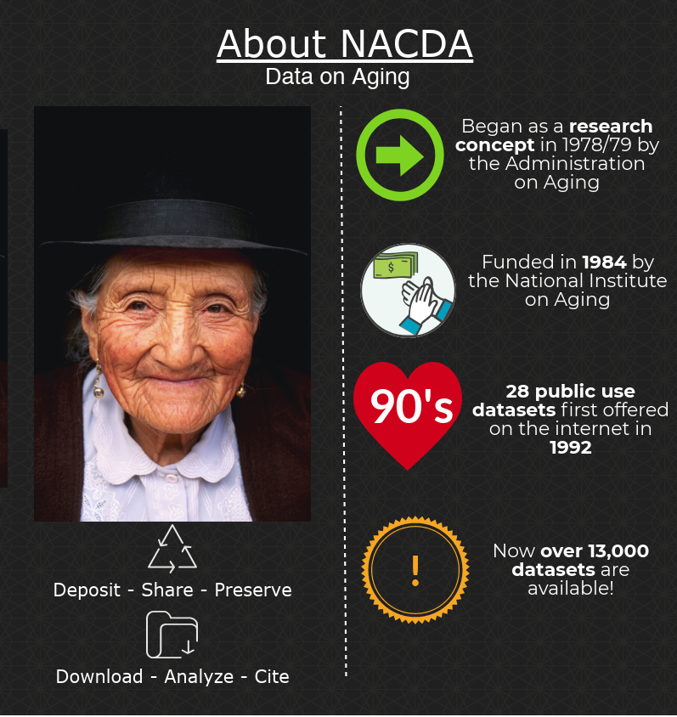
National Archive of Computerized
Data on Aging
More than 40 years of experience
Funded by the National Institute on Aging (NIA)
Open to all at no cost
Mostly quantitative data
Part of ICPSR

Slide 8

ICPSR is a Social Science Data Archive
The Inter-university Consortium for Political and Social Research
Comprised of several different units and projects
Funded by a variety of sources
Mostly public-use data, some restricted data
Data are available for download from study pages at no cost to data users
Data are cleaned, organized, managed, converted to multiple formats, and preserved for long term use
Adheres to FAIR principles (findable, accessible, interoperable, reusable)
Part of the Institute for Social Research, at the University of Michigan
https://www.icpsr.umich.edu/

Slide 9

Do You Have Access to NACDA and ICPSR Resources?
Yes!
NACDA is part of ICPSR, which is a larger archive with data covering research topics in addition to data on aging – health and medical care, demography, criminal justice, art, and more.
ICPSR Member access, < more than 800 members (most people have affiliate access)
Federally-funded archives (like NACDA) are open to the public
Self-published data resources – also open

Slide 10
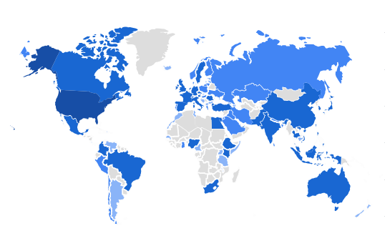
Data Resources Available from Anywhere, Anytime
This is an actual map from our recent Google Analytics data, showing we have individuals using our site to find data resources from all over the world.

Slide 11
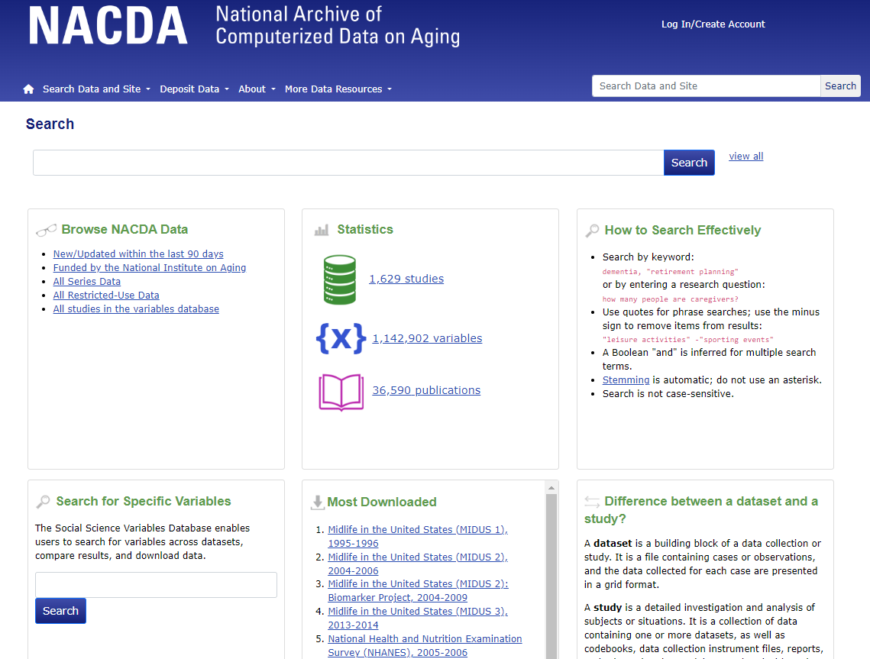
Search for Data Resources
Search by:
  Keyword
  Phrase
  PI name
  Related Publication
  Acronym
  Study title
  Variable
  And more!

Slide 12
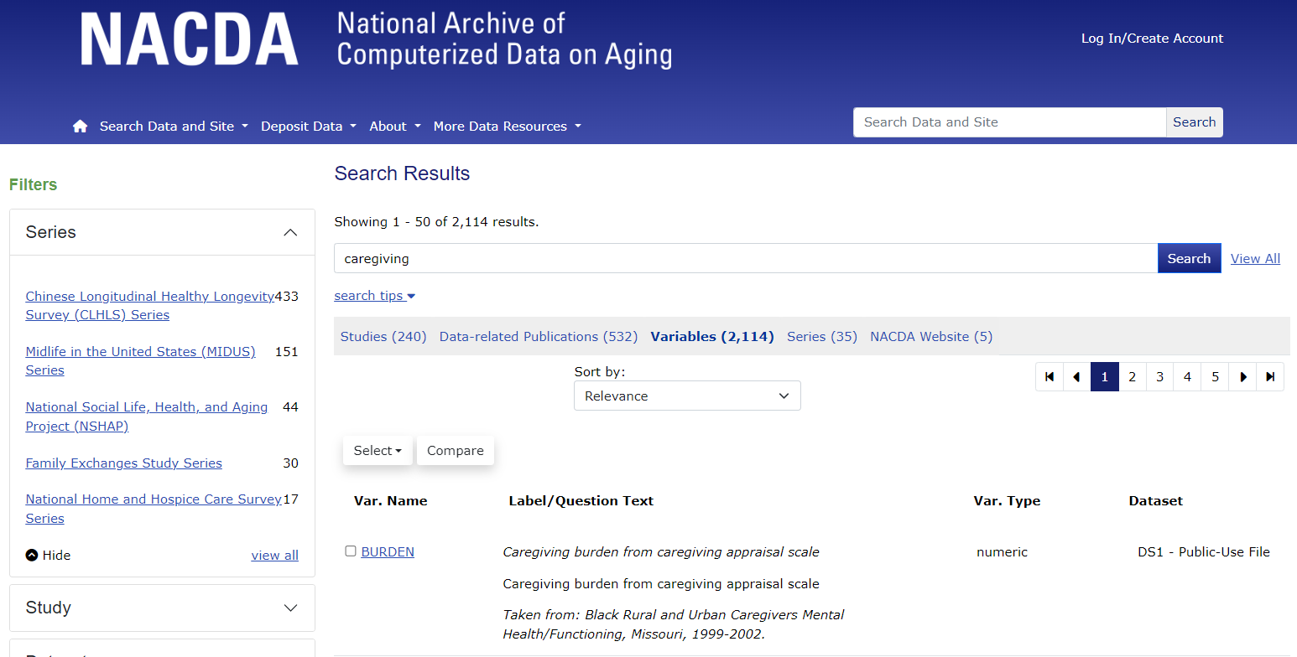
Search Results – Default by Study

Slide 13
Metadata – What Makes Search Possible
Metadata is the key to data. Some examples:
Collection level metadata
  Study title
  PI
  Description/Abstract
  Subject terms
  Collection dates
  Sampling
  Universe
  Data type
Variable level metadata
  Variable name
  Variable label
  Value labels
  Missing designations
  Question text
  Variable concepts

Slide 14
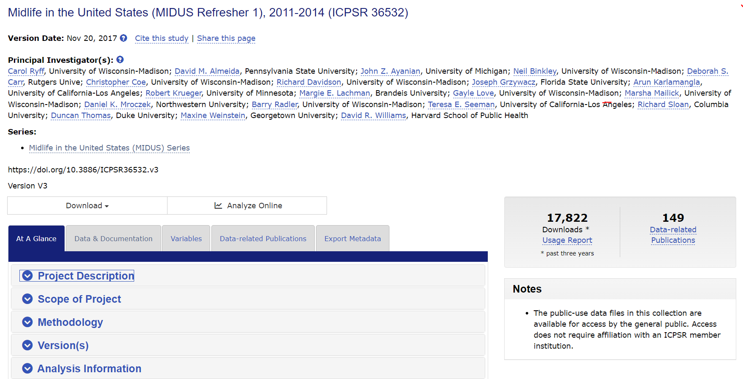
Collection Level Metadata (Study Pages)

Slide 15
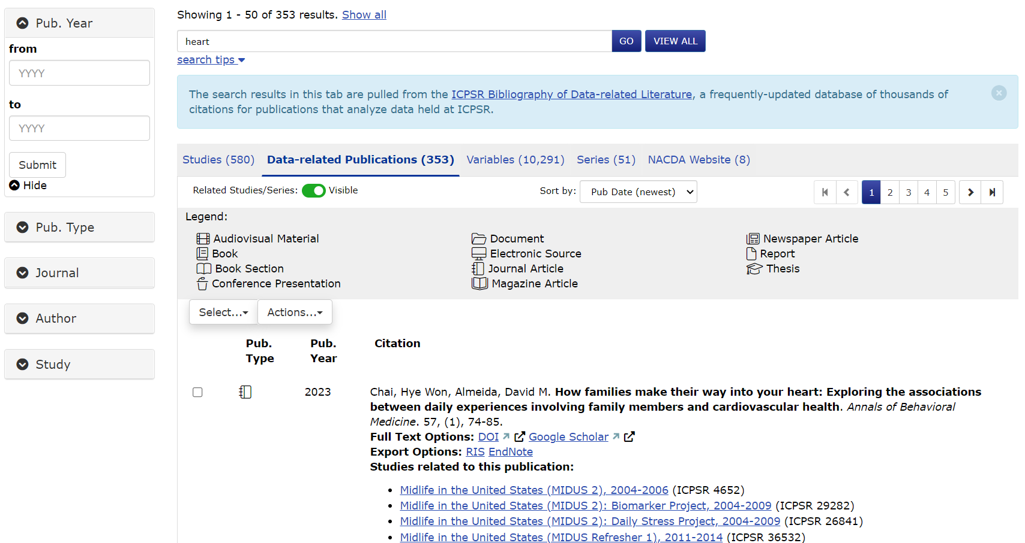
Related Publications

Slide 16
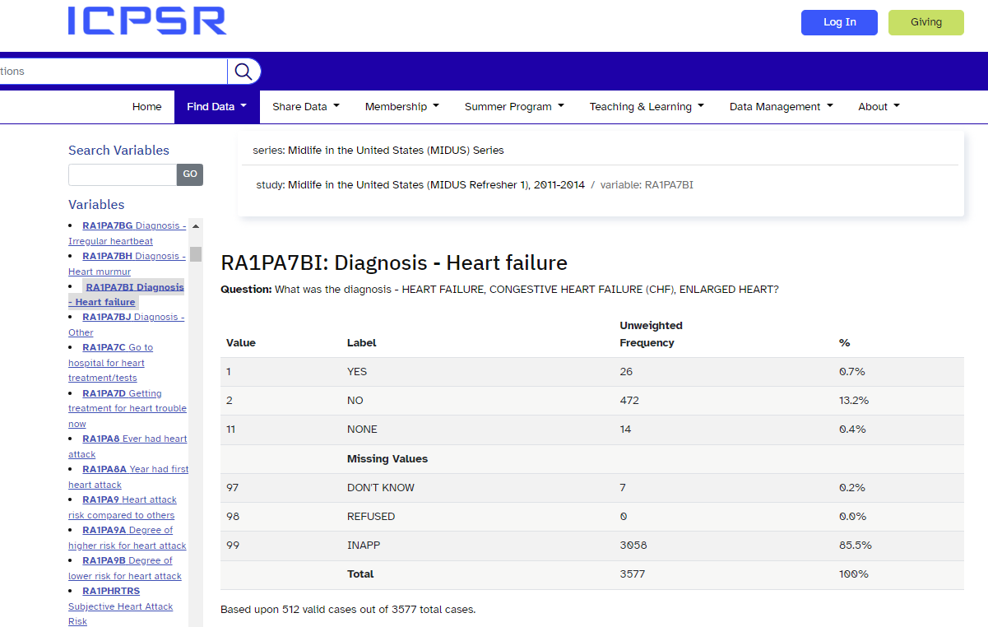
Variable Level Metadata

Slide 17
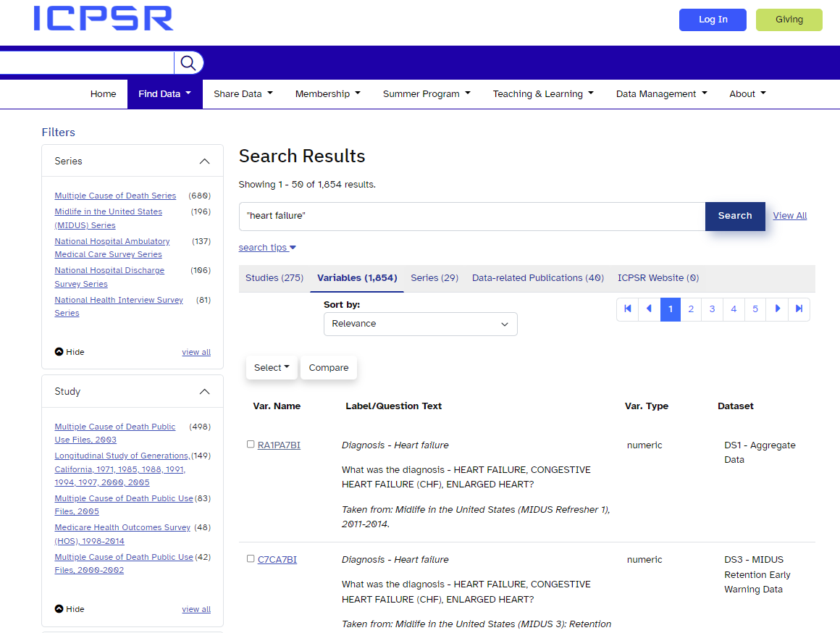
Variable Search

Slide 18
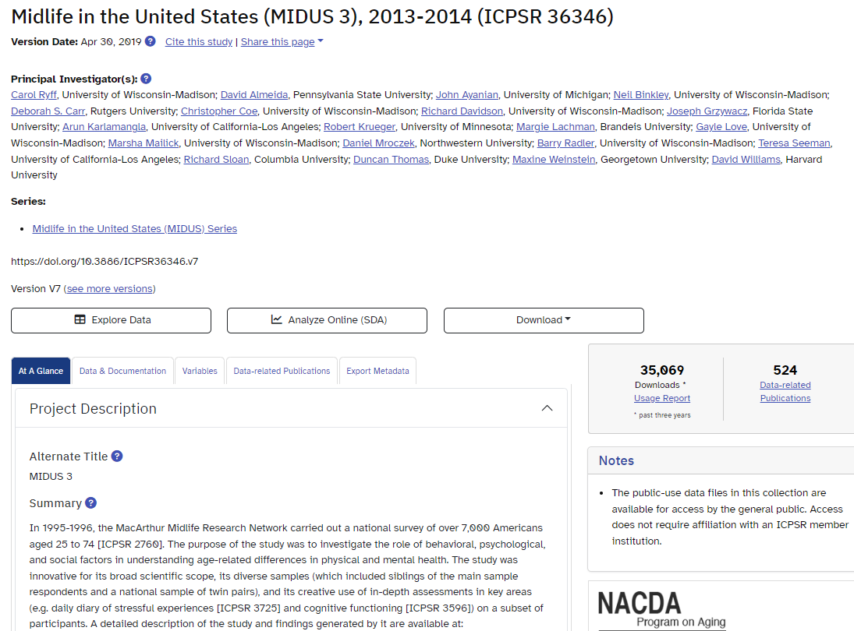
How to Download From the Study Page

Slide 19
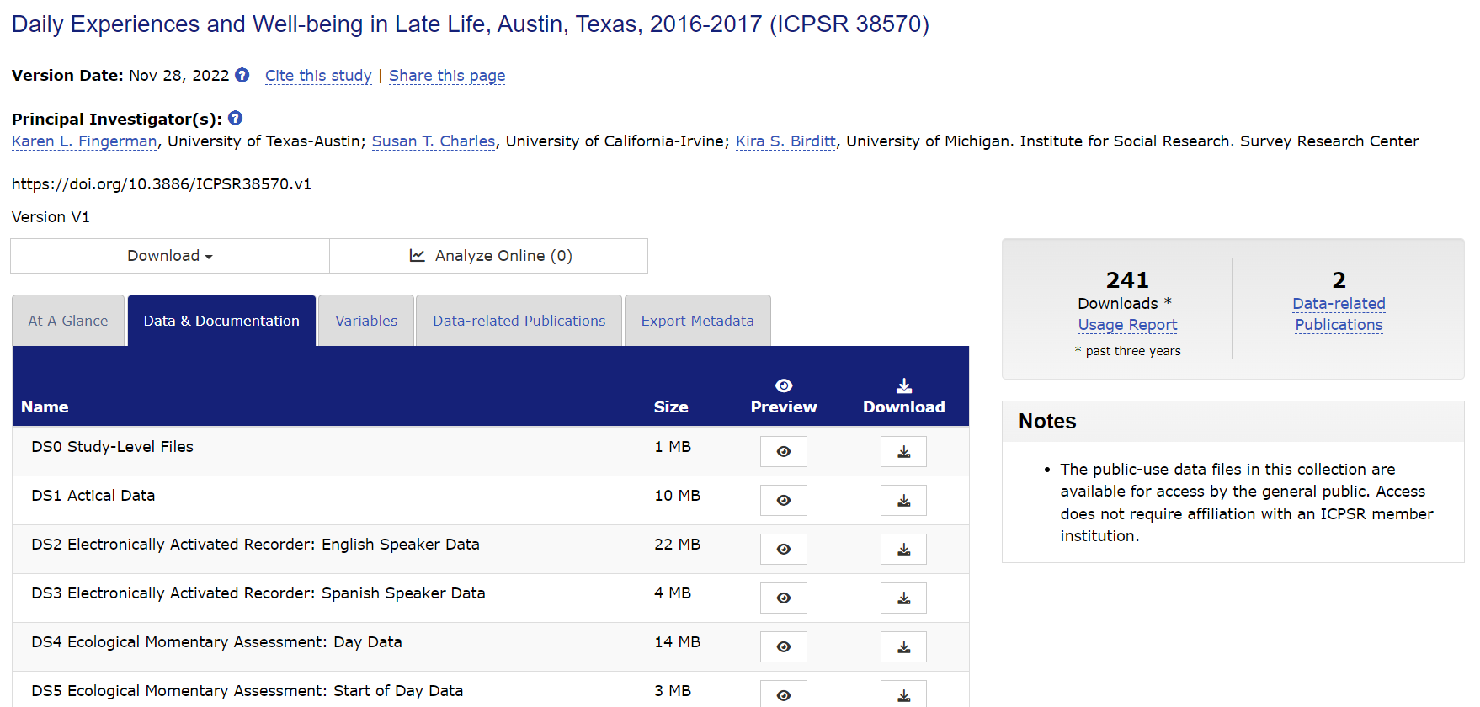
How to Download – Data and Doc Tab

Slide 20
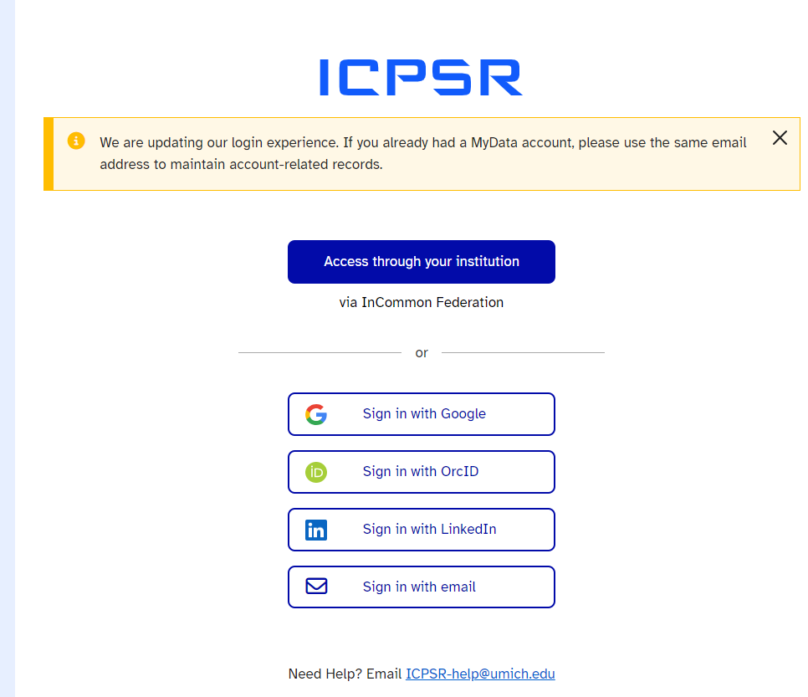
You Must Be Logged Into Your ICPSR Account to Download Data (Researcher Passport)
It’s free
Very little info is needed
We do not spam you or sell your data

Slide 21
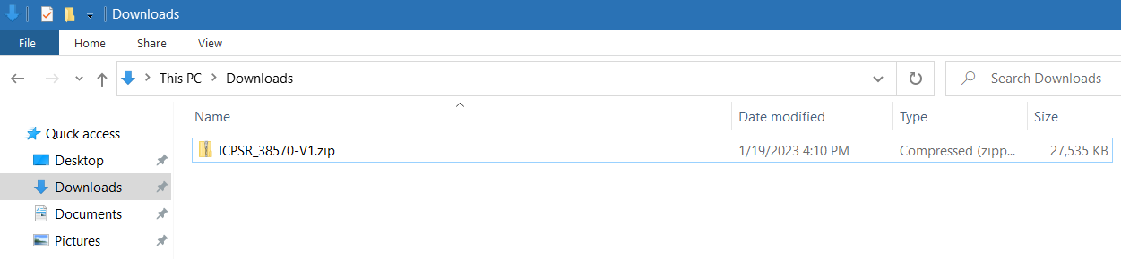
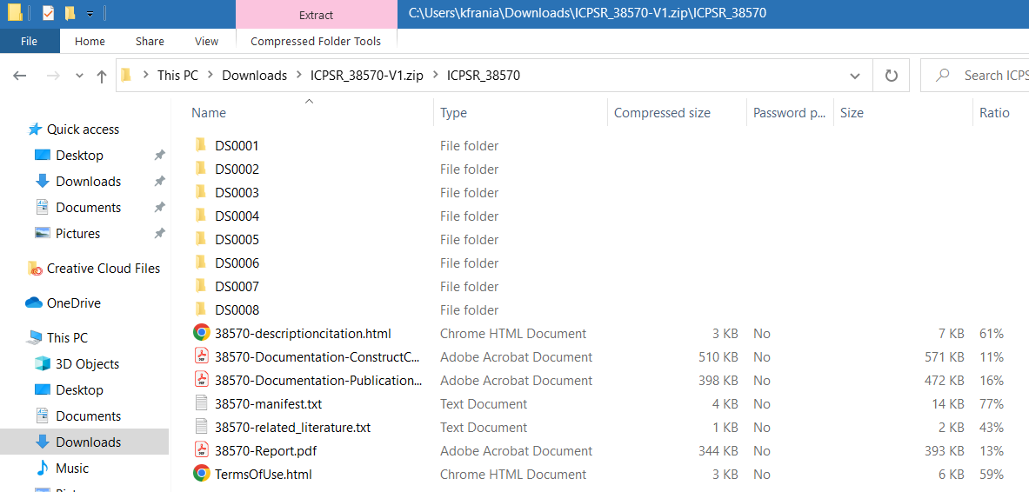
What the Download Looks Like

Slide 22

ICPSR Data and Documentation File Formats
SPSS
Stata
SAS
R
ASCII + Setup
PDF
Excel
Plain Text
*These are ICPSR’s standard for quantitative data.

Slide 23
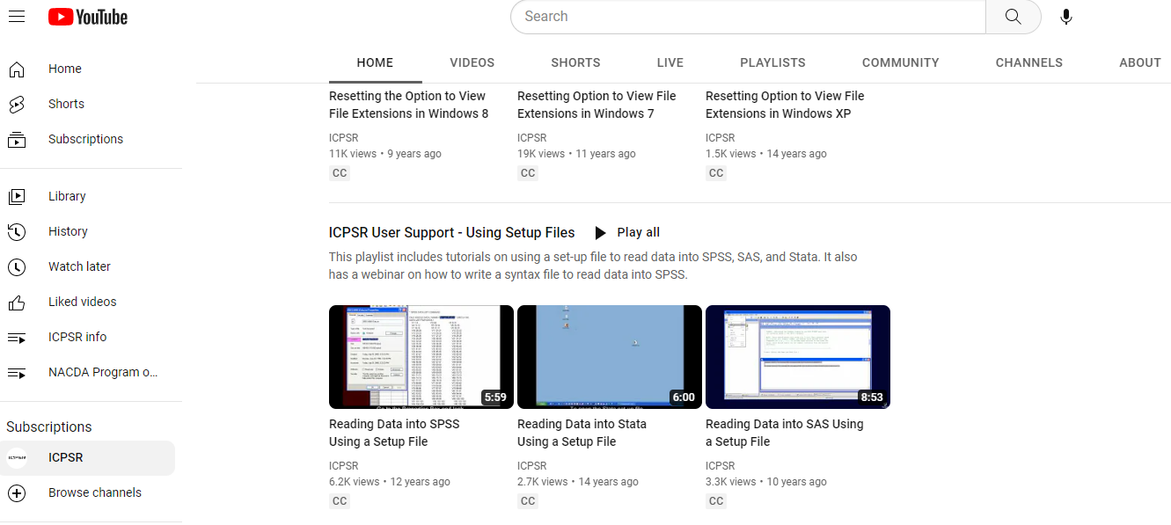
Reading ASCII Data

Slide 24
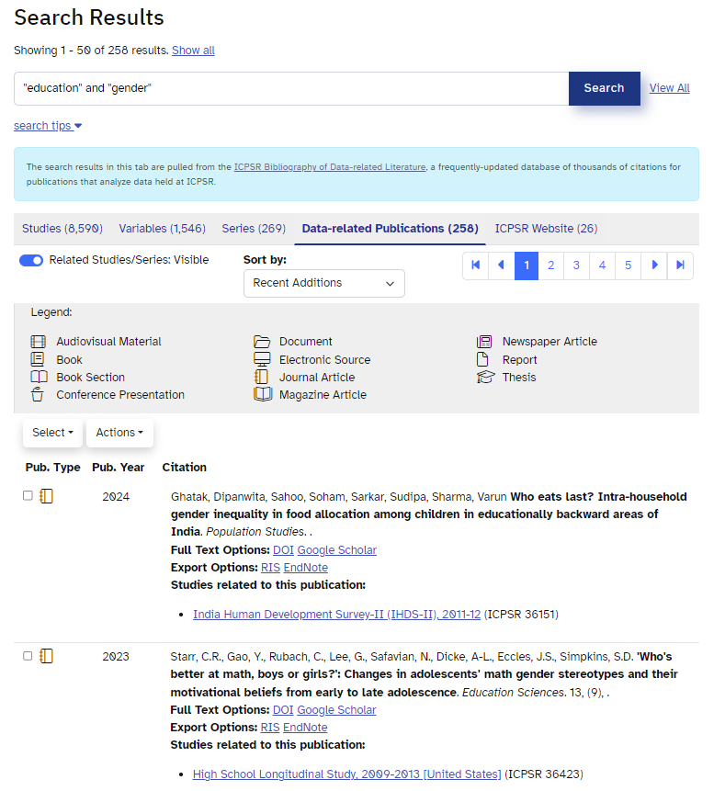
Example Search Starting with Related Pubs
Sort searches by date, title, author, and more
Results include the study/data referenced in the publication

Slide 25
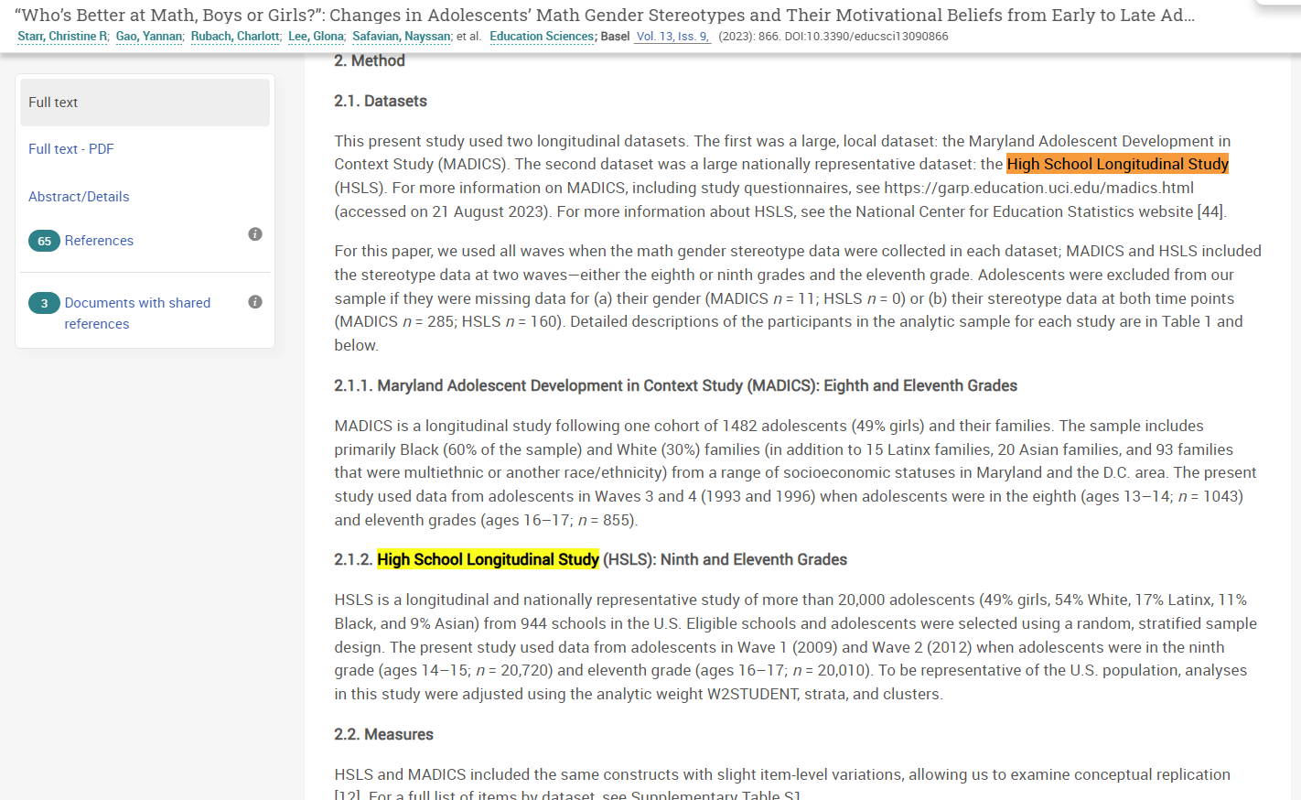
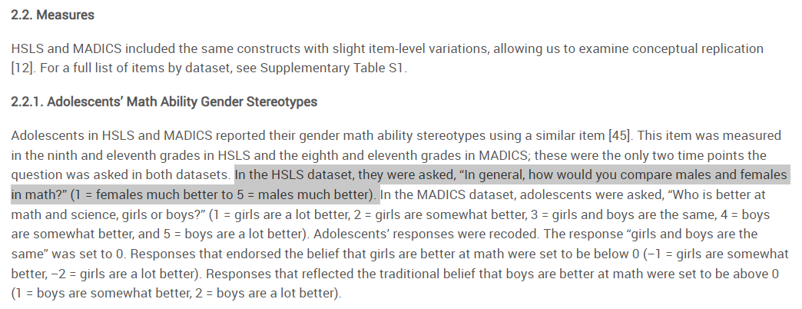
Review and Read the Publication

Slide 26
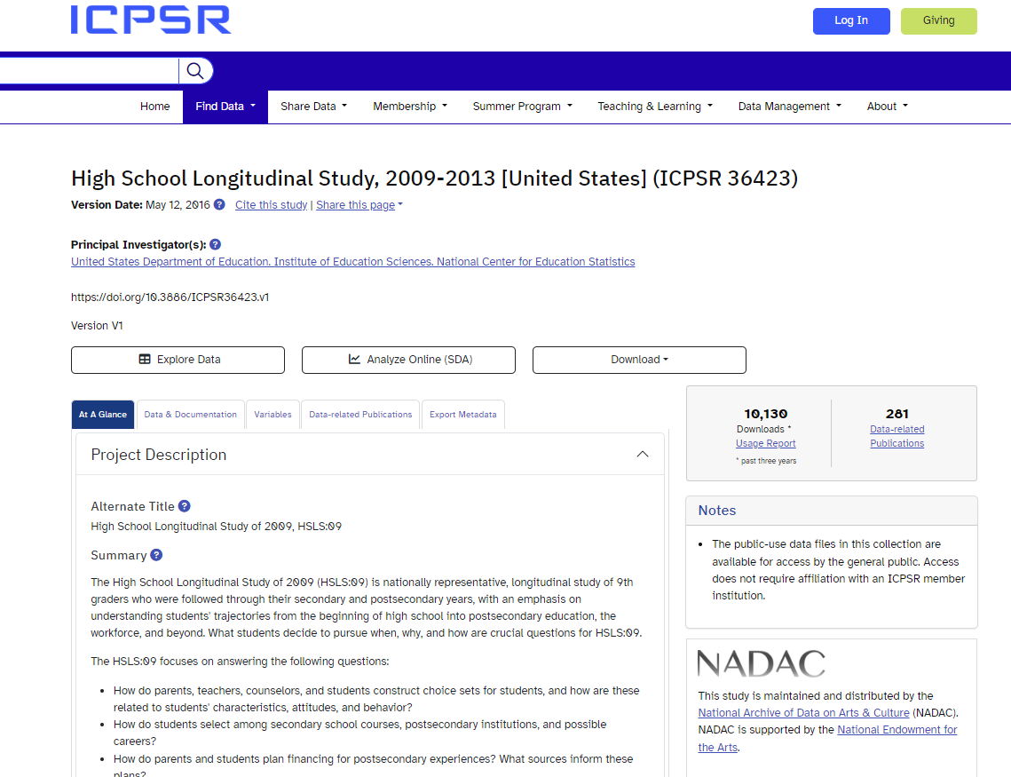
From the Study Page, Go to the Study

Slide 27
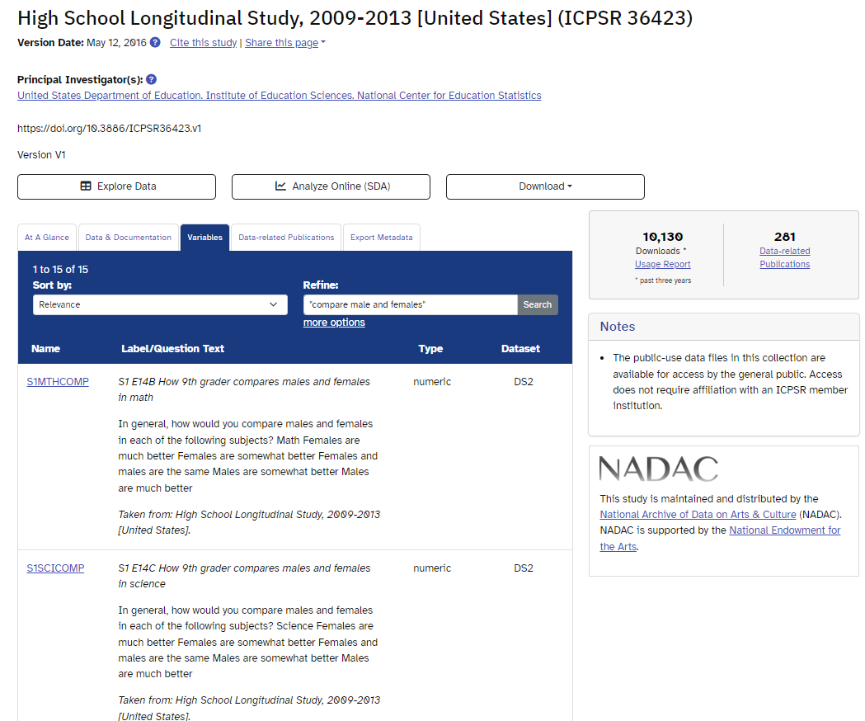
Searching a Study at the Variable Level
Type in a search term – using the related publication we found, search for “compare males and females”
The study page results will display any related variables and note which study and dataset they can be found within.
Once you locate the variable you want you can go to the study page and download the files you need.

Slide 28
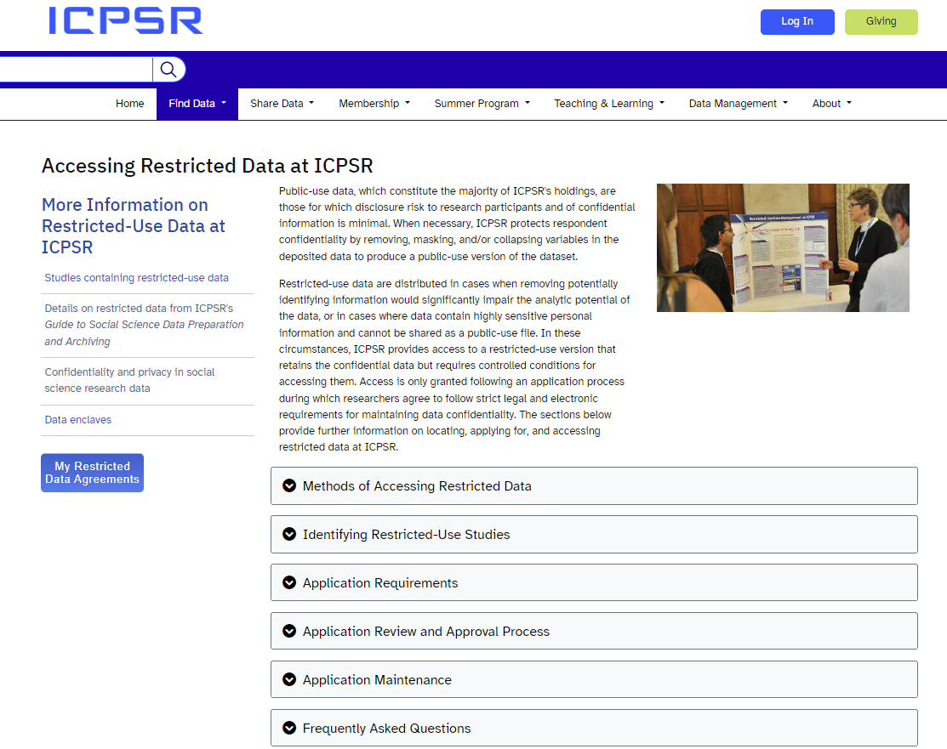
Accessing Restricted Data

Slide 29
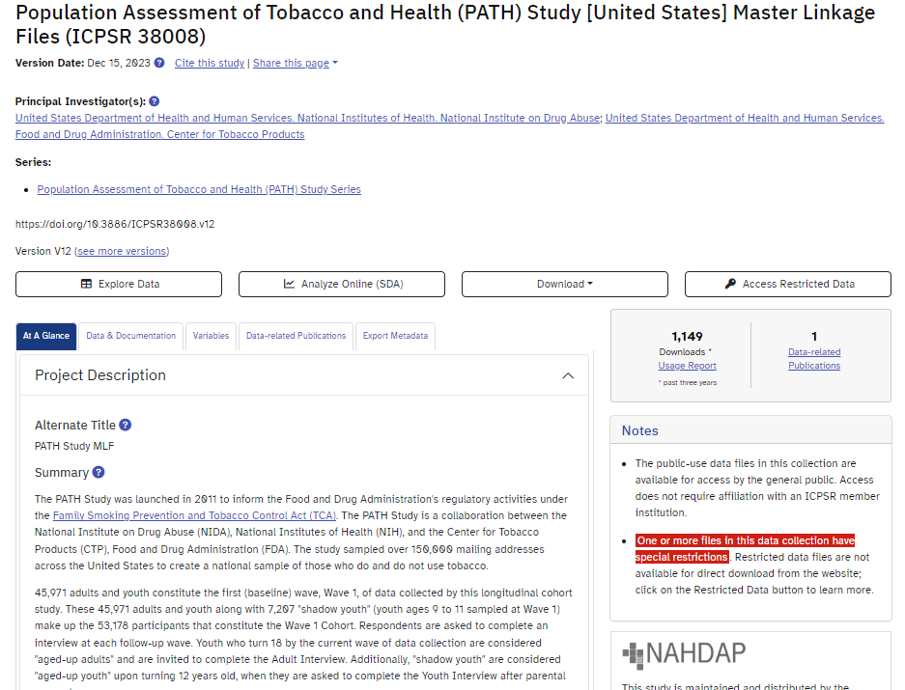
Identifying Restricted-Use Studies
Most of ICPSR’s data are publicly available, however, some studies require additional clearance to ensure ethical research use by secondary data users.

Slide 30
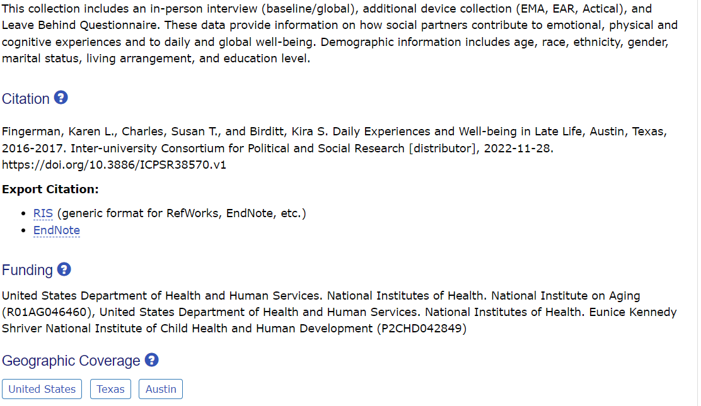
How to Cite Data You Have Used From NACDA
Refer to the Study Homepage – At a Glance section - Citation

Slide 31
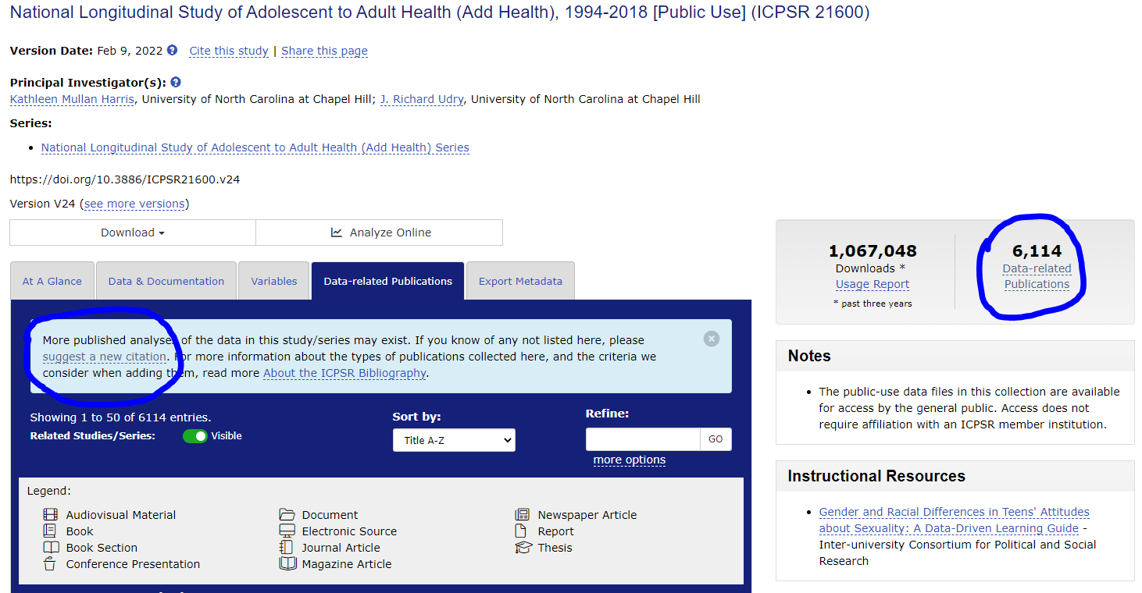
Have You Used NACDA or ICPSR Data?
Submit Your Citation to Us!
Email us using
icpsr-nacda@umich.edu OR use our ICPSR citation submission form that provides the citation directly to our bibliography team.
Your publication will be linked to the data you used and become part of our bibliography database!
You can also find the option to suggest a citation from any study page – data-related publications tab.

Slide 32
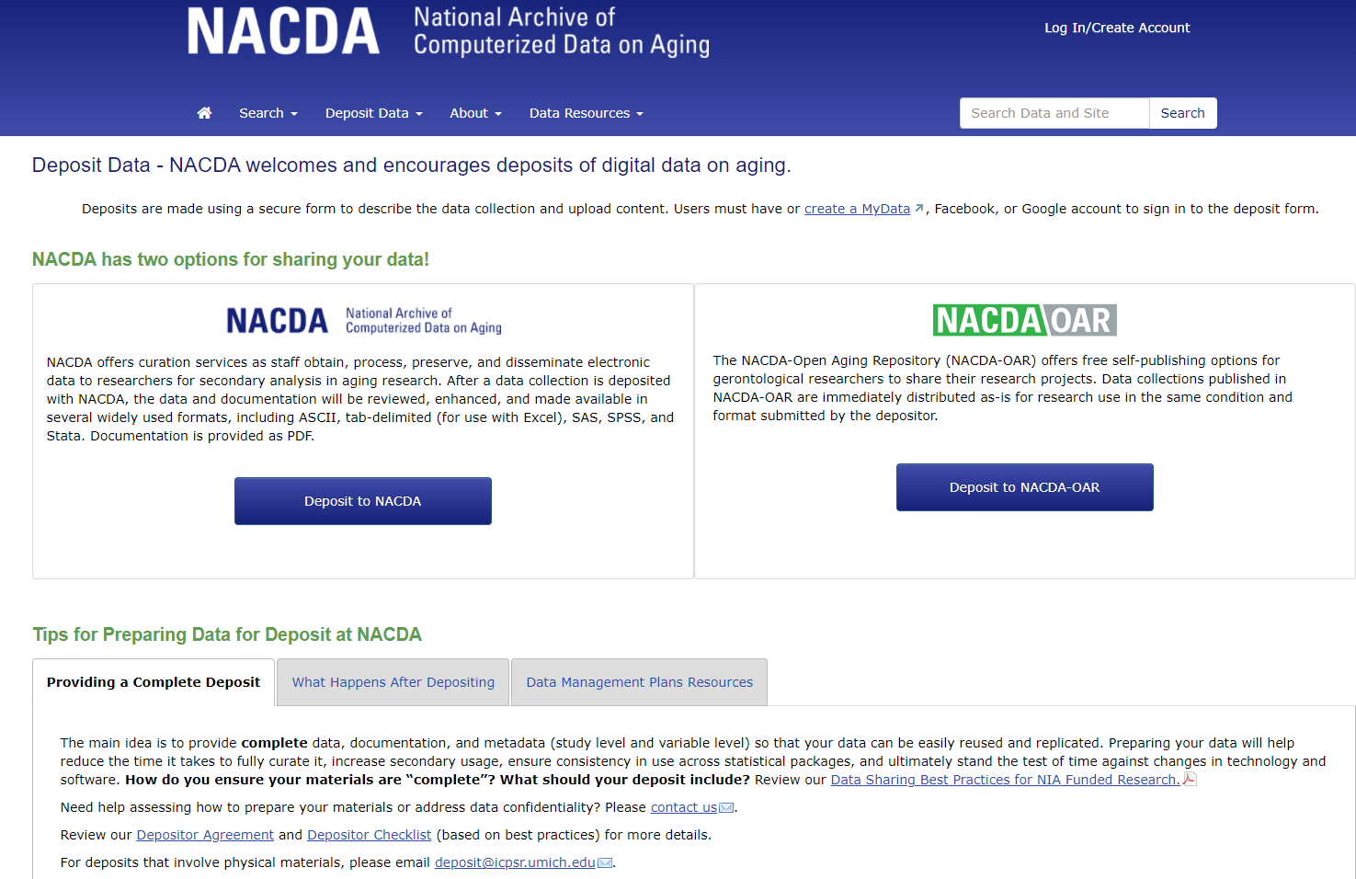
Share Data Using NACDA

Slide 33
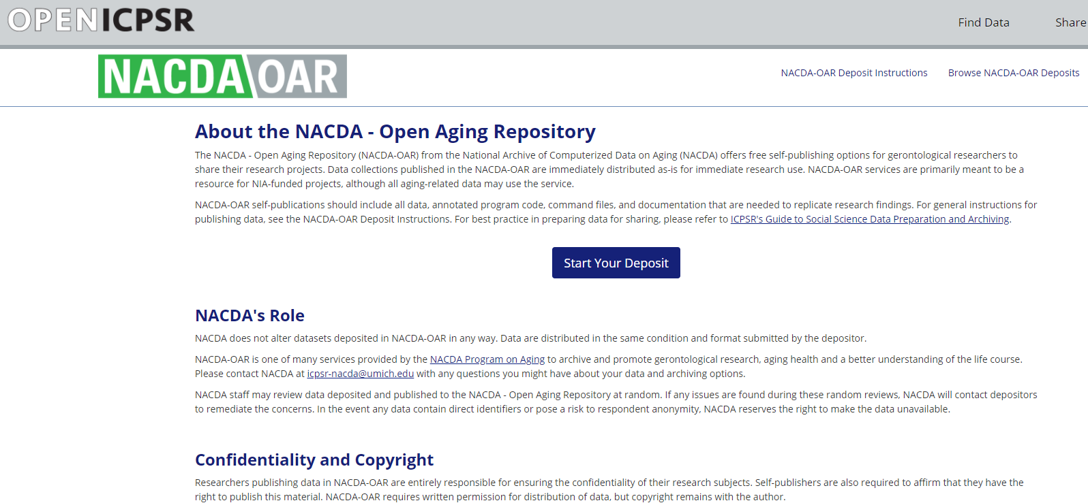
NACDA-OAR (Self-Published) - Data and Syntax Sharing

Slide 34
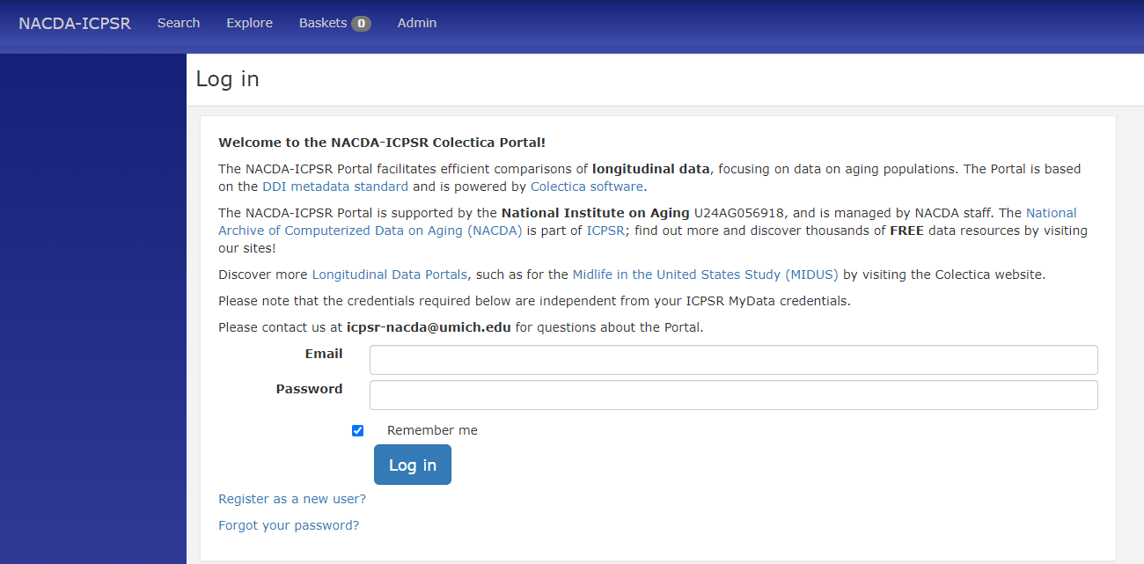
Colectica Portal – Another Way to Discover Data
Your login credentials for the portal are not the same as your MyData login credentials (unless you make them that way).

Slide 35
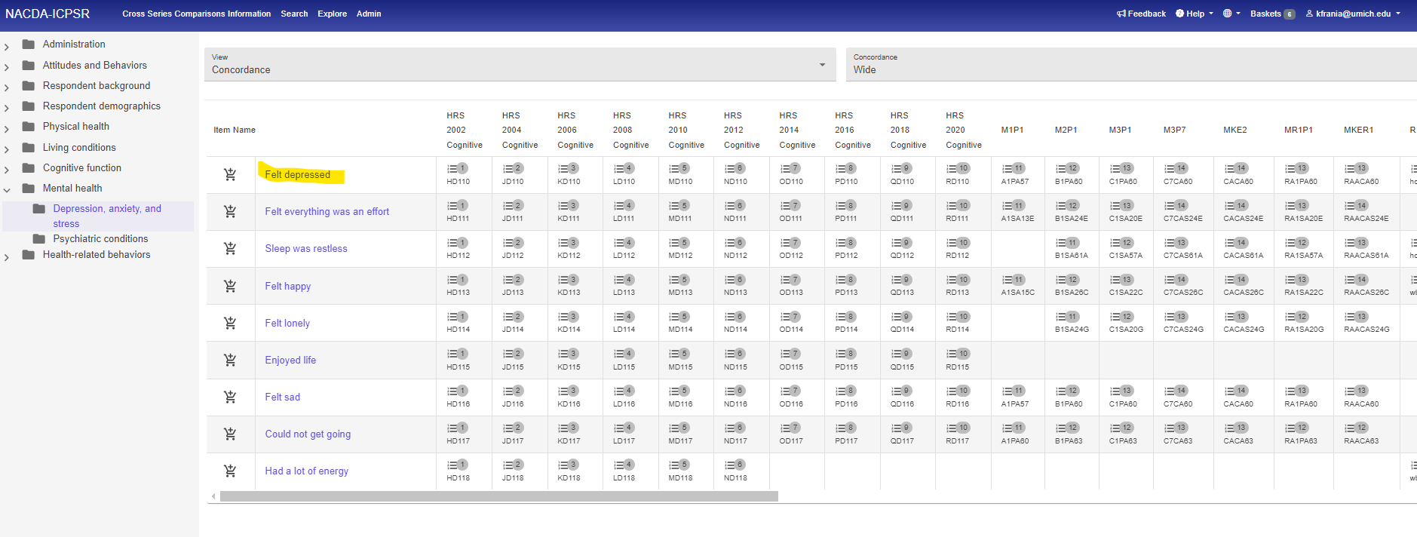
Colectica Portal – Explore Across Series

Slide 36
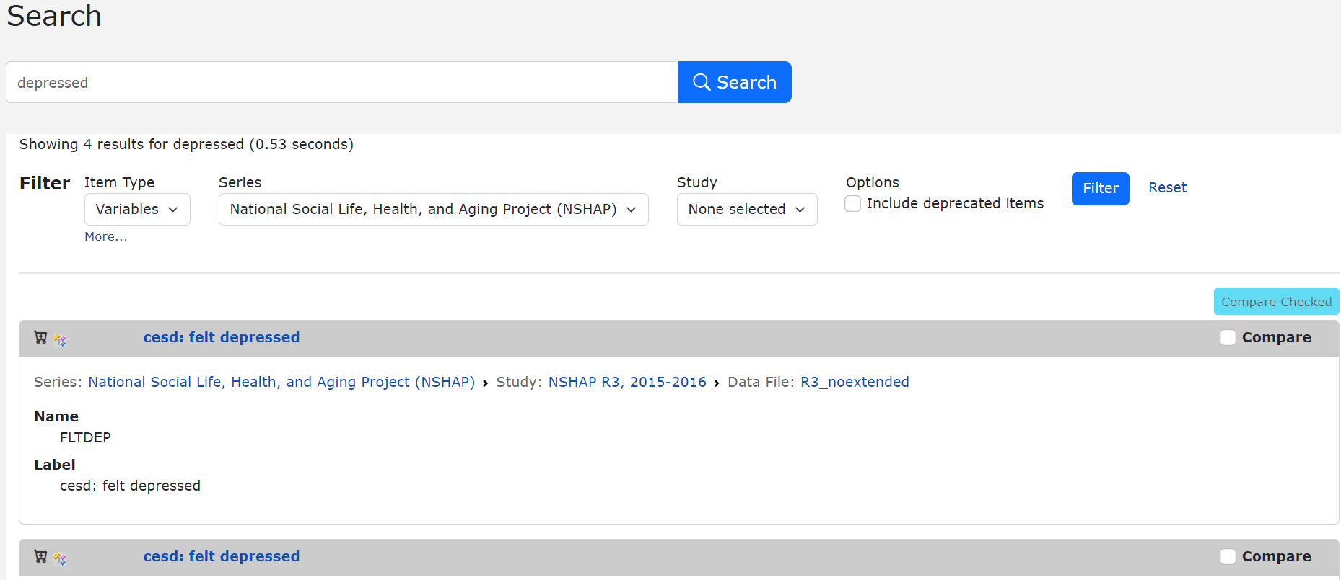
Colectica Portal – Search

Slide 37
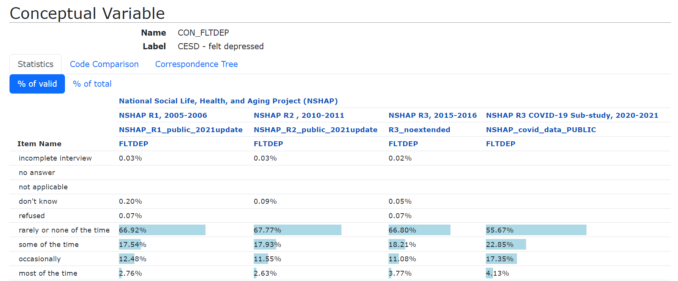
Colectica Portal – Variable Details

Slide 38
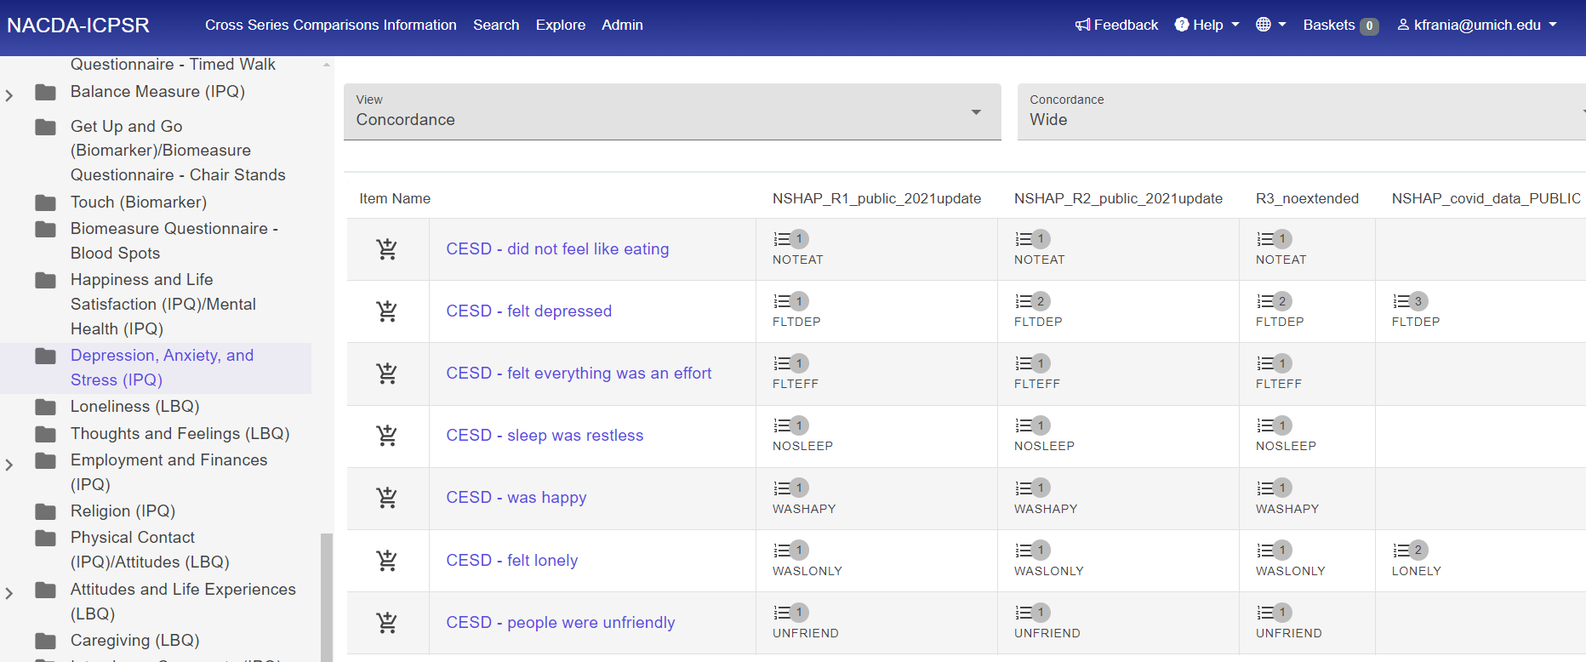
Colectica Portal – Add Variables to Basket

Slide 39
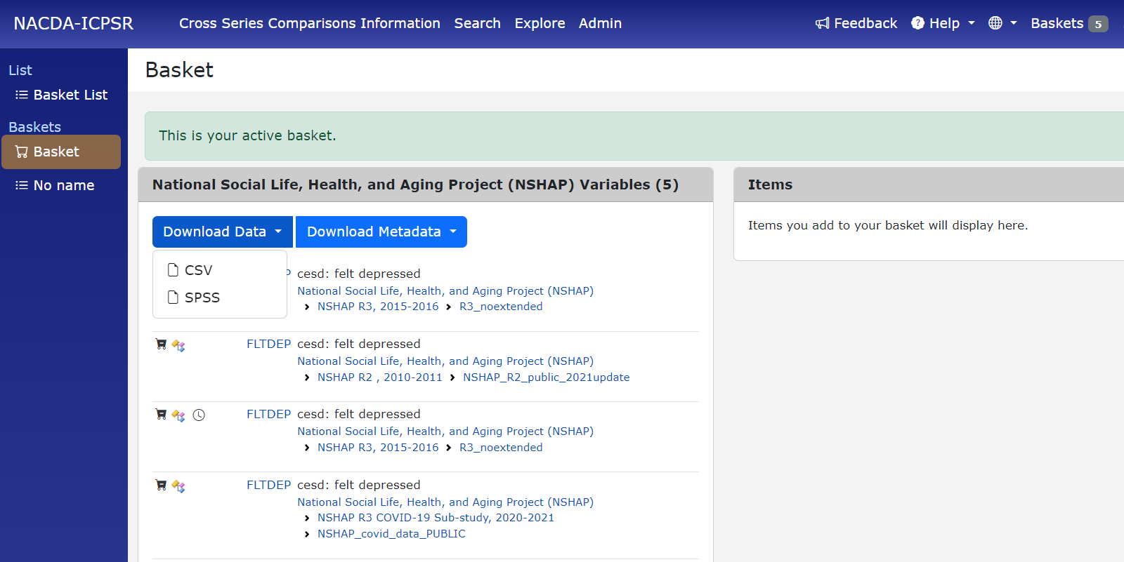
Colectica Portal – Download Custom Files

Slide 40
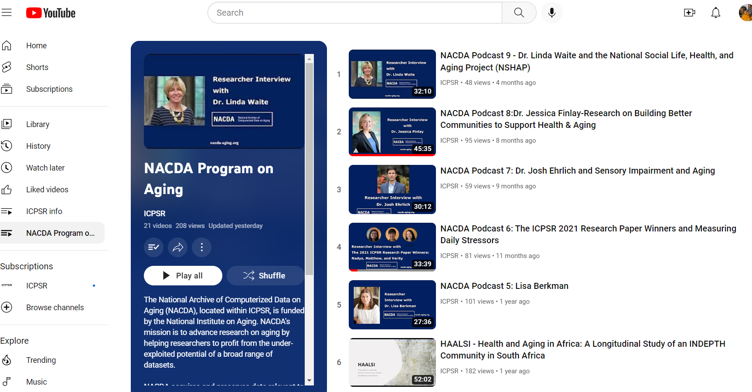
Podcasts and Researcher Interviews

Slide 41
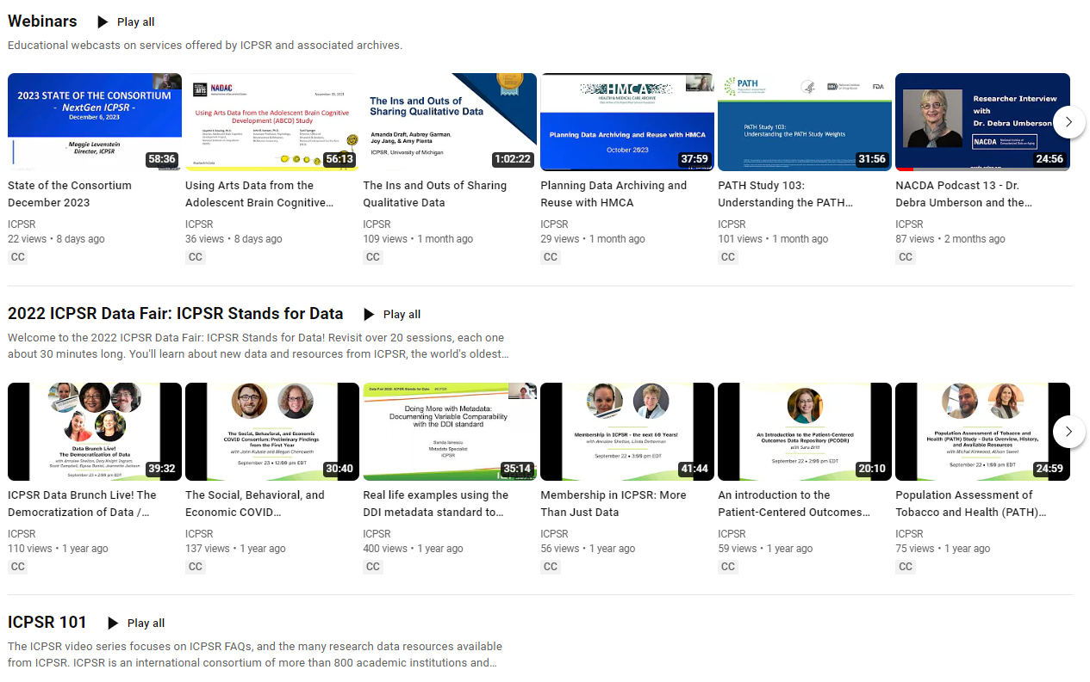
YouTube Resources

Slide 42
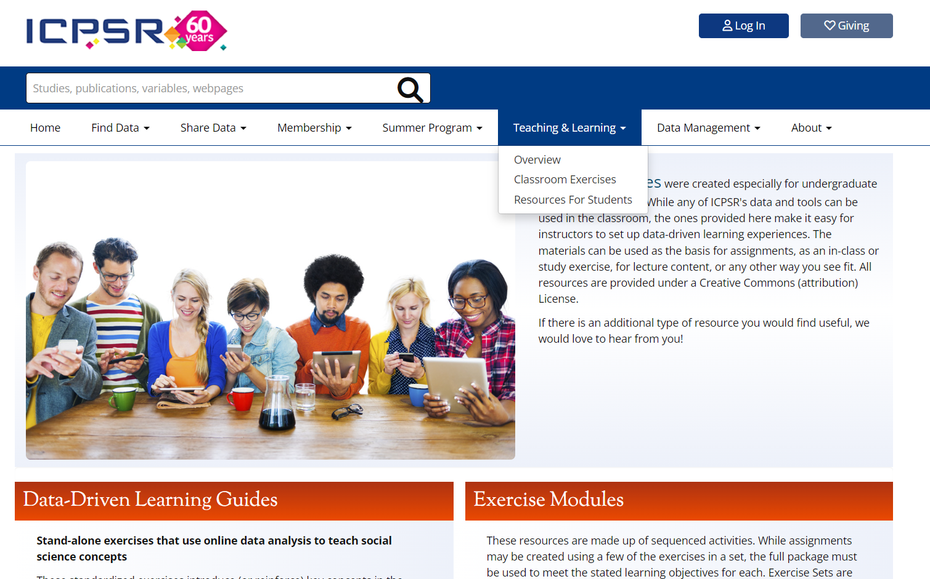
ICPSR Instructional Resources

Slide 43

Data User Support
icpsr-help@umich.edu
-Data questions
-Data access
-Other concerns
Email us anytime.

Slide 44
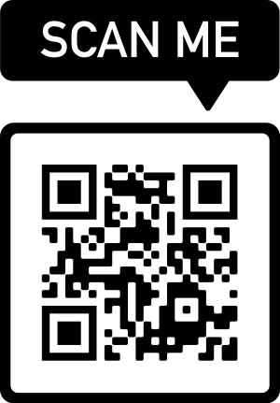
Thank You!
Scan this QR Code to get to our LinkTree:
NACDA website
NACDA Colectica Portal
YouTube playlist
Newsletter signup
NIH data sharing resources

