Slide 1
Talking Cells
Quantitative analysis of
intercellular and intracellular signaling in living integrated cell systems

Slide 2



Outline
Research motivation and approach (6 slides)
Fluorescence and bioluminescence reporter application examples (13 slides)
Modeling (11 slides) (optional)
There should be plenty of time to stop and discuss – it’s not important to get to all the slides. Modeling is at the end because it is optional.

Slide 3

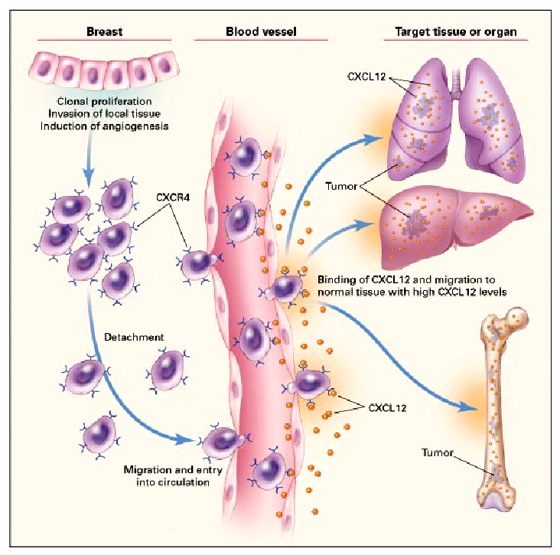
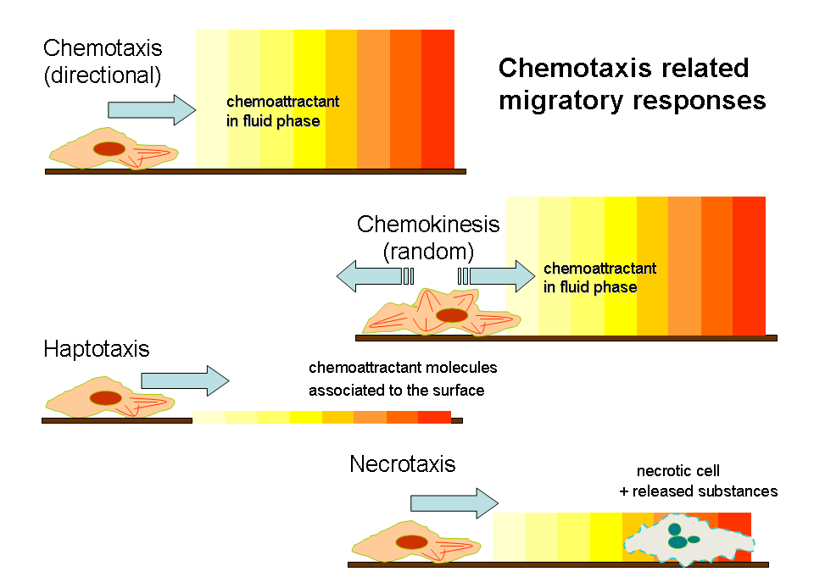
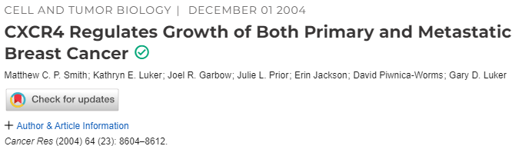
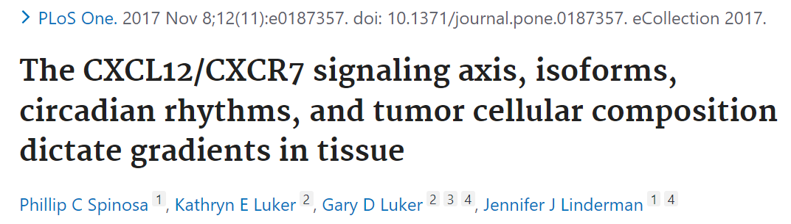
Why study cell decisions to move?
Chemotaxis, chemokinesis, and haptotaxis are among the cell movements that are prompted by external gradients. (will use “chemotaxis” to imply all 3 of these in this talk)
One important system in breast cancer is the CXCR4/CXCR7/CXCL12 system that favors migration of breast cancer cells to bone and lung, where stromal cells are producing CXCL12.
In this system, CXCL12 is displayed on endothelial cells as well as within the bone marrow or lung tissue.
For normal bone marrow hematopoietic stem cells, the cyclical circadian expression of CXCL12 by bone marrow stromal cells regulates nightly release to the bloodstream and morning re-homing of these cells to bone marrow.
Breast and prostate cancer cells (among other types) are thought to be occupying this niche and acting as a stem-like source of late recurrence of cancer.
Notes:
Explain how single cells or small groups of cells drive cancer progression.

Slide 4
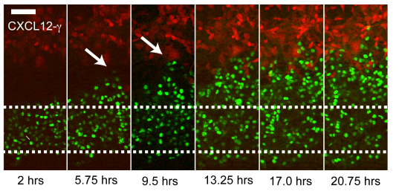
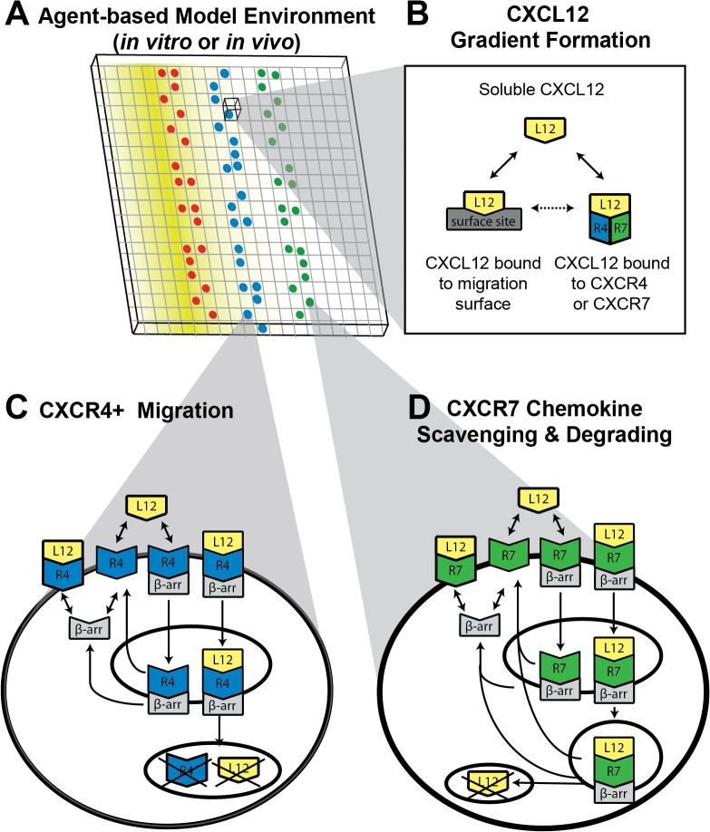
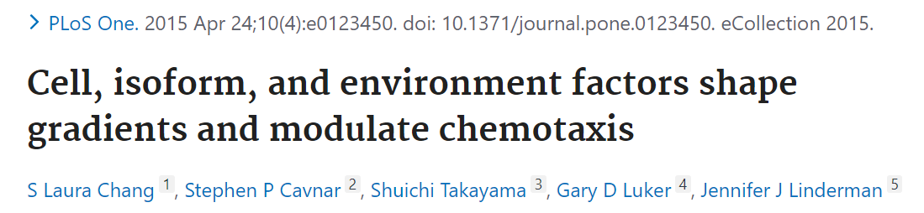
Chemotaxis is heterogeneous – can we understand why?
In our 2015 paper, we modeled the gradients formed by different isoforms of CXCL12 secreted by donor cells and shaped by the scavenger receptor CXCR7, by measuring chemotaxis of CXCR4-expressing MDA-MB-231 cells.
As most chemotaxis assays do, we ignored the many cells that do not migrate, tallying only the fraction that do move directionally.
But what about the ones that don’t respond? Is there some reason that some do and some don’t? Is that useful to us to help prevent cancer metastasis and recurrence?
If seemingly identical cells make different “decisions”, can we gather relevant single-cell information about the internal states of cells and the external cues they are receiving, to understand and predict their decisions?
Can we shape the decisions of cells using knowledge of their internal states and decision-making regulatory networks?
MDA-MB-231 cells expressing CXCR4 (green) chemotax toward the same cell type expressing CXCL12 (red)
Notes:
Demonstrate that cells vary in their response to the gradient. What makes some respond and others not?

Slide 5
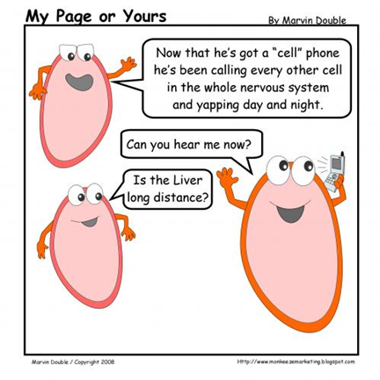
Listening in on cell communication and decision making
We need “real time” information about the cell as it responds to stimuli.
The bulk of the cells are not performing the function of interest, so we must query individual cells as they respond.
While some of our modeling is mechanistic, some models do not require mechanistic understanding to be predictive.
Any measurable feature of cells can provide information about cellular states, interactions, and responses. For example, in real time we can measure and track…
Protein association
Kinase activity
Mechanosensing
Protein localization
Metabolic activity
Subcellular organelle features
Gene Expression
Movement
Morphology
Division
Adjacency
Identity

Slide 6
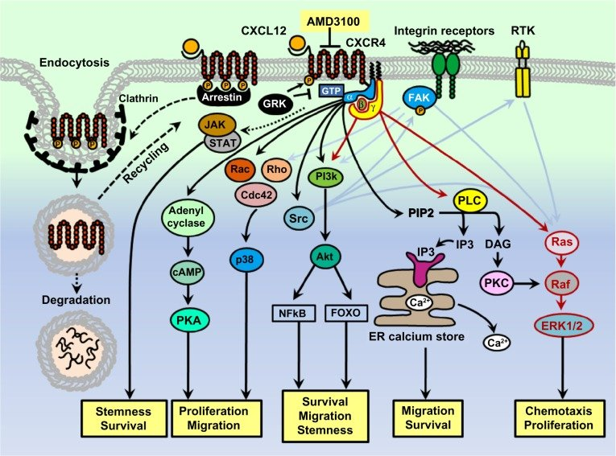
Identifying specific reporter targets
Typical signaling diagram for CXCR4 (note that only the forward reactions are shown in most diagrams)
Imaging targets here include
  Ligand localization and binding
  Receptor localization and stability
  Arrestin recruitment to receptor
  G-protein activation
  Kinase activation (p38, Akt, ERK)
  Gene expression
  Cell movement
  Cell division
  Other items we image that can impact signaling include mitochondrial morphology, NADH/NADPH and FAD

Slide 7
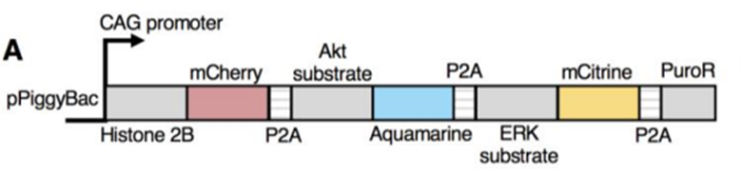
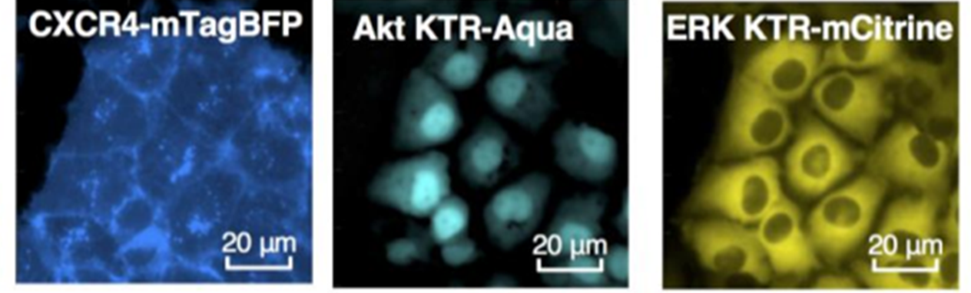
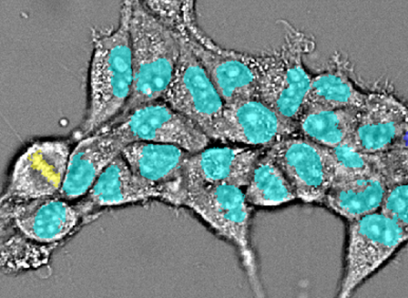
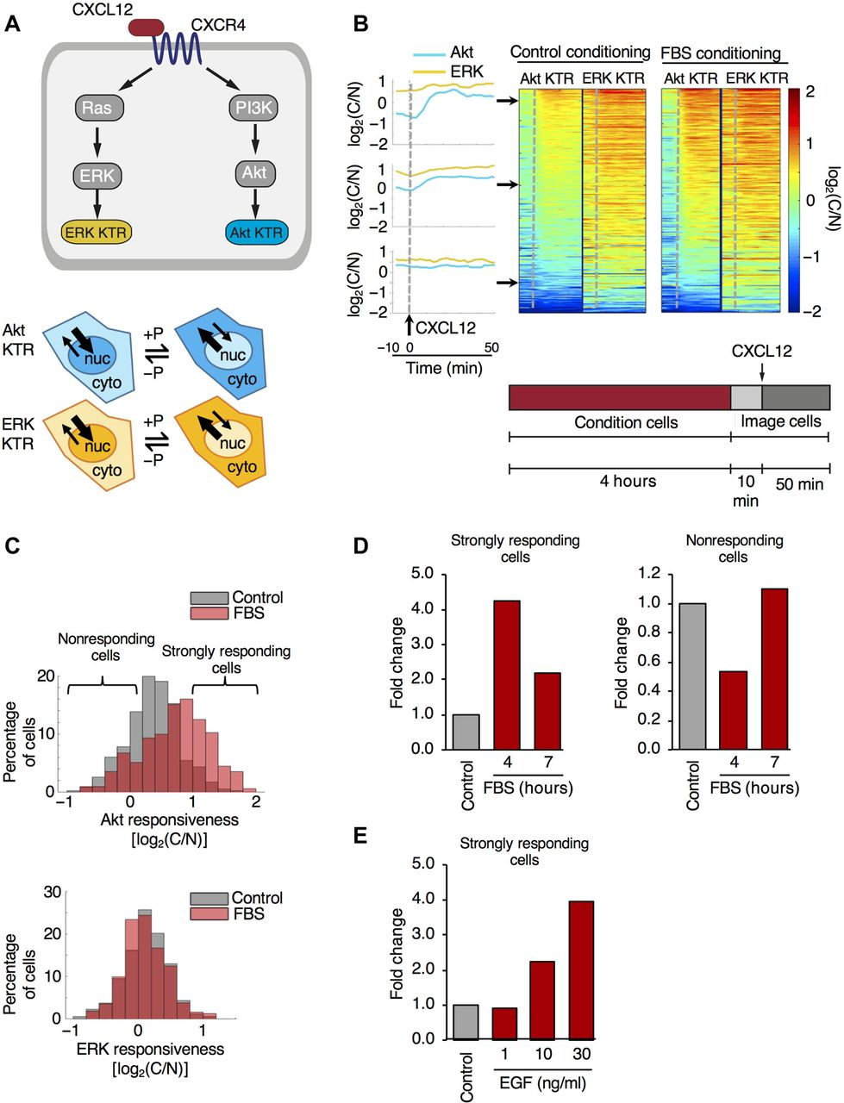
Building experimental pipelines for live cell work
To tap into the signaling world of live cells we need
multiplexed reporter systems – reliable co-expression at similar levels in all cells makes automated image processing work smoothly. Innovation in luminescent and fluorescent reporters is a foundational aspect of our work.
imaging methods – live cell microscopy needs speed to cover multiple wells in a well plate, sensitivity to avoid light damage to cells, resolution to capture sharp images for segmentation, environmental control to ensure that cells can move and signal reproducibly, and flexibility to multiplex 4+ channels.
data extraction pipelines – need to be baked into the experimental design, both for image processing and feature extraction and management plans for high-dimensionality time-lapse cell data. This is also a major area of innovation for our team.
modeling approaches – Models need reliable data streams and must produce testable predictions. Over 10+ years, we have developed multiple modeling approaches with our team (combo of ODE and agent-based). In the past three years, our team has been exploring novel physics and chemistry-based approaches including variational systems inference and inverse reinforcement learning.
Classification of mitotic cells

Slide 8
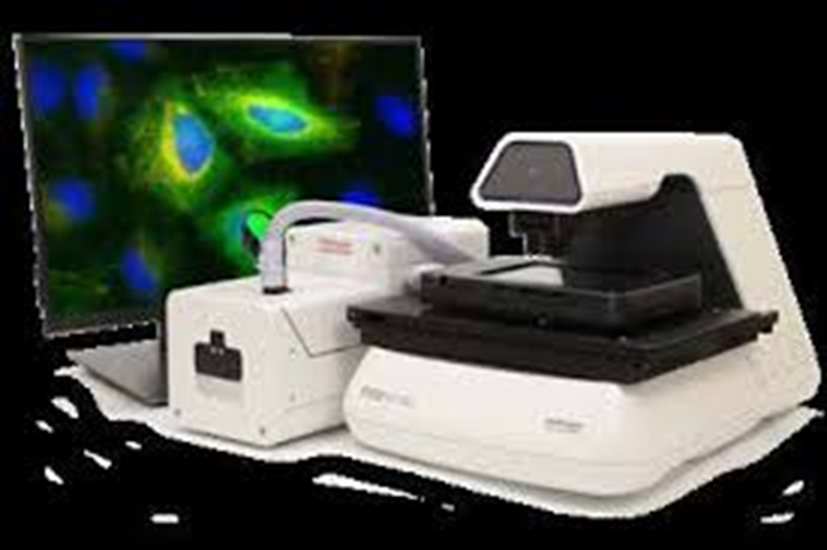
Our time-lapse fluorescence microscopes
Leica THUNDER automated epifluorescence microscope
EVOS capabilities with better speed, sensitivity, resolution, and flexibility
8 LED light engine
2 quad cubes allow flexible excitation/emission settings
high-speed cleanup bandpass filter wheel
High resolution and high sensitivity camera
Feedback control of temperature
Water immersion 20x for less scatter and higher light recovery.
Deconvolution in the data stream (THUNDER) for removing out-of-plane haze.
Olympus 2-photon
Dual IR laser lines (tunable and fixed 1040) for simultaneous excitation
4 detectors with user-modifiable filter cubes
FLIM imaging module
Incubated stage with gas controller
Suitable for multicolor imaging of 2D and 3D cultures
Uses immersion (dipping) objectives so can’t be used with multiwell plates, but is suitable for animal imaging
EVOS M7000 epifluorescence microscope with incubation (humidity and C02) (BI also owns one)
Automated stage and cube control
Simplified operation for non-microscope experts
Compatible with glass-bottom well plates
Good resolution and sensitivity when fitted with appropriate objectives
Uses standardized LED light cubes
Olympus LV200 bioluminescence and fluorescence microscope (BI owned, Shea lab location)–
Specialized optics optimal for bioluminescent detection.
Automated and incubated for live cell work.
Details later in this presentation.

Slide 9
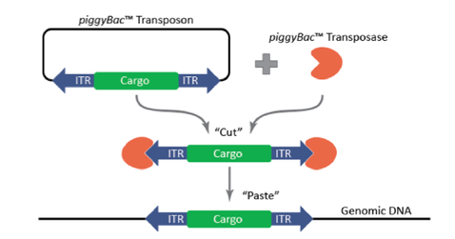
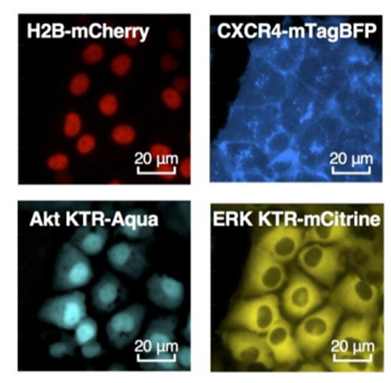
Expression of multiplexed reporters
Although for a single ORF we often use lentviruses with an IRES or P2A to a selection marker, we most commonly use transposons for tight, stable co-expression of our reporters.
These kinase translocation reporters in cyan and yellow channels are co-expressed with H2B-mCherry. The receptor is expressed as CXCR4-mTagBFP2 fusion in a lentivirus.

Slide 10
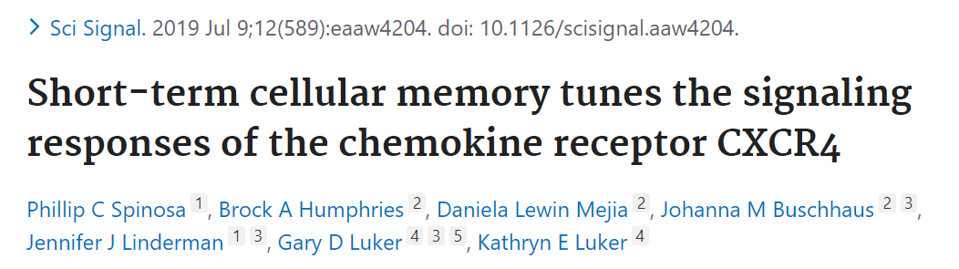
Heterogeneous responses visible in ERK and AKT
ERK and AKT activity are quantified with Kinase Translocation reporters (KTRs). The nucleus is segmented with the H2B mCherry. For each reporter, the Cytoplasmic/Nuclear Ratio of intensities for each cell are expressed as the log2(CNR). This gives a range of detection from -2 to +2. MDA-MB-231 cells shown.
Imaging every 3 min, we create chymographs with heat maps of kinase activity. Cells in static culture were treated with 10 ng/ml CXCL12 at the dotted line. We have sorted the several hundred cells in this experiment by AUC for AKT for better visualization.
Notes:
We are showing 50 minutes of signaling here. How will this look in a long term chemotaxis experiment which last about 24 hours.

Slide 11
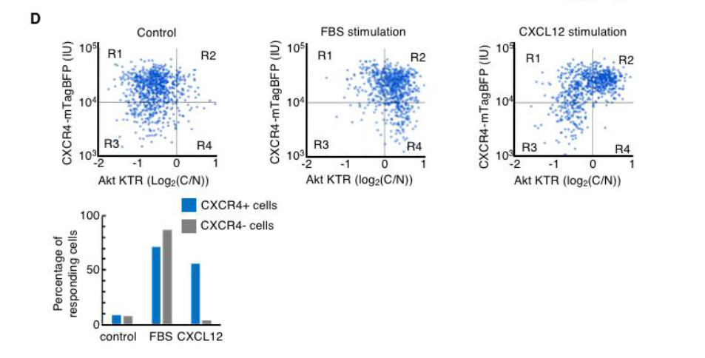
Shifting the internal state of cells
Cells “remember” a pretreatment with serum even after returning to their original basal ERK and AKT states.
Serum-pretreated cells “stored” the information about the pretreatment and responded much more strongly than the untreated population.
This is consistent with our observation that the initial ERK or AKT state was not strongly correlated with responsiveness to the stimulus.
As long as cells expressed CXCR4-mTagBFP2, there was no correlation of receptor level with signaling.

Slide 12
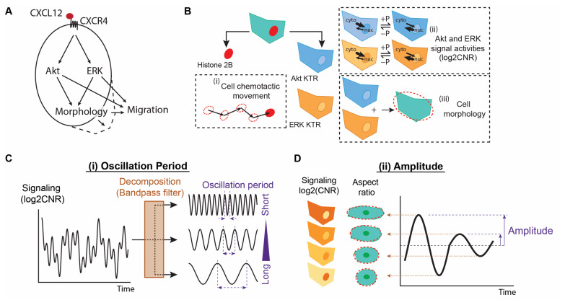
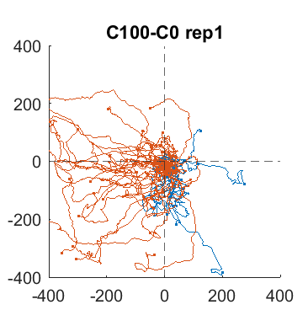
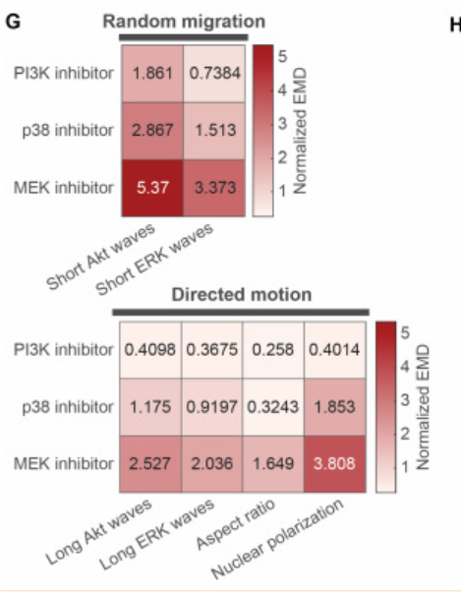
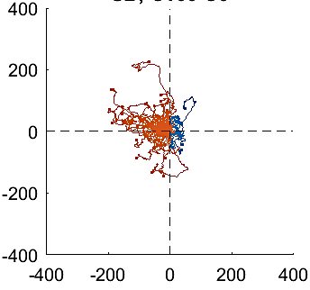
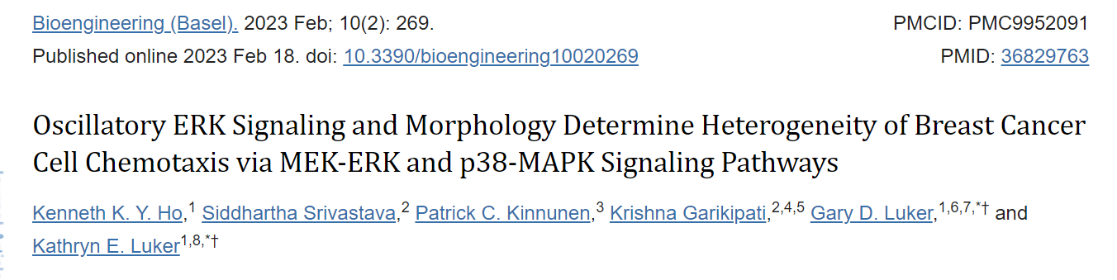
Using KTR and morphology time domain data
CXCL12 gradient
Red, forward
Blue, reverse
MDA-MB-231 Cells expressing CXCR4 in a chemotactic gradient of CXCL12
We tracked ERK and AKT kinase signaling, morphology (orientation of long axis of cell) and movement of single cells overnight, imaging every 4 minutes
CXCL12 gradient
P38 inhibitor
SB203580
Decomposing the ERK and AKT oscillations into short and long amplitude waves showed that short (30-60 min) ERK waves were most correlated with migration speed, and long (90-120 min) ERK waves were most correlated with directed motion.
Inhibiting P38, AKT (PI3K) or ERK (MEK) has impacts on the features of signaling waves, the aspect ratio of cells, and nuclear polarization along the gradient axis. EMD (earth-mover distance) is a measure of the change in the distribution of these features, where 0=no change.

Slide 13
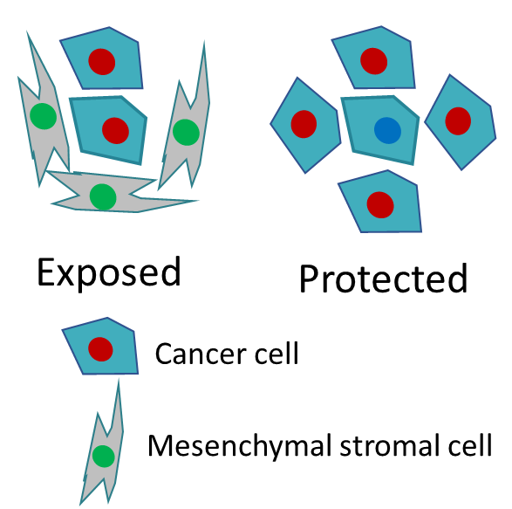
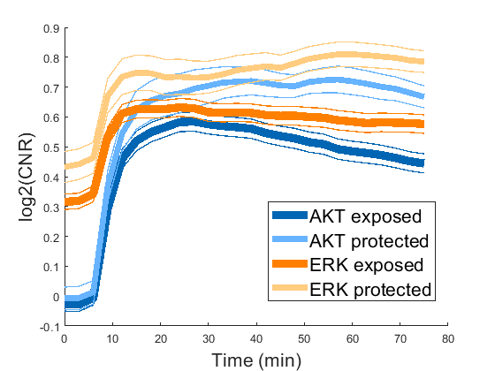
Local Stromal Neighbors Influence Cancer Cell Signaling
Stromal cells can change neighboring cells through contact, so we are looking for an effect of neighboring stromal cells on CXCL12 responsiveness
Coculture cells for 72 hrs, MDA-MB-231 cancer cells express 3 colors of KTRs (ERK, Akt and P38), HS5 bone marrow stromal cells express only 2 (ERK and Akt) so they can be distinguished.
Treat static co-culture with CXCL12 (10 ng/ml)
Measure distances from cancer cells to closest stromal cell. Divide into exposed and protected pools to examine signaling
Adjacent HS5 stromal cells depress both basal and stimulated ERK in MDA-MB-231 cancer cells
Adjacent stromal cells don’t affect basal Akt activity but depress stimulated Akt
Similar experiments with other cancer cells showed different patterns, but still showed an effect

Slide 14
Inheritance of internal cell states
When stimulated with CXCL12, the response curves in Akt and ERK for sister cells are often highly correlated (25%) , while non-sister neighboring or randomly chosen cells are less commonly highly correlated (~5%).
If we track cells for several hours prior to adding a stimulus, we can identify mother cells and their daughters that subsequently respond to a stimulus, 10 ng/ml CXCL12 on CXCR4 expressing MDA-MB-231 cells
In the unstimulated condition, the Akt and ERK state of cells is not inherited from the mother but is often well correlated in sister cells.
Correlation coefficients
% Highly Correlated
Basal AKT
Basal ERK
p=4 x 10⁻³¹
p=4 x 10⁻⁴²
Rho
% of population
NS for all others
Shared color = sister cells
Sis1-
Sis2
Mom-
Sis1
Mom-
Sis2
Sis1-
Sis2
Mom-
Sis1
Mom-
Sis2
Sister Adjacent Random
Sis
Adj
Rand
These experiments provide evidence of cellular internal states that are “remembered” by cells and that can be changed by environmental cues. We aim to describe the internal states and develop interventions to change responses.

Slide 15
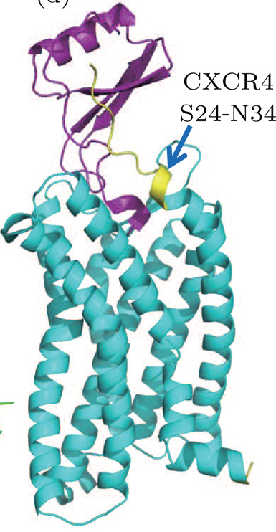
Imaging chemokine ligand-receptor interactions
Another area of interest is the regulation of chemotaxis by chemokine interactions with cell surfaces.
CXC Chemokines bind to glycosaminoglycans on cell surfaces through positively charged C-terminal tails, potentially resulting in increased local concentrations on donor and acceptor cell surfaces that either potentiate or impede signaling and scavenging of these ligands.
Using a naturally-occurring system of receptors and ligands with variable C-terminal tail configuration and, we can measure ligand-receptor interactions in living cells.
How to measure the temporal and spatial dynamics transfer of ligands from stromal cells to receptors on cancer cells? Need a protein association reporter for low levels in the extracellular environment.
Made by stromal cells
Ligands
CXCL12-alpha
CXCL12-beta
CXCL12-gamma
CXCL12-delta
CXCL12-epsilon
CXCL11-1
CXCL11-2
CXCL14
Receptors
CXCR3 (signaling)
CXCR4 (signaling)
CXCR7 (scavenging)
Made by cancer cells

Slide 16
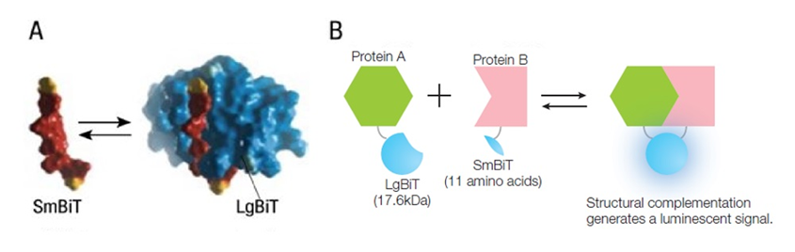
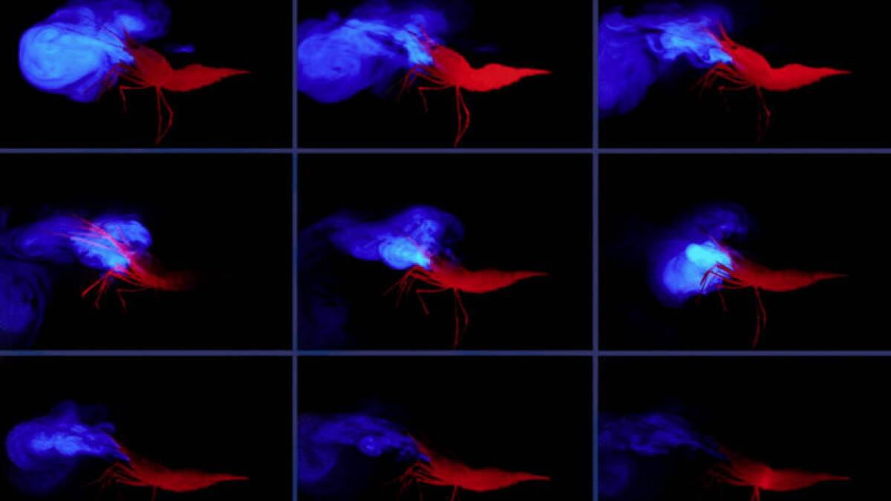
NanoLuc Luciferase complementation
19 kD NanoLuc can be expressed in 2 parts 17.6 kD and 11 AA that are inactive alone, but when they are brought close by interacting fusion proteins, they are enzymatically active.
Brightest signal of all luciferases
Absolutely no background
Very small, little perturbation of fusion protein structure
Origin of NanoLuc luciferase: deep-sea shrimp Oplophorus gracilirostris (red) releases a cloud of luciferase and substrate (blue) as a defense mechanis.

Slide 17
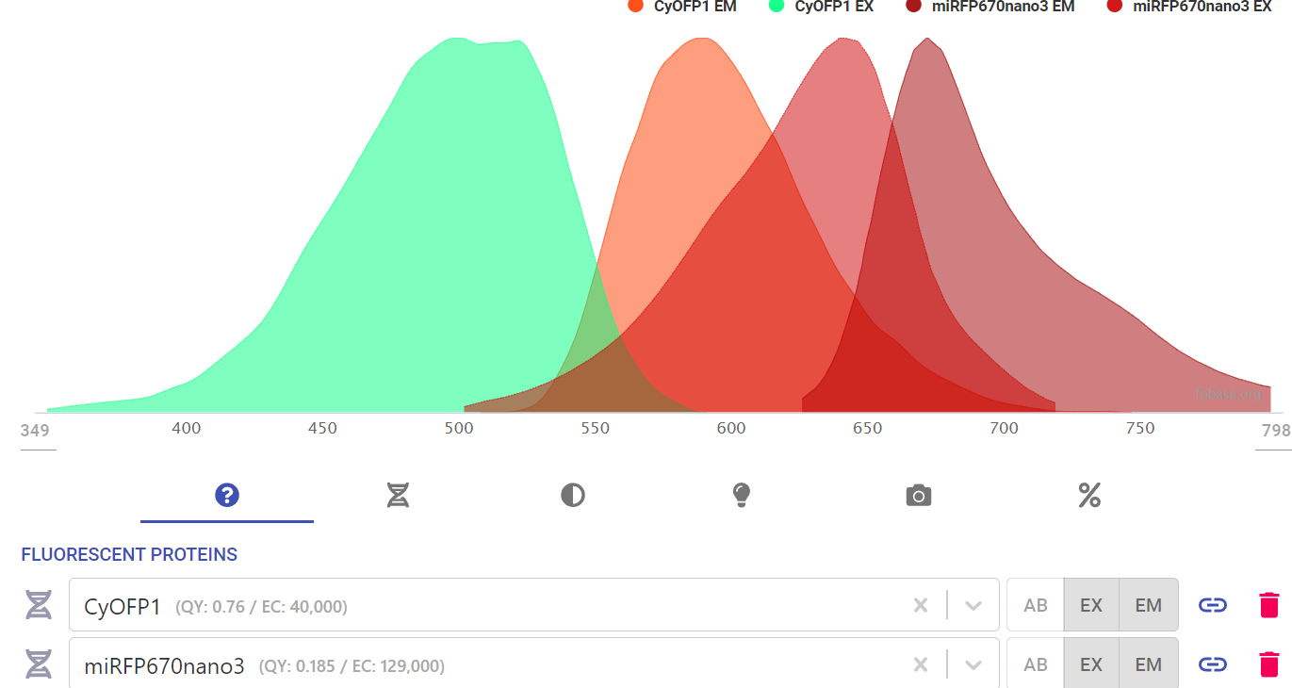
Constructs for measuring ligand-receptor interaction
For chemokine secreting donor cells, with cherry fluor retained in the cell
CAG
Sec-Ligand
nSmBit V5
IRES
mCherry
P2A
Hygro
The V5 enables instant quantitation with our custom NbV5-LgBit detection reagent.
Mark separately with H2B-mCitrine nuclei
For receptor expressing cells, with LgBit on the extracellular surface, and orange CyOFP1 fused to receptor on the cytoplasmic side. LgBit can be quantified with HiBit reagent.
CAG
Sec-LgBit
Receptor
CyOFP1
P2A
Hygro
Mark separately with H2B-iRFP670nano3 nuclei alone or with ERK (mCitrine) and Akt (Aquamarine)KTRs
Use fluorescent markers to provide cell identity, distances, receptor location and expression level, and signaling information to correlate with luminescence intensity

Slide 18
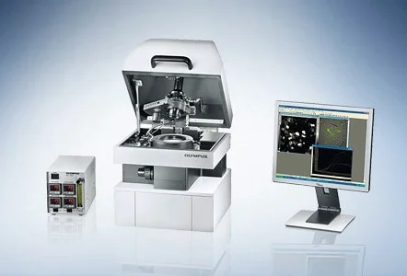
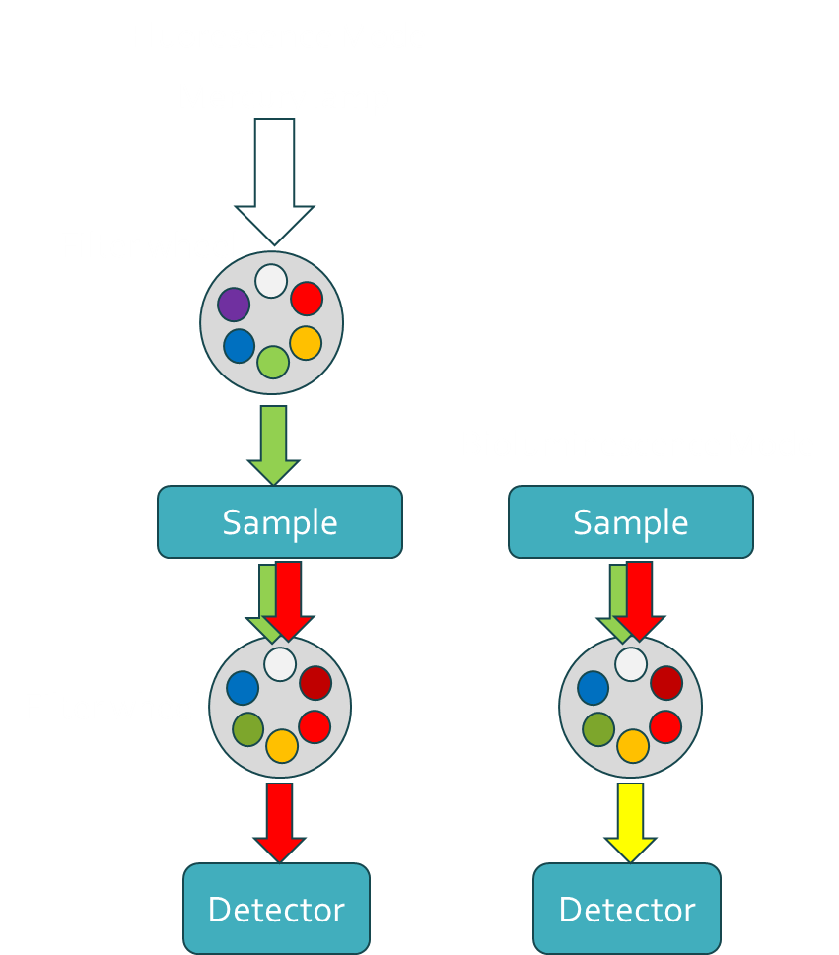
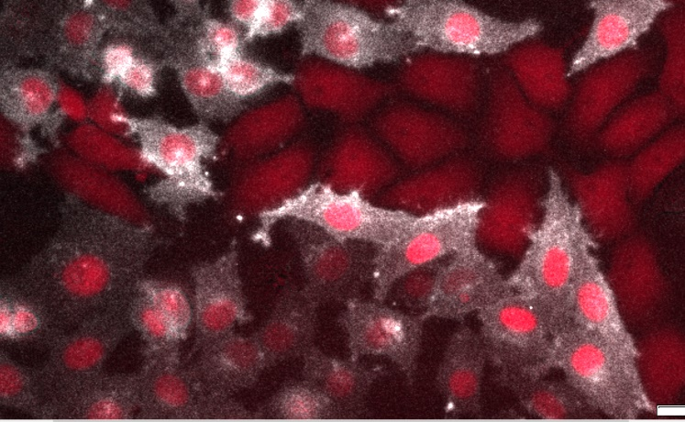
LV200 Bioluminescence and Fluorescence Microscope
The Olympus (Evident) LV200 shared instrument is fitted with an onstage incubator and CO2 control and has been newly updated for high resolution, high sensitivity imaging with
new operating software
Andor iXon Ultra 888 1024x1024 camera
high NA UPLXAPO 20x objective (also has 10x, 40x, and 100x)
Bioluminescence (white) is ligand-receptor binding for CXCL12 secreted by donor cells (large red cells) on CXCR7 receptor-expressing cells (red nuclei). Signal is highest where receptor cells directly contact the donor cells.
Bioluminescence
Fluorescence

Slide 19
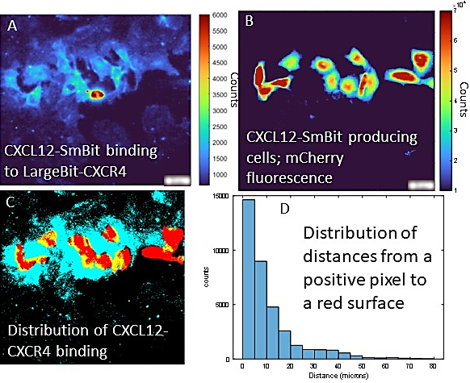
Measuring ligand delivery by local transfer vs fluid diffusion
Chemokine
Donor Cell
Cell positions
Receptor Cells
Chemokine
Donor Cell
Predicted result for
Diffusion transfer
Receptor Cells
Chemokine
Donor Cell
Predicted result for
Contact transfer
Combined NanoLuc complementation and fluorescence for CXCL12-CXCR4 binding. A) Pseudocolor bioluminescence microscopy of CXCL12-SmBit binding to Large-Bit-CXCR4. Scale bar, 20 µm. 1 minute acquisition, 20X objective. B) Cells (marked by mCherry fluorescence) that secrete CXCL12-SmBit in co-culture with Large-Bit-CXCR4 cells. C) Pseudocolor image shows limited distribution of CXCL12-CXCR4 binding. Cyan and yellow = luminescence > 1000 counts. Red and yellow = CXCL12-SmBit cells (mCherry). Yellow = overlap. D. Graph shows CXCL12-CXCR4 binding predominantly occurs in adjacent cells (< 1 cell distance separation).
Receptor Cells
Bright signal
No signal

Slide 20
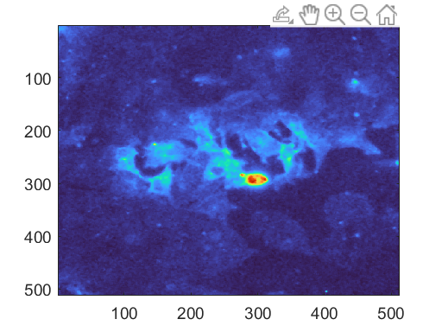
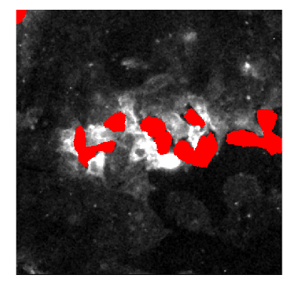
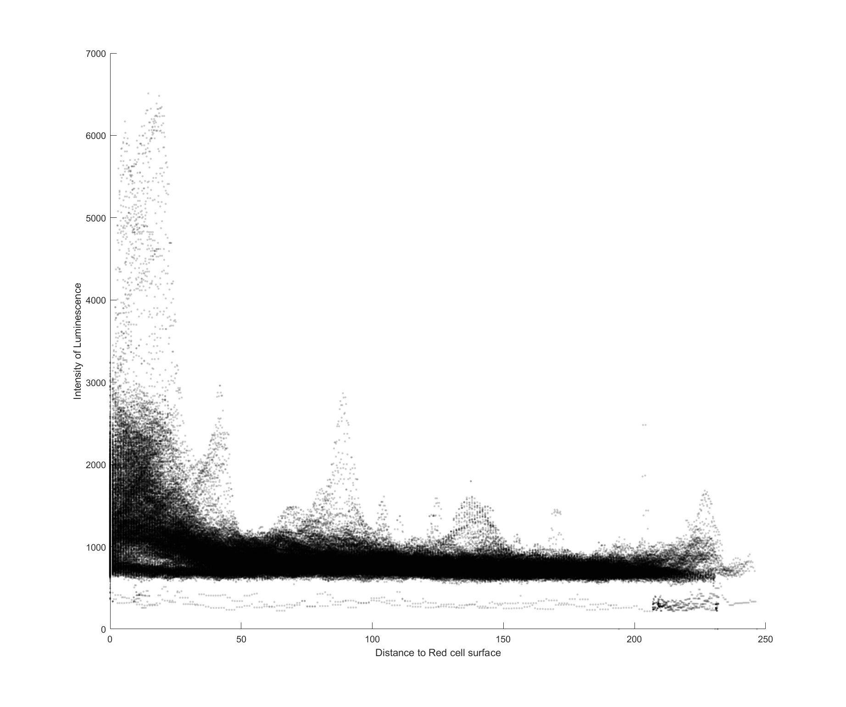
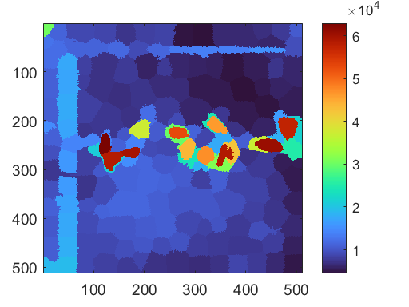
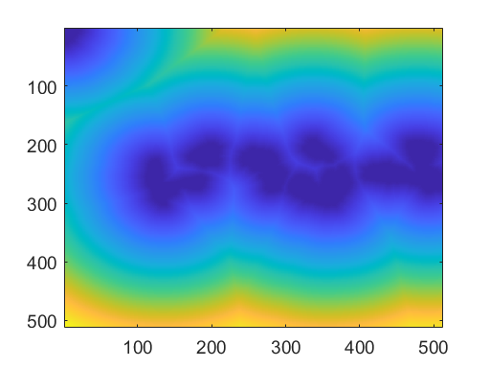
Image processing approach for to measure transfer (bulk field)
Lum image, spikes suppressed
Superpixels thresholded to make binary mask (red)
Shown overlayed on lum intensity image
Plot of luminescence of pixels (Y axis) against distance map
Red image, converted to superpixels and averaged
Distance map (bwdist) for every pixel

Slide 21
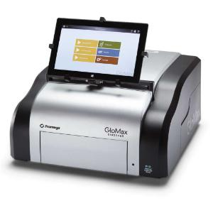
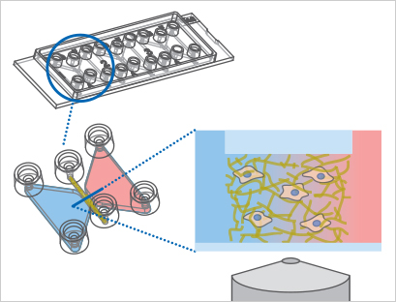
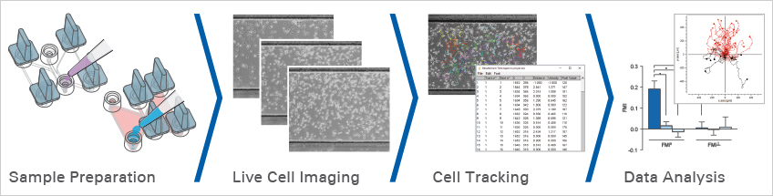
Gaining insight into chemotaxis
To understand how ligand-receptor interactions could be impacting the cell decisions to chemotax, we can extend this technology to measure things like…
Spatial and temporal dynamics of cell-cell interactions in ligand-receptor paired cells in time-lapse imaging using combination of NanoGlo and Vivizine for up to 8 hours of LV200 imaging or GloMax Discover high-sensitivity plate reader.
Secretion and distribution of ligand using ligand fused to intact Nanoluc
Use chemotaxis devices on the LV200 to visualize single cell ligand-receptor interaction over several hours, using cell-derived or synthetic chemokine-SmBit fusions.
CXCL12 gradient
Red, forward
Blue, reverse
GloMax Discover from Promega

Slide 22
Work in progress
How we are applying this toolset to understand ligand presentation
Ligands
CXCL12-alpha
CXCL12-beta
CXCL12-gamma
CXCL12-delta
CXCL12-epsilon
CXCL11-1
CXCL11-2
CXCL14
Receptors
CXCR3
CXCR4
CXCR7
Combine with
tools for instant measurement of ligand and receptor concentrations (NbV5-Lgbit and HiBit)
methods to disrupt the cell surface characteristics (block or remove surface GAGs, or overexpress GAG synthesis enzymes
Multiple donor and receptor cell types
Measures of internal signaling
Markers of individual cell physical shape and movement of cells as they interact
Chemotaxis chambers and patterned seeding

Slide 23


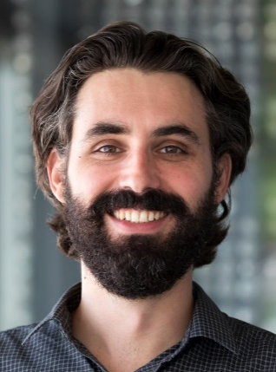
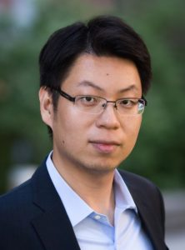
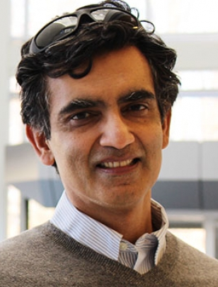
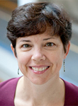
Our team for developing models of heterogeneity
Single-Cell Data
Artificial Intelligence
Systems Biology
Gary Luker
Kathryn Luker
Nikola Banovic
Xun Huan
Krishna Garikipati
Jennifer Linderman
Radiology
EECS
Mech. E.
Mech. E.
Chem. E.
Unique imaging reporters
Automated image processing
Inverse Reinforcement Learning
AI for modeling complex behavior
Hybrid Agent-based Modeling
System Inference of Physical/Chemical Phenomena

Slide 24

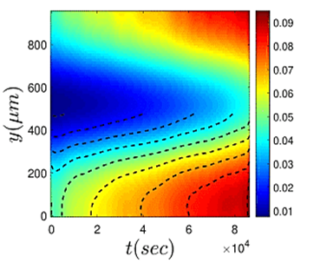
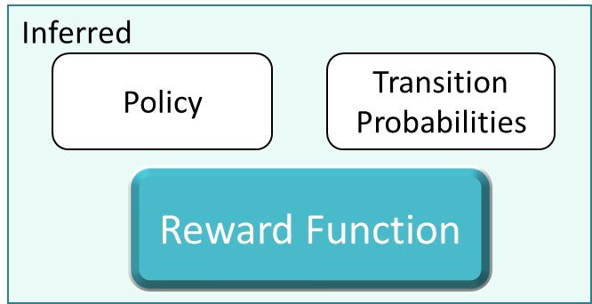
Our team is integrating 4 model conceptualizations
Ordinary differential equations
Agent-based Models
Variational Systems Inference
Inverse Reinforcement Learning

Slide 25
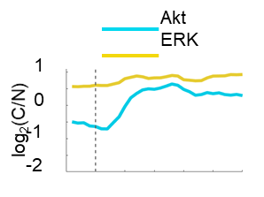
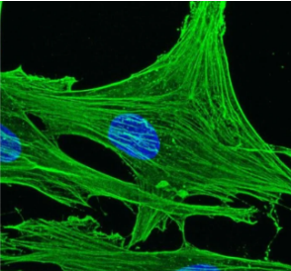
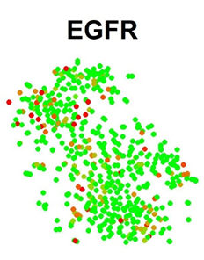
Making sense of the chaos of single cell behavior
Live-Cell Imaging
Signaling
Migration
Proliferation
Single Cell Type Model
Environmental Cues
Drivers of cell decisions (CXCL12, EGF)
Local neighborhoods
?
Time(min)
Single Time-Point Data
Mixed Cell Type Model
Cyclic Immunofluorescence
Single Cell RNA Sequencing
Generate integrated multi-omic data sets
Innovate new approaches to extract and merge data streams from models that generate heterogeneous cell behaviors
Establish a broadly applicable paradigm for cellular decisions and interactions in normal physiology and multiple diseases

Slide 26



How the team works together
$$\frac{∂C}{∂t}=D∇^{2}C$$
Transition Probabilities and Model
Experimental Data: Signaling, Migration, Division,
Mechanistic modeling
Physics/Chemistry Mechanistic Models
Scientific Artificial Intelligence
Interventions to control cell behaviors
Predictions
Data driven inference
Testable interventions to ensure
accurate model
New questions for AI Model
Coarse/fine-graining of model structure to answer new questions with AI
Test interventions about mechanisms of cell decision making
Molecular Regulation of Heterogeneity, Cell Decisions, and Intercellular Interactions
Notes:
Use icons

Slide 27
Using patterns of heterogeneity to parameterize models
Example 1. Conditions shift the pattern
The computational model must incorporate a dynamic component that explains the shift in signaling phenotype.

Slide 28
Using patterns of heterogeneity to parameterize models – Example 2. Receptor levels don’t dictate response
Cells expressing a range of levels of CXCR4-BFP were treated with CXCL12.
No significant correlation between CXCR4 expression levels and responsiveness.
The computational model must account for insensitivity to receptor expression levels

Slide 29



Using patterns of heterogeneity to parameterize models – Example 3. Correlations give clues to mechanism

Slide 30

Modeling heterogeneity in signaling with Ordinary Differential Equations
Three parameters (Ras, PI3K and mTORC1) defined single-cell signaling states.
mTORC1 integrated and negatively regulated ERK and AKT activation by CXCR4

Slide 31


Agent based Modeling of heterogeneous chemotaxis
Agent-based models use rules for cell actions deduced from observed cell behavior.
Rules in ABMs include embedded ordinary differential equations for biochemical species in the cells.

Slide 32








Modeling cells as diffusive materials with
Variational Systems Inference
Cells show random/directed migration (diffusion/advection) and proliferation (reaction)
Cells show near-diffusive migration
Infer the diffusive mechanism
Random motion
Directed motion
Cell proliferation

Slide 33
Inverse Reinforcement Learning
Inferred
Observed (Experimental)
Policy
Transition Probabilities
States
Actions
Reward Function
Physical/Chemical models provide rules, mechanisms, equations
IRL is an AI framework for modeling behavior
In IRL:
  Only state and action sequences are observed
  What reward function could have led to this observed behavior?
Reward function encapsulates the motivation driving the agent’s behavior
IRL thus gives us the “why” behind cell behavior!
Notes:
Fix this one. Flow chart horizontal

Slide 34





Our overall modeling vision
Develop a novel scientific artificial intelligence platform grounded in physics and chemistry of biomedicine
Apply this technology to predict and enable intervention in the decisions of cells in heterogeneous cell systems
Create a new, general approach to predict and intervene in other interconnected systems where insight into mechanism is required

Slide 35
Extra slides

Slide 36
Step 1 – modifying SmBit to remove charges
Signal Peptide, mature human CXCL12 peptide, Gly/Ser linker, SmBit, Charge Removed for neutral tag
Construct | Sequence
CXCL12α-L11-SmBit | MNAKVVVVLVLVLTALCLSDGKPVSLSYRCPCRFFESHVARANVKHLKILNTPNCALQIVARLKNNNRQVCIDPKLKWIQEYLEKALNKGSSPGSGSPGGVTGYRLFEEIL
CXCL12α-L11-nSmBit | MNAKVVVVLVLVLTALCLSDGKPVSLSYRCPCRFFESHVARANVKHLKILNTPNCALQIVARLKNNNRQVCIDPKLKWIQEYLEKALNKGSSPGSGSPGGVTGYRLFEAIL
CXCL12α-L11-Natural peptide | MNAKVVVVLVLVLTALCLSDGKPVSLSYRCPCRFFESHVARANVKHLKILNTPNCALQIVARLKNNNRQVCIDPKLKWIQEYLEKALNKGSSPGSGSPGGVTGWRLCERILA
CXCL12α-L11- nNatural peptide | MNAKVVVVLVLVLTALCLSDGKPVSLSYRCPCRFFESHVARANVKHLKILNTPNCALQIVARLKNNNRQVCIDPKLKWIQEYLEKALNKGSSPGSGSPGGVTGWRLCEAILA

Slide 37
Comparing CXCL12 isoforms with nSmBit fusions
Differs from Alpha
Construct | Sequence | Net Charge
CXCL12α | KPVSLSYRCPCRFFESHVARANVKHLKILNTPNCALQIVARLKNNNRQVCIDPKLKWIQEYLEKALNK | +8
CXCL12β | KPVSLSYRCPCRFFESHVARANVKHLKILNTPNCALQIVARLKNNNRQVCIDPKLKWIQEYLEKALNKRFKM | +10
CXCL12γ | KPVSLSYRCPCRFFESHVARANVKHLKILNTPNCALQIVARLKNNNRQVCIDPKLKWIQEYLEKALNKGRREEKVGKKEKIGKKKRQKKRKAAQKRKN | +22
CXCL12δ | KPVSLSYRCPCRFFESHVARANVKHLKILNTPNCALQIVARLKNNNRQVCIDPKLKWIQEYLEKALNNLISAAPAGKRVIAGARALHPSPPRACPTARALCEIRLWPPPEWSWPSPGDV | +10
CXCL12ε | KPVSLSYRCPCRFFESHYCTCLIRVSFHGATPLTQGSWVLYSLSCAGGETGLREPGPMVSPRVESHQEGRLGVPGPVNLGKA | +2

