Slide 1

Notes:
Hello to all of you at girls that geek and thank you for having me! I'm Rianna Walcott, I work at the University of Maryland as a researcher of Black Digital Communication, and I'm very excited to be with you today to talk a bit about my work.

Slide 2



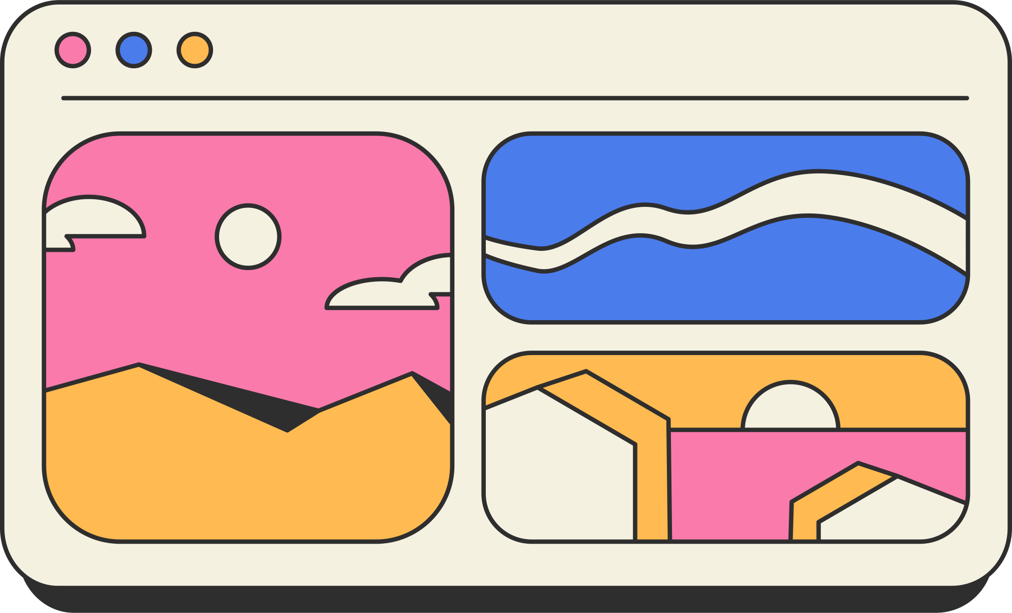
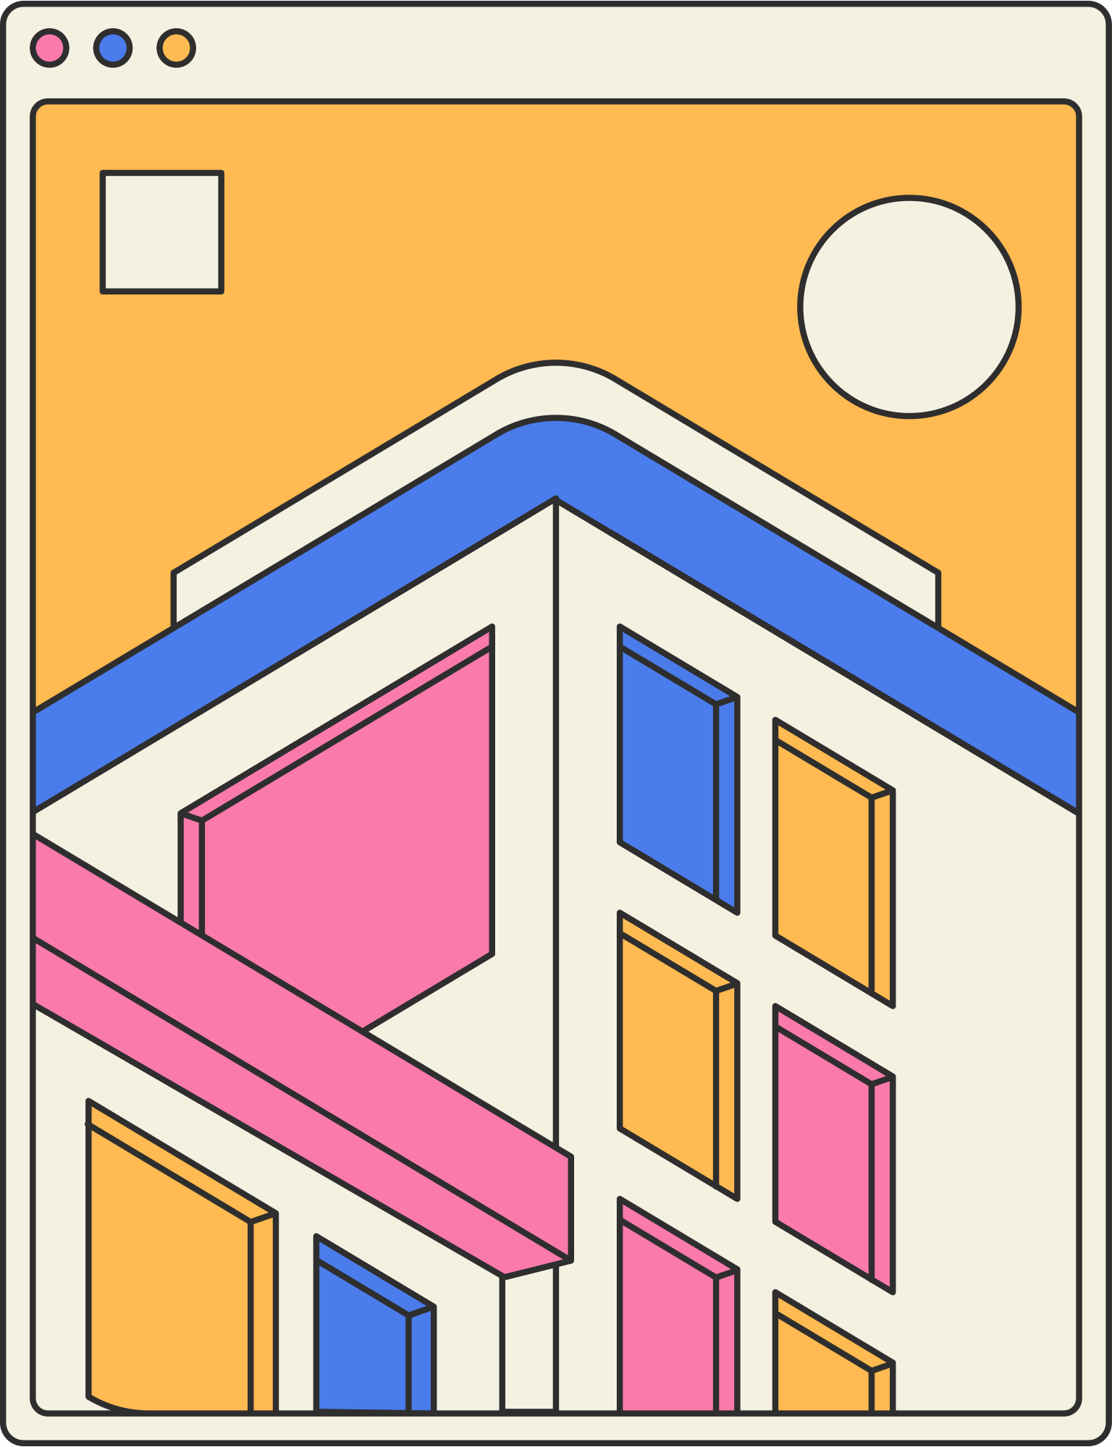

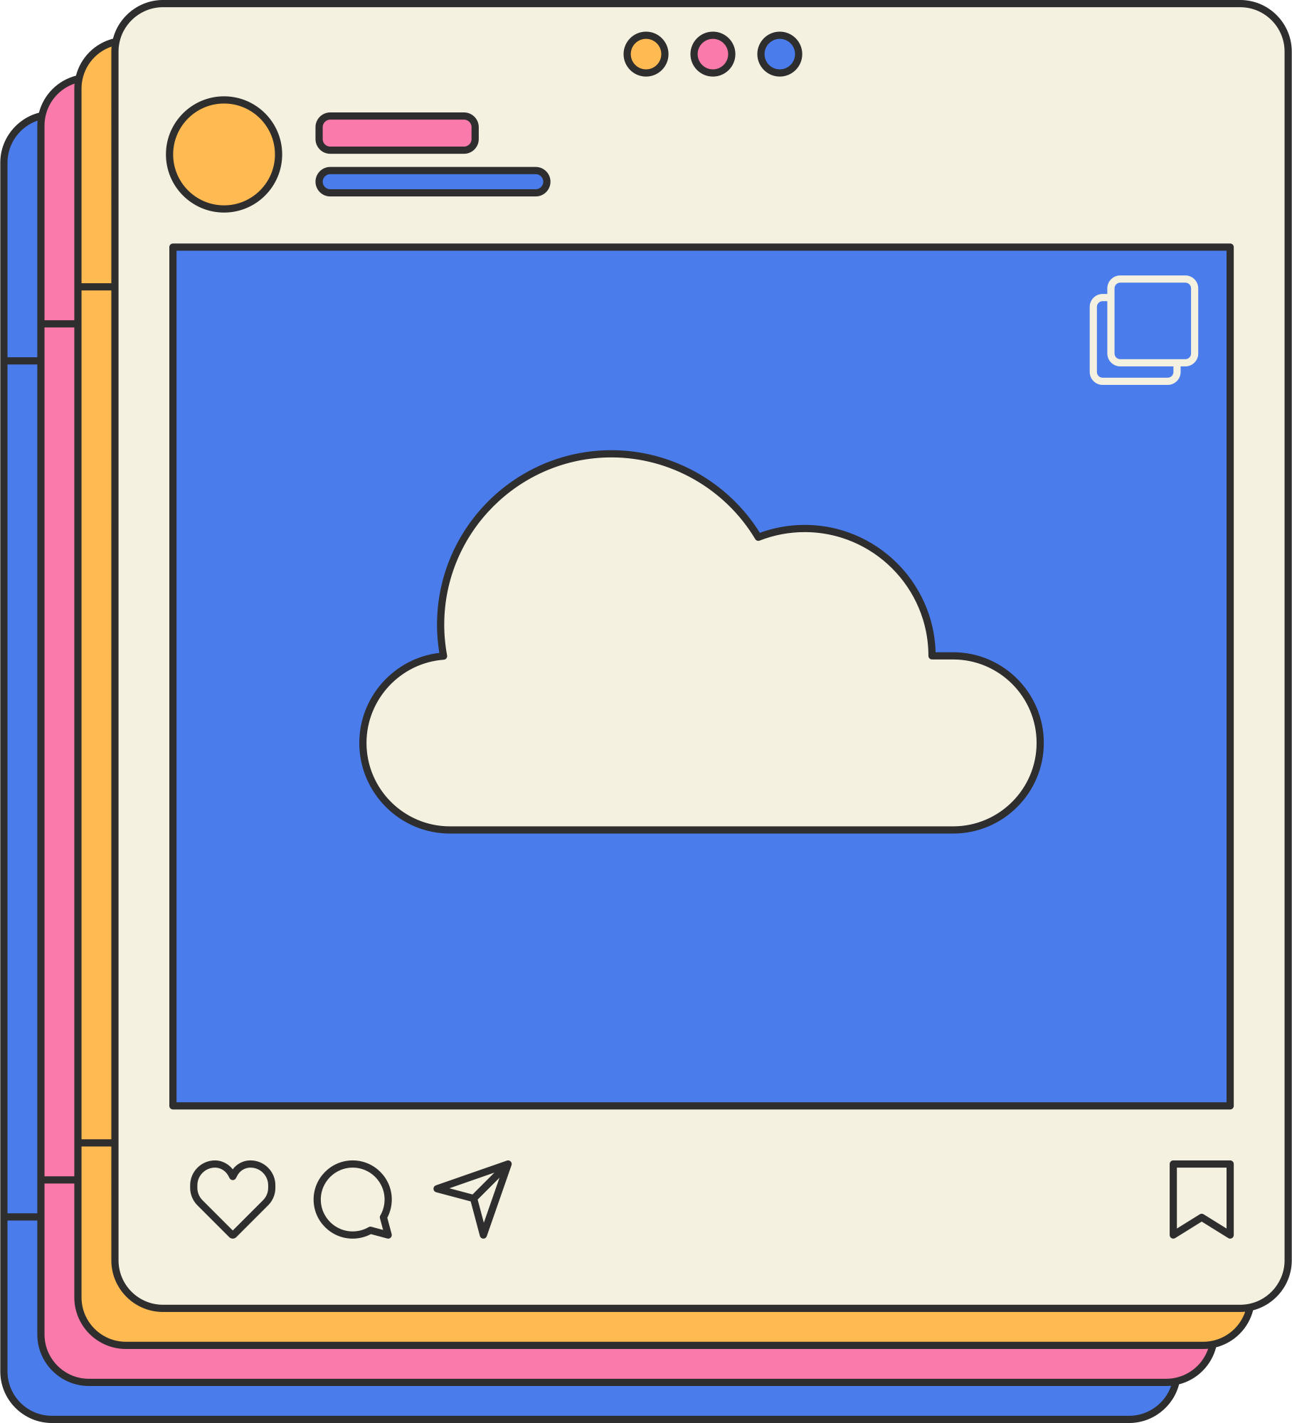

Digital
Community
Notes:
The main things I'll be thinking through today is this idea of 'community' - what makes a community, and where do we find it?
What communities do you belong to, and how do digital spaces allow you to connect more, or less easily, with those communities?

Slide 3

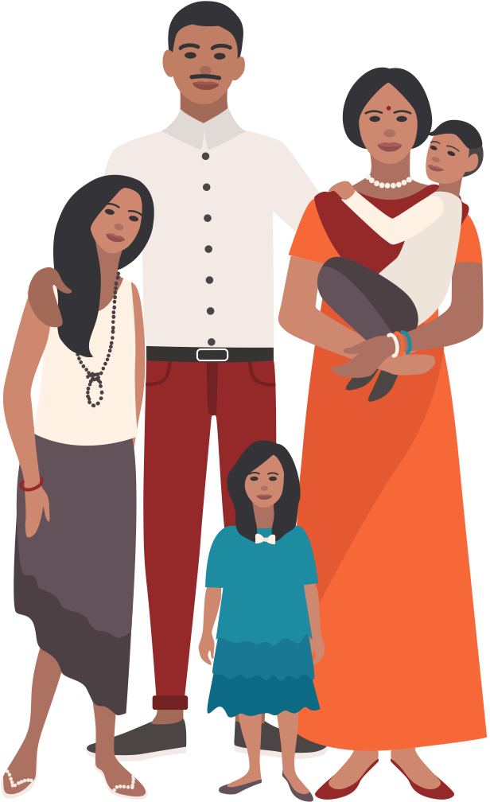
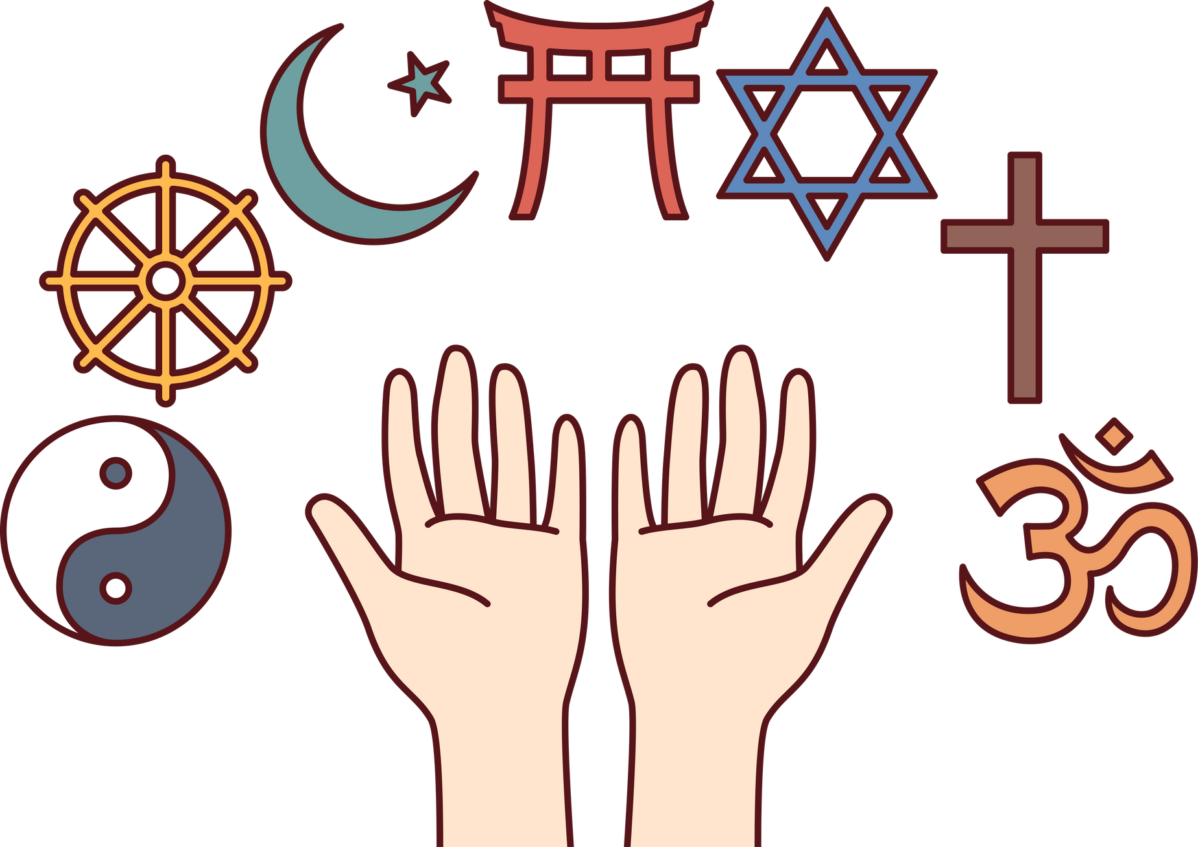


About you...
Where do you find your community in person?
Notes:
So I'll start us off with a question that you can answer using the slido tool -
Where do you find your community, or communities?
School?
Community groups?
Sports?
Religion?
Extended family?
Fandoms?
What communities do you belong to?

Slide 4


Where do you find community offline?
ⓘ Start presenting to display the poll results on this slide.

Slide 5

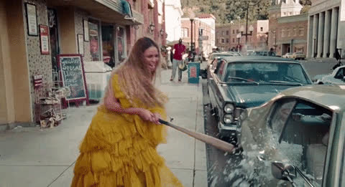

About me...
Notes:
Lemonade story, and finding community online when unavailable offline
This work started, as all good stories should, with Beyoncé. With the release of Beyoncé’s ground-breaking audio-visual album Lemonade in April 2016, my social media networks were filled with commentary, critique, memes and adoration. It seemed to be all anyone was talking about. There were communal watch parties, opinion pieces, heartfelt outpourings of love and gratitude to Beyoncé for making Black life visible on such a scale.
I was studying at Edinburgh University, a mainly white institution, and I tried to explain how momentous this album and its online reception was to my white classmates, my boyfriend, and my teachers, only to find that this news, that was all any of my friends online were talking about, was barely a blip on their newsfeed. For the first time, I realised the extent to which Black digital worlds didn't overlap with white ones.

Slide 6
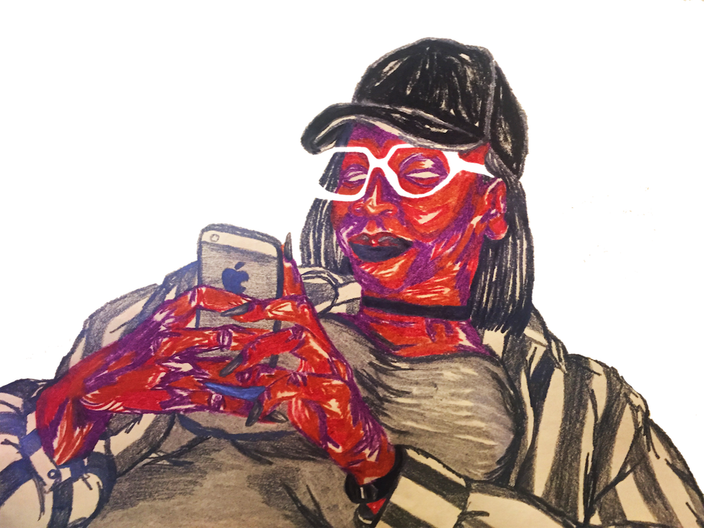
About me...
  Finding community online, when I couldn’t find it offline
  What I research
  Why it’s important WoC do this work
Notes:
While at university I had limited access to Black peers, or even makeup or hair products I could use, so I had to make the most of digital connections, by joining Facebook groups - which I'm sure almost none of you in the room use - that had different functions, from talking about Afro hair; to makeup brands suited for darker skinned people, to politics and activism. These groups were really important to me during a time when I was feeling quite isolated, and I learned a lot from the members of those groups.
This experience of isolation led me to the kinds of questions I’m still exploring with my work.
- I wanted to see myself in education, to talk about the creative ways that Black women in particular use technology to find and teach each other, and also just because I was having so much FUN online, and wanted to talk about that.
- My research looks at the behaviours of Black British people online – I’m interested in the spaces we go to find community, the things we talk about in those spaces, the language we use to create a community that is recognizable to other people in that community, and almost like a secret code that keeps out people who aren’t members.

Slide 7
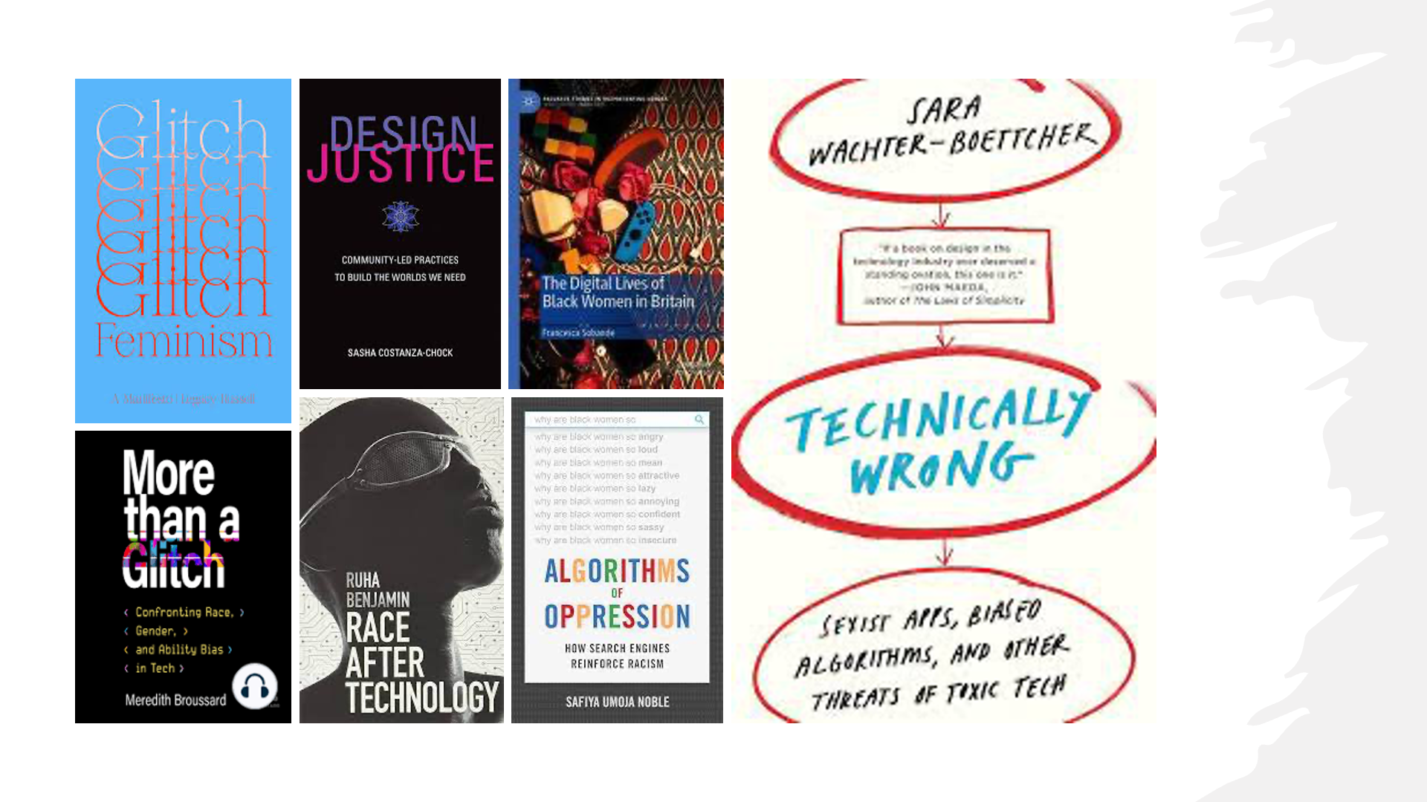
Notes:
Why it’s important that WoC do this work (we need to be involved in the technology that impacts us)
Real life impacts of WoC erasure from this work
- How tech design leaves us out
- what does this result in?
- Search engines, AI mimicry, brands benefitting from our labour

Slide 8
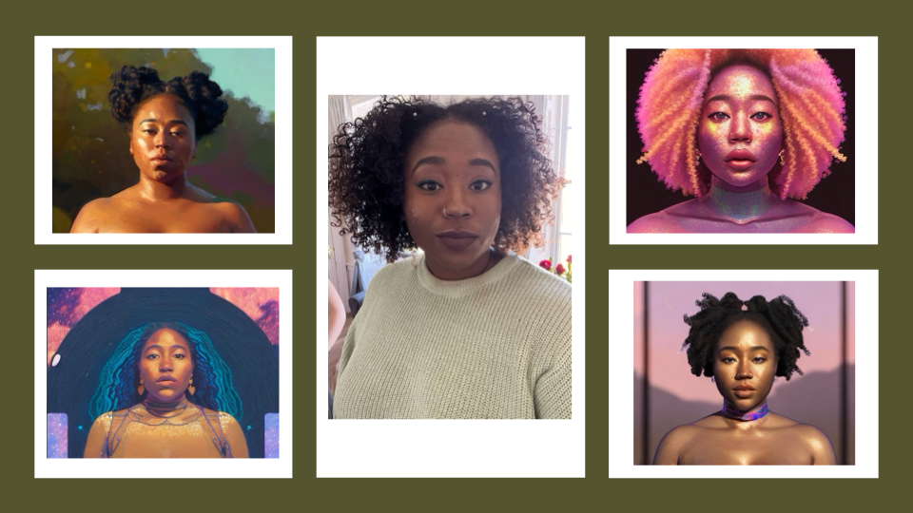
Notes:
So this slide shows an experience I had while playing around with an image generating AI (Lensa AI) in late 2022. I've had to crop the images because they were not child-friendly!
After inputting images of myself much like the one in the middle, the results were almost exclusively hyper-sexualized avatars, with little input drawn from the actual reference images.
Analyse the pics, lots of pastoral scenes, me and flowers, rarely smiling though I often was in my input pictures, lot of smizing,
While all of the reference images were fully clothed, Lensa undressed me, lightened my complexion and eye color, and exaggerated my features. The AI's imagination of what a futuristic, fantasy Black woman looks like was filled with racist and sexist stereotypes, most likely based on the influences in the data it is trained on, and the relative lack of Black people working in AI engineering. The very sexism and racism that women of colour live with, makes its way into the technology we use.
These complaints, of being made lighterskinned or having your face shape adjusted are also found in other examples like snapchat/Instagram filters.

Slide 9
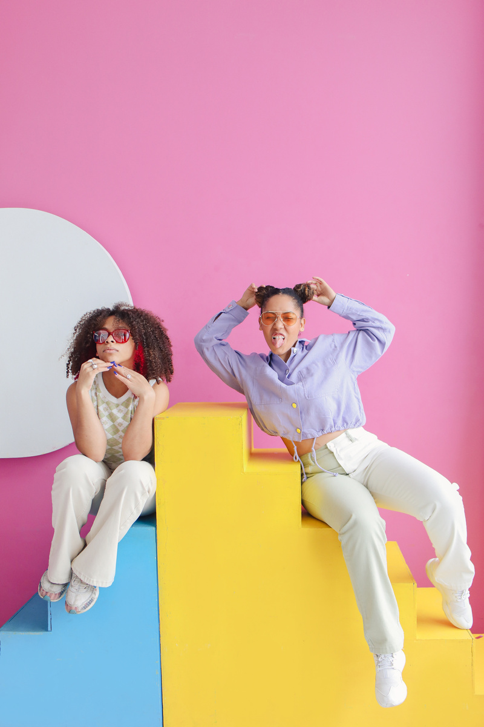
This is not a warning to not use tech!
•It just means that we need to be aware of the biases that are baked into the technology we use
•Technology is not neutral!
•And what we see, how we see it, how we engage with it, is affected by certain rules.

Slide 10
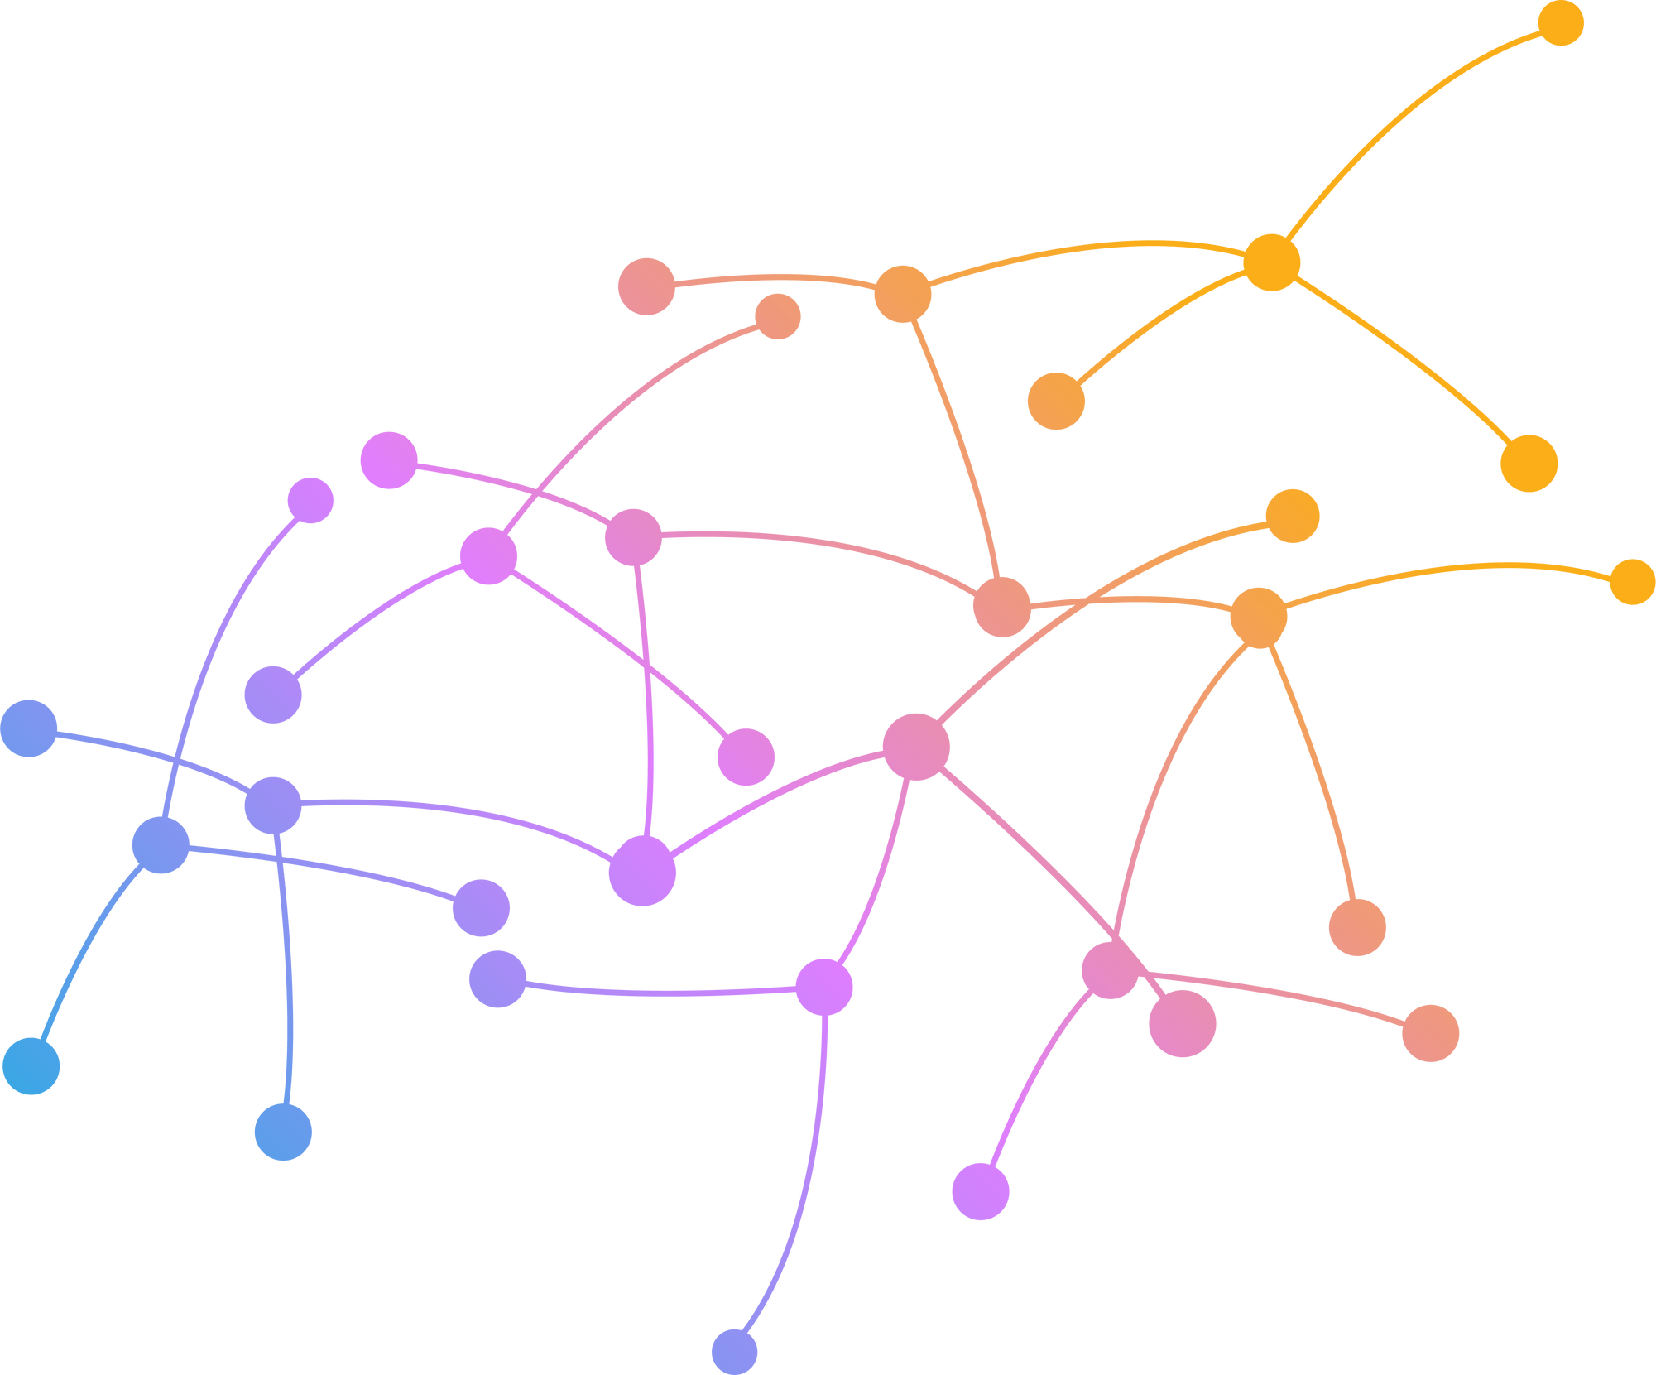
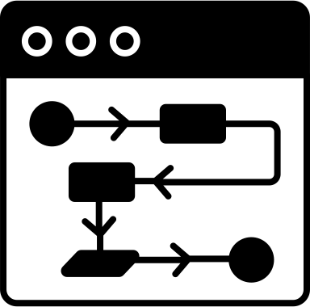
What is an algorithm?
A social media algorithm is a compilation of rules and data that make decisions about what users want to see on the platform. Social media sites create unique algorithms for every person who uses the site, which means no two people will have the exact same social media news feed.
Notes:
Whats an algorithm? SO how are we matched together?

Slide 11

Who Has:
ⓘ Start presenting to display the poll results on this slide.

Slide 12
How do you find community online?
ⓘ Start presenting to display the poll results on this slide.

Slide 13


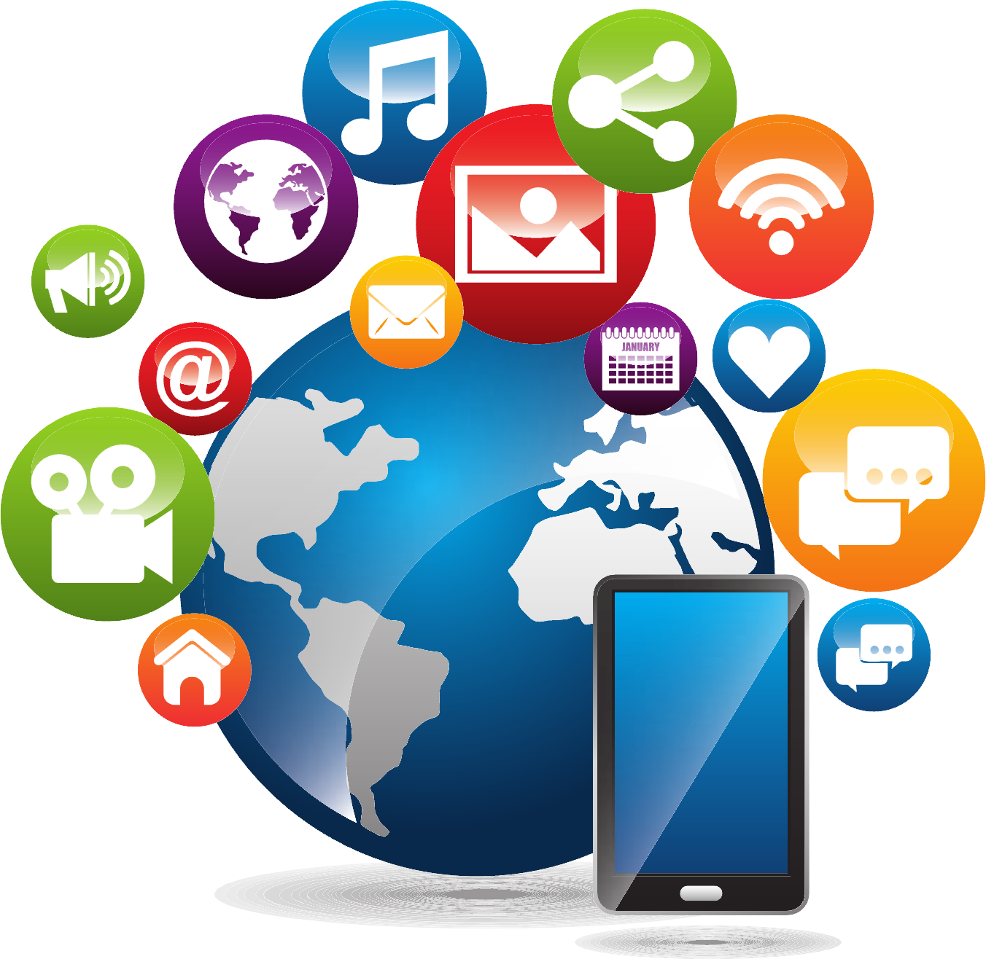





So how do we find our communities online?
Notes:
Different to building community offline
With a site like TikTok, for example, how are we introduced to content that matches our interests, to find new people to follow?
Return to ‘what platforms do you use’ slido
Where do people go to find community? How does our platform usage change dependent on country/age/gender/ethnicity? Where do we go when some platforms stop working as well, or just become a bit uncool?
Part of finding community online mirrors offline choices - e.g following your phone contacts on snapchat, or people you meet in your day to day life, or being introduced to someone new via a group chat
Creating community online is not wholly different to finding it offline - many of the same factors connect users (age, gender, ethnicity, class, interests, politics, nationality, fan culture etc), but the point I'm getting at is that digital spaces MEDIATE and ENCOURAGE those connections.
What's the benefit of being part of a community online?
Meaningful relationships, global connection, activist or radical potential. The internet as an extension of the world around us, making our communities accessible on more than just a local scale
How do communities of women gather to make change, considering movements like BLM, like #metoo, in terms of radical activist potential
Potential for education: being able to teach each other, like me with learning how to do my own hair, YouTube braiders etc, communities sharing videos on TikTok on how to cook their own cultural foods etc
there doesn't always have to be a point. sometimes its just more fun! Same reason we have communities at all. But also the potential for fun: watching television live, live tweeting about love island, or the Grammys etc. I’m interested in the mundane too, the things that bring us joy.

Slide 14
Thank you!
Questions?

Slide 15

Audience Q&A Session
ⓘ Start presenting to display the audience questions on this slide.

