Slide 1

Labours of Love
Dr. Rianna Walcott
frank23
Notes:
While I was a PhD student in the UK, I did all the things you would expect one to do. I taught, I read, I wrote (infrequently, sadly), I presented my research. However, I was the first – and only – Black member of staff/PhD student that my department had ever had, so in practice, I had to do much, much more.
I was a magnet for extra work. Being so visibily other to the rest of the staff drew students of colour to me from institutions outside of my own for support and guidance, and somehow – with no training at all other than lived experience – I was an Equality Diversity and Inclusion expert.
Today I will be talking about labours of love. The work you do because it feels like you have no choice, because it feels like the most ethical thing to do, or because no-one else is doing it.

Slide 2

Invisible Labour
What types of labour are visible and valued?
Notes:
I’d like to start by posing a question to you – what types of labour do you do that you feel is visible, or valued by the people you do it for?
Is that work the more tangible kind, the practical, or administrative work that has physical outputs? In what ways are you compensated for that kind of work? Does this make up the majority of your workload?

Slide 3
Invisible Labour
What types of labour are unrecognized, but feel morally necessary?
Notes:
And then the opposite – what types of labour do you take on that ends up feeling invisible? Is it the more emotional, pastoral work, things like advising students, helping with interpersonal problems, or even just commiserating about how hard it all is? Those with less tangible outputs, or outputs that aren’t profitable to the workplace? ADD EXAMPLES
For me, that ended up being the bulk of my work.
While I was at university, I started an organization called ‘Project Myopia’ – a project designed to make existing in predominantly white, cisheteropatriarchal institutions a bit more comfortable for those who did not fit that mould.
PM is a collaborative, crowdsourced initiative where marginalized scholars recommend works for study that aren’t traditionally included as part of the canon – works by women, LGBT people, people of colour, differently abled people etc. I have and continue to pour years of time, money and resources into this project, often at the expense of other parts of my career outputs, because it feels necessary.
In academia the publish or perish system means much of the recognized and respected labour is based on research outputs. The work of improving the institution is more incidental to your career – worthwhile, but in the grand scheme of achieving a permanent position, less valuable.

Slide 4
Invisible Labour
What would recognition look like?
Notes:
I’ve been thinking through these various forms of hidden labour (emotional, practical, pedagogical, administrative, etc) that are undertaken primarily by minority staff and students in academia.
I wonder what changes would need to happen to this system in order to make the ethical, invisible labour carry more meaning to the institutions we institutions we perform them for. If I – for example – am doing twice as much outreach work than my peers, and as a result putting half as much time into my research, how can I make sure that isn’t detrimental to my career overall?
This of course comes with the caveat about where we want recognition from – I value the work I do, and the recognition I get is more valuable from within my own community than I could likely ever receive from my workplace. That said, that recognition does not always pay my rent or put food on my table. Let’s go back to talking about uneven workplace cultures, and who disproportionately suffers from them.

Slide 5

Who performs these ‘invisible labours’?
Notes:
In the wake of George Floyd’s murder in the summer of 2020, my workspace felt compelled to respond to the tragedy. This of course meant, that I was compelled, as the only Black staff member, to respond to the tragedy.
I was called on to lead a staff departmental meeting about anti-Black racism in the university because someone, somewhere had heard I had ties to UKBLM. This was not true – beyond attending some marches and writing some articles about racism, I was not a member – I was just Black. However, it didn’t occur to me to say no. This was beyond the remit of my job, and certainly no other PhD students would be in attendance, but it still felt like the only morally correct option.
If I wanted the university to improve, to become a space that myself and others like me could survive and thrive within, surely it was my duty to do what I could, even if it would be unpaid? Practically speaking too, if I wanted to work within that same department in future, surely it would look unfavourable if I turned down the opportunity?
So. In the midst of the global pandemic, in the midst of the intracommunity grieving that Black people globally were doing, I led that departmental meeting. It was a good meeting, and in the aftermath of it, I continued to do some funded work, researching and interviewing Black students about the barriers to higher education they felt existed in our field.
I also became a go-to person for free labour in the department, particularly as related to race. I sat on hiring panels, spoke at events, ran EDI workshops. All the while wondering – would this be legible in a few years, when the time came for me to join the job market?

Slide 6
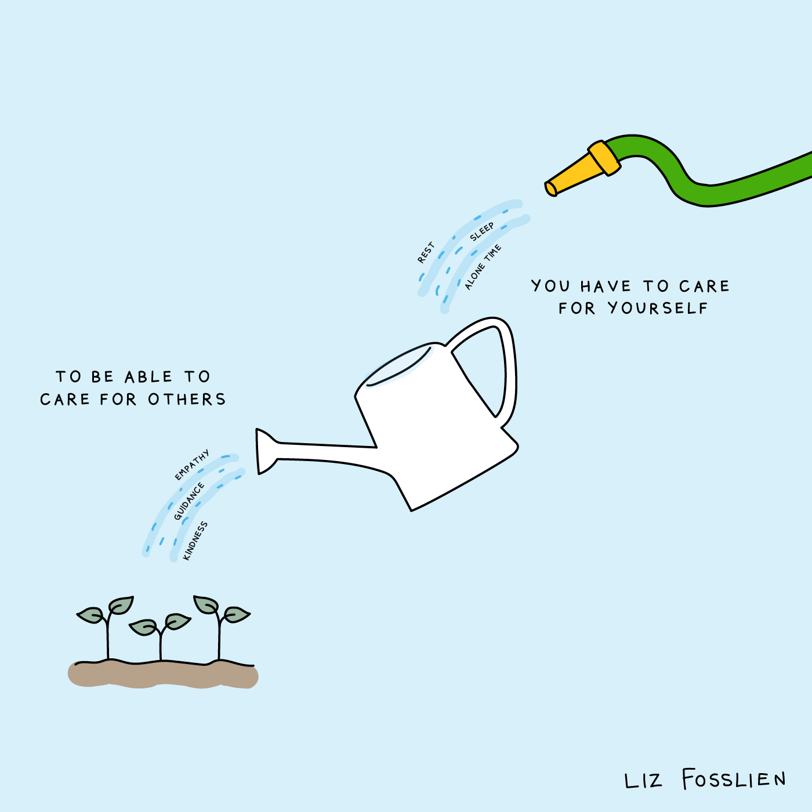
Withdrawal as self-preservation
Self-care for longevity
Notes:
I’ve come to the end of my PhD now, and I have moved overseas for an academic job. I like it here, so far I haven’t felt that gnawing at my time and energy, that fear that I am pouring from a reserve of energy and optimism that has a a bottom in clear sight.
That exhaustion I was feeling not too long ago, however, has been hard to recover from. By the end of my PhD, I was pouring from an empty cup, and needed to learn to establish boundaries - a skill I am still very much working on. My email signature is one way I tried to establish a boundary. It reads:
Please note – the impact of both pandemics (covid-19 and globalised anti-blackness) are making my responses slower than usual. I’m receiving more requests than I can handle for anti-racist work lately, and I would ask that you consider paying consultancy fees to the PoC you reach out to, and always for the work you request!
Insisting on being paid makes people a little more thoughtful about what they ask, I found. My personal three part decision on whether I do extra work now follows three parts:
Is the work paid? Is that pay fair?
If no, is the work relevant to my field, will it advance me and my career in the way I need it to?
If no again, is the work important, ethical, necessary?
Doing this is my way of self-preservation, but I have been lucky. I made a career out of my ethical side hustles and found a job that not only values but rewards that kind of labour. That isn’t always the case, particularly in academia. For many Black academics, in the UK especially, the only way method of self-preservation has been total withdrawal, leaving academia entirely for other industries.

Slide 7
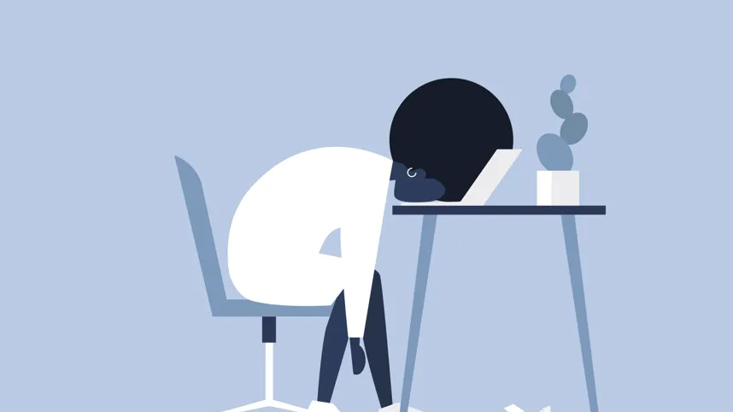
Indexing Labour – towards restitution and redress
How do you quantify labour?
Notes:
The question I’m asking now is – how can we move towards a model that rejects these uneven work cultures, that so disproportionately impacts minorities in the workplace? In order to move towards restitution and redress of this exhausting pattern we have to be able to quantify what that labour looks like.
But how do we do that? In terms of literal time? Energy? Of outputs comparative to less marginalized peers? What about that gradual build up that takes us closer to burnout with every task?
We have to be able to think about labour in terms of more than just tangible outputs. In terms of academia, that might mean thinking about quality of life, and ethical impacts as just as valuable as research outputs.
In terms of restitution, we then have to question what could offset that energy expended. In an academic context again, that might look like
o financial remuneration;
o rest and assistance as currency;
o extra protected research time;

Slide 8
Indexing Labour – towards restitution and redress
Carbon offsetting as a model:
  What types offsetting actions should we be aiming for?
Notes:
A model I’ve found helpful is the ‘carbon offset’ model, which is basically just compensating for carbon dioxide emissions by making equivalent reductions. So in our case, offsetting the labour with an equivalent activity.
The British Council have something like this, where 10% of workload for everyone is for Continuing Professional Development, but also 5% of your time is to work towards EDI goals. By building this into the workload expectations and compensating it, it stops being an optional extra that just the most marginalized voluntarily take on, and starts being a process we are all equal parts of.
Some restitution also has to be more nebulously defined, especially when we are talking about recovering energy, or replenishing that draining cup. That may have to be time, or funds to be together, to rest. My workplace has a monthly offering of ‘Eats’ events, offering space for students and faculty to be in community, rejuvenate our spirits, watch films, build connections and EAT good food.
Because these labours are undertaken from a place of love, perhaps some of that love has to take centre stage if we want to have longevity, if we are to maintain the energy necessary to dream of and build a better, more just world.

