Slide 1



Associations between high-risk business types for respiratory pathogen transmission and COVID cases in Wisconsin neighborhoods
Andrew Hoover, May 10th
SBE CCC ANNUAL MEETING 2024

Slide 2
Background & Aims

Slide 3
COVID Neighborhood Project (CONEP)
Build a nationwide COVID-19 database at the census tract/zip code level by…
Contacting every health department in the U.S.
Collecting spatially-referenced case data for 21 states
Linking with neighborhood data from the National Neighborhood Data Archive (NANDA).
  Disadvantage, affluence, and population density

Slide 4
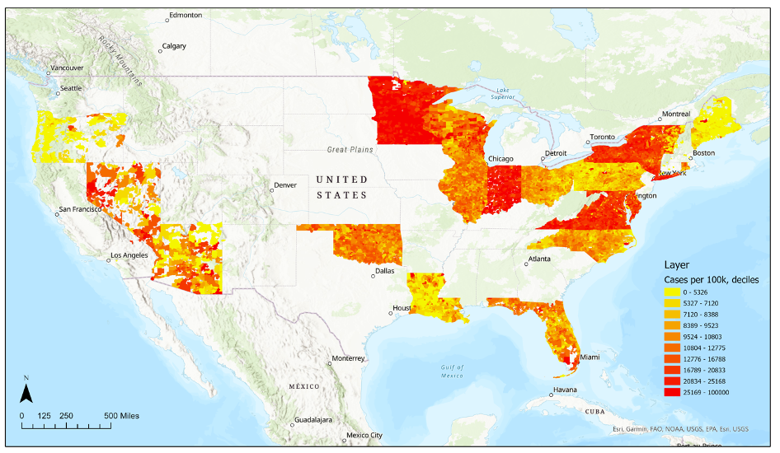
COVID cases per 100,000 population from 2020-2022

Slide 5
COVID-19 burden varies across US neighborhoods!
Why… susceptibility of residents? built environments?

Slide 6
Aims
Characterize business types in Wisconsin according to their hypothesized risk for respiratory pathogen transmission
Examine the association between neighborhood-level average transmission risk based on business types and COVID-19 cases across Wisconsin.
Explore whether or not associations shift when incorporating neighborhood-level social factors

Slide 7
Why Wisconsin?
Most complete COVID-19 case count data
Daily
Census-tract
Confirmed and probable cases
Include tests
Had decent variability among neighborhood case counts
Not all high or low
CONEP found Wisconsin did not have robust relationship between SES and COVID cases
Does business distribution provide insight into relationship?

Slide 8
Methods

Slide 9
Business categorizations
Created a score to identify high-risk business types for respiratory pathogen transmission in Wisconsin neighborhoods based on two factors:
Congregation
Contact
Categorized 67 business types with count data at the census tract-level in NANDA in 2017
Counts from National Establishment Time Series Database (NETS)

Slide 10
Congregation & contact scores
Congregation
Calculated the average number of visits in a business type
  Advan Research mobile phone data
Created quartiles for average number of visits across all business types in Wisconsin
  1- lowest quartile
  2
  3
  4- high quartile
Contact
Conceptualized the most prevalent interaction occurring in a business type
  3-step characterization
  CDC COVID-19 guidelines
    1- no contact
      Never ≤6 ft of someone
    2- non-conversational contact
      ≤6 ft of someone but did not speak
    3- conversational contact
      ≤6ft of someone and spoke
    4- physical contact
      Touched someone
Summed congregation and contact scores to get overall transmission risk

Slide 11
Neighborhood-level average transmission risk based on business types
Mapped the scores for each business type to their corresponding count in Wisconsin census tracts
Averaged transmission risk scores across business types for each census tract
4 businesses in a tract
Business A = 2
Business B = 1
Business C = 1
Mapped values (count * score)
Business A = 14
Business B = 3
Business C = 5
Average transmission score for tract
(14+3+5)/4 = 5.5
Transmission scores
Business A = 7
Business B = 3
Business C = 5

Slide 12
Average transmission risk characteristics across Wisconsin neighborhoods
Business type score range: 2-8
Average score for a neighborhood range: 4.2-6.7
Mean: 5.10
Median: 5.09
Standard Deviation: 0.19

Slide 13
Statistical analyses
Negative binomial models assessed the associations between neighborhood-level COVID cases and average transmission risk from business types, adjusting for neighborhood social factors from NANDA
Model 1
  cases = average transmission risk + population density
Model 2
  cases = average transmission risk + population density + disadvantage
Model 3
  cases = average transmission risk + population density + affluence

Slide 14
Results & Conclusions
Notes:
We just began modeling the relationship between types of businesses in neighborhoods and COVID cases, so these are preliminary

Slide 15
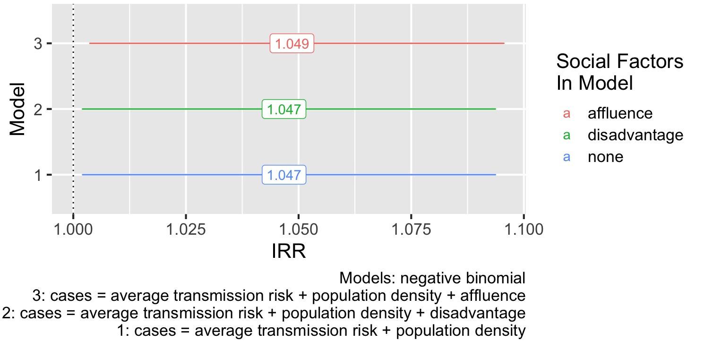
Incident rate ratios (IRRs) for neighborhood average transmission risk and COVID cases
Notes:
In Wisconsin census tracts, a 1-point increase in average transmission risk is associated with a 4.9% increase in COVID cases, adjusting for population density
This result is statistically significant and doesn’t change much when including the social factors disadvantage and affluence into the model

Slide 16
Findings & future directions
Findings
Evidence that the distribution of businesses across Wisconsin neighborhoods is associated with COVID cases
  Increased transmission risk based on business types and increased case counts
Relationship was not attenuated by neighborhood affluence or disadvantage
Future Directions
Improve categorizations (i.e., add time spent in business types)
Analyze other 20 states with COVID data
Identify high risk businesses and corresponding neighborhoods
Conduct in-depth reviews to understand why areas are high risk
Disseminate information to health departments

Slide 17
We must explore the mechanisms by which neighborhoods may face increased respiratory pathogen burden, like their business distributions, to understand how to mitigate infectious disease disparities!

Slide 18
Acknowledgements
Thank you to my co-authors, mentors, and lab members for their contributions to this project:
Grace Noppert, John Kubale, Kate Duchowny, Chihua Li, Lauren MacConnachie, Rohini Perera, Lindsay Gypin, Robert Melendez, and Philippa Clarke
Funding: NIA-funded Network on Life Course Dynamics and Disparities in the 21st Century (R24 AG045061) NINR / NIMHD U01 NR020556 (MPI Noppert & Clarke)

Slide 19
Thank you!
Questions?
Andrew Hoover
aphoover@umich.edu

