Slide 1



How the Neighborhood Environment Shapes COVID-19 Burden: Early Findings from the COVID Neighborhood Project
Andrew Hoover¹, Philippa Clarke¹, Sonia Hegde², John Kubale¹, Robert Melendez¹, Kate Duchowny¹, & Grace Noppert¹
1) University of Michigan 2) Johns Hopkins University

Slide 2
U.S. COVID-19 Burden Is Not Equal
Demographics
  Racial and ethnic minorities and low-income populations are known to have higher COVID-19 case and death rates.
Location
  Studies have shown disadvantaged counties tend to have worse COVID-19 related outcomes.
COVID-19 burden isn’t just health related!
  Social and economic impacts too.

Slide 3
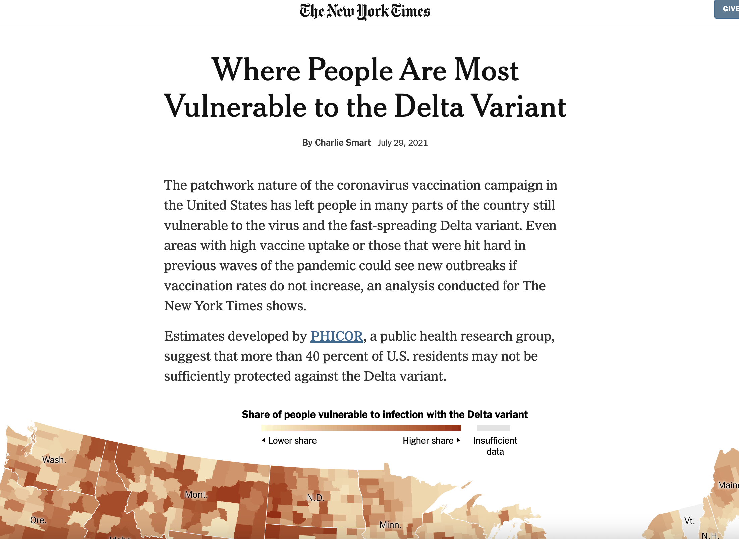
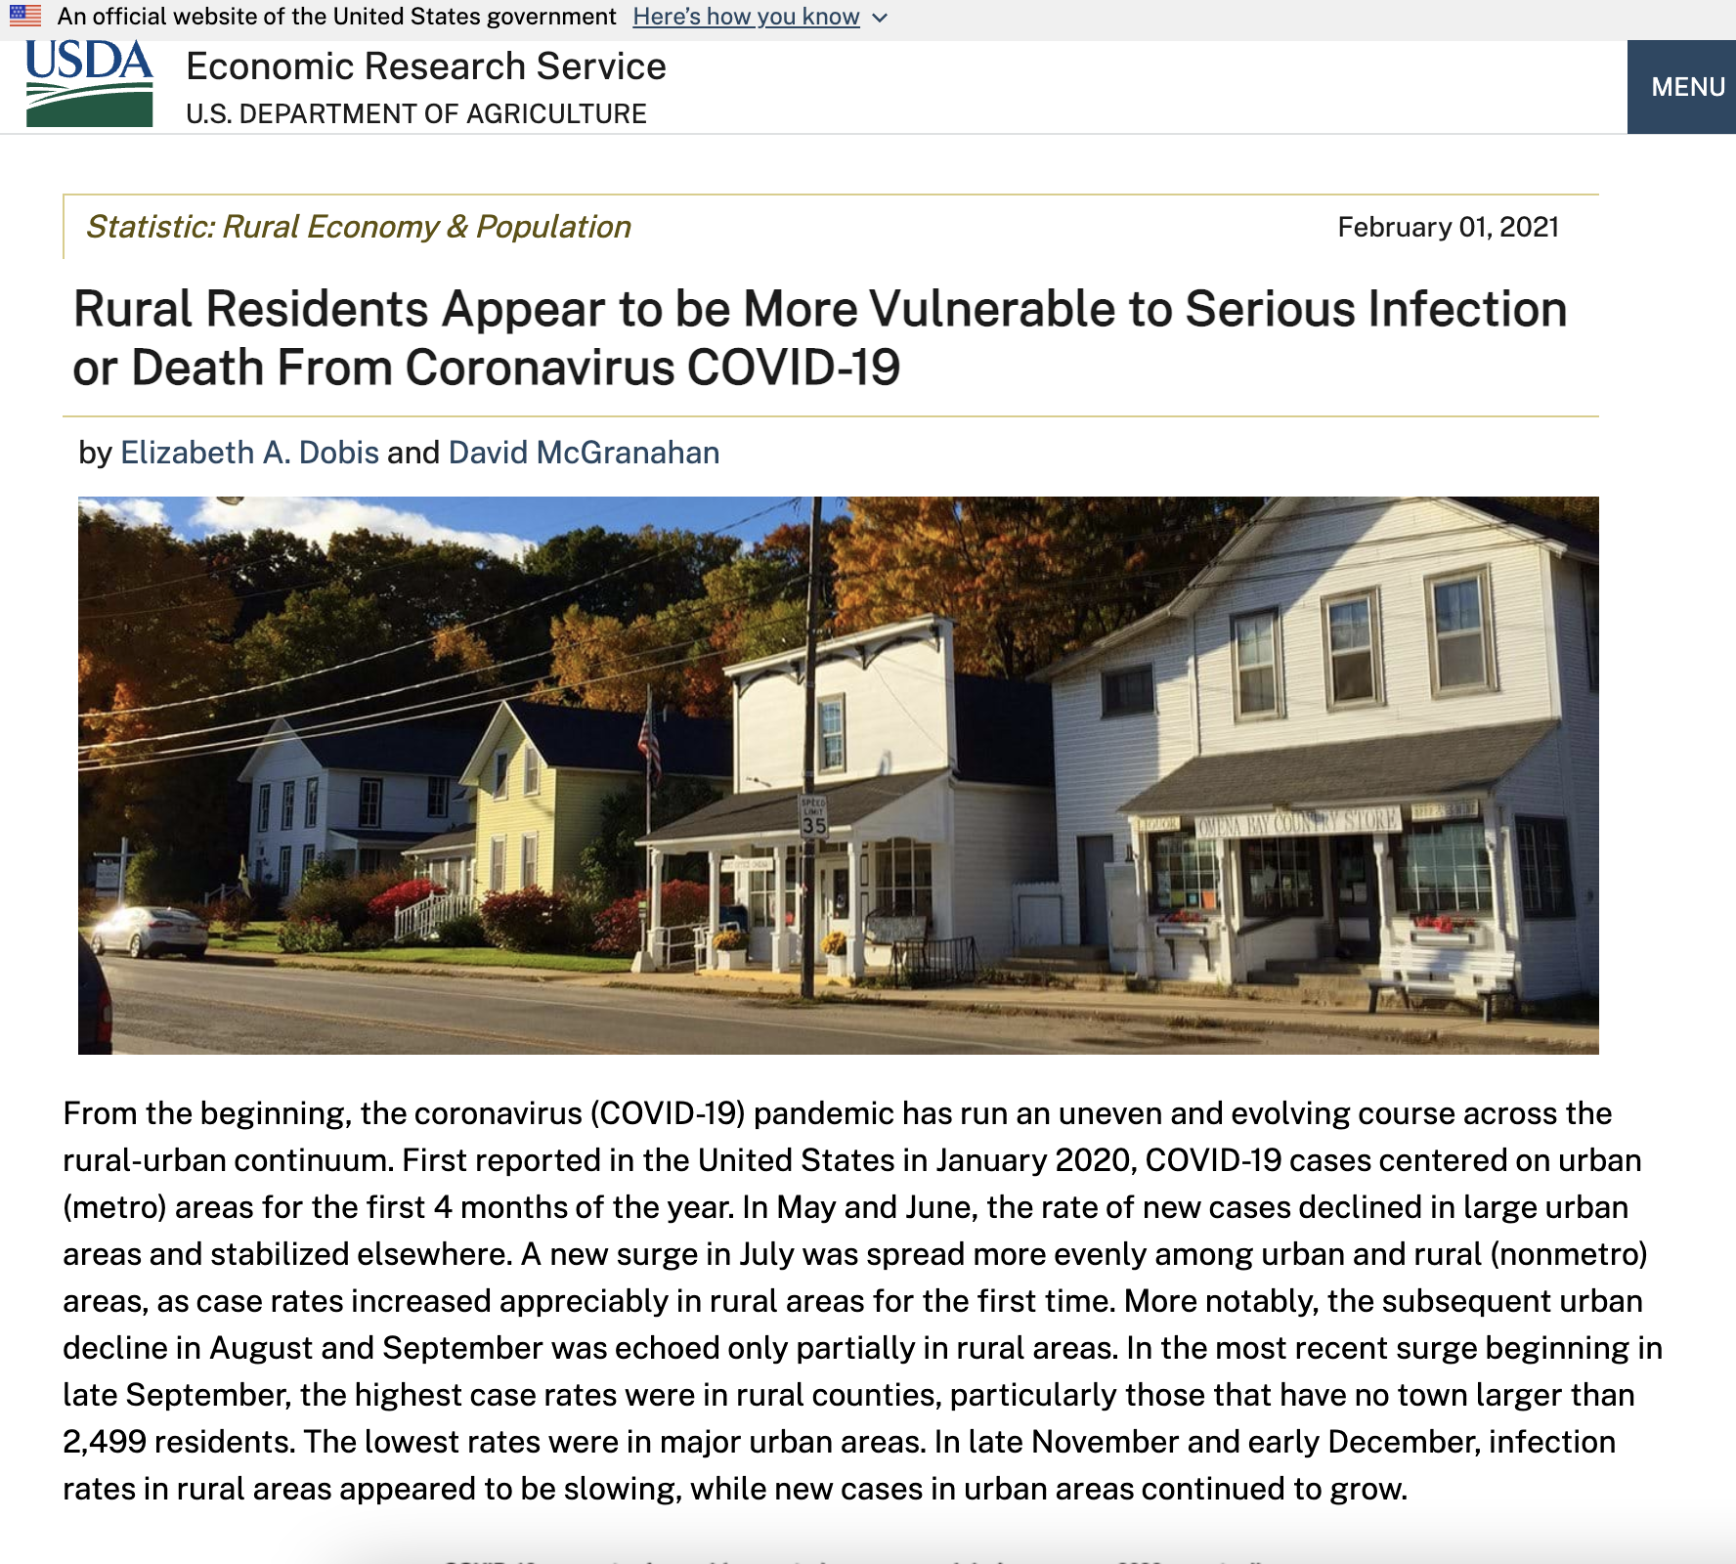
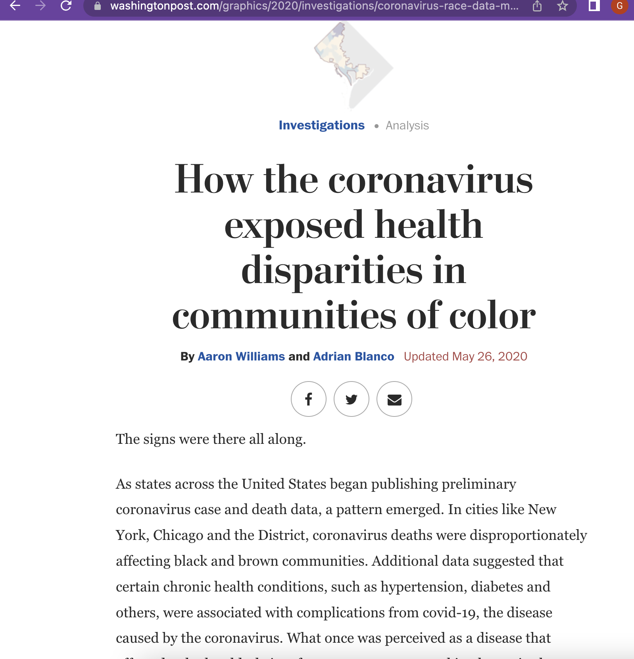

Slide 4
Source | Project Name | Spatial Resolution | Geographic Area
CDC | COVID-19 Data Tracker | County | U.S.
Johns Hopkins | Coronavirus Resource Center | County | U.S.
The Atlantic | The COVID Tracking Project | State | U.S.
New York Times | Coronavirus in the U.S.: Latest Map and Case Count | County | U.S.
Country
State
County
Zip code
Census tract
Census block group
Census block

Slide 5
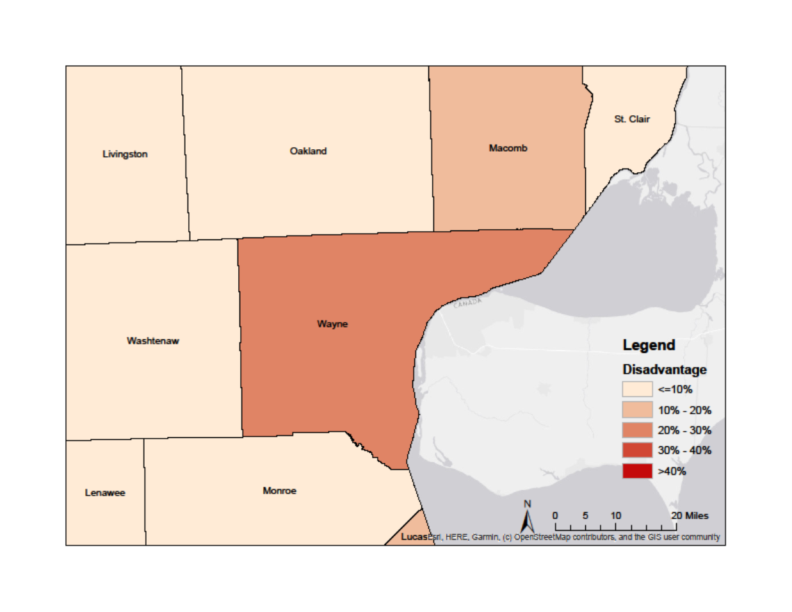
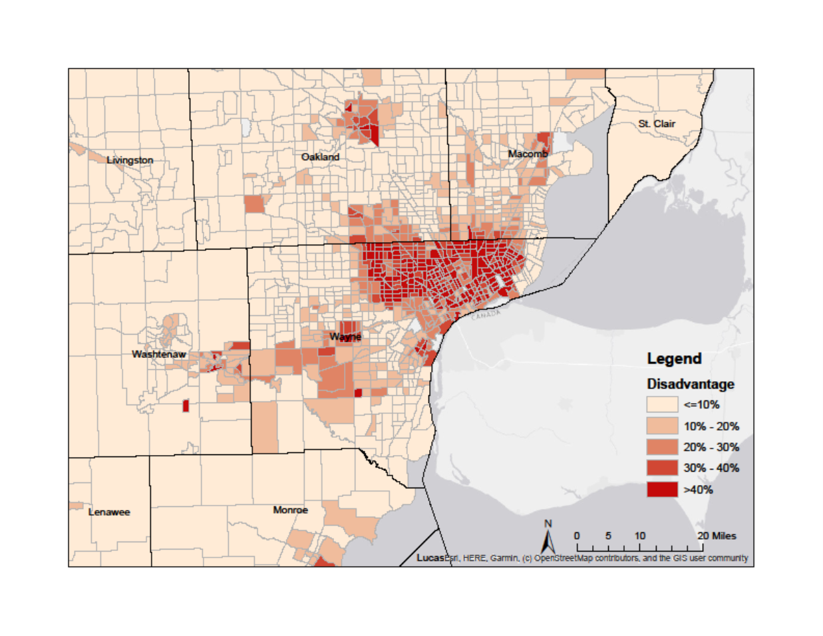
Differences In Spatial Resolution
Southeast Michigan disadvantage at the county-level
Southeast Michigan disadvantage at the census tract-level

Slide 6
County-level data is not enough!

Slide 7
83
989
2,813
Michigan counties
Michigan zip code tabulation areas
Michigan census tracts

Slide 8

COVID NEIGHBORHOOD PROJECT (CONEP)
Build a nationwide COVID-19 database at the census tract or zip code-level! For this project we:
Contacted every health department in the U.S.
Collected spatially-referenced case data for 21 states
Linked with neighborhood data from the National Neighborhood Data Archive.
  Disadvantage, affluence, and population density

Slide 9
Data Collection Was Difficult
Explore State Health Department Website
Data Publicly Available
Data Not Publicly Available
Averaged 1-4 Months Per State
Download Data
Apply for Data Through Data Portal
Email/Call State Epidemiologist or Data Manager
Complete Data Request Form and/or Sharing Agreement
Complete Secure Data Transfer
Limited based on state privacy regulations, time constraints, and data collection capabilities.

Slide 10
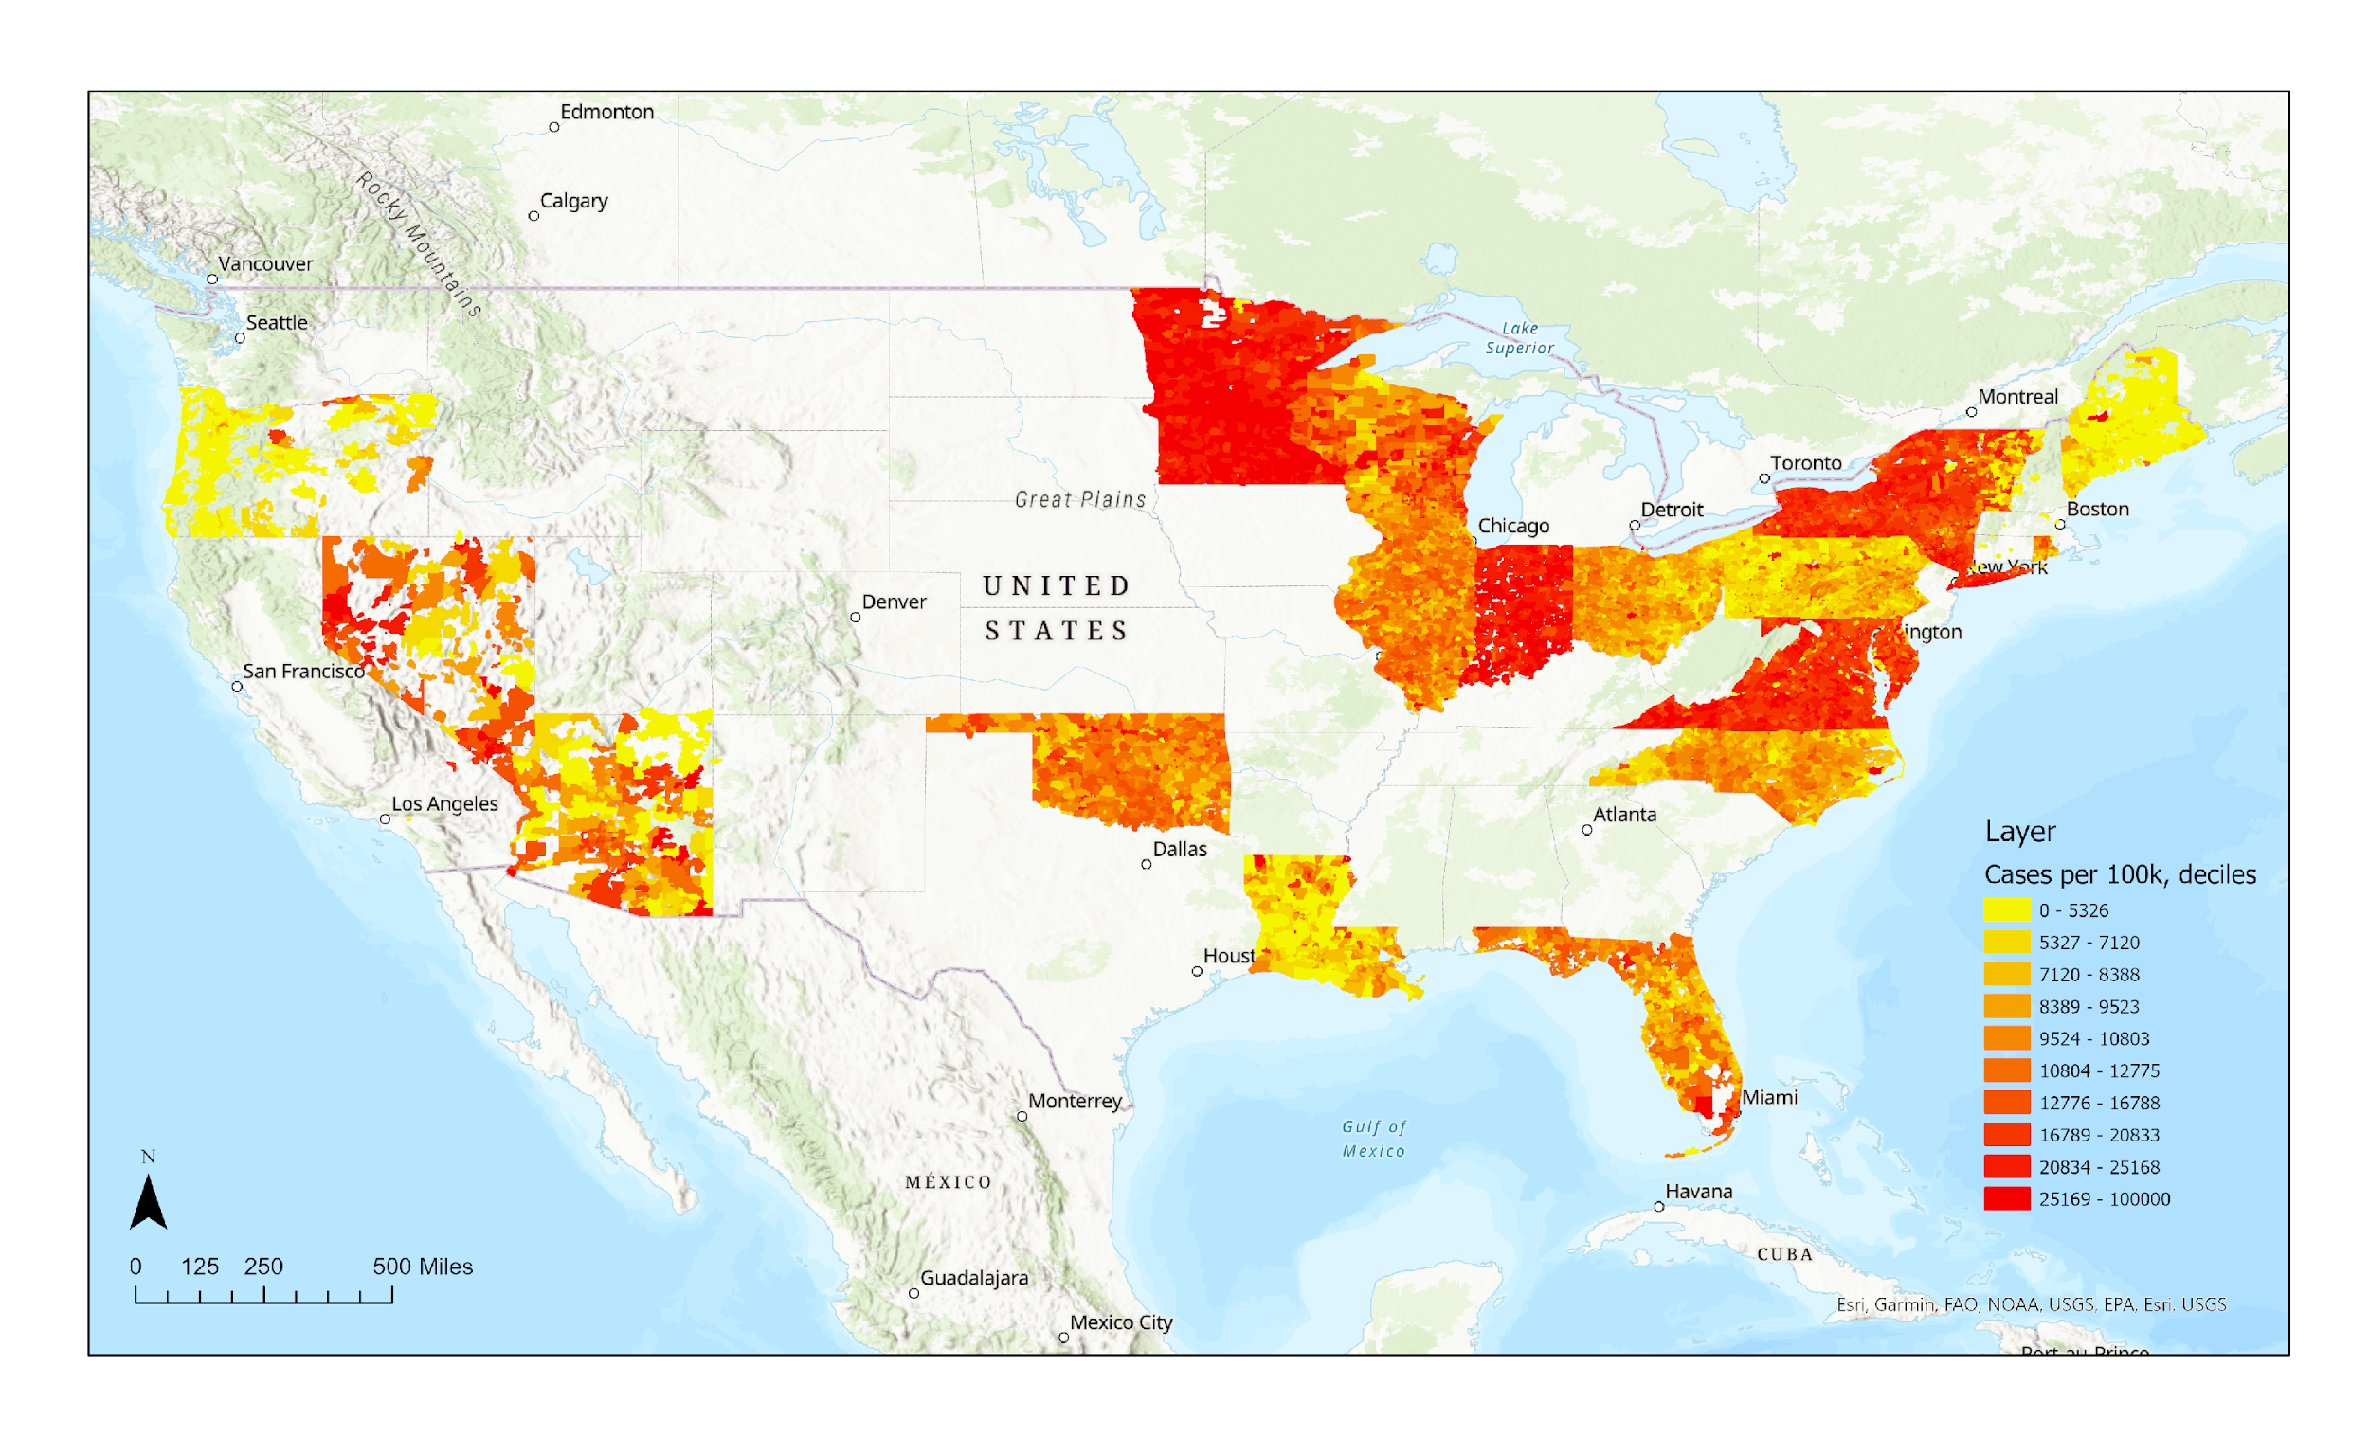
21 states: neighborhood deciles of cases per 100,000 persons, 2020-2022.

Slide 11
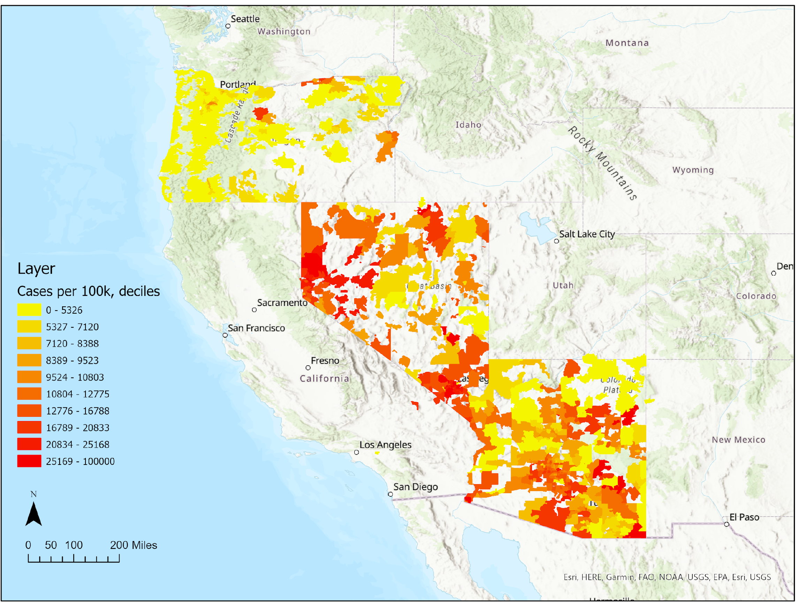
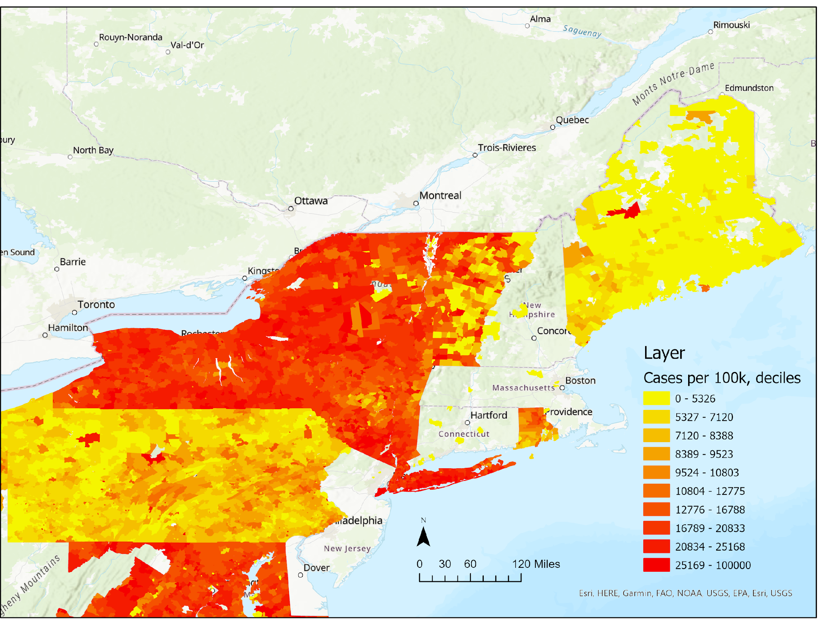
Variation in the neighborhood distribution of COVID-19 by states.

Slide 12
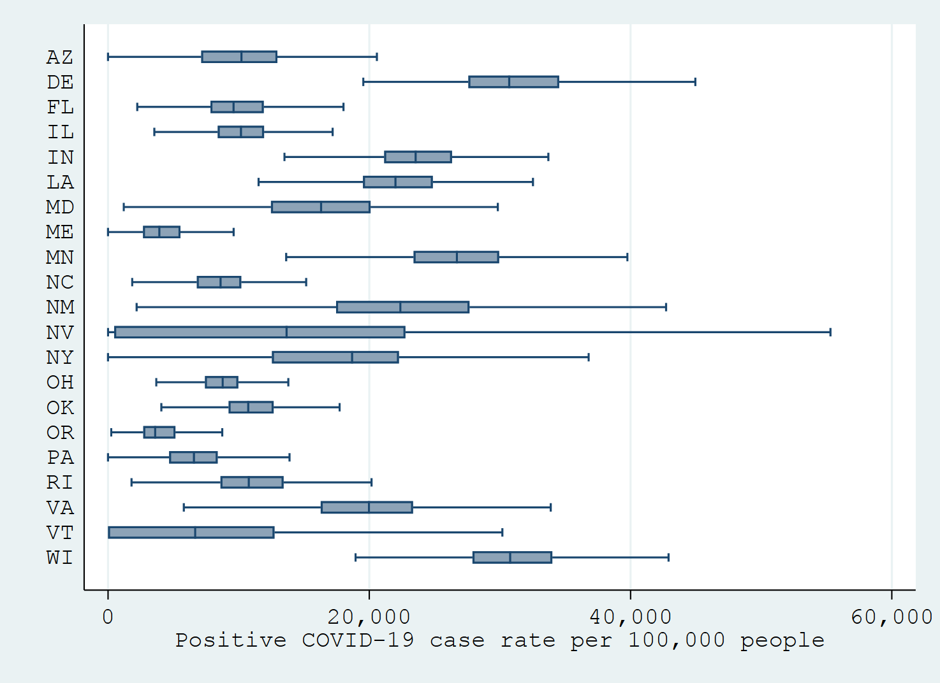
Variation in the neighborhood distribution of COVID-19 by states.

Slide 13
Associations between neighborhood disadvantage & neighborhood COVID burden.
Results from Poisson regression models estimating the incidence rate ratio. Note: neighborhood population is used as the offset term.
 | Maryland |  | Oregon |  | Indiana |  | Nevada
Disadvantage | Model 1 | Model 2 | Model 1 | Model 2 | Model 1 | Model 2 | Model 1 | Model 2
Q1 (ref)
Q2 | 1.17*** [1.17-1.18] | 1.17*** [1.16-1.18] | 1.19*** [1.17-1.21] | 1.17*** [1.15-1.19] | .96*** [.96-.97] | .96*** [.95-.96] | .72*** [.72-.73] | .87*** [.86-.88]
Q3 | 1.25*** [1.24-1.26] | 1.25*** [1.24-1.26] | 1.37*** [1.35-1.4] | 1.35*** [1.33-1.38] | .95*** [.94-.95] | .95*** [.94-.95] | .77*** [.76-.77] | .8*** [.79-.81]
Q4 | 1.41*** [1.4-1.42] | 1.41*** [1.4-1.42] | 1.94*** [1.91-1.98] | 1.9*** [1.86-1.93] | .92*** [.92-.93] | .94*** [.93-.94] | .51*** [.51-.52] | .54*** [.54-.55]
Model 1 controls for neighborhood population density. Model 2 controls for neighborhood population density + county-level political partisanship.

Slide 14
Associations between neighborhood affluence & neighborhood COVID burden.
Results from Poisson regression models estimating the incidence rate ratio. Note: neighborhood population is used as the offset term.
 | Arizona |  | Oregon |  | Indiana |  | Nevada
Affluence | Model 1 | Model 2 | Model 1 | Model 2 | Model 1 | Model 2 | Model 1 | Model 2
Q1 (ref)
Q2 | .88*** [.87-.88] | .88*** [.88-.89] | .75*** [.74-.76] | .76*** [.75-.77] | 1.09*** [1.08-1.09] | 1.06*** [1.05-1.07] | 1.48*** [1.47-1.49] | 1.4*** [1.39-1.41]
Q3 | .74*** [.73-.74] | .74*** [.73-.74] | .74*** [.73-.75] | .76*** [.75-.77] | 1.07*** [1.06-1.07] | 1.05*** [1.04-1.05] | 1.4*** [1.39-1.41] | 1.63*** [1.62-1.64]
Q4 | .72*** [.72-.73] | .72*** [.71-.72] | .52*** [.51-.53] | .53*** [.52-.54] | 1.16*** [1.16-1.17] | 1.16*** [1.15-1.16] | 2.09*** [2.08-2.11] | 1.93*** [1.91-1.94]
Model 1 controls for neighborhood population density. Model 2 controls for neighborhood population density + county-level political partisanship.

Slide 15
Conclusions
There is no one-size-fits-all for the neighborhood distribution of COVID-19 in states!
Fine spatial-resolution data must be available and more accessible to public health professionals and researchers so that they can:
  Understand COVID-19 burden in local communities.
  Understand how they will be impacted by COVID-19 long-term.

Slide 16
Better data is key

Slide 17
Implications
Finer Geographic Data for COVID-19
Effective Allocation of Health Resources
More Funding toward Local Data Surveillance and Infrastructure
Better Understanding of Where COVID-19 Burden Is Highest
Improved Health Outcomes
Less Missing Geographic Data for COVID-19
Robust Research to Explain Distribution of COVID-19 Burden

Slide 18
Acknowledgements
Thank you to my co-authors, mentors, and lab members for their contributions to this project:
  Grace Noppert, Kate Duchowny, Philippa Clarke, Sonia Hegde, John Kubale, Robert Melendez, Lauren MacConnachie, Yuelin He, Sasha Aleksandra Fredricka, Timothy Nagel, & Geetika Raghavaraju
Funding: NIA-funded Network on Life Course Dynamics and Disparities in the 21st Century (R24 AG045061) NINR / NIMHD U01 NR020556 (MPI Noppert & Clarke)

Slide 19

Thanks!
Any questions ?
Get in touch!
Andrew Hoover
@andrew_hooverr
aphoover@umich.edu

