Slide 1


Associations between PFAS perceptions and consumer behaviors across Michigan
Andrew Hoover | March 26, 2024

Slide 2
Seminar Structure
1
Background & Aims
2
Methods
3
Results
4
Conclusions

Slide 3
1
Background & Aims

Slide 4
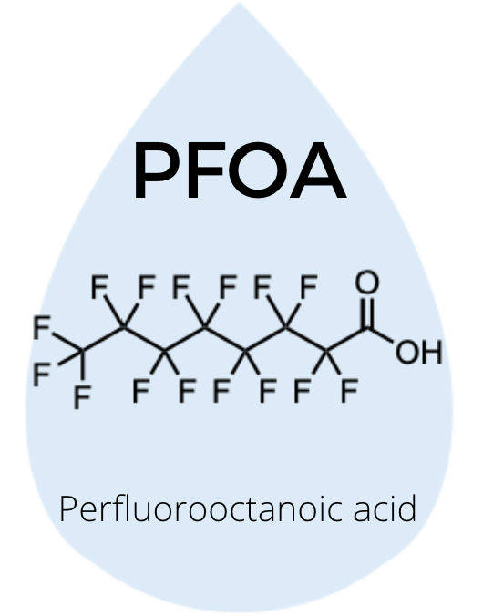
What are PFAS?
Per- and polyfluoroalkyl substances (PFAS) a.k.a. forever chemicals
  Family of chemicals
    PFOA, PFOS, PFNA…
Widely used in industry
  Repel water, grease, and other liquids
Don’t degrade easily in the environment
Stay in the body over time
  In ~97% of Americans
(NIEHS, 2024)
(UNC, n.d.)

Slide 5
~9,000 PFAS in 2021
~15,000 PFAS now
(Hammel et al., 2022)
(NIEHS, 2024)
Notes:
Increase due to…
Usefulness
Increase in government activity to ban PFAS chemicals

Slide 6
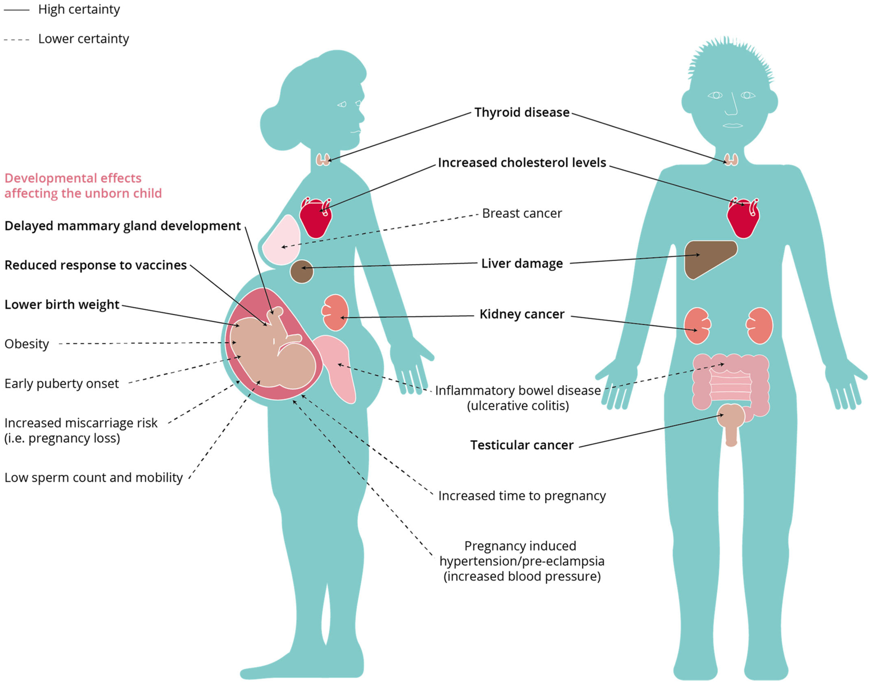
PFAS Health Outcomes
(Fenton et al., 2021)
Notes:
Psychosocial effects too

Slide 7
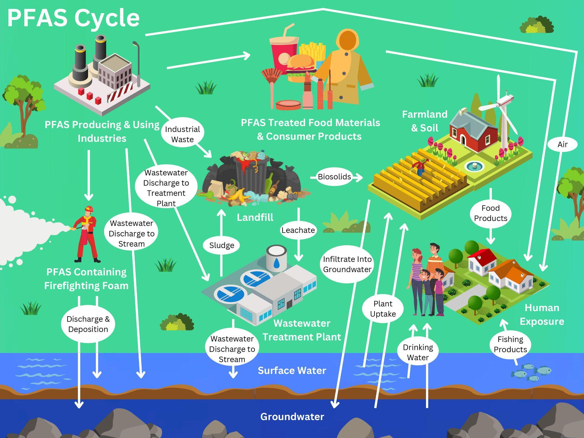
(Avenue et al., 2023)
(Sunderland et al., 2019)
Notes:
Communities of color exposed at higher rates due to location of PFAS producing and using industries

Slide 8
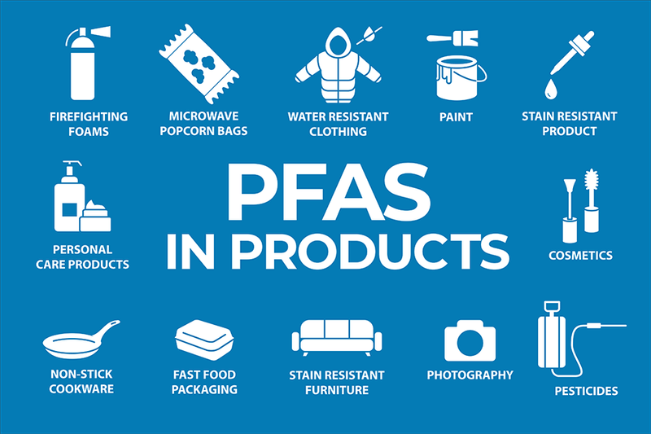
(FSAWWA, 2023)

Slide 9
PFAS Perceptions
Little insight in how perceptions influence behaviors
Not well known
  Growing concern on media
People are concerned about PFAS once hearing about them
Corporations can coerce communities into not seeking PFAS information
Most work has focused on perceptions in environmental justice communities
(Banwell et al., 2021)
(Tian et al., 2022)
(Wickham & Shriver, 2021)

Slide 10
Aims
Administer a pilot survey to Michigan residents and describe the associations between:
  Demographic factors and PFAS perceptions
  PFAS perceptions and PFAS-related consumer choices
Hypothesis: A finer understanding of PFAS fosters an increased risk perception and likelihood that one will engage in consumer behaviors to reduce PFAS exposure.

Slide 11
2
Methods

Slide 12





Study Population
University Students
Facebook Users
Ann Arbor
East Lansing/Lansing
Contacted 15 public universities in Michigan
5 surveyed students
  Graduate and undergraduate
2 received enough responses for analysis
Joined Facebook groups for 5 cities containing universities
  Approved if needed
5 participated
Dearborn and Detroit Combined for analyses
Houghton/Keweenaw County
Detroit/Metro Area

Slide 13
Survey Dissemination
1
2
3
Direct Email UM
Indirect Email MSU
Facebook Post
Email sent by me
Email sent by staff
Message posted in Facebook feeds
Occurred over October 2023
2 weeks; 1 follow up post for universities and 3 for Facebook

Slide 14
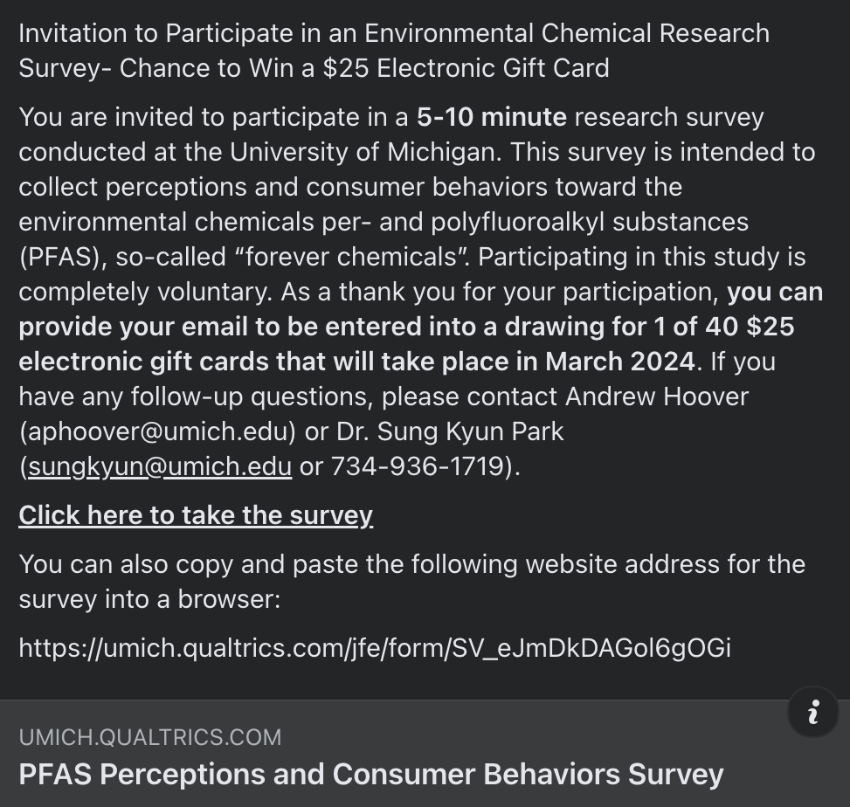
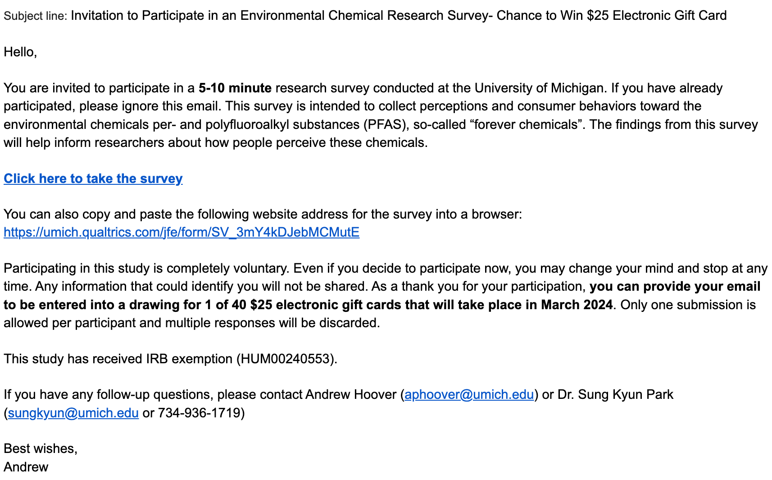

Slide 15
Survey

Slide 16

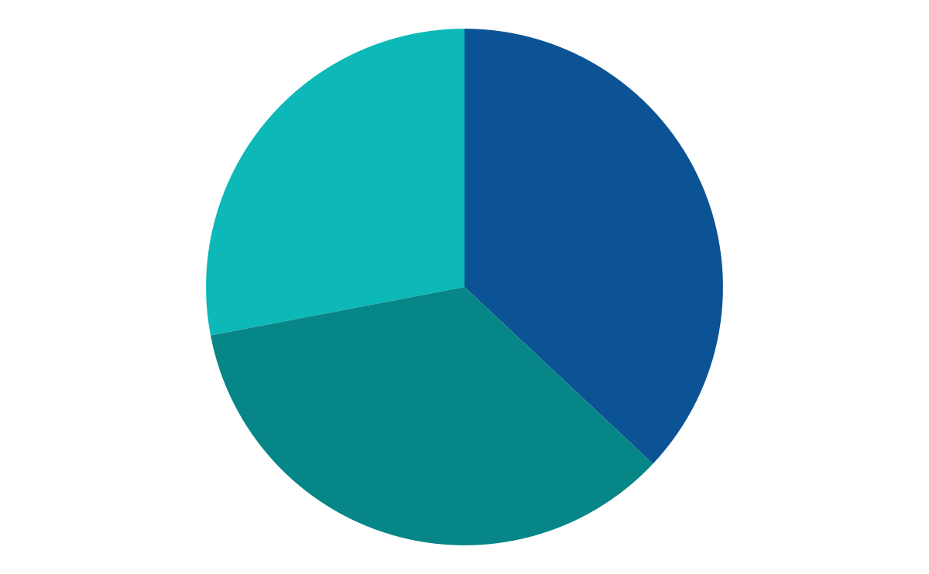
Summary
11
PFAS Perceptions
10
PFAS-related Consumer Behaviors
Median:
~5 minutes
8
Demographic Information
Compensation: Raffle for 60 $25 e-gift cards

Slide 17
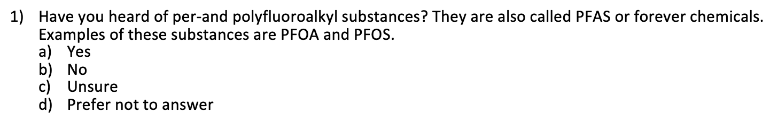
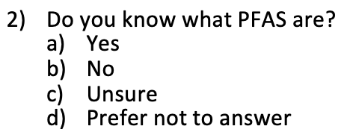
PFAS Perceptions Pt. 1
2 questions determined if people knew what PFAS were
  Following question wording based on this (believe vs think)

Slide 18
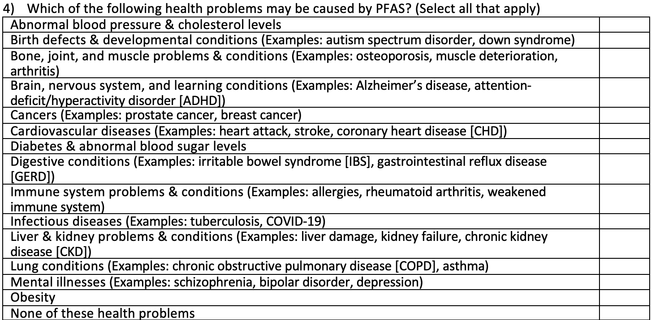
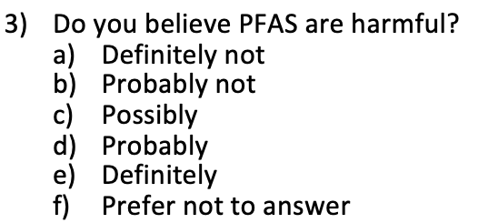
PFAS Perceptions Pt. 2
3 sets of questions about health outcomes of PFAS and what they are in
Likert Scale
Select all that apply
Notes:
Skip logic was incorporated here

Slide 19
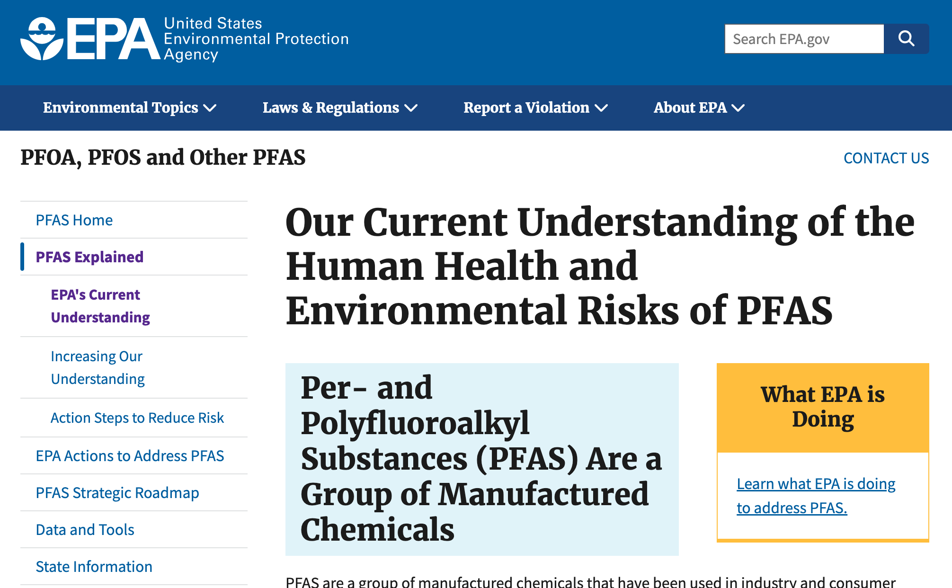
PFAS Perceptions Pt. 3
Responses graded based on EPA PFAS information
PFAS knowledge score (0-13)
  Higher score = higher knowledge about PFAS
Two other questions about information sources and reliability
Notes:
Information sources asked to people who knew what PFAS were

Slide 20
PFAS-related Consumer Behaviors
How often do you consider PFAS being in products when choosing one to buy?
  Never/rarely; sometimes; often/always
If a product said “PFAS free” on its label, would you be more likely to buy it?
  No; unsure; yes
Suppose a product without a “PFAS free” label costs $5. What is the highest price you would pay for a similar product with a “PFAS free” label?
  $5.01-$6.00; $6.01-$7.50; $7.51-$10.00; $10.01 or more; none
  Similar question for a $50 item

Slide 21
Demographic Information
1
Age
2
Gender
3
Race/Ethnicity
4
Education (In Facebook Groups)
5
Household Income (In Facebook Groups)
6
Location
7
Residential ZIP Code
8
Email (Optional)
Notes:
ZIP code used to filter out non-Michigan residents from drawing (not analyses)
Email used to send e-gift cards to raffle winners

Slide 22
Question Validation
1
2
Research Team
readable.com
?
?
4
3
Pilot Testing
QUAID
Notes:
Both are validated survey tools to help simplify the wording of questions

Slide 23
Statistical Analyses
1
2
3
Knowledge Score Distributions
Consumer Behavior Distributions
Logistic Regression Models for Knowledge Score and Consumer Behaviors
Covariates: knowing what PFAS are, age, gender, race/ethnicity, location, education (in Facebook models)
Smaller groups were collapsed in models

Slide 24
3
Results

Slide 25
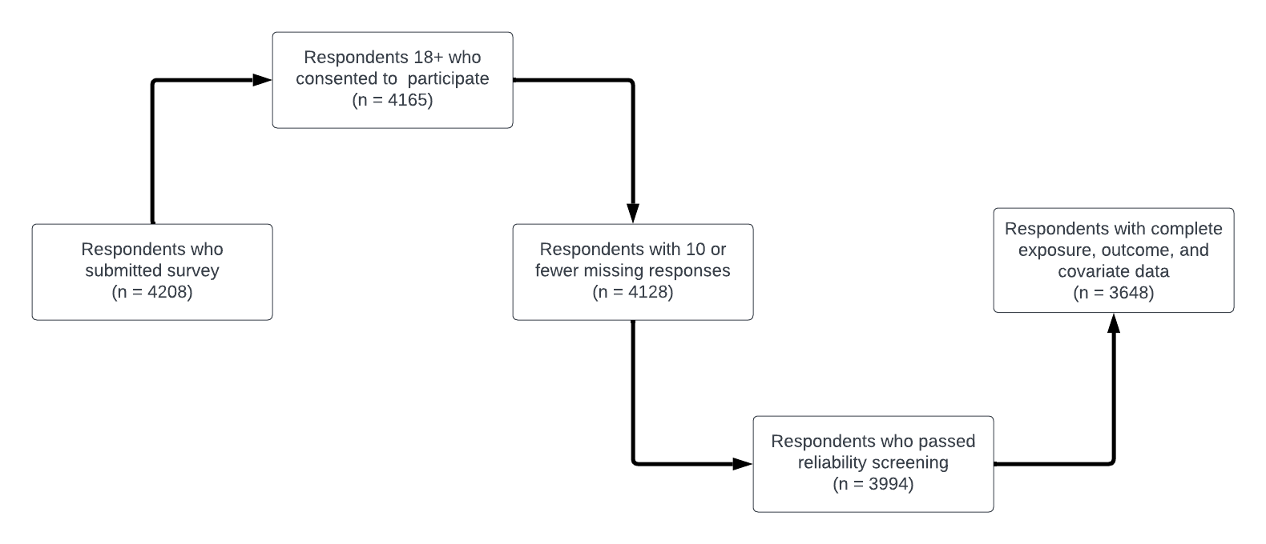
Responses
560 (13.3%) responses excluded from analyses

Slide 26
Reliability
Compared answers to 2 questions:
  Do you believe PFAS are harmful?
    Definitely not; Probably not; Possibly; Probably; Definitely; Prefer not to answer
  Do you believe PFAS are healthy?
    Definitely not; Probably not; Possibly; Probably; Definitely; Prefer not to answer
Removed those who were unsure if they’d heard of PFAS, but knew what they were

Slide 27
Knowledge Scores
Notes:
Mention speeding through the next slides

Slide 28
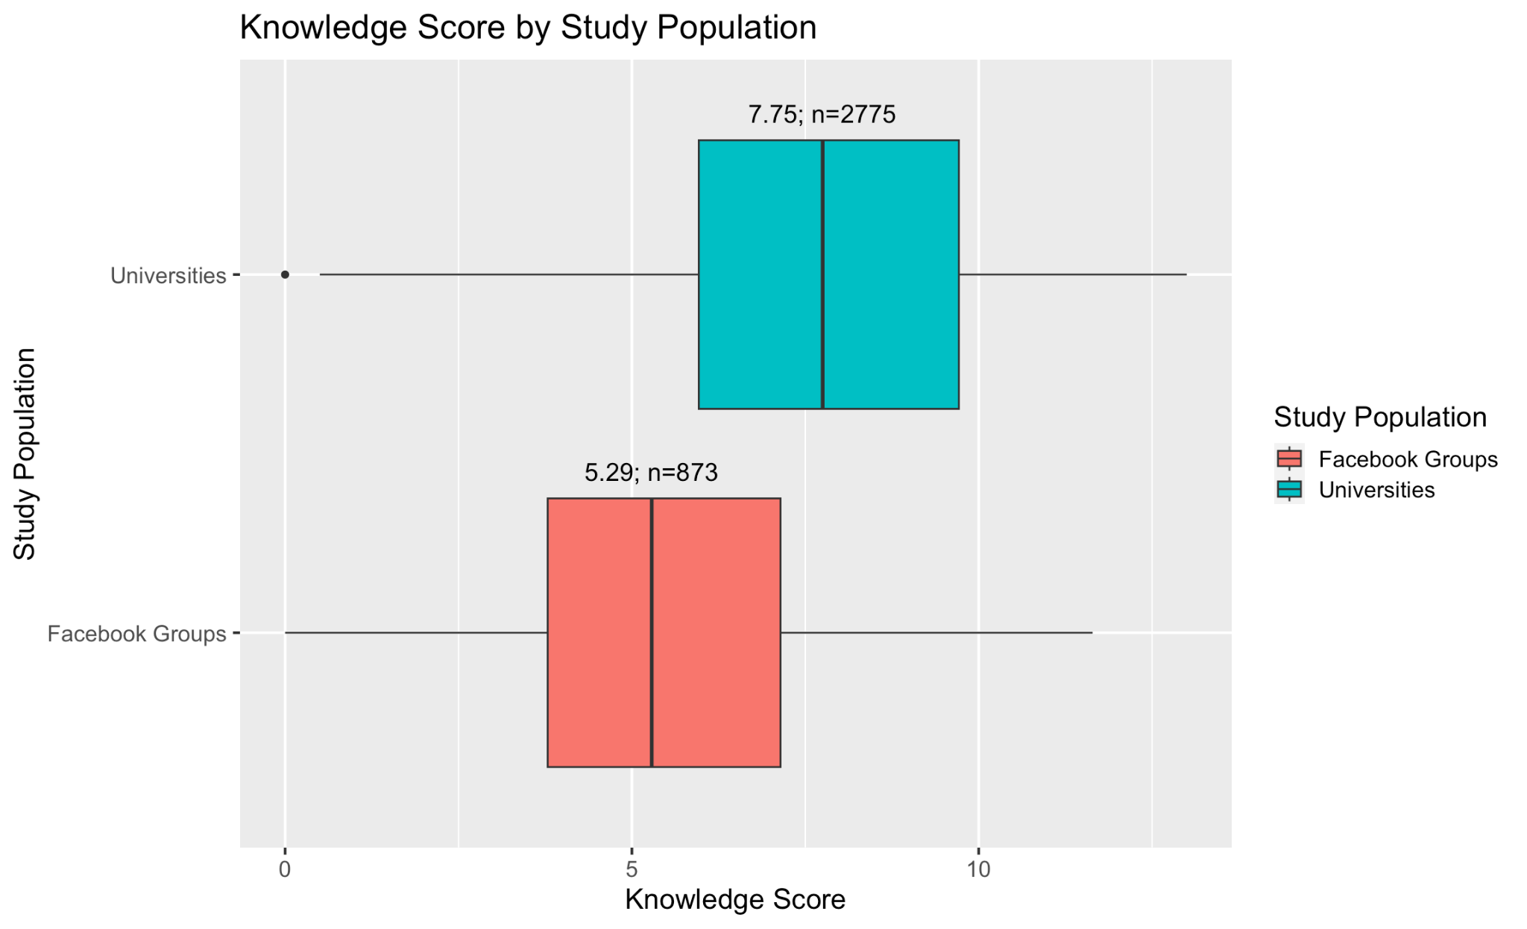
Knowledge Score by Study Population
Considered groups separately for analyses
Notes:
The number next to the sample size is the median for this slide and the following.

Slide 29
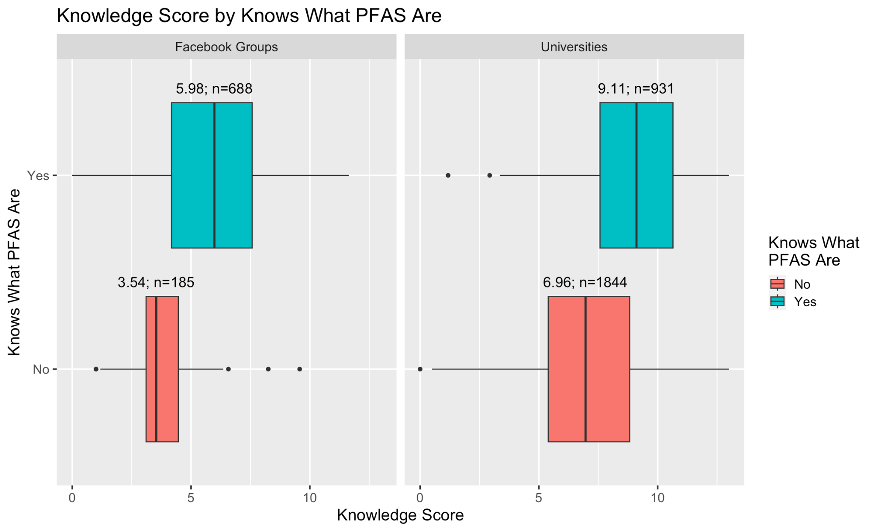
Knowledge Score by Knows What PFAS Are

Slide 30
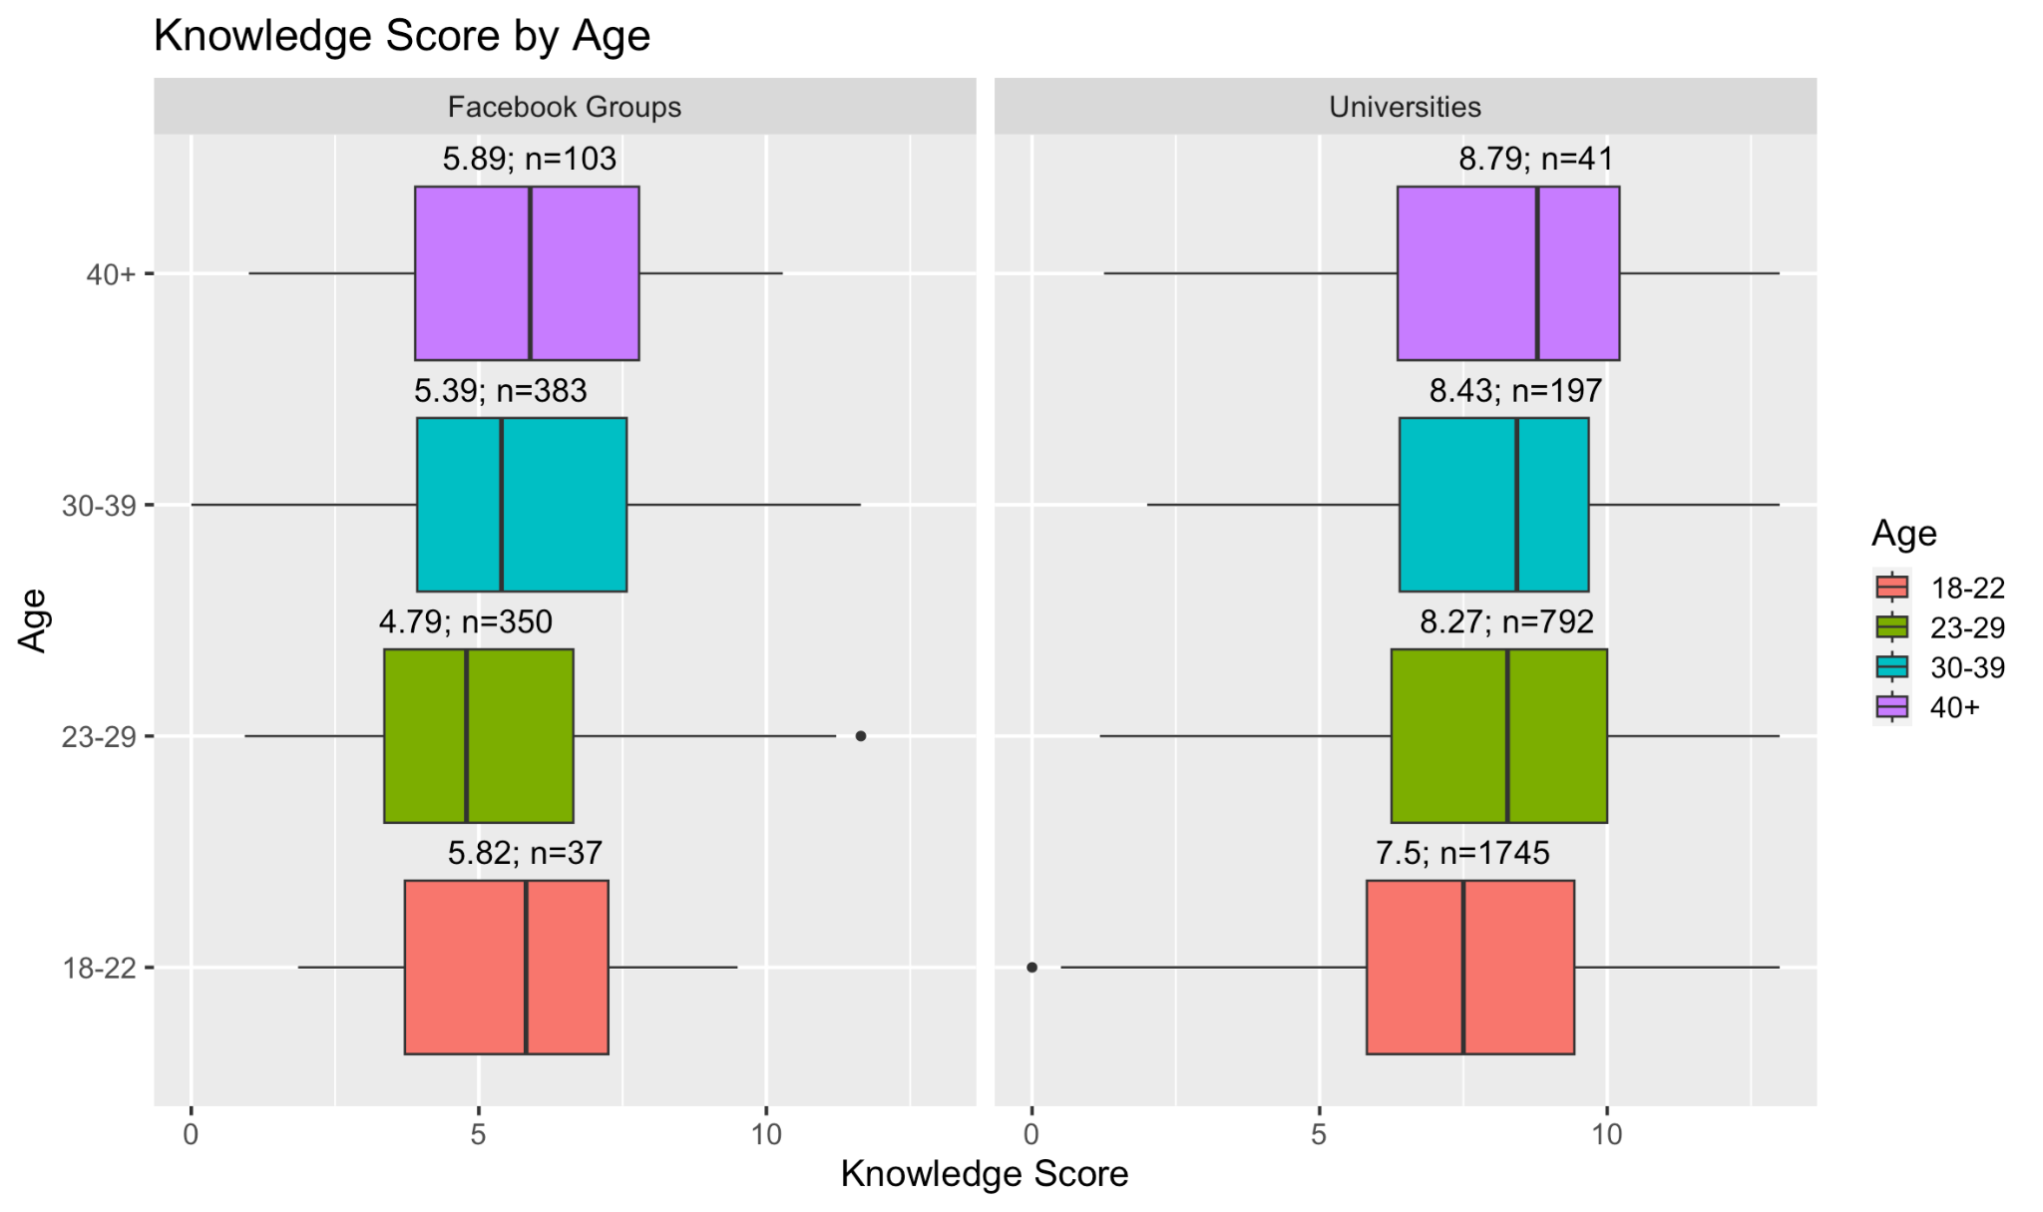
Knowledge Score by Age

Slide 31
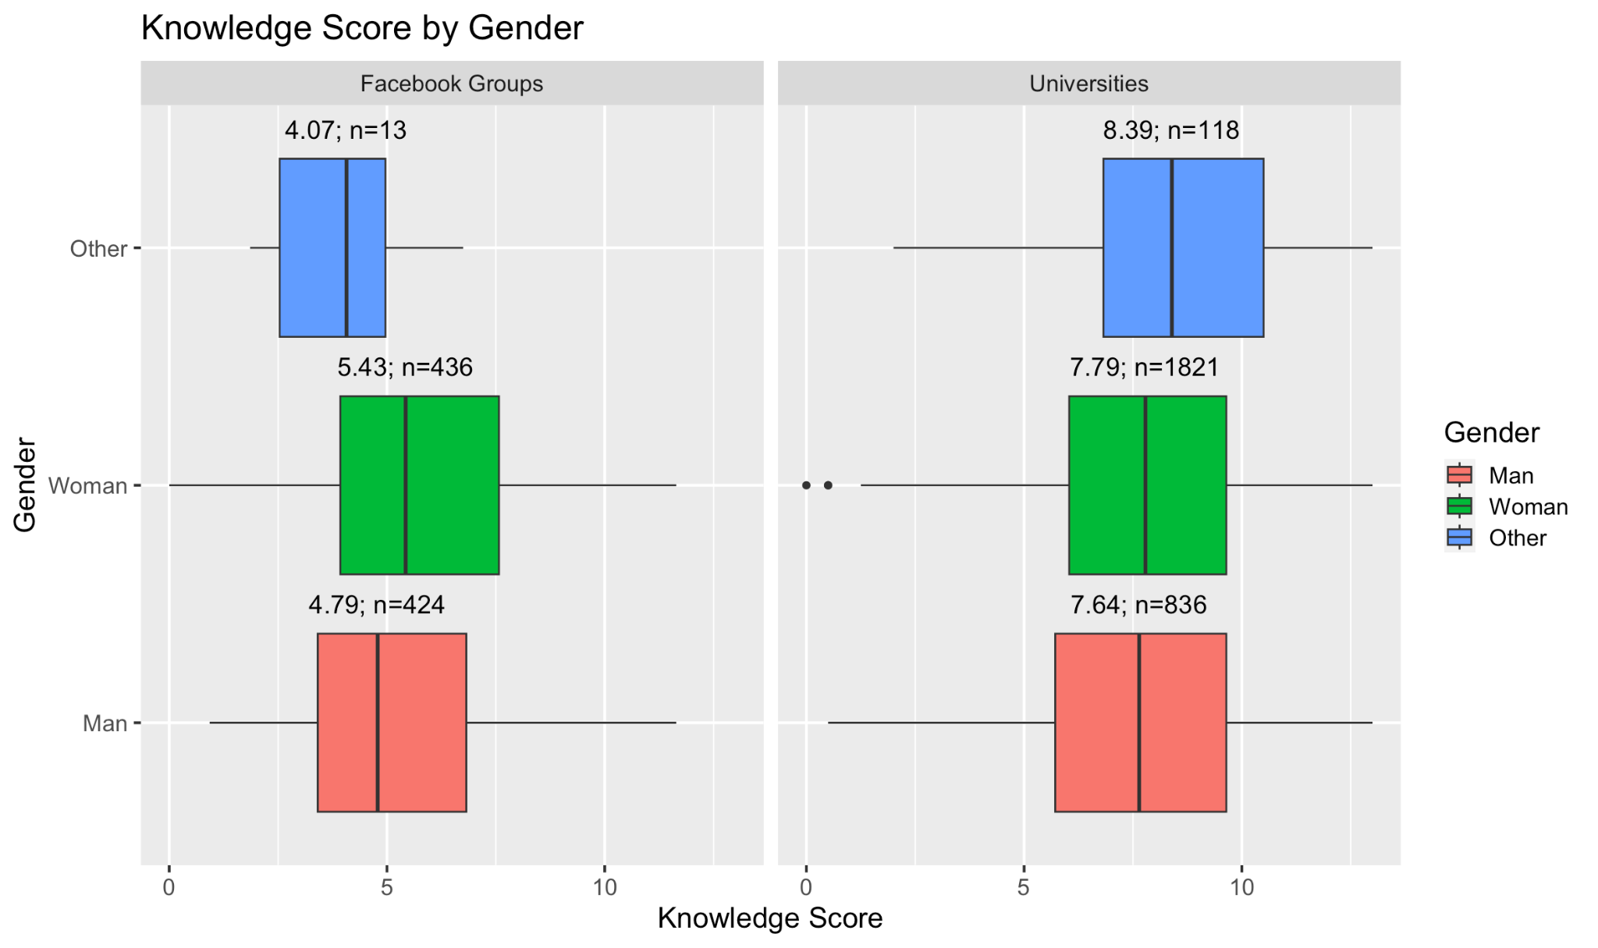
Knowledge Score by Gender

Slide 32
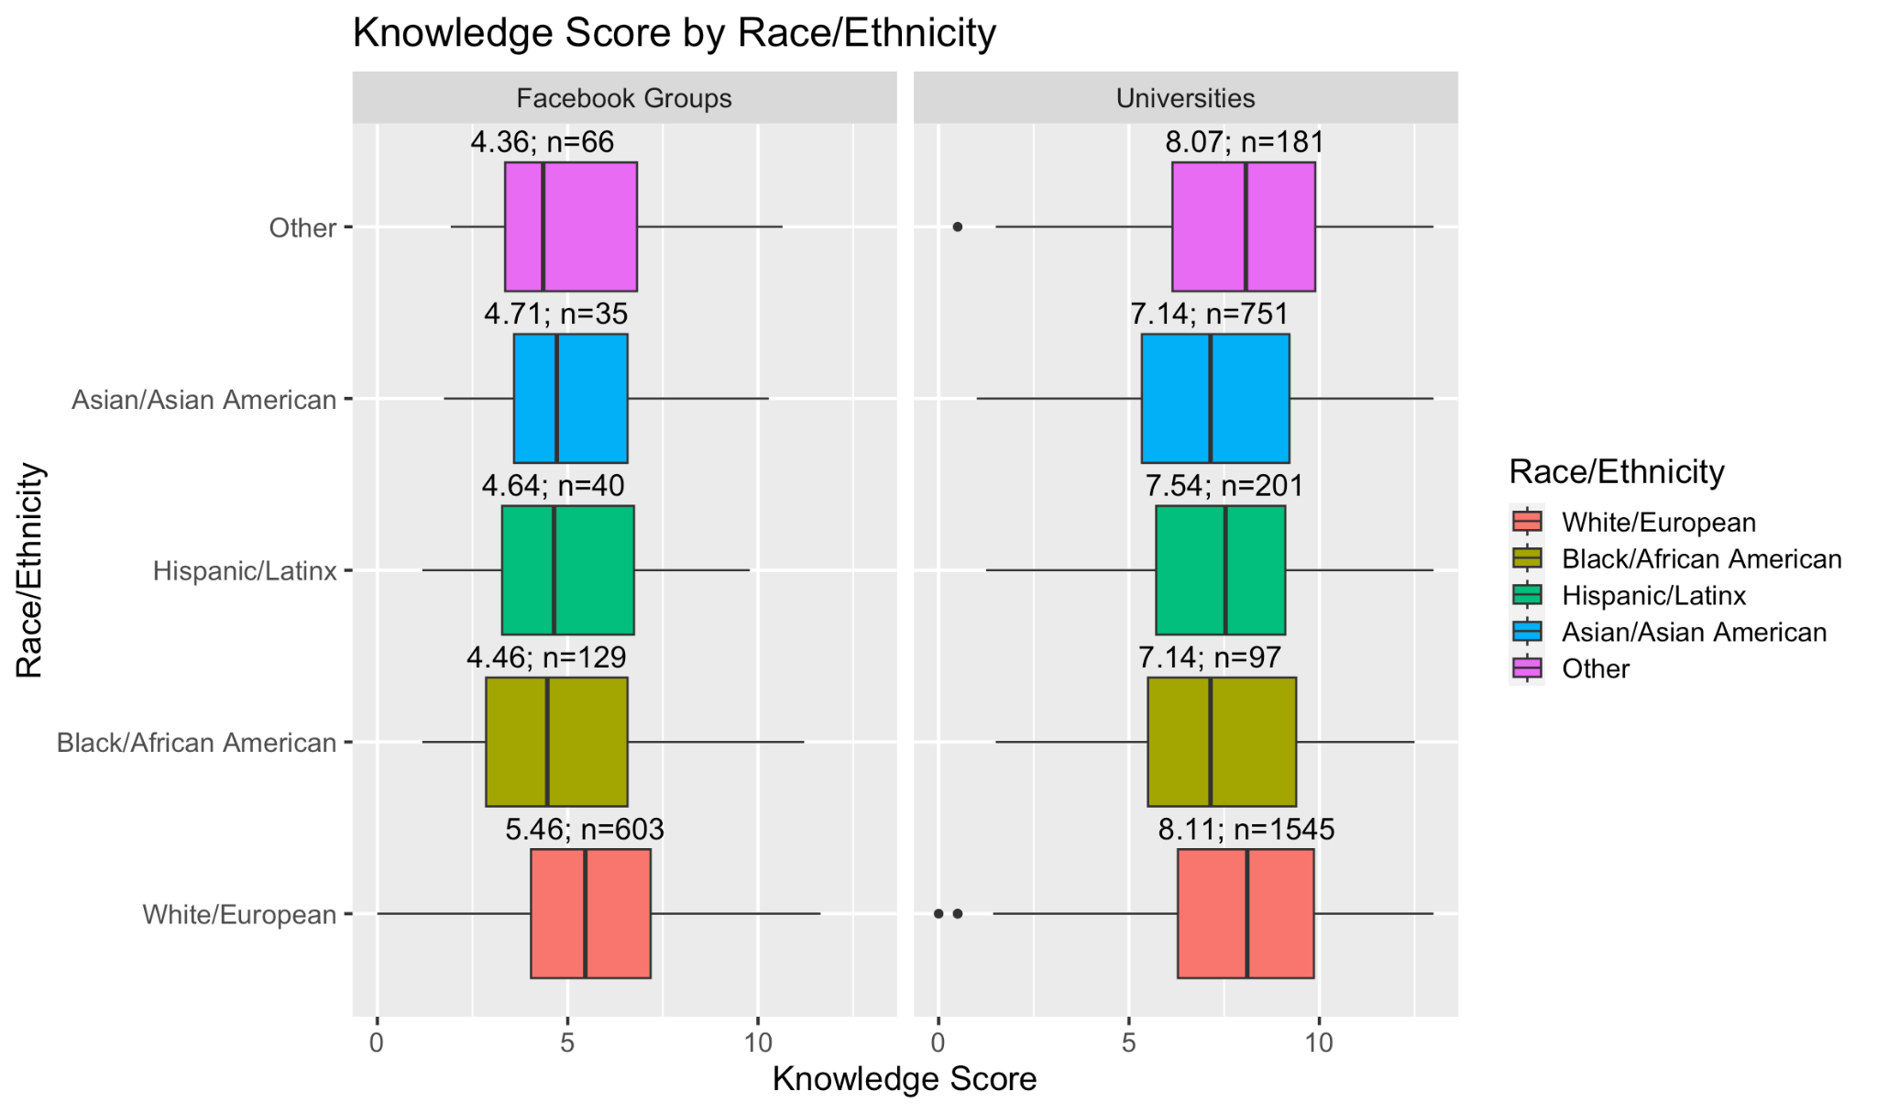
Knowledge Score by Race/Ethnicity

Slide 33
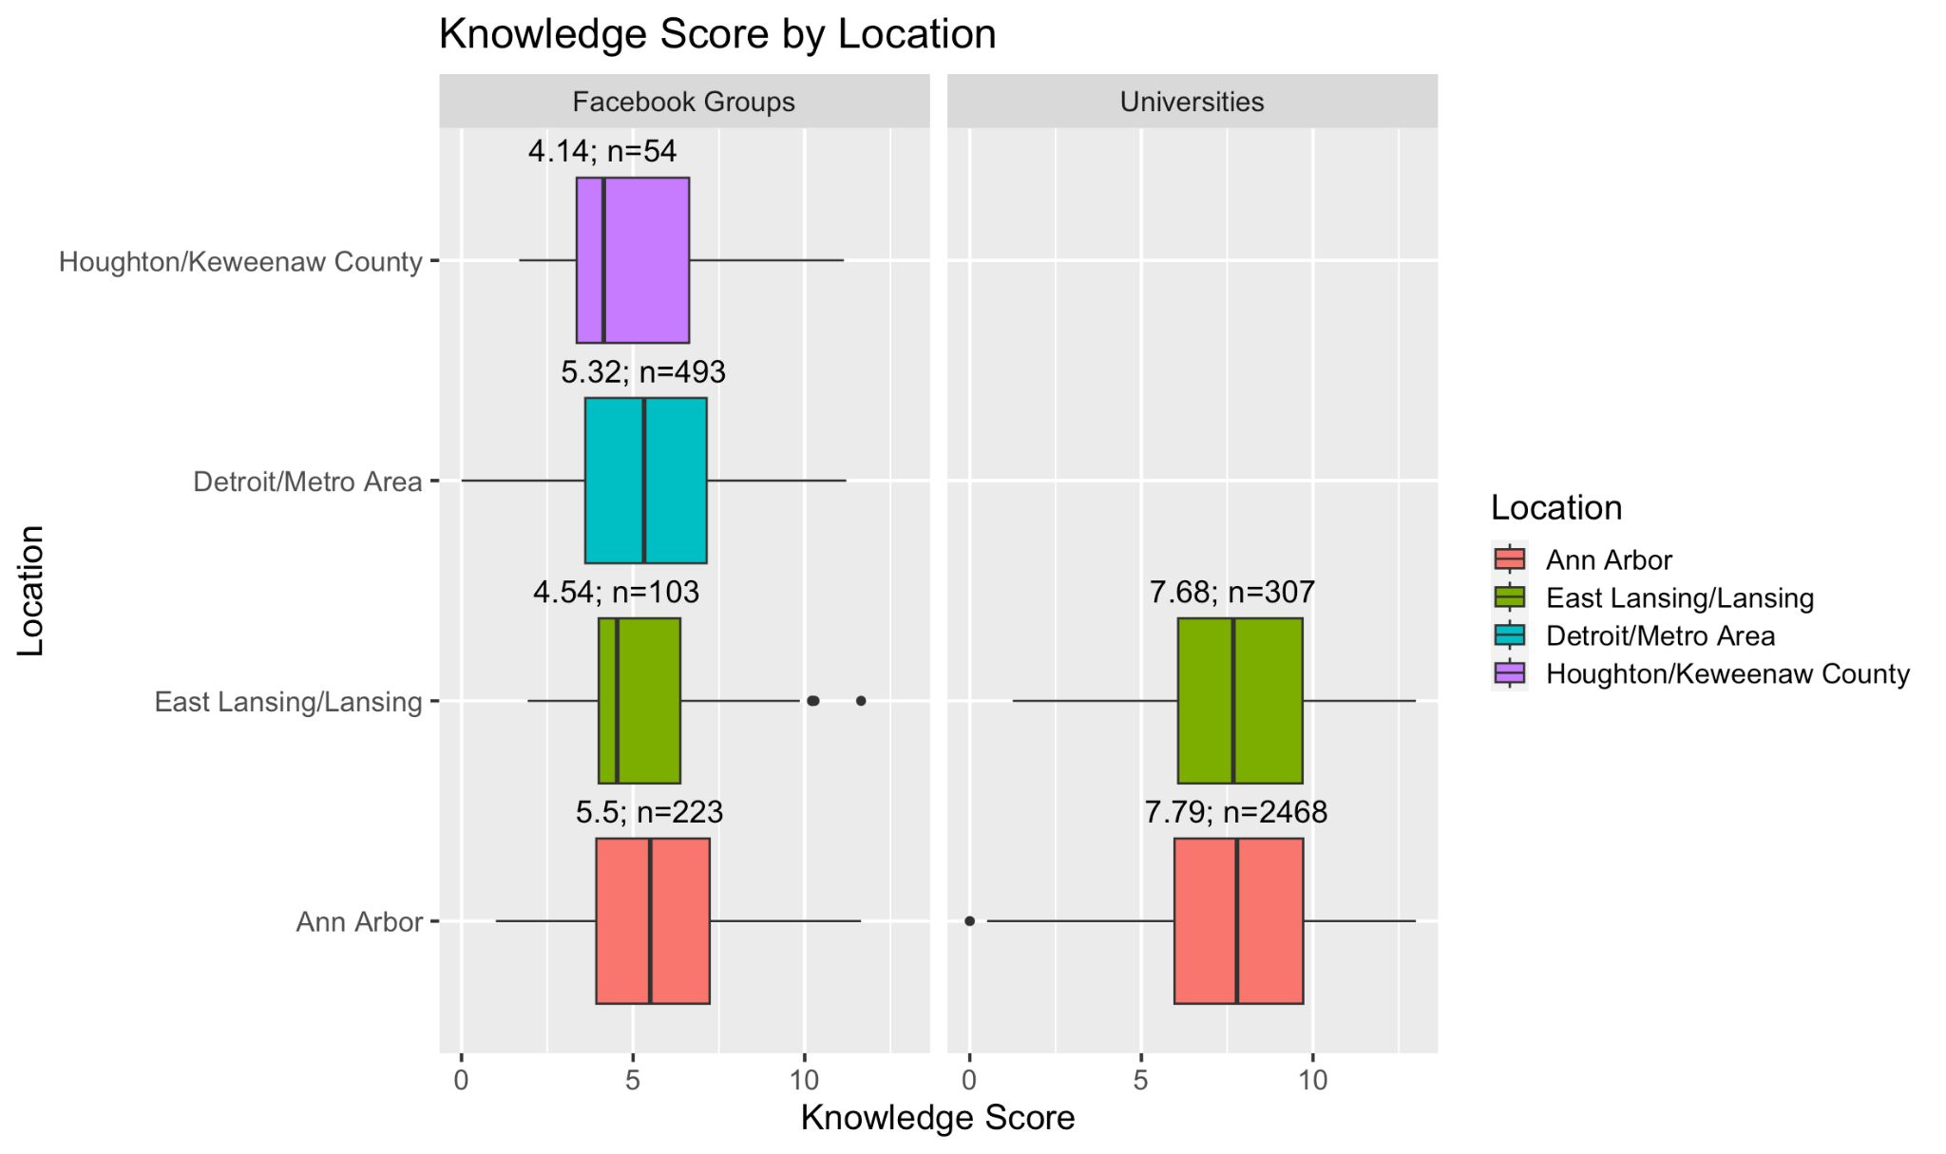
Knowledge Score by Location

Slide 34
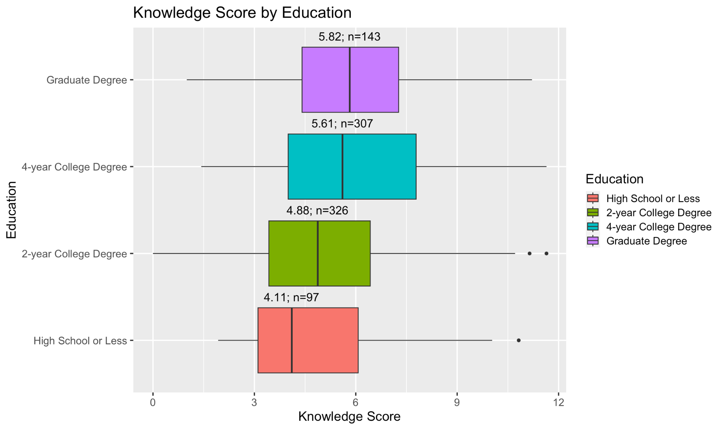
Knowledge Score by Education in Facebook Groups

Slide 35
Consumer Behaviors

Slide 36
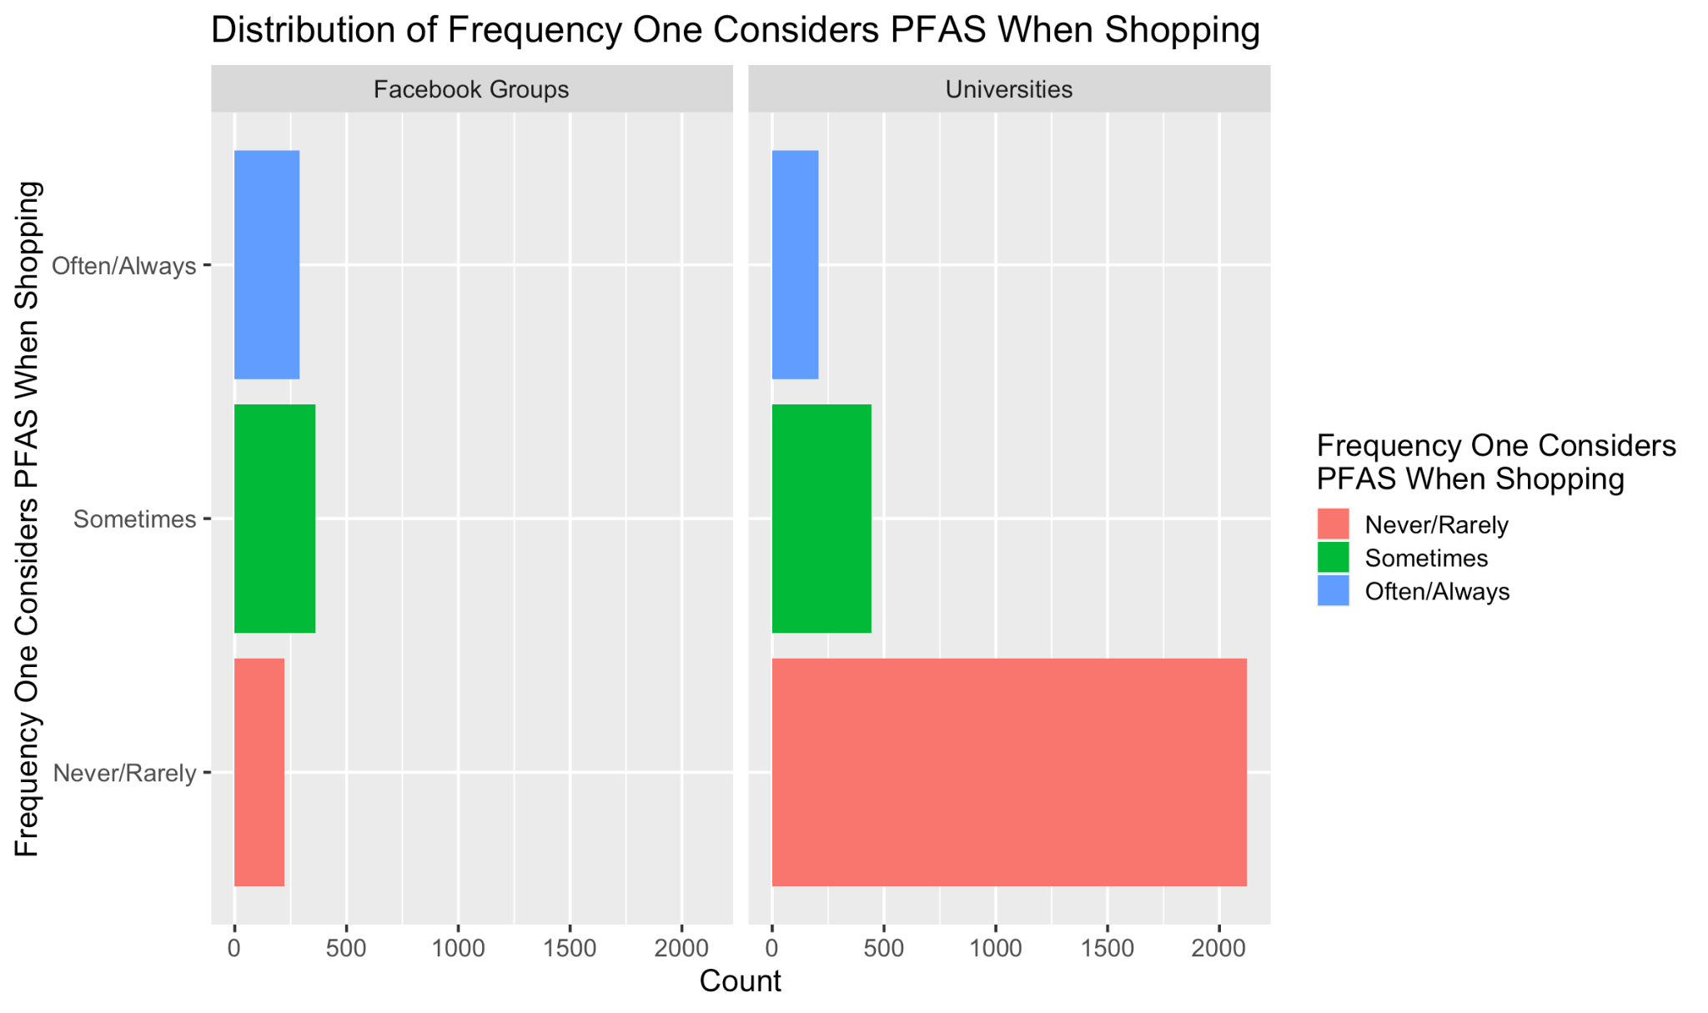
Frequency One Considers PFAS Being In Products When Shopping by Study Population

Slide 37
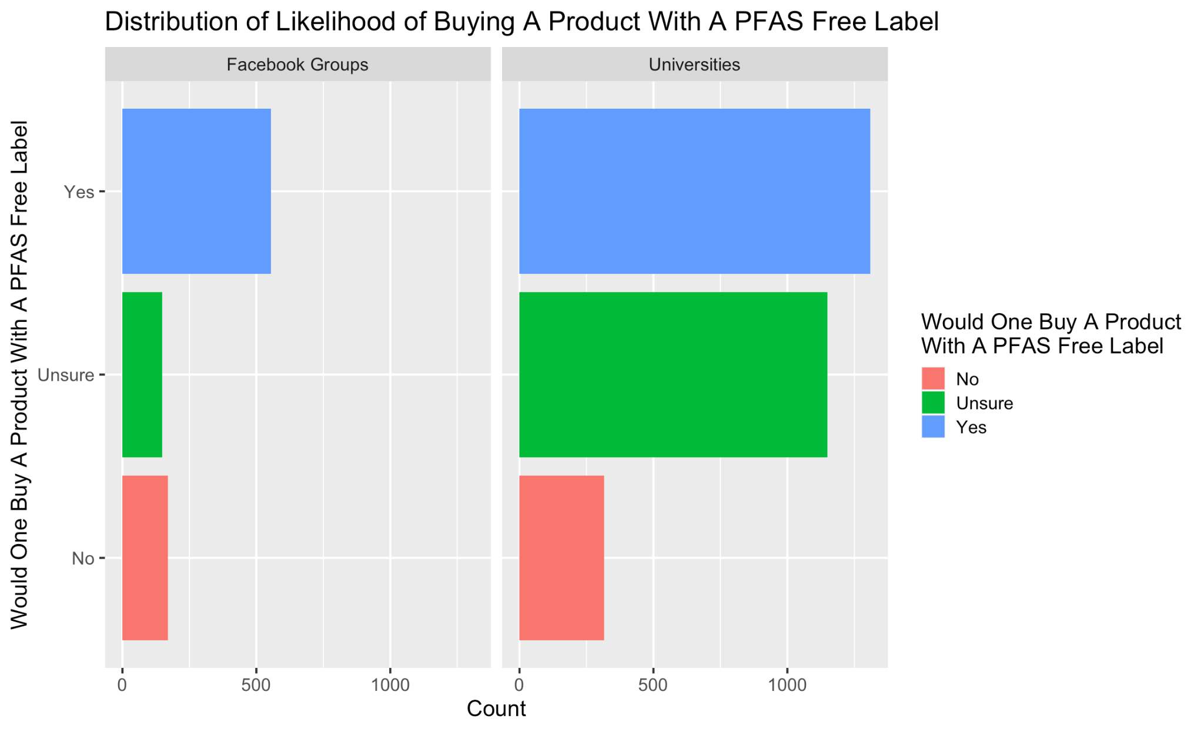
Would One Be More Likely To Buy A Product Labeled “PFAS free” by Study Population

Slide 38
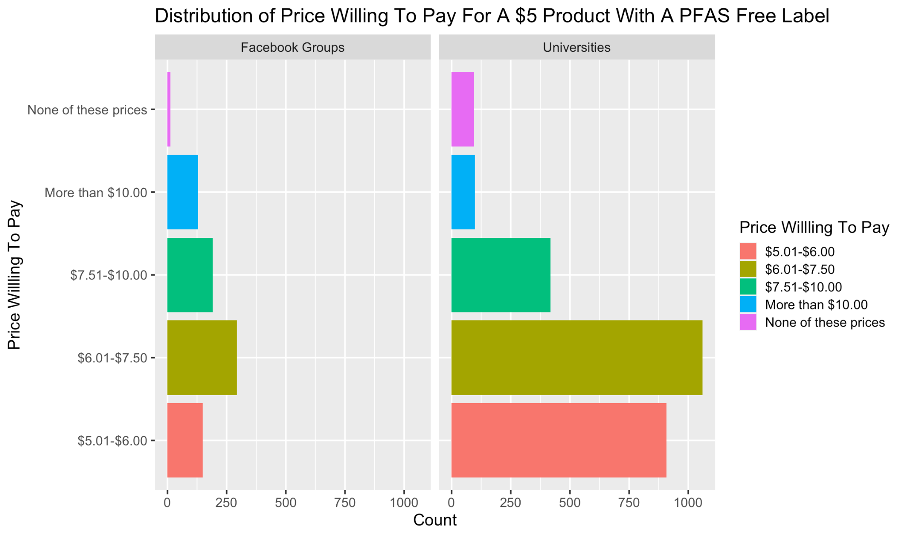
Suppose a product without a “PFAS free” label costs $5. What is the highest price you would pay for a similar product with a “PFAS free” label?

Slide 39
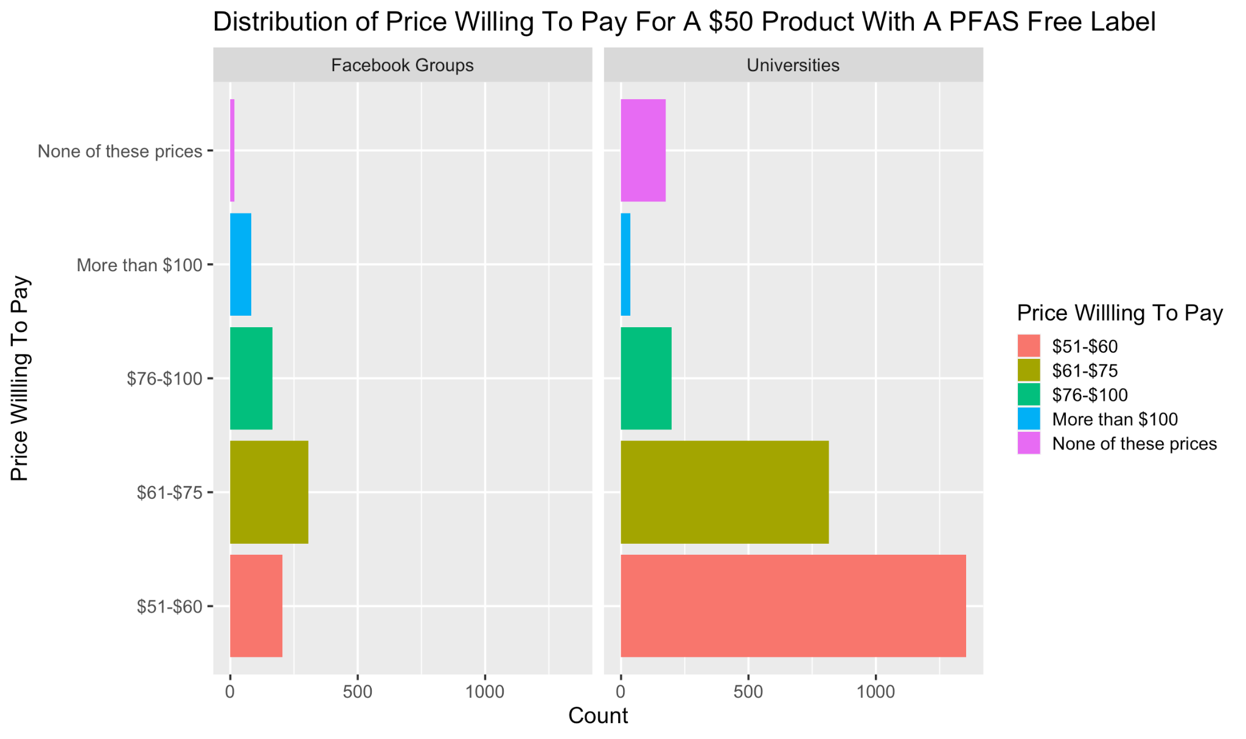
Suppose a product without a “PFAS free” label costs $50. What is the highest price you would pay for a similar product with a “PFAS free” label?

Slide 40
Models

Slide 41
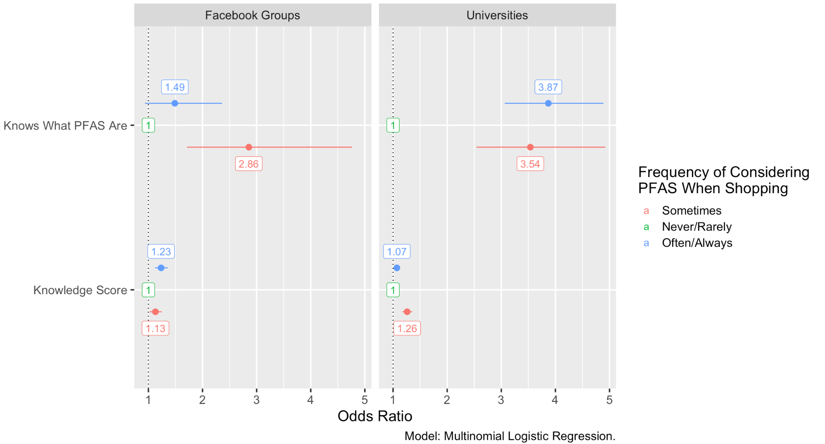
Odds Ratios for Knows What PFAS Are and Knowledge Score with Frequency One Considers PFAS Being In Products When Shopping
Outcome
Exposure
log(freq of considering PFAS when shopping) ~ knows what PFAS are + knowledge score + age + gender + race/ethnicity + location + education(in Facebook groups); reference group = never/rarely
Notes:
Break down variables
From the bottom left in the blue, a one point increase in knowledge score is associated with a 23% increased odds of considering PFAS often or always when shopping compared to never or rarely, for Facebook respondents
It was associated with a 7% increased odds for university respondents, which you can see in the bottom right
From the top left in the blue, compared to those who don’t know what PFAS are, those who do know have a 49% increased odds of considering PFAS often or always when shopping compared to never or rarely, for Facebook respondents
It was associated with a 2.87 times higher odds for university respondents, as shown in the top right

Slide 42
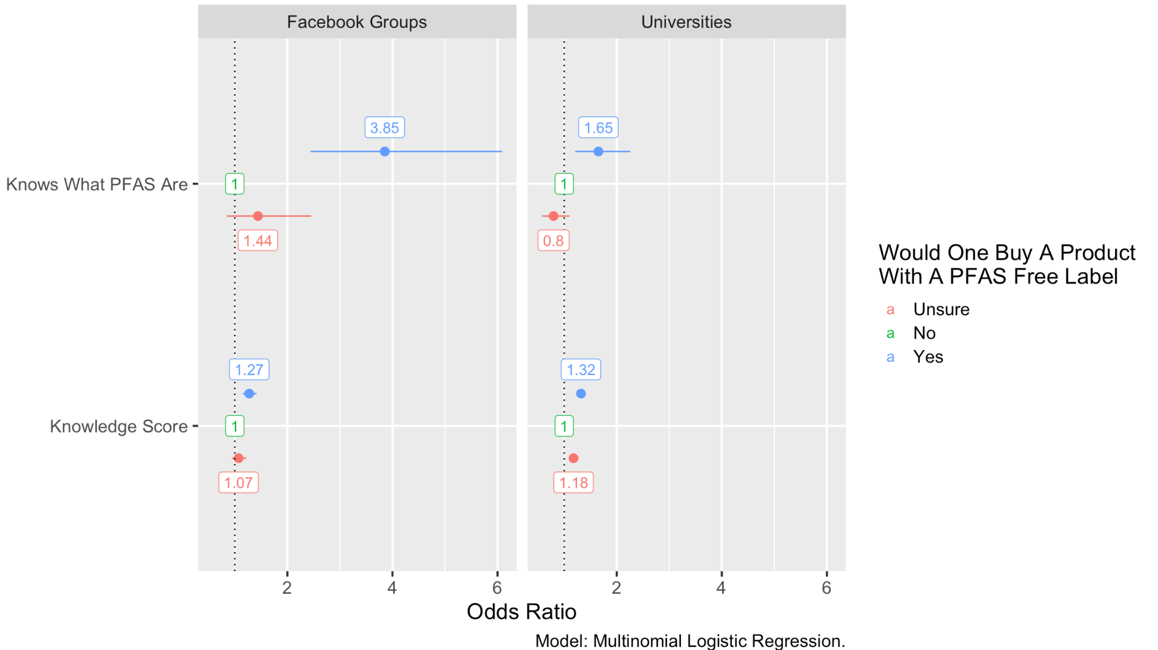
Odds Ratios for Knows What PFAS Are and Knowledge Score with Would One Be More Likely To Buy A Product Labeled “PFAS free”
Outcome
Exposure
log(would one buy a product labeled PFAS free) ~ knows what PFAS are + knowledge score + age + gender + race/ethnicity + location + education(in Facebook groups); reference group = never/rarely
Notes:
Break down variables
From the bottom left in the blue, a one point increase in knowledge score is associated with a 27% increased odds of buying a product with a PFAS free label compared to not buying the product, for Facebook respondents
It was associated with a 32% increased odds for university respondents, which is shown in the bottom right
From the top left in the blue, compared to those who don’t know what PFAS are, those who do know have a 2.85 times higher odds of buying a product with a PFAS free label compared to not buying the product, for Facebook respondents
It was associated with a 65% increased odds for university respondents as shown in the top right

Slide 43
4
Conclusions

Slide 44
Findings
1619 respondents (44.4%) knew what PFAS were
Socially advantaged groups had the highest knowledge scores
  Ann Arbor, White/European, and currently in or graduated from university
Knowing what PFAS were and PFAS knowledge score were significantly associated with increased consideration of PFAS when shopping and willingness to buy a product labeled PFAS free
Mean (SD) knowledge score was 7.22 (2.65)

Slide 45
Strengths and Limitations
Strengths
Limitations
Gathered large number of responses across multiple communities in Michigan
Provided novel insight into how PFAS perceptions influence consumer behaviors
Created a survey that can be implemented within other environmental health contexts
Incorporated reliability measures
Recruitment bias
  Respondents likely more passionate about PFAS and of higher SES
Survey disseminated in multiple ways
  Difficult to accurately measure response rates
Excluded three universities and ~350 respondents, and merged some covariates due to small sample sizes
Didn’t measure rural/urban as a possible confounder

Slide 46
Future Directions
Further Research
Does consumer behavior influence PFAS exposure?
PFAS Education
Consumer Product Regulation
Government Advocacy
Inform vulnerable populations about PFAS health consequences
Shift away from chemicals being “innocent until proven guilty”
Push for family-level PFAS regulation
Notes:
I’m planning to explore how consumer behaviors influence PFAS exposure and why, but also what social factors may promote or limit one’s ability to reduce their own chemical exposures, in a future PhD.
Implement more complex methods to address the sample size issue with covariate by imputing values.
Conduct qualitative interviews to get more in-depth information about considering PFAS when shopping, including how one reads labels and what barriers may be present in considering PFAS in consumer behaviors
Compare levels of PFAS in consumers and see if consumer behaviors influence PFAS levels in the blood

Slide 47
Final Thoughts
Consumer behaviors are an important possible exposure to chemicals that needs to be further investigated
Perception surveys offer a unique approach to environmental health
  Require a lot of work, but allow communities to voice opinions
  Results can be directly applied back towards communities
The fight between corporations and government over PFAS use isn’t going anywhere
  Other interventions (i.e., education) may be useful for helping people mitigate their exposure in the meantime

Slide 48

Acknowledgements
Thank you to my thesis committee, mentors, and MPEG lab members for their contributions to this project:
  Sung Kyun Park, James Wagner, Marie O’Neill, Grace Noppert, Laura Arboleda Merino, Victoria Zhang, Jiaxin Wu, Yundan Zhang, and Qingyi Cai

Slide 49
Thanks!
Any Questions?
Andrew Hoover
aphoover@umich.edu

Slide 50
References
National Institute of Environmental Health Sciences (NIEHS). (2024). Perfluoroalkyl and Polyfluoroalkyl Substances (PFAS). https://www.niehs.nih.gov/health/topics/agents/pfc
University of North Carolina (UNC). (n.d.). What Are PFAS? https://ncpure.collaboratory.unc.edu/science/what-are-pfas/
Hammel, E., Webster, T. F., Gurney, R., & Heiger-Bernays, W. (2022). Implications of PFAS definitions using fluorinated pharmaceuticals. iScience, 25(4), 104020. https://doi.org/10.1016/j.isci.2022.104020
Fenton, S. E., Ducatman, A., Boobis, A., DeWitt, J. C., Lau, C., Ng, C., Smith, J. S., & Roberts, S. M. (2021). Per- and Polyfluoroalkyl Substance Toxicity and Human Health Review: Current State of Knowledge and Strategies for Informing Future Research. Environmental Toxicology and Chemistry, 40(3), 606–630. https://doi.org/10.1002/etc.4890
Sunderland, E. M., Hu, X. C., Dassuncao, C., Tokranov, A. K., Wagner, C. C., & Allen, J. G. (2019). A Review of the Pathways of Human Exposure to Poly- and Perfluoroalkyl Substances (PFASs) and Present Understanding of Health Effects. Journal of Exposure Science & Environmental Epidemiology, 29(2), 131–147. https://doi.org/10.1038/s41370-018-0094-1
Avenue, 677 Huntington, Boston, & Ma 02115. (2023, May 15). Communities of color disproportionately exposed to PFAS pollution in drinking water. News. https://www.hsph.harvard.edu/news/press-releases/communities-of-color-disproportionately-exposed-to-pfas-pollution-in-drinking-water/
FSAWWA. (2023). PFAS Resources. https://www.fsawwa.org/page/PFAS
Tian, H., Gaines, C., Launi, L., Pomales, A., Vazquez, G., Goharian, A., Goodnight, B., Haney, E., Reh, C. M., & Rogers, R. D. (2022). Understanding Public Perceptions of Per- and Polyfluoroalkyl Substances: Infodemiology Study of Social Media. Journal of Medical Internet Research, 24(3), e25614. https://doi.org/10.2196/25614
Wickham, G. M., & Shriver, T. E. (2021). Emerging contaminants, coerced ignorance and environmental health concerns: The case of per- and polyfluoroalkyl substances (PFAS). Sociology of Health & Illness, 43(3), 764–778. https://doi.org/10.1111/1467-9566.13253
Banwell, C., Housen, T., Smurthwaite, K., Trevenar, S., Walker, L., Todd, K., Rosas, M., & Kirk, M. (2021). Health and social concerns about living in three communities affected by per- and polyfluoroalkyl substances (PFAS): A qualitative study in Australia. PLOS ONE, 16(1), e0245141. https://doi.org/10.1371/journal.pone.0245141

