Slide 1
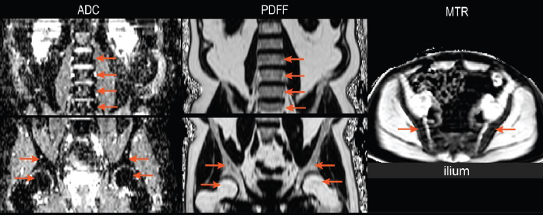
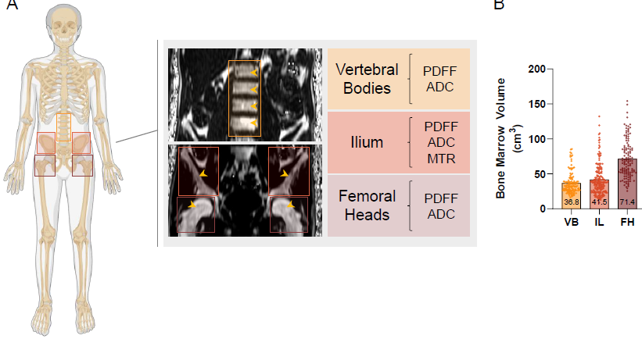
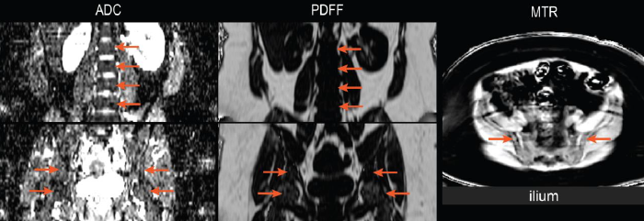
MRI Reliably Captures Bone Marrow Metrics in Myelofibrosis
Tanner H. Robison, Annabel Levinson, Winston Lee, Kristen Pettit, Dariya Malyarenko, Timothy D. Johnson, Thomas L. Chenevert, Brian D. Ross, Moshe Talpaz, and Gary D. Luker
University of Michigan School of Medicine, Ann Arbor, Michigan, United States
Objective:
Develop QIBs to assess myelofibrosis (MF) impact on human bone marrow
Methods:
66 study participants in clinical trial NCT01973881
MRI readout (QIB)
  Spleen volume
  DWI (ADC)
  CSE Dixon (PDFF)
  Magn Transfer (MTR)
Analysis
  Regional & voxel-wise
Normal
Myelofibrosis

Slide 2
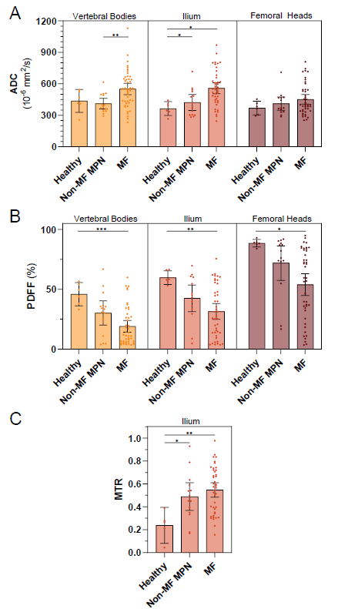
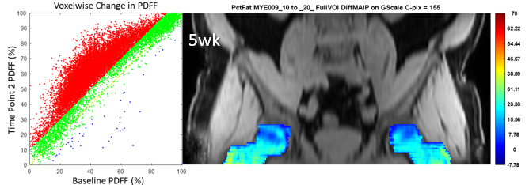
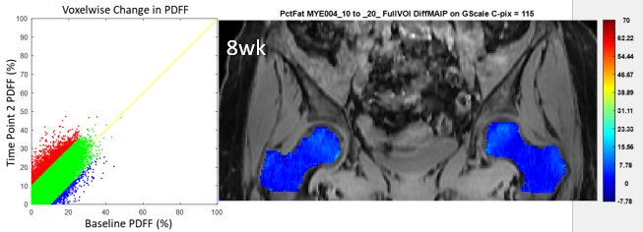
Regional
Temporal: Ruxolitinib Tx (voxel-wise)
Strong
PDFF
Change
Weak
PDFF
Change
Conclusion:
MRI QIBs are promising in assessment of MF disease status, spatio-temporal heterogeneity, and Tx response

