Slide 1

Evolving Diagnostic Gold Standards in Gynecologic Pathology:
Margin Assessment for HPV-independent Vulvar Neoplasia
PRESENTED BY
Stephanie L. Skala, MD
Clinical Associate Professor of Pathology
Director of Surgical Pathology
University of Michigan

Slide 2
Important Information
Regarding CME
The CME/evaluation process will only be available on the USCAP website until September 30, 2025.
No claims can be processed after that date!
After September 30, 2025 you will NOT be able to obtain any
CME credits for attending this meeting.

Slide 3
Disclosure of Relevant Financial Relationships
The faculty, committee members, and staff who are in position to control the content of this activity are required to disclose to USCAP and to learners any financial relationships that have occurred within the last 24 months with ineligible companies whose primary business is producing, marketing, selling, re-selling, or distributing healthcare products used by or on patients. USCAP has reviewed the disclosures and mitigated all relevant financial relationships.
I have no relevant financial relationships.
USCAP staff associated with the development of content for this activity reported no relevant financial relationships.

Slide 4
Case
65 yo with history of lichen sclerosus and differentiated vulvar intraepithelial neoplasia (dVIN), undergoing partial vulvectomy
pT1a VSCC, invasive carcinoma 1 cm from nearest margin

Slide 5
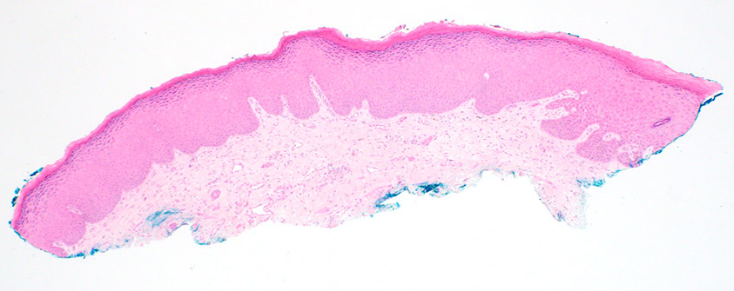
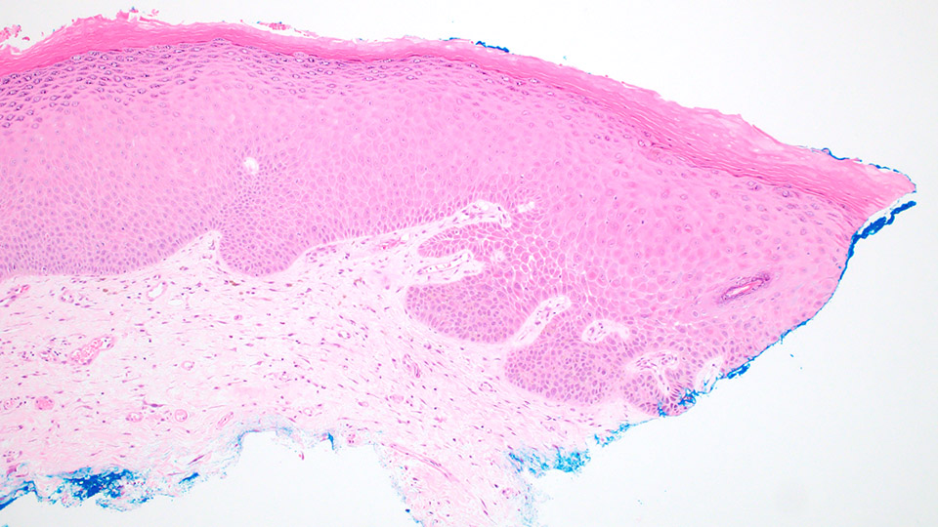
Tip section:

Slide 6
Case
What is the significance of this finding?

Slide 7
Vulvar Squamous Cell Carcinoma
Despite the known biologic differences between HPV-associated VSCC and HPV-independent VSCC, treatment guidelines are largely the same for all VSCC.
NCCN and ESGO recommend ancillary testing to determine:
  HPV status (p16 IHC, HR HPV RNA ISH, sequencing)
  p53 status (p53 IHC or NGS) in HPV-negative tumors

Slide 8
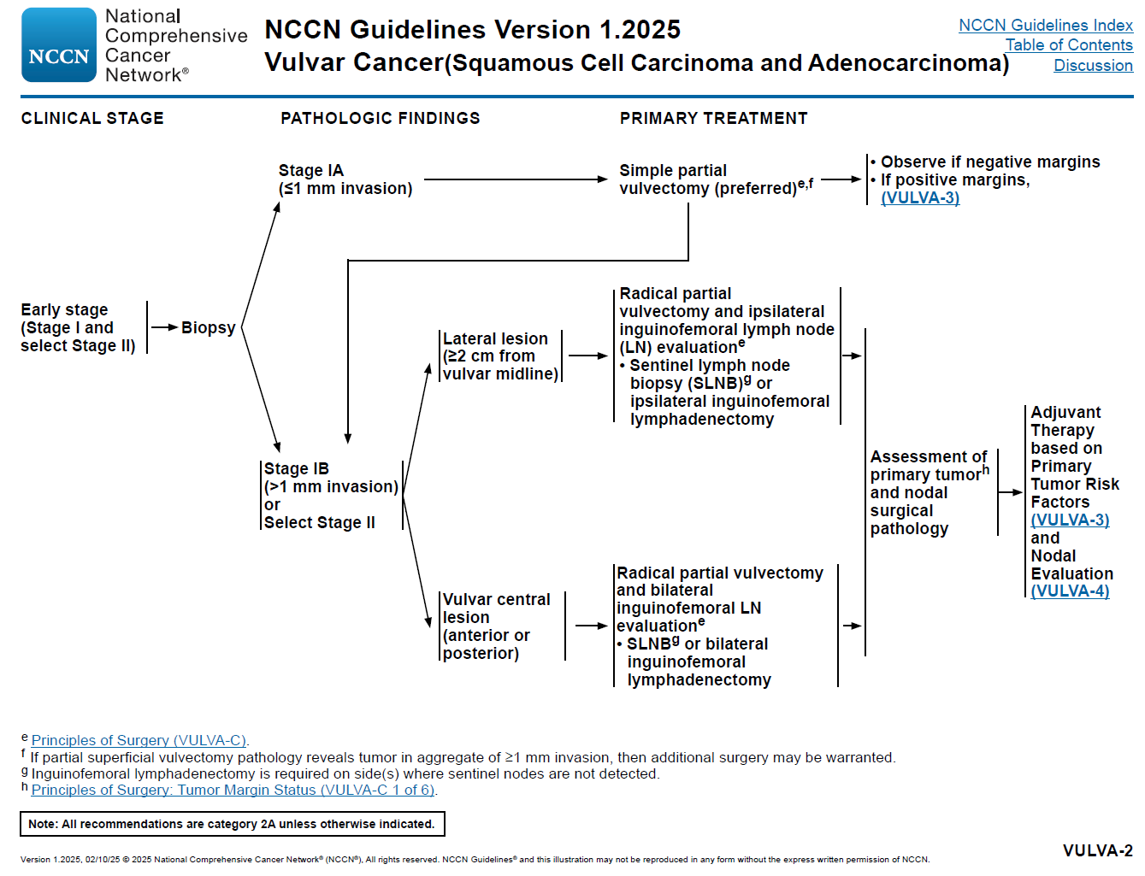
ESGO guidelines recommend radical local excision for invasive tumors

Slide 9
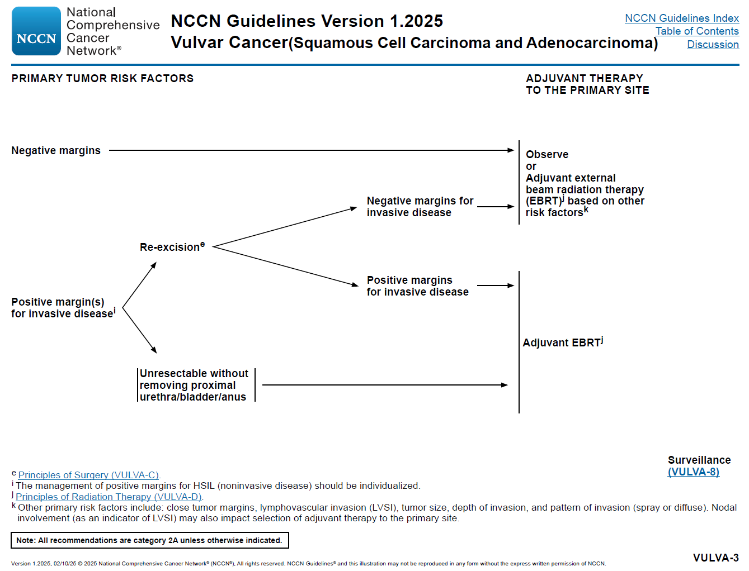
Relevant risk factors include close tumor margins, LVSI, size, depth, pattern of invasion
1 cm gross surgical margin*
Presence of dVIN and LS are also noted to play a role in recurrence.
Re-excision of positive/close margins may not be beneficial if radiation is required for other reasons

Slide 10
Margin Status for Vulvar Cancer
Historical goal: tumor-free margins of at least 8 mm
  Surgical impression of 1 cm seems to correlate with pathologic margin of 8 mm after formalin fixation
  Data not stratified based on HPV or TP53 mutation status
Data are mixed re: relationship between tumor-free margin and recurrence risk
  Confounding factors include node status, HPV status, margin status for VIN, histologic type, treatment, etc.
  Some studies suggest that presence of dVIN at margin +/- LS (but not HSIL at margin) are more predictive of recurrence than tumor-free margin is
    Yap et al. 2016, Pleunis et al. 2018, te Grootenhuis et al. 2019, Durden et al. 2024

Slide 11
Margin Status for Vulvar Cancer
Some studies suggest that a smaller tumor-free margin may be acceptable
  Preserve midline structures (clitoris, urethra, anus)
  Maintain sexual function
  Caveat: not stratified by HPV or TP53 status
Other studies suggest that dVIN +/- p53abn epithelium should be fully excised
  Increased risk of local recurrence if dVIN/p53abn at margin*
  ESGO recommends superficial excision of adjacent dVIN as part of primary excision

Slide 12
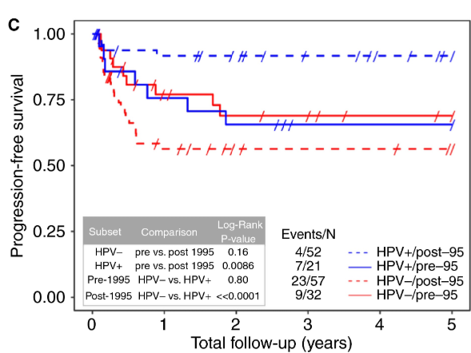
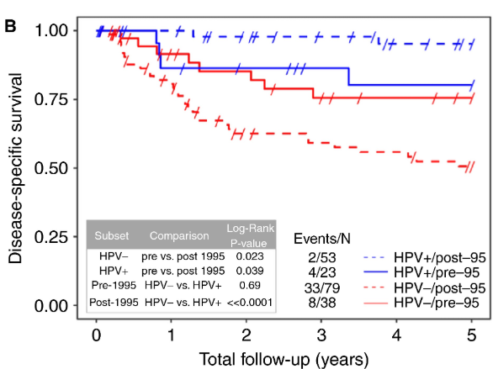
HPVi VSCC
McAlpine, et al. Histopathol 2017.
  1985-1995: more aggressive en bloc radical dissections
  1996-2005: more localized radical surgery
  More conservative surgical approach may have contributed to worse outcomes for patients with HPVi VSCC

Slide 13
Margin Status for VIN
ACOG and FIGO recommend gross margin of 0.5-1 cm
HSIL (HPV-A VIN)
  Does not necessarily require surgical treatment
  Other options include:
    Imiquimod cream
    Cidofovir gel
    LASER
  p16 IHC useful for margin assessment
HPV-I VIN
  Negative margins strongly encouraged, especially for dVIN*
  p53 IHC may be helpful for margin assessment
Notes:
*For purposes of this talk, dVIN = HPVi p53abn VIN

Slide 14
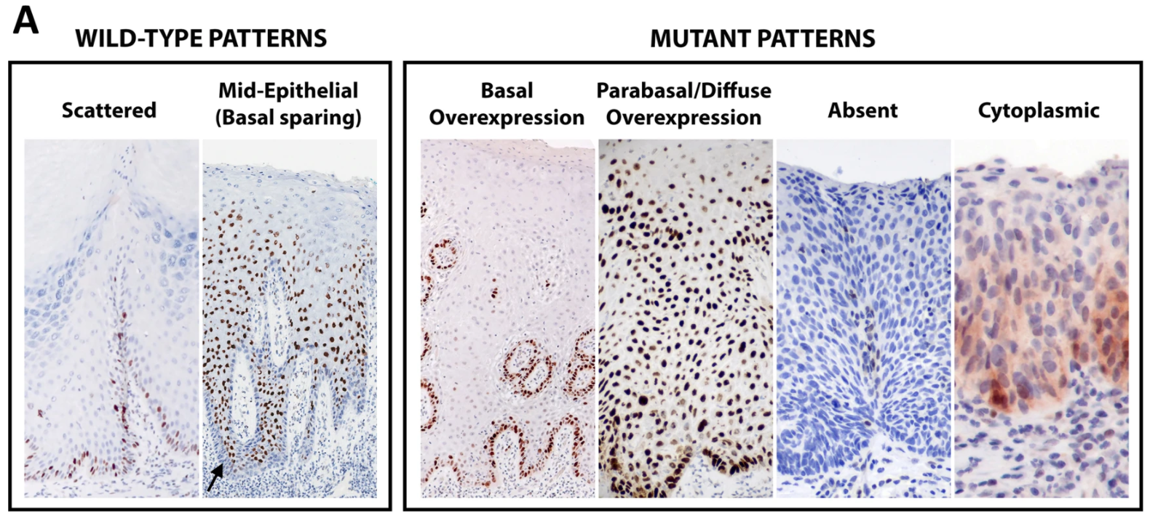
p53 Immunohistochemistry
Tessier-Cloutier B, et al. Mod Pathol 2020;33(8):1595-1605.
Notes:
Even so, there are several complicating factors. Distinction between high-level scattered staining and basal OE or between low-level scattered staining and absent/null staining is subjective.

Slide 15
Margin Status for HPVi, p53abn VIN
Interobserver agreement for p53 IHC status leaves something to be desired
  Especially true for basal overexpression pattern!*
Careful interpretation of p53 IHC pattern can aid in assessment of margin status for dVIN

Slide 16
Margin Status for HPVi, p53abn VIN
Thompson et al., Mod Pathol. 2023
  73 HPVi, p53abn VSCC (+/- associated dVIN) with reported negative margins on vulvectomy
    p53 IHC identified 21 additional cases (29%) with p53abn “fields of dysplasia”
  Histology of p53abn in situ lesions varied and became more subtle farther away from the VSCC*
    15 (21%) had p53abn epithelium at a resection margin
      TP53 mutation confirmed
      3-fold increased risk of local recurrence
        5/7 (71.4%) vs 6/22 (27.3%), p = 0.036

Slide 17
Margin Status for HPVi, p53abn VIN
CK17 IHC may be a helpful adjunct when p53 interpretation is challenging
  Cytoskeletal intermediate filament protein expressed in activated suprabasal keratinocytes
  NOT specific for HPVi VIN, but sensitive
  HPVi VIN is essentially always positive for CK17
    Podoll et al. 2016, Dasgupta et al. 2018, McMullen-Tabry et al. 2022, Cook et al. 2024, Hartsough et al. 2025

Slide 18
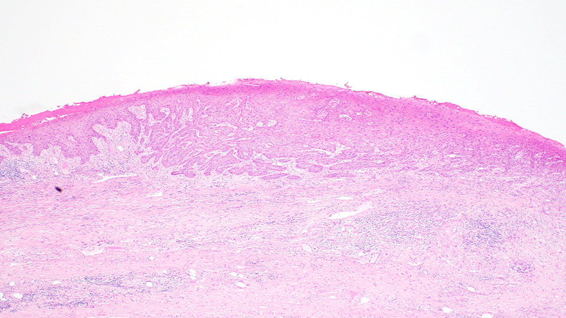
H&E

Slide 19
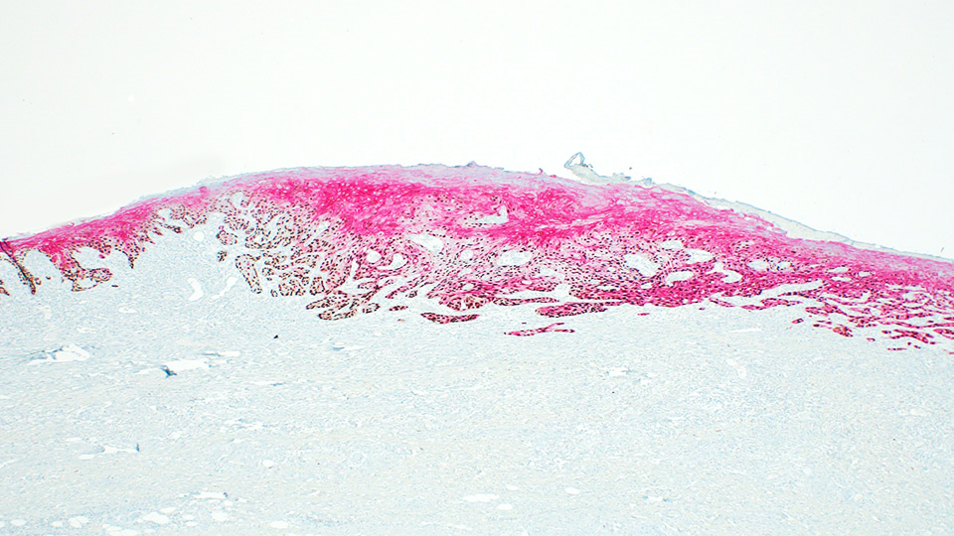
p53/CK17 IHC

Slide 20
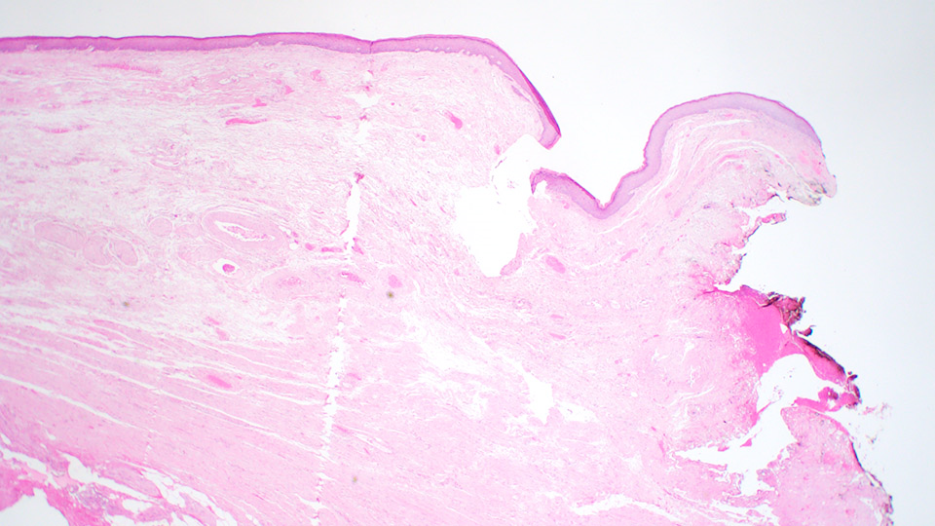
H&E

Slide 21
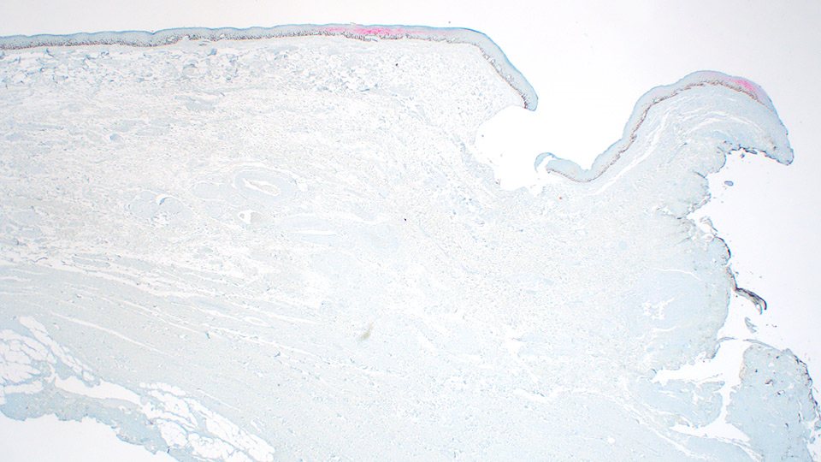
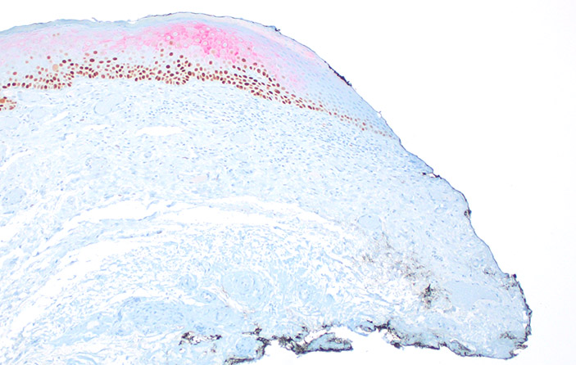
p53/CK17 IHC

Slide 22
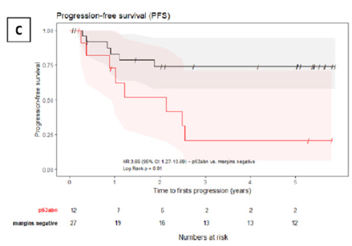
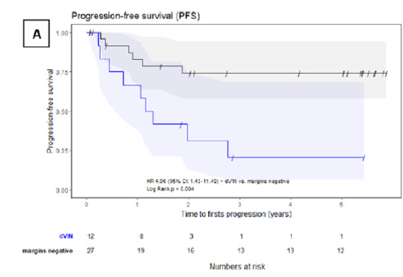
dVIN at resection margin for VSCC
Thompson et al. Int J Gynecol Cancer. 2022
  51 cases of stage I-II HPVi, p53abn VSCC
    dVIN at margin (n=12)
    p53abn at margin (n=12)
    Margins negative (n=27)
  Recurrence rates ~75% for dVIN or p53abn at margin, vs 33% for negative margins (p=0.009)
  Multivariate analysis showed that positive in situ margins were associated with recurrence, while invasive margin distance was not

Slide 23
Back to our case
p53/CK17 dual IHC

Slide 24
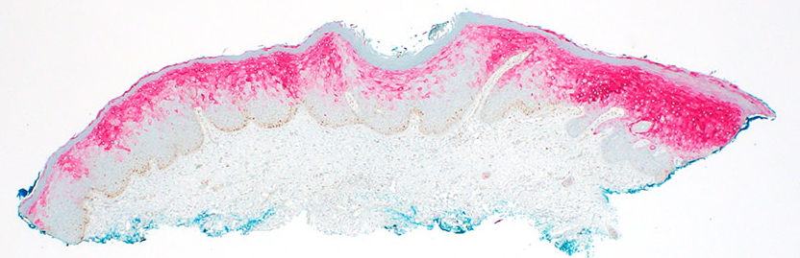
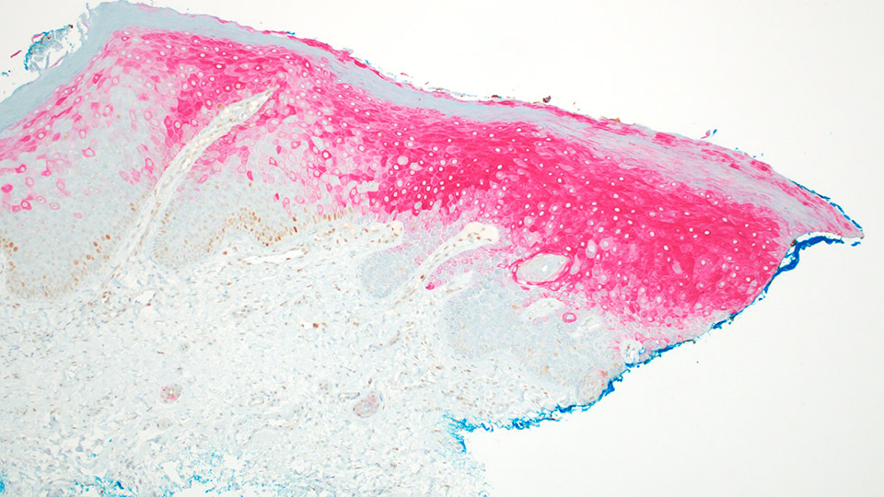
Tip section
(p53/CK17):

Slide 25
Margin Sampling for Vulvar Squamous Neoplasia

Slide 26
CAP: Vulva_5.1.0.0.REL_CAPCP
Sections to include the following should be taken (if appropriate):
  Tumor, representative sections, including site of deepest invasion and interface of tumor with adjacent epithelium
  Resection margins (perpendicular sections to margins may be particularly helpful, especially for HPV-I lesions, as they allow to more accurately assess margin clearance as well as the spectrum of morphologic and/or immunohistochemical changes leading up to the margin)
  Sections of abnormal epithelium or other tissue away from tumor
  Sections of area(s) marked by surgeon
  Sections of prior biopsy or resection site of tumor if no tumor is present grossly

Slide 27

STRIVE Trial
STRatIfication of Vulvar Squamous Cell Carcinoma by HPV and p53 Status to Guide Excision
Goals:
  HPV-A VSCC
    To demonstrate that de-escalation of surgery is safe and will improve quality of life
  HPV-I VSCC
    To demonstrate that re-excision to achieve clear margins will improve outcomes
      Clear margin: invasive cancer at least 8 mm from margin, no dVIN at margin, no p53 IHC abnormality at margin
Notes:
https://ctv.veeva.com/study/stratification-of-vulvar-squamous-cell-carcinoma-by-hpv-and-p53-status-to-guide-excision

Slide 28
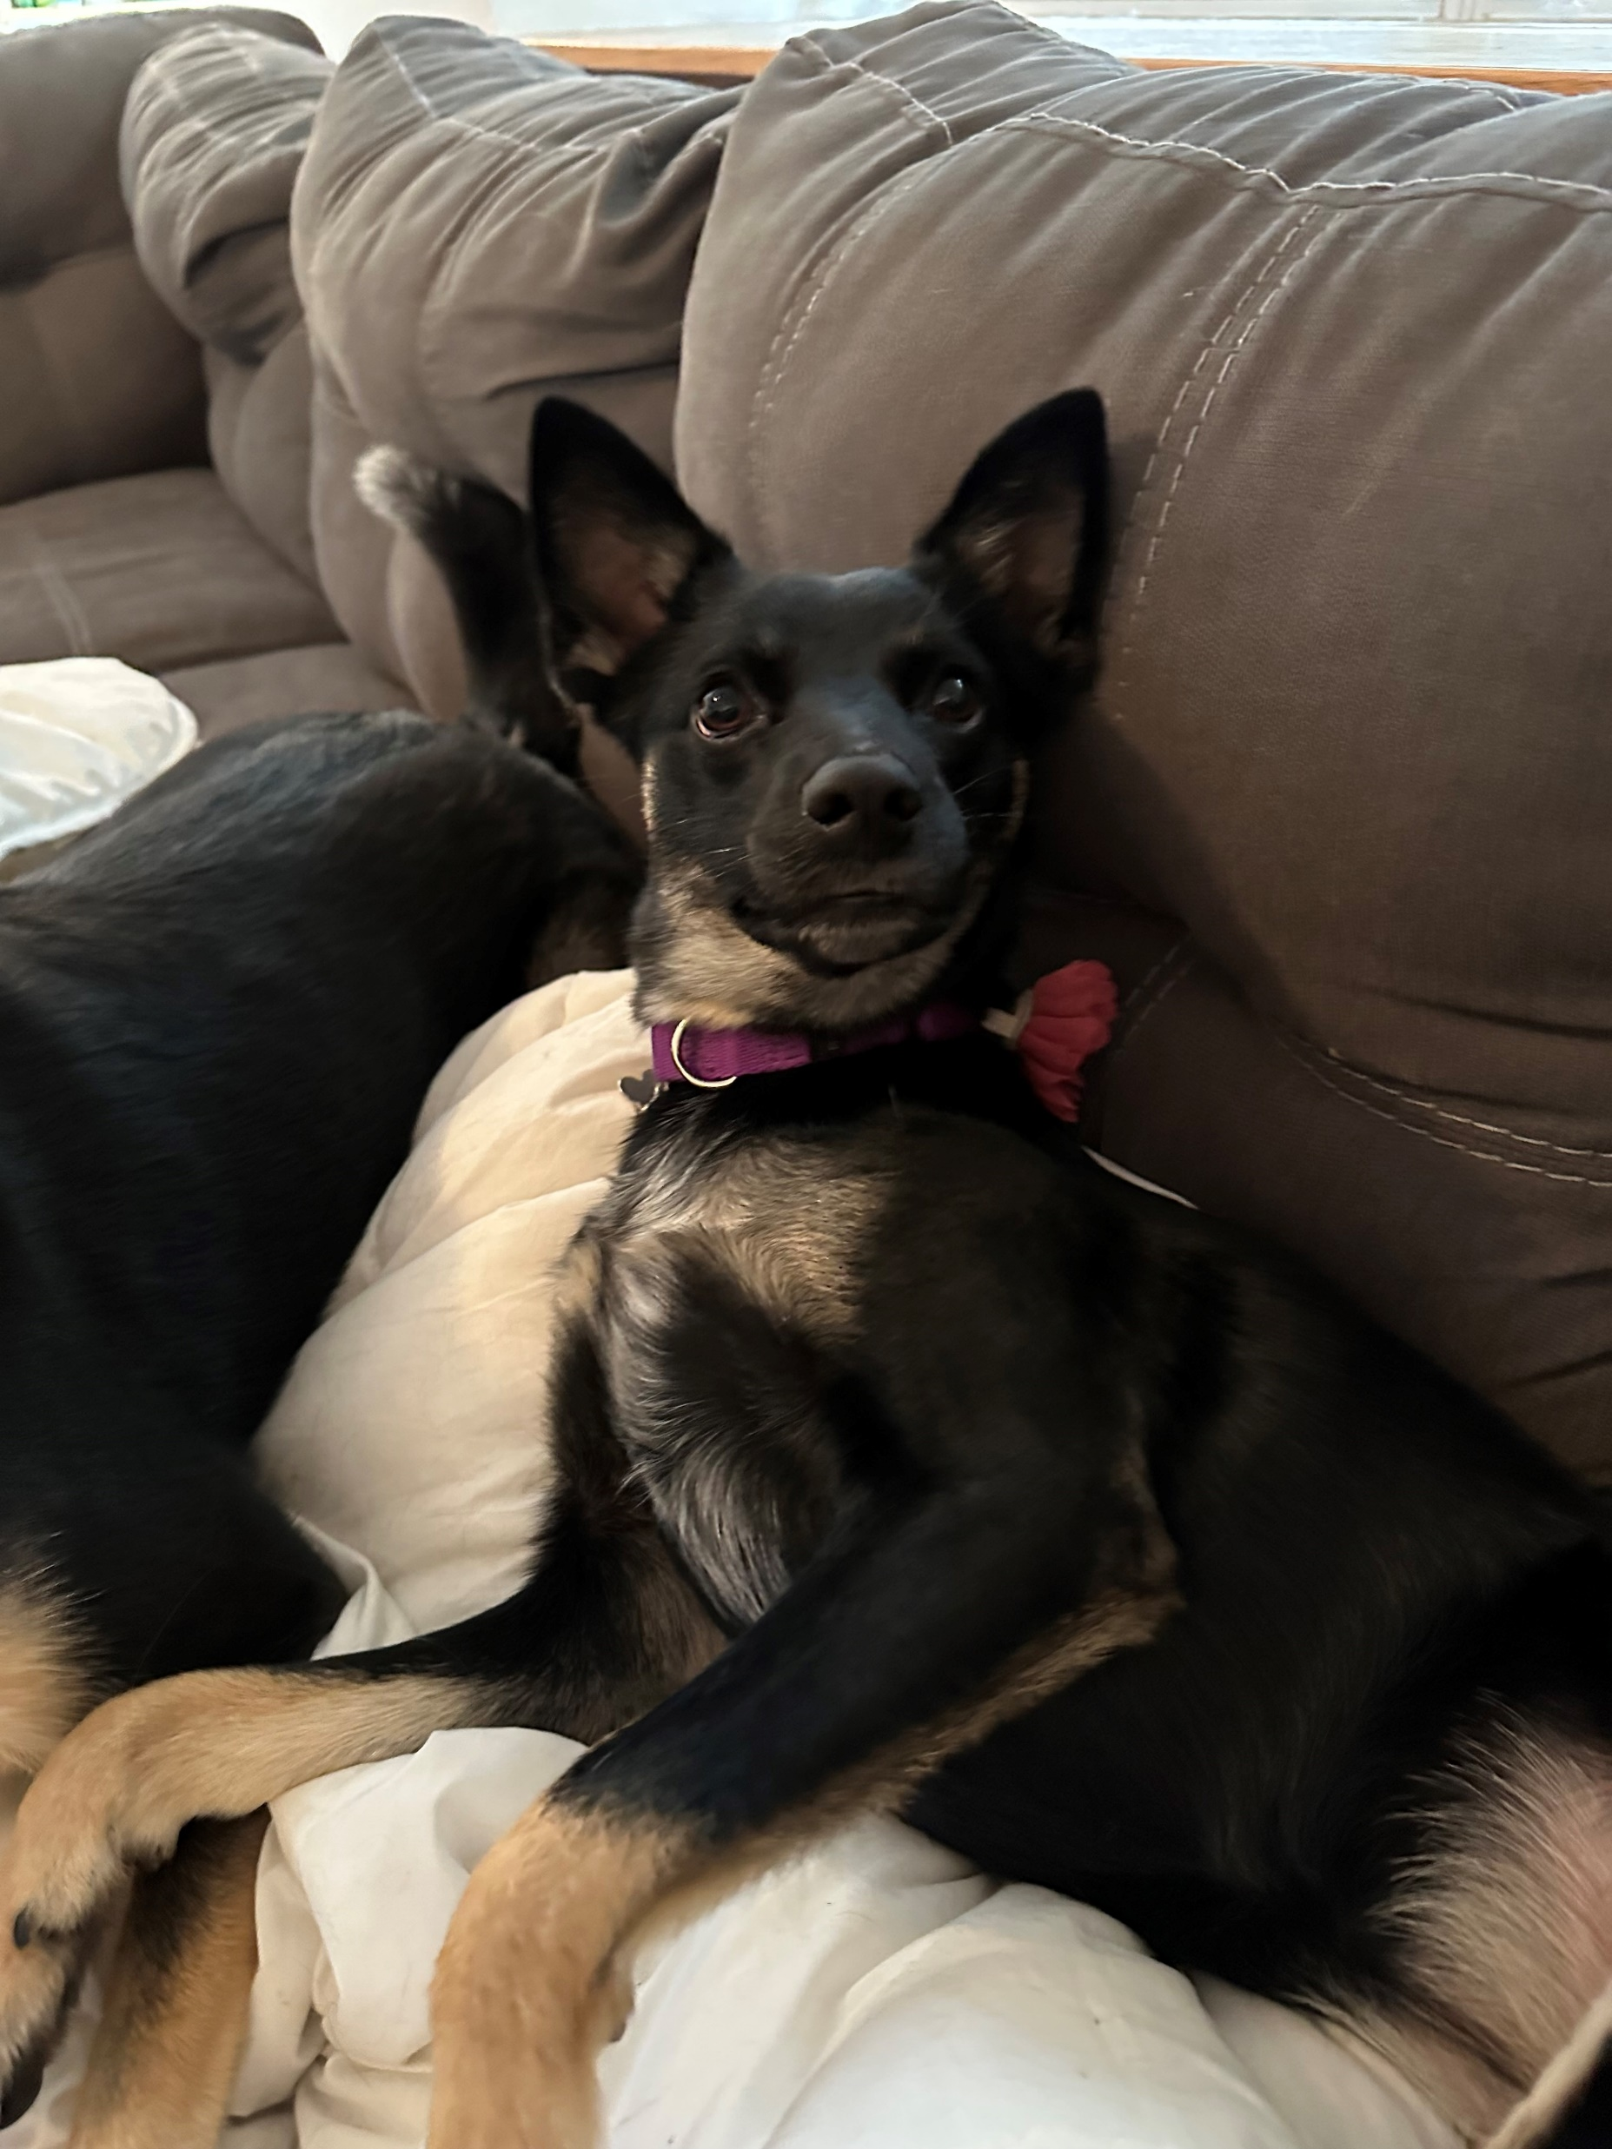
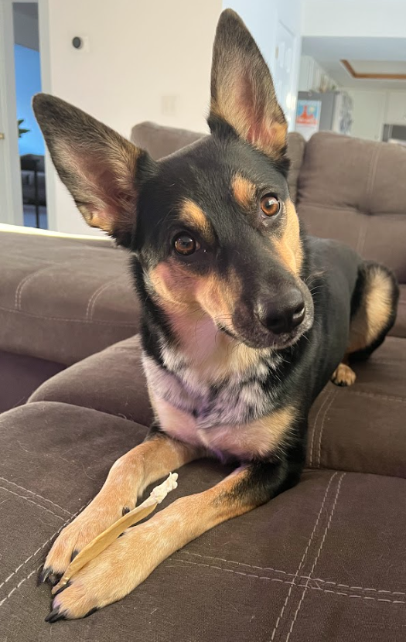
Questions?
sskala@med.umich.edu

Slide 29
Kortekaas KE, Bastiaannet E, van Doorn HC, et al. Vulvar cancer subclassification by HPV and p53 status results in three clinically distinct subtypes. Gynecol Oncol. 2020;159:649-656.
te Grootenhuis NC, Pouwer AW, de Bock GH, et al. Margin status revisited in vulvar squamous cell carcinoma. Gynecol Oncol. 2019;154:266-275.
Woelber L, Griebel LF, Eulenberg C, et al. Role of tumour-free margin distance for loco-regional control in vulvar cancer - a subset analysis of the Arbeitsgemeinschaft Gynäkologische Onkologie CaRE-1 multicenter study. Eur J Cancer. 2016;69:180-188.
Pleunis N, Leermakers MEJ, van der Wurff AA, et al. Surgical margins in squamous cell carcinoma, different for the vulva? Eur J Surg Oncol. 2018;44:1555-1561.
Micheletti L, Preti M, Cintolesi V, et al. Prognostic impact of reduced tumor-free margin distance on long-term survival in FIGO stage IB/II vulvar squamous cell carcinoma. J Gynecol Oncol. 2018;29(5):e61.
Taran FA, Pasternak J, Staebler A, et al. Tumor-Free Resection Margin Distance in the Surgical Treatment of Node-Negative Squamous Cell Cancer of the Vulva Has No Impact on Survival: Analysis of a Large Patient Cohort in a Tertiary Care Center. Cancers. 2023;15:4110.
Durden AA, Sanderson P, Ghaoui N, et al. Vulval squamous cell cancer — does precursor lesion margin status affect recurrence-free survival after optimal surgical resection for early-stage disease? Ginekol Pol. 2024;95(10):796-802.
Nooij LS, van der Slot MA, Dekkers OM, et al. Tumour-free margins in vulvar squamous cell carcinoma: Does distance really matter? Eur J Cancer. 2016;65:139-149.
Yap JKW, Fox R, Leonard S, et al. Adjacent Lichen Sclerosis predicts local recurrence and second field tumour in women with vulvar squamous cell carcinoma. Gynecol Oncol. 2016;142:420-426.
Zapardiel I, Iacoponi S, Coronado PJ, et al. Prognostic factors in patients with vulvar cancer: the VULCAN study. Int J Gynecol Cancer. 2020;30:1285-1291.
Yang J, Delara R, Ghaith S, et al. Tumor-free margins and local recurrence in squamous cell carcinoma of the vulva. Gynecol Oncol. 2020;158:555-561.
Chen JJ, Hoang LN. A review of prognostic factors in squamous cell carcinoma of the vulva: Evidence from the last decade. Sem Diagn Pathol. 2021;38:37-49.
McAlpine JN, Leung SCY, Cheng A, et al. Human papillomavirus (HPV)-independent vulvar squamous cell carcinoma has a worse prognosis than HPV-associated disease: a retrospective cohort study. Histopathol. 2017;71(2):238-246.
https://ctv.veeva.com/study/stratification-of-vulvar-squamous-cell-carcinoma-by-hpv-and-p53-status-to-guide-excision
National Comprehensive Cancer Network. Vulvar Cancer (Version 1.2025). https://www.nccn.org/professionals/physician_gls/pdf/vulvar.pdf. Accessed March 12, 2025.
Oonk MHM, Planchamp F, Baldwin P, et al. European Society of Gynaecological Oncology Guidelines for the Management of Patients with Vulvar Cancer - Update 2023. Int J Gynecol Cancer. 2023;33(7):1023-1043.
Thompson EF, Wong RWC, Trevisan G, et al. p53-Abnormal “Fields of Dysplasia” in Human Papillomavirus-Independent Vulvar Squamous Cell Carcinoma Impacts Margins and Recurrence Risk. Mod Pathol. 2023;36:100010.
Thompson EF, Shum K, Wong RWC, et al. Significance of p53 and presence of differentiated vulvar intra-epithelial neoplasia (dVIN) at resection margin in early stage human papillomavirus-independent vulvar squamous cell carcinoma. Int J Gynecol Cancer. 2022;32:1229-1235.
Preti M, Joura E, Vieira-Baptista P, et al. The European Society of Gynaecological Oncology (ESGO), the International Society for the Study of Vulvovaginal Disease (ISSVD), the European College for the Study of Vulval Disease (ECSVD) and the European Federation for Colposcopy (EFC) Consensus Statements on Pre-invasive Vulvar Lesions. J Low Genit Tract Dis. 2022;26:229-244.
Podoll MB, Singh N, Gilks CB, Moghadamfalahi M, Sanders MA. Assessment of CK17 as a Marker for the Diagnosis of Differentiated Vulvar Intraepithelial Neoplasia. Int J Gynecol Pathol. 2016;36:273-280.
Dasgupta S, Graham P, van Kemenade F, et al. Differentiated vulvar intraepithelial neoplasia (dVIN): the most helpful histological features and the utility of cytokeratins 13 and 17. Virchows Archiv. 2018;473(6):739-747.
McMullen-Tabry ER, Schechter SA, Wang GY, et al. p53/CK17 Dual Stain Improves Accuracy of Distinction Between Differentiated Vulvar Intraepithelial Neoplasia and Its Mimics. Int J Gynecol Pathol. 2022;41(3):298-306.
Cook E, Van de Vijver K, Parra-Herran C. Diagnosis of verruciform acanthotic vulvar intra-epithelial neoplasia (vaVIN) using CK17, SOX2 and GATA3 immunohistochemistry. Histopathol. 2024;84(7):1212-1223.
Hartsough EM, Nazarian RM, Watkins JC. CK17 Immunohistochemistry Is a Useful Adjunct in the Diagnosis of HPV-independent, TP53-wild-type Verruciform/Acanthotic Vulvar Intraepithelial Neoplasia (vaVIN). The American Journal of Surgical Pathology ():10.1097/PAS.0000000000002383, March 10, 2025. | DOI: 10.1097/PAS.0000000000002383

Slide 30
Margin Status for HPVi, p53wt VIN
Diagnosis of HPVi, p53wt VIN (by whatever name you prefer) is even more challenging
Stains that help to support diagnosis of HPVi, p53wt VIN may also be of use for margin assessment
  CK17
  GATA3
  SOX2

Slide 31
Effect of Adjacent Lichen Sclerosus
Yap et al. 2016
  201 consecutive cases of VSCC → characterization of surrounding epithelium possible for 199
    171 (85.9%) had LS or VIN adjacent to tumor
  Local recurrence
    Local relapse (within 2 cm of primary tumor)
    Second field tumor (>2 cm from primary tumor)
  Multivariable analyses confirmed the presence of adjacent LS increases risk of local relapse (2.7x) and second field tumor (4.4x)
  Close follow-up recommended so local vulvar recurrences can be detected early

