Slide 1
Emerging predictive biomarkers affecting choice of therapy for gynecologic cancers
Stephanie L. Skala, MD
Clinical Associate Professor of Pathology
Director of Surgical Pathology
University of Michigan

Slide 2
Mirvetuximab Soravtansine (ELAHERE)
Antibody-drug conjugate targeting folate receptor α
Approved for treatment of platinum-resistant ovarian cancer in the US
Moore KN, Angelergues A, Konecny GE, et al. Mirvetuximab Soravtansine in FRα-Positive, Platinum-Resistant Ovarian Cancer. N Engl J Med 2023;389:2162-2174.

Slide 3
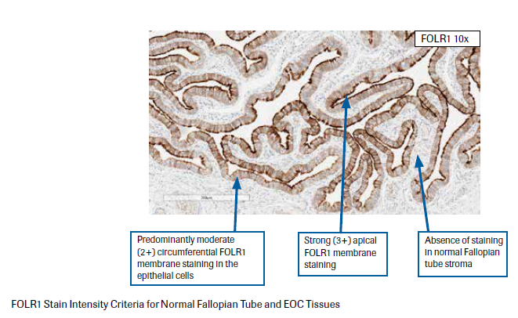
VENTANA FOLR1 Assay
Scoring of intensity is based on membrane localization only.
Negative (0): absence of any detectable signal (may show pale grey cytoplasmic and/or membranous discoloration)
Weak (1+): faint gold/light brown hue, partial or circumferential
Moderate (2+) or Strong (3+): chocolate brown to thickened dark brown, black hue, partial or circumferential

Slide 4
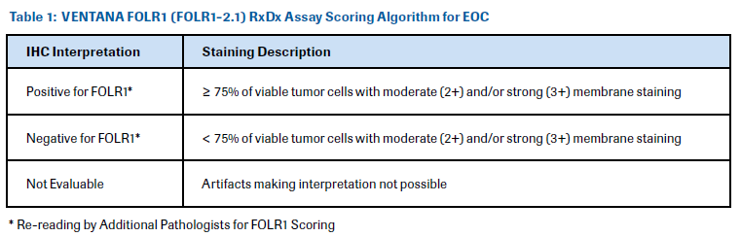
VENTANA FOLR1 Assay
*For cases near the threshold of 75% (65-85%), re-reading of the slide by a second pathologist is recommended.

Slide 5

FOLR1 Negative (20%)

Slide 6

FOLR1 Negative (30%)

Slide 7

FOLR1 Negative (60%)

Slide 8
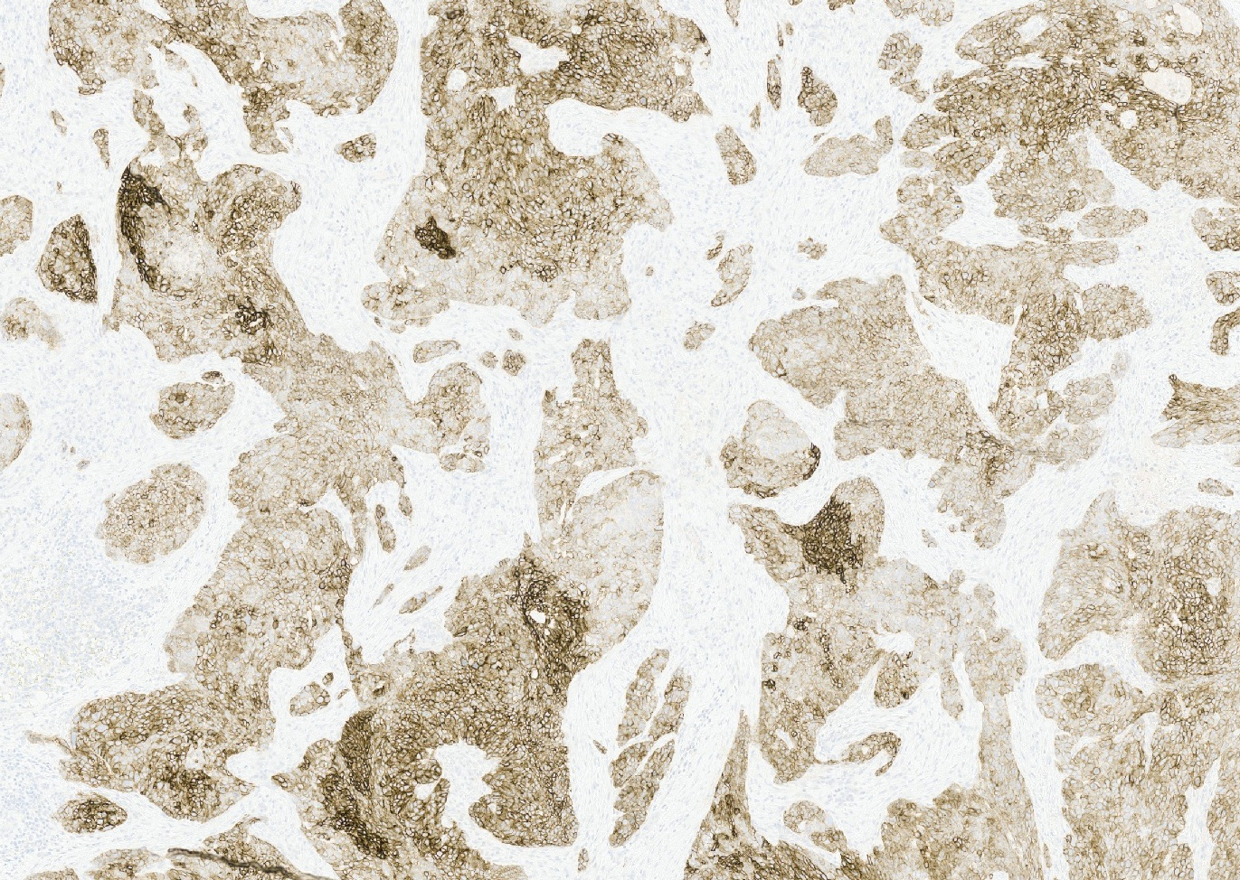
FOLR1 Positive (75%)

Slide 9
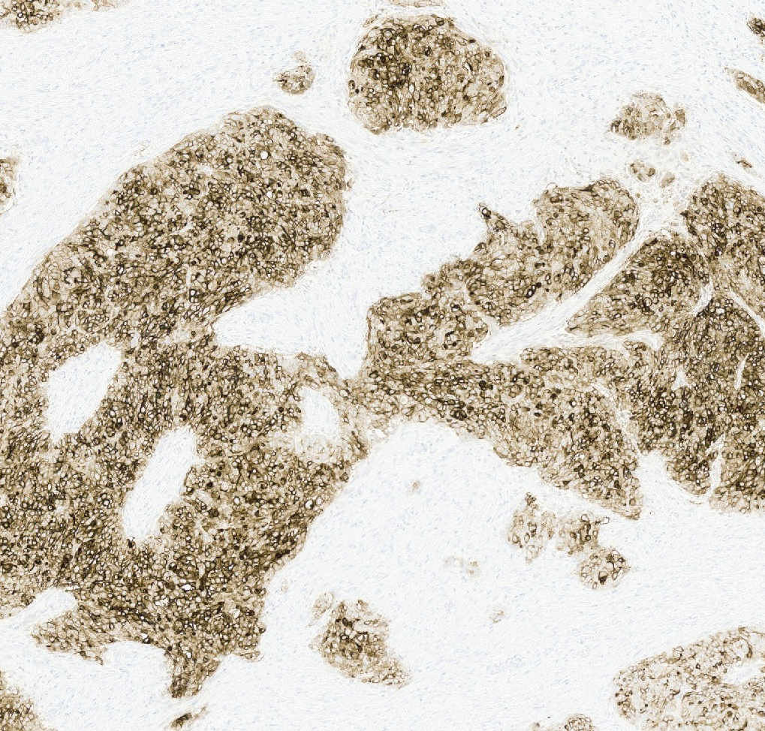
FOLR1 Positive (90%)

Slide 10
FOLR1 Assay for Epithelial Ovarian, Fallopian Tube, or Primary Peritoneal Carcinoma
FOLR1 result: [Positive] or [Negative]
Percentage of tumor cells with 2+ or 3+ membranous staining: _%
This FDA-approved immunohistochemical assay uses mouse monoclonal FOLR1 antibody (clone FOLR1-2.1) to assess expression of FOLR1 protein in formalin-fixed, paraffin-embedded tissues of epithelial ovarian, fallopian tube, or primary peritoneal carcinoma stained on a Ventana BenchMark Ultra instrument.
A positive result is defined as moderate (2+) or strong (3+), partial or circumferential, membranous staining in at least 75% of the tumor cells, and is intended to aid in identifying patients eligible for treatment with ELAHERE.

Slide 11
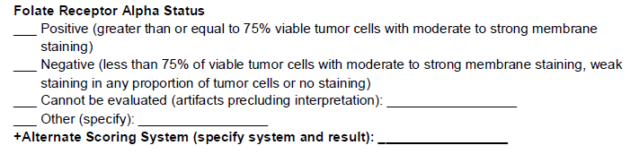
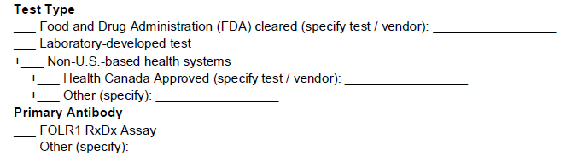
CAP Protocol: Gynecologic Biomarkers

Slide 12
Trastuzumab (Herceptin)
A phase II clinical trial of trastuzumab + cisplatin + paclitaxel in patients with HER2-positive, advanced stage or recurrent endometrial serous carcinoma showed improved OS and PFS over cisplatin + paclitaxel alone
As a result, anti-HER2 therapy was adopted into the NCCN guidelines
Fader AN, Roque DM, Siegel E, et al. Randomized phase II trial of carboplatin-paclitaxel versus carboplatin-paclitaxel-trastuzumab in uterine serous carcinomas that overexpress human epidermal growth factor receptor 2/neu. J Clin Oncol. 2018;36:2044-51.

Slide 13
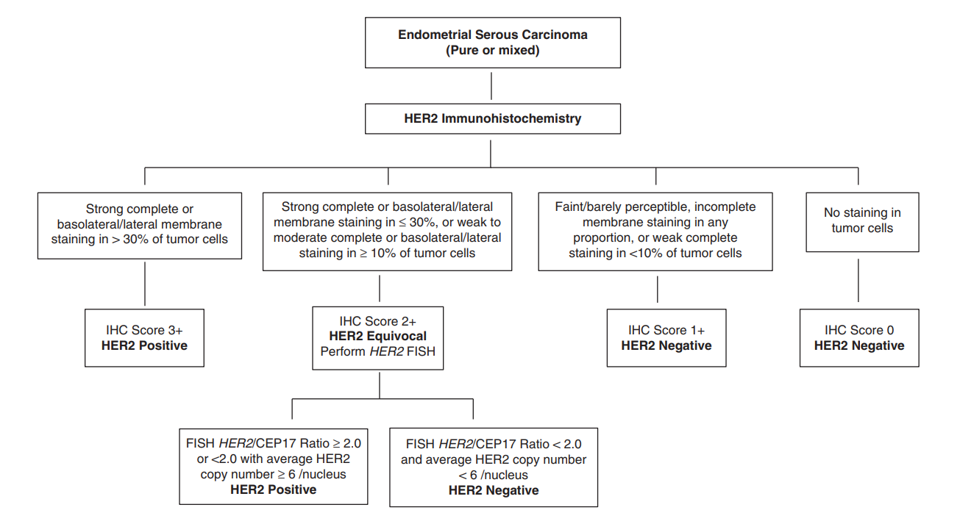
Proposed HER2 Scoring Criteria
Buza N. HER2 Testing and Reporting in Endometrial Serous Carcinoma: Practical Recommendations for HER2 Immunohistochemistry and Fluorescent In Situ Hybridization: Proceedings of the ISGyP Companion Society Session at the 2020 USCAP Annual Meeting. Int J Gynecol Pathol. 2021;40(1):17-23.
Notes:
Endometrial serous carcinomas have heterogeneity of HER2 overexpression and ERBB2 amplification, and basolateral staining similar to GEJ carcinoma

Slide 14
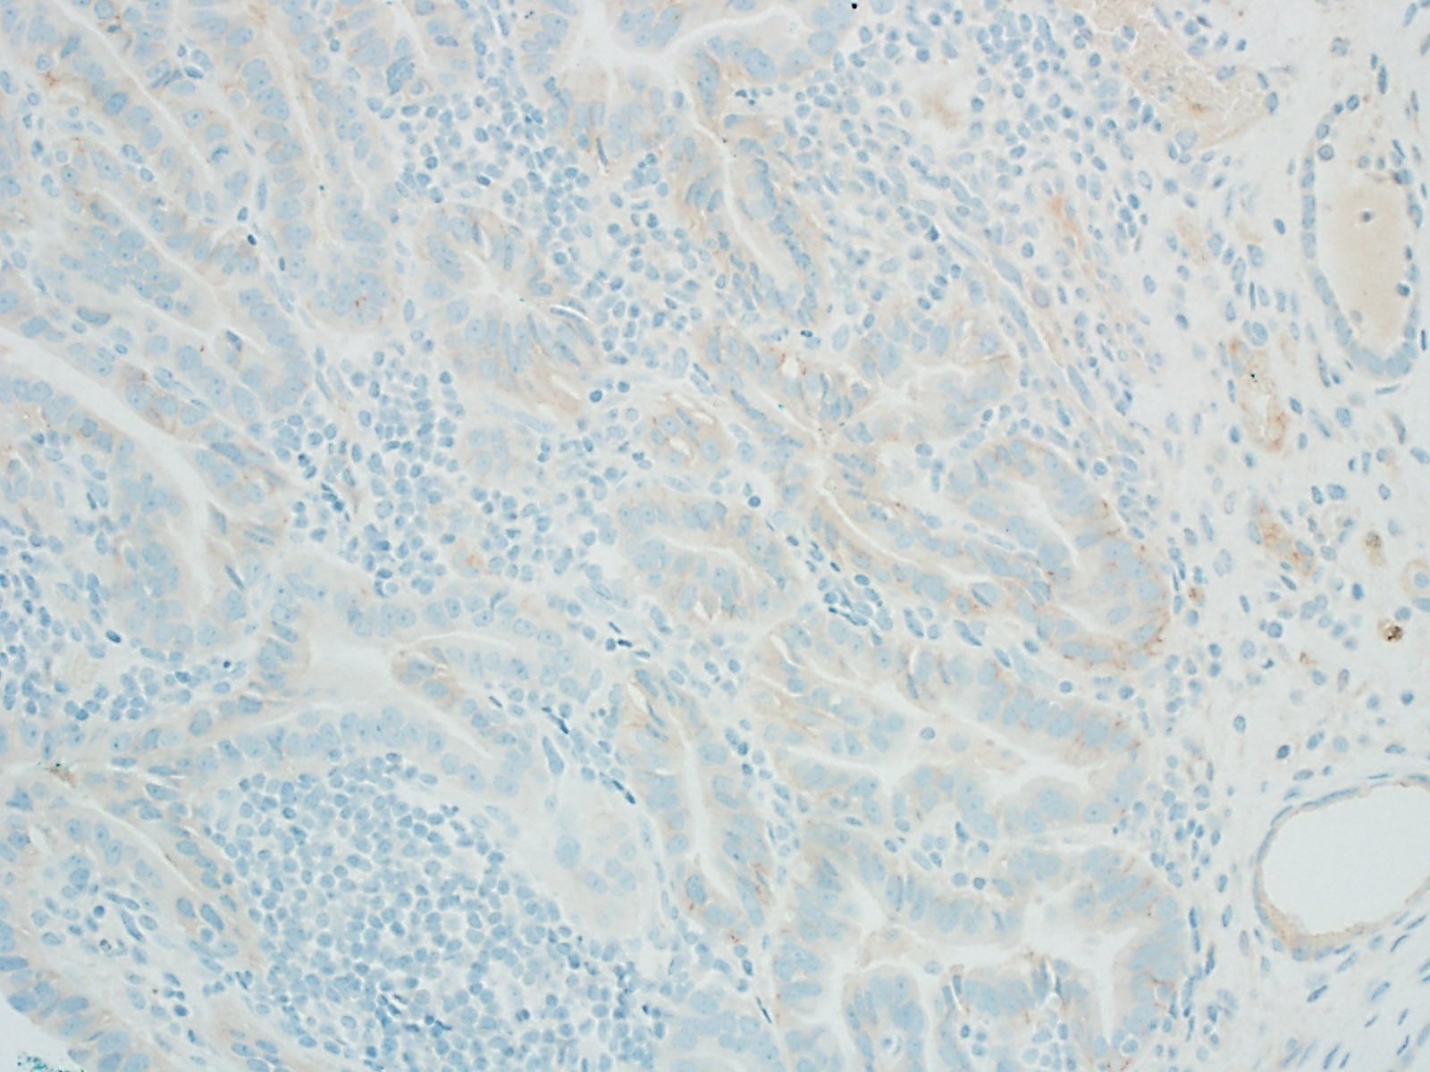
1+

Slide 15
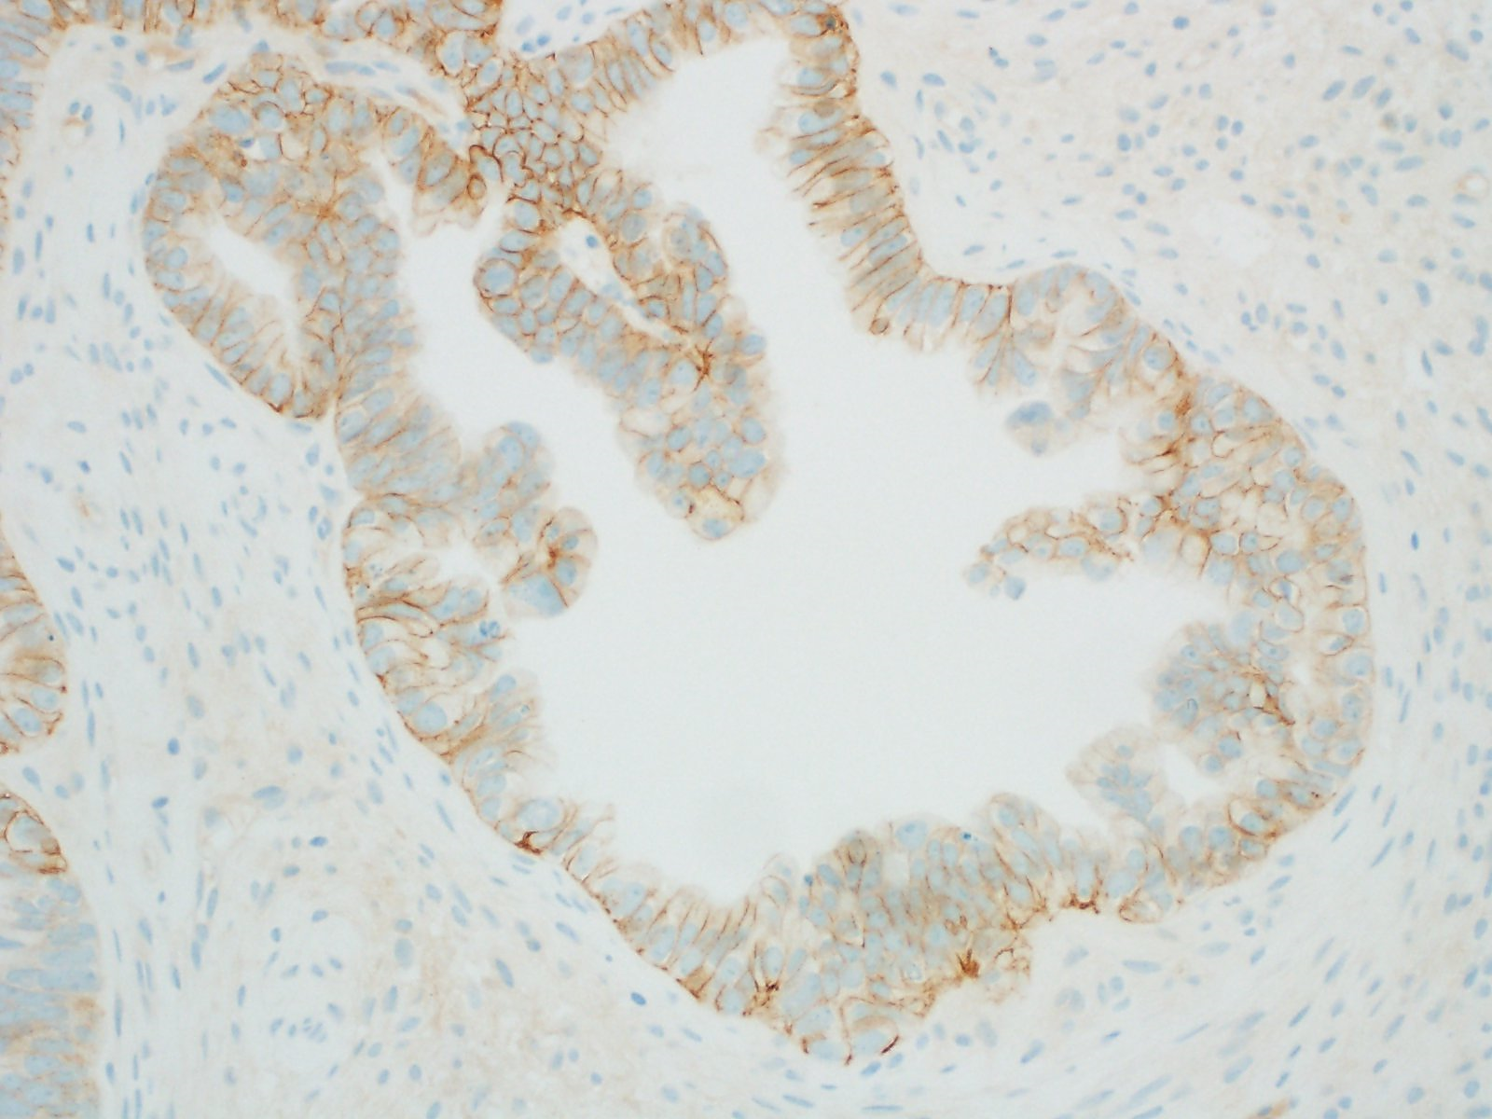
2+

Slide 16
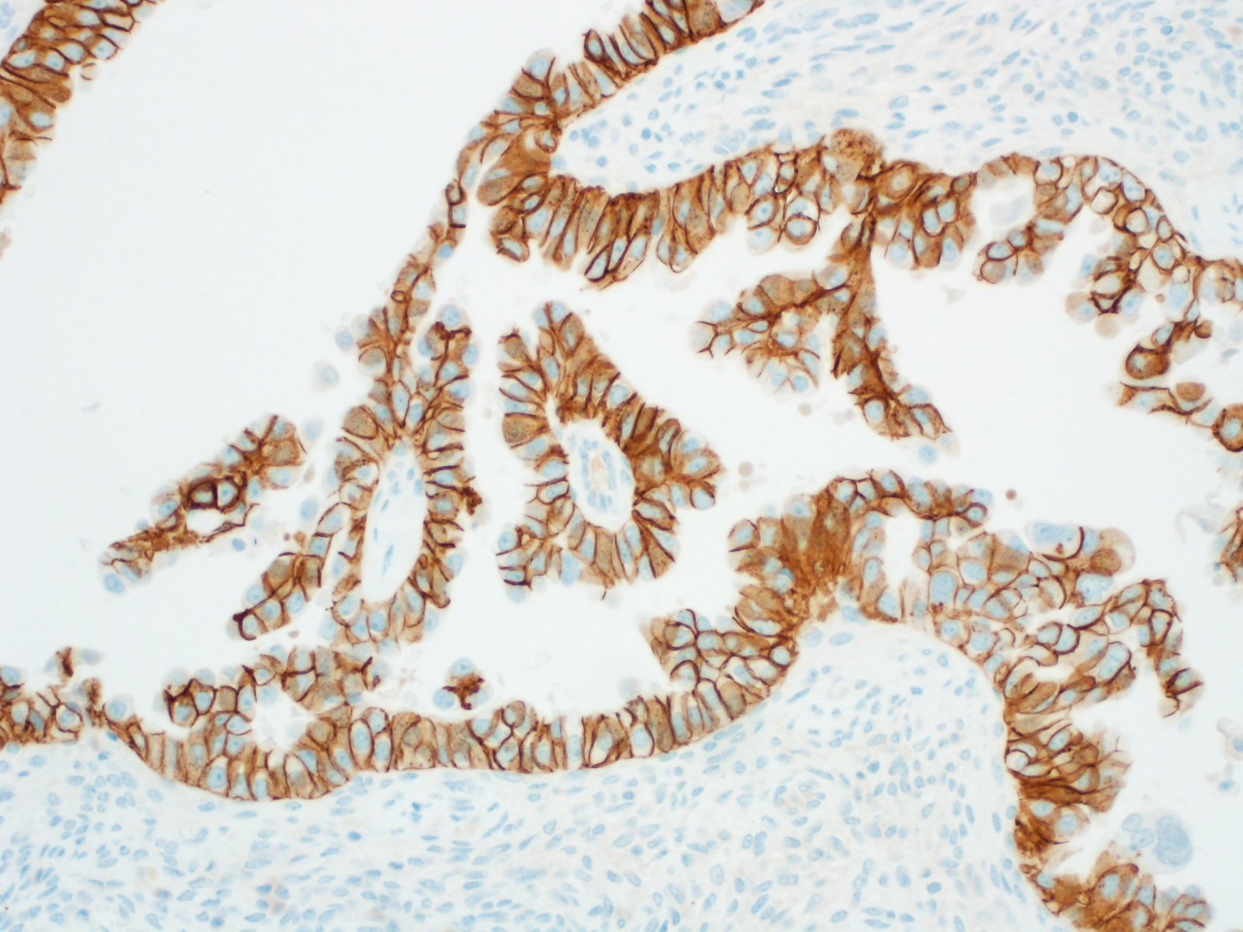
3+

Slide 17
Pitfalls of HER2 Interpretation
Interpretation is not always this straightforward
Intratumoral heterogeneity
  Much more significant of a problem than in breast carcinoma; rates are similar to GEJ carcinoma
  Even FISH can show heterogeneity of amplification
When should one test?
  Some cases show a discrepancy between biopsy/curettage and hysterectomy
  Role of neoadjuvant anti-HER2 therapy not well defined for serous carcinoma
Notes:
Buza N, Hui P. Marked heterogeneity of HER2/NEU gene amplification in endometrial serous carcinoma. Genes Chromosomes Cancer. 2013 Dec;52(12):1178-86.
Rottmann D, Assem H, Matsumoto N, et al. Does specimen type have an impact on HER2 status in endometrial serous carcinoma? Discordant HER2 status of paired endometrial biopsy and hysterectomy specimens in the presence of frequent intratumoral heterogeneity. Int J Gynecol Pathol. 2021 May;40(3):263-71.

Slide 18
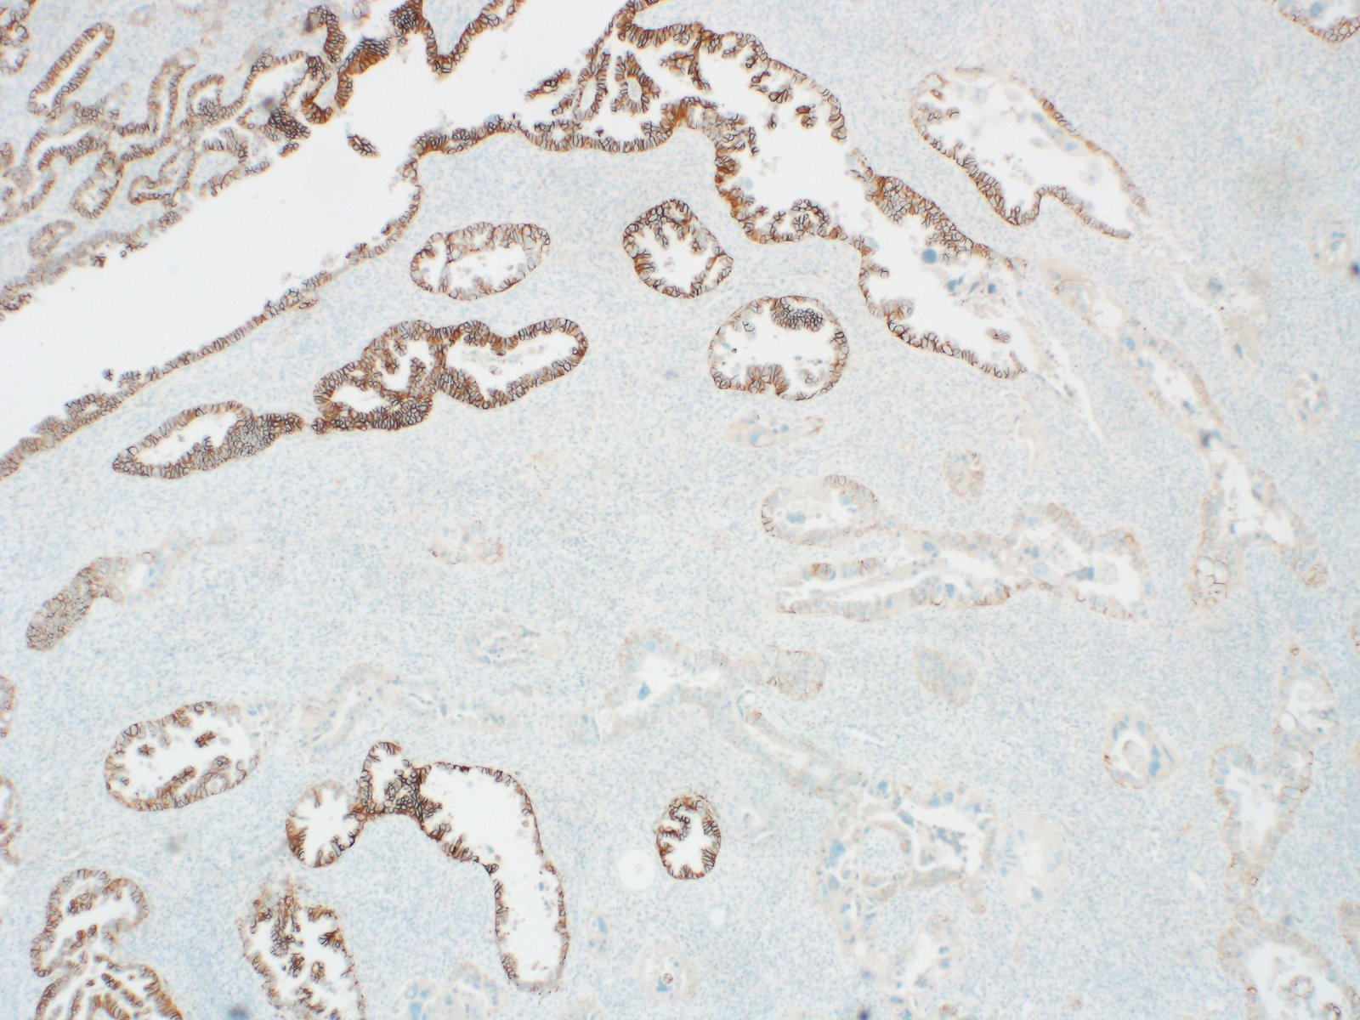

Slide 19
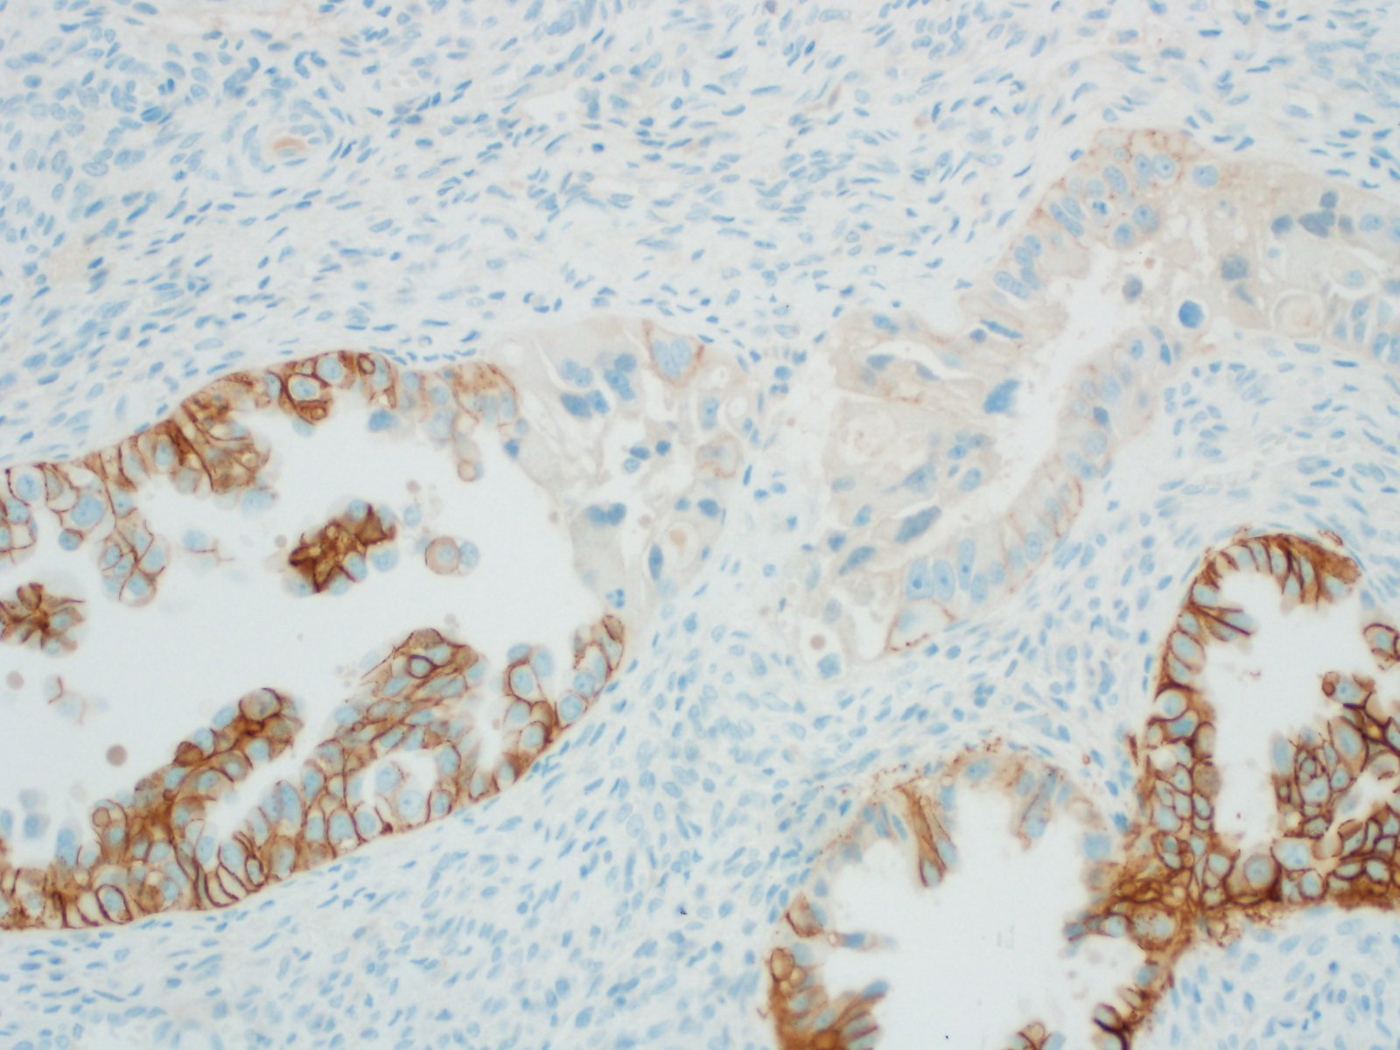

Slide 20
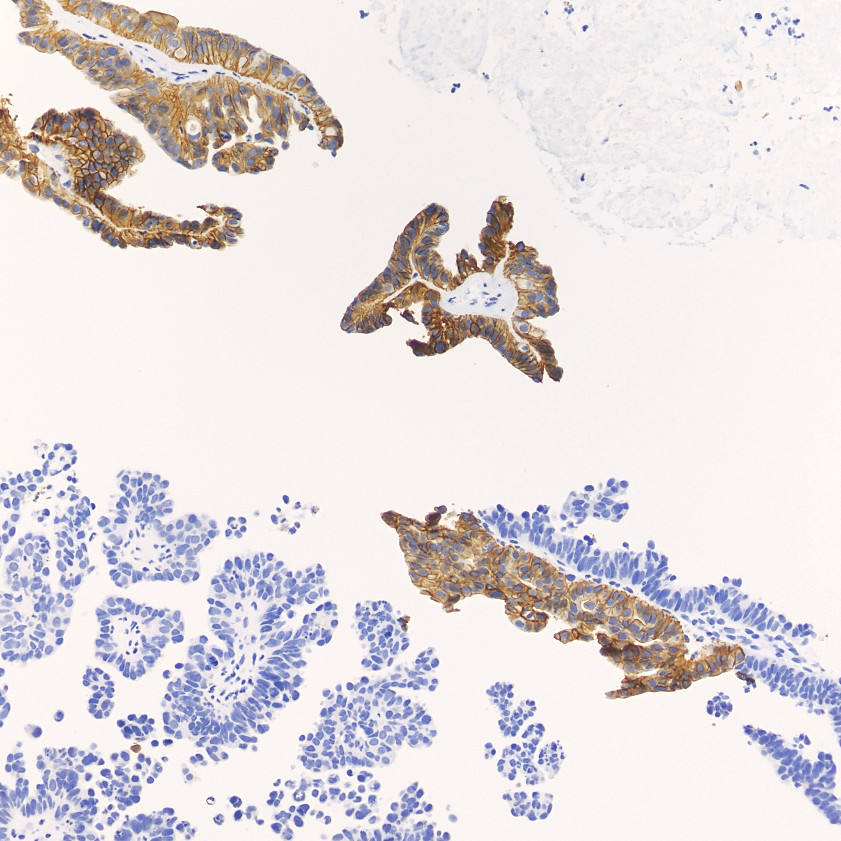

Slide 21

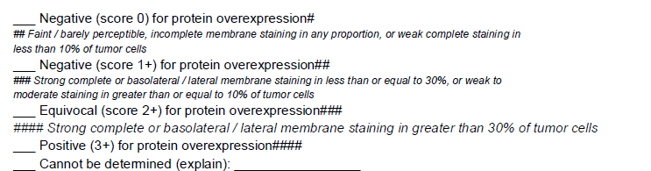
CAP Protocol: Gynecologic Biomarkers

Slide 22
Trastuzumab deruxtecan (T-DXd; Enhertu)
Antibody-drug conjugate:
  Humanized IgG1 monoclonal antibody targeting HER2
  Tetrapeptide-based cleavable linker
  Potent topoisomerase I inhibitor payload

Slide 23
DESTINY-PanTumor02
Open-label phase 2 trial
T-DXd showed clinically meaningful antitumor activity in pretreated patients with HER2-expressing solid tumors
  Locally advanced or metastatic disease after at least 1 systemic treatment or without alternative treatments
  Greatest benefit in patients with HER2 IHC 3+
    Note: ~75% of patients enrolled based on results from local HER2 IHC testing
    HER2 scoring based on ASCO/CAP guidelines for gastric cancer (but without requirement for FISH)
Oaknin A, Lee J-Y, Makker V, et al. Efficacy of Trastuzumab Deruxtecan in HER2-Expressing Solid Tumors by Enrollment HER2 IHC Status: Post Hoc Analysis of DESTINY-PanTumor02. Adv Ther 2024;41:4125-4139.

Slide 24
When can Enhertu be used?
In April 2024, the FDA granted accelerated approval for adult patients with unresectable or metastatic HER2-positive (3+ by IHC) solid tumors that have progressed after prior treatment
Approval is agnostic of tumor type*
  Tumor types included in DESTINY-PanTumor02: biliary tract, bladder, cervix, endometrium, ovary, pancreas, “other”
    Separate trials for breast cancer, non-small cell lung cancer, gastric cancer, colorectal cancer
  Further details about histologic type not available

Slide 25
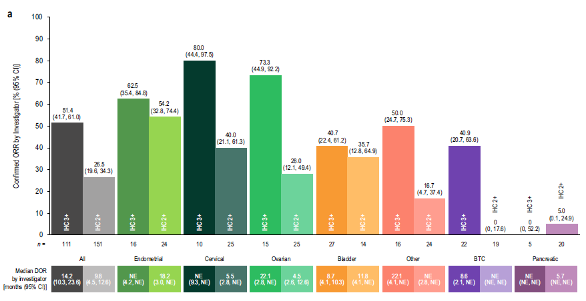
ORR and DOR according to tumor type

Slide 26
GYN: Current state at UM
HER2 IHC performed upon clinician request
  Fairly common request, especially in tumor board

Slide 27
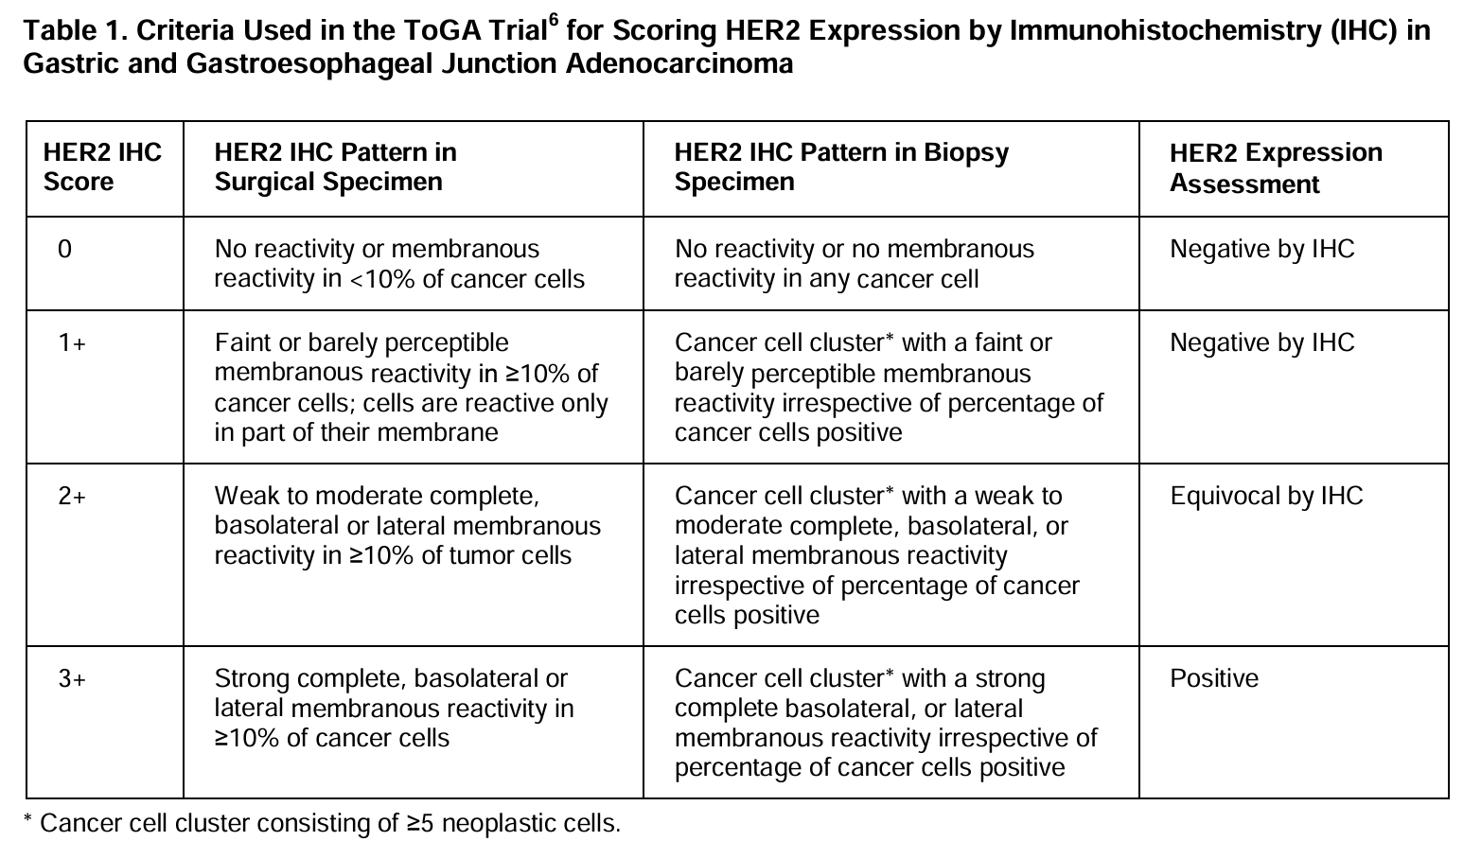
CAP Guidelines for Scoring HER2 IHC in Gastric Cancer

Slide 28


HER2 IHC 3+

Slide 29
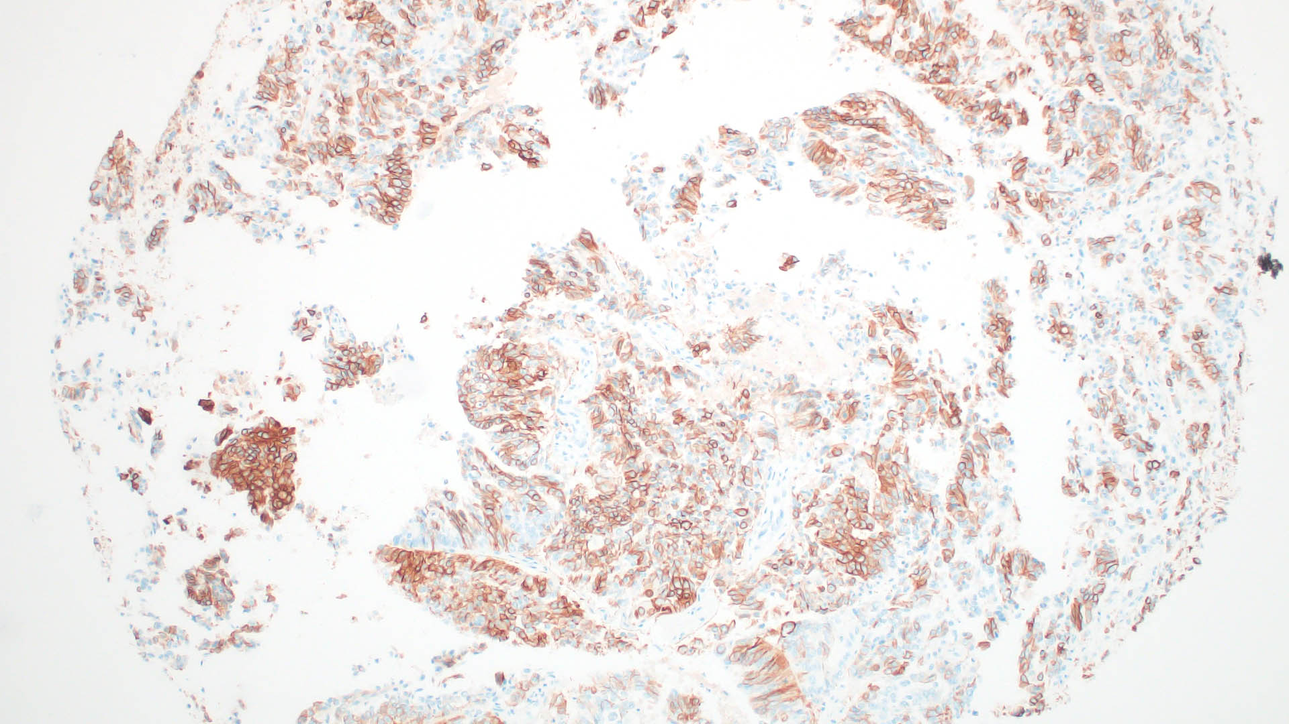
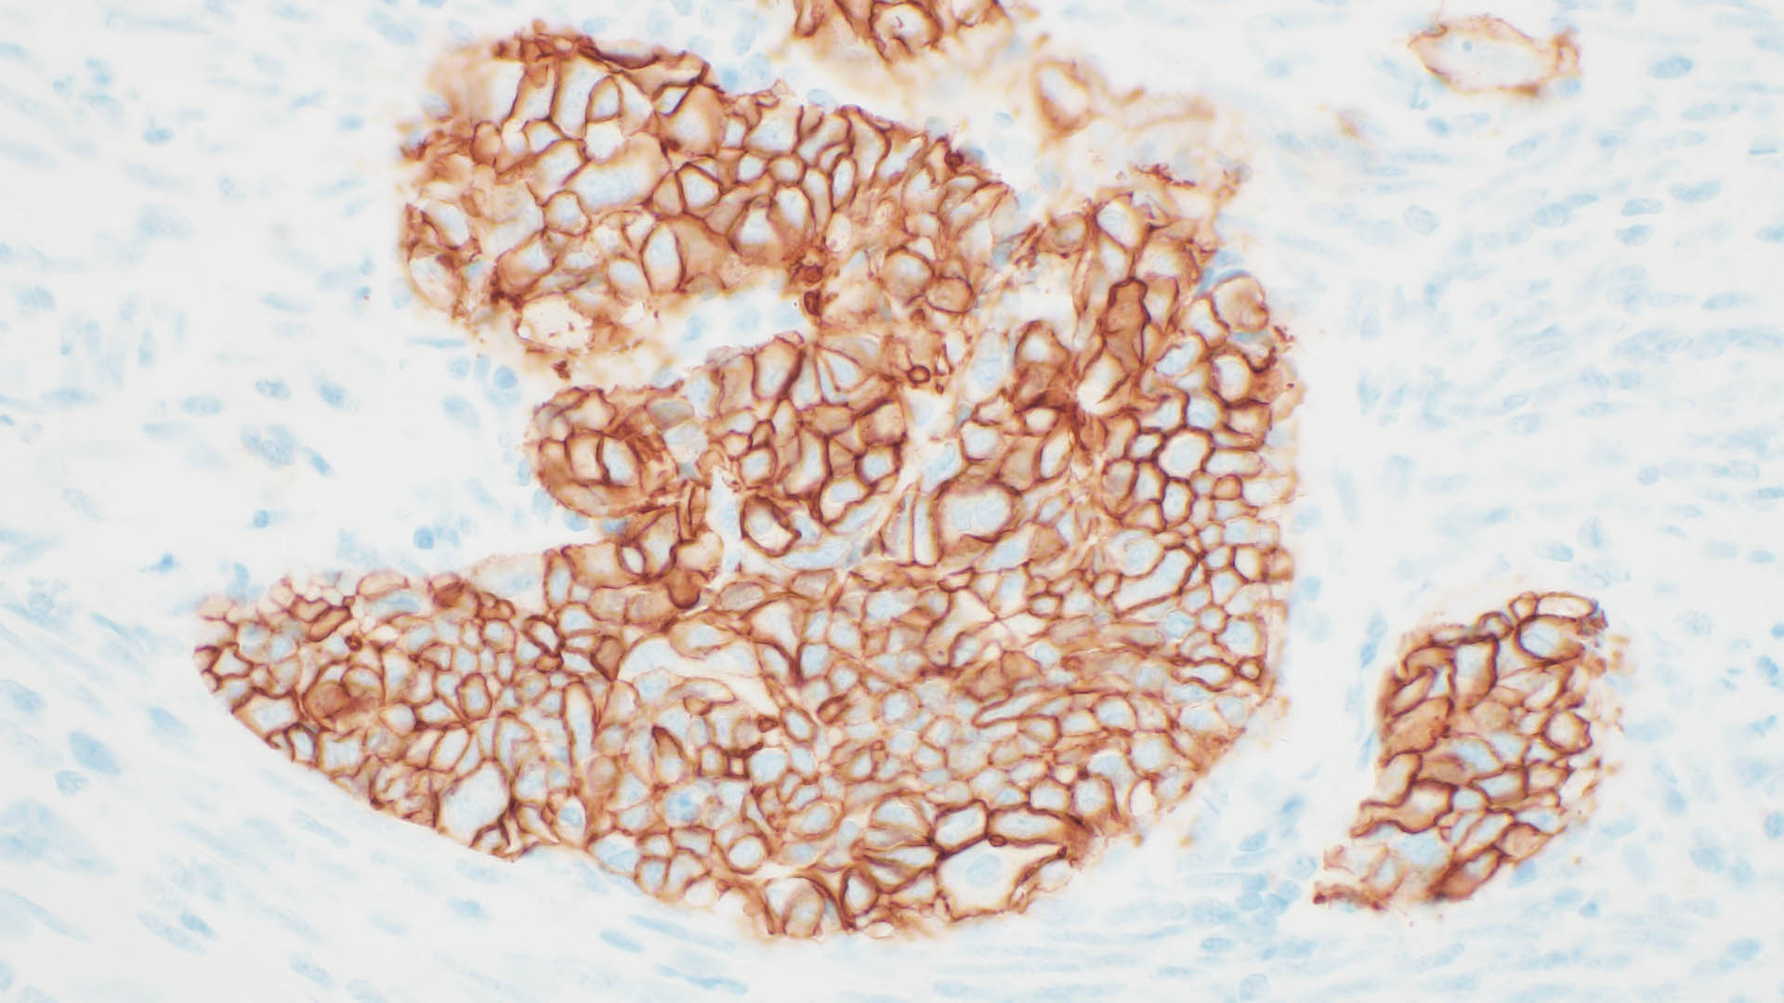

HER2 IHC 3+

Slide 30
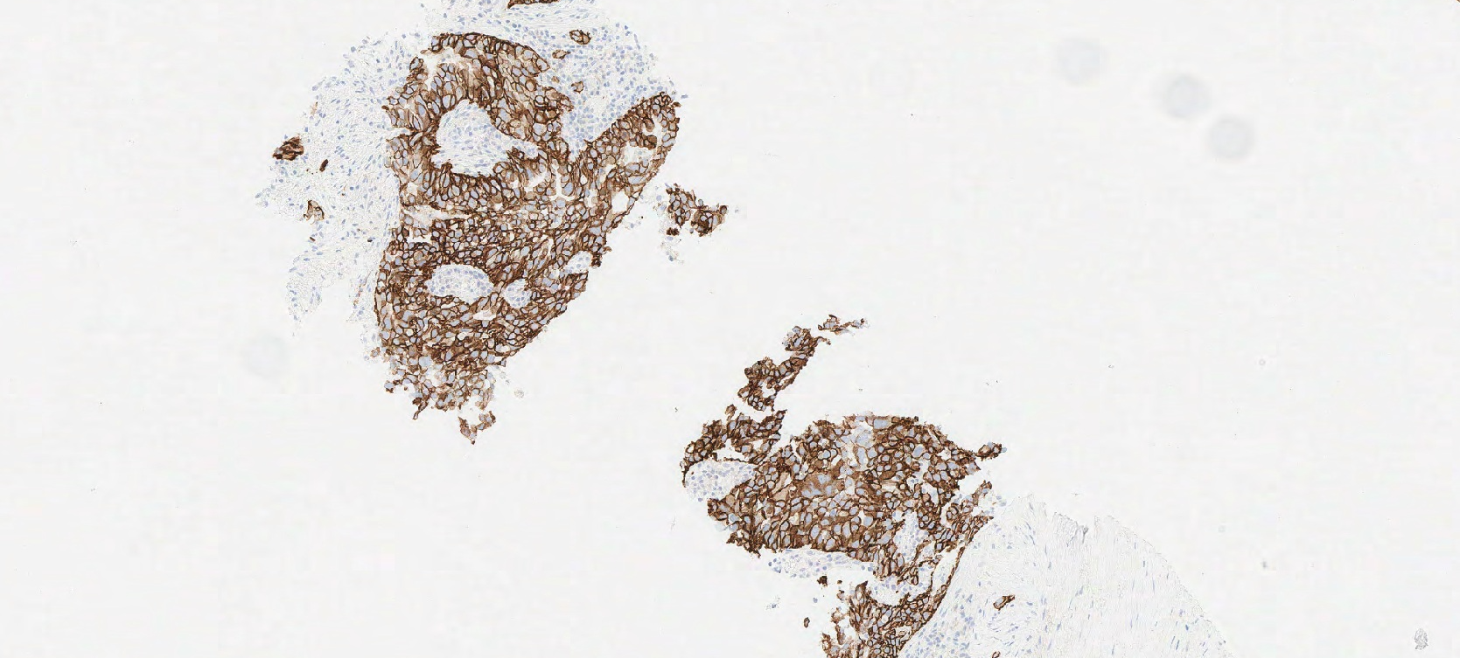
HER2 IHC 3+

Slide 31
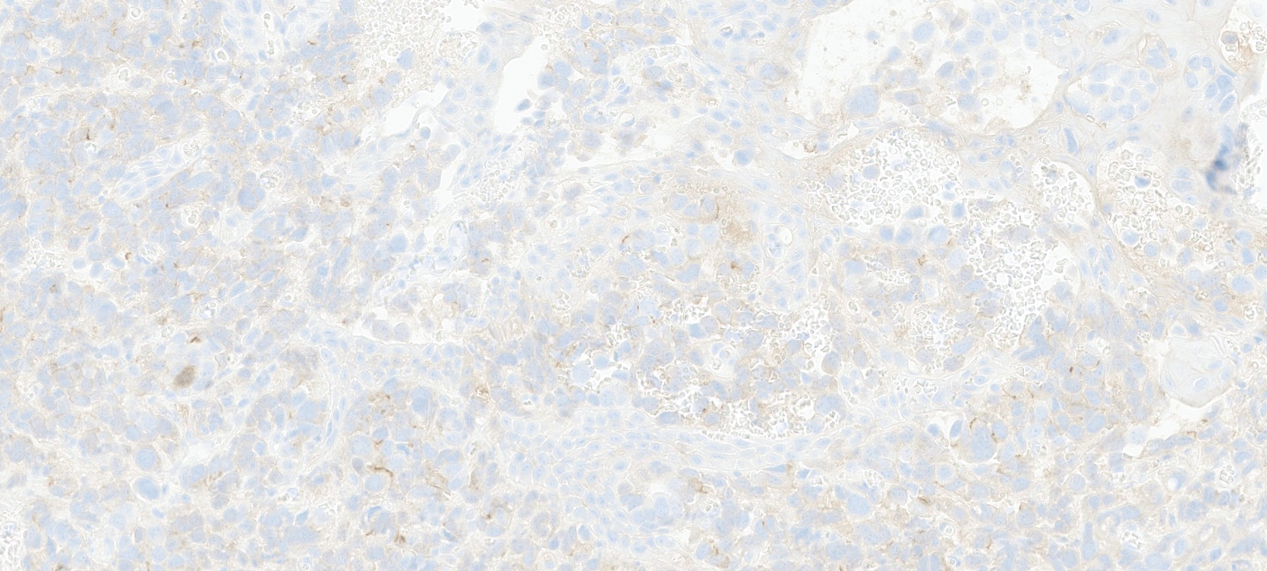

HER2 IHC 1+

Slide 32


HER2 IHC 1+

Slide 33
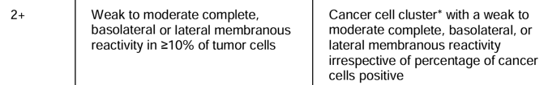
What about HER2 IHC 2+ (equivocal)?
FISH wasn’t utilized in the DESTINY trial and therefore isn’t routinely used in HER2 assessment for Enhertu therapy
  Staining in the high 2+ / low 3+ range may pose additional challenge when FISH is not used to adjudicate HER2 status
Should we stain biopsies or resections?
Should we stain primary or recurrent/metastatic disease?
Does antigenicity of the FFPE tissue degrade over time?

Slide 34


HER2 IHC 2+

Slide 35

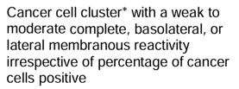
HER2 IHC 2+

Slide 36

HER2 IHC 2+
Notes:
Vs 3+. FISH showed HER2 amplification.

Slide 37

Example: metastatic endometrioid carcinoma

Slide 38
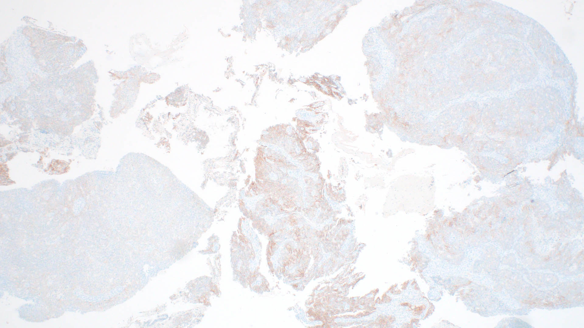
Example: metastatic endometrioid carcinoma

Slide 39
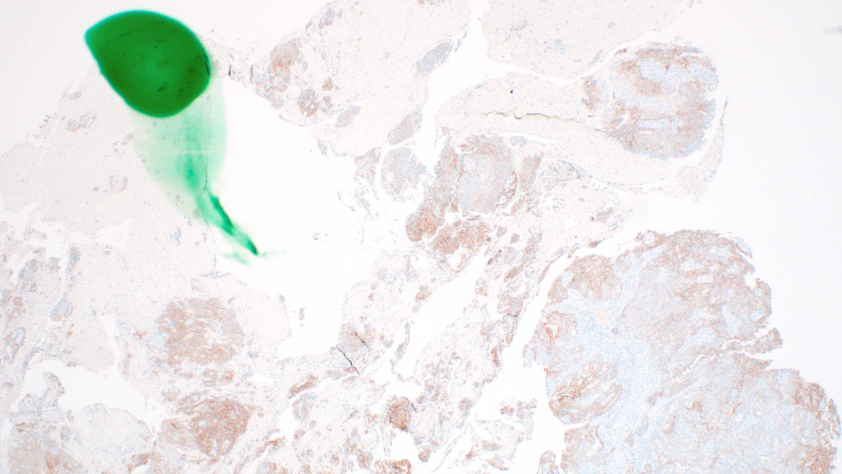
Example: metastatic endometrioid carcinoma

Slide 40
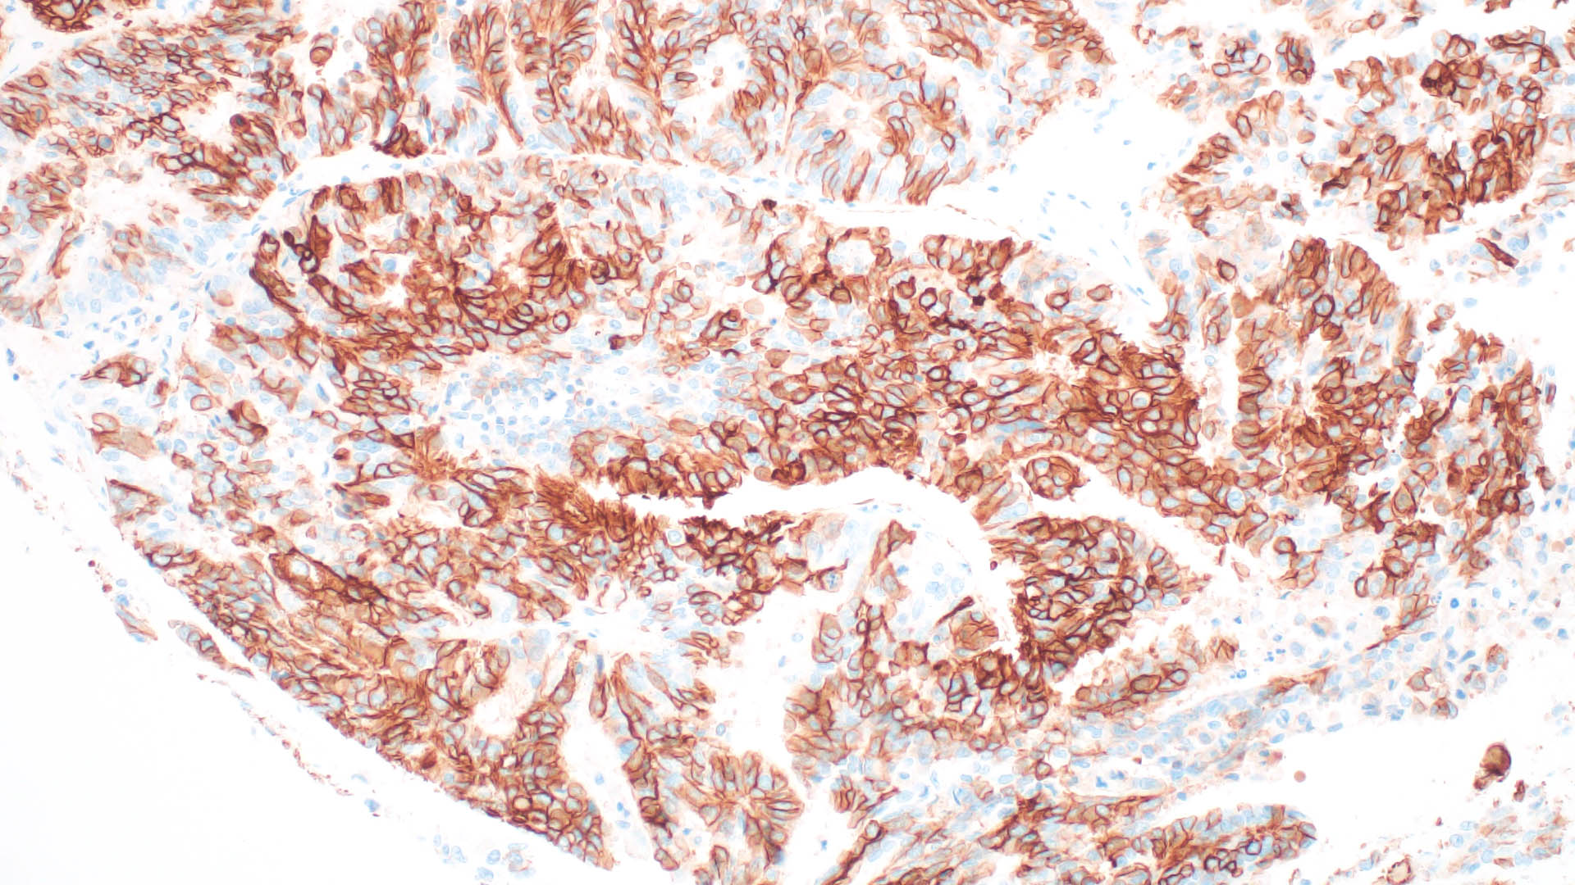
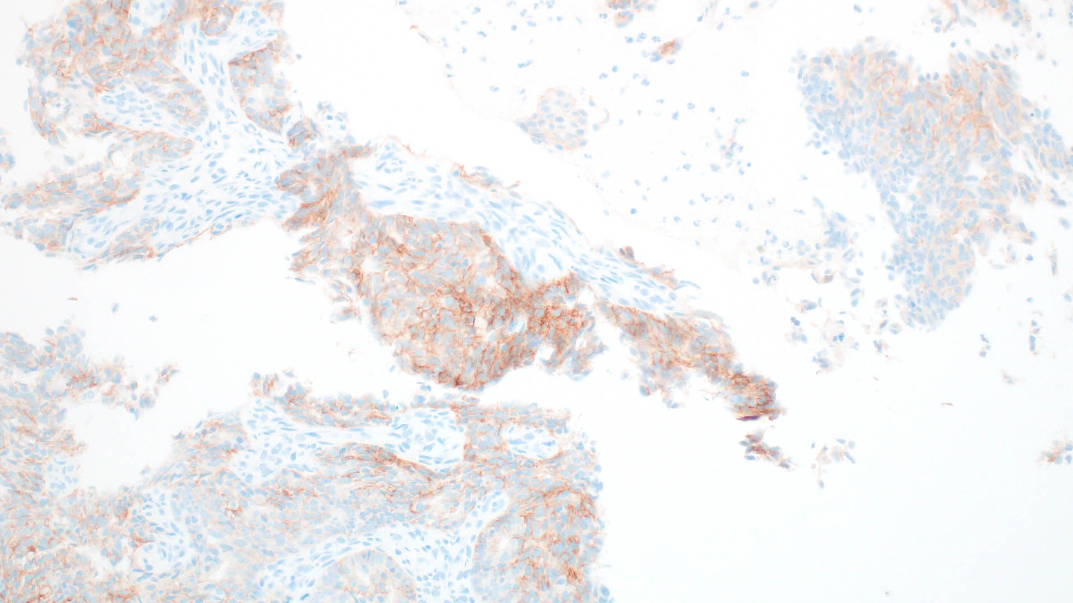
Example: metastatic endometrioid carcinoma

Slide 41
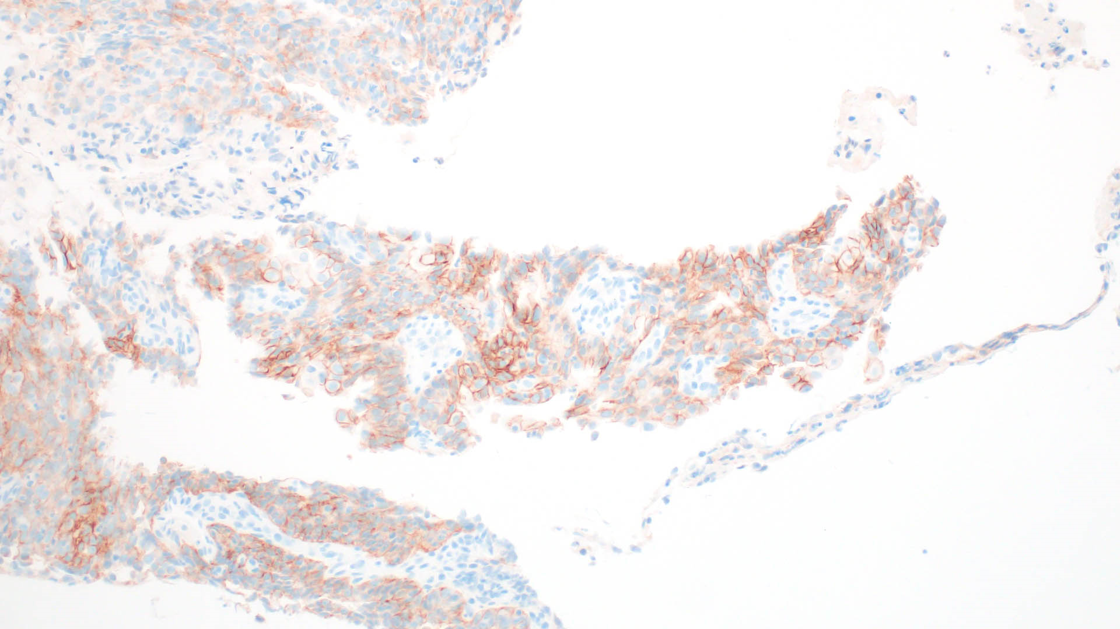
Example: metastatic endometrioid carcinoma

Slide 42
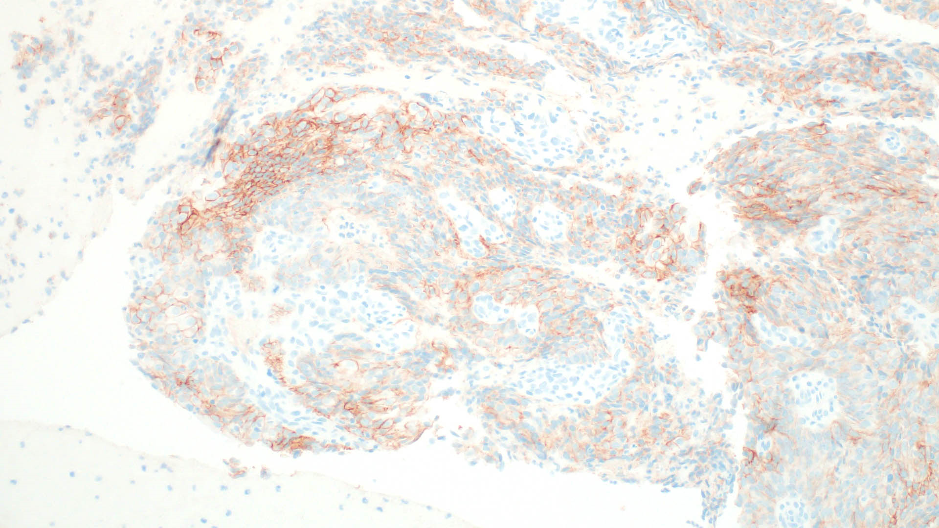
Example: metastatic endometrioid carcinoma

Slide 43
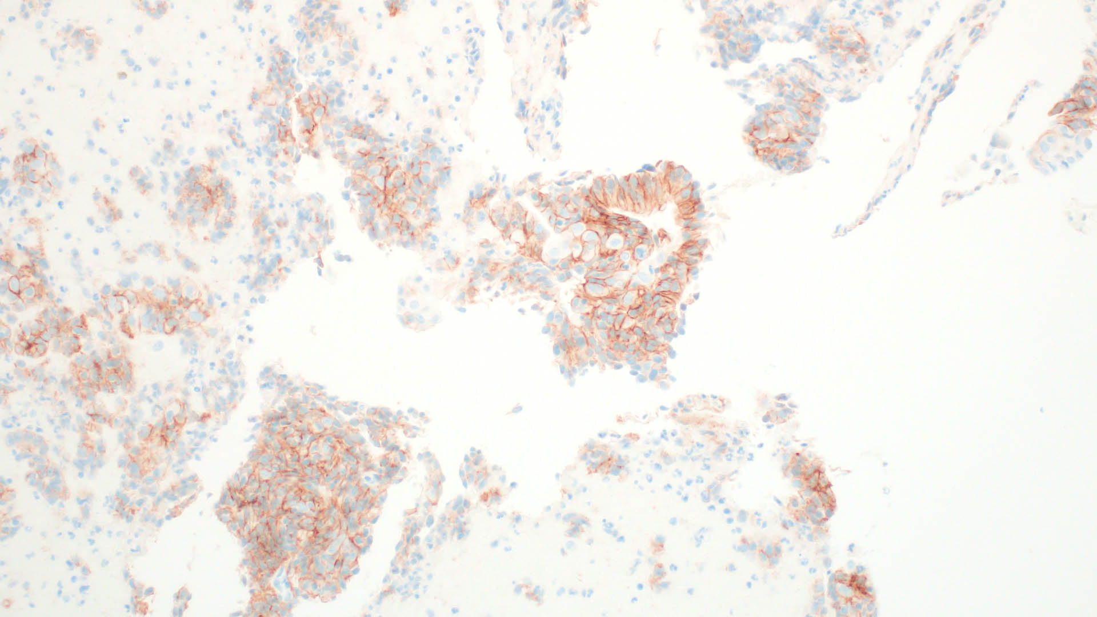
Example: metastatic endometrioid carcinoma

Slide 44
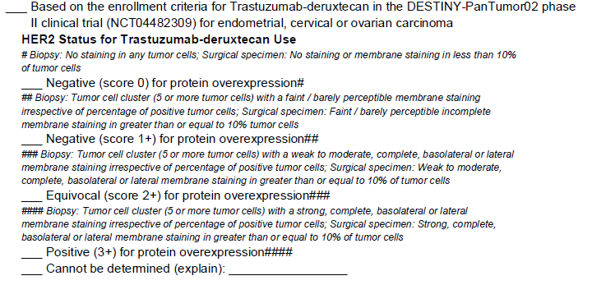
CAP Protocol: Gynecologic Biomarkers

Slide 45
Group discussion at UM
Re: antigenicity of FFPE tissue
  Cut into block instead of using unstained slides, when possible
  Likely helpful to cut into the block if possible, since the very surface is more likely to lose antigenicity
  ~10% signal lost per 8.5 years based on a breast study
    PMID 26568292

