Slide 1

Wolves in sheep’s clothing: challenging histotypes of endometrial carcinoma
Stephanie L. Skala, MD
Clinical Associate Professor of Pathology
Director of Surgical Pathology
University of Michigan

Slide 2
Learning Objectives
Identify deceptively bland forms of endometrial carcinoma
Describe histologically bland forms of endometrial carcinoma which are considered aggressive histological types by FIGO 2023

Slide 3
Case #1
62 yo with history of endometrial cancer

Slide 4
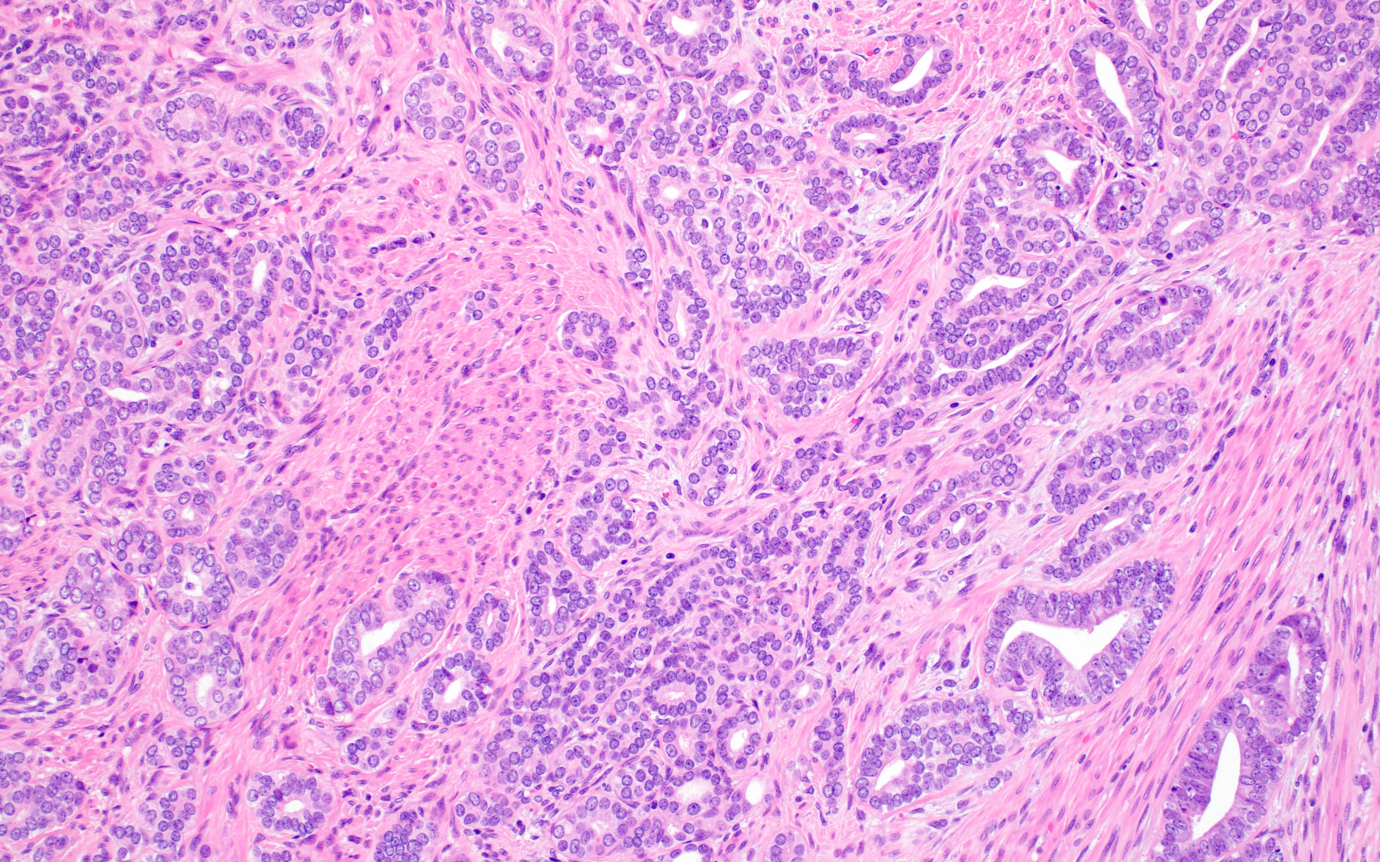

Slide 5
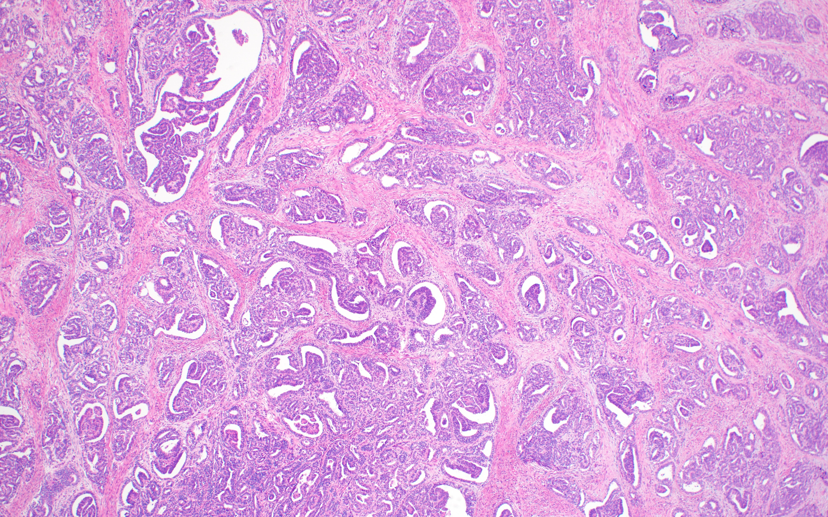

Slide 6
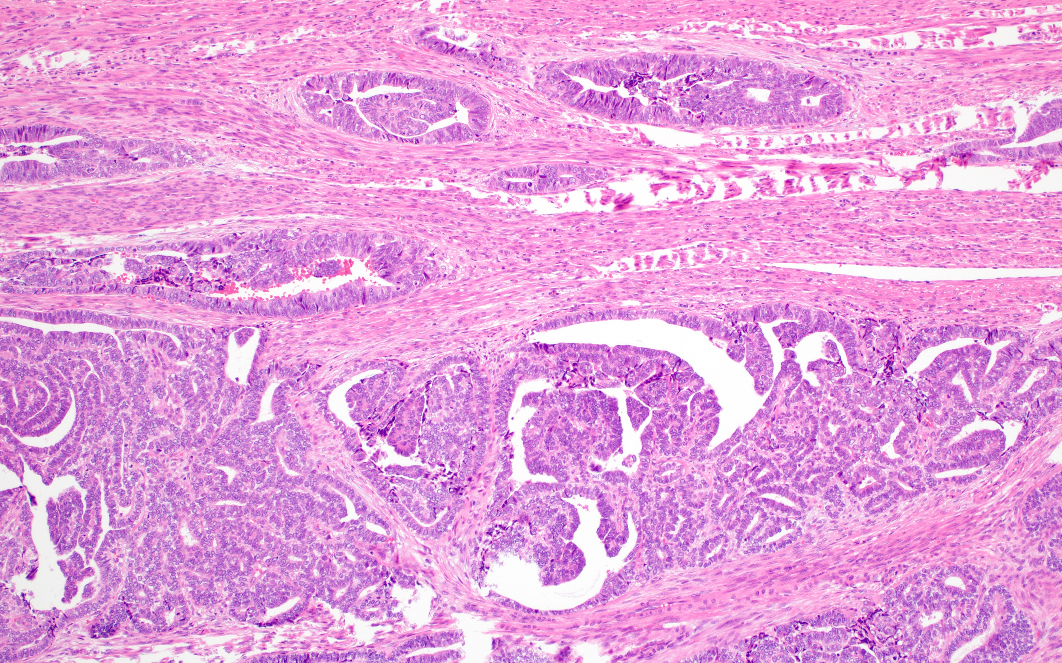

Slide 7
Mesonephric-like Endometrial Carcinoma
Morphology
  Range of architectural patterns including tubular, ductal, papillary, sieve-like, corded, spindled, glomeruloid
  Often monotonous ovoid vesicular nuclei which may be reminiscent of papillary thyroid carcinoma
Why does this matter clinically?
  These tumors tend to be mistaken for low-grade endometrioid carcinomas, but they behave aggressively.

Slide 8
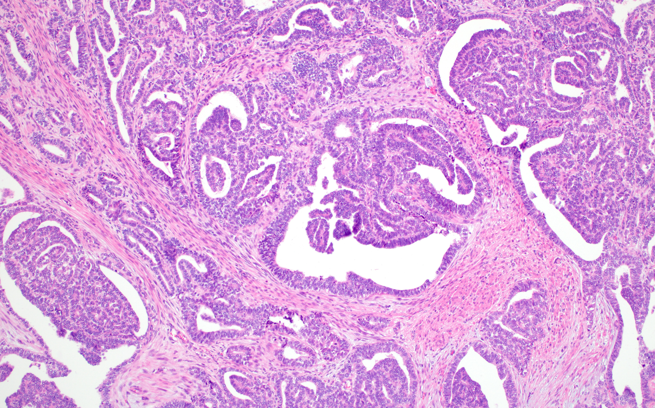

Slide 9
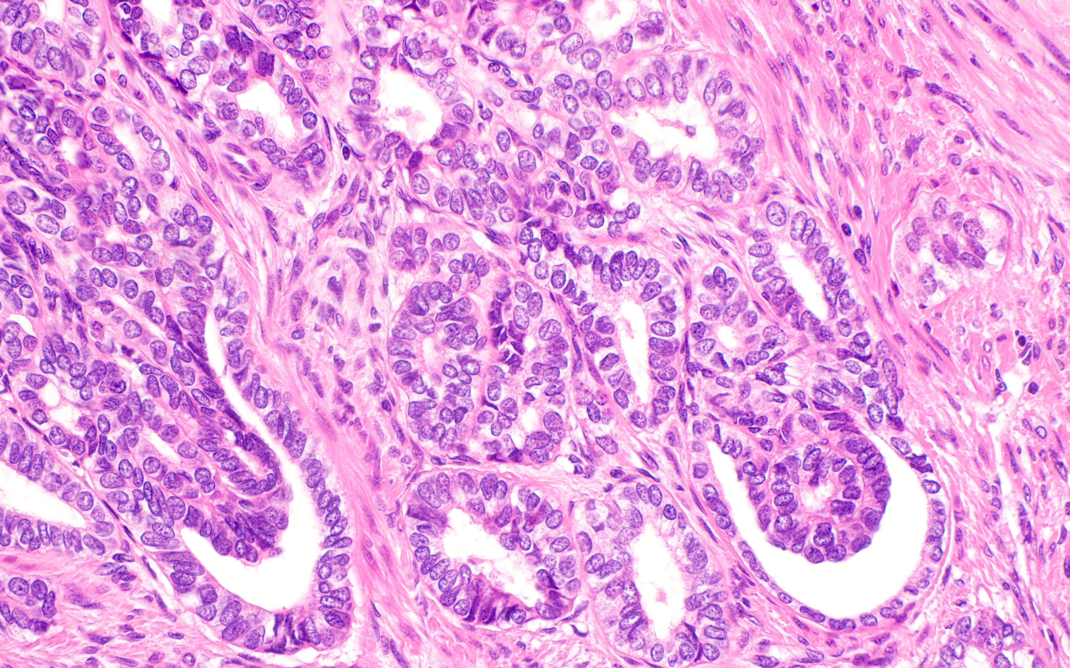

Slide 10
Mesonephric-Like Endometrial Carcinoma
Immunohistochemistry
  Estrogen receptor and progesterone receptor negative (or focal)
  Positive for TTF-1, GATA3, and/or luminal CD10
Molecular
  Frequent KRAS mutations
  No mismatch repair deficiency, TP53 mutation, or PTEN mutation

Slide 11
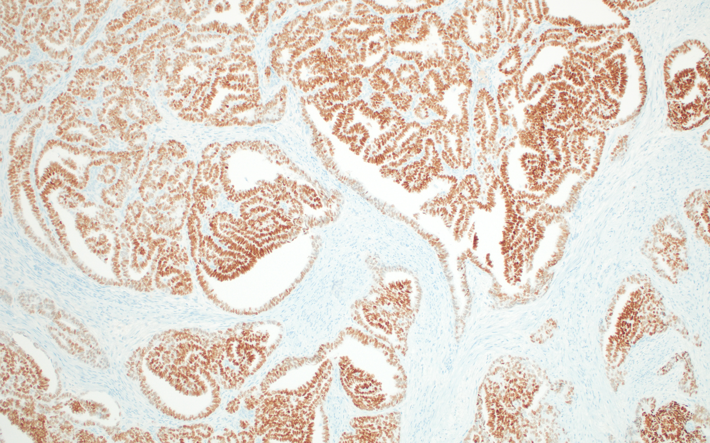
TTF-1

Slide 12
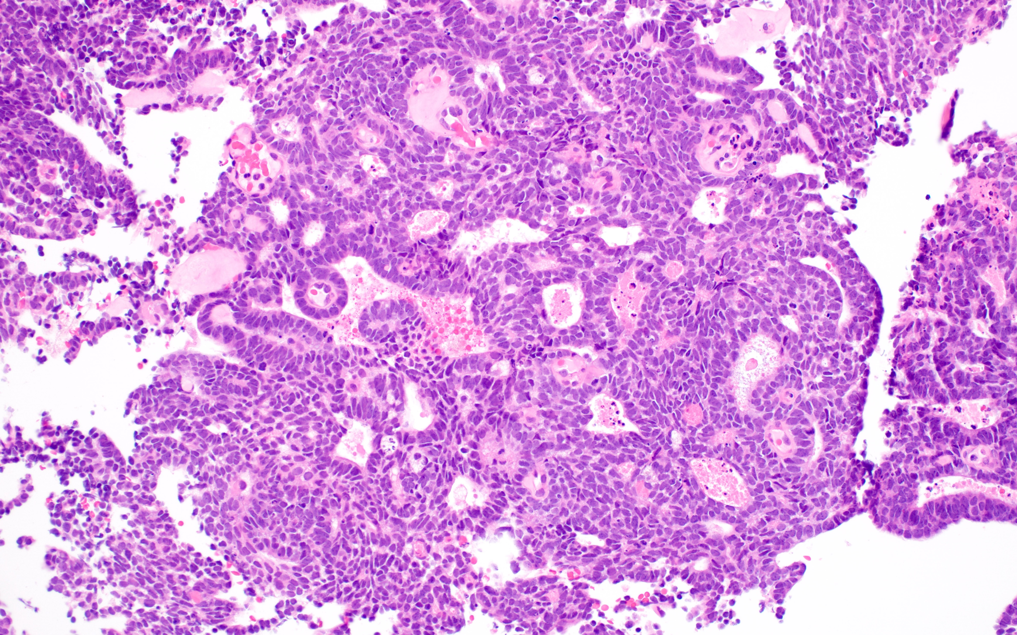

Slide 13
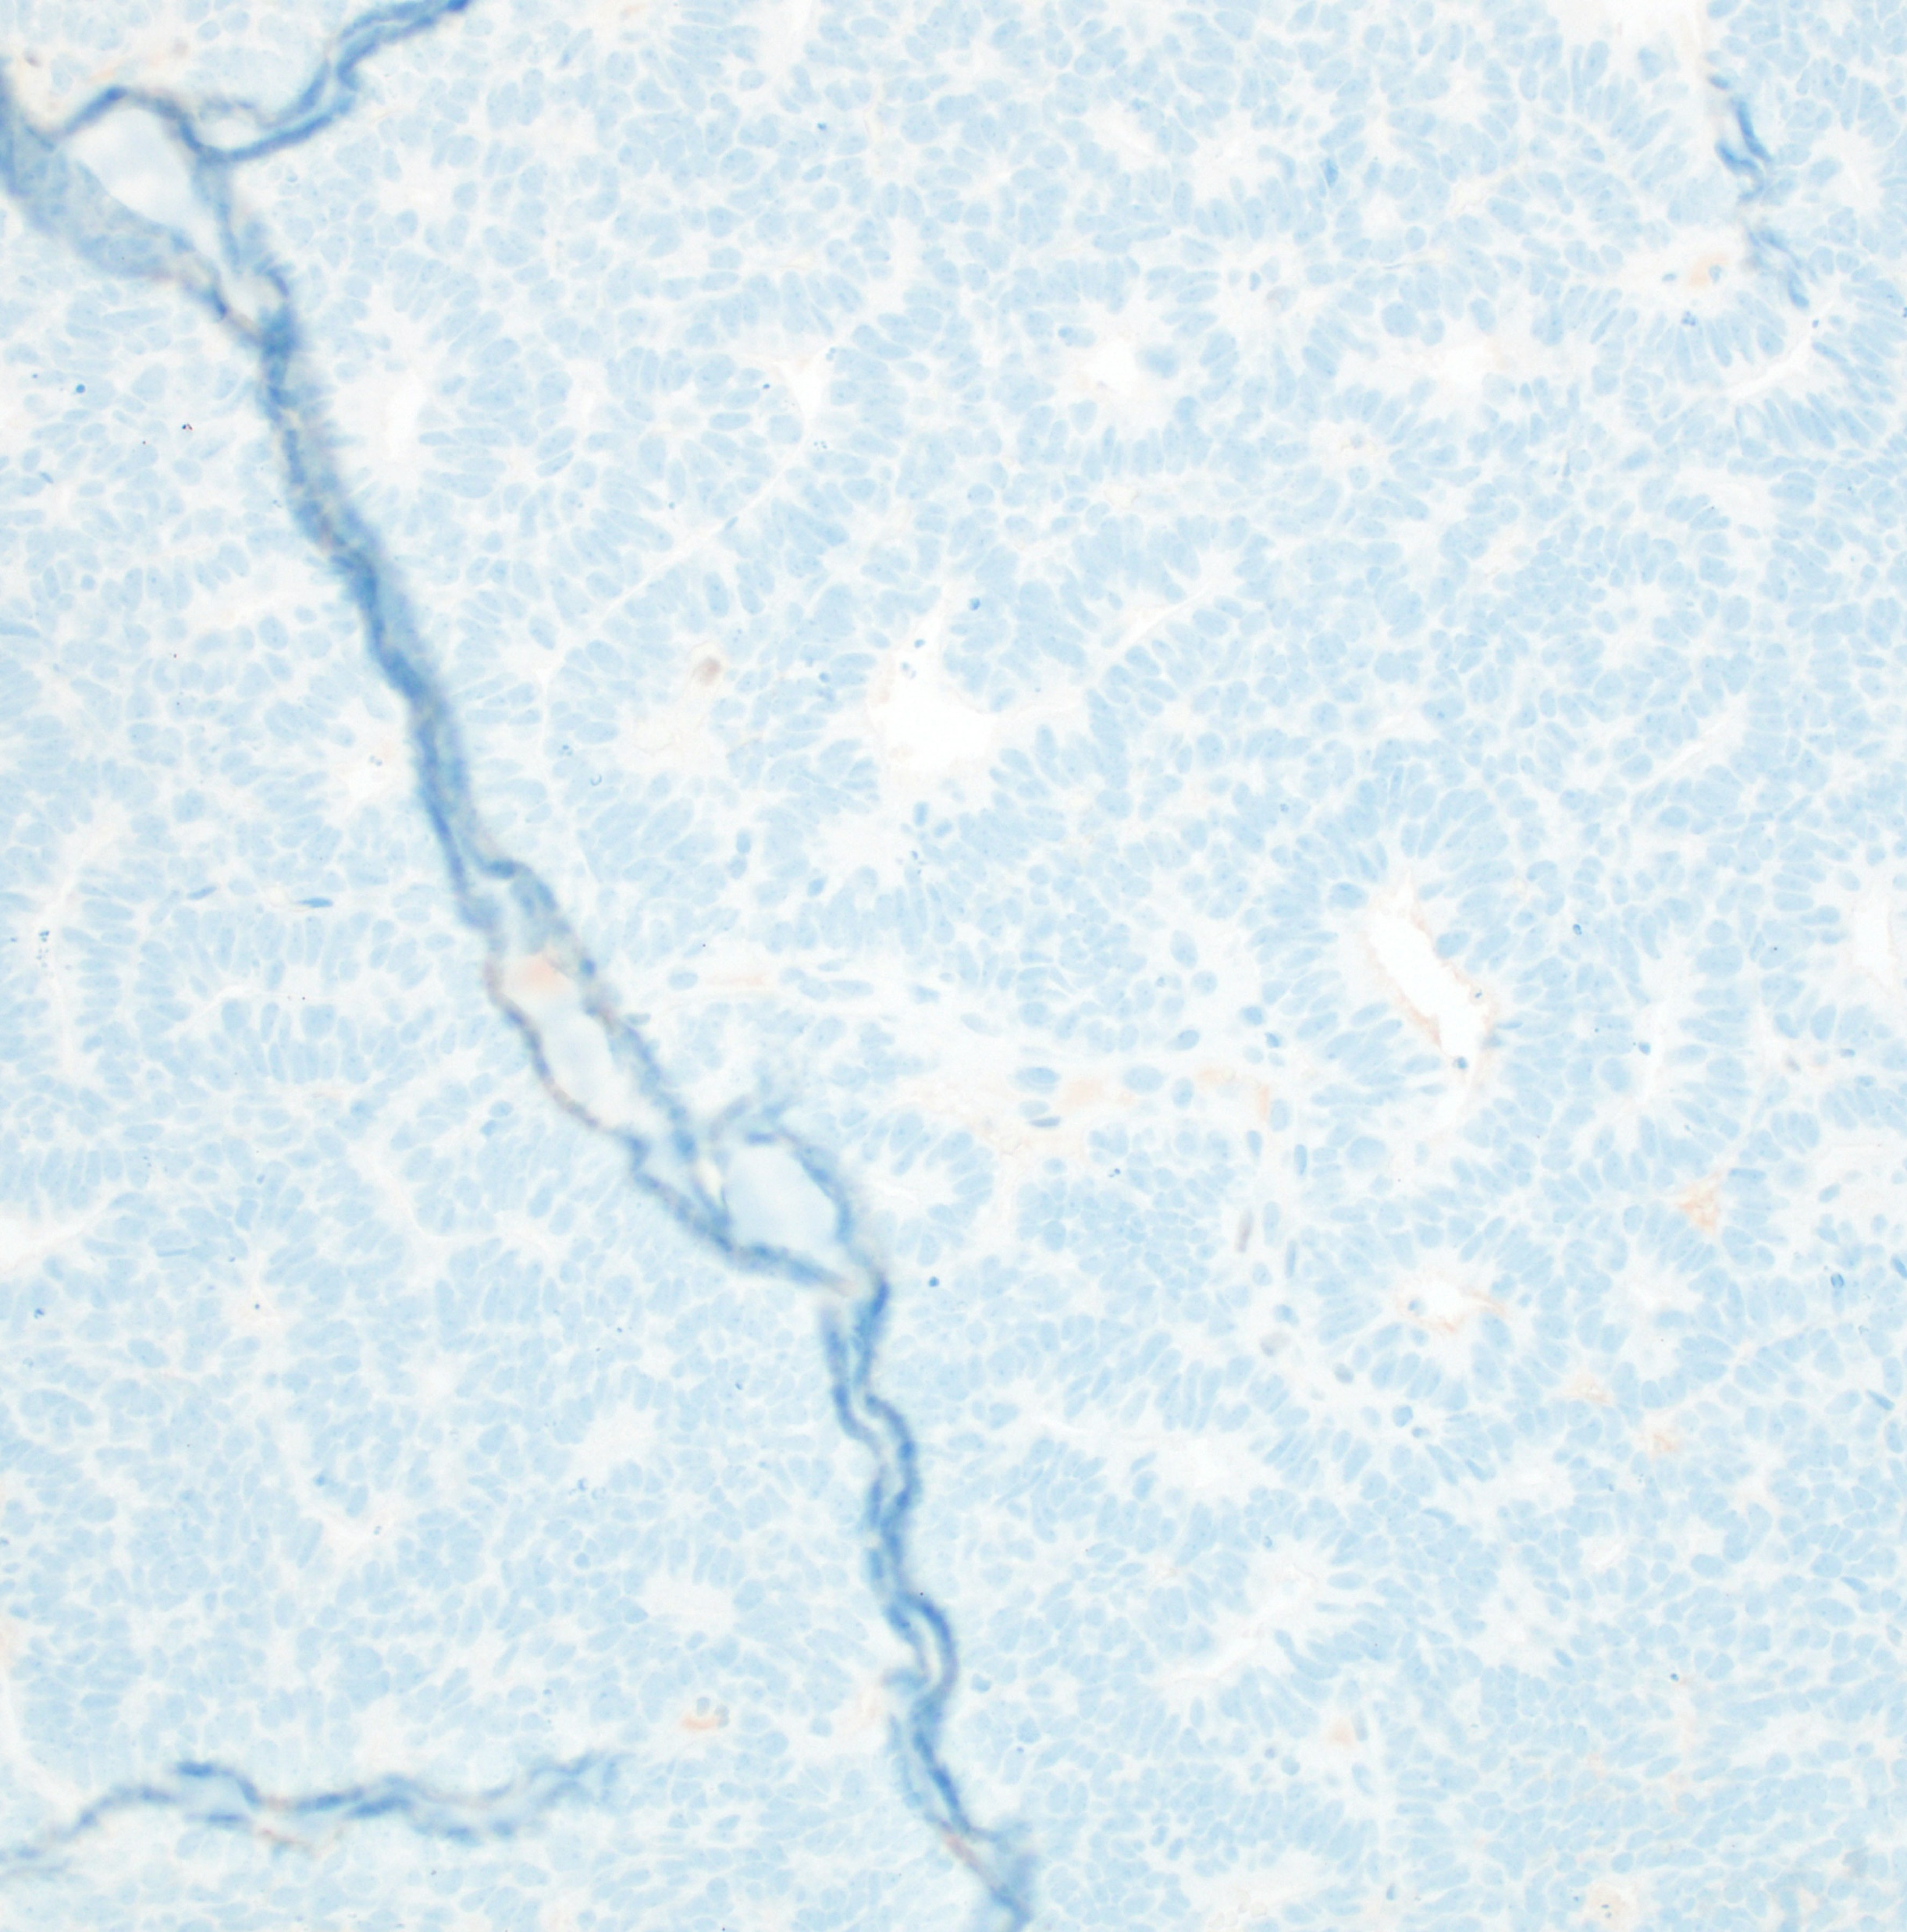

ER/PR

Slide 14
Case #2
41 yo with cervical dysplasia

Slide 15
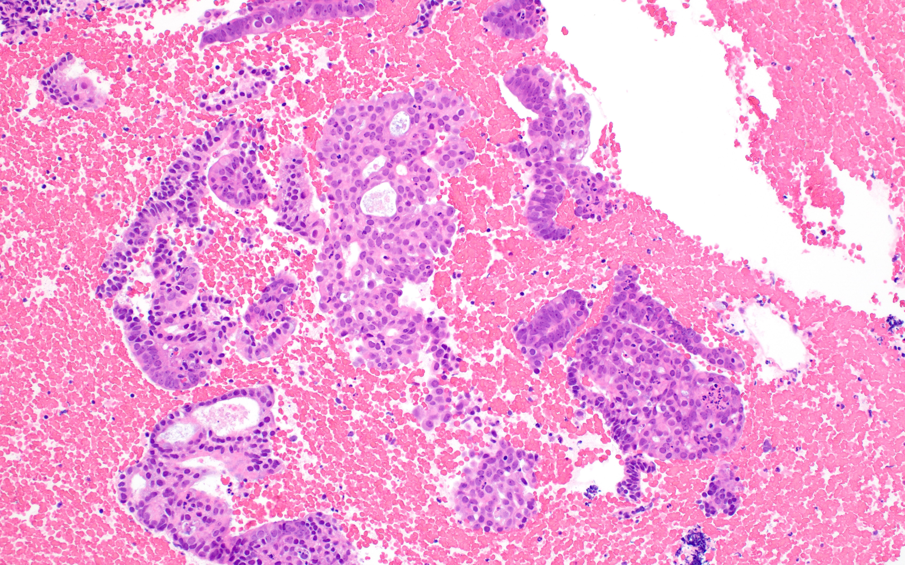

Slide 16
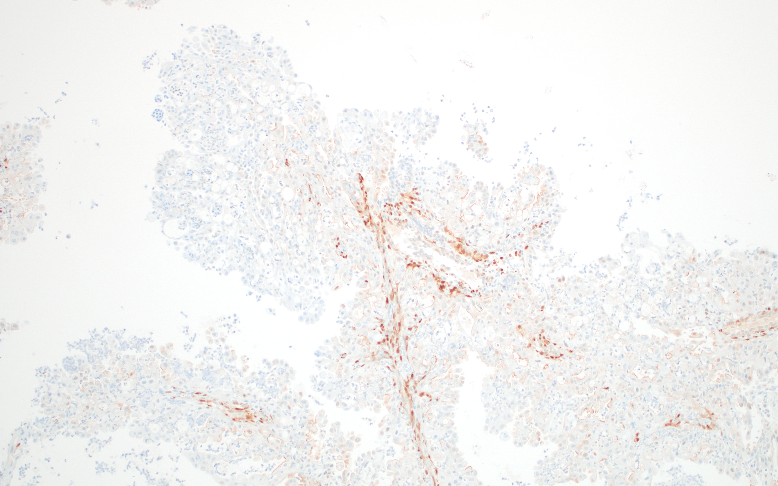
PTEN

Slide 17
Endometrioid Carcinoma with Microglandular Hyperplasia-like Pattern
Morphology
  Frequent morphologic overlap between endocervical microglandular hyperplasia and low-grade endometrioid carcinoma
  Rare mitotic figures may be present in MGH; mitotic figures are usually not numerous in low-grade endometrioid carcinoma
  Cytologic atypia may be mild in both entities
  A subcolumnar reserve cell layer is seen in MGH but not in endometrioid carcinoma
Why does this matter clinically?
  Cancers with this microglandular pattern may be misdiagnosed as benign endocervical microglandular hyperplasia.

Slide 18
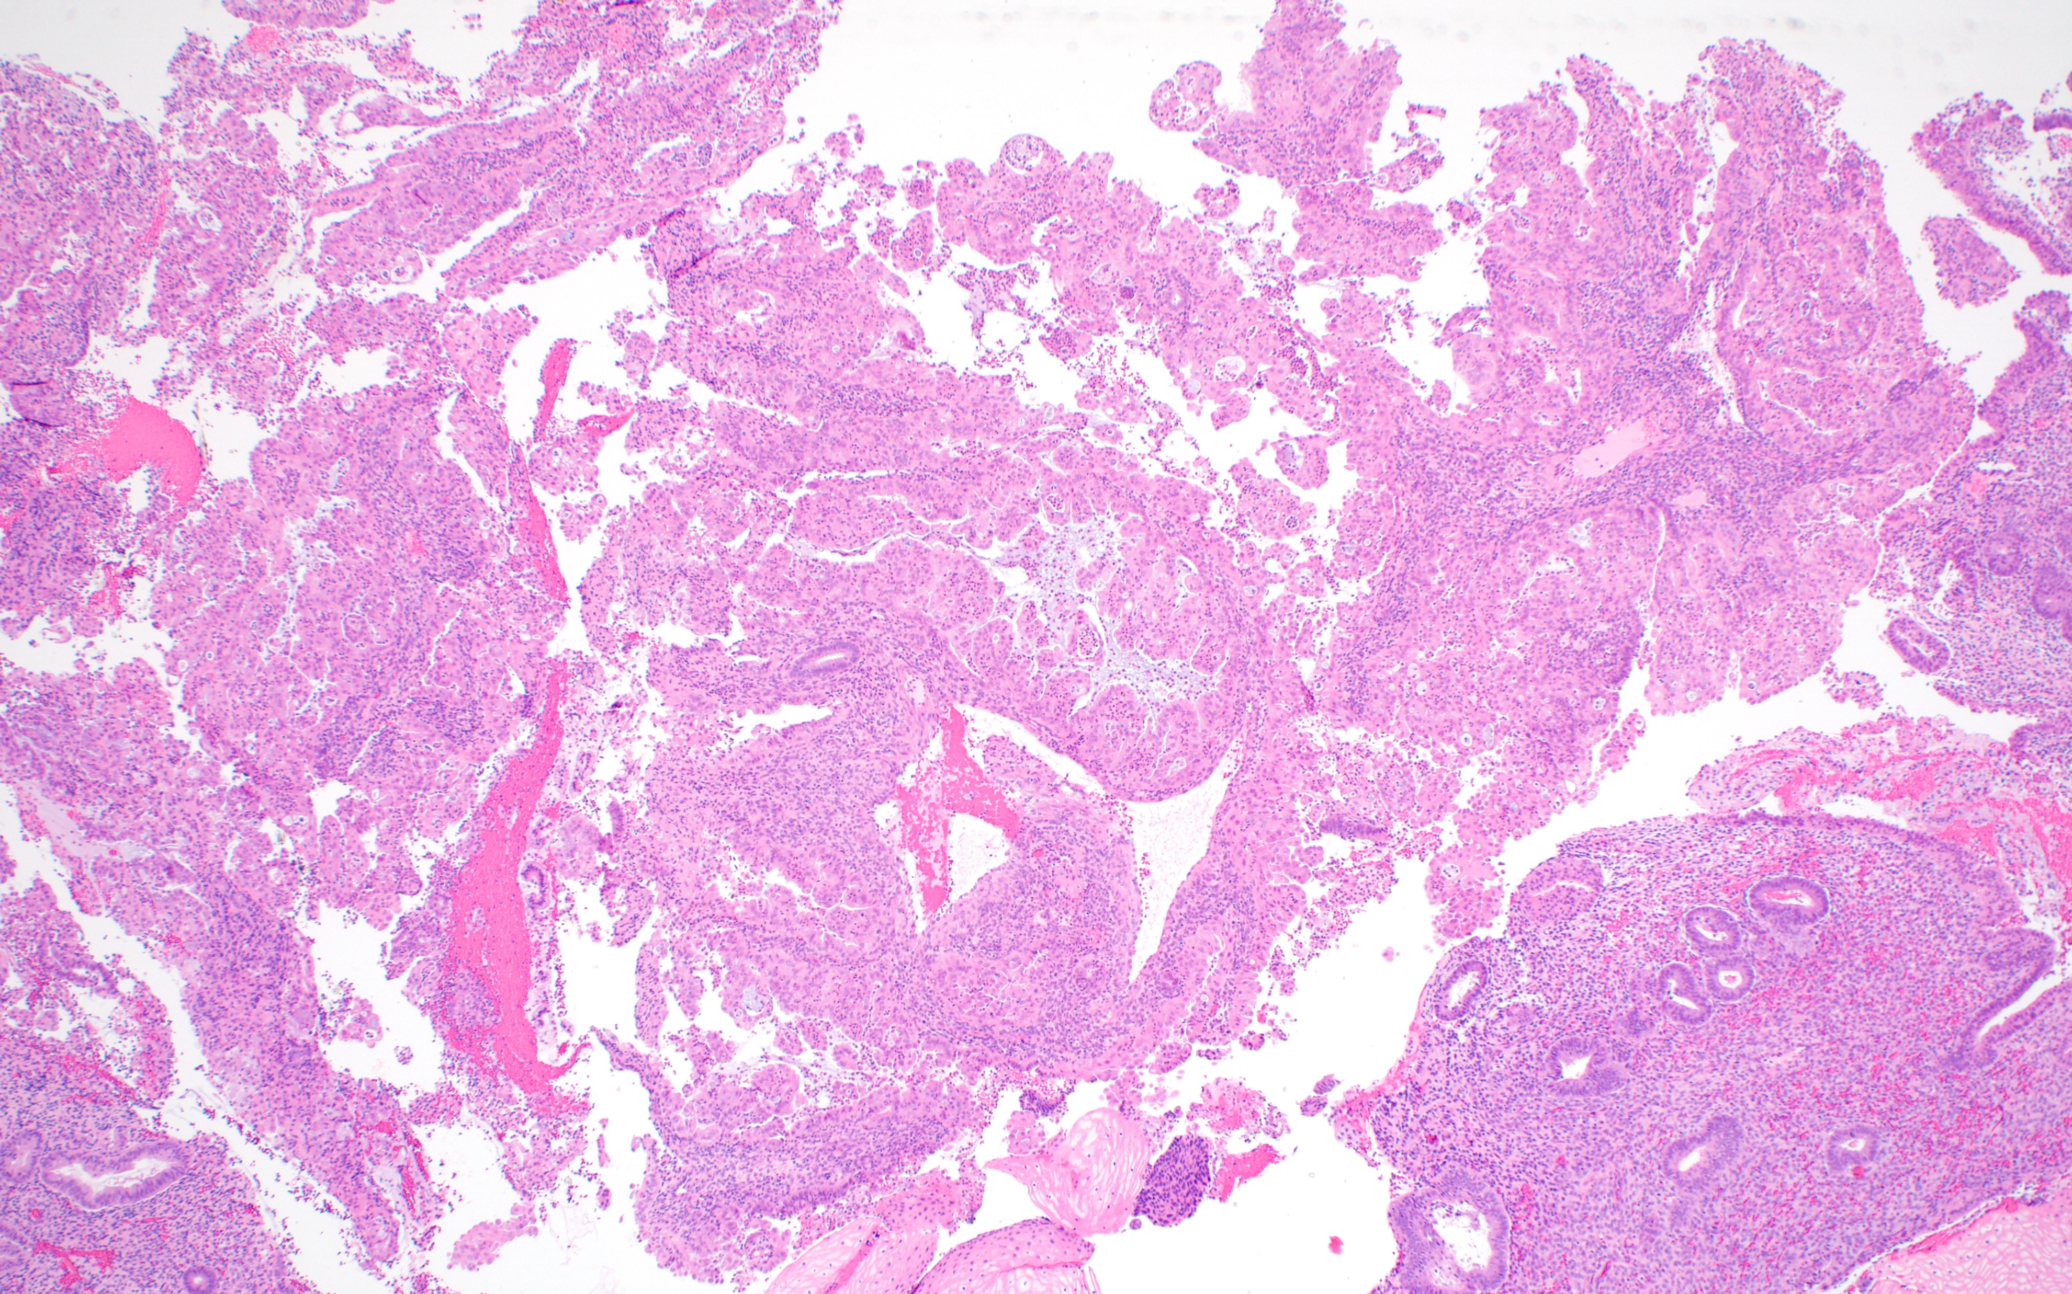

Slide 19
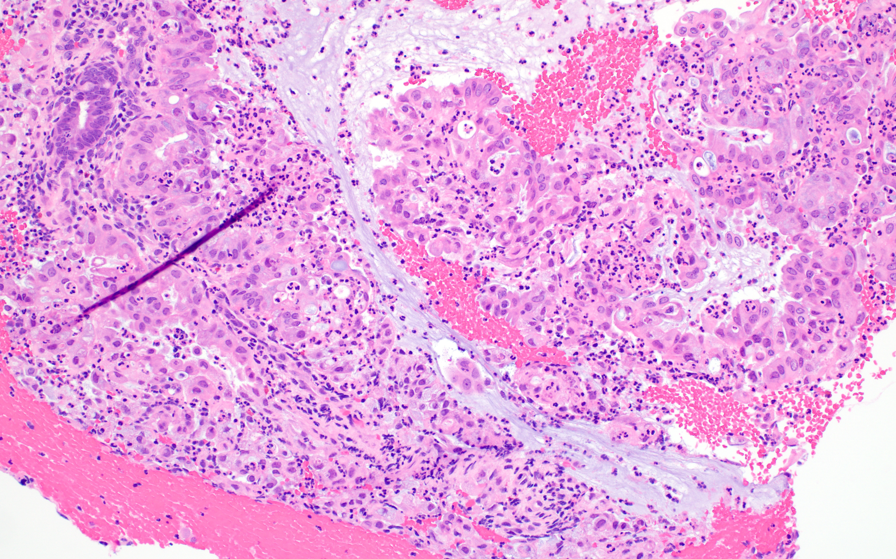

Slide 20
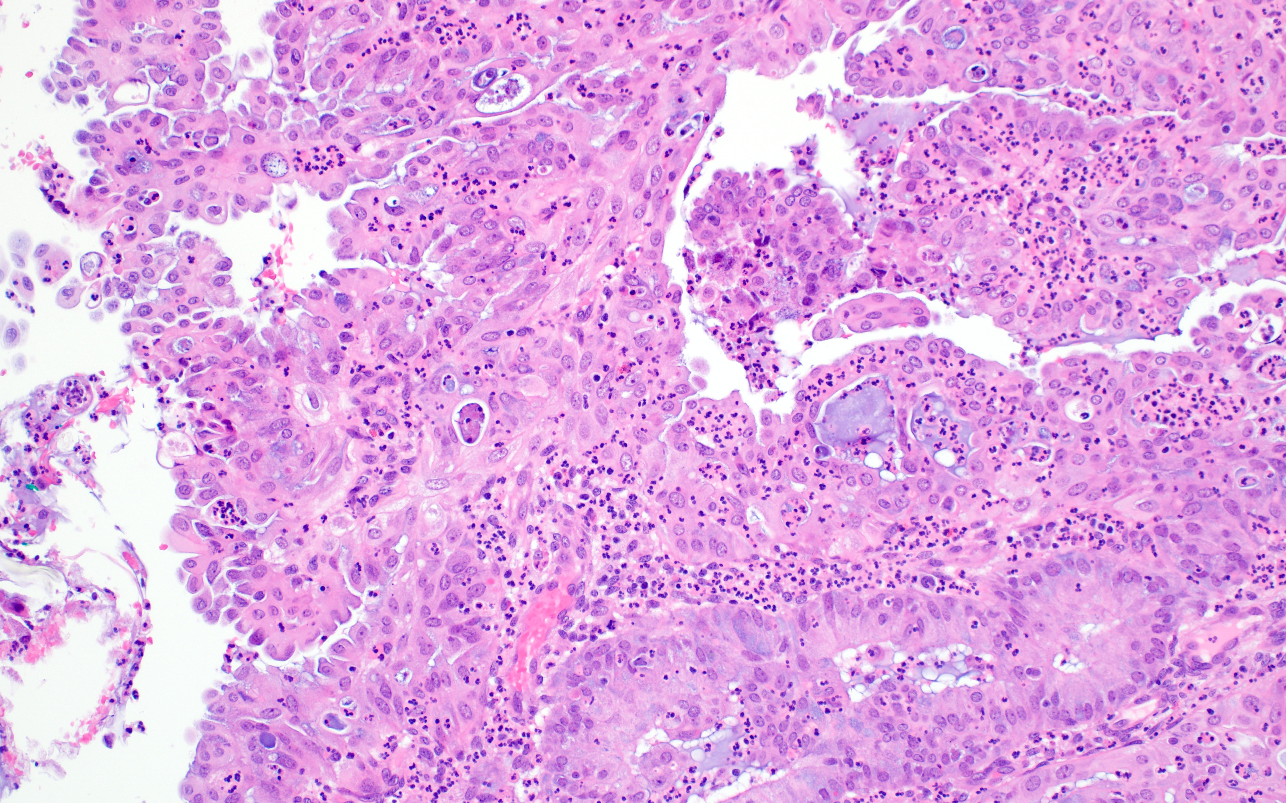

Slide 21
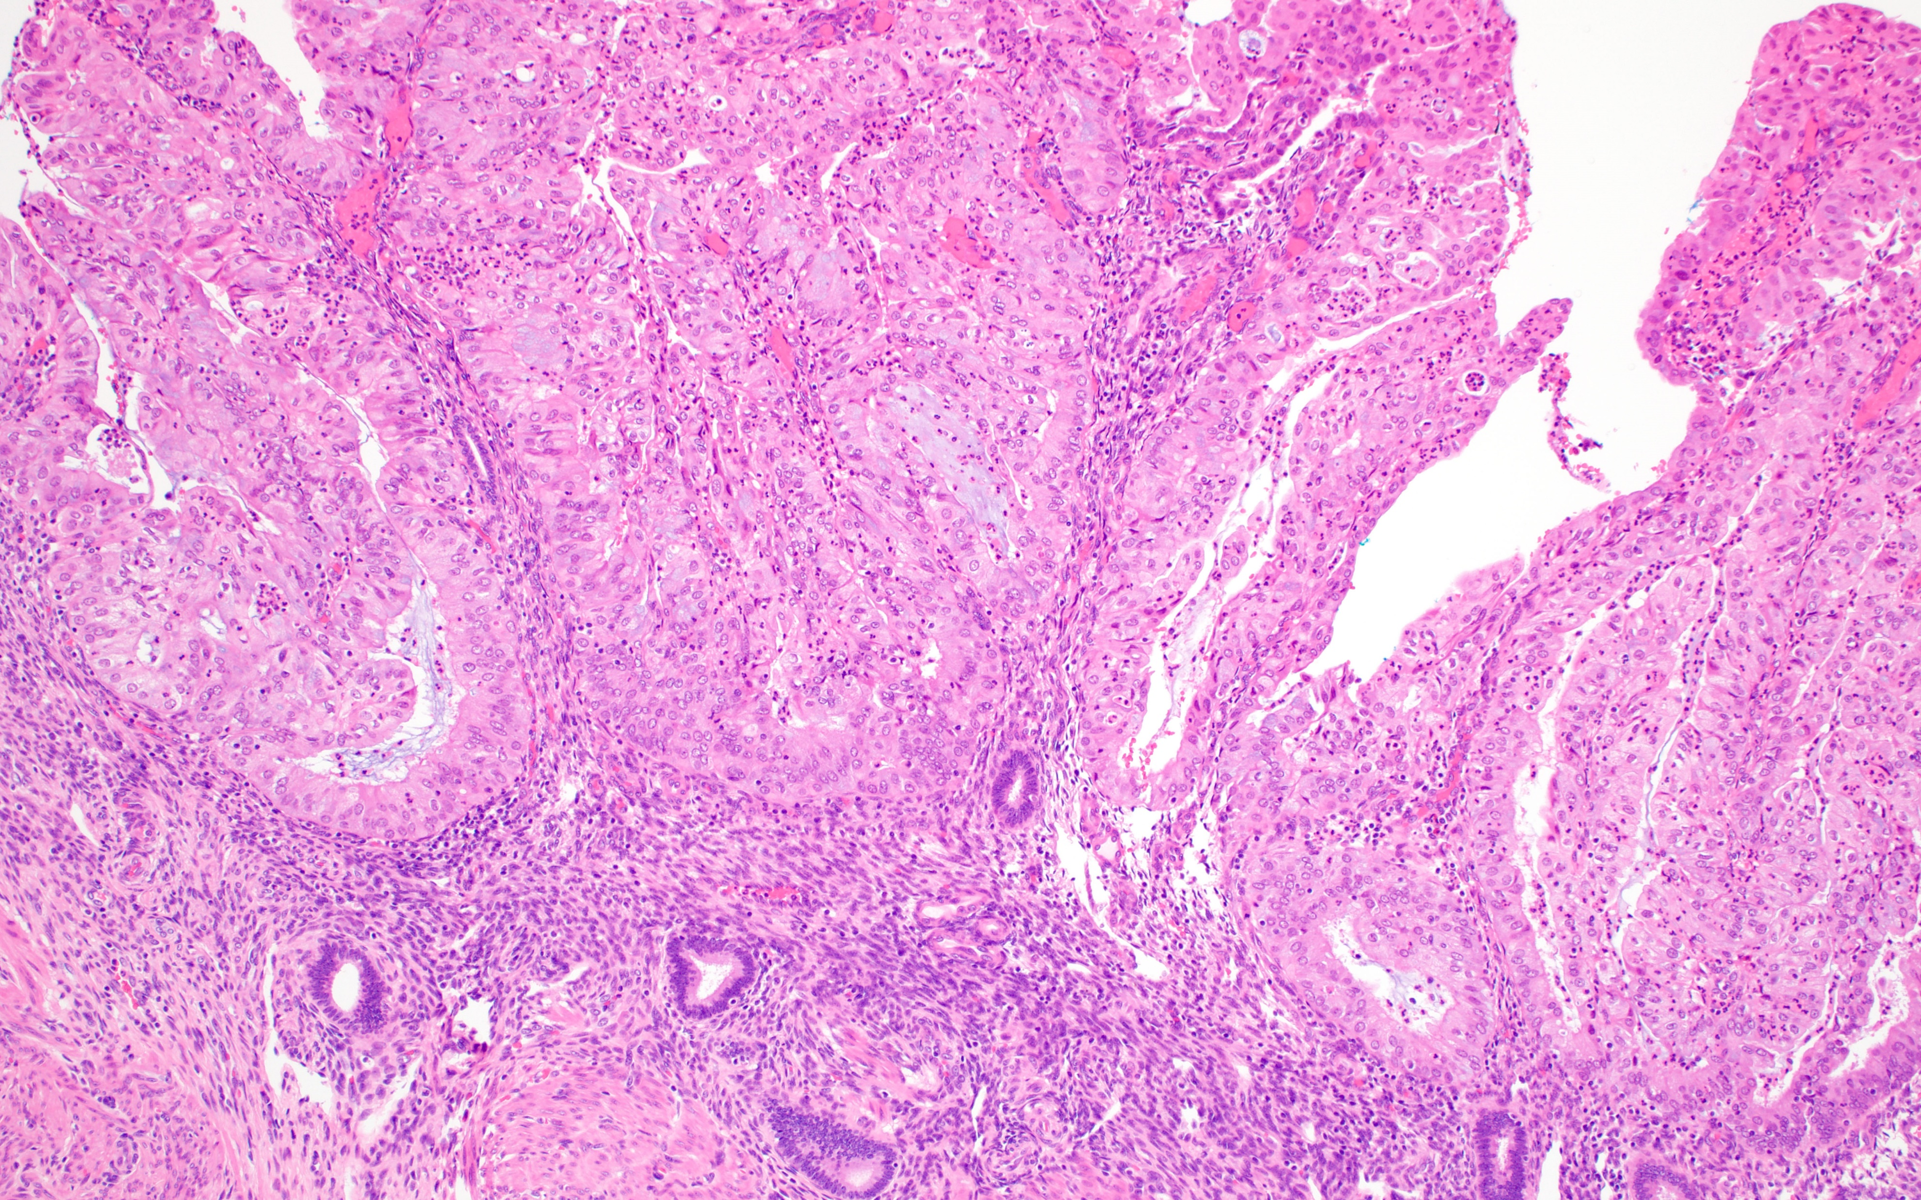
Hysterectomy following case #2

Slide 22
Endometrioid Carcinoma with Microglandular Hyperplasia-like pattern
Immunohistochemistry
  The usual “endocervical vs endometrial” stains don’t work in this scenario
    MGH is not HPV-associated, so p16 is not helpful
    Benign endocervical glands may be positive for hormone receptors
    Ki-67 proliferative activity can be seen in both entities
  P63 can be useful if it highlights a clear subcolumnar reserve cell layer, supporting a diagnosis of MGH
  PTEN can be useful if the microglandular proliferation shows loss of expression
    For reference, normal endocervical glands and MGH show retained expression of PTEN

Slide 23
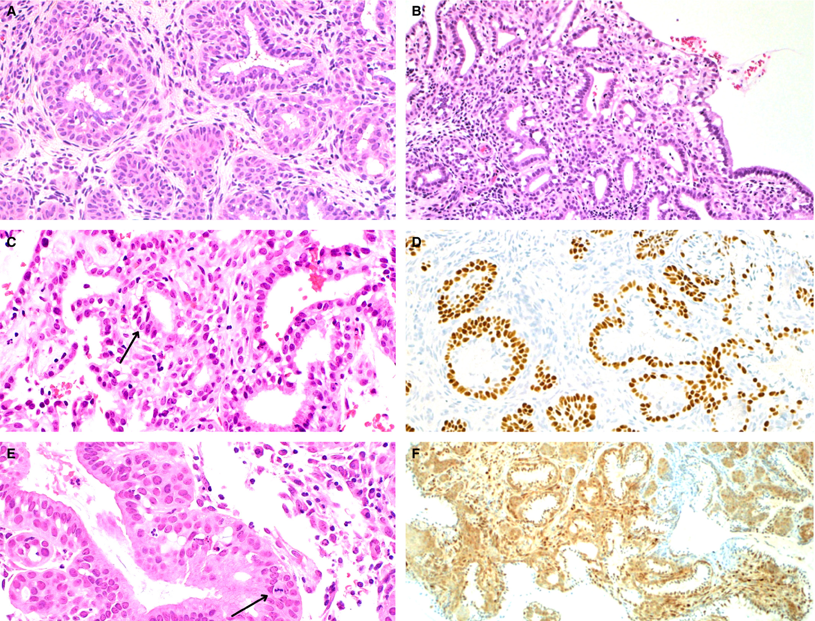
Endocervical microglandular hyperplasia may show a prominent reserve cell layer, although reserve cells are not always conspicuous on H&E-stained sections.
Linear nuclear immunoreactivity for p63 was seen in subcolumnar reserve cells [D]. Immunohistochemical expression of PTEN was retained in MGH [F].

Slide 24
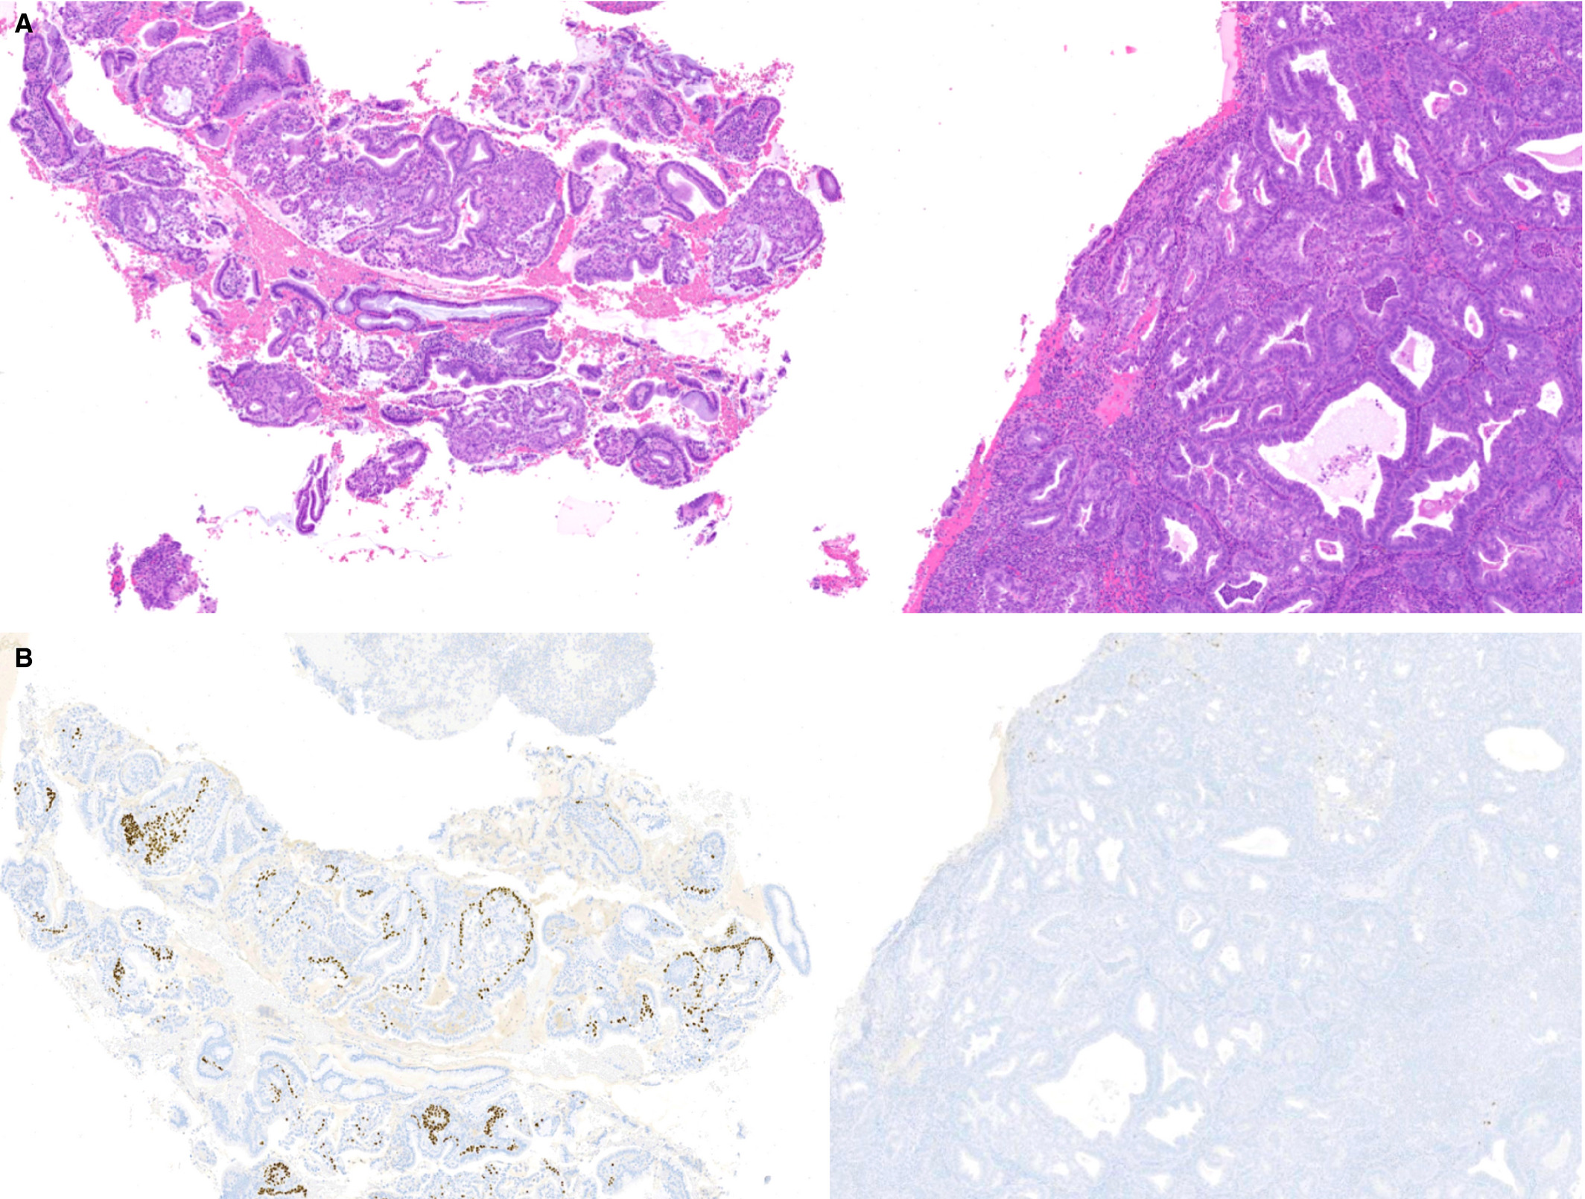
These endometrial curettings included foci of microglandular hyperplasia (MGH) (left) in addition to foci of low-grade endometrioid carcinoma with mucinous features (right).
A p63 immunostain highlighted the linear expression of endocervical reserve cells in MGH, which were not seen in areas of endometrioid carcinoma.

Slide 25
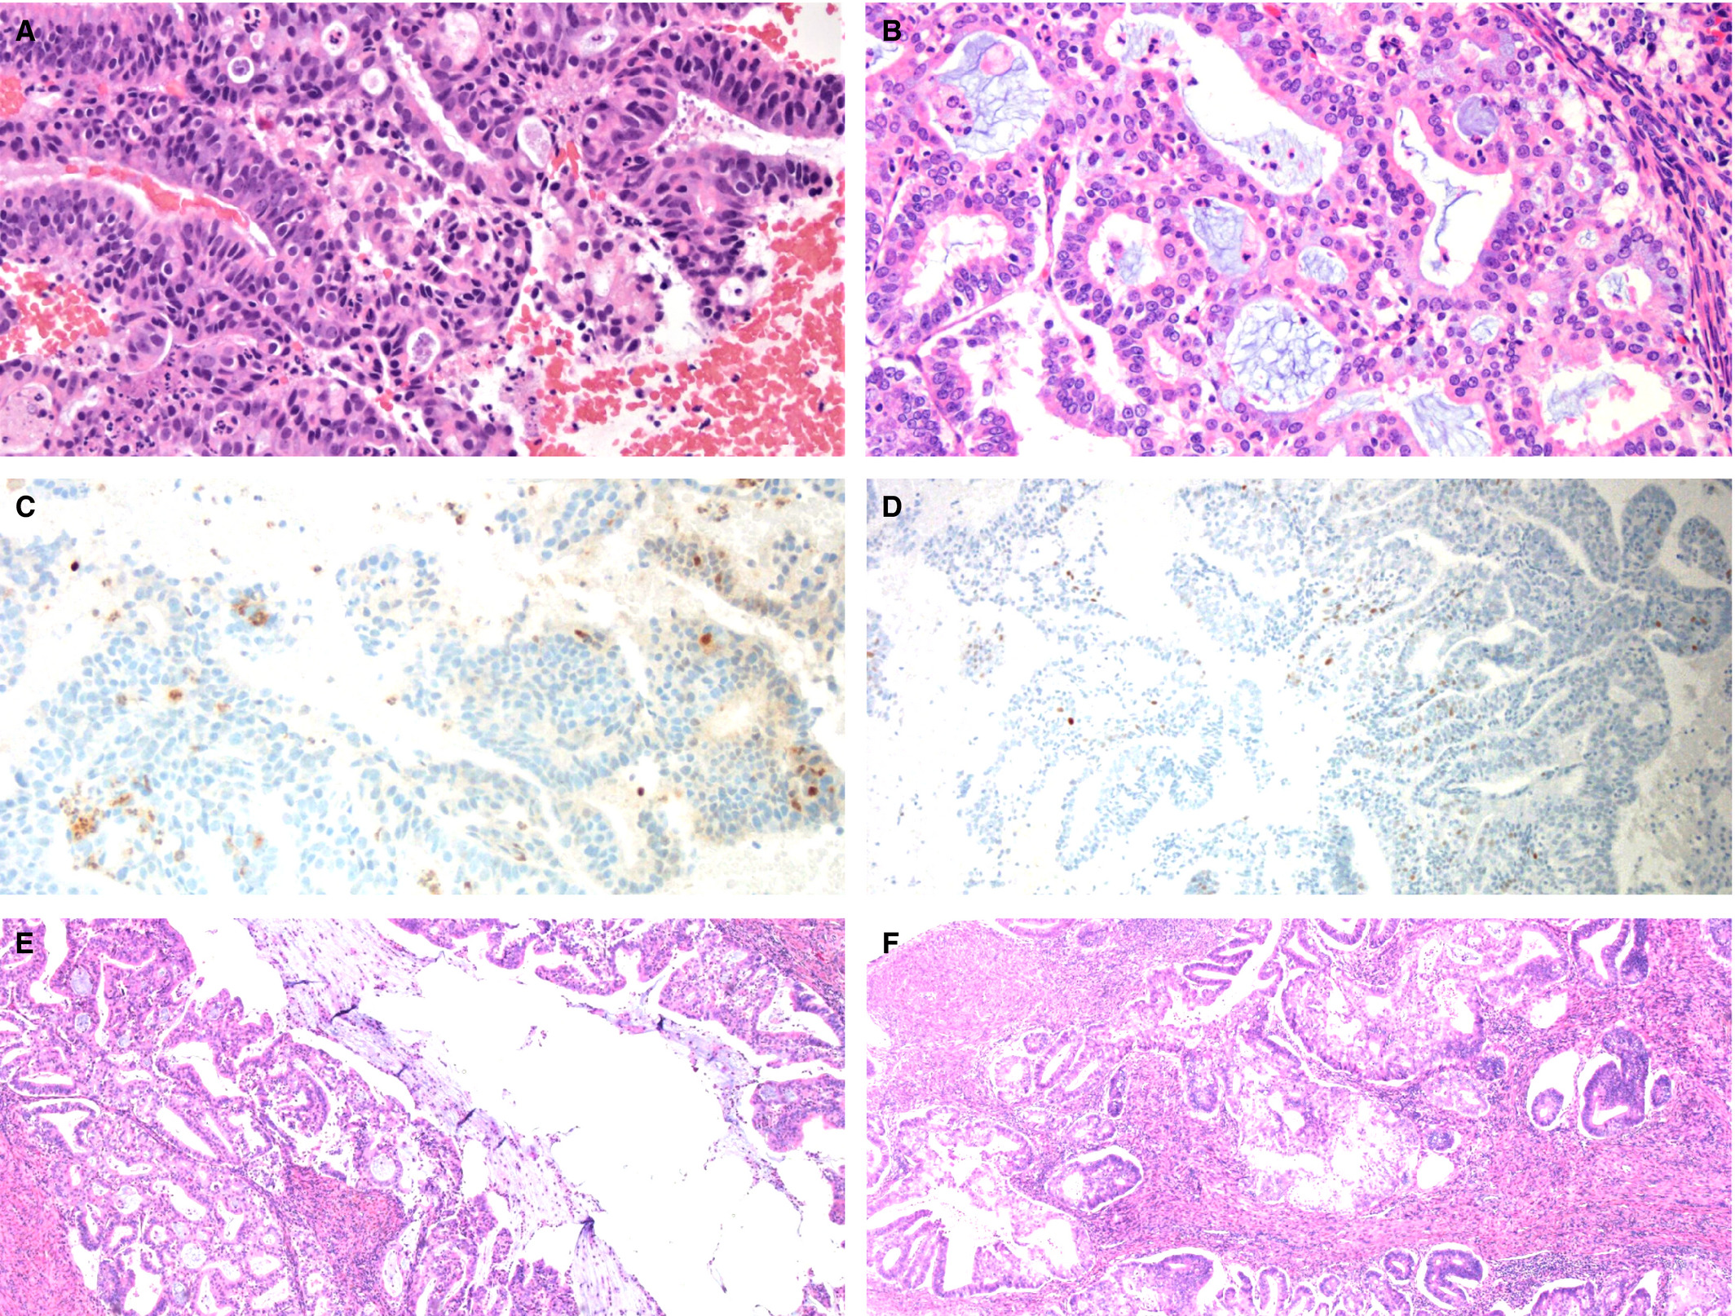
Some atypical microglandular proliferations show morphological features considered insufficient for more specific classification, including small tightly packed glands with mild cytological atypia and prominent neutrophilic inflammation. This case showed loss of PTEN expression [C] and focal non-specific p63 staining [D]. The subsequent hysterectomy confirmed the diagnosis of endometrial endometrioid carcinoma.

Slide 26
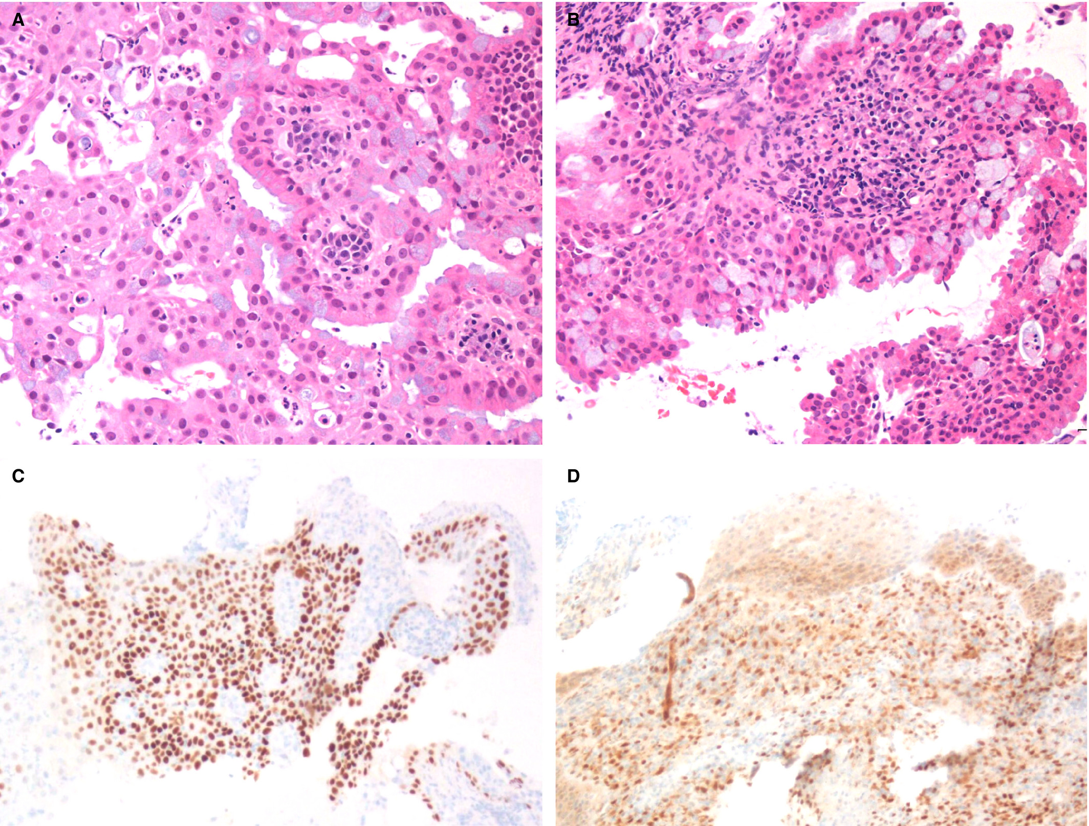
The biopsy shown in panel (A) was diagnosed as an atypical microglandular proliferation given the small, tightly packed glandular spaces, squamous and mucinous features, and acute inflammation. A follow-up biopsy more clearly showed features of microglandular hyperplasia (B). p63 highlighted squamous cells and reserve cells [C], and PTEN expression was retained [D].

Slide 27
Case #3
70-year-old with endometrial carcinoma

Slide 28
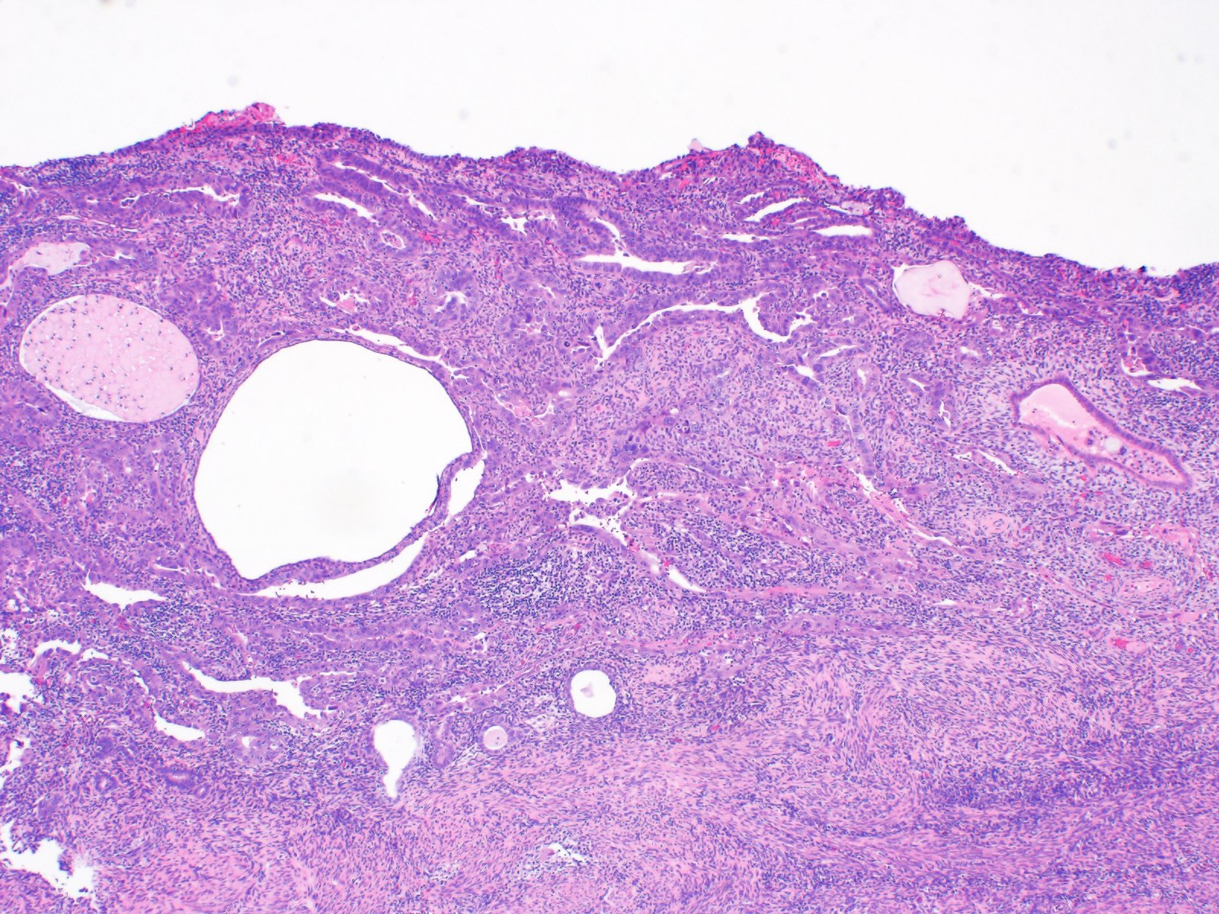

Slide 29
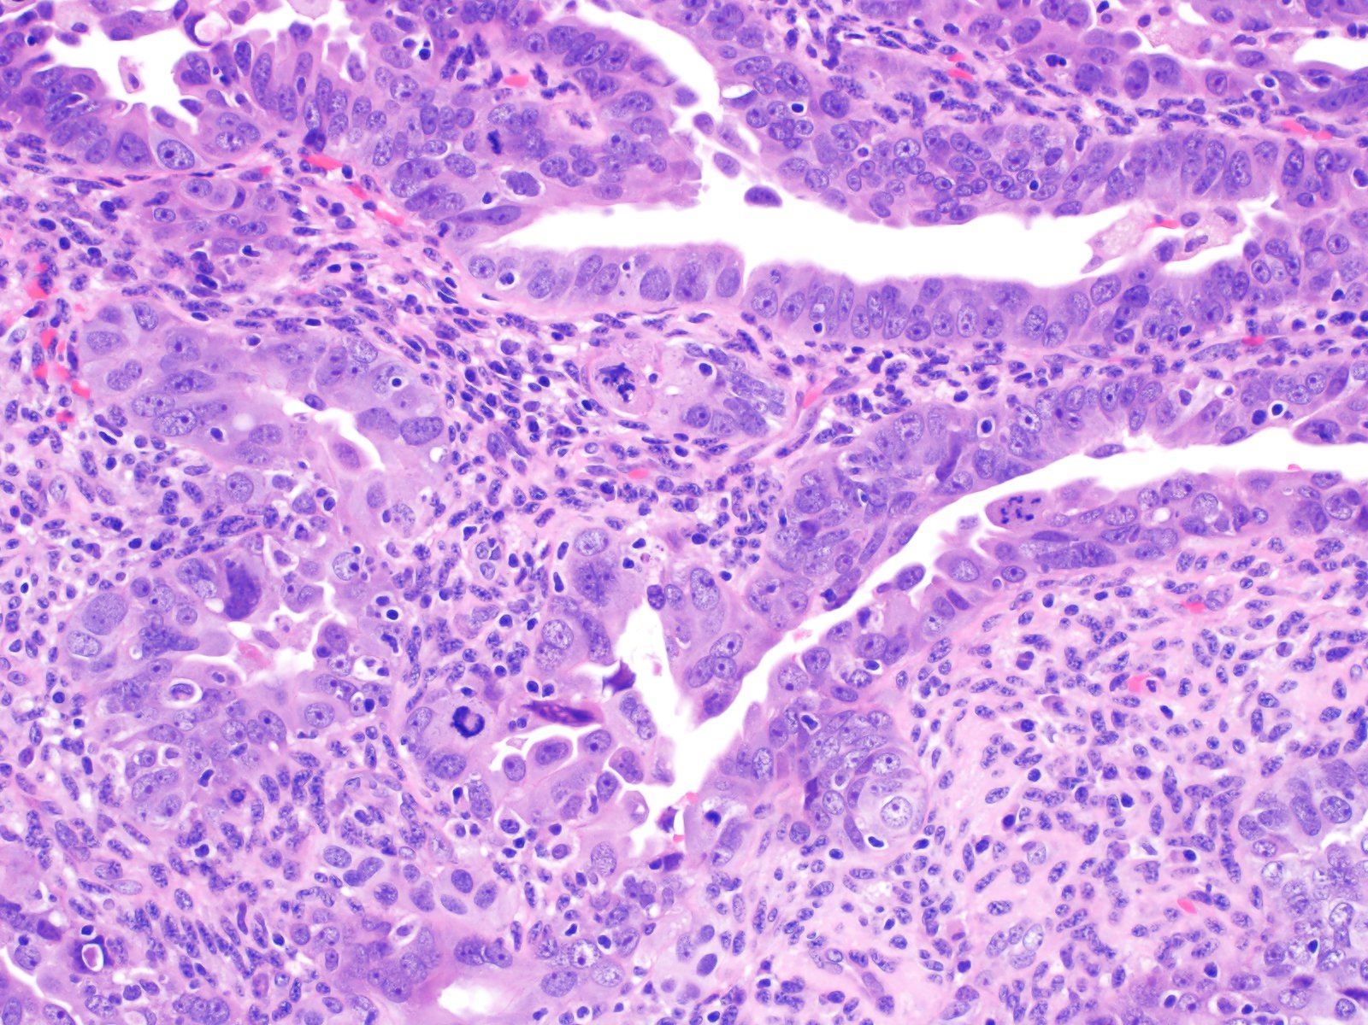

Slide 30
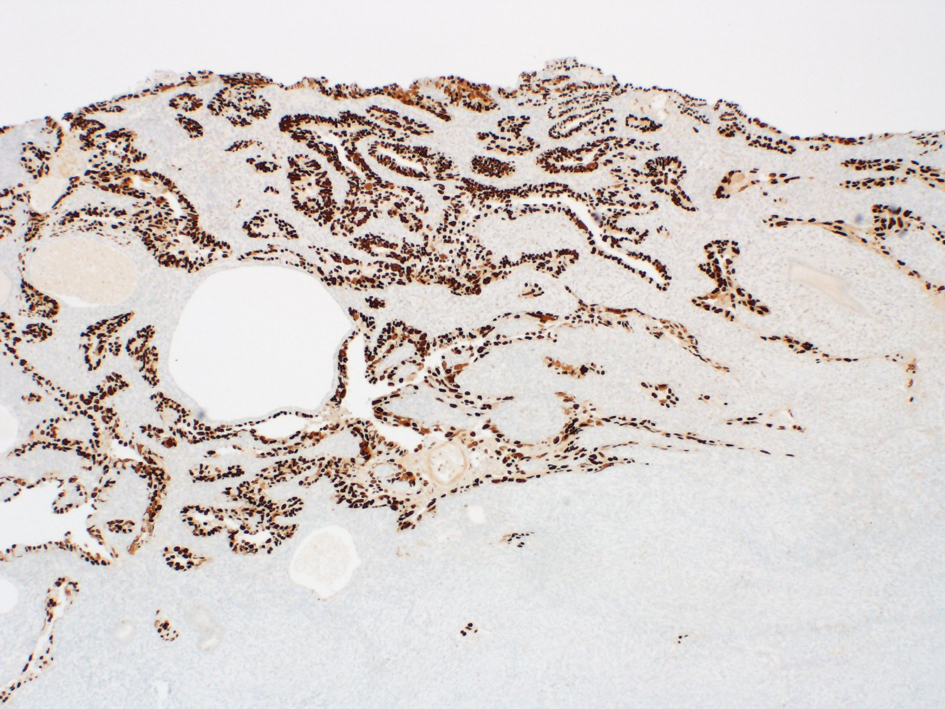
p53

Slide 31
Minimal Uterine Serous Carcinoma
MUSC is an umbrella term encompassing both SEIC (confined to the surface endometrium) and non-myoinvasive USC, first defined in 2000 by Wheeler et al.
Patients can present with high-stage, extrauterine disease even without invasion (i.e., behaves like serous carcinoma)
  Patients with uterus-confined disease tend to do well, though
Frequently arises in a polyp and may be confined to it
  If not, there is a higher risk of high-stage disease, per one study
Main differential diagnoses are with metaplastic change or endometrioid intraepithelial neoplasia (EIN)
Notes:
Wheeler DT, Bell KA, Kurman RJ, Sherman ME. Minimal uterine serous carcinoma: diagnosis and clinicopathologic correlation. Am J Surg Pathol. 2000 Jun;24(6):797-806.
Assem H, Rottmann D, Finkelstein A, et al. Minimal uterine serous carcinoma and endometrial polyp: a close clinicopathological relationship. Hum Pathol. 2021 Dec;118:1-8.

Slide 32
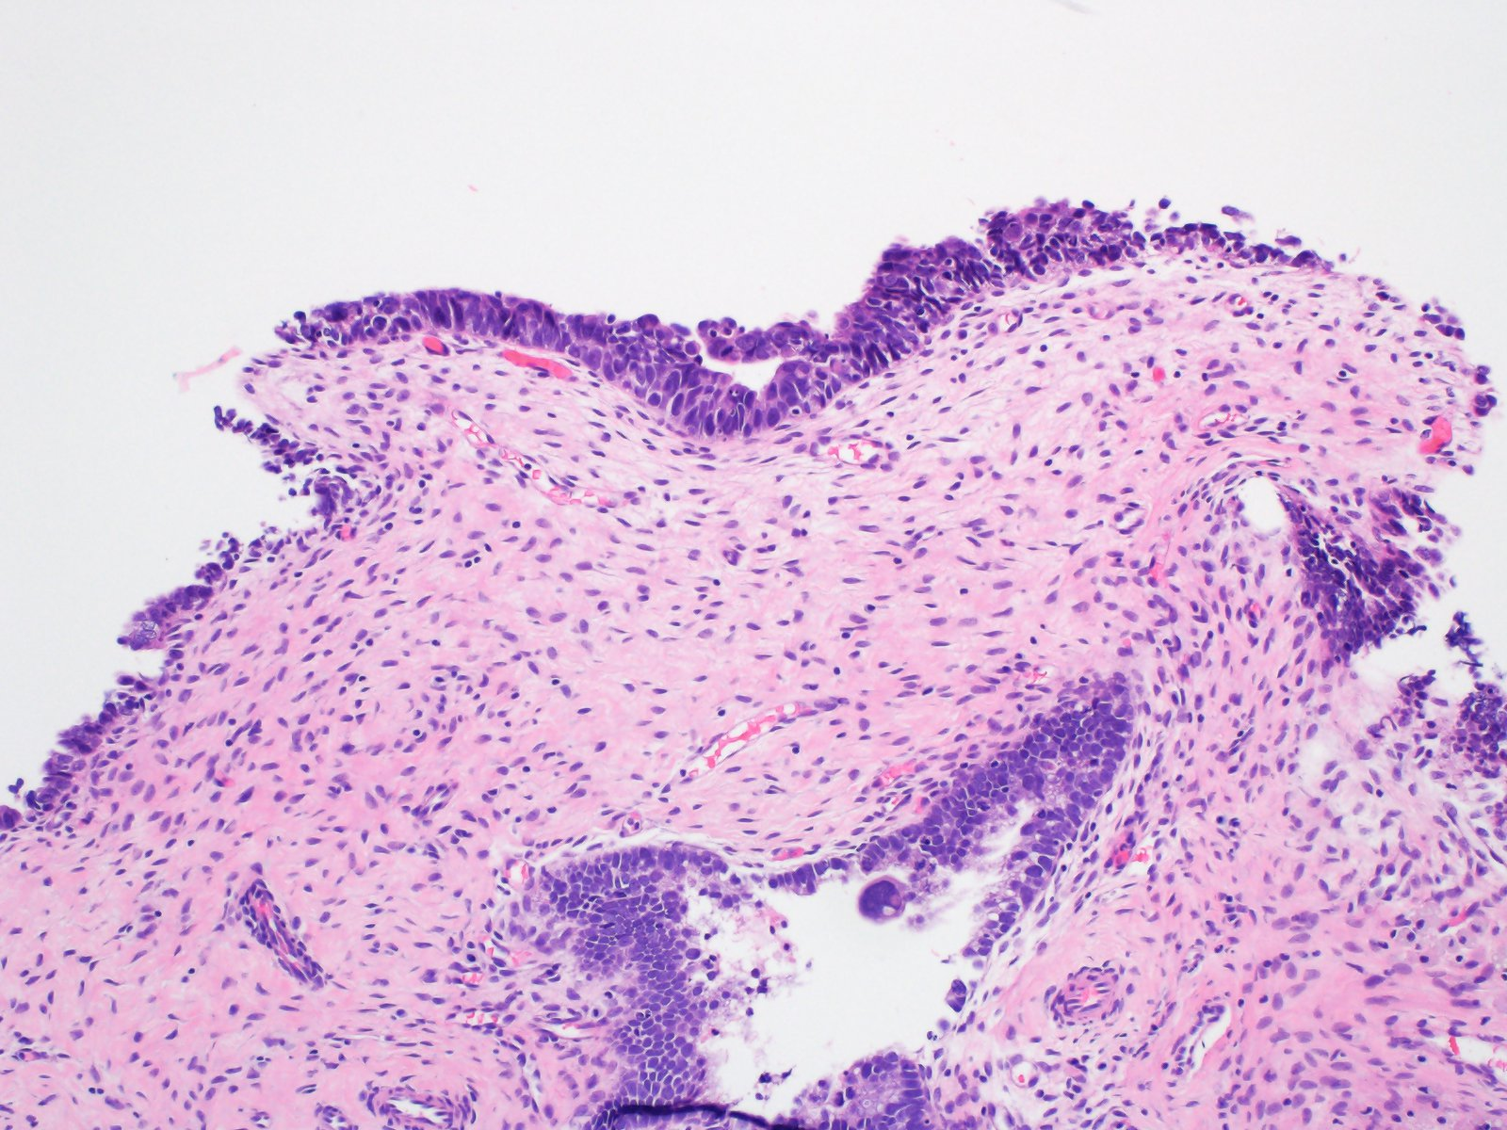

Slide 33
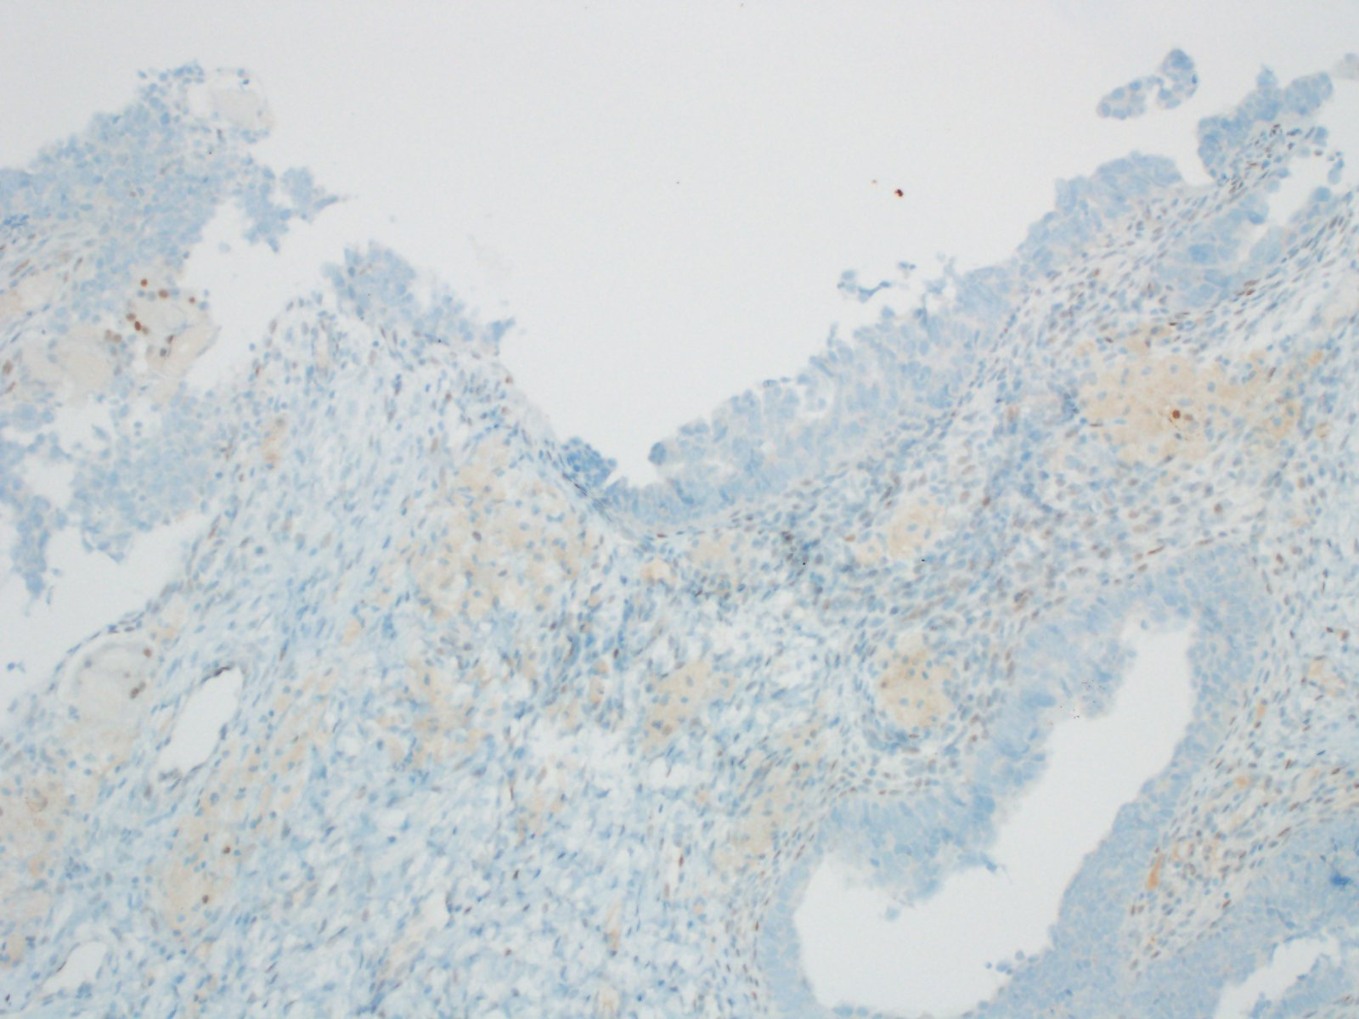
p53

Slide 34
Case #4
70-year-old with endometrial cancer
Notes:
Gastrointestinal mucinous carcinoma

Slide 35
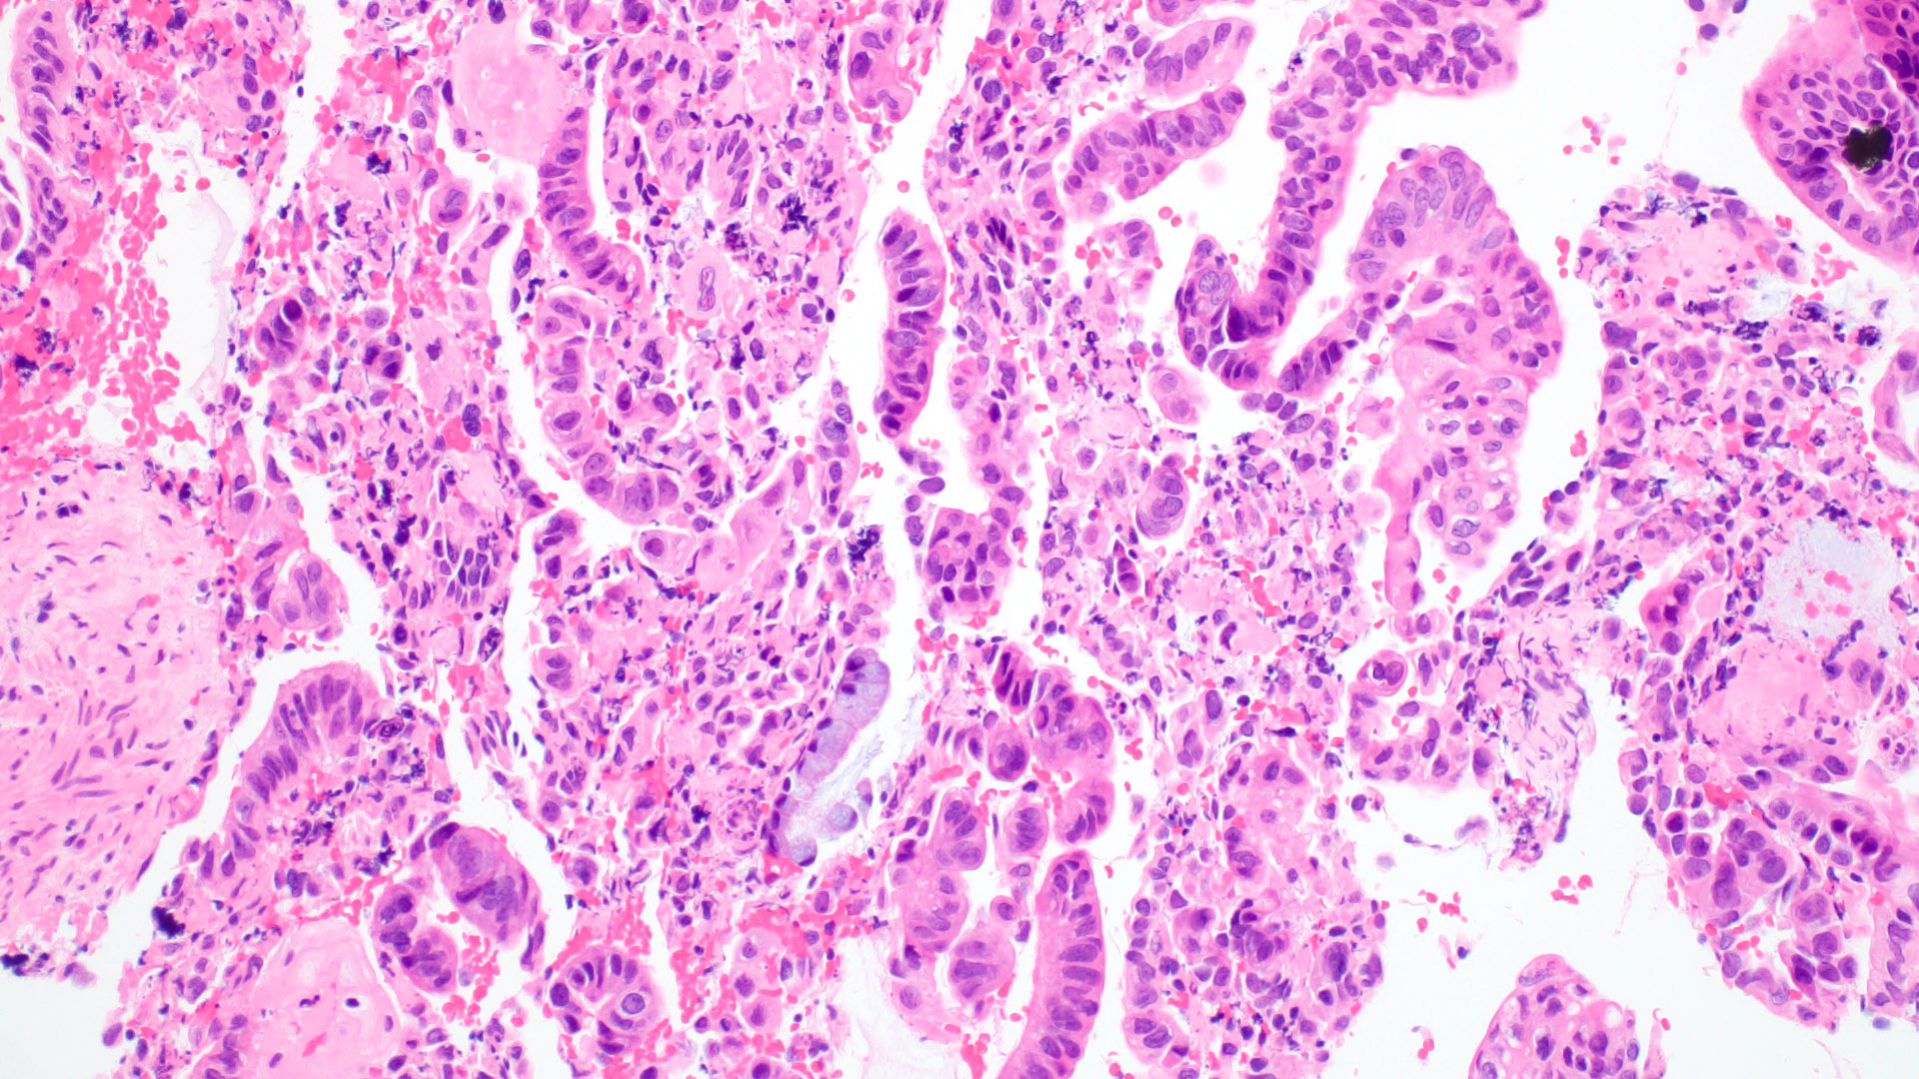

Slide 36
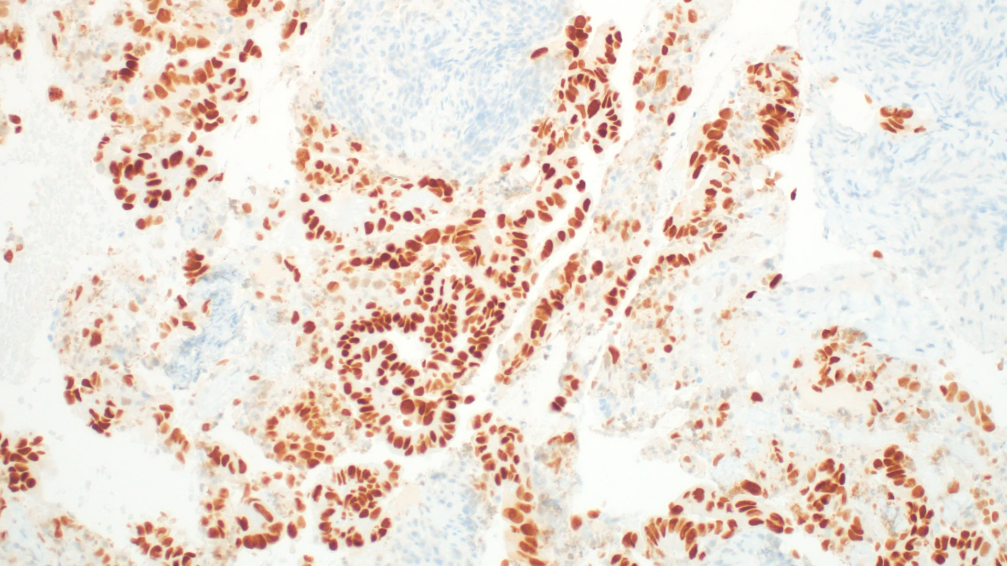
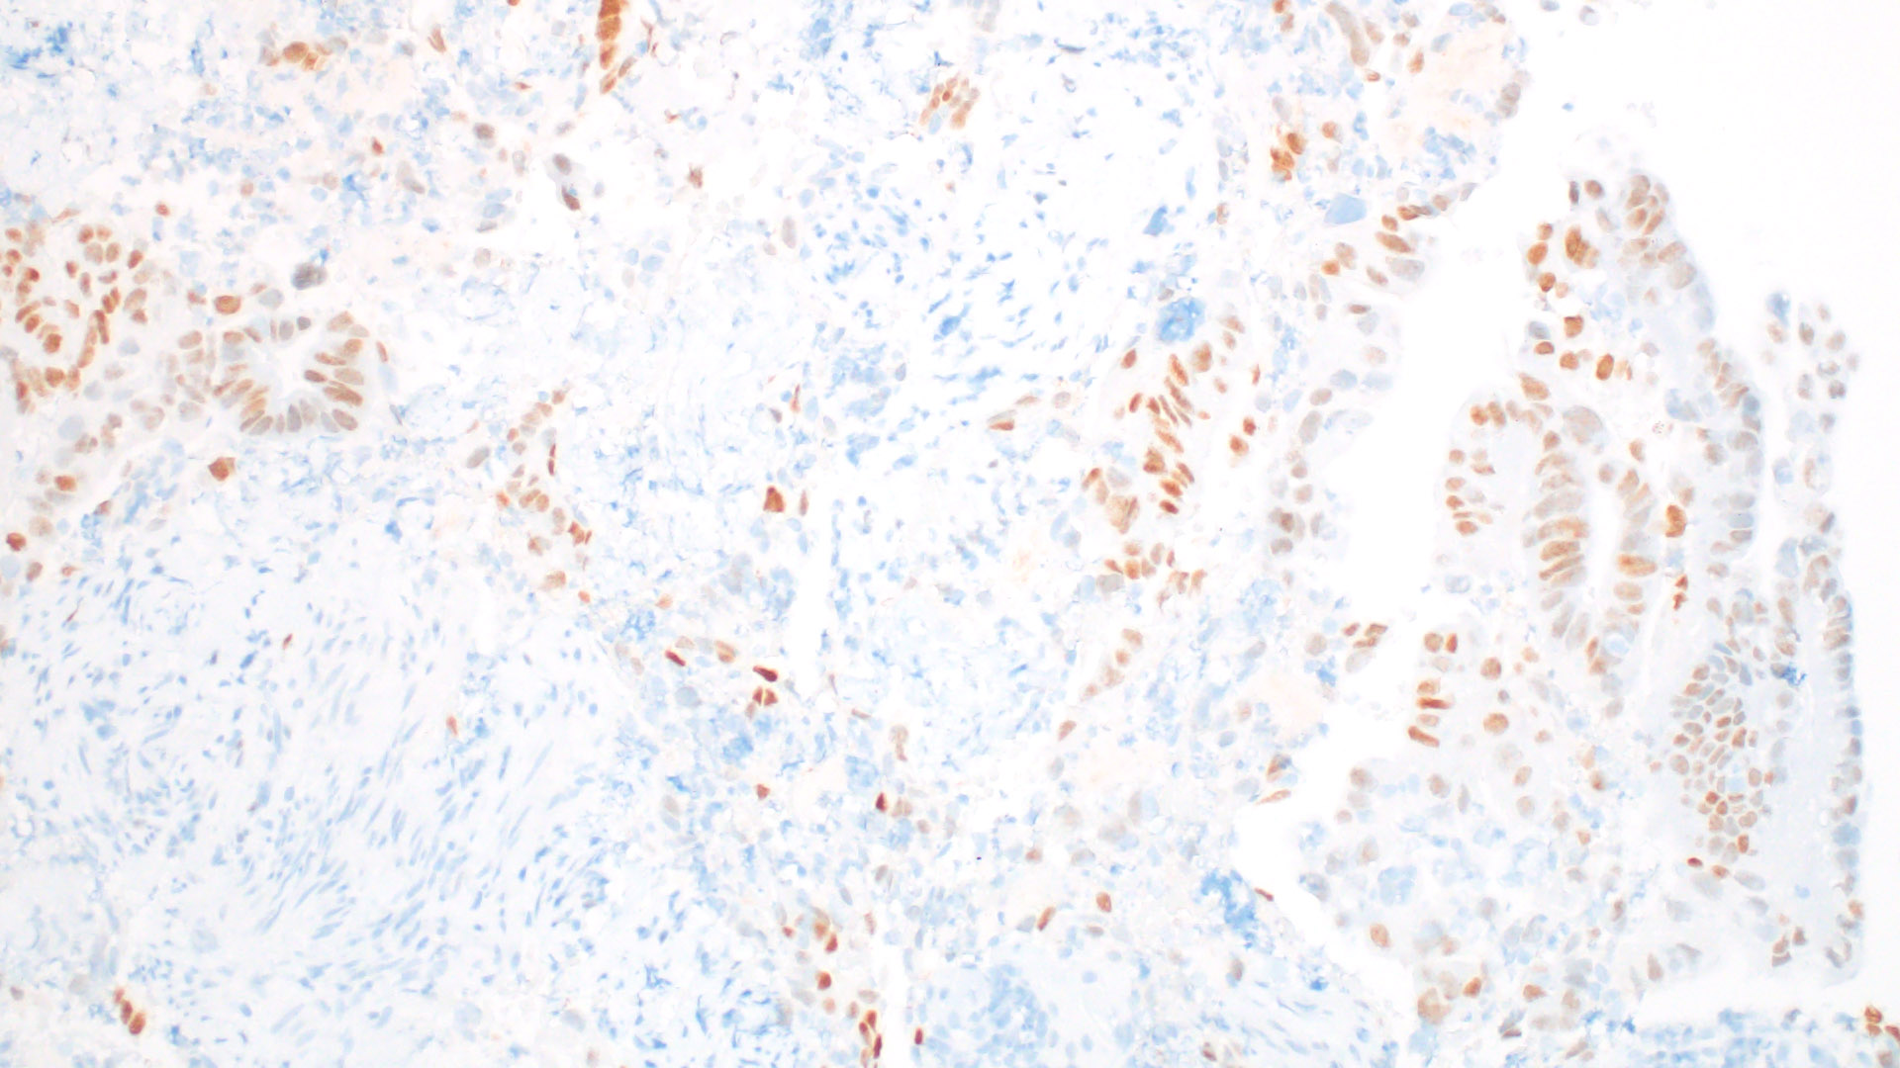
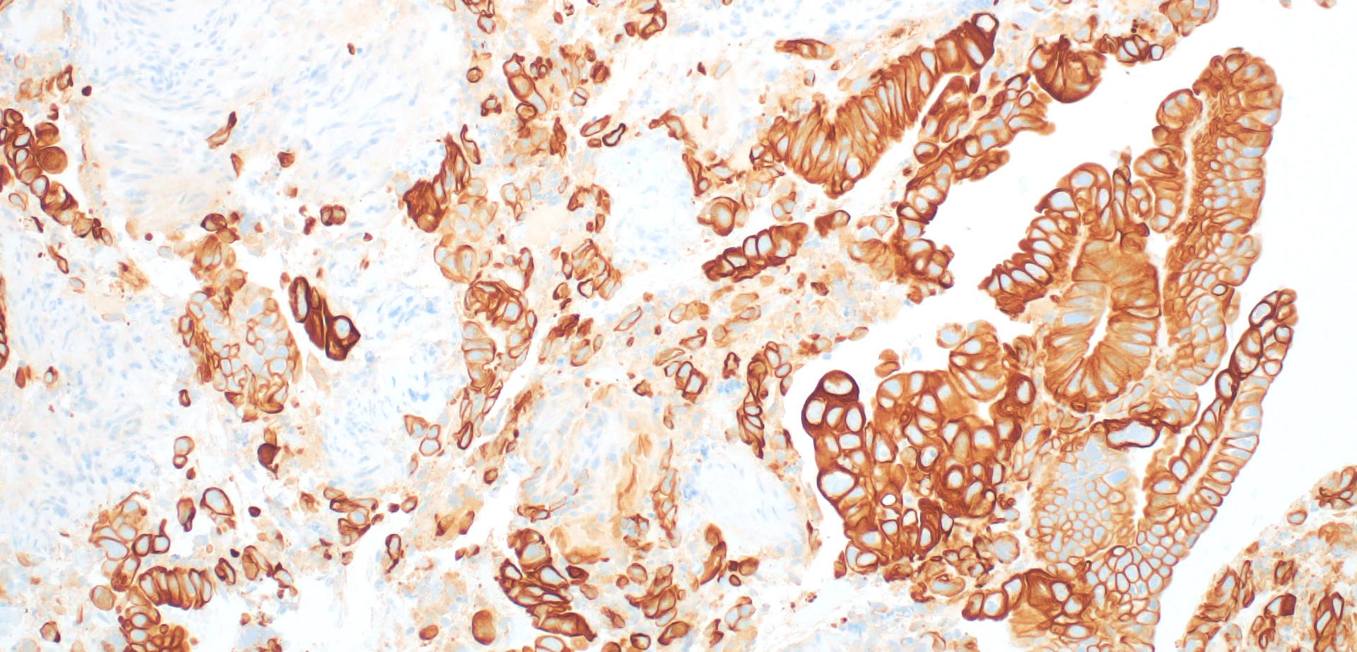
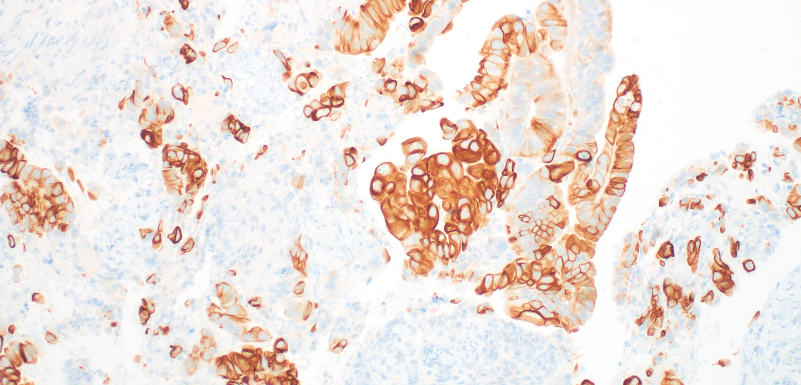
CDX2
SATB2
CK7
CK20

Slide 37
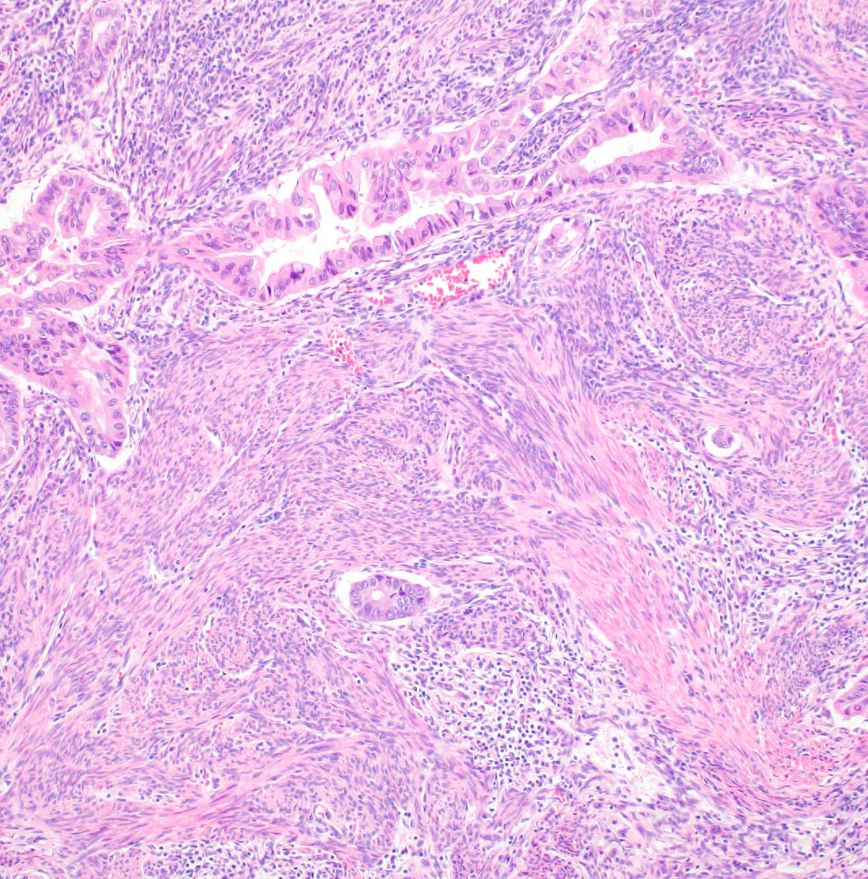
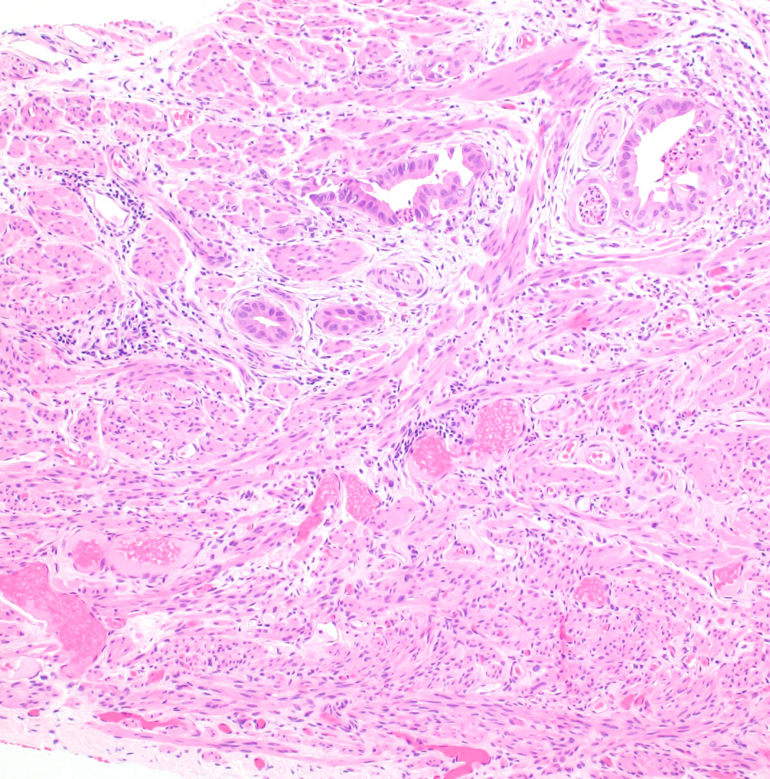

Slide 38
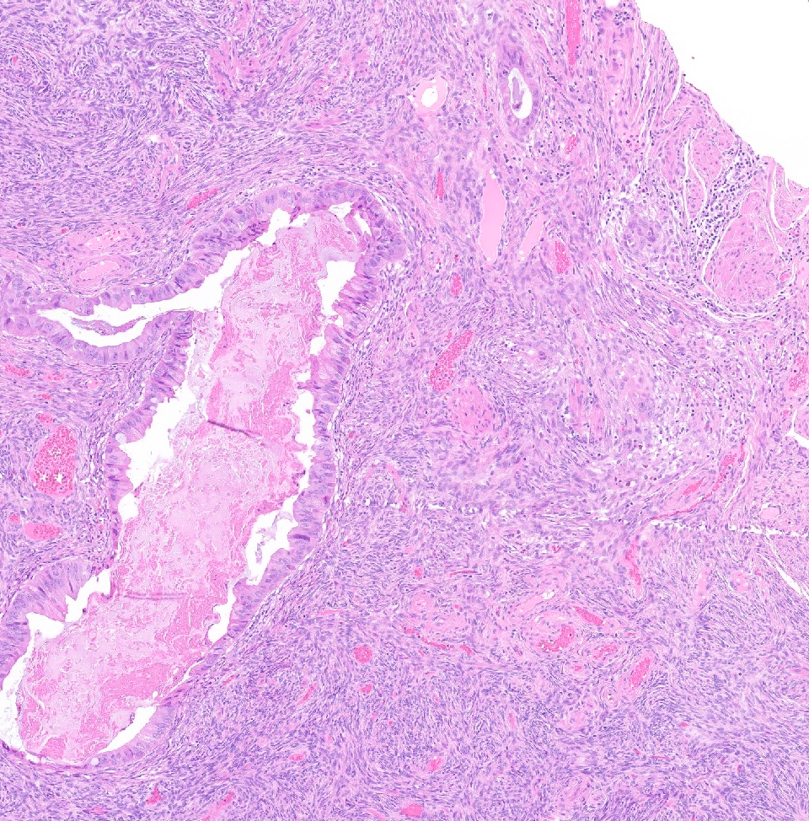
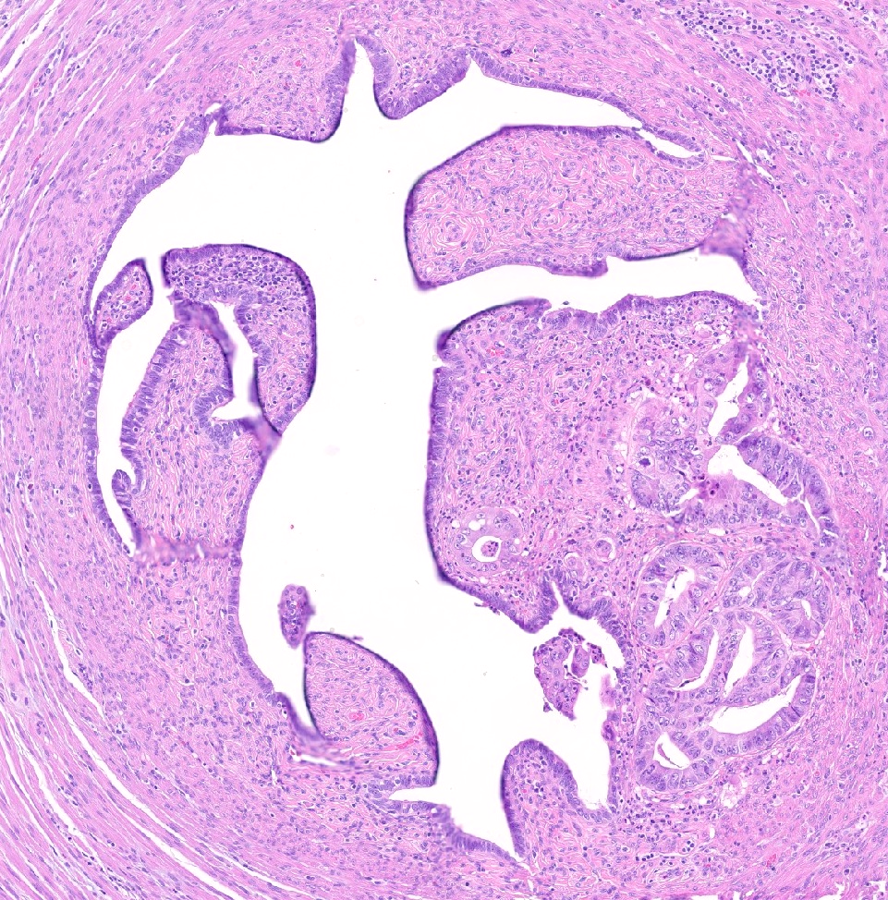

Slide 39
Gastric (gastrointestinal)–type mucinous carcinoma
Proposed criteria
  Presence of gastric-type morphology (voluminous, pale eosinophilic or clear cytoplasm with distinct cell borders) and/or goblet cells in an endometrial adenocarcinoma with no evidence of any other primary site
  Absence of typical endometrioid component
  Absence of cervical glandular or stromal involvement (with complete sampling of the cervix)
  At least focal immunohistochemical expression of one or more gastrointestinal markers (MUC6, CK20, CDX2, SATB2)
  Absent or minimal (<5%) expression of estrogen receptor
Notes:
Am J Surg Path 2020; PMID 31567280

Slide 40
Aggressive histotypes per FIGO 2023
High-grade endometrioid carcinoma (FIGO grade 3)
Serous carcinoma
Clear cell carcinoma
Mesonephric-like carcinoma
Gastrointestinal-type mucinous carcinoma
Undifferentiated carcinoma
Carcinosarcoma

Slide 41
References
Mesonephric-like endometrial carcinoma
  1. Pors J, Segura S, Chiu DS, et al. Clinicopathologic Characteristics of Mesonephric Adenocarcinomas and Mesonephric-like Adenocarcinomas in the Gynecologic Tract: A Multi-institutional Study. Am J Surg Pathol. 2021 Apr 1;45(4):498-506.
  2. McCluggage WG. Mesonephric-like Adenocarcinoma of the Female Genital Tract: From Morphologic Observations to a Well-characterized Carcinoma With Aggressive Clinical Behavior. Adv Anat Pathol. 2022 Jul 1;29(4):208-216.
  3. Mills AM, Jenkins TM, Howitt BE, Fan J, Ring KL, Cook I. Mesonephric-like Endometrial Carcinoma: Results From Immunohistochemical Screening of 300 Endometrial Carcinomas and Carcinosarcomas for This Often Overlooked and Potentially Aggressive Entity. Am J Surg Pathol. 2022 Jul 1;46(7):921-932.
  4. Kolin DL, Costigan DC, Dong F, Nucci MR, Howitt BE. A Combined Morphologic and Molecular Approach to Retrospectively Identify KRAS-Mutated Mesonephric-like Adenocarcinomas of the Endometrium. Am J Surg Pathol. 2019 Mar;43(3):389-398.
Low-grade endometrioid carcinoma with microglandular features
  1. Young RH, Clement PB. Pseudoneoplastic glandular lesions of the uterine cervix. Semin Diagn Pathol. 1991;8:234–249.
  2. Young RH, Scully RE. Uterine carcinomas simulating microglandular hyperplasia. a report of six cases. Am J Surg Pathol. 1992;16:1092–1097.
  3. Zaloudek C, Hayashi GM, Ryan IP, Powell CB, Miller TR. Microglandular adenocarcinoma of the endometrium: a form of mucinous adenocarcinoma that may be confused with microglandular hyperplasia of the cervix. Int J Gynecol Pathol. 1997;16:52– 59.
  4. Aoun BA, Skala SL. Utility of p63 and PTEN staining in distinguishing cervical microglandular hyperplasia from endometrial endometrioid carcinoma with microglandular/mucinous features. Histopathology. 2022 Jun;80(7):1102-1111.
  5. Houghton O, McCluggage WG. The expression and diagnostic utility of p63 in the female genital tract. Adv Anat Pathol. 2009;16:316–321.
  6. Pavlakis K, Vrekoussis T, Messini I et al. Mucinous epithelial lesions in endometrial curettage material: a diagnostic challenge. Appl Immunohistochem Mol Morphol. 2012;20:607–613.

Slide 42
References
Minimal uterine serous carcinoma
  1. Wheeler DT, Bell KA, Kurman RJ, Sherman ME. Minimal uterine serous carcinoma: diagnosis and clinicopathologic correlation. Am J Surg Pathol. 2000;24(6):797-806.
  2. Hui P, Kelly M, O’Malley DM, et al. Minimal uterine serous carcinoma: a clinicopathologic study of 40 cases. Mod Pathol. 2005;18(1):75-82.
  3. Hui P. Endometrial polyps in postmenopausal women. Arch Pathol Lab Med. 2022. Online ahead of print.
  4. Assem H, Rottmann D, Finkelstein A, et al. Minimal uterine serous carcinoma and endometrial polyp: a close clinicopathological relationship. Hum Pathol. 2021;118:1-8.
Gastric (gastrointestinal)–type mucinous carcinoma
  Wong RW-C, Ralte A, Grondin K, Talia KL, McCluggage WG. Endometrial Gastric (Gastrointestinal)-type Mucinous Lesions. Am J Surg Pathol. 2020;44:406-419.
  WHO Classification of Female Genital Tumours, 5th edition.

