Slide 1
Vulvar pathology: updates in terminology and classification
Stephanie L. Skala, MD
Clinical Associate Professor of Pathology
Director of Surgical Pathology
University of Michigan, Ann Arbor, MI, USA

Slide 2
Disclosures
I have no financial disclosures or conflicts of interest.

Slide 3
Learning Objectives - VIN
List the common histologic features of differentiated vulvar intraepithelial neoplasia (dVIN) / HPV-independent (HPVi) VIN with p53 abnormality.
Recognize the challenges in diagnosis of HPVi VIN with and without p53 abnormalities.
Describe the evolving terminology used for HPVi(p53wt) lesions.
Explain the rationale for universal ordering of p16 and p53 immunostains on suspected VIN specimens.
Identify key entities in the differential diagnosis of HPVi VIN and how this may impact management.

Slide 4
WHO (5th ed): Vulvar intraepithelial neoplasia, HPV-independent
“Non-invasive precursor of HPVi squamous cell carcinoma, characterized by atypia of the basal and parabasal keratinocytes in an otherwise well-differentiated epithelium”
  Acceptable terminology: differentiated VIN
  Subtypes: differentiated exophytic vulvar intraepithelial lesion (DEVIL), vulvar acanthosis with altered differentiation (VAAD)
  Frequent abnormal p53 staining, but TP53wt HPVi intraepithelial lesions may harbor somatic mutations in PIK3CA, NOTCH1, or HRAS
  Essential: atypia of the basal layer
Thick keratinized plaques or erosive erythematous macules or plaques

Slide 5
HPVi VIN
Distinguishing between TP53 mutant (differentiated vulvar intraepithelial neoplasia [dVIN]) and TP53 wild-type lesions likely has prognostic importance
TP53 wild-type acanthotic vulvar lesions
  Vulvar aberrant maturation (VAM)*
  HPVi, p53-wild-type verruciform acanthotic VIN (HPVi(p53wt) vaVIN)*
  Includes lesions previously classified as:
    Differentiated exophytic vulvar intraepithelial lesion (DEVIL)
    Vulvar acanthosis with altered differentiation (VAAD)
    Verruciform lichen simplex chronicus (vLSC)
    Vulvar aberrant maturation (VAM)

Slide 6
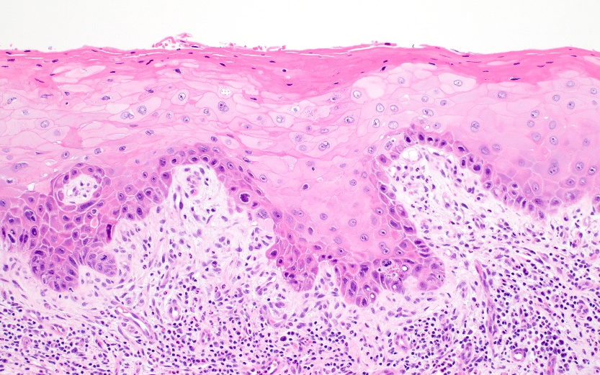
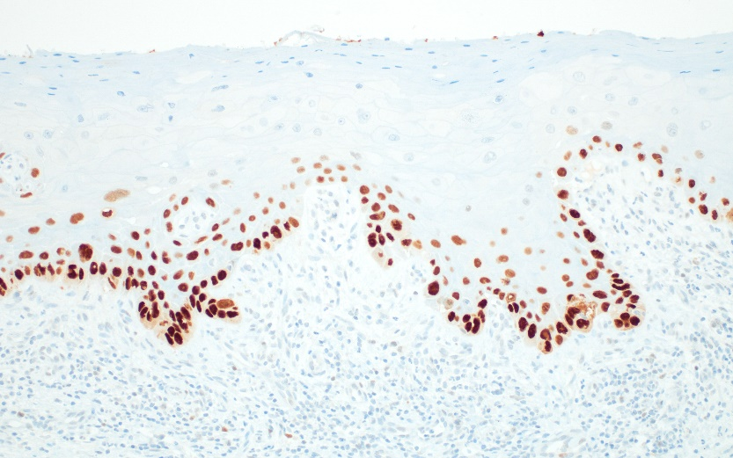
Differentiated Vulvar Intraepithelial Neoplasia (dVIN)
Arises in a background of lichen sclerosus or lichen simplex chronicus
Diagnostic criteria are somewhat subjective
  Abnormal maturation/keratinization
  Acanthosis
  Elongated and/or anastomosing rete ridges
  Parakeratosis
  Atypia of basal layer
Aberrant staining for p53
p16 typically not block positive; HR HPV negative

Slide 7
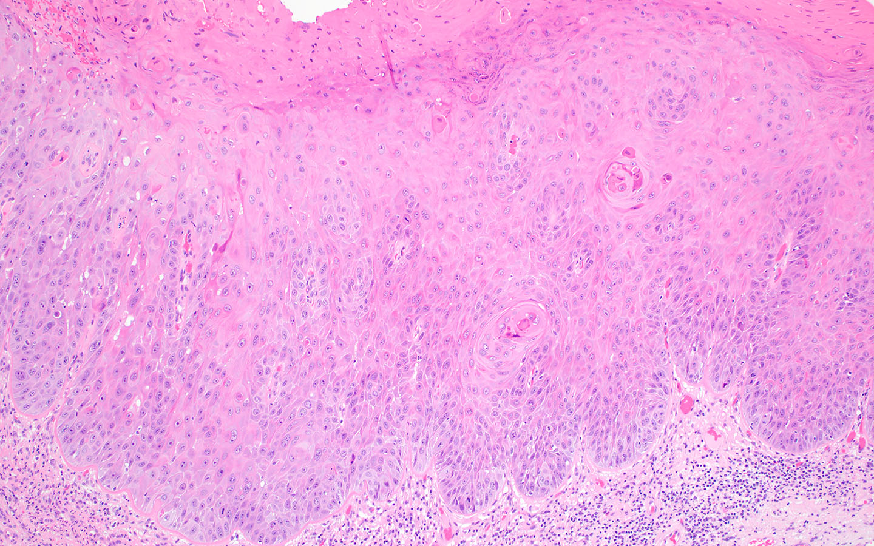
Abnormal Maturation/Keratinization

Slide 9
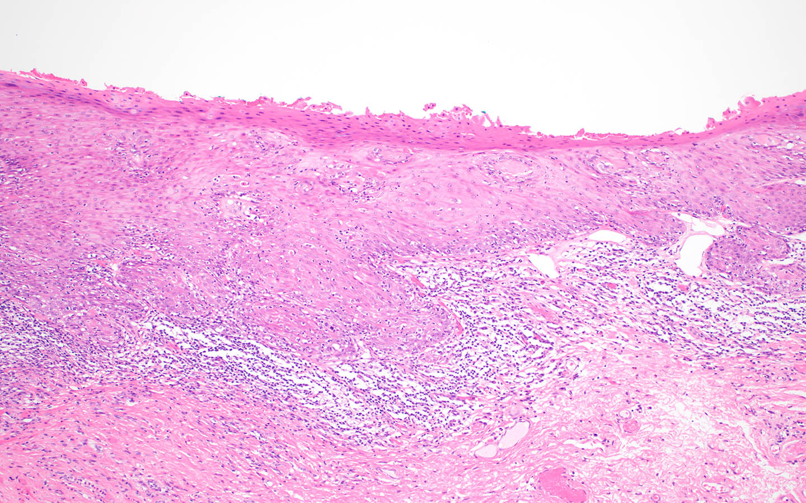
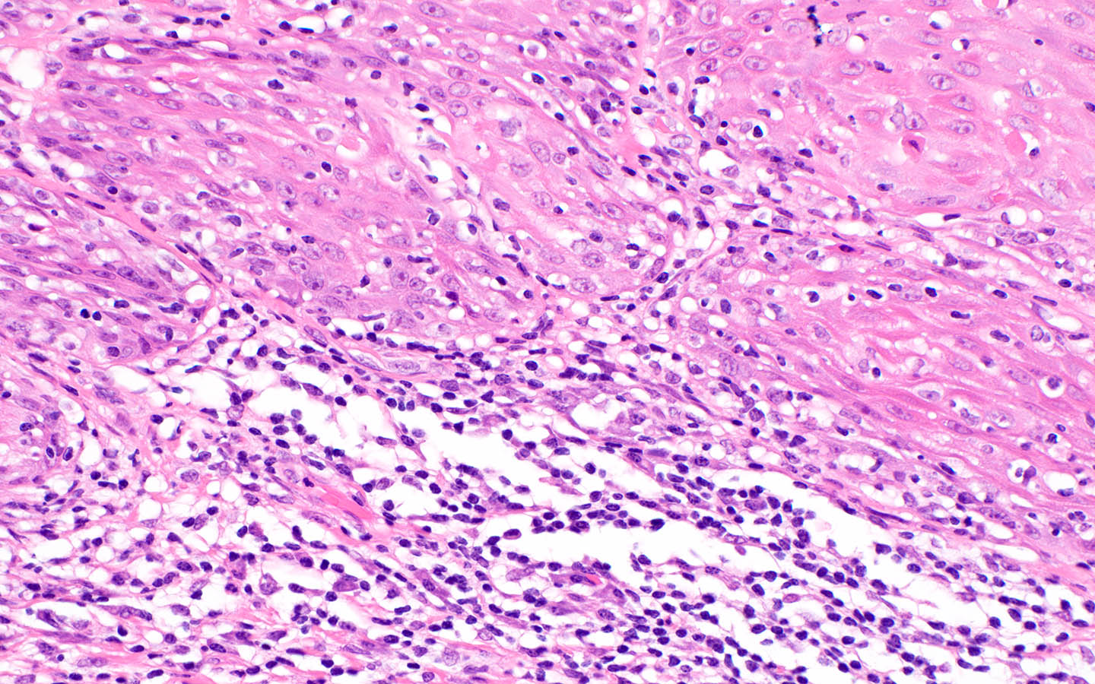
Notes:
Atypical features of basal keratinocytes include nuclear enlargement (>3x the size of a lymphocyte nucleus), as well as pleomorphism and hyperchromasia. In some cases, basal keratinocytes have open chromatin with enlarged and sometimes multiple nucleoli.

Slide 10
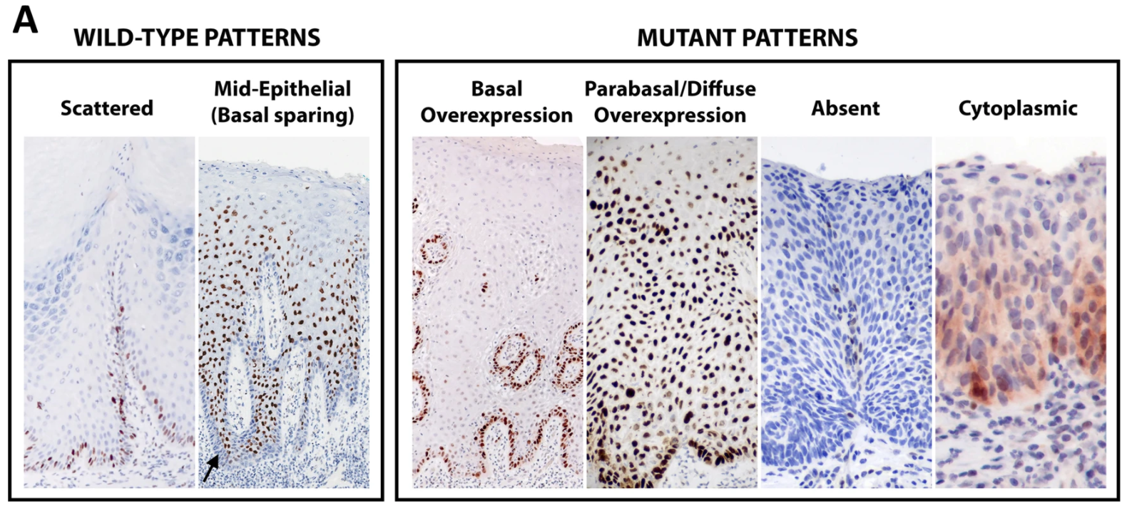
p53 Immunohistochemistry
Tessier-Cloutier B, et al. Mod Pathol 2020;33(8):1595-1605.
Notes:
Even so, there are several complicating factors. Distinction between high-level scattered staining and basal OE or between low-level scattered staining and absent/null staining is subjective. Beyond that, TP53 mutation does not necessarily indicate neoplasia. Within the HPVi(p53wt)vaVIN, it is unclear how to classify lesions with acanthosis, aberrant maturation, non-atypical nuclei, and p53 patterns at the high end of wild type or low end of overexpression.

Slide 11
p53/CK17 Dual Stain: dVIN

Slide 12
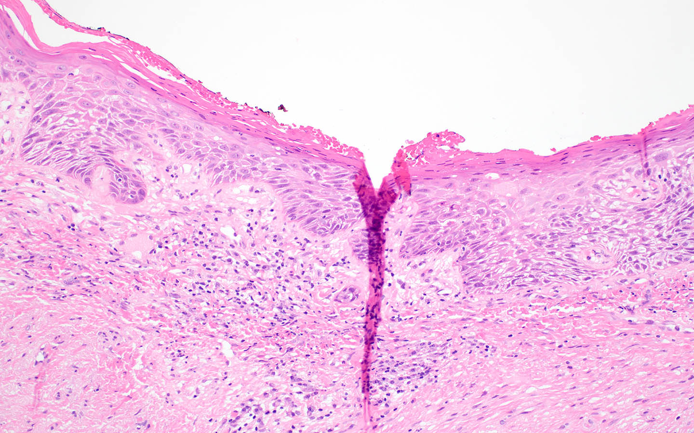
Case #1

Slide 13
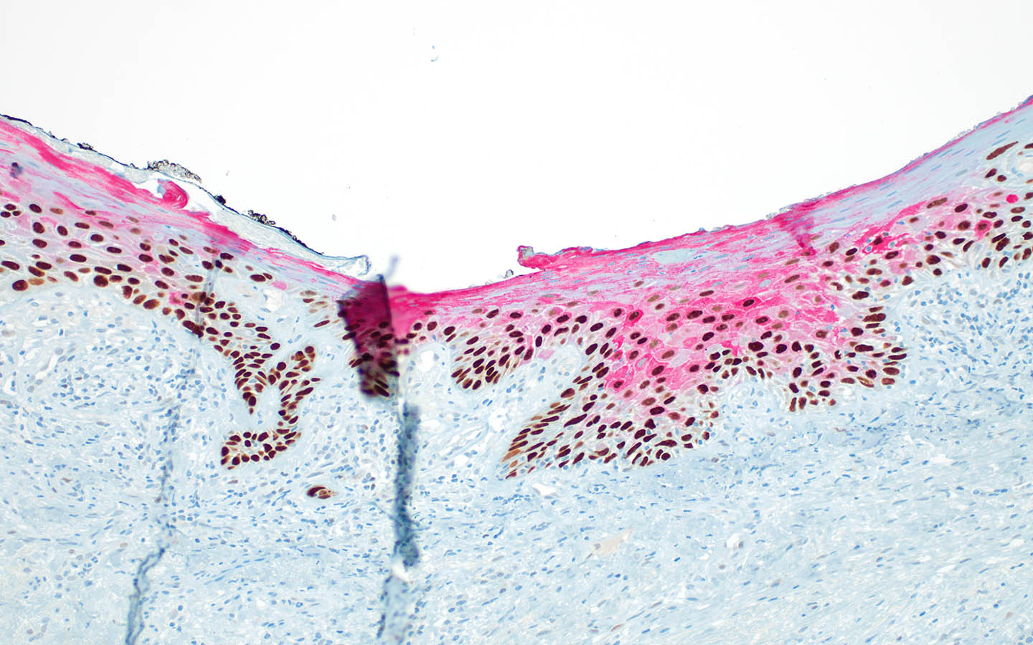
p53/CK17

Slide 14
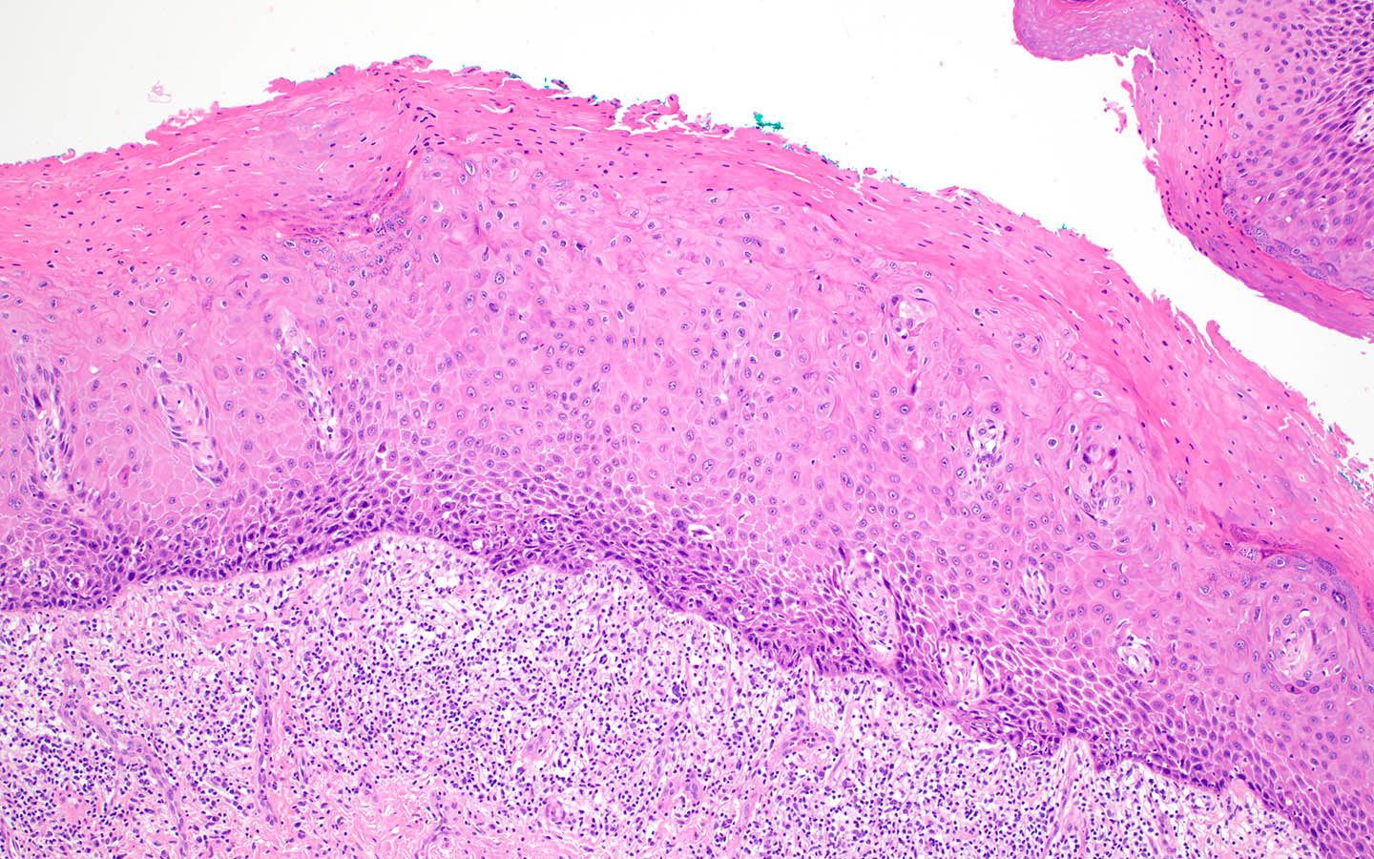
Case #2

Slide 15
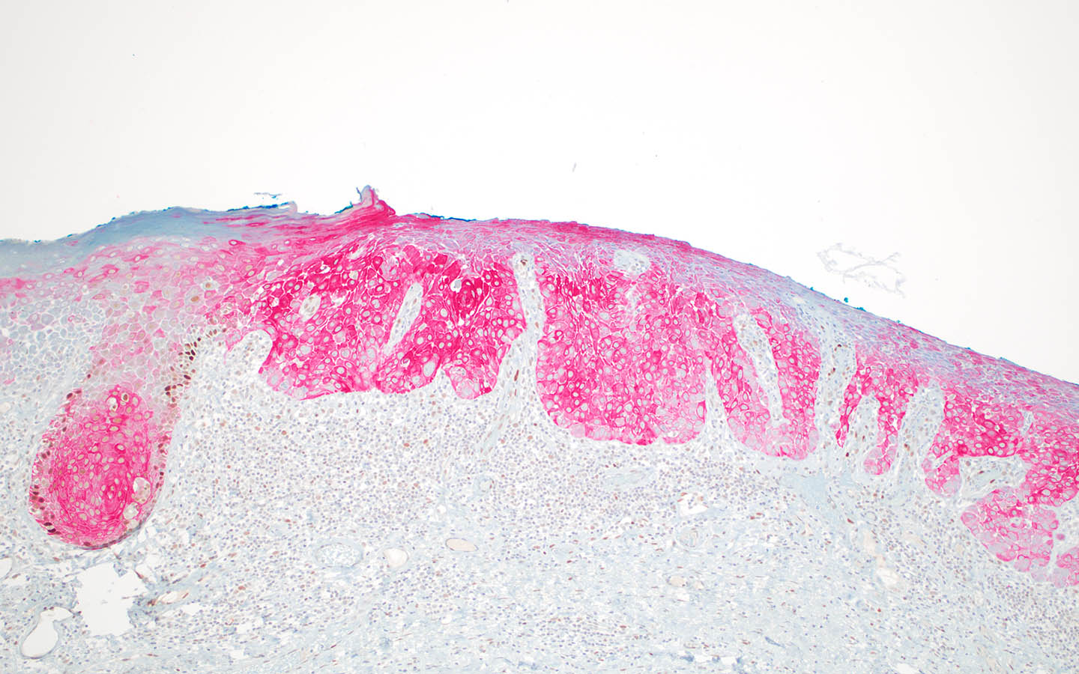
p53/CK17

Slide 16
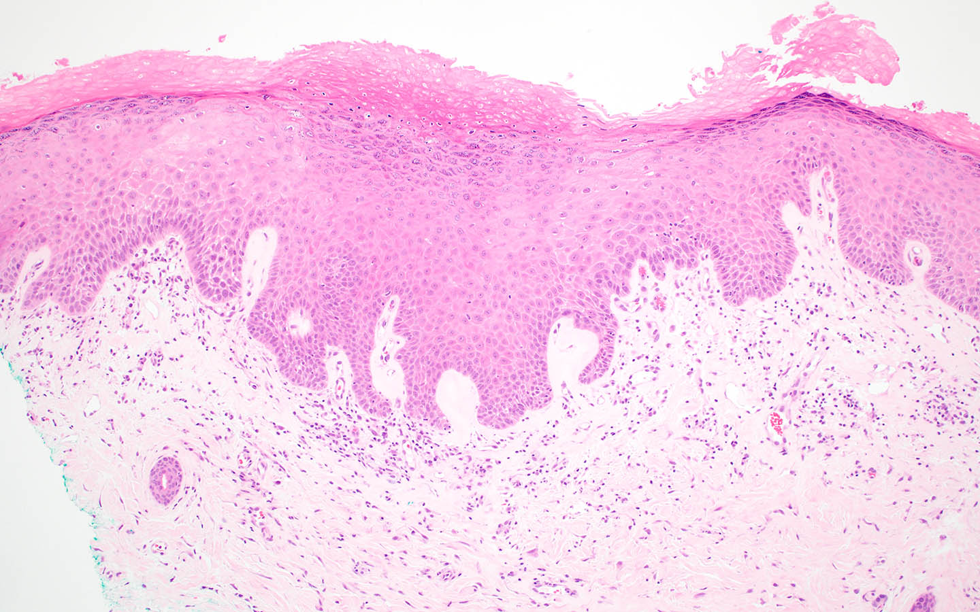
Case #3

Slide 17
p53

Slide 18
p16

Slide 19
hrHPV ISH

Slide 20
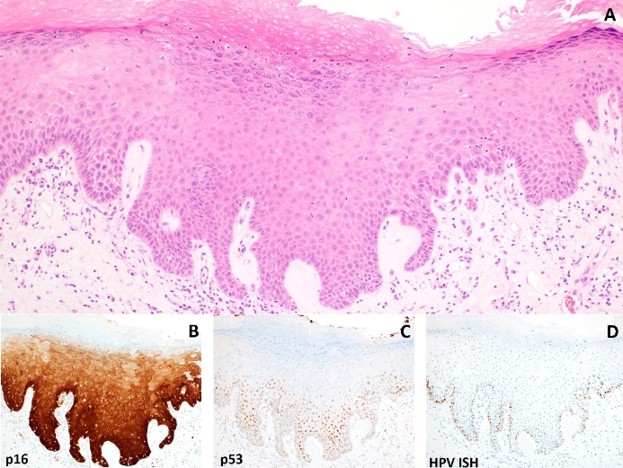
HSIL with Features Mimicking dVIN
Features similar to dVIN with some exceptions*:
  May be full thickness cytologic atypia
  Cytologic atypia may be more severe than expected for dVIN
Block positive p16 (sometimes limited to base), mid-epithelial p53 staining sparing base, HPV ISH often limited to base
Areas with more conventional HSIL morphology may be seen nearby
Lichen sclerosus may also be seen nearby
Average age seems to be ~60s
Griesinger L, et al. Int J Gynecol Pathol 2021;40(3):205-213.

Slide 21
HPVi(p53wt) Acanthosis
Where do we draw the line between reactive/inflammatory and neoplastic?
ISSVD DPDC argues that these are lesions rather than neoplasia and may represent response to inflammation or neoplastic transition
  “VAM” allows for individualized management based on assessment of neoplastic vs surgical risks
  Excision or intensified medical management may be reasonable
  Agree with separating these from dVIN
  Close follow-up is warranted!
Notes:
ISSVD proffered vulvar aberrant maturation (VAM) to (1) describe a spectrum of histopathologic features under a single simple name, (2) signal pathologists' concern that transition to neoplasia may soon arise or has occurred, (3) avoid making premature determinations about “intraepithelial lesion” vs “intraepithelial neoplasia” status and (4) facilitate individualized decision-making about treatment and follow-up. Parra-Herran et al argue these cases are always neoplastic, pointing to mutations in NOTCH1, RAS, and PIK3CA, and progression to SCC in 40% in 3 to 4 years. They advocate for abandonment of VAAD, DEVIL, and vLSC to better align terminology with tumor biology rather than morphology. In contrast, the 2020 WHO classification categorizes DEVIL and VAAD as sub-types of dVIN, under a heading of HPV-independent neoplasia.

Slide 22
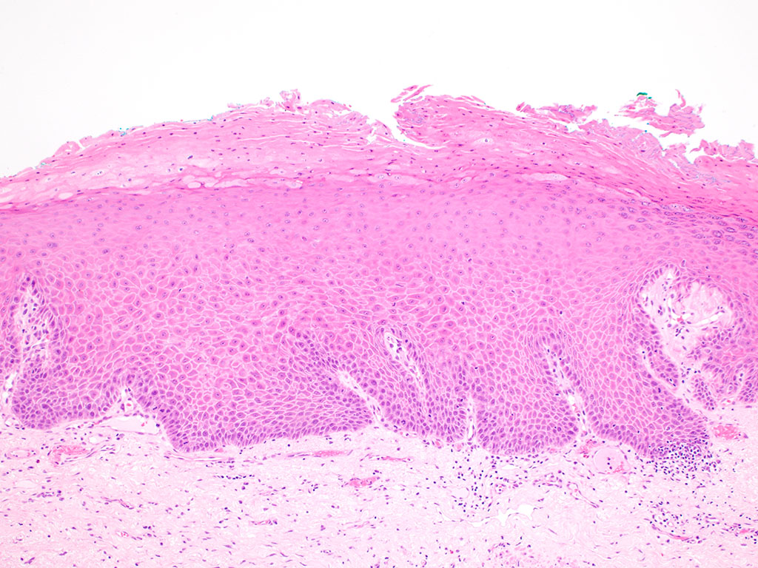
HPVi(p53wt) vaVIN / VAM
May or may not show background of lichen sclerosus or lichen simplex chronicus
Clinically discrete lesion in a patient ≥ 60 yo
Consider excision with negative margins vs close surveillance with follow-up biopsies
  ~40% progress to VSCC within 3-4 years

Slide 23
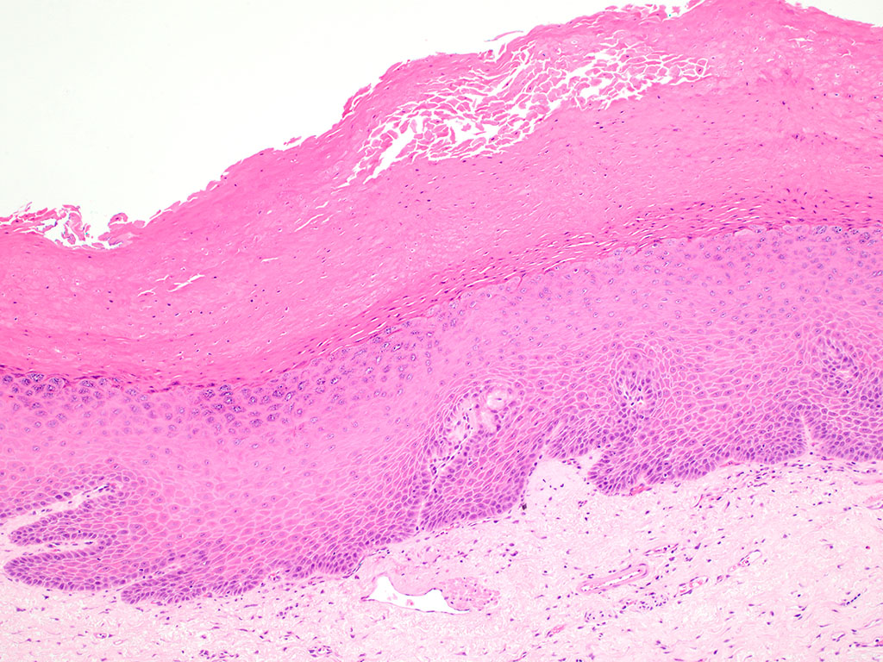
HPVi(p53wt) vaVIN / VAM
Verruciform and/or acanthotic architecture
Absent to mild basal/parabasal atypia
Absence of p53 abnormality
Differentiated exophytic vulvar intraepithelial lesion (DEVIL)
  Acanthotic/verruciform architecture
  Abnormal keratinocyte differentiation
Verruciform acanthosis with altered differentiation (VAAD)
  Epithelial pallor or eosinophilic change
  Hypogranulosis
  Parakeratotic hyperkeratosis
Verruciform lichen simplex chronicus (vLSC)
  Hypergranulosis
  Thick hyperkeratosis
  Absence of eosinophilic change or pallor

Slide 24
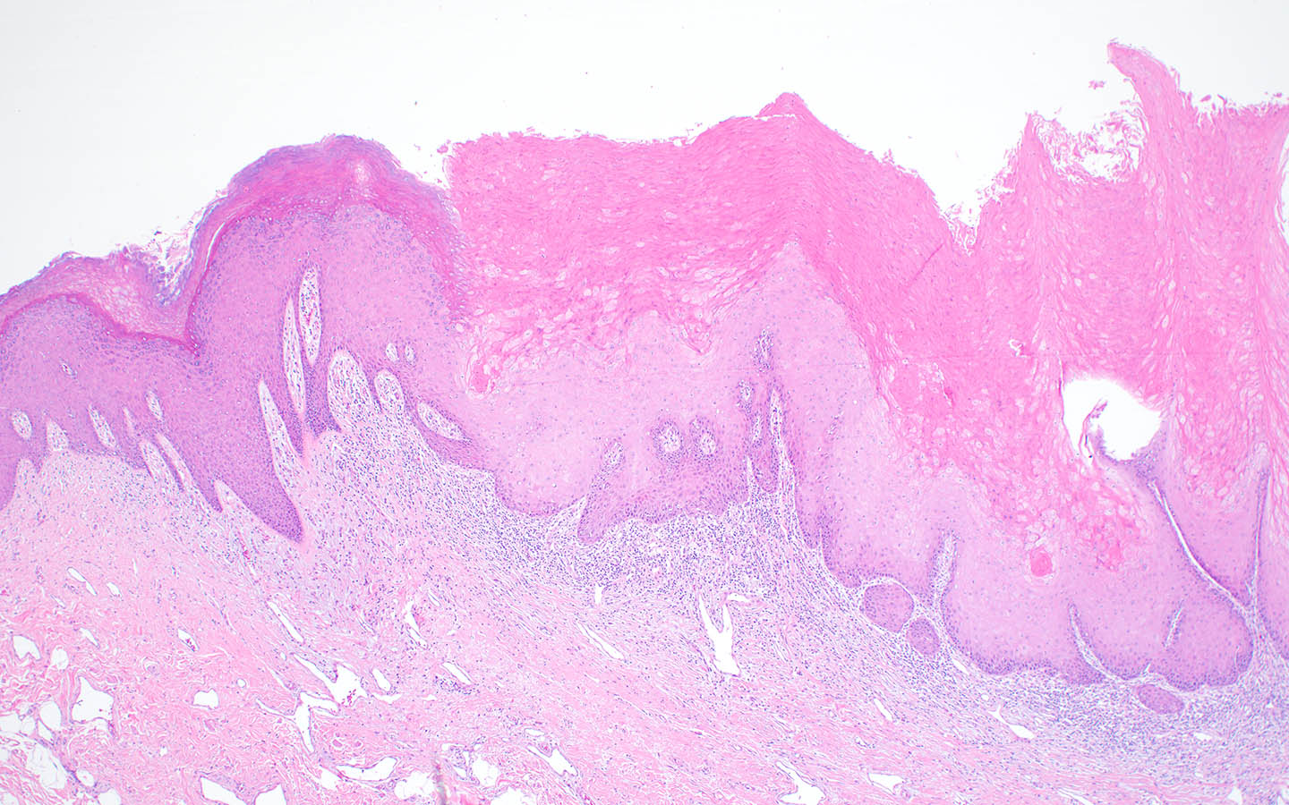
Case #4

Slide 25
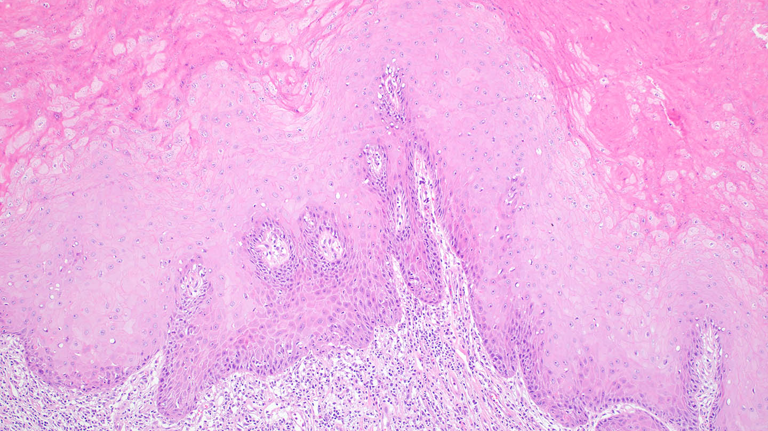

Slide 26
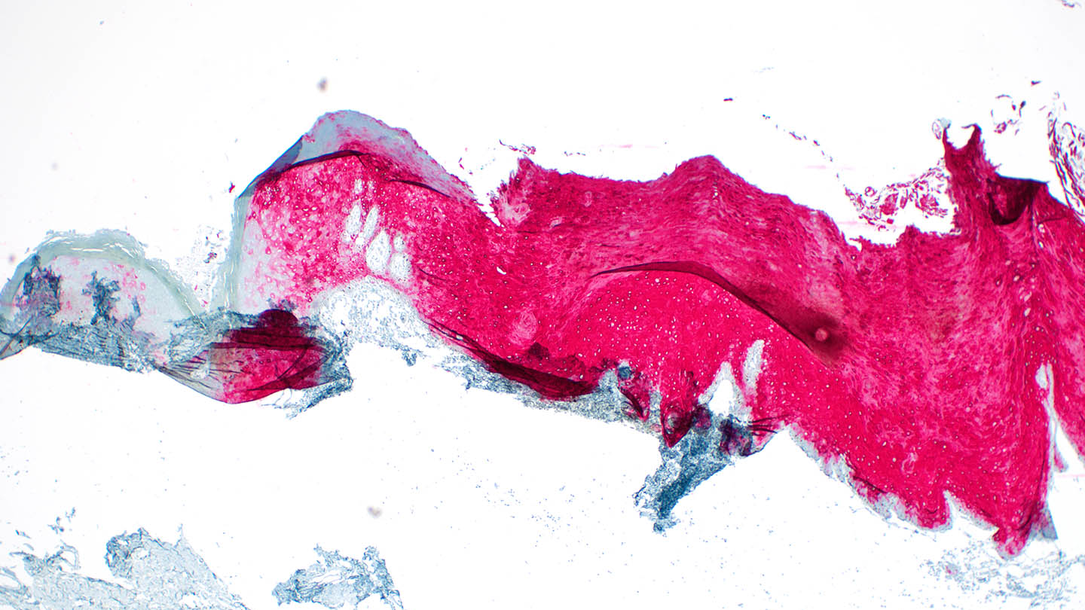
p53/CK17

Slide 27
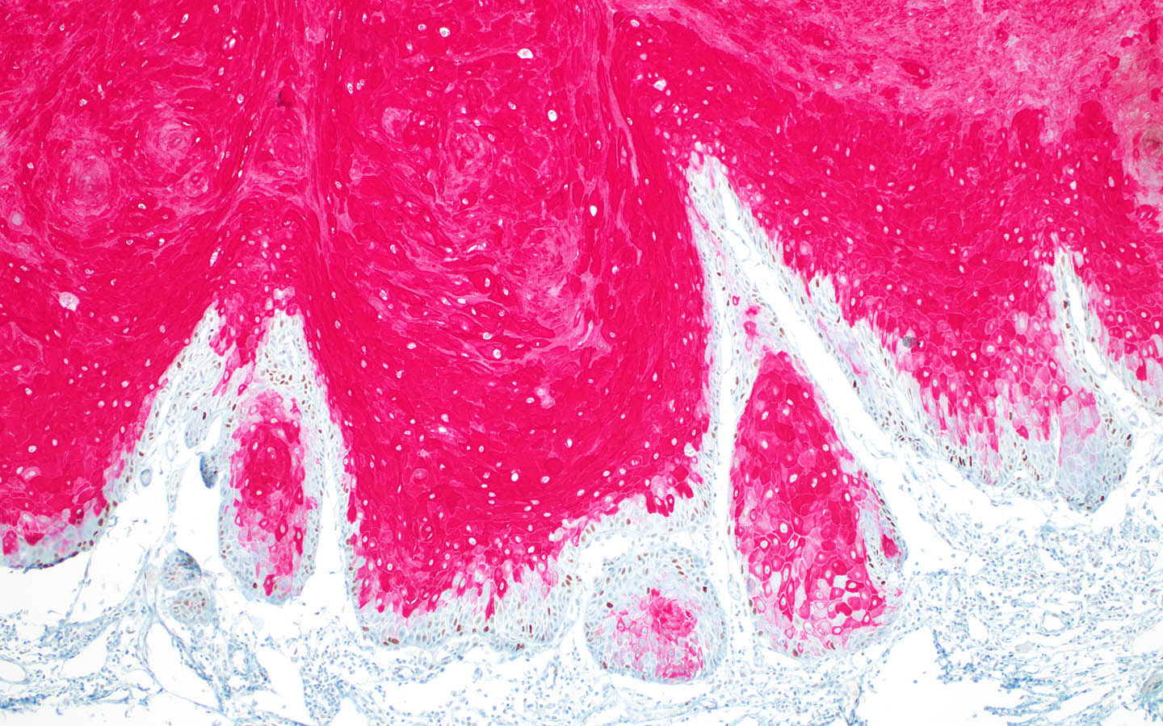
p53/CK17

Slide 28
ISSVD Recommendations for dVIN
Aim for universal clinical photography of suspected dVIN and VAM
Obtain biopsies from morphologically distinct areas, as dVIN and VAM may be multifocal and have a different appearance at each site
Document presence of LS and/or LP and previous diagnoses of HSIL, VAM, dVIN, or SCC on pathology request forms
Pathologists may need to solicit additional information from clinicians if clinical notes are insufficient as to history and examination findings
Universal p16 and p53 in cases of suspected squamous neoplasia are advisable because dVIN and HSIL cannot be reliably distinguished by routine microscopy
  If this is not possible, p16 and p53 are essential in:
    Biopsies obtained from treatment-resistant lesions within LS
    Suspected dVIN and VAM
    Presumed HSIL in women older than 45 years, with comorbid LS/LP, or nonresponse to LASER or imiquimod
Indicate type of dVIN and presence of LS/LP in pathology reports
Communication between clinician and pathologist or expert multidisciplinary review is recommended before embarking on cytotoxic, ablative, or extirpative procedures
J Low Genit Tract Dis. 2021; 25(1): 57–70.

Slide 29
Other Pitfalls
Reactive changes must be considered
  Lichen simplex chronicus
    Acanthosis, hyperkeratosis like HPVi VIN
    Lacks significant basal atypia
    Typically shows non-aberrant p53 staining pattern
    HYPERgranulosis (which can also be seen in HPVi VIN)
    Vertically oriented papillary dermal fibrosis
Any lesion with morphologic features of LSC but with exaggerated acanthosis and/or verruciform architecture should be strongly suspected to represent HPVi(p53wt) vaVIN (Parra-Herran et al., Mod Pathol. 2022;35(10):1317-1326)
Infectious causes must be considered before they can be ruled out in some cases!

Slide 30
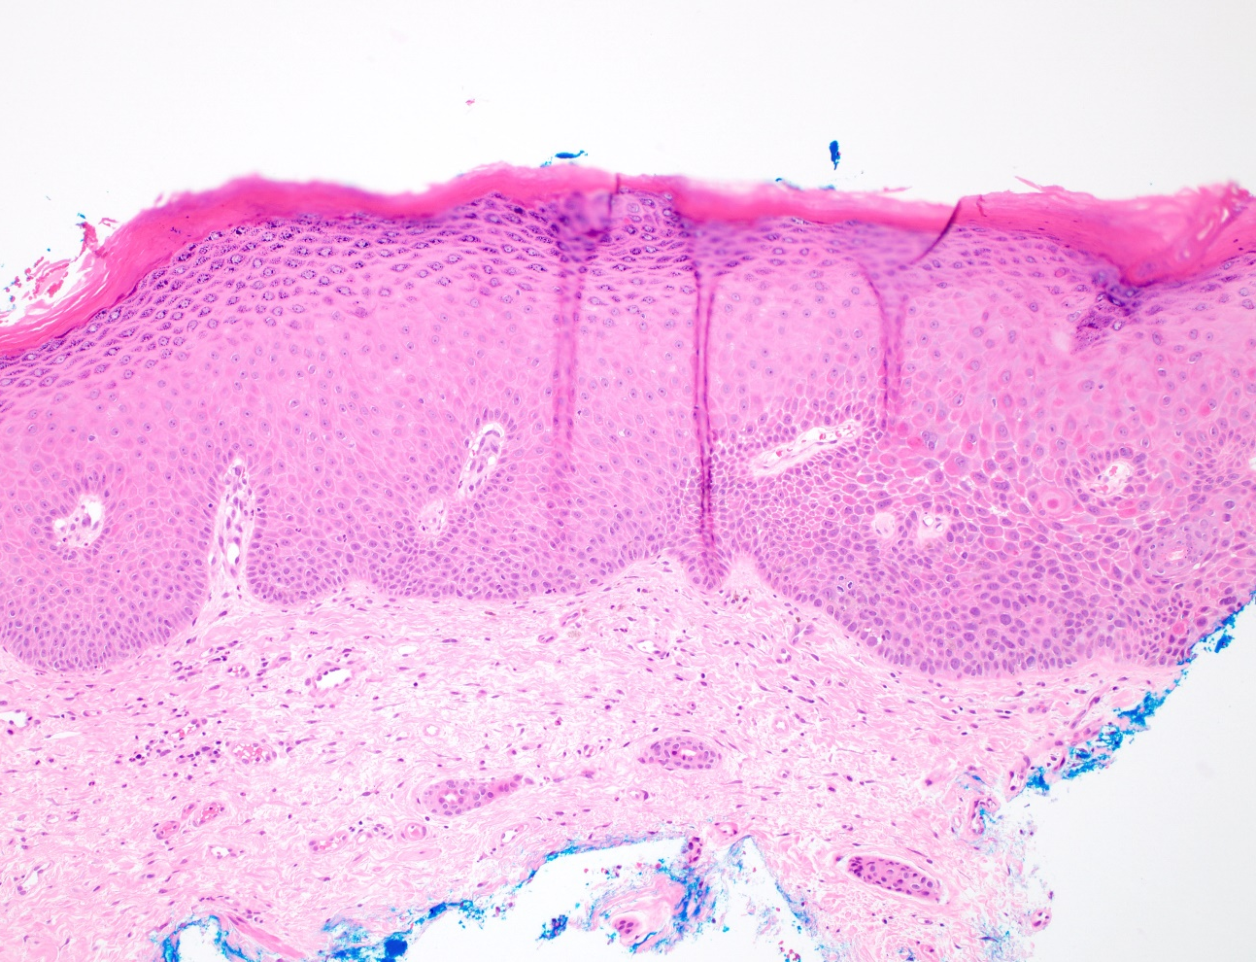
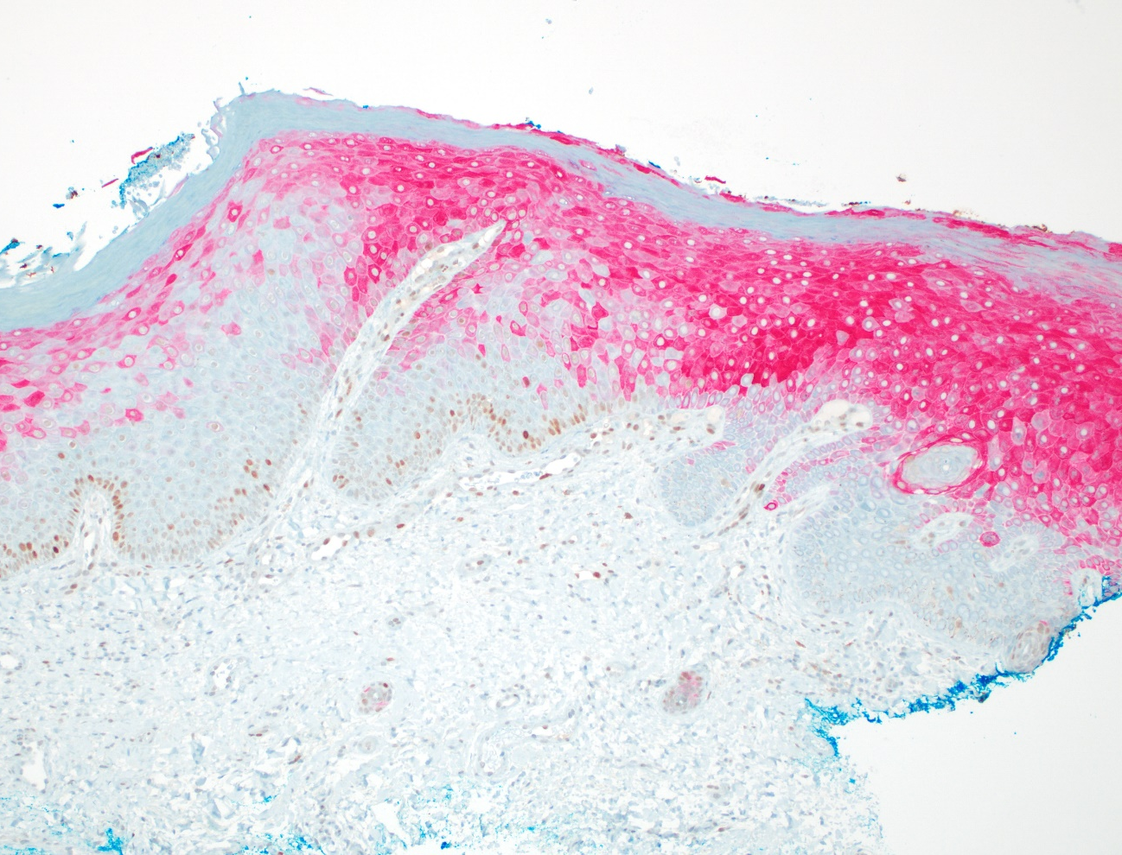
p53/CK17 Dual Stain: LSC and dVIN

Slide 31
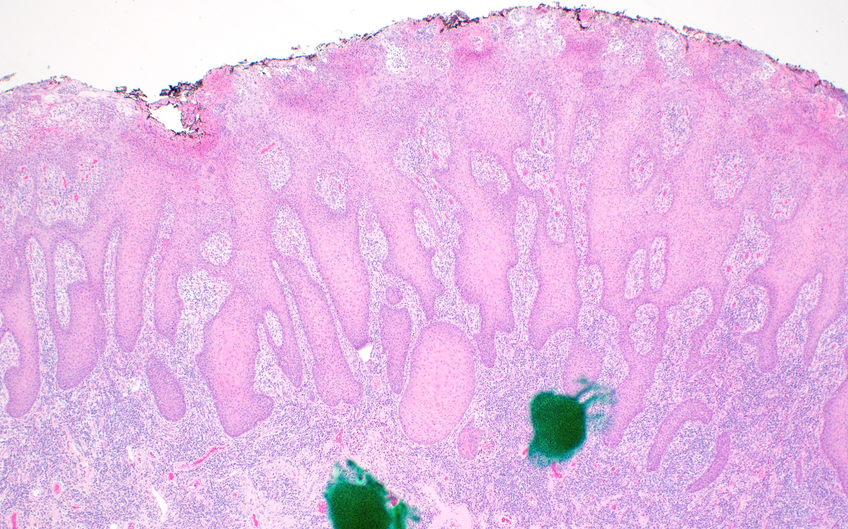
Case #5

Slide 32
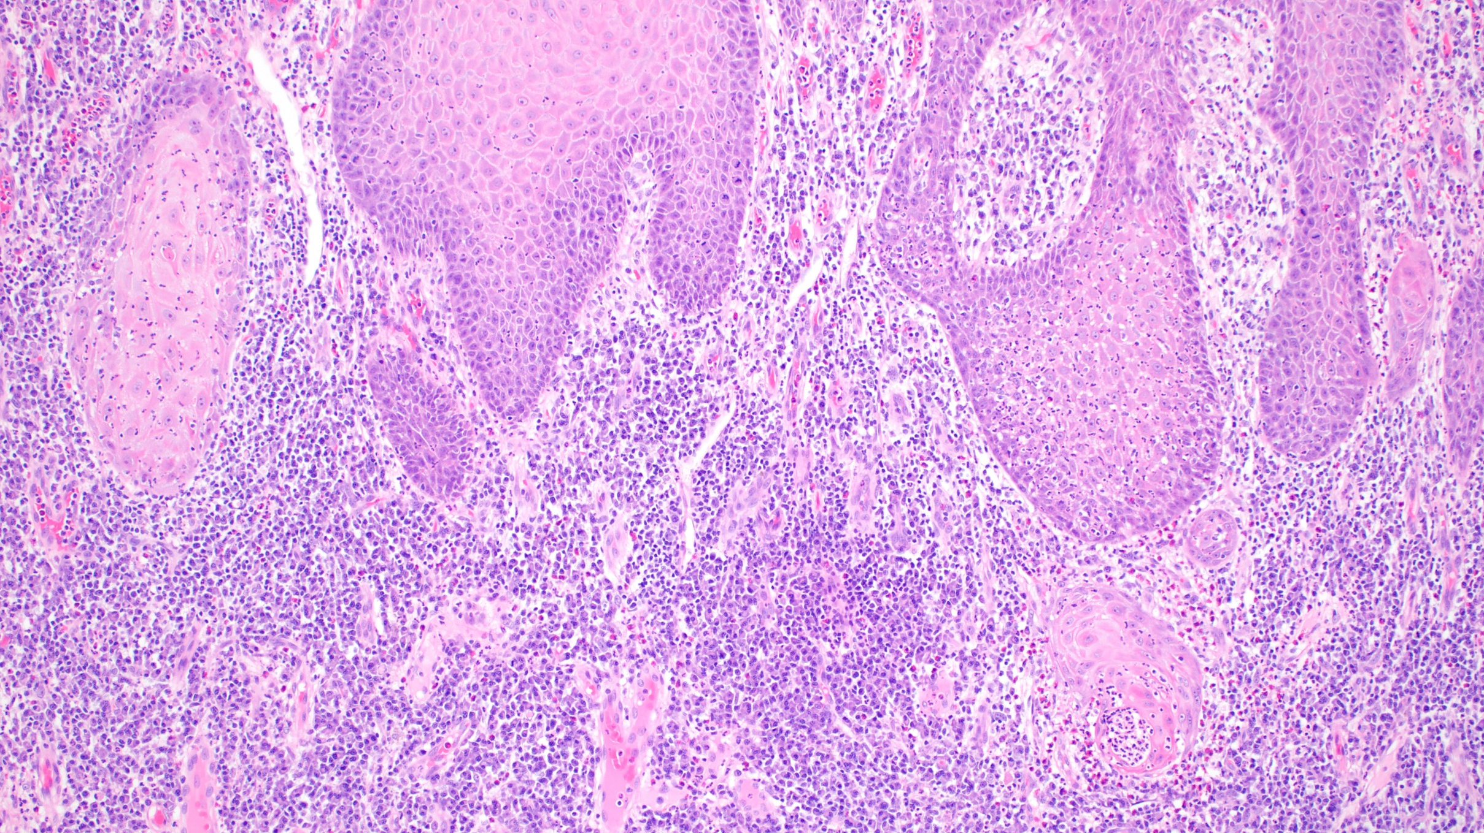

Slide 33
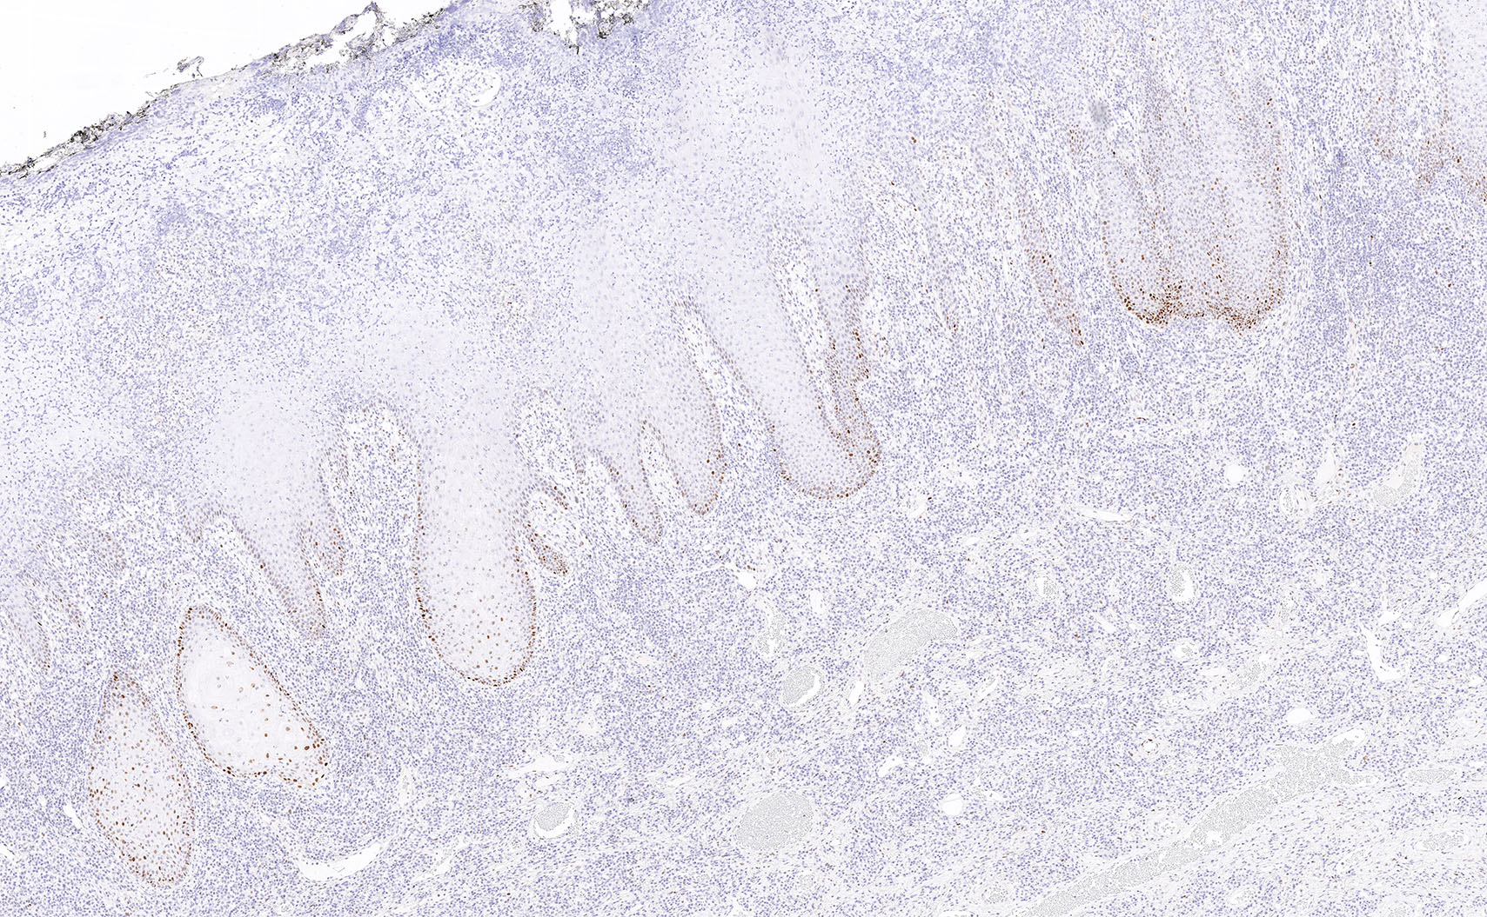
p53

Slide 34
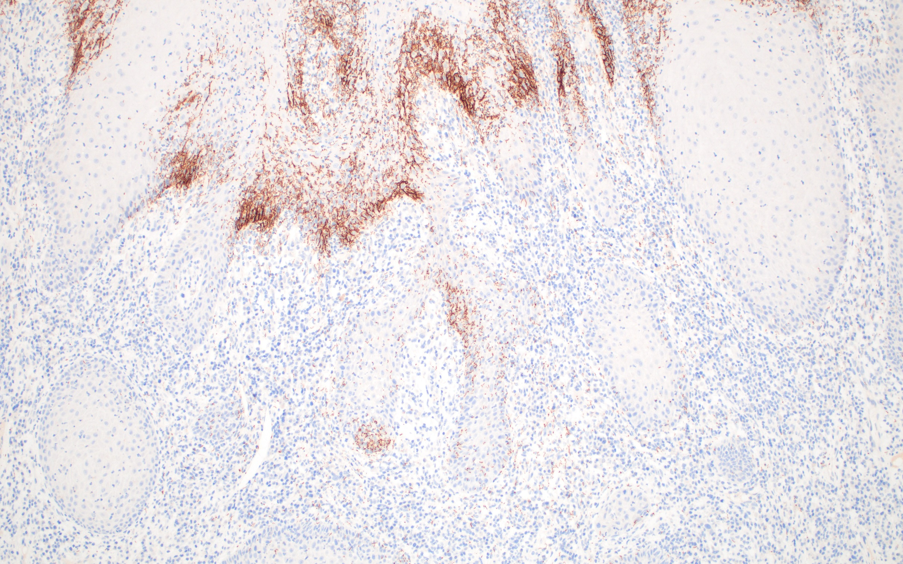
Spirochete

Slide 35
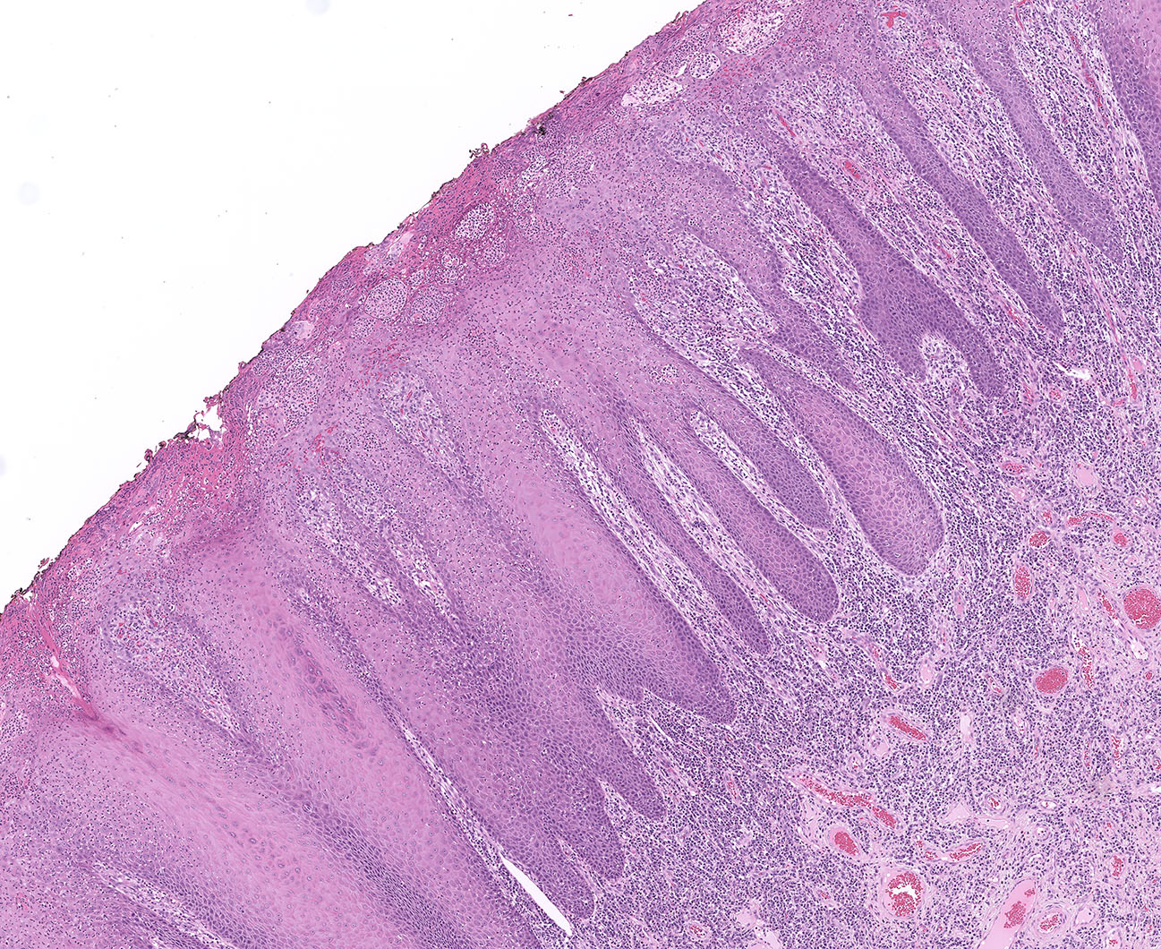
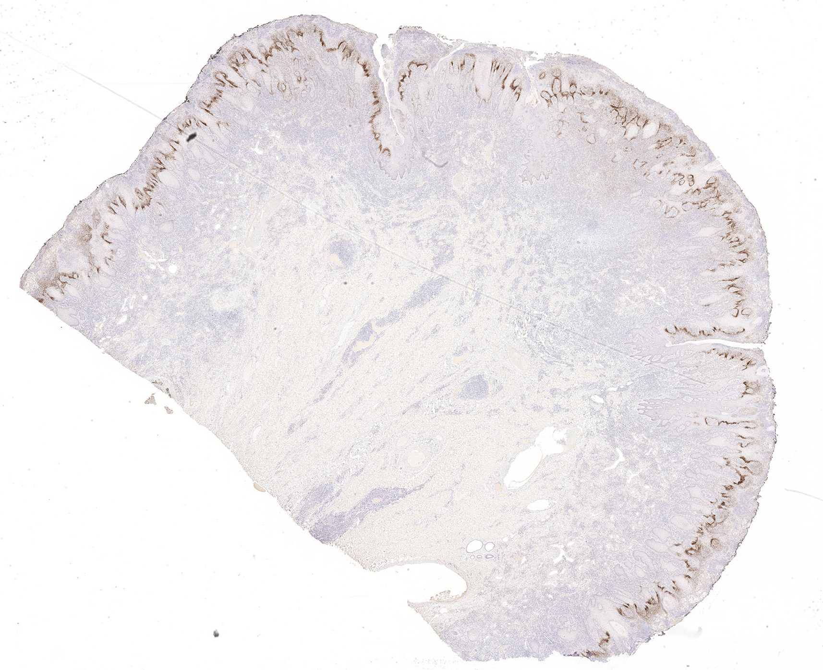
Syphilis
Morphology overlaps with HPVi VIN
  Acanthosis and hyperkeratosis
  Often lichenoid inflammatory infiltrate
  Pseudoepitheliomatous hyperplasia may mimic invasion
Key differences from HPVi VIN
  Marked intraepithelial acute inflammation
  Marked dermal chronic inflammation including plasma cells
  May see plasma cell endarteritis
  Unusual combinations of psoriasiform, lichenoid, spongiotic, and granulomatous patterns*
  Positive spirochete stain

Slide 36
My approach re: IHC/ISH
Any suspected VIN
  p16
  p53 (or p53/CK17 if reactive changes are deemed likely)
Notable acute inflammation
  GMS or PAS
Notable acute and chronic inflammation
  Spirochete
  HSV1-2
In select cases when diagnosis remains unclear
  HR HPV RNA ISH
  LR HPV RNA ISH
Photo courtesy of University of Michigan Immunohistochemistry Lab
https://www.pathology.med.umich.edu/immunohistochemistry/ihc-antibody-list

Slide 37
References
WHO Classification of Tumours Editorial Board. WHO Classification of Tumours Series: Female Genital Tumours, Vol 4, 5th ed. International Agency for Research on Cancer; 2020.
Heller DS, Day T, Allbritton JI, et al. Diagnostic Criteria for Differentiated Vulvar Intraepithelial Neoplasia and Vulvar Aberrant Maturation. J Low Genit Tract Dis 2021;25(1):57-70.
McAlpine JN, Kim SY, Akbari A, et al. HPV-independent differentiated vulvar intraepithelial neoplasia (dVIN) is associated with an aggressive clinical course. Int J Gynecol Pathol 2017;36(6):507–516.
Report of the ISSVD Terminology Committee: Proceedings of the Eighth World Congress, Stockholm, Sweden. J Reprod Med. 31:973-974, 1986.
Kim YT, Thomas NF, Kessis TD, Wilkinson EJ, Hedrick L, Cho KR. P53 mutations and clonality in vulvar carcinomas and squamous hyperplasias: evidence suggesting that squamous hyperplasias do not serve as direct precursors of human papillomavirus-negative vulvar carcinomas. Hum Pathol. 1996;27:389-395.
Gardner HL. The Vulvar Dystrophies, Atypias, and Carcinomata in Situ: An Invitational Symposium. J Reprod Med. 1976;17(3):131-136.
Tessier-Cloutier B, Kortekaas KE, Thompson E, et al. Major p53 immunohistochemical patterns in in situ and invasive squamous cell carcinomas of the vulva and correlation with TP53 mutation status. Mod Pathol 2020;33(8):1595-1605.
Yang B, Hart WR. Vulvar intraepithelial neoplasia of the simplex (differentiated) type: a clinicopathologic study including analysis of HPV and p53 expression. Am J Surg Pathol 2000;24(3):429–441.
Day T, Marzol A, Pagano R, Jaaback K, Scurry J. Clinicopathologic Diagnosis of Differentiated Vulvar Intraepithelial Neoplasia and Vulvar Aberrant Maturation. J Low Genit Tract Dis 2020;24:392-398.
Watkins JC, Howitt BE, Horowitz NS, et al. Differentiated exophytic vulvar intraepithelial lesions are genetically distinct from keratinizing squamous cell carcinomas and contain mutations in PIK3CA. Mod Pathol 2017;30:448-458.
Akbari A, Pinto A, Amemiya Y, Seth A, Mirkovic J, Parra-Herran C. Differentiated exophytic vulvar intraepithelial lesion: clinicopathologic and molecular analysis documenting its relationship with verrucous carcinoma of the vulva. Mod Pathol 2020;33:2011-2018.
Neville G, Chapel DB, Crum CP, et al. Interobserver reproducibility of differentiated exophytic vulvar intraepithelial lesion (DEVIL) and distinction from its mimics. Histopathol 2021;79:957-965.
Nascimento AF, Granter SR, Cviko A, Yuan L, Hecht JL, Crum CP. Vulvar acanthosis with altered differentiation: a precursor to verrucous carcinoma? Am J Surg Pathol 2004;28(5):638-43.
Roy SF, Wong J, Le Page C, et al. DEVIL, VAAD and vLSC constitute a spectrum of HPV-independent, p53-independent intraepithelial neoplasia of the vulva. Histopathol 2021;79:975-988.
Parra-Herran C, Nucci MR, Singh N, et al. HPV-independent, p53-wild-type vulvar intraepithelial neoplasia: a review of nomenclature and the journey to characterize verruciform and acanthotic precursor lesions of the vulva. Mod Pathol. 2022 Oct;35(10):1317-1326.
Bohl T, Day T, Heller D, et al. Comment on HPV-independent, p53-wild-type vulvar intraepithelial neoplasia: a review of nomenclature and the journey to characterize acanthotic precursor lesions of the vulva. Parra-Herran C. et al Mod Pathol 2022 Apr 18 doi: 10.1038/s41379-022-01079-7. Mod Pathol. 2022 Dec;35(12):2031-2032.
Rakislova N, Alemany L,Clavero O, et al. Differentiated Vulvar Intraepithelial Neoplasia-like and Lichen Sclerosus-like Lesions in HPV-associated Squamous Cell Carcinomas of the Vulva. Am J Surg Pathol. 2018 Jun;42(6):828-835.
Watkins JC, Yang E, Crum CP, et al. Classic Vulvar Intraepithelial Neoplasia With Superimposed Lichen Simplex Chronicus: A Unique Variant Mimicking Differentiated Vulvar Intraepithelial Neoplasia. Int J Gynecol Pathol. 2019 Mar;38(2):175-182.
Griesinger LM, Walline H, Wang GY, et al. Expanding the Morphologic, Immunohistochemical, and HPV Genotypic Features of High-grade Squamous Intraepithelial Lesions of the Vulva With Morphology Mimicking Differentiated Vulvar Intraepithelial Neoplasia and/or Lichen Sclerosus. Int J Gynecol Pathol. 2021 May 1;40(3):205-213.
Domfeh AB, Silasi D-A, Lindo F, Parkash V. Chronic hypertrophic vulvar herpes simulating neoplasia. Int J Gynecol Pathol. 2012 Jan;31(1):33-7.
McKean R, Wolf J, Wong TT, Yin YM, Kanis MJ. Recurrent herpes simplex virus mimicking vulvar carcinoma in patient with Human Immunodeficiency Virus: A case report. Gynecol Oncol Rep. 2023 Jan 24;45:101142.
ExpertPath

Slide 38
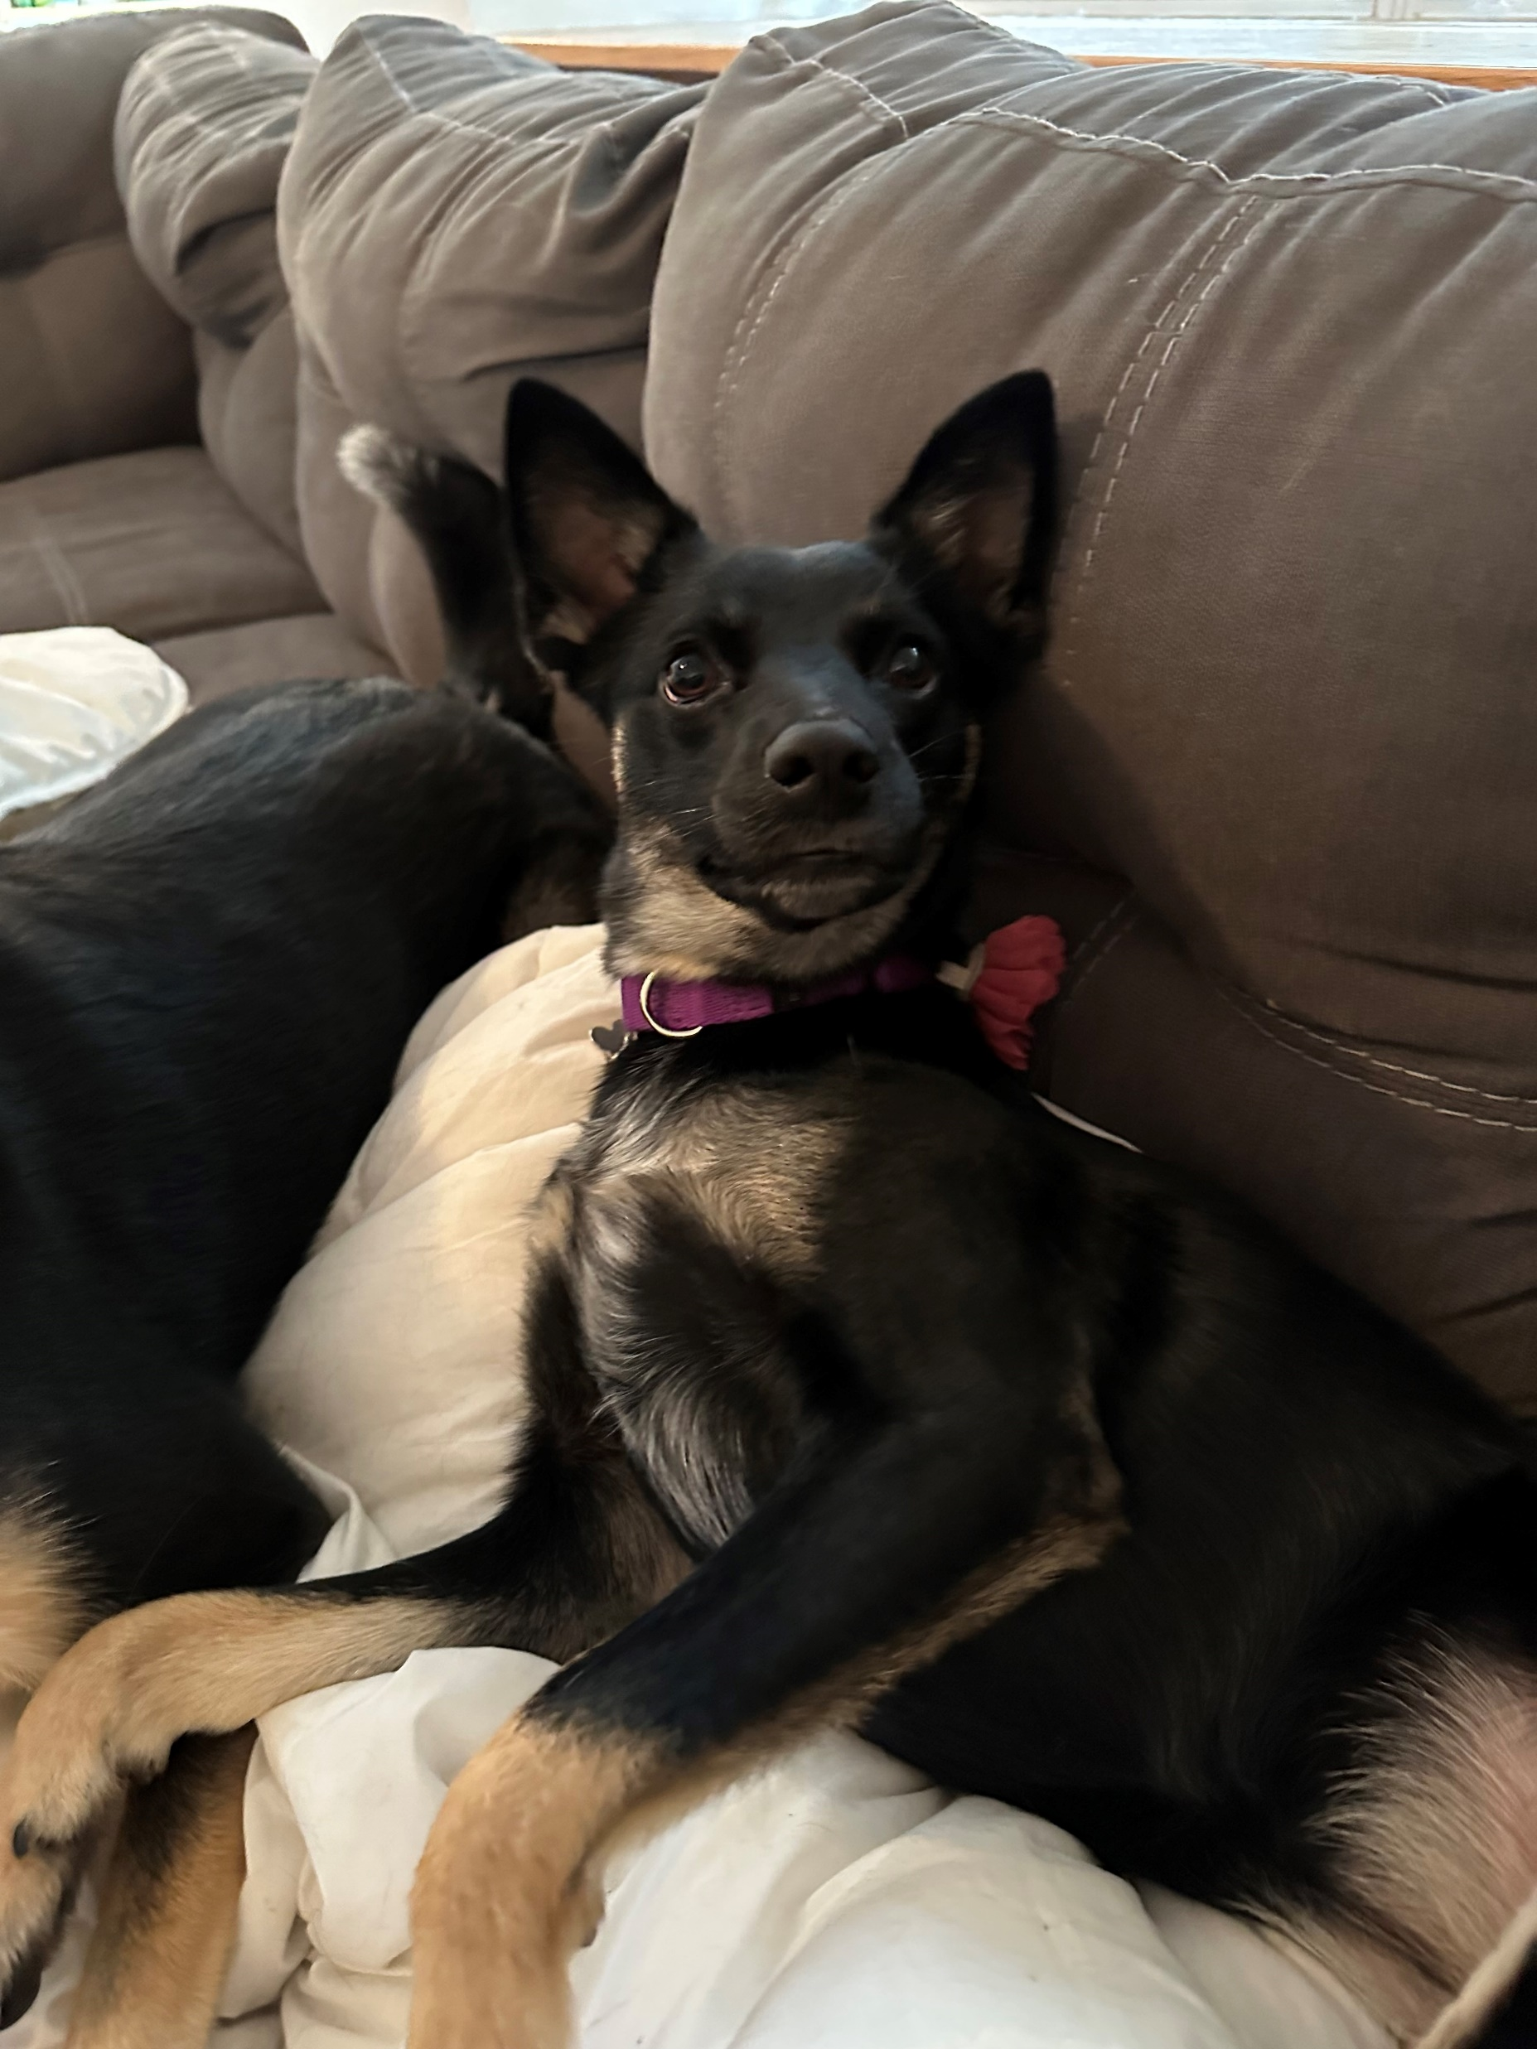
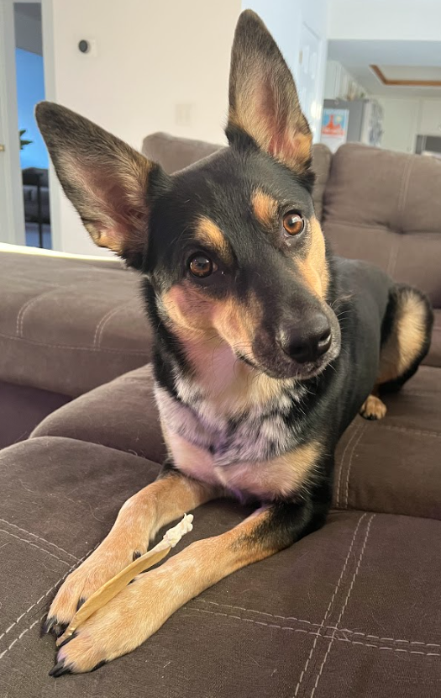
Questions?
sskala@med.umich.edu

