Slide 1
Neither a Luddite nor a Lemming: Librarians as the Lorax in our GenAI Obsessed World?
INCONECSS 2025
Berlin, Germany
Corey Seeman
Director, Kresge Library Services, University of Michigan
cseeman@umich.edu

Slide 2
Introduction
The Lorax
What is the librarian’s role here?
How things work at Michigan
Bouncing forward?

Slide 3

The Lorax
The Lorax was written in 1971 by Dr. Suess (or Theodor Seuss Geisel if you remember your cataloging class in library school).
Dr Suess said the book "came out of my being angry. The ecology books I'd read were dull…” (Lebduska 1994).
This book was likely the first environmental work many children (now adults) were exposed to.
“I am the Lorax. I speak for the trees.”

Slide 4
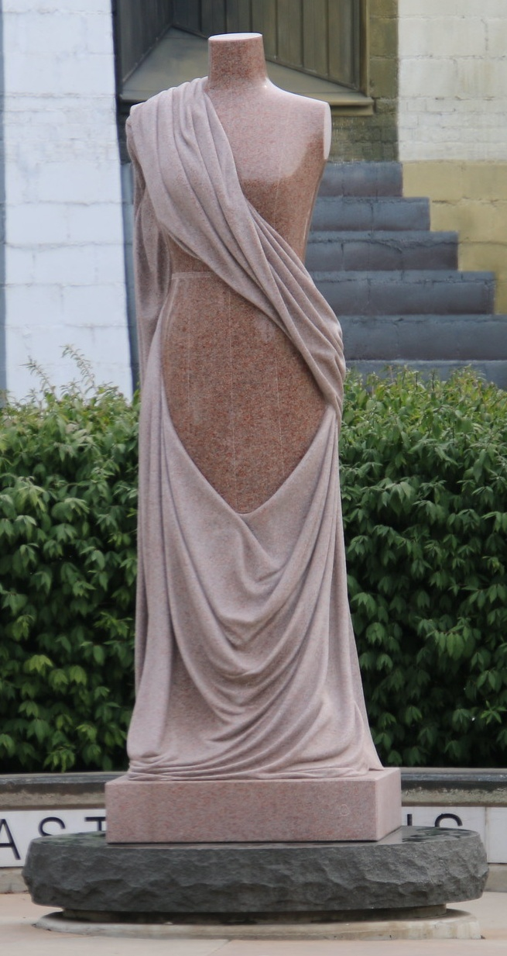
The Lorax
The Once-ler (who you never see), has discovered that a product could be made from the Truffula Tree’s tuft – the Thneed.
  “Look Lorax,” I said. “There’s no cause for alarm.
  I chopped just one tree. I am doing no harm.
  I’m being quite useful. This thing is a Thneed.
  A Thneed’s a Fine-Something-That-All-People-Need!

Slide 5
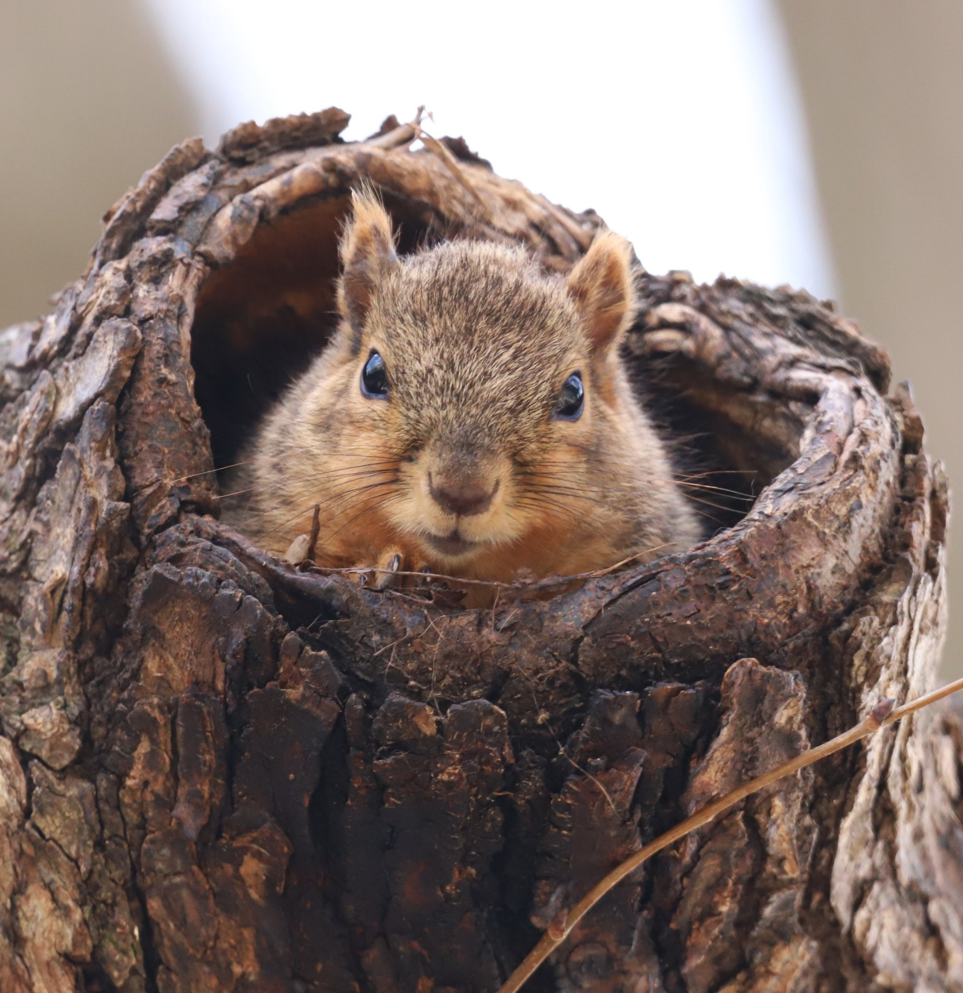
The Lorax
As demand grows for Thneed’s, more and more trees are removed.
The Lorax then leads out the bears, the birds and the fish for their land and water without these Truffula trees is not inhabitable.
The story actually begins at the end, with the Once-ler telling his story of woe to a young visitor.
The destruction had already happened.

Slide 6
The Lorax
“A Thneed’s a Fine-Something-That-All-People-Need!”
The appeal of GenAI is absolutely understandable.
We have been using AI for years in many forms
GenAI has the capacity to not only augment our work, but complete some of it on its own.
With GenAI - we have
  the capacity to “do more with less.”
  the capacity to meet unrealistic deadlines.
  the capacity to “do more with fewer.”

Slide 7
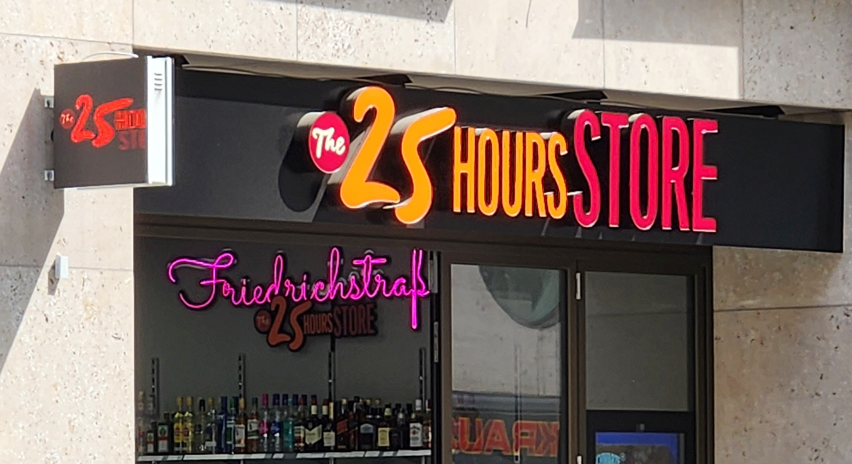
The Lorax
With GenAI - we have potentially the gift of time.

Slide 8

What is the librarian’s role here?
In the world of GenAI, our work as librarians has not really changed all that much.
We help people find data, articles, books, reports and other secondary research to advance and idea further dive into a subject.
We also help people understand the availability and complexity of data – countering assumptions that everything is available somewhere.

Slide 9
What is the librarian’s role here?
Some of the issues librarians see here are in two major buckets
Issues that are Information Related:
  Accuracy of Results
  Appropriate Use & Licensing
Issues that might be Societal or Ethical:
  Privacy
  Employment
Like the Lorax, we ca bring these up – and faculty or students may or may not listen.
We have to be OK with that (because it is happening anyway).

Slide 10
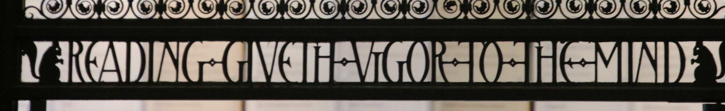
What is the librarian’s role here?
Raganathan’s Five Laws of Library Science (1931)
4. Save The Time Of The Reader
If you really want to save the time of the reader – not only find the items they want, but also summarize it for them.

Slide 11
How things work at Michigan
The University of Michigan has gone all in - https://genai.umich.edu/
Upon his sudden departure, President Santa Ono listed accomplishments during his tenure and started with this (message to community – May 4th, 2025):
  Artificial Intelligence and Digital Innovation
    Prioritized the strategic expansion of artificial intelligence, making Michigan the first university to offer custom AI tools to our entire academic community.
    Forged transformative partnerships with OpenAI and Los Alamos National Laboratory and launching a new $1.2B artificial intelligence research ecosystem.

Slide 12
How things work at Michigan - Faculty
Two recent requests at Ross
Faculty wanted all press releases from Fortune 1000 companies for 15 years – to analyze via text mining.
  Were not happy with RavenPack (scored assessments) or TDM Studio (cloud based assessments of smaller data sets). Dow Jones would not pull the content.
PhD student wanted more detailed car registration data. We could not purchase – cost was well over $300K USD.
Data requests appear to have increased recently (possibly because they moved to the library group).
For more on Ross and AI – visit - https://michiganross.umich.edu/about/AI-at-michigan-ross
Using GenAI is simply using the most cutting edge tool – so it is front and center with many researchers.

Slide 13
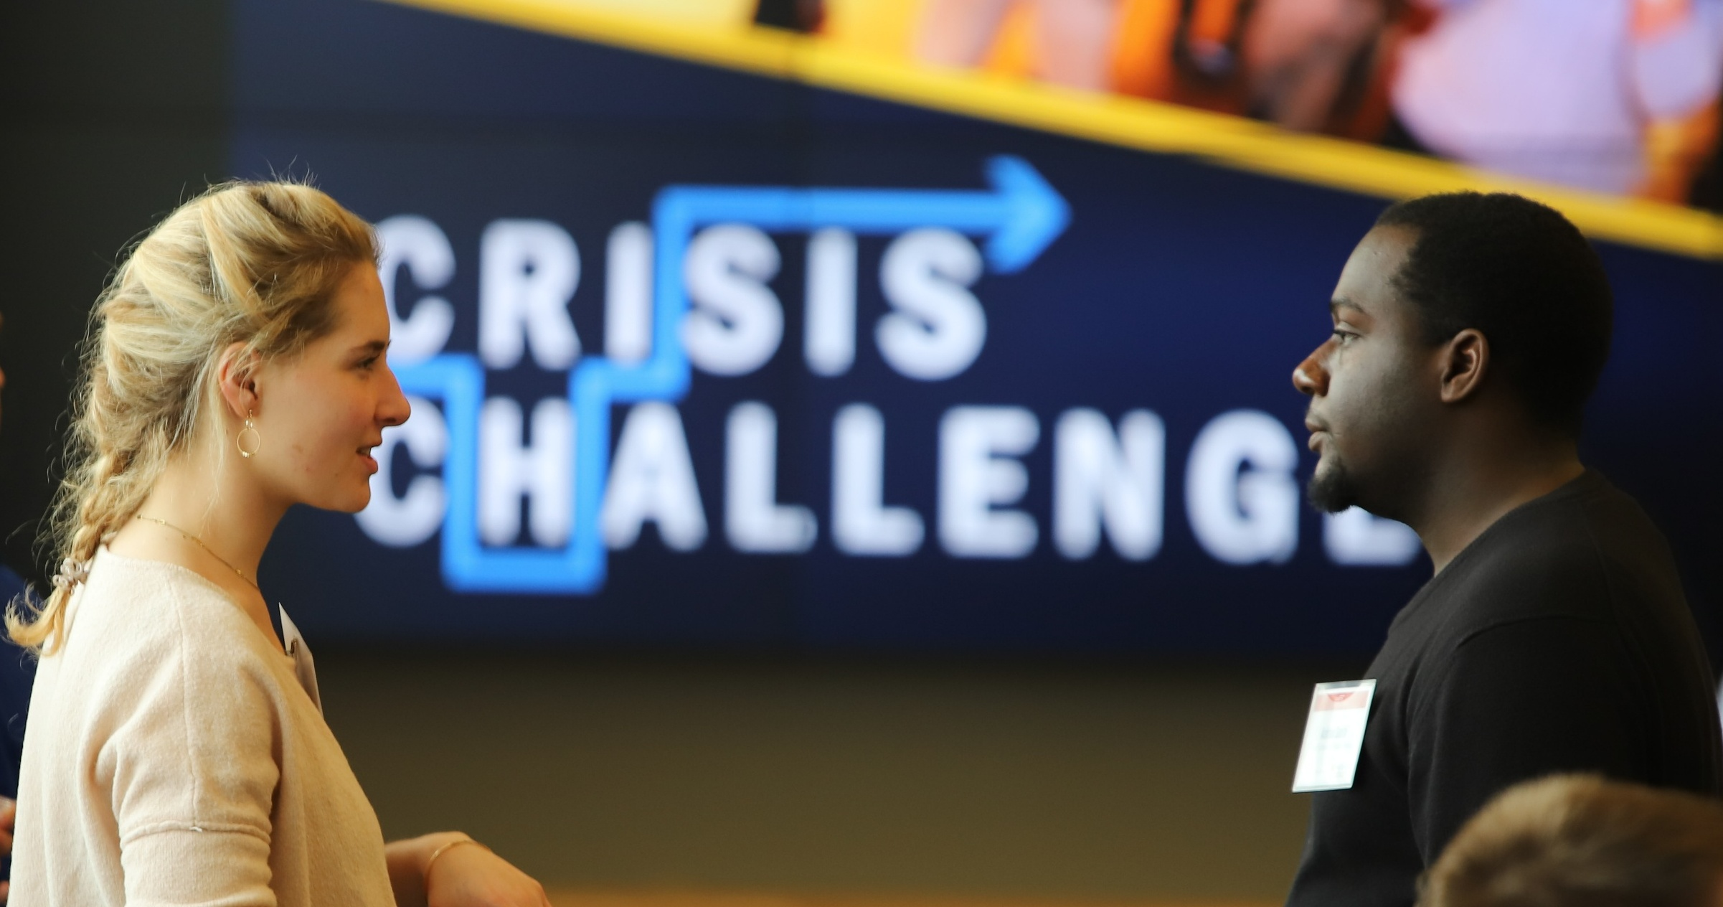
How things work at Michigan - Students
Anecdotally, we are seeing students use GenAI as something in their toolkit.
Conceptually, the more that they use it college, the more they will need this when moving into a career. They may not have the muscle memory to do the critical thinking.
They are using it for the note taking capacity in Zoom (including the ability to catch up if they arrive late).
They are using it to synthesize an break down larger reports (maybe despite the inclusion of an executive summary).
Some students are using it to get their research started.

Slide 14
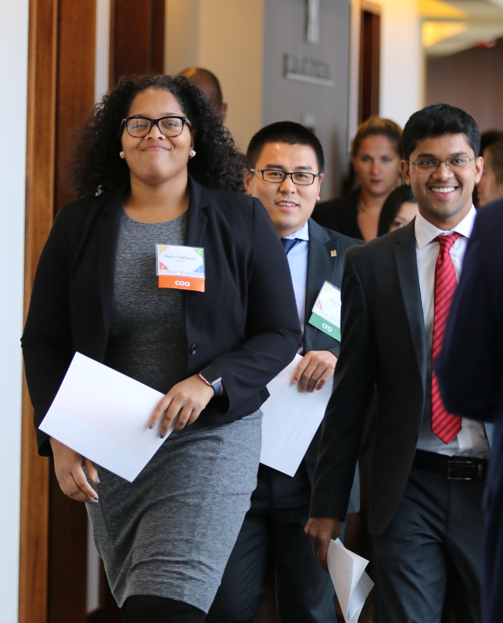
How things work at Michigan - Students
We continue to receive requests to track down citations to documents that do not exist. Chasing phantom citations is not something new, but it has increased for sure.
Noticed numerous ads on YouTube from Grammarly – especially towards the end of the term - when I am on campus.

Slide 15
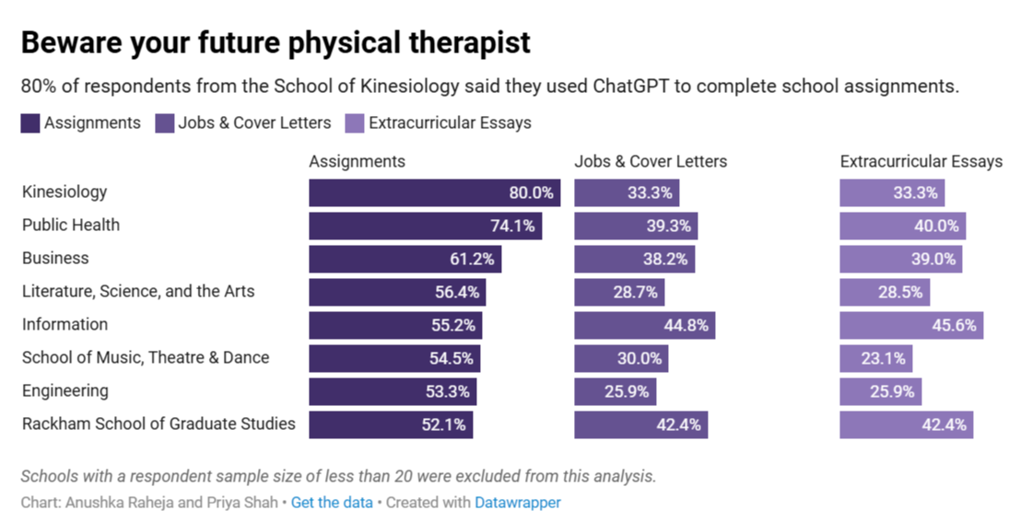
How things work at Michigan - Students
Michigan Daily Assessment of use of ChatGPT in February 2024.

Slide 16
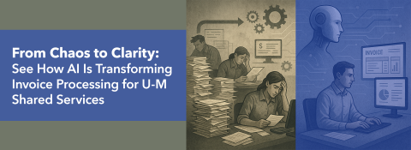
How things work at Michigan - Staff
One case study from the GenAI site discussed the benefit of invoice processing at the Shared Service Center (SSC) on campus.
GenAI can be more sophisticated and beneficial than processes previously used like RPA (Robotic Process Automation).
See - https://genai.umich.edu/use-cases/327

Slide 17

Bouncing forward?
At the end of the story, the Lorax simply left.
  “And all that the Lorax left here in this mess
  Was a small pile of rocks, with the one word…
  “UNLESS.”
  Whatever that meant, well, I just couldn’t guess.

Slide 18
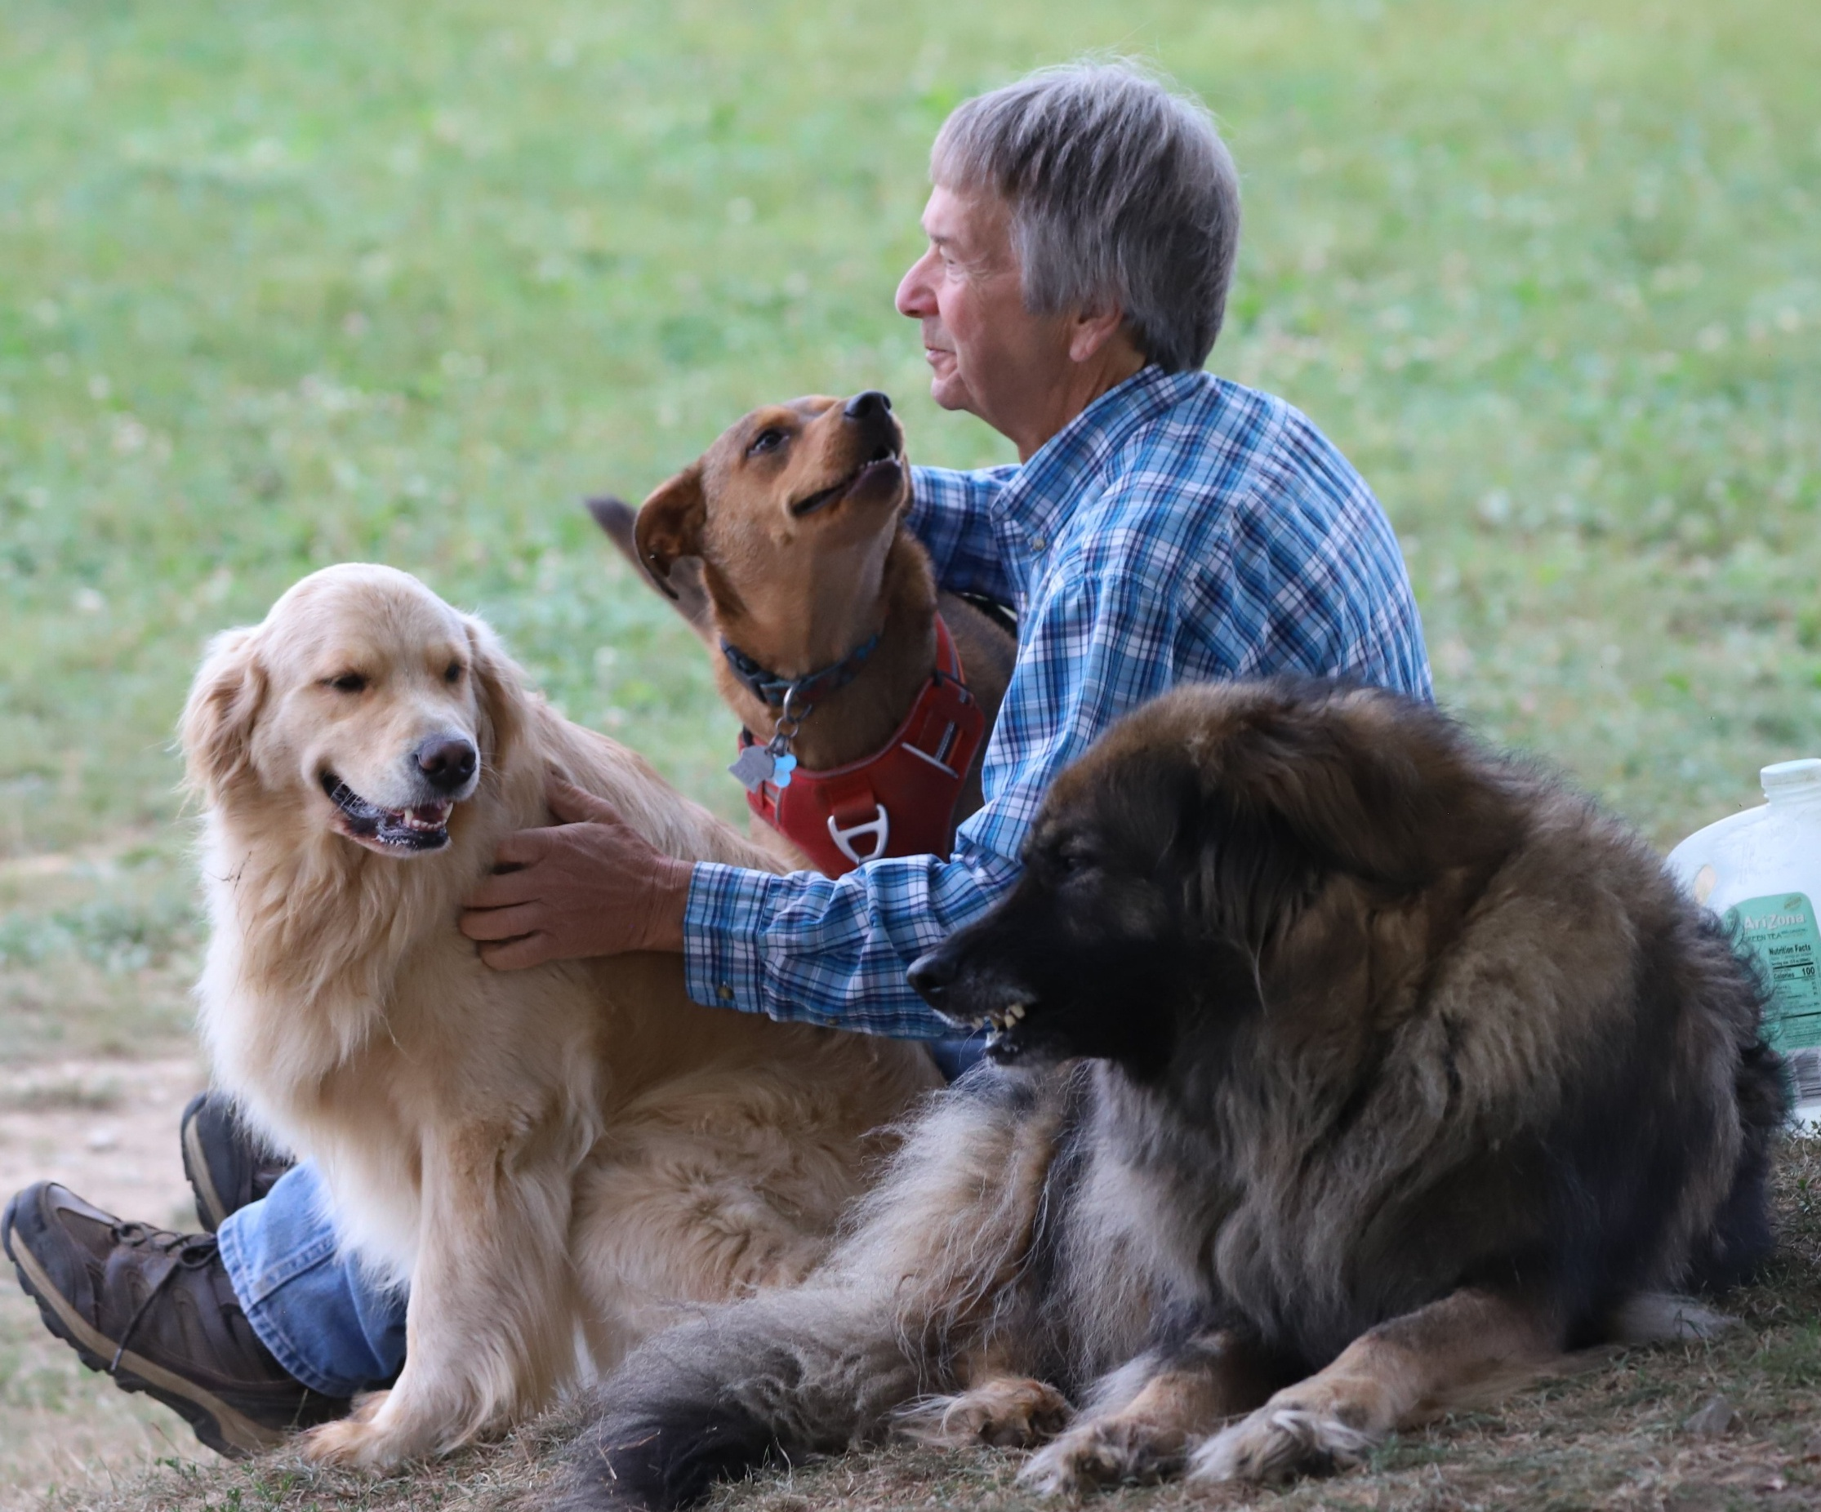
Bouncing forward?
“But now,” says the Once-ler,
“Now that you’re here,
The word of the Lorax seems perfectly clear.
UNLESS someone like you
Cares a whole awful lot,
Nothing is going to get better.
It’s not.

Slide 19
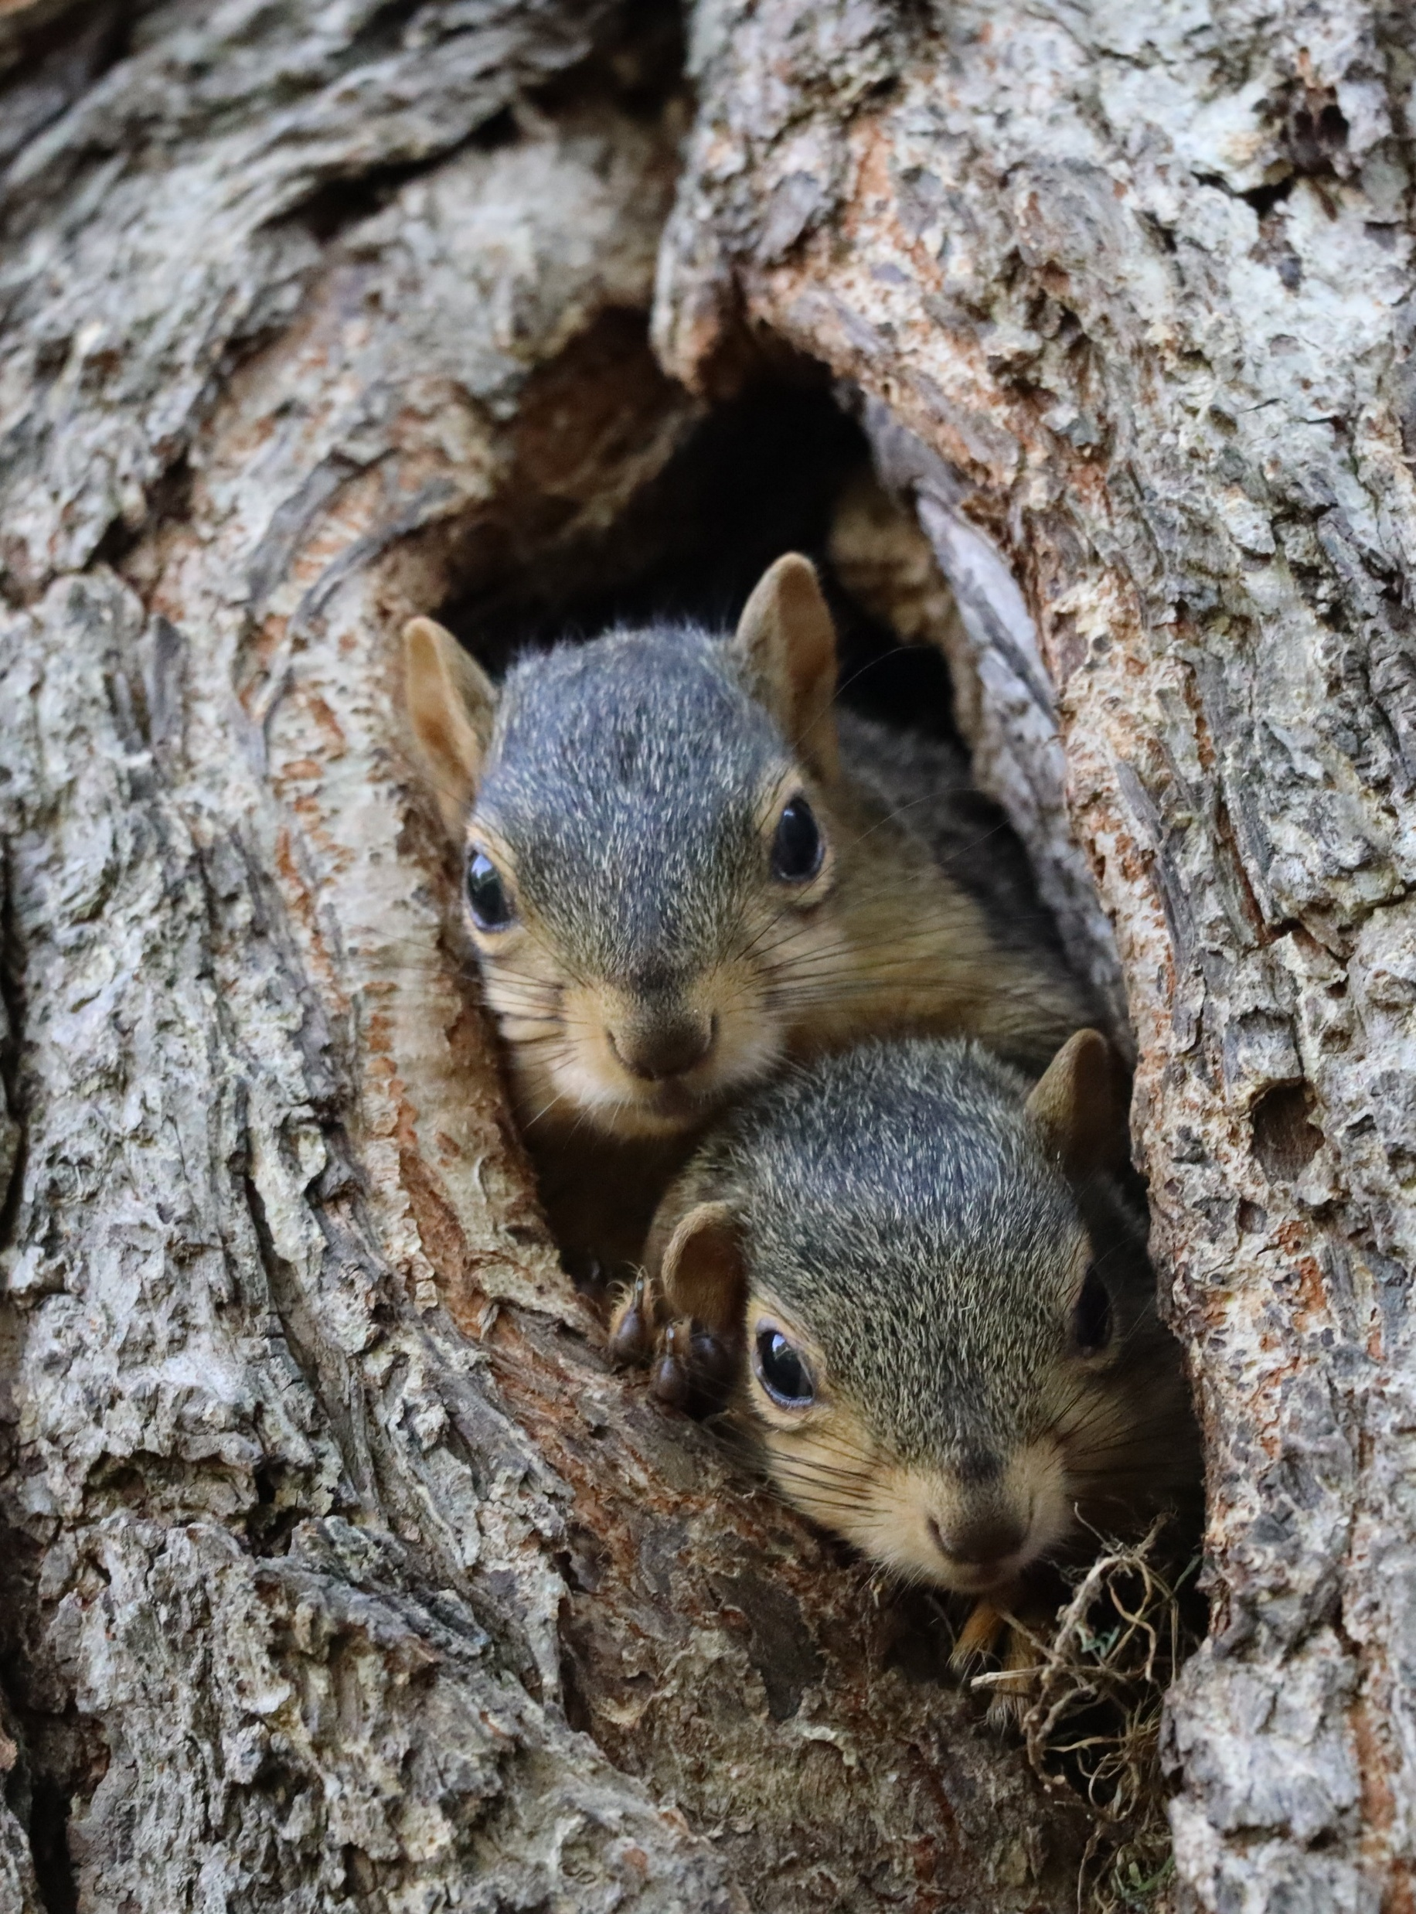
Bouncing forward?
This is a pragmatic position we find ourselves in.
In a service mode, we should strive to help our community succeed, right? If these tools get them there, that is good, right?
Librarians are not the captains of this ship – nor should they behave that way.

Slide 20
Bouncing forward?
The Lorax was there to attempt to have the Once-ler change his ways. But his arguments were not compelling to the Once-ler.
Librarians raising concerns about GenAI might lead to the same result as in the Lorax.
Our information landscape is changing before our eyes it will continue this way whether or not we think it is a good idea.

Slide 21

Bouncing forward?
In GenAI, we find a world full of Luddites and Lemmings.
The Lorax seems to be in the middle ground.
But in actuality, the Lorax was right – but they did not listen to the warnings.
So keep talking, maybe someone will care.

Slide 22
Thank you
Corey Seeman
University of Michigan
Director, Kresge Library Services (Ross School of Business)
cseeman@umich.edu
https://www.bus.umich.edu/Kresgelibrary/
https://www.squirreldude.com/

Slide 23
Cited Works
Lebduska, L. (1994). Rethinking Human Need: Seuss's The Lorax. Children's Literature Association Quarterly 19(4), 170-176. https://dx.doi.org/10.1353/chq.0.0932.
Shah, Priya, Anushka Raheja and Hasika Sridhar. How do students use ChatGPT? Michigan Daily, February 4, 2024 - https://www.michigandaily.com/web/data/how-do-students-use-chatgpt/

