Slide 1
Because it is so Much Better: Exploring Waste and Wants in the Age of Uncertainty
Joint Meeting Vienna 2025
Vienna, Austria
Corey Seeman
Director, Kresge Library Services, University of Michigan
cseeman@umich.edu

Slide 2

Introduction
‘Because it is so much better.’
Drowning by Numbers
Thinking Through our Resource Use

Slide 3
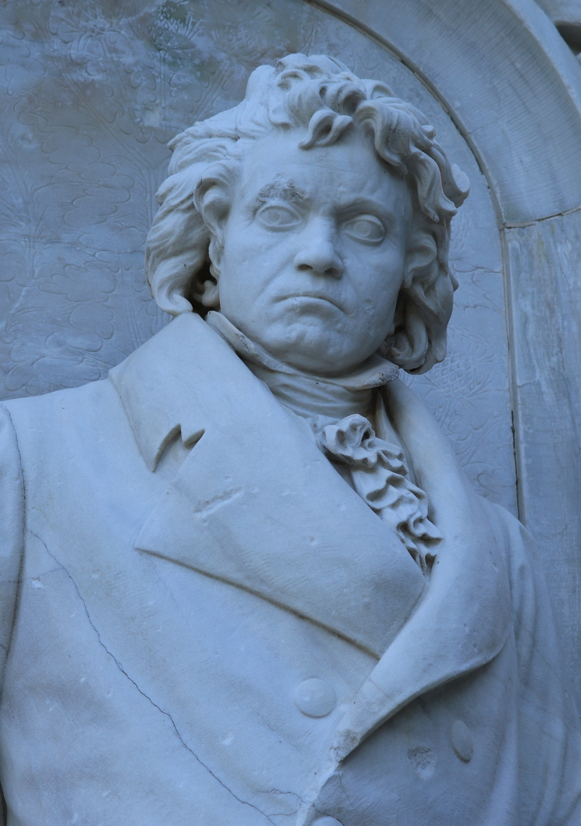
‘Because it is so much better.’
On February 27, 1814, Ludwig von Beethoven premiered his 8th Symphony at the Hofburg Imperial Palace.
Also on the program was his 7th Symphony, that had premiere two months earlier.
The response to his new symphony was somewhat muted by the attendees in Vienna, especially when compared to the 7th.
According to his student Carl Czerny, when someone asked Beethoven why the 7th was more popular than the 8th, he was reported to reply "Because the eighth is so much better."

Slide 4

‘Because it is so much better.’
If we ponder about two pieces of music, two databases, two movies, etc….we can often identify preferences.
Even Haydn’s 104 symphonies are all different.
Fundamentally, it is not a definitive statement of fact – just a statement of preference.
So lets move some 211 years into the future and move a few thousand miles west.

Slide 5
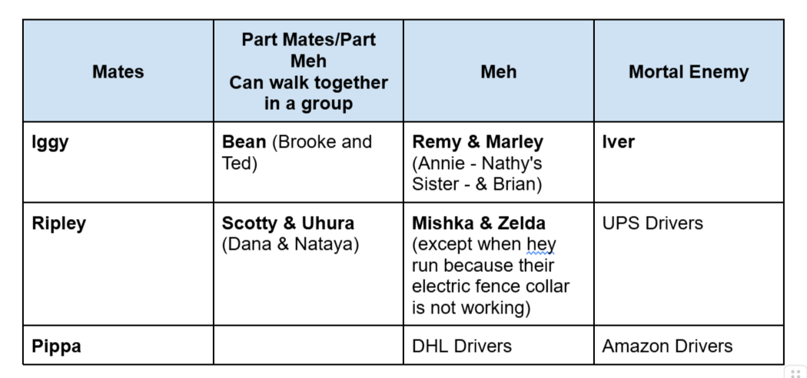

‘Because it is so much better.’
What actually constitutes better???

Slide 6
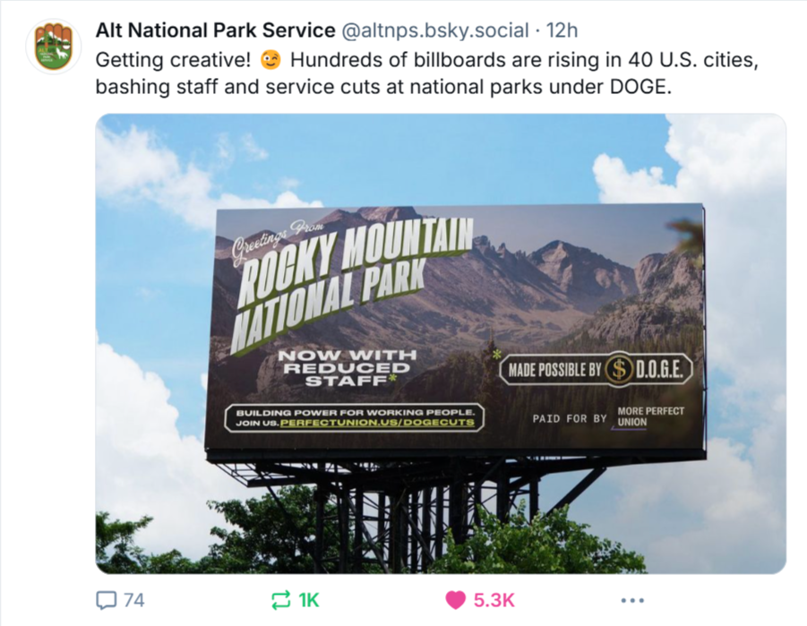
‘Because it is so much better.’
During the past four months in the United States, there has been a tremendous effort to ‘eradiate waste’ from the budget.
Waste is something that is part of every organization; part of every family; part of every company.
From Alt National Park Service Bluesky Account – May 5, 2025 - https://bsky.app/profile/altnps.bsky.social/post/3lohdhyhbik2r

Slide 7
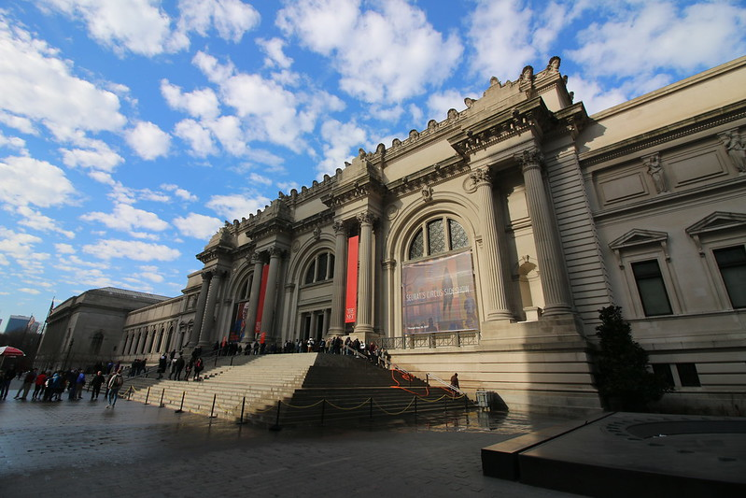
‘Because it is so much better.’
And while the administration is claiming they are only eliminating wasteful spending, they are simply eliminating programs they do not like.

Slide 8

‘Because it is so much better.’
Sometimes, it is hard to figure out who is driving our government these days.

Slide 9
‘Because it is so much better.’
Waste is something that certainly is part of our libraries as well.
  Databases that are not used as much as we like.
  Databases that serve smaller departments and programs. (I know this is not waste, but numbers people might see it that way”).
  Services that are not embraced by our community.
Wants are difficult/impossible to meet when your faculty and students are active.
When finances are good, you can afford to carry resources and services that are not as robustly used….

Slide 10
‘Because it is so much better.’
…but when finances are not good, then we have problems in libraries (among others).
In the United States, our library budgets are likely to be contracting.
There will be greater scrutiny of our budgets and spending. Library databases are one of the larger non-salary slices of the Ross School.
So how do we do the work of being good stewards of the University’s money.

Slide 11

Drowning by Numbers
Drowning by Numbers is a movie by Peter Greenaway (1988). I used that as the title for an article on baseball (sports) historiography in 1993.
We affix numbers of all sorts of activities and race to find a score that is satisfactory.

Slide 12
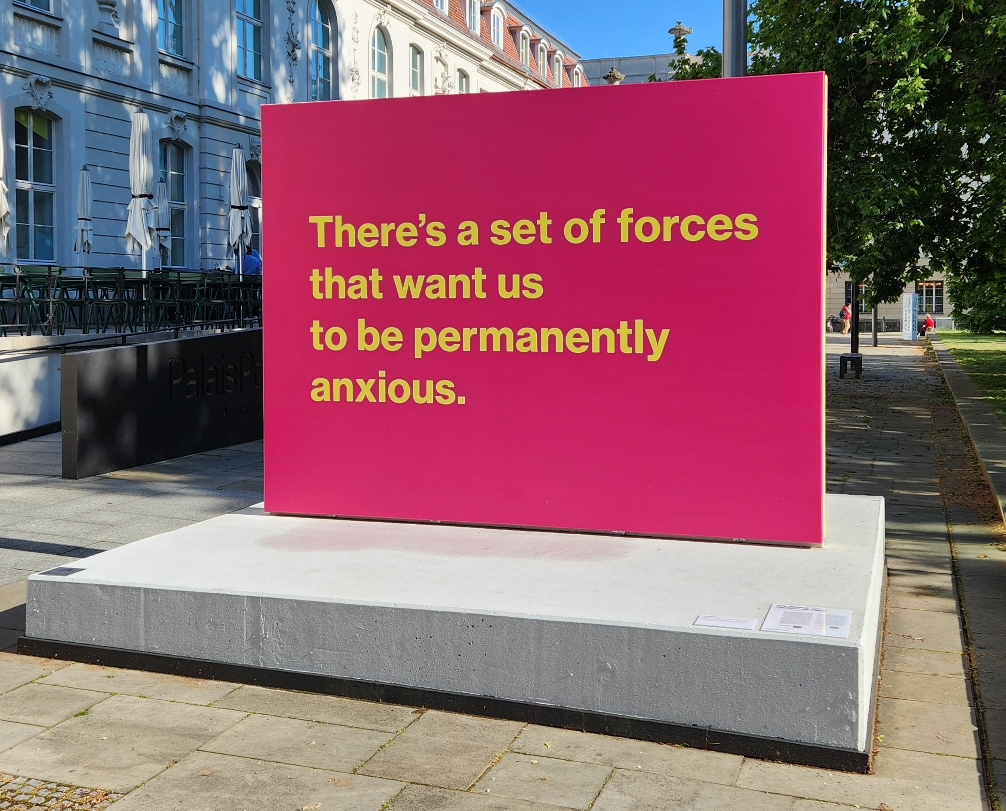
Drowning by Numbers
I was thinking of a sign that could summarize what I felt about these days…
Found it in Berlin.

Slide 13
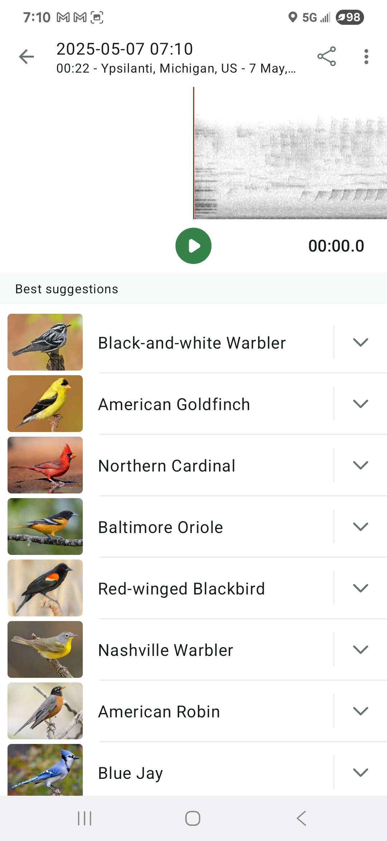
Drowning by Numbers
There is a sense that numbers or a quantitative assessment gives you sufficient inputs.
What if something is happening and you cannot observe it?
Birds suggested by eBirds during a morning walk, May 7th, 2025.

Slide 14

Drowning by Numbers
We can analyze available numbers to measure both impact and waste.
We have a great deal of data.
But what value does it provide?
And what do any of these numbers mean?
https://www.aau.edu/newsroom/leading-research-universities-report/nih-research-funding-supports-jobs-fuels-us-economy

Slide 15
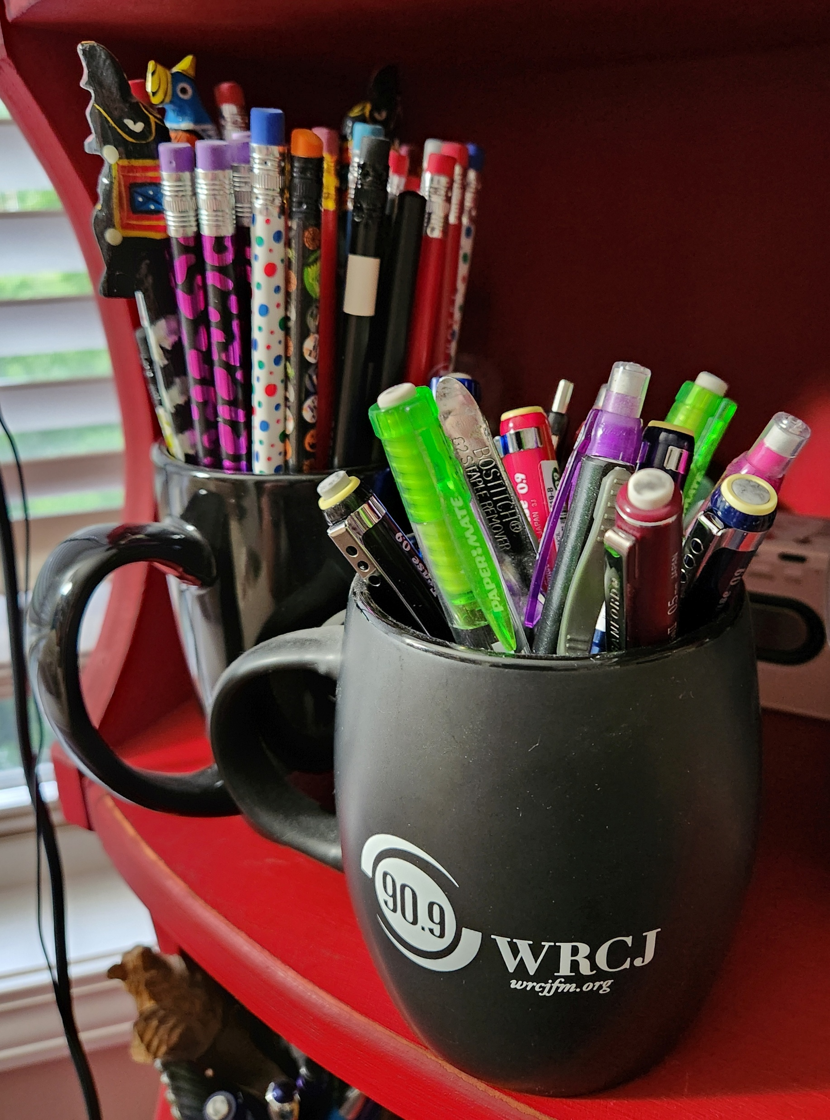
Drowning by Numbers
So can you have enough pencils for example?
Someone said I have too many….tough it’s not quite 250.

Slide 16
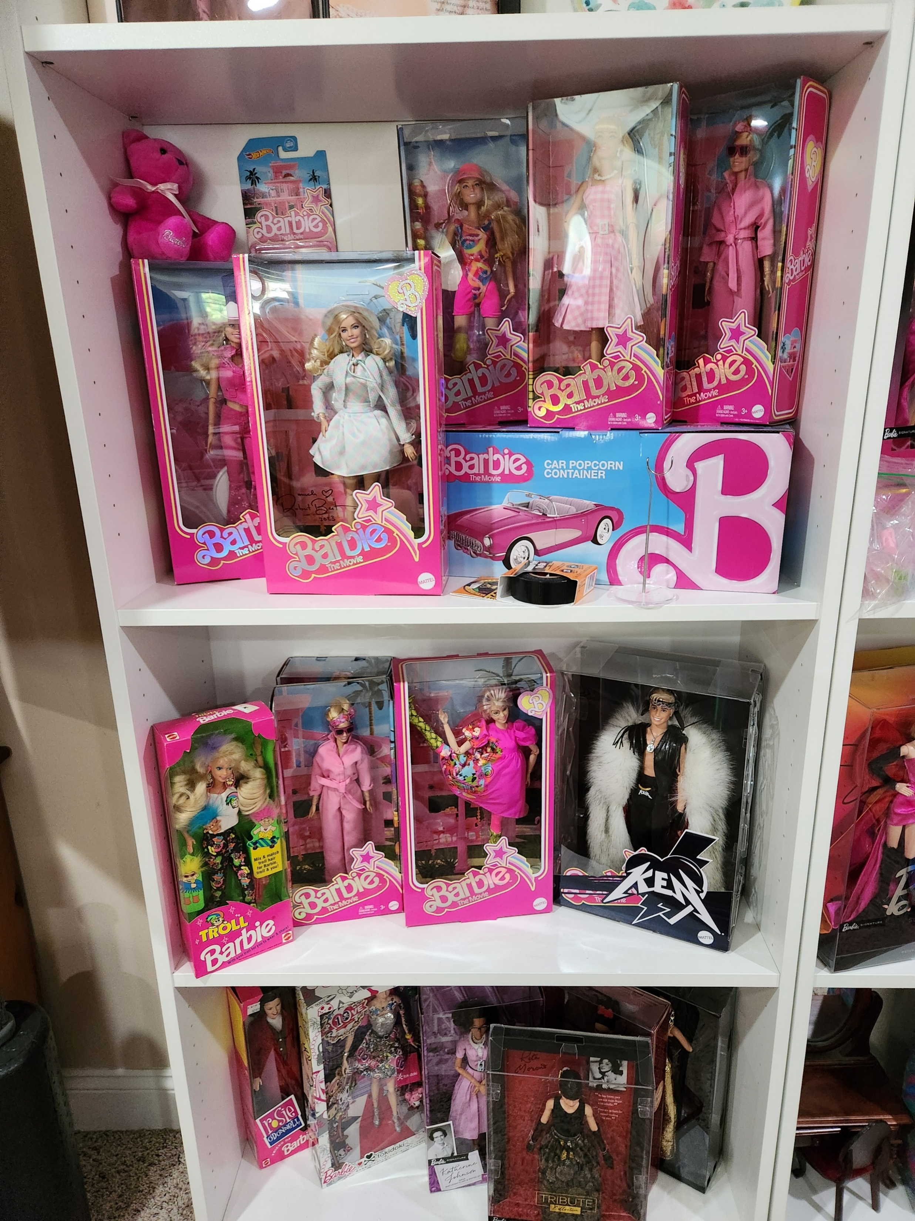
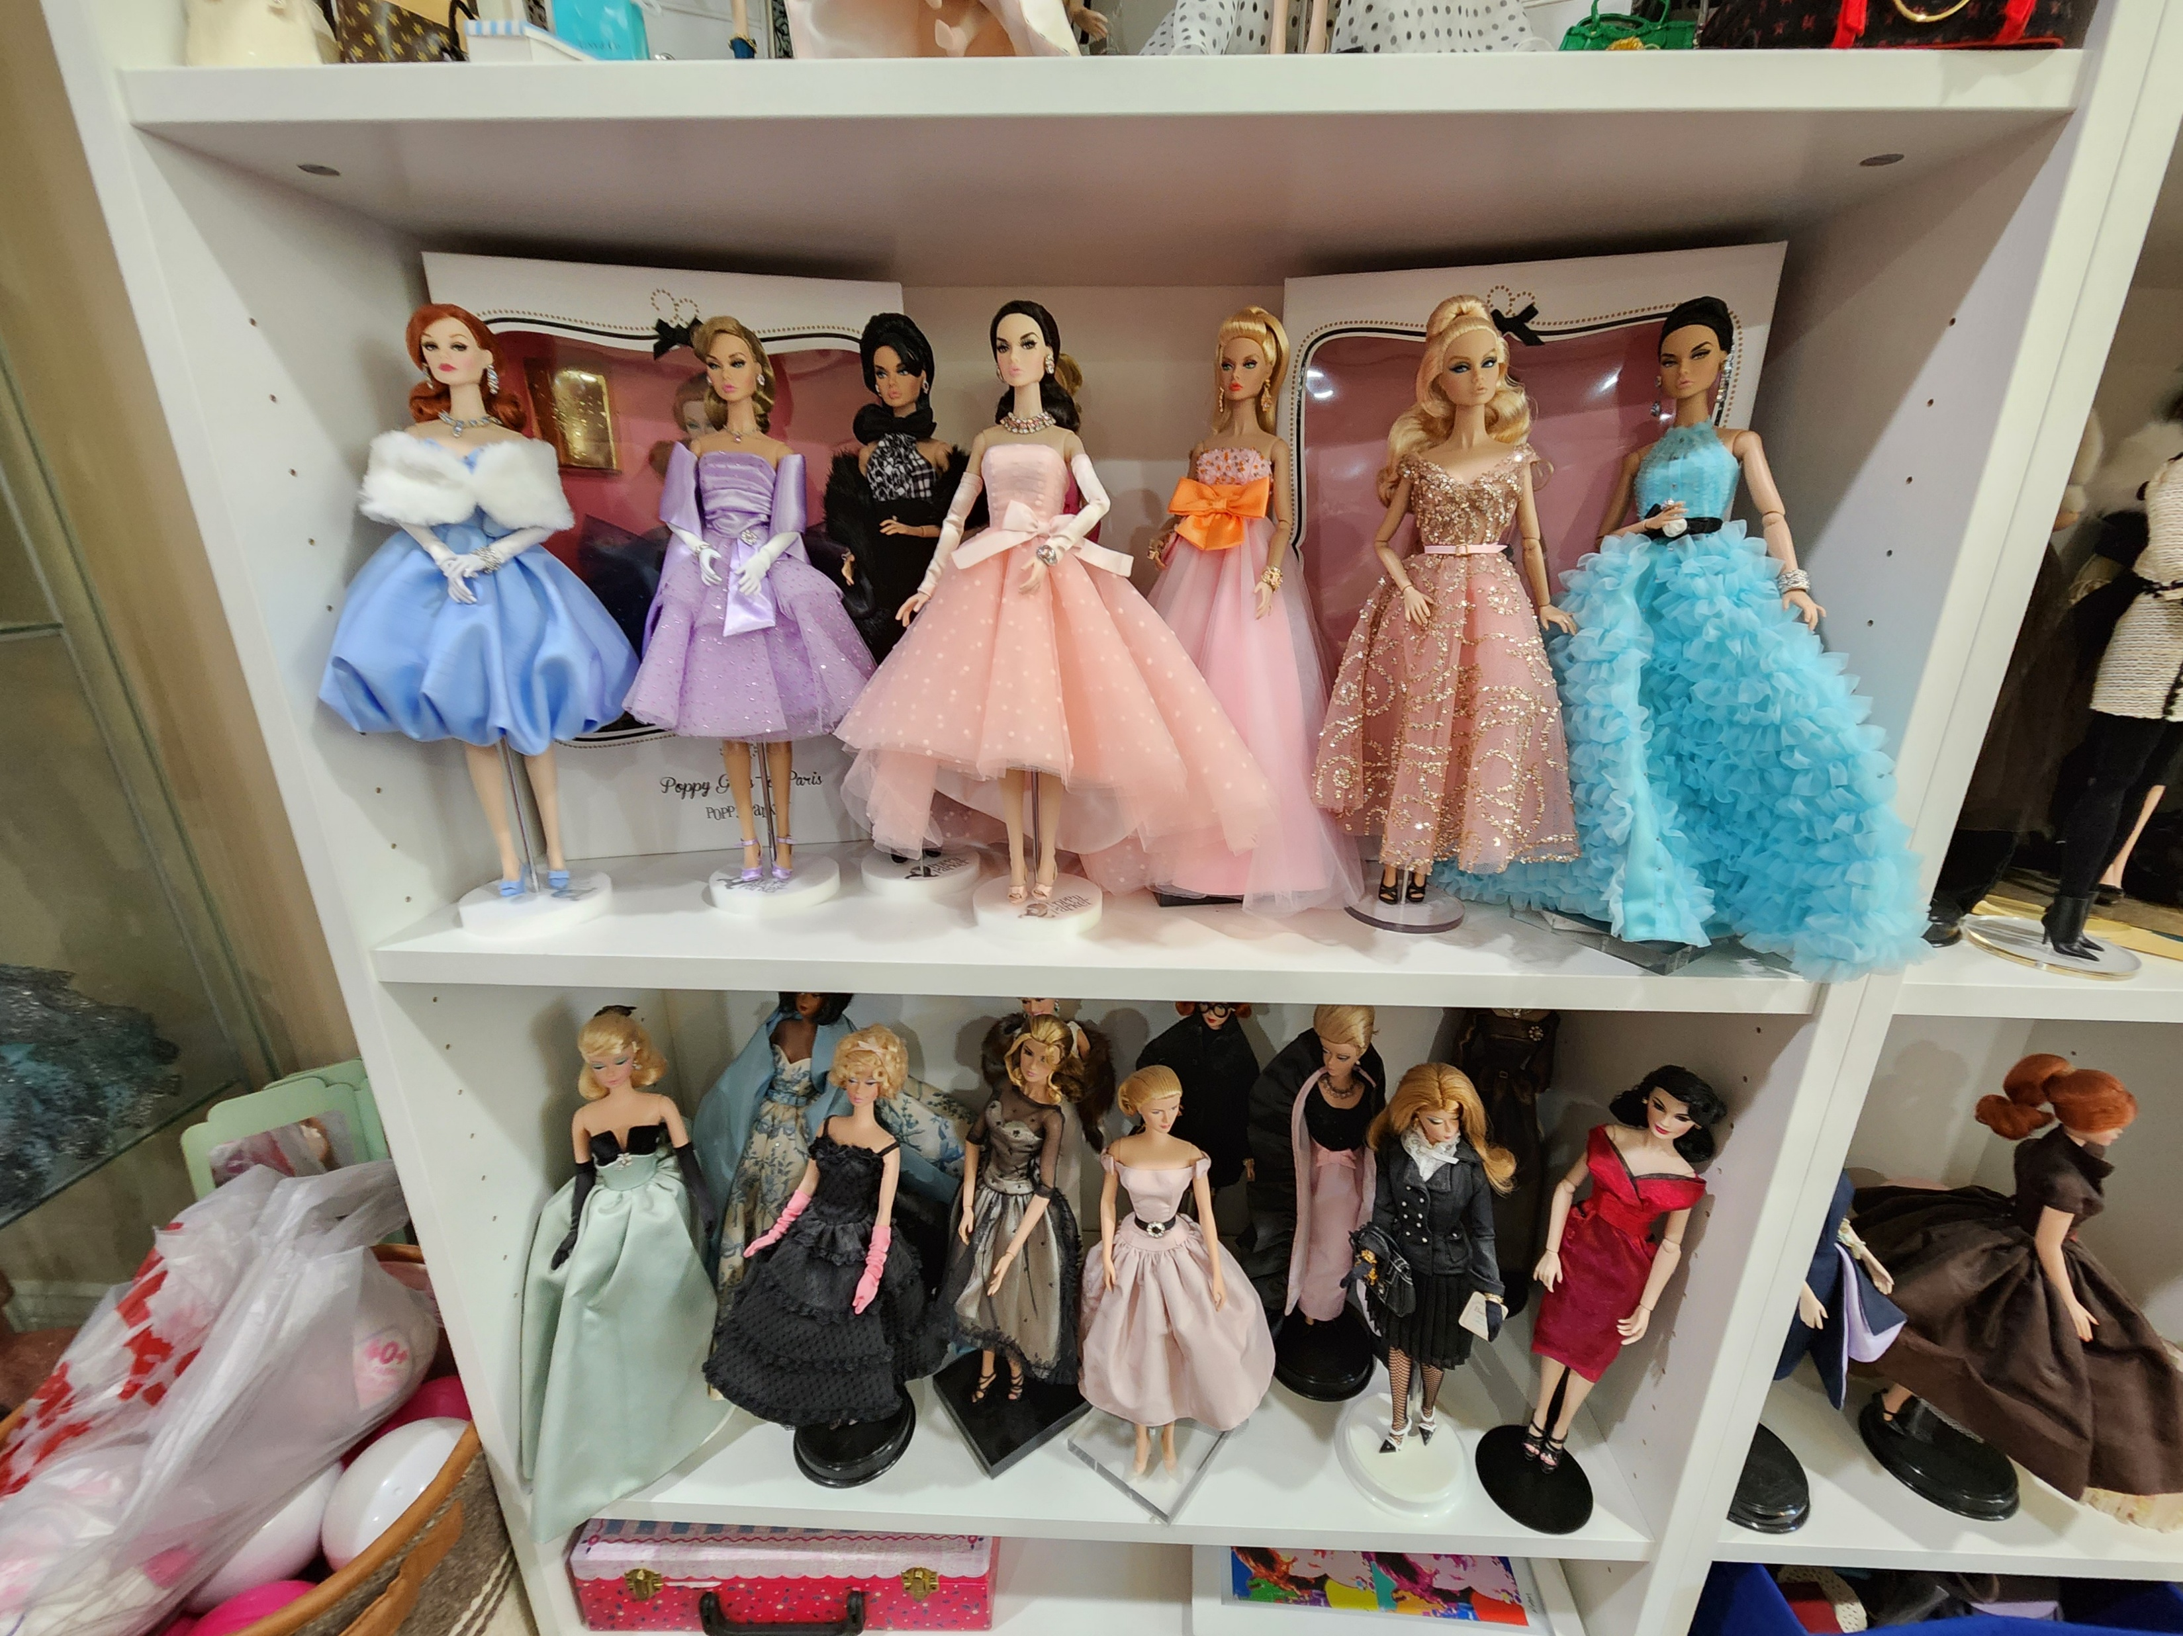
Drowning by Numbers
So can you have enough dolls for example?
Someone said we have too many…like 30….
…and no!

Slide 17
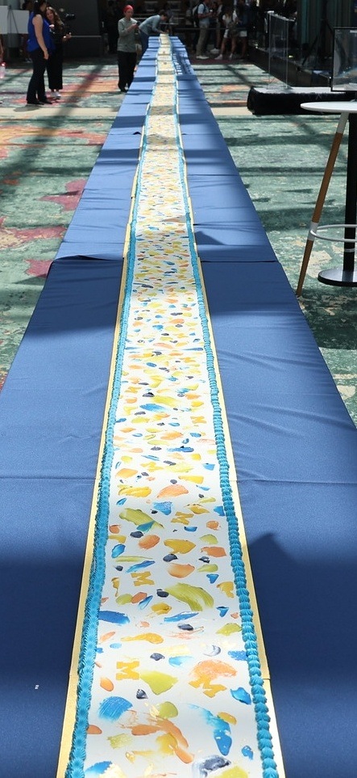
Drowning by Numbers
Not all numbers are what they appear…
Ross School of Business – 100 years celebration with a 100 foot cake (30.48 meters)
A large percentage of the cake was just frosting…over cardboard.

Slide 18
Drowning by Numbers
From vendors, we are often told our usage is quite excellent or off the charts.
The usage numbers do not have any great intrinsic meaning.
It is very difficult (at any scale) to see what is the impact of those statistics.

Slide 19
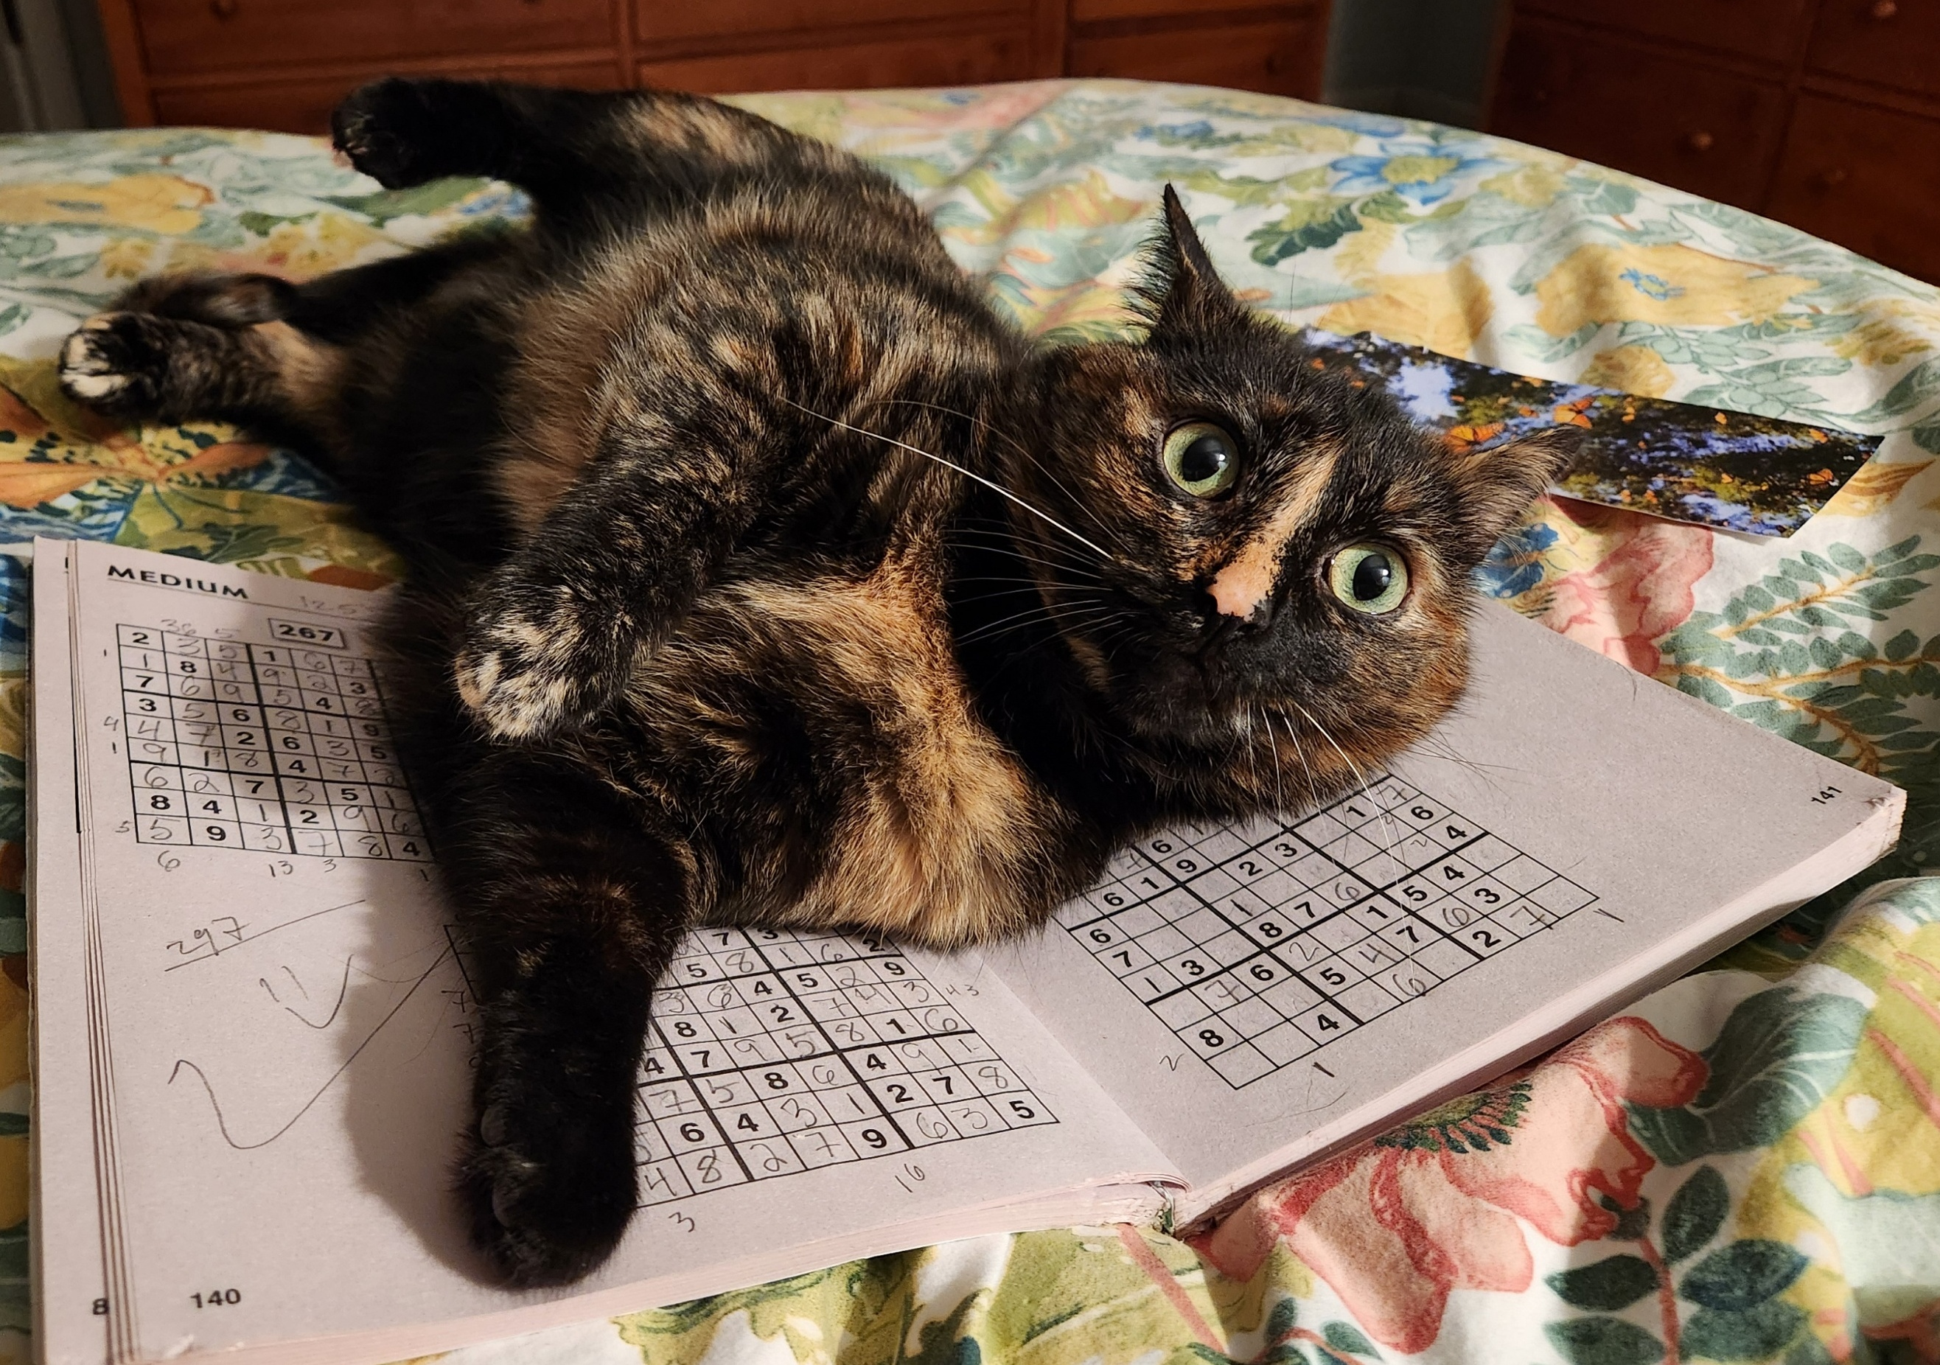
Drowning by Numbers
Our actions that generate numbers:
  Usage statistics
  Circulation*
  Reference statistics
  Evaluations
  Gate count*
These tell some story…

Slide 20
Drowning by Numbers
How ROI killed the academic Library (Chris Bourg at the Joint Meeting at Stanford in 2012) - https://chrisbourg.wordpress.com/2012/12/18/how-roi-killed-the-academic-library/
Two big problems with ROI focused assessment
  ROI tends to focus on the short-term & quantitative; and real impact of academic libraries tends to be long-term & qualitative.
  An ROI framework doesn’t account very well for “rare events”. And I think Academic Libraries are about, at least in part, facilitating rare events.

Slide 21
Drowning by Numbers
MAP Evaluations (Winter 2025)
We noticed that overall evaluations for librarians are decreasing. We also do not have that many metrics to pull from.
I worked with two teams in a program.
  Team A – 3.75/5 → No interaction
  Team B – 3.66/5 → Lots of interaction
  From Team B – “Corey was solid, sometimes we had inquires he could not answer but that was more an issue of readily available materials & not an indictment on him or the Library.”

Slide 22
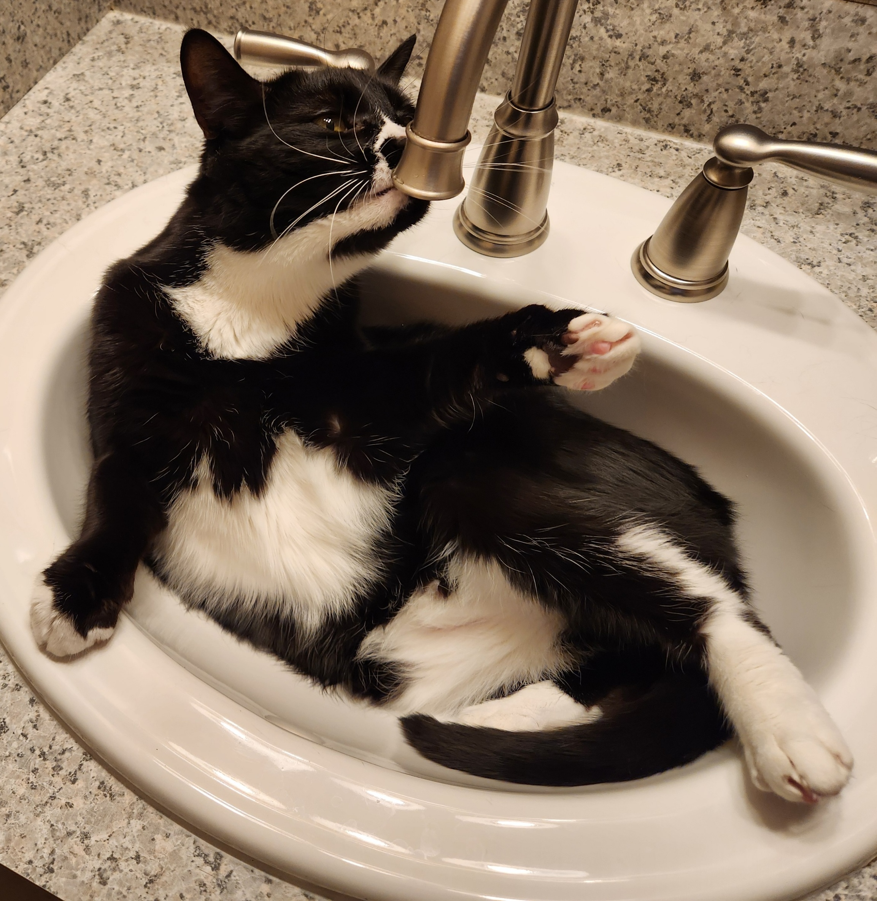
Thinking Through our Resource Use
Collections are built on professional judgement.
Need qualitative vs. quantitative measures.
Audience varies with resources.

Slide 23

Thinking Through our Resource Use
Collections are built on professional judgement
We ensure (or attempt) to offer resources that cover all departments and topics of interest.
Trying to bridge between the qualitative and quantitative can be elusive.

Slide 24

Thinking Through our Resource Use
Need qualitative vs. quantitative measures
In libraries we often focus on the Cost Per Use (CPU) or the Cost vs. Retail (CVR)
Neither of these really give us anything useful.
However, if our funders and directors need to see it – we need to provide something meaningful and useful.

Slide 25
Thinking Through our Resource Use
How can you measure the CPU between a data feed that nearly $100K USD and a news database that offers thousands of articles?
How can you measure the CPU between a database with smaller reports vs. one with fewer topics, but more in-depth resources?
For libraries that report to business schools, how can we factor for usage within the school vs. in the rest of the University?

Slide 26

Thinking Through our Resource Use
We have been tasked with making sense of all these usage statistics by the Dean’s Office and Ross Finance.
Our goal is to not compare all resources cost and use together, but to bunch them so their impact can be better revealed.
We want to control what is purchased and what we cut.
Limiting waste (or underused collections) can help us redirect costs.
However, we will ALWAYS be subject to inflationary increases.

Slide 27
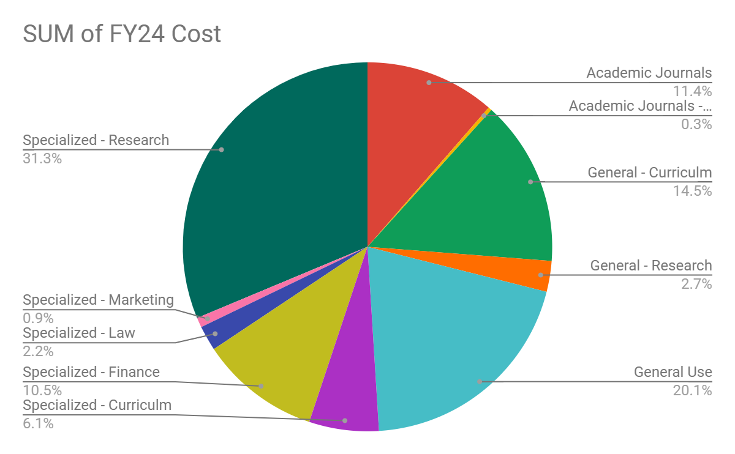
Thinking Through our Resource Use
Academic Journals
Academic Journals - Finance
General - Curriculum
General - Research
General Use
Specialized - Curriculum
Specialized - Finance
Specialized - Law
Specialized - Marketing
Specialized - Research

Slide 28
Thinking Through our Resource Use
So this is our goal in moving forward.
We are starting with this.
We hope to show how we are using our resources and tracking resources we do not need.
That will help identify available budget for things that fill wants.
Aspirational for sure – but we hope it works.

Slide 29
Thank you
Corey Seeman
University of Michigan
Director, Kresge Library Services (Ross School of Business)
cseeman@umich.edu
https://www.bus.umich.edu/Kresgelibrary/
https://www.squirreldude.com/

Slide 30
Cited Works
Steinberg, Michael, 'Ludwig van Beethoven', The Symphony: A Listener ‘s Guide (New York, NY, 1995; online edn, Oxford Academic, 31 Oct. 2023), https://doi-org.proxy.lib.umich.edu/10.1093/oso/9780195061772.003.0001, accessed 12 May 2025.
Broyles, M. (1982). Beethoven, Symphony No. 8. 19th-Century Music, 6(1), 39–46. https://doi.org/10.2307/746230
Seeman, Corey. "Drowning by Numbers: the State of Baseball History." Pittsburgh History, Vol. 76, Number 2, Spring, 1993 https://journals.psu.edu/wph/article/view/4382/4199
All Photos from Author except where noted.

