Slide 1

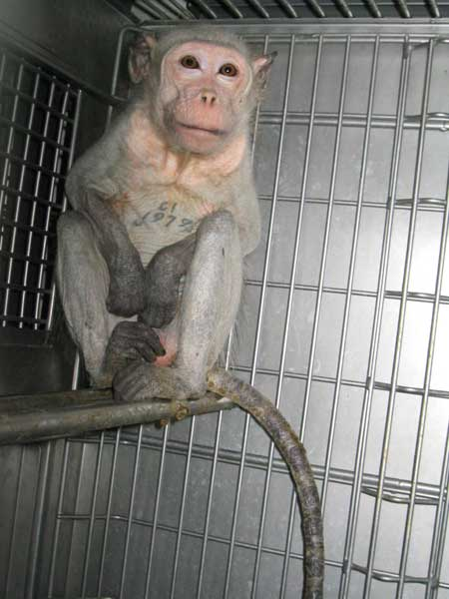
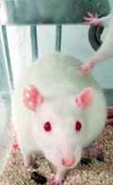
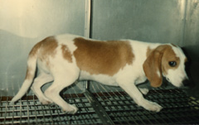

Personal introductions
Testing 1,2,3: Behind the Scenes of University of Michigan’s Laboratories
Ryan and Ppage1.jpgulin
Alka Chandna, Ph.D.
Laboratory Oversight Specialist
Laboratory Investigations Department
People for the Ethical Treatment of Animals

Slide 2

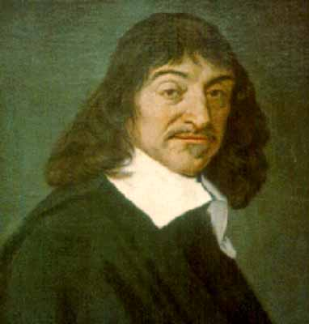
Descartes: Father of
Modern-Day Vivisection
page2.jpg
“Animals are nothing more than unconscious machines. Lacking consciousness, they lack reason or language.” Descartes felt that an animal’s cry was like the sound of a rusty clock that needed oiling.
Rene Descartes French Philosopher & Vivisector 1596 – 1650

Slide 3
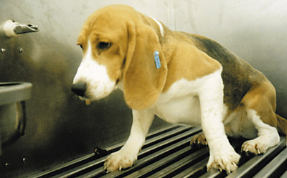
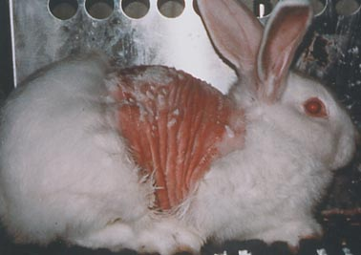
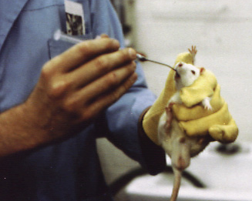
Testing of Cosmetics, Personal Care Products, and Household Products
page2.jpg

Slide 4
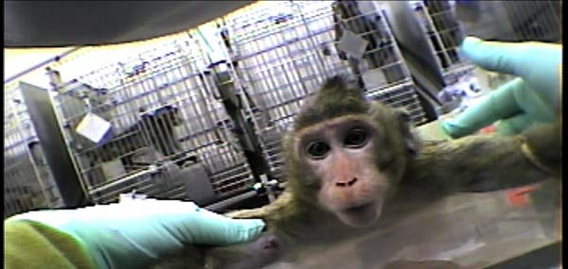
Testing of Pharmaceuticals, Pesticides, and Industrial Chemicals
page2.jpg

Slide 5

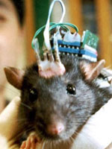
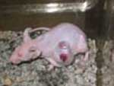
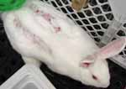
Basic or Curiosity-Driven Experiments at Universities
page2.jpg
Mouse with overgrown tumors
Lesions cut into rabbit’s spine
Electrodes implanted into brain of restrained monkey
Electrodes implanted into brain of mouse

Slide 6
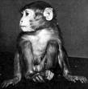
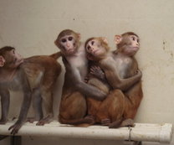

Maternal Deprivation: Monkeys without Mothers
page2.jpg

Slide 7


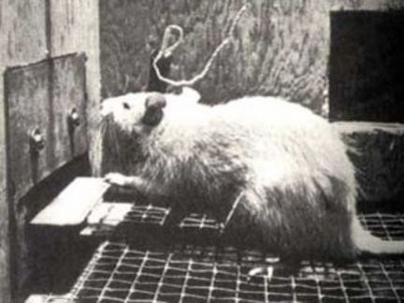
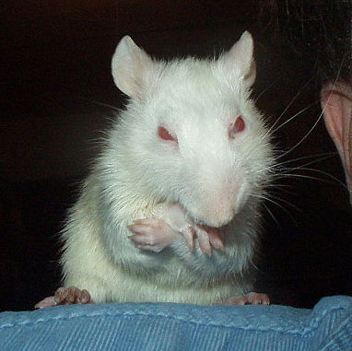

University of Michigan
page2.jpg
Huda Akil
U-M Department of Psychiatry
National Institute of Drug Addiction $1,237,415

Slide 8
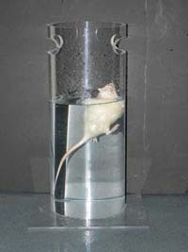

University of Michigan
page2.jpg
Stanley Watson
The Molecular & Behavioral Neuroscience Institute

Slide 9
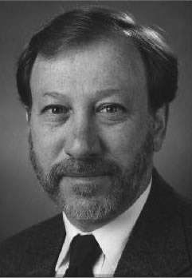

University of Michigan
page2.jpg
Christopher Coe

Slide 10
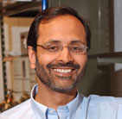

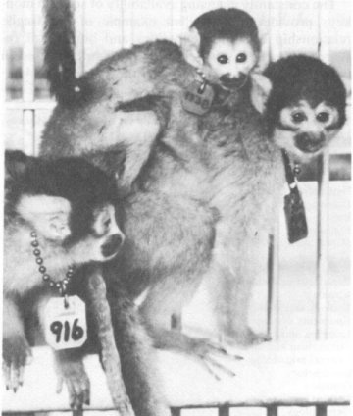
University of Michigan
page2.jpg
Paresh Patel
The Molecular & Behavioral Neuroscience Institute

Slide 11
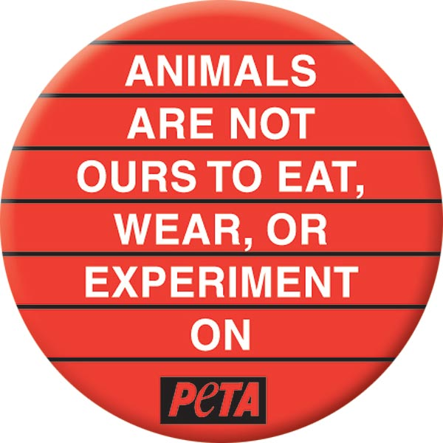

Slide 12
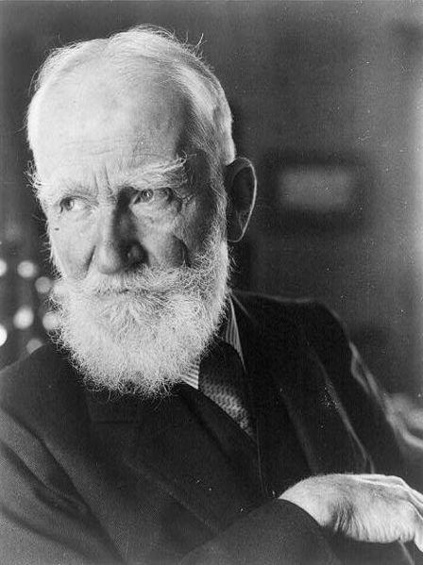
George Bernard Shaw
page2.jpg
“You do not settle whether an experiment is justified or not by merely showing that is if of some use. The distinction is not between useful and useless experiments, but between barbarous and civilized behavior.”

Slide 13
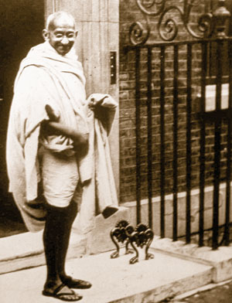
Mahatma Gandhi
page2.jpg
“Vivisection is the blackest of all the black crimes that a man is at present committing against God and his fair creation.”

Slide 14
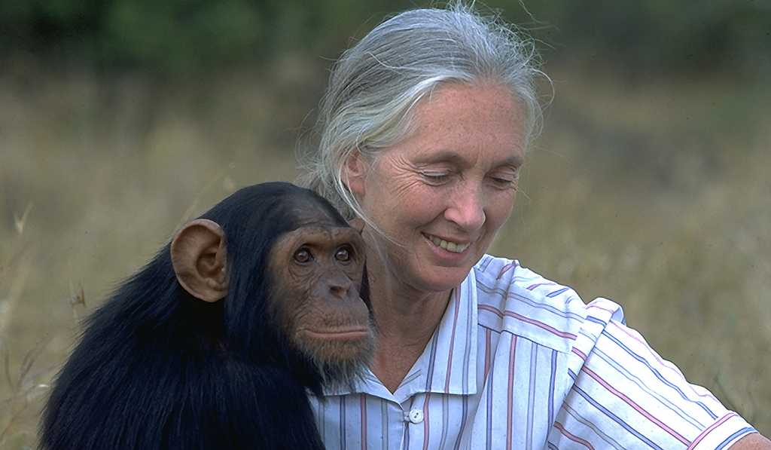
Dr. Jane Goodall
page2.jpg
"We need to recognize at the outset that what we do to animals [in laboratories] from their perspective certainly, and probably from ours, is morally wrong and unacceptable."

Slide 15
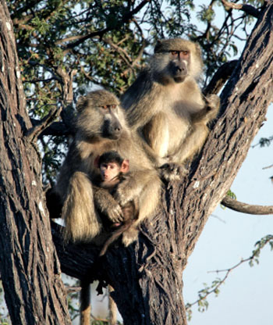
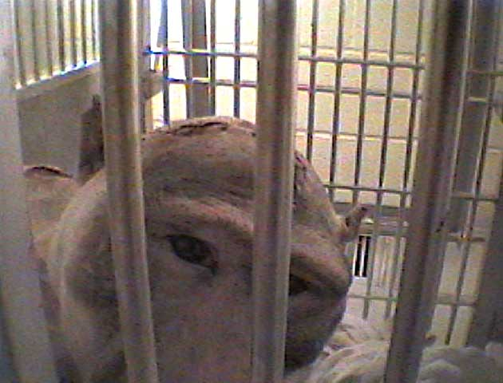
Life in a Laboratory: Baboons
page2.jpg

Slide 16

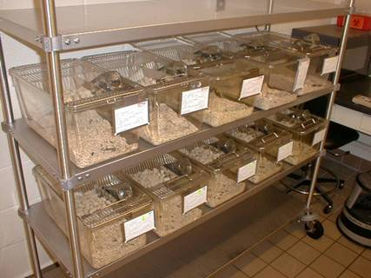
Life in a Laboratory: Mice
page2.jpg

Slide 17
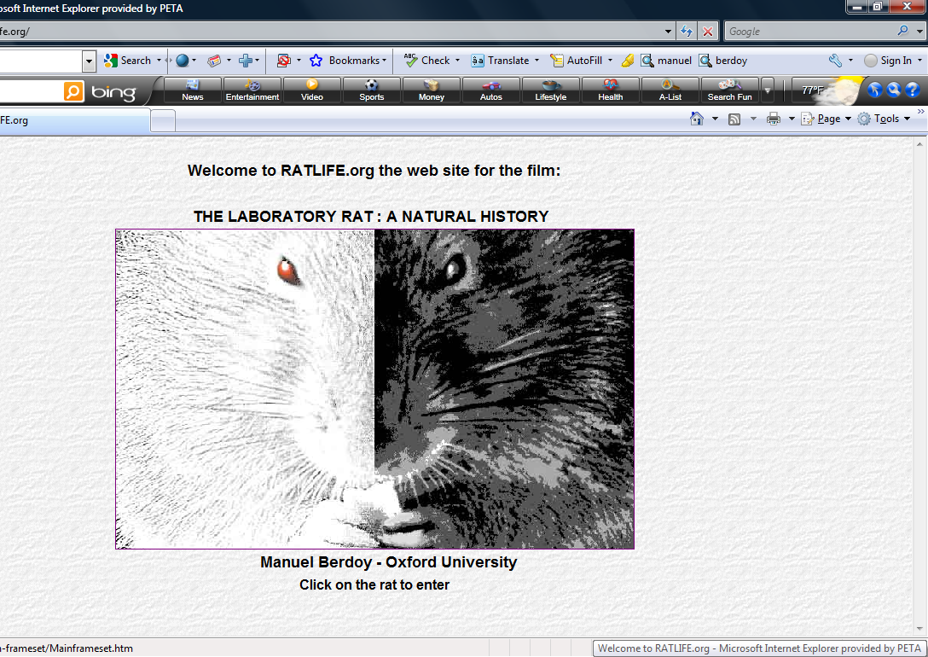

Slide 18
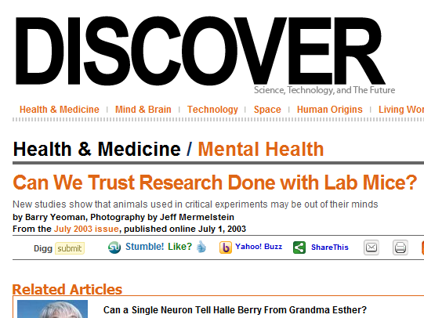
page2.jpg

Slide 19
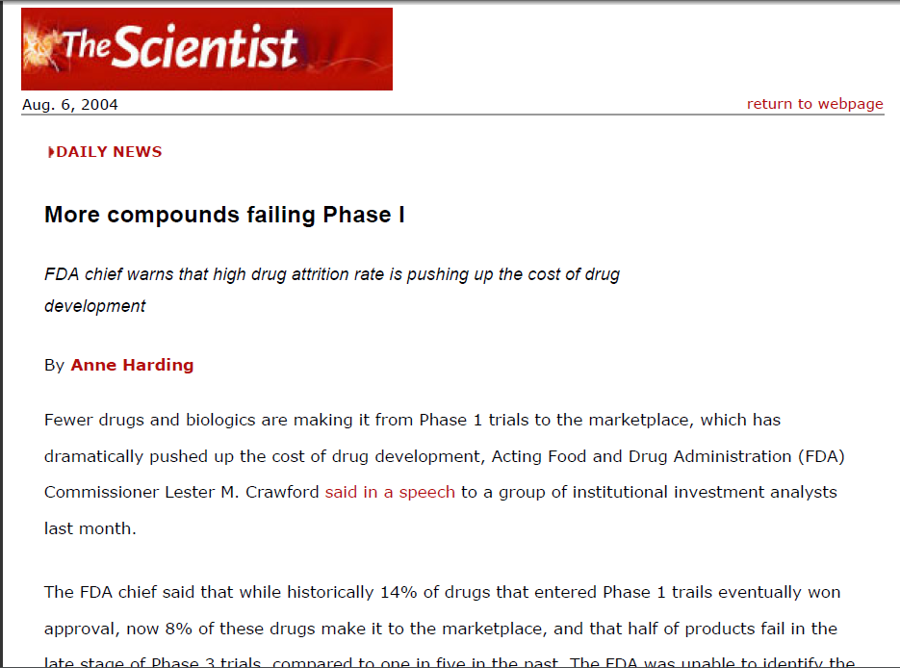
page2.jpg

Slide 20
NAS Report: Toxicity Testing
in the 21st Century
page2.jpg
“Using the results of animal tests to predict human health effects involves a number of assumptions and extrapolations that remain controversial. Test animals are often exposed to higher doses than would be expected for typical human exposures, requiring assumptions about effects at lower doses or exposures. Test animals are typically observed for overt signs of adverse health effects, which provide little information about biological changes leading to such health effects. Often controversial uncertainty factors must be applied to account for differences between test animals and humans. Finally, use of animals in testing is expensive and time consuming, and it sometimes raises ethical issues.”

Slide 21
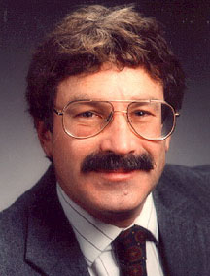
The Failed War on Cancer
page2.jpg
The history of cancer research has been the history of curing cancer in the mouse. We have cured mice of cancer for decades and it simply didn’t work in human beings.
Dr. Richard Klausner, M.D.
Former Director, National Cancer Institute

Slide 22
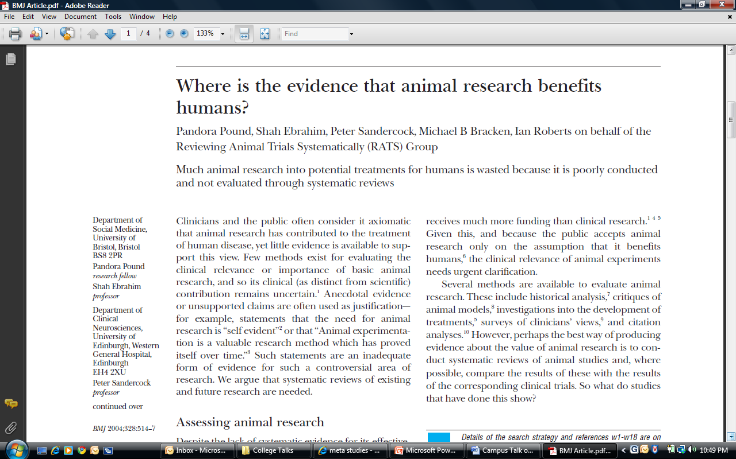
page2.jpg

Slide 23
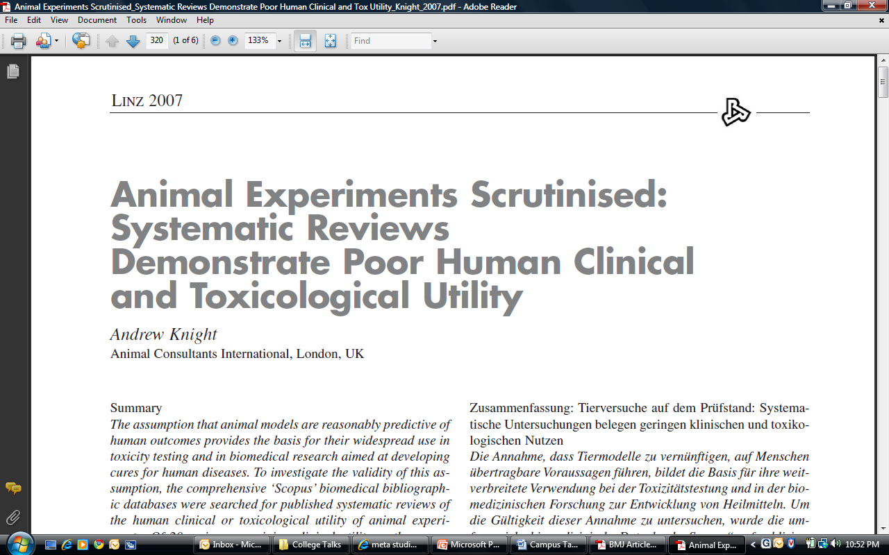
page2.jpg

Slide 24
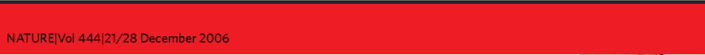
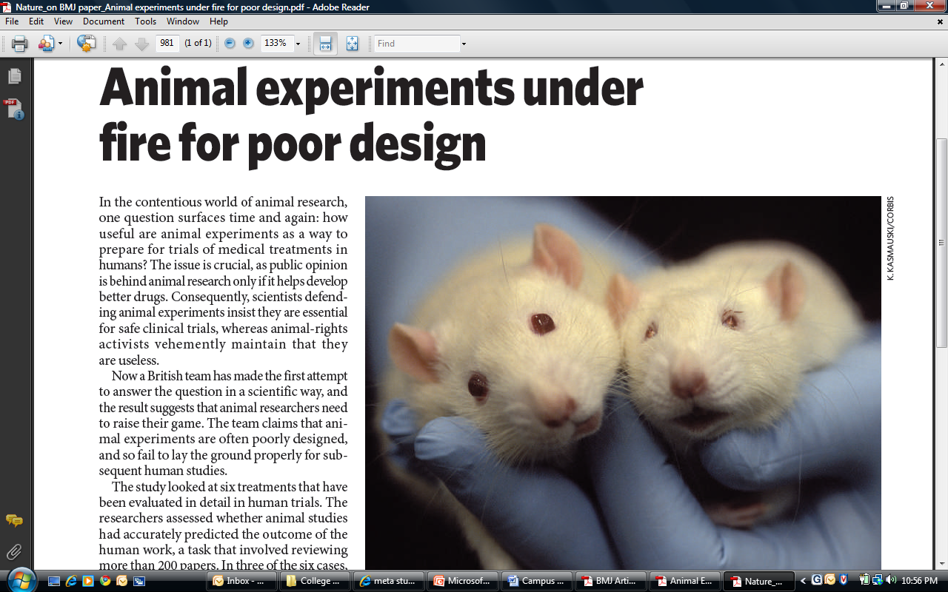

Slide 25
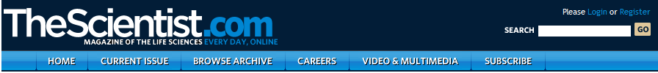


Slide 26
Questioning the Scientific Validity of Animal Experiments: Meta Studies
page2.jpg
Number of HIV/AIDS vaccines that have worked in nonhuman primates:
85
Number of HIV/AIDS vaccines that have worked in humans:
0
Number of diabetes cures found in animals:
Two dozen
How many of these cures translated to humans?
0
Number of stroke treatments that have worked in animals:
150
How many of these treatments worked in humans?
0
Conclusion drawn from years of experiments on kittens to study congenital blindness:
Such blindness cannot be cured.
Conclusion reached by clinical researchers working with humans:
Congenital blindness can be cured.

Slide 27
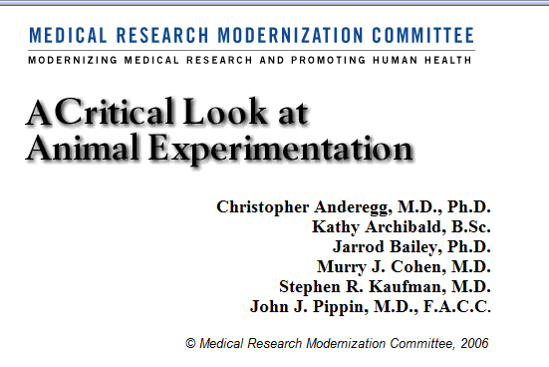
www.mrmcmed.org
www.safermedicines.org
www.pcrm.org
www.stopanimaltests.com

Slide 28

PETA’s Pragmatic Approach
page2.jpg
  Enriched environments
  More space
  Better veterinary care
  Mandatory use of pain relief
  Also …

Slide 29
p
What You Can Do
page2.jpg
Work with peta2 to gain more access to details about what happens inside laboratories at your university.
Work with peta2 to encourage lab workers at your university to blow the whistle on campus cruelty.
Petition for alternatives to dissection and the use of live animals in classrooms.
Please check out www.stopanimaltests.com and download PETA’s answers to frequently asked questions on animal experimentation. Share the information with friends.
Write letters to the editor.
Show your friends, family members, and co-workers video footage of animal laboratories at www.petatv.com.
Ensure that your purchases and donations do not support experimentation on animals.

Slide 30

page2.jpg

Slide 31
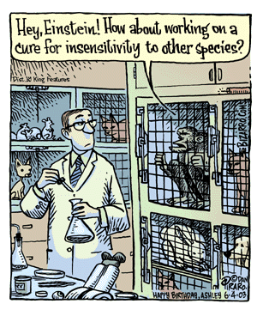

Slide 32
page2.jpg
Questions/Discussion

