Slide 1


Synergies Between Electric Vehicle Penetration & Grid Reliability Services
April 15, 2011
Team
Hanns Anders| Kripal Kavi| Mark Leo| Brian Moss
Advisor
Prof. John DeCicco
Sponsor
Better Place

Slide 2
Agenda
Introduction
EVs & V2G
Demand Response
Model and Analysis
Conclusions
Ancillary Services
Findings and Recommendations
Notes:
This is our agenda for today
Provide a brief introduction
Describe EVs & V2G technology
Move on to a description of Demand Response and Ancillary Services
Finally, we will review our model and analysis
Before wrapping up with our conclusions

Slide 3
Agenda
Introduction
EVs & V2G
Demand Response
Model and Analysis
Conclusions
Ancillary Services
Findings and Recommendations

Slide 4
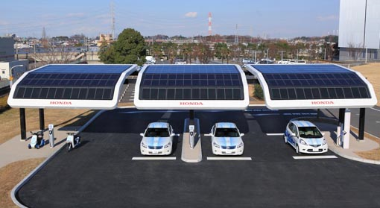
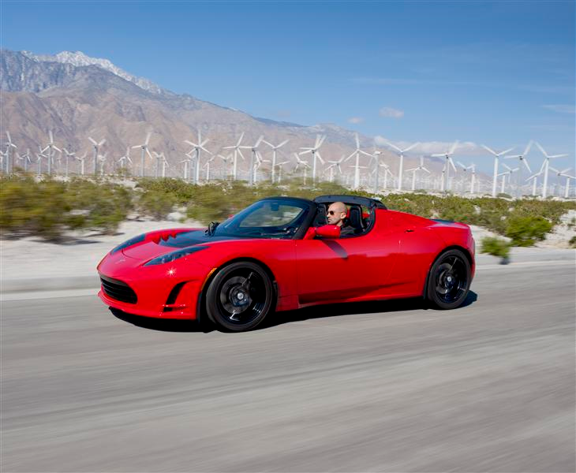
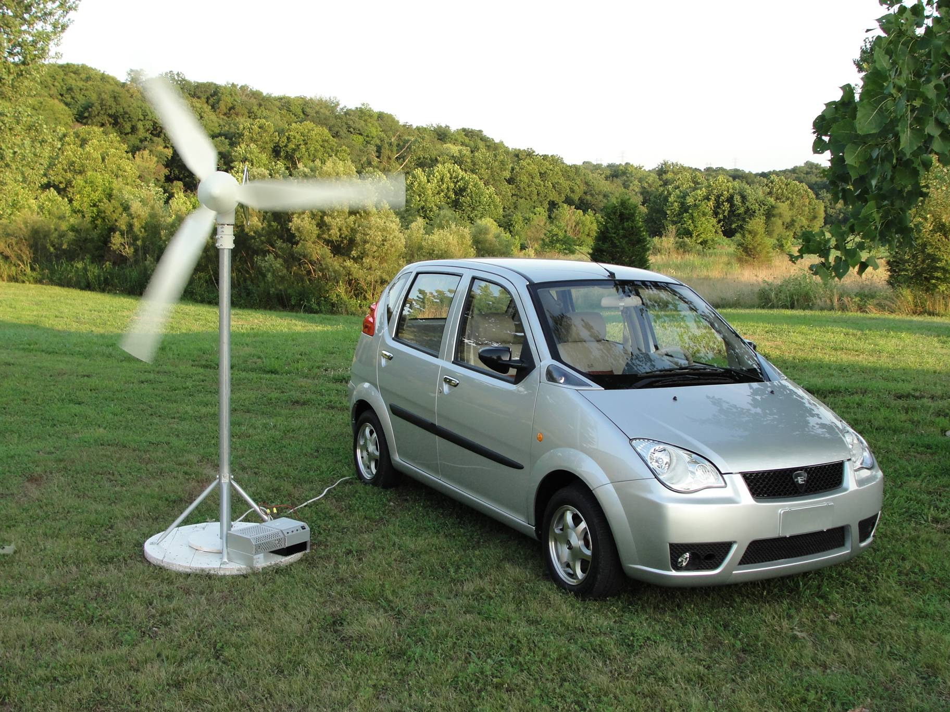
What is sustainable transportation and how do we achieve it?
Notes:
While deciding on a topic for our masters project, we focused on the question: what is sustainable transportation?
After all, even if we manage to convert a substantial portion of the fleet to electric vehicles, we will still rely on fossil-fuels like coal and natural gas to charge our batteries.
While researching the subject, we came across a substantial amount of information dedicated to the impact that EVs will have on carbon emissions, but very little on the relationship between EVs and renewables.
At the same time, we found that the marketing materials of many automakers, utilities, and service companies seemed to imply that EVs will free us from our dependence on conventional and dirty energy sources. We wanted to investigate how this might happen and why.
We found ourselves asking questions like:
1.) What synergies, if any, exist between EVs, the grid, and renewables?
2.) Will the penetration of one drive the adoption of another?
It was around this time that we approached Better Place about being our sponsor.

Slide 5
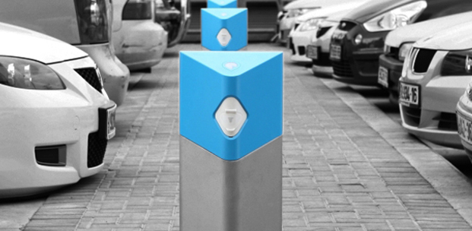
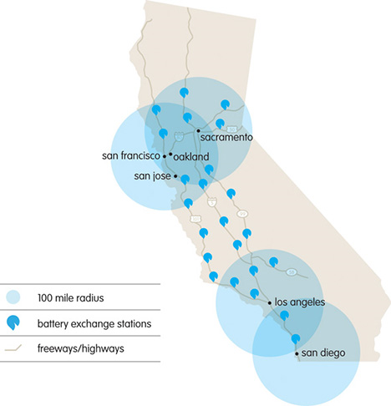

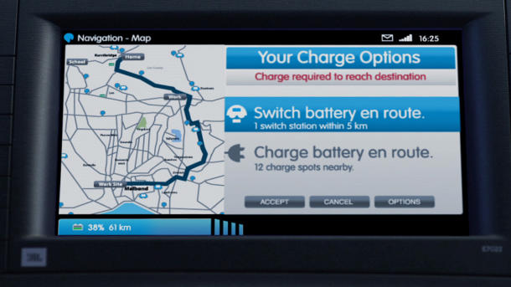
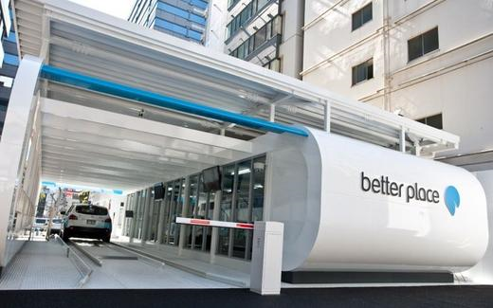
Better Place aims to solve the world’s addiction to oil by:
Providing a network of charging spots and battery swap stations managed by advanced software
Offering mileage plans like minutes for cell phones
Rolling out 1st network in Israel by end of 2011, to be followed by Denmark, Hawaii, and the San Francisco Bay Area in the coming years
Notes:
Founded in 2007 by software executive Shai Agassi, who was inspired to solve the world’s addiction to oil after attending the World Economic forum in Davos
The company has raised almost $700 million in equity financing from HSBC, Morgan Stanley, VantagePoint Ventures – a considerable amount of money from investors that you would assume want to see a nice return on their investment
So why does Better Place need all this capital?
Better Place plans to manage networks of EVs (with and without swappable batteries) by supplying EV charging services
In order to do so, the company wants to build and operate networks that include:
1.) thousands of commercial and at-home charge spots
2.) battery switch stations (rapid swap stations that are designed to reduce range anxiety and enable longer trips)
3.) software and back-office systems to optimize the EV driving experience for both drivers and utilities
This diagram represents what such a system may look like for CA
In return for its services, Better Place will charge drivers for the miles they drive, similar to the way that cell phone operators charge mobile phone users for minutes
It also expects to derive a significant portion of its revenue from grid support services, a topic we will examine later in the presentation
The company is rolling out its 1st network in Israel by the end of 2011, with Denmark, Hawaii, and the San Francisco Bay Area following over the coming years

Slide 6
Test hypothesis by answering three questions:
1) How do renewables impact grid stability?
2) Are EVs capable of providing stability services?
3) What is the market value of these services?
Hypothesis: EVs will drive the adoption of renewables in CA by helping to
mitigate intermittency
Grid Stability
EVs
Renewables
Notes:
So, in our discussions with the company we noticed that they were interested in the role EVs will play in tomorrow’s smart grid and the adoption of renewables. After all, EVs and renewables are expensive. If you can show that they support each other, it is a compelling argument for more of both.
Unfortunately, how these vehicles can be used and compensated for their services is not well understood
That is why, after speaking with Better Place, we decided to test the hypothesis that networked EVs will drive the integration of renewables by mitigating the intermittency of these resources
We chose to focus on the state of California for three primary reasons: 1.) the state’s favorable policies towards EVs, energy storage, and renewables 2.) its concentration of early adopters and 3.) Better Place’s plans to enter the Bay Area
We set out to answer three key questions:
1.) How will renewables impact grid stability, if at all?
2.) Are EVs capable of stabilizing the grid, and can they provide utilities and other grid operators with the appropriate services?
3.) What is the market value of these services? In other words: What is the revenue opportunity? Without this last piece there is little incentive for companies like Better Place to spend the time and effort to provide such services.
We like to think of our project in terms of this ven diagram, with our scope lying in the middle.

Slide 7
Agenda
Introduction
EVs & V2G
Demand Response
Model and Analysis
Conclusions
Ancillary Services
Findings and Recommendations

Slide 8
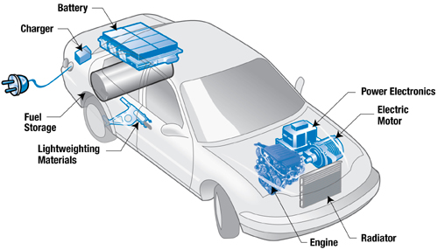
Plug-in Hybrid (PHEV) Diagram
Vehicle Type | Key Characteristics | Example
Plug-in Hybrid (PHEV) | Upgrade of the standard “Full Hybrid” Larger battery than standard hybrid vehicles Added plug-in capability | Toyota Prius Plug-In
Image: Generic PHEV schematic
http://www.transportation.anl.gov/publications/transforum/v7/v7n1/images/phev_diagram.jpg

Slide 9
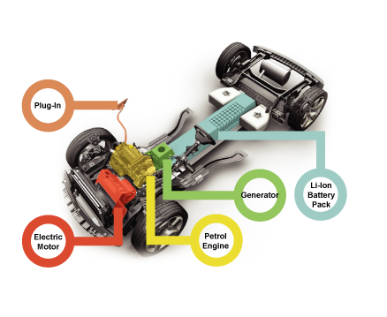
Range Extender (eREV) Diagram
Vehicle Type | Key Characteristics | Example
Range Extender (eREV) | Electric motor powers wheels Battery is charged via plug or small, efficient ICE ICE does not power wheels | Chevy Volt
Image: Chevy Volt drivetrain schematic
http://movementbureau.blogs.com/projects/2007/01/the_chevrolet_v.html

Slide 10
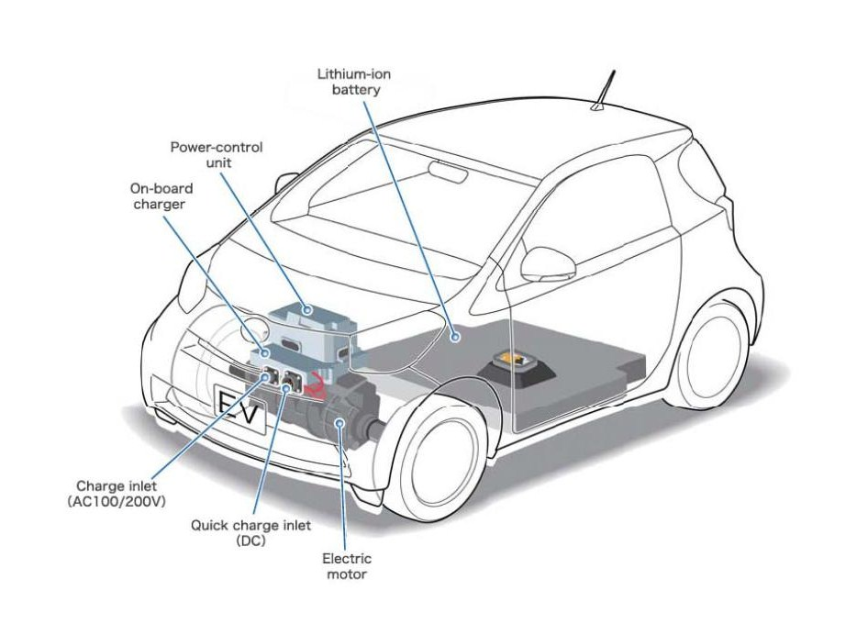
Battery Electric Vehicle (BEV) Diagram
Vehicle Type | Key Characteristics | Example
Battery Electric Vehicle (BEV) | Electric motor provides power to wheels Large battery is charged via plug This is a “pure” electric vehicle | Nissan Leaf
Image: Toyota iQ EV prototype schematic
http://autoesque.blogspot.com/2011/02/toyota-iq-ev-prototype.html

Slide 11

Our definition of Electric Vehicles
Vehicle Type | Key Characteristics | Example
Battery Electric Vehicle (BEV) | Electric motor powers wheels Large battery is charged via plug | Nissan Leaf
Range Extender (eREV) | Electric motor powers wheels Battery can be charged via plug or small, efficient ICE ICE does not power wheels | Chevy Volt
Plug-in Hybrid (PHEV) | Upgrade of the standard “Full Hybrid” Larger battery than standard hybrid vehicles Added plug-in capability | Toyota Prius Plug-In
Full Hybrid | Has both ICE and electric motor that can power wheels either independently or in combination No plug-in capability | Toyota Prius
Notes:
What is the difference between a Hybrid and an Electric Vehicle (EV)?
Hybrid vehicles are propelled by an ICE or an electric motor either independently or in combination
Electric vehicles are propelled by a battery-powered electric motor only
For the sake of our project, we include PHEV + eREV + BEVs in our definition of “Electric Vehicles”. This is fairly common practice in the industry, but is worth noting because sometimes people who are discussing EV projections do not always compare apples to apples.

Slide 12
Sample of EV Sales Projections, 2020
Notes:
Currently, there is a tremendous amount of uncertainty around how quickly electric vehicles will be adopted in the US.
This graph illustrates the wide range of EV adoption forecasts for the year 2020.
The most important factors that drive EV forecasts include:
Who is actually conducting the analysis
Assumptions regarding uncertain future events, such as:
Vehicle Costs
Battery cost reduction
Technical improvements in batteries
Government incentives
Fossil fuel price volatility
Timing of Smart Grid deployment
Speed of grid Infrastructure improvements
Consumer acceptance of EV range limitations
Because of the complexities involved in forecasting EV adoption, we chose not to conduct our own projections.
Instead, we decided to use documented forecasts to generate our own EV adoption scenarios (Low, Medium, High) to be used as inputs for our model.

Slide 13
Our EV scenario projection methodology
% of EVs in CA
Total EV Sales (US)
% of EVs Sold in CA
Estimated Yearly EV Retirement
Total Registered Passenger Vehicles in CA
Key Assumptions: For our scenarios we assumed that the % of passenger vehicles registered in California remained constant over time. Importantly, however, the total number of vehicles registered in California was forecast to increase as a function of projected US passenger vehicle registrations. Likewise, the % of EVs sold in California was held constant over time but the number of EVs sold increased as a function of projected registered passenger vehicles in California.
Data Sources: US Bureau of Transportation Statistics, National Highway Traffic Safety Administration, National Automobile Dealers Association, California New Car Dealer Association, Boston Consulting Group, Center for Automotive Research, PRTM, J.D. Power & Associates, Frost & Sullivan
Notes:
Due to the large number of factors impacting EV adoption, we chose not to create our own EV forecast model
Instead, we generated 3 scenarios of EV adoption (High, Medium, Low) based on different sales forecasts.
In order to convert available data into scenario inputs for our model, we:
1)Estimated total sales of EVs in the US
2) Modeled EV retirement rates based on ICE historical data
3) Subtracted retired EVs from EV sales on an annual basis
4) Using a factor for % of EVs projected to be sold in CA, we estimated annual net EVs on the road in CA
5) We then divided by the total registered passenger vehicles projected to be on the road in CA
And arrived at a figure that represents the ratio of CA EVs to total registered passenger vehicles in CA on an annual basis

Slide 14
Forecast Scenarios of CA EV Sales
Notes:
This graph illustrates the results of our scenario modeling. As you can see, there was a fairly significant difference between each scenario.
The HIGH scenario was generated using data from consulting firm PRTM, published in 2010. In its report, PRTM takes a relatively optimistic view of EV adoption projections, citing growing concern over climate change, anticipated increases in fossil fuel price volatility, financial incentives offered by governments, and increasing levels of urban pollution caused by ICEs as the primary drivers of EV adoption.
The MEDIUM scenario was generated using OEM production forecasts, compiled and published by Frost and Sullivan in 2009. It makes sense that this scenario would fall in the middle of the range because when OEMs are budgeting for capital expenditures and production cycles, their forecasts require equal parts caution and optimism, which results in pragmatic forecasts.
The LOW scenario was generated using data from a JD Power and Associates special report published in 2010, which takes a relatively pessimistic view of EV adoption rates over the coming decade, citing low consumer acceptance of battery technology, low (and subsidized) fossil fuel prices, and global regulatory policy as three of the most significant barriers that will impact EV adoption rates.
The S-curve is a result of a decrease in the number of EVs being sold relative to the total number of cars on the road.

Slide 15
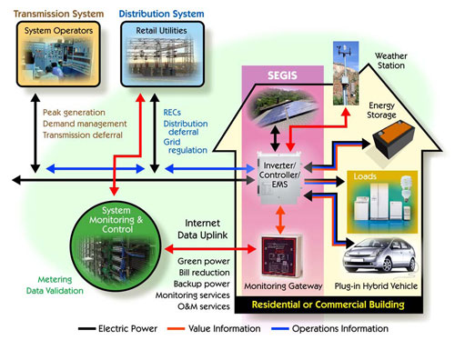
Smart Grid and Vehicle-to-Grid (V2G)
Source: U.S. Department of Energy, Energy Efficiency and Renewable Energy
Notes:
Some of you have probably heard of smart grid and Vehicle-to-Grid technology, which involves the bi-directional flow of electricity and information between the electricity grid and electric vehicles.
This graphic illustrates how the smart grid will connect the various stakeholder groups required to manage the system, including Utilities, T&D firms, monitoring groups, homeowners, and EVs.
It is through this 2-way flow of power and data that EV aggregators like Better Place plan to enhance vehicle ownership for consumers and earn additional revenues for themselves.
However, to date only one pilot has ever succeeded in supplying power back to the grid through the reliability service markets, even this required a larger battery installation to participate.
Therefore, while V2G is technically feasible, we are not considering it for our study because it is not commercially viable in the short-to-medium term.

Slide 16
Agenda
Introduction
EVs & V2G
Demand Response
Model and Analysis
Conclusions
Ancillary Services
Findings and Recommendations

Slide 17
There are two mechanisms through which demand response is provided
Demand Response (DR) - changes in electricity usage relative to normal consumption patterns as a result of incentives designed to encourage lower use ¹
Price-based | Incentive-based
Time-of-use (TOU) | Interruptible/Curtailable DR
Real-time pricing (RTP) | Demand bidding/buyback
Critical peak pricing (CPP) | Emergency DR
 | Capacity market
 | Ancillary Services
¹ Source: Federal Energy Regulatory Commission (FERC)
Notes:
While the bi-directional flow of electricity between EVs and the grid may be years away from commercialization at scale, networked EVs promise nearer term benefits as a result of demand response (DR).
The Federal Energy Regulatory Agency defines DR as the changes in electricity usage relative to normal consumption patterns as a result of incentives designed to encourage lower use.
Common demand response applications include large C&I demand side resources such as HVAC and lighting systems, but have recently expanded into large home appliances such as hot water heaters
DR programs are commonly classified according to their participants, timescales, compensation, customers, and function. Here we have broken them up by their compensation structures into two groups:
1.) Price-based DR – typically passive programs that rely on dynamic rates to induce lower usage
2.) Incentive-based DR – emergency or open market programs that take a more active role in load management
Although a number of states and utilities are pursuing price-based initiatives that include dynamic rates and smart grid technologies, our project focuses on incentive-based DR, specifically the ancillary service markets, which we will discuss in a few minutes

Slide 18
Key stakeholders in demand response markets
Grid Operators
CAISO
RTO/ISO
Power Dispatchers
Better Place
CSP/ Aggregator
Utility
Customers
EV Owner
Residential
C&I
Institutions
Source: Frost & Sullivan
Notes:
DR involves a variety of market participants
The arrows in this diagram represent the flow of information, notification processes, and payments among these participants
Grid operators sit at the top – they include Regional Transmission Operators and Independent System Operators
These non-profit organizations are responsible for maintaining system reliability for a particular service area, and act as the market maker for AS
Next we have the power dispatchers, which play a vital role by managing the exchange of data and the notification process amongst balancing authorities, utilities, and end-users in restructured markets.
This group includes CSPs such as Enernoc, Comverge, and other aggregators of Demand Response such as utilities
First, they sign contracts with end-users to assume control of specific energy assets
Then, they weigh consumption patterns and needs of electricity customers against variable electricity prices to establish curtailment plans
Finally, they aggregate this data into portfolios of load reduction commitments, which are pledged to Grid Operators in return for recurring compensation
This aggregation function provides the scale, control, and flexibility required to participate in wholesale energy and reliability markets
When the stability of the system is threatened, operators require the aggregator to reduce or “dispatch” a portion of its contracted portfolio.
In return, dispatchers receive additional compensation that may take the form of rate discounts, incentive payments, and bill credits.
Dispatchers then take a profit of the total revenue collected before splitting the remaining revenue amongst their own customers.
Note that utilities may also act as a go-between between the CSP and end customers.
Within the scope of our project
EV Owners are the end-user/electricity customer
Better Place is the 3rd party aggregator
While the CAISO serves as the grid operator

Slide 19
There are two ways of providing Demand Response via EVs (DR-EV)
 | Enhanced Aggregation (schedulable demand) | Dynamic Pricing (autonomous price response)
Steps Required | Aggregator Collects driver behavior and preferences Compares against prices Creates charging profiles and capacity schedules Supplies grid operators with schedules Manages charging to maintain commitments | Dispatchers provide hourly retail rates directly to drivers using separate EV metering technology Drivers enter preferences On-board software compares real-time prices against preferences and adjusts charging accordingly
Relevant Parameters | Amount of energy required to reach target state of charge at desired time for each user Maximum and normal charge rate Maximum charge level | Dynamic prices from utilities Real-time needs and preferences
Notes:
Now that we understand who is involved in procuring DR, how can EV’s supply this resource? There are two plausible scenarios for managed charging.
1.) The first is Enhanced Aggregation, which is essentially scheduling demand.
1.) Not surprisingly, this requires an aggregator, which may take the form of a 3rd party such as Better Place, GM through its On Star System, or the utilities
2.) This entity manages the flow of information as well as electrons between the EV owners, generators, and the grid operator
These aggregators are responsible for:
1.) Collecting behavior and preferences of EV owners
2.) Weighing this information against prices provided from grid operators
3.) Creating charging profiles of customers, which are then turned into capacity schedules and provided to the grid operator
4.) and finally, managing charging to maintain previously made commitments to drivers and grid operators
In order to provide this service, these aggregators must know 3 things:
The amount of energy required to reach a particular targeted state of charge at a desire time for each driver
The maximum and normal charge rate for each EV
The maximum charge level for each EV
Finally, it is important to note that in this system, EVs that are “off” network are unavailable to provide DR services because they are being driven or have been made unavailable by the owner
2.) The second form of managed charging relies on dynamic pricing – autonomous price response schemes that rely on “time-based” rates
e.g. higher prices during peak periods or critical events are supposed to incent drivers to charge their vehicles at night, when demand for electricity is less.
Although unavailable to retail loads in today’s markets, dynamic pricing is expected to expand along with AMI as it requires separate metering for EVs
For the purposes of this report, we are not considering dynamic pricing, as it is not a service that is easily quantifiable or relevant to aggregators

Slide 20
Agenda
Introduction
EVs & V2G
Demand Response
Model and Analysis
Conclusions
Ancillary Services
Findings and Recommendations

Slide 21
There are three categories of grid-related applications for energy storage
Category 1 – Electricity Supply
Electric Energy Time Shift
Category 2 – Ancillary Services
Regulation
Category 3 – Grid System Support
Transmission Support
Electric Supply Capacity
Spinning Reserves
Supplemental Reserves
Replacement Reserves
Load Following
Voltage Control
System Control
Real Power Loss Replacement
Transmission & Congestion Relief
Transmission & Distribution Upgrade Deferral
Substation On-Site Power
Notes:
How can DR-EV be used to provide service to the grid?
There are three categories of storage applications which are possibilities. Since we are focused specifically on demand response, two of these categories are not applicable.
Category 1, Electricity supply requires very large amounts of energy, deals with arbitrage, or storing energy when it is abundant and consuming it when it is in low supply. This isn’t a good match for EVs because of their low capacity.
Category 3 focuses on services which support the transmission grid, which are not applicable to EV’s because the service requirements tend to be localized and also have very large energy requirements.
We will be focusing on Category 2, applications known as Ancillary Services which are a much more appropriate application.

Slide 22
Our study focused on Ancillary Services (AS)
Simply put, the activities and functions that enable the produced electricity to reach end consumers reliably.
Service | Function
Regulation | Second to second balancing of load and generation under normal conditions – control service rather than energy source
Spinning Reserves | Increase or decrease production according to a dispatch signal – synchronized with the grid and immediate
Supplemental Reserves | Corrects for generation and load imbalances within 10 minutes
Replacement Reserves | Corrects for generation and load imbalances within 30 or 60 minutes
Load Following | Tracks inter-hour changes in customer loads
Voltage Control | Injects or absorbs reactive power to maintain transmission system voltages
System Control | Operator functions that schedule and monitor generation units, transmission resources, and transactions
Real Power Loss Replacement | Compensates for transmission system power losses associated with power flows from generators to customers
Notes:
So what are ancillary services?
Basically adjust for all the noise in the grid as demand increases and decreases and generation sources come on and off line.
It is an open efficient market run by CAISO, and is operated in an auction format that qualified provider bid into.
Each service has different characteristics and requirements. For example, regulation is second to second balancing of load generation while Supplemental and replacement reserves correct for load imbalances for 10 to 60 minutes.
These services can be provided with any type of generation including traditional sources such as coal and natural gas, as well as with newer techniques such as flywheels and Demand response.
But, while it is technically possible to supply all of them with DR, certain limitations exist. As result, only some of these services are realistically able to be provided by DR-EV, and in a minute we’ll explain why some are more suitable than others.

Slide 23
Four criteria were employed to determine which Ancillary Services were compatible with DR-EV
Supply Duration
Period of time for which the service is called on at every instance
Directional Shifts
Frequency, direction, and duration
Response Rate
The time within which resource needs to initiate service
Service Duty
Nature of consumption, planned vs. unplanned
Notes:
Supply Duration: This is the period of time for which the service is called on at every instance. This is a scale issue. Traditional generation can provide significantly more amounts of energy while capacity provided by EVs is much more limited. Supply durations ranging from a few minutes to a few hours are ideal for DR-EV.
Directional Shifts: In both supply and demand, shifts are bidirectional. Services with more directional shifts cause greater degradation of traditional generating assets, resulting in higher costs. Since there is no degradation with demand response, EVs can be more competitive when providing these services. For example coal plants experience 3x the wear and tear on their turbines when providing AS rather than normal operation.
Response Rate: This is the time within which the resource providing the service needs to initiate. Depending on the nature of the event, response times for various ancillary services range from less than one minute up to one hour. Traditional providers of ancillary services need fairly long ramp up times. To provide the rapid response services, generators tend to keep plants idling but operational so that they can ramp up rapidly in the case of an emergency. This increases costs due to continued fuel consumption even though the service is not being actively demanded. The advantage that DR-EV provides is that it can ramp up or down rapidly without requiring to be idled.
Service Duty: Service duty refers to the nature of consumption of the ancillary services. Some services are called on only in the case of a previously unforeseen event – a plant outage or a sudden unplanned increase in load. Other services such as Regulation and Voltage Control are required virtually around the clock. While DR-EV can technically provide both services, Pre-planned consumption of the service allows aggregators to plan the charge schedule ahead of time. Therefore pre-planned services are better.

Slide 24
Regulation and Reserves are most compatible with DR-EV
Service | Supply Duration | Directional Shifts | Response Rate | Service Duty | Suitable for DR-EV?
(Frequency) Regulation | 10–15 min | High | <1 min | Planned | Yes
Spinning Reserves | 10 min–2 hours | Low | <10 min | Unplanned | Yes
Supplemental Reserves | 10 min–2 hours | Low | <10 min | Unplanned | Yes
Replacement Reserves | 2 hours | Low | <30 min | Unplanned | Yes
Voltage Control | - | - | - | - | No
Load Following | 1–10 hours | Medium | <1 hour | Unplanned | No
System Control | NA | NA | NA | Planned | No
Real Power Loss Replacement | 1–10 hours | Low | <10 min | Planned | No
Regulation
Spinning Reserves
Supplemental Reserves
Replacement Reserves
Notes:
Based on our criteria, we determined that the four services that are suitable for EV EES are:
Regulation – short supply duration, high directional shifts, short response rate
Spinning reserves – relatively short supply duration, short response rate
Supplemental reserves – relatively short supply duration, short response rate
Replacement reserves – relatively short supply duration, short response rate
Voltage control would require V2G in order to contribute reactive power into the grid.
The rest of these services have combinations of attributes that make them less than ideal candidates for DR-EV.

Slide 25

CAISO: DR as comparable resource
“FERC Order 719: RTO/ISOs must accept bids from demand response resources for ancillary services in a comparable manner to other resources by eliminating certain charges to buyers for reducing load during system emergency.”¹
Provision | Implication
Remove resource type restrictions | Batteries (EVs) can participate
Reduce minimum rated capacity to 500 kW | Increases the likelihood that an aggregator can participate (~250 vehicles)
Reduce minimum continuous energy requirement from 2 hours | Aggregators qualify with shorter duration times
¹ Source: FERC Order 719
Notes:
There are also favorable regulatory conditions that now allow DR-EV to participate in the ancillary services market.
FERC order 719 basically states that RTO/ISOs must treat demand response the same as any other generation source and accept bids into the ancillary services market.
Some of the specific provisions include:
Removal of resource restrictions – this means that now in addition to traditional generation sources, nontraditional sources such as batteries can participate in these markets
There used to be minimum rated capacities of 1 or 2 Megawattts, which could have potentially prevented DR from participating. The reduction to 500KW makes it much more likely that a DR aggregator can participate with about 250 cars in its fleet.
There also used to be a minimum requirement of 2 hours of continuous energy which has now been done away with. This helps aggregators participate in the market since their duration times are likely to be much shorter than traditional providers.

Slide 26
US Ancillary Service market: Over $20 Billion in 2008
Notes:
Later in the presentation we will discuss our analysis and revenue opportunities, but in the mean time this slide will briefly demonstrate the order of magnitude of the markets which we are discussing.
You can see that across the US in 2008, the overall market was worth $2 Billion. The services that we are focusing on constitute about 50% of that.

Slide 27
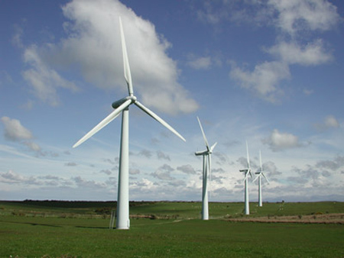

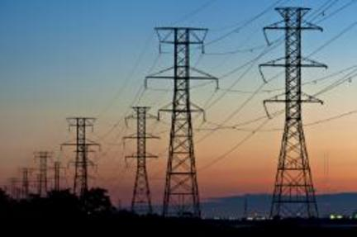
Increased penetration of renewable energy impacts Ancillary Service requirements
Steadily Increasing Penetration Rates
Falling LCOE
REC Markets
Increased Uncertainty and Variability
Forecasting Error
Intermittency
Increased Need for Ancillary Services
Regulation
Reserves
Increasing RPS
Source: 2010 NREL Western Wind and Solar Integration study
Notes:
So how do renewables fit into this picture ?
-ancillary services are a necessary component of the grid.
-Though conditions vary from region to region, the demand for these services has historically increased in step with the increases in overall load.
However, as renewable penetration rates have begun to increase, it has become clear that the demand for these services is accelerated as intermittent sources are added to local grids.
The increase of renewables is caused by ……….
This is mainly due to unpredictability of wind and solar resources as well as errors in forecasts of weather conditions.
The response from regulators to these new conditions is an increase in procurement of Ancillary Services to help smooth out these imbalances.

Slide 28
3 + 5 is a good rule of thumb
3 + 5 Rule
3+5 Rule is a good approximation for necessary AS requirements:
3% of load plus 5% of forecasted wind
Magnitude of hourly overall ramping requirements
Intra-hour variability
Over-generation issues (particularly wind)
Large, near-instantaneous production ramps (particularly solar)
Source: 2010 NREL Western Wind and Solar Integration study
Notes:
Now that it is clear that the need for AS increases with renewable penetration, the question becomes by how much do renewables increase the demand for AS?
The answer to that question is unclear and depends on numerous factors that are specific to different areas.
However, it is clear that renewables cause increases in overall ramping requirements, intra-hour variability, over-generation issues, and near instantaneous ramps.
In order to estimate what how much additional capacity a region will need, some regulators in west the use 3% of overall load plus 5% of the forecasted wind load as a general rule of thumb when estimating how much AS to procure.
As wind is currently and likely to remain the dominant source of renewable energy, the demand for these services clearly follows penetration, and will increase as CA fulfills its RPS of 33% by 2020.

Slide 29
Agenda
Introduction
EVs & V2G
Demand Response
Model and Analysis
Conclusions
Ancillary Services
Findings and Recommendations

Slide 30
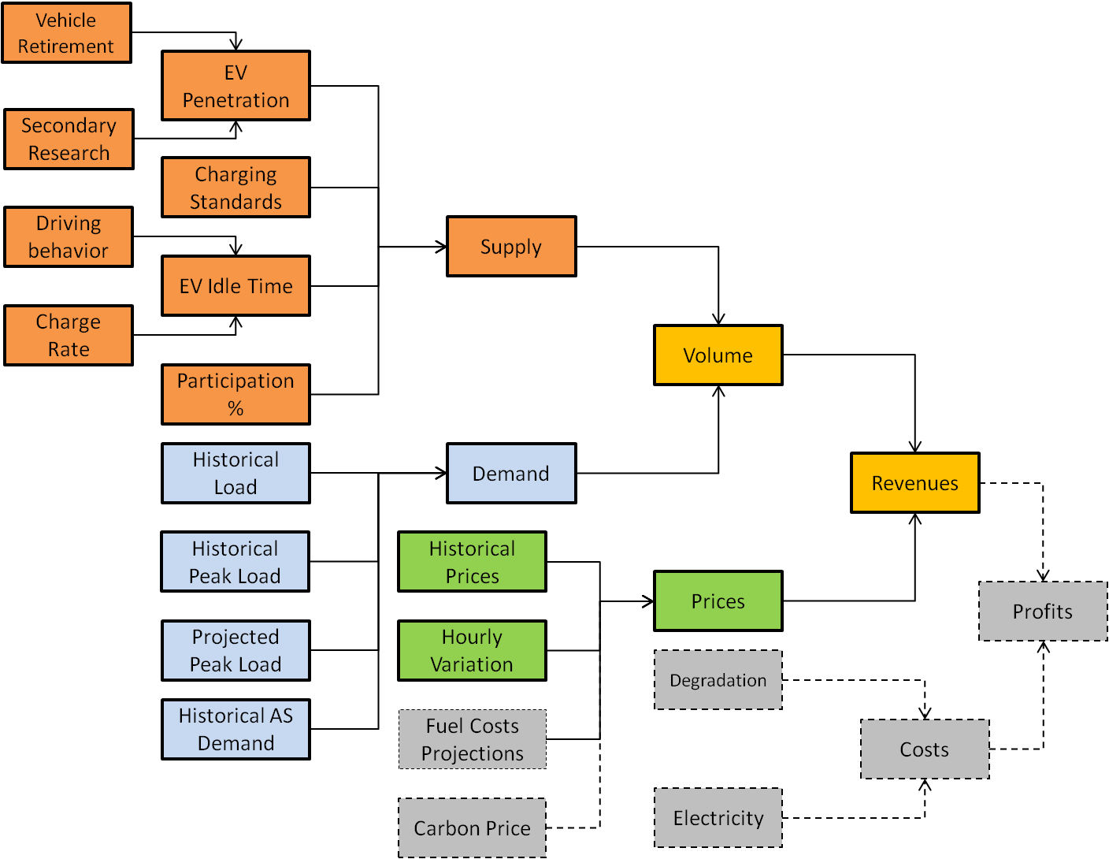
We developed a model to simulate the DR-EV Ancillary Service revenue opportunity
Notes:
-

Slide 31
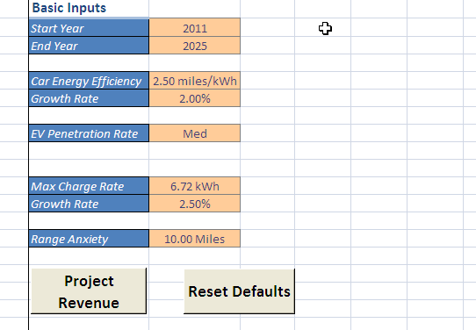
The model inputs are straightforward and come preloaded with default values for California
Timeline for projections
Energy efficiency of the EV (miles/kWh)
Penetration rate scenario¹
Maximum rate of charge (kWh)
Range anxiety of the user (miles)
The default values include:
  Timeline: 2011 – 2030
  Efficiency: 3.04 miles/kWh²
  Rate of Charge: 19.2 kW-h³
  Range Anxiety: 20 miles⁴
Screenshot from “Inputs” tab
¹ The three scenarios are low, medium and high. Actual percentages were determined by team research and analysis
² Source: EPA Rating for Nissan Leaf, Nissan Company Website (Accessed Feb-2011); Team Analysis
³ Source Society of Automobile Engineers, Standard No: J1772 (Published on 15-01-2010); Team analysis
⁴ Source: (Kempton & Tomic, Vehicle-to-grid Power Fundamentals: Calculating Capacity and Net Revenue, 2005)
Notes:
- Developed a VB based model to simulate market size and revenue opportunities in this space
- Sets of 5 inputs
- Model is mainly for California Region, but inputs for other regions are tracked by respective ISOs and should be fairly easily available.

Slide 32
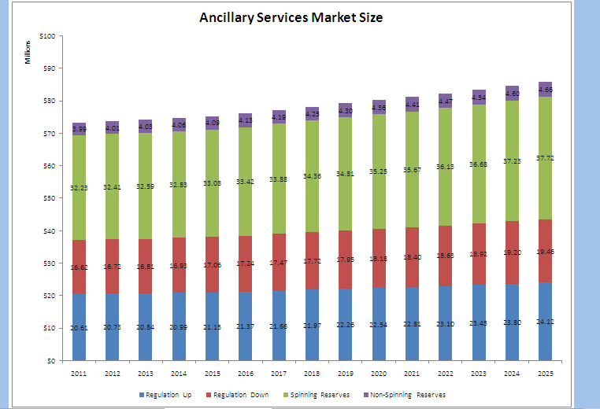
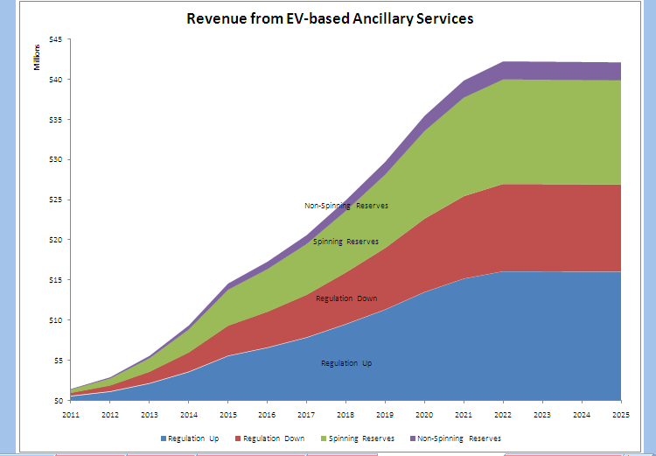
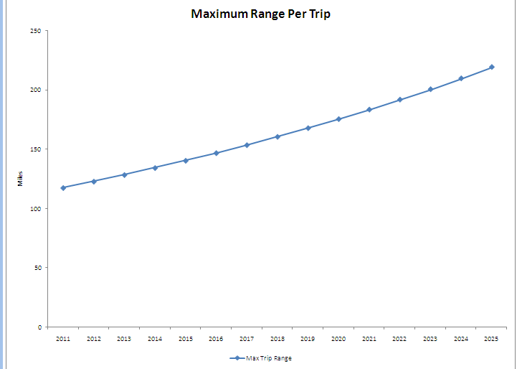
There are three primary model outputs
Model Outputs
Market size for each of the Ancillary Services by year
Revenue potential for Demand Response via EV-based Ancillary Services
Maximum theoretical range per trip allowed
Market Size
Revenue Opportunity
Maximum Range
Notes:
Three outputs
Overall market size by year
The revenue opportunity from DR-EV
Maximum range per trip given these revenue opportunities

Slide 33
The model works through three distinct yet interconnected components
1
2
3
Forecast Load
Forecast Demand
Forecast Supply
Data Required
Hourly actual load (current)
Future peak loads (by year)
Sources
CAISO
EIA Annual Energy Outlook 2010
Intermediate Output
Hourly load forecasts for future years
Data Required
Hourly actual ancillary service demand (current)
Sources
CAISO OASIS Database
Intermediate Output
Hourly ancillary services forecasts for future years
Data Required
Hourly residential vehicle trip data
Aggregate residential driver data
Sources
2009 National Household Transportation Survey
Intermediate Output
Hourly Demand Response capacity available from EVs
Notes:
Three steps in the model
Data, Sources and Outputs

Slide 34
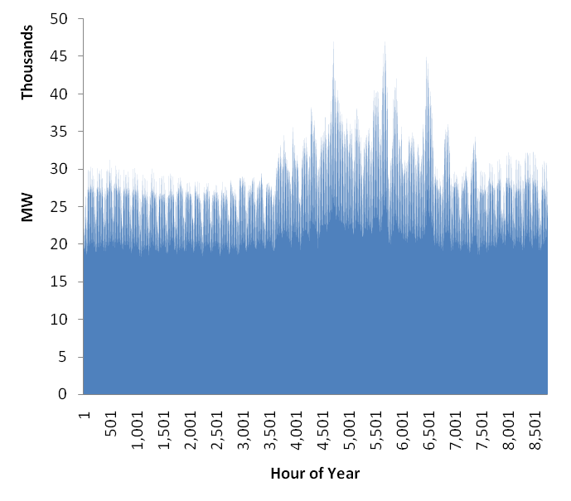
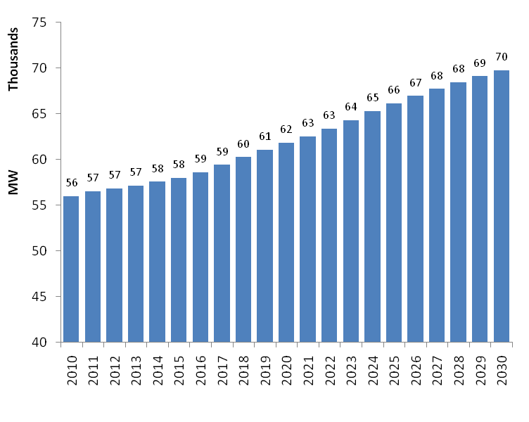
Forecasting load is straightforward
1
California System Load for 2010¹
By Hour
California System Peak Load (2010 – 2030)²
By Year
¹ Source: CAISO OASIS Database (Accessed on March, 2011)
² Source: Energy Information Administration, Annual Energy Outlook (2010)
Notes:
- Fraction

Slide 35

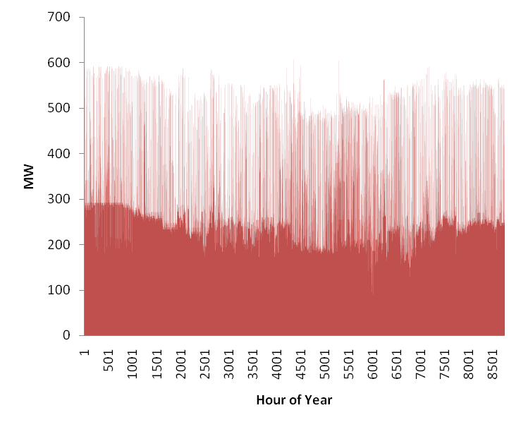
Our model relies on a fairly simplistic set of equations to forecast Ancillary Service demand
2
California System Load for 2010¹
By Hour
California Regulation Up Demand for 2010¹
By Hour
¹ Source: CAISO OASIS Database (Accessed on March, 2011); Team Analysis

Slide 36
Demand Response capacity was estimated per hour at the individual trip level…
3
Demand Response Capacity¹
Per trip per hour
Key Assumptions
Maximum rate possible is 19.2 kW-h ²
Linear recharge of battery on an hourly basis
Driver would like to recharge at the fastest rate possible if there was no Demand Response
Battery does not recharge in the hour that trip is taken
¹ Illustrative only - actual number will vary depending on the discharge per trip; assumes linear recharge of battery
² This is the rate allowed by the Level-II charger

Slide 37
And this was aggregated across the entire day…
3
Hour of Recharge
 | 1 | 2 | 3 | 4 | 5 | 6 | 7 | 8 | 9 | 10 | …
0:00
1::00
2:00
3:00
4:00
5:00
6:00
7:00
8:00
9:00
10:00
11:00
….
Hour of Trip
California Driving Profile¹
By Hour of Day
¹ Source: National Household Transportation Survey (2001), National Household Transportation Survey (2009)

Slide 38
To determine the Demand Response capacity available
3
California Demand Response Capacity Available per trip per hour¹
By Hour of Day
Increase in … | Results in …
Penetration rate of EVs
EV energy efficiency
Charging rate limitations
Driver range anxiety
¹ Source: Team Analysis

Slide 39
While the total revenue opportunities offered by Ancillary Services are sizeable…
Total ~ $1,625 M

Slide 40
Ancillary Services provided by DR-based EV aggregation offers limited revenue opportunities
Low
Input Variables
- Timeline: 2011 to 2030
- Energy Efficiency: 3.04 m/kWh
- Max. Charge Rate: 19.2 kWh
- Range Anxiety: 30 miles
- EV Penetration: Medium
Med
High
Input Variables
- Timeline: 2011 to 2030
- Energy Efficiency: 3.04 m/kWh
- Max. Charge Rate: 19.2 kWh
- Range Anxiety: 10 miles
- EV Penetration: High
Input Variables
- Timeline: 2011 to 2030
- Energy Efficiency: 3.04 m/kWh
- Max. Charge Rate: 19.2 kWh
- Range Anxiety: 20 miles
- EV Penetration: Medium
Total ~ $20 M
Total ~ $40 M
Total ~ $146 M

Slide 41
Agenda
Introduction
EVs & V2G
Demand Response
Model and Analysis
Conclusions
Ancillary Services
Findings and Recommendations

Slide 42
Conclusions
Increased renewable penetration increases the need for Ancillary Services
V2G is not a viable mechanism to provide Ancillary Services in the near term
EVs can participate in the Ancillary Service markets through Demand Response
As a grid support mechanism, EVs are not likely to contribute to renewable penetration
Despite large market for Ancillary Services, DR-EV revenue is minimal on a per car basis
Notes:
Key takeaways:
1.) Increased renewable penetration increases the need for Ancillary Services
2.) V2G is not a commercially viable method to provide AS in the near future
3.) EV can participate in the AS markets via Demand Response
4.) While there is a large domestic market for AS, DR-EV revenue is very low on a per-vehicle basis
THEREFORE
5). Our research demonstrates that EVs are not likely to contribute to the penetration rate of renewable energy in California in the near-medium term (unfortunately)

Slide 43
Questions?

Slide 44
Appendix

Slide 45
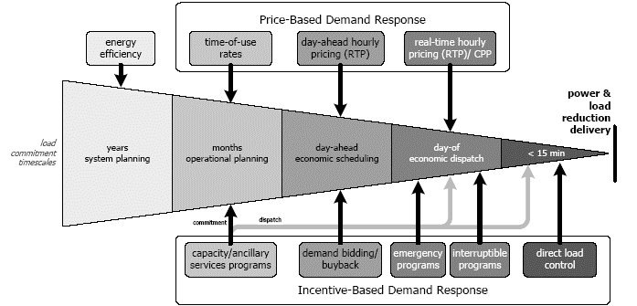
Ancillary Services (DR)
Notes:
Where do AS fit in the DR universe?

Slide 46
The quantity of DR is a function of behavior
Notes:
In order to estimate the potential for DR across a fleet of EVs, you must determine the number of EVs that may potentially participate in a particular program.
Programs require buy-in from customers
How many are likely to enlist under dynamic price programs and at what prices?
How many are likely to enlist in direct control programs?
Frost and Sullivan has shown that the majority of residential customers are likely to participate
Higher % of respondents interested in dynamic pricing than direct control, but still more than 50%
Highest number of respondents willing to opt-in to dynamic pricing for $16-30/mo.
Highest number of respondents willing to opt-in to DLC for >$45/mo.
This begs the question, what is the revenue opportunity for DR via EVs and how do you manage charging?
Derived from Frost and Sullivan Survey on Consumer Behavior

Slide 47
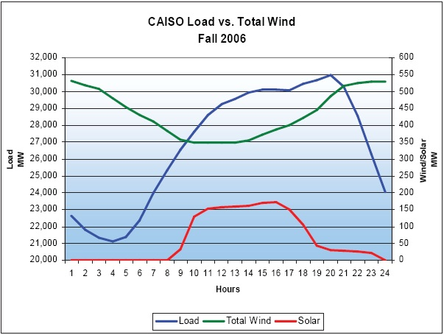
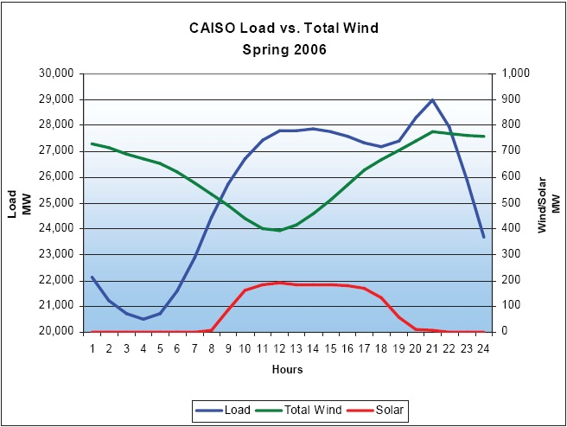
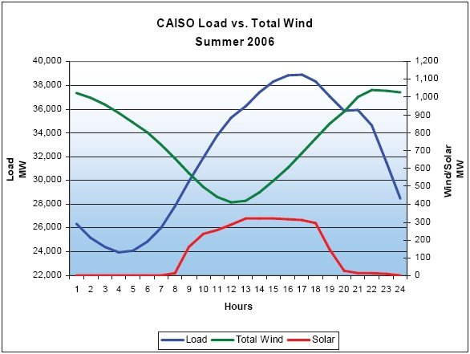
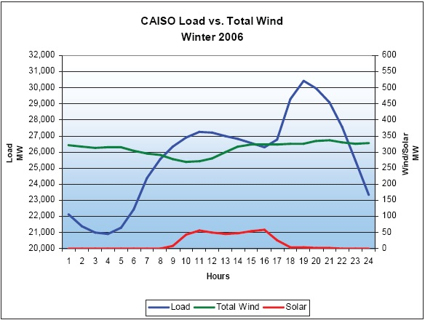
Production Profiles - Variability

Slide 48
Removed Slides

Slide 49
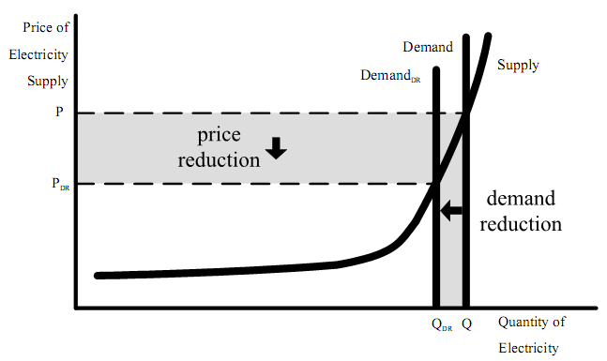
FERC has passed regulation mandating that DR is price-equivalent to traditional sources of energy
FERC Order 745: DR resources that meet the following requirements must receive the full market price for energy, also known as the locational marginal price (LMP):
  Provide an alternative to generation by balancing supply and demand
  Pass a net benefit test (dispatching DR must reduce the LMP by more than the cost of compensating and dispatching the DR)
Notes:
FERC has supported DR in its pursuit of competitive wholesale energy markets. Recently, the Commission ruled to amend the Federal Power Act with Order 745. This rule effectively puts DR on even footing with generation – we expect payments will be based on the market rate going forward.
In its comments, the Commission justified its ruling by stating that DR may:
1.) reduce dispatch of higher-priced resources to satisfy load
2.) mitigate market power of generators by increasing risk that suppliers that bid high prices will not be dispatched
3.) provide quick balancing of the grid, supporting system reliability and meeting resource adequacy and management challenges
DOE. Benefits of DR in Electricity Markets and Recommendations for Achieving Them. Feb 2006.

Slide 50
DR providers are compensated through two payment mechanisms– Capacity and Energy
Capacity
Decreases the need for addition of generation and transmission capacity
Function of dispatched energy, based on spot market energy prices
EES system enable utilities to avoid capacity additions
Small amounts of energy actually delivered
Up-front payments for pre-specified load reductions, based on market prices
Energy
Storage of a significant amount of energy by the EES system
Offsets energy that would otherwise need to be purchased from and generated by the grid
Notes:
So how will aggregators be paid for these services?
Ancillary services are an incentive-based form of DR. They may participate in day-ahead or real-time markets and are expected to command two forms of compensation.
1.) Capacity payments
2.) Energy payments
Capacity can very simply be thought of as back up resources that if called upon, can produce and deliver energy if necessary. This backup capacity allows utilities to avoid making large capital investments to cover incremental loads, and can therefore save significant costs. In reality, small amounts of energy are actually delivered.
Energy payments are made when energy is actually delivered. This requires significant amounts of energy to be transferred, so as you can imagine this will not be a large revenue source for EVs which have limited battery capacity.
The vast majority of the revenue opportunities we will discuss here are derived from energy payments.

