Slide 1
Challenges and Successes in Providing Digital Access to Discipline Specific Information
Nathan Rupp, University of Michigan
Rachel Wexelbaum, St. Cloud State University
Moshe Pritzker, Journal of Visualized Experiments

Slide 2
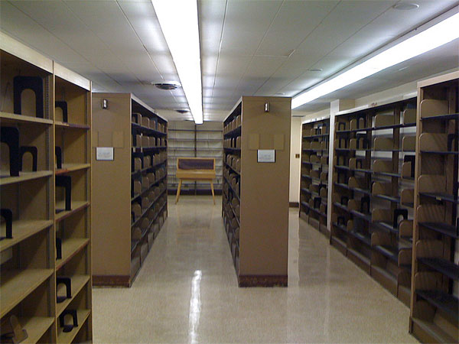

The Digital Library Is Here!

Slide 3
Not so Fast…
Implications for research in
  Business
  LGBT studies
  Science
Problems
  Business
  LGBT Studies
Success
  Science

Slide 4
Moving Beyond 10Ks
Collecting and Providing Access
to Historical Company Information in an Academic Business Library

Slide 5
Kresge Library Profile
Structure & Staffing
  “Independent” library at UM, part of Stephen M. Ross School of Business
  Twenty staff total (eight librarians)
Collection
  Shared purchasing for some resources with University Library (76,379 e-journals; 24,723 e-books)
  Own content
    75 databases
    125,000 print volumes

Slide 6
125,000 Print Volumes?
In a business library? Really?
Clientele Served
  3,000 students
    1,100 undergrads
    1,700 MBAs (full-time, evening, weekend, executive, global)
    100 other master’s students
    100 PhDs
  125 faculty members

Slide 7
Types of Business “Data”
Financing – stocks and bonds, pricing, number of shares outstanding, market capitalization
Financials – 10Ks, balance sheet, cash flow statement
Products – brands, advertising
Context – industry context, corporate “family tree,” value chain (suppliers, customers, competitors)
Personnel – leadership, board members, executives’ connections and education, number of employees, contact information

Slide 8
Interest in Data
Mutual fund holders
Current
Serious Investors
Interest
Industry analysts
Historical
Academic researchers
Context
Financing
Products
Personnel
Financials

Slide 9
Problematic Questions (1)
Q: What was Ford’s revenue last quarter?
A: $32.4 billion (12/31/10) (Yahoo! Finance)
Q: What was Ford’s revenue in 1915?
A: $2.3 million (ProQuest Historical Annual Reports)

Slide 10
Problematic Questions (2)
Q: What was GE’s closing stock price Friday?
A: $19.89 (Yahoo! Finance)
Q: What was GE’s close on December 4, 1896?
A: $33 (ProQuest Historical Wall Street Journal)

Slide 11
Problematic Questions (3)
Q: What are Pepsico’s brands?
A: Pepsi-Cola, Mountain Dew, etc. (Gale’s Companies and Their Brands)
Q: What were Pepsico’s brands in 1995?
A: Pepsi-Cola, Mountain Dew, Pizza Hut, Taco Bell, KFC (Past editions of Companies and Their Brands)

Slide 12
Problematic Questions (4)
Q: What are Pfizer’s subsidiaries?
A: Include King Pharmaceuticals, Pharmacia, Wyeth (OneSource)
Q: What were Pfizer’s subsidiaries before it merged with
  King Pharmaceuticals (2010)?
  Wyeth (2009)?
  Pharmacia (2003)?
  Warner Lambert (2000)?
A: ????? (?????)

Slide 13
Data Problems
Archiving
Availability
Accessibility

Slide 14
Impact on Libraries
Vendor Perspective
Library Options
Patron Support

Slide 15
Vendor Perspective
Lack of recognition of data’s value
A great deal of recognition of data’s value
Opportunity cost
Customer base

Slide 16
Library Options
Print vs. electronic
  Keep print? Seriously?
  Funding both formats
Collaborative relationships
  Identification
  Maintenance
Content delivery

Slide 17
Patron Support
Who Are Your Customers?
Reference Interview
Manage Expectations
Think Outside the Box

Slide 18
Business = Humanities. Really.
Preservation
Access
Customer Service
Collaboration

