Slide 1
Worth Watching: Assessment of Video Tutorials in Academic Libraries
Sally Ziph
(Librarian, Ross School of Business, University of Michigan),
Jennifer Lammers Zimmer (Librarian, Ross School of Business, University of Michigan),
Kelly Burr (Digital Technologies Assistant, Ross School of Business, University of Michigan)
*With special thanks to Elizabeth Beers, Assessment Librarian, University of Chicago

Slide 2
Overview
Background information
Overview of projects
Results
Conclusions
Going forward
Notes:
Presentation outline

Slide 3
Background - 2010 and 2012 Survey
New MBA Consortium students
Asked us to create the video tutorials in 2009
Videos were intended to help complete a specific task: i.e. Build-a-list in OneSource

Slide 4
Background – Testing Group
MBA Consortium Student Group 2013:
Age: 26-35
Minority students
Met with job recruiters off-campus before ever coming to Kresge
Notes:
Off-campus in summer
Had never been to Kresge Library
Chance to meet recruiters

Slide 5
Background - Creation of Videos
Wrote scripts based on FAQs
Technologies: Audacity for audio and Camtasia for screen capture
Advertised videos by email
Videos added to our Instruction page
  http://www.bus.umich.edu/kresgelibrary/support/instruction.htm
Notes:
Scripts based on our experience with students’ job hunting
Elizabeth Beers and Kelly Burr (Digital Library Assistant, old and new) created videos with Audacity and Camtasia
Can email Kelly with questions—kblurr@umich.edu

Slide 6
Overview of Two Projects
2010: How do we evaluate the effectiveness of non-interactive task-based point-of-use video tutorials?
2012: Can grad students (MBAs) learn a library database task through a screencast video tutorial?
In 2012, we wanted to delve deeper into student learning outcomes.
Notes:
Started with one project, turned into two
Did an extensive literature search (see bibliography on TLA site http://mcore-apps.com/tla2012 or on our web page)
And a short survey to find out if they used the videos and if they said they “learned” anything.
2012 project used Best Practices
Tested learning outcomes in a more systematic way.

Slide 7
2010 Literature Search
How do we evaluate the effectiveness of non-interactive task-based point-of-use video tutorials?
Best practices included:
  Pre/post Tests
  A/B tests
  Focus groups and user interviews
  Surveys
  Statistics
Notes:
Evaluated literature for articles on any type of video tutorial evaluation.
Not all of the methods we found were appropriate for our screencast video
Best Practices:
Pre/post test
Takes time to develop, but can be very effective
Content should be exactly the same—pre-test and post-test
Can include qualitative questions
A/B tests
Creating a test that uses the exact same content in two different formats,
Video tutorial vs. classroom instruction, for example.
Time consuming
Difficult to tell whether students’ learning was based on the content or on the presentation type/format.
Focus groups and user interviews.
Difficult to construct questions
Need to provide an incentive to get volunteers to participate
Need a skilled facilitator
Surveys
Difficult to come up with good questions
We used a UM expert in Learning and Teaching to help us clarify “what we wanted to know.”
Usage statistics—
Number of clicks, etc. can’t tell source
Good to have, but they don’t tell you anything about learning outcomes.

Slide 8
Survey Methodology 2010
Questions made up by librarians (based on our experience)
Qualtrics survey emailed to MBA Consortium students

Slide 9
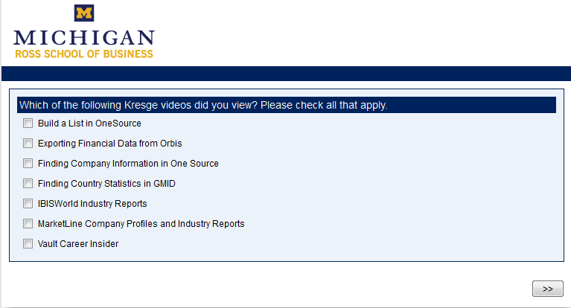
Screen Shot 2010 Survey
Notes:
Question is:
Which of the following Kresge Library videos did you view?
Check all that apply.

Slide 10
Results 2010
30% students responded to email survey (13 out of 45 total)
23% of respondents had used the videos
77% of respondents didn’t use videos because:
  Didn’t know they were available
  Videos were not “relevant”
Notes:
Results in percentages--

Slide 11
Conclusions From 2010 Project
List of Best Practices and pros/cons of each practice
We concluded that future evaluation should include:
  Continued gathering of usage statistics
  Focus groups to refine tutorials/topics
  Testing methodologies that more accurately measure learning outcomes and usefulness
Notes:
Our initial conclusions based on 2010 project.

Slide 12
Conclusions 2010, con’d
Clarify what the Kresge Library can do to help MBA Consortium students
We need to send reminders at strategic times
Notes:
Send more than one reminder.

Slide 13
2012 Research Question
Can grad students (MBAs) learn a library database task through a screencast video tutorial?
Same MBA Consortium Group population (same demographics)
Café coupon incentive ($10)
Notes:
Tested 10 students from the next first year group of MBA Consortium students
Each received a $10 voucher

Slide 14
Survey Methodology 2012
Based on paper by colleagues
Questions vetted by UM Center for Learning & Teaching expert
Tested Qualtrics survey on other librarians
Notes:
2012 survey different: WHAT WE DID DIFFERENTLY!
Elizabeth Beers, my co-author of the first project found a paper by fellow UM librarians Jo Angela Oehrli, Amanda Peters and library student Benjamin Nanamaker.
The title is “Do Screencasts Really Work? Assessing Student Learning through Instructional Screencasts.” It’s a paper in the ACRL 2011 Proceedings in Philadelphia.
I decided to follow a similar model and asked Jennifer Zimmer, Digital Technologies Librarian, and Kelly Burr, Digital Library Assistant to work on the project with me.
Angie and Amanda used a carefully developed survey and tested Undergraduate students one by one (15 total) they selected students who claimed they had never viewed a library video tutorial before.
We decided to recreate this study using our Graduate MBA students, (all from a select group), who had only been exposed to the existence of the videos by an email from the Library Director.
Our test focused on the completion of a specific task that happened to be a feature of a database.
Their test asked Undergraduated to us the the UM lib.umich.edu website to “find a psychology database” so they could find good articles for a paper on birth order.

Slide 15
2012 Pre-test/Post-test and Survey
The Survey questions of our Qualtrics questionairre were qualitative
  i.e., different questions before and after the video tutorial
Pre-test questions and screenshots (before the video tutorial) were exactly the same as Post-test questions
Notes:
The meat and potatoes of this was the Pre/Post test.
Even though we concluded we should try Focus Groups in 2010, our colleagues’ paper convinced us we should use Pre/Post testing instead.
We developed the specific questions for the pre/post tests. We also asked qualitative survey questions prior to the pre-test, and as a follow-up to the Post-test.
(Copy of our survey?)
We were careful to make the pre-test and post-test exactly the same, so that any differences could only be ascribed to learning.

Slide 16
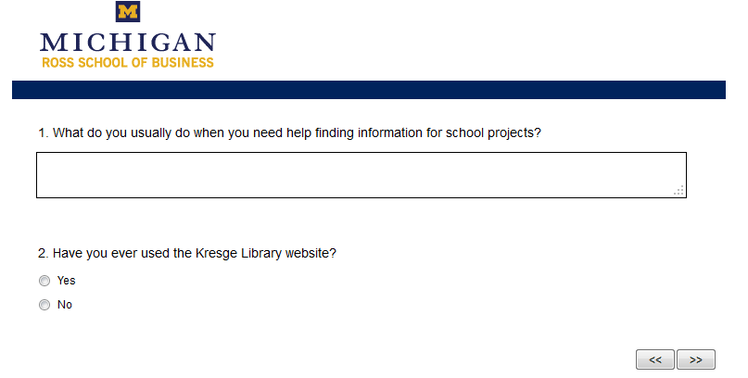
Screen shot 2012 Survey
Notes:
Our qualitative pre and post-test questions focused on:
Experience with video tutorials in general
Experience with Kresge web site
Experience with Kresge video tutorials
Suggestions for improvement or topics for future videos
Quote from copy of survey?

Slide 17
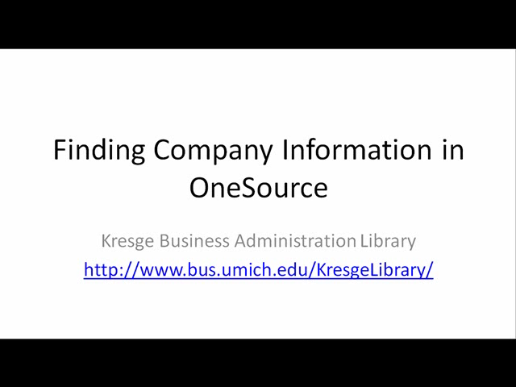
2012 Survey Video
Notes:
View a minute of the video.

Slide 18
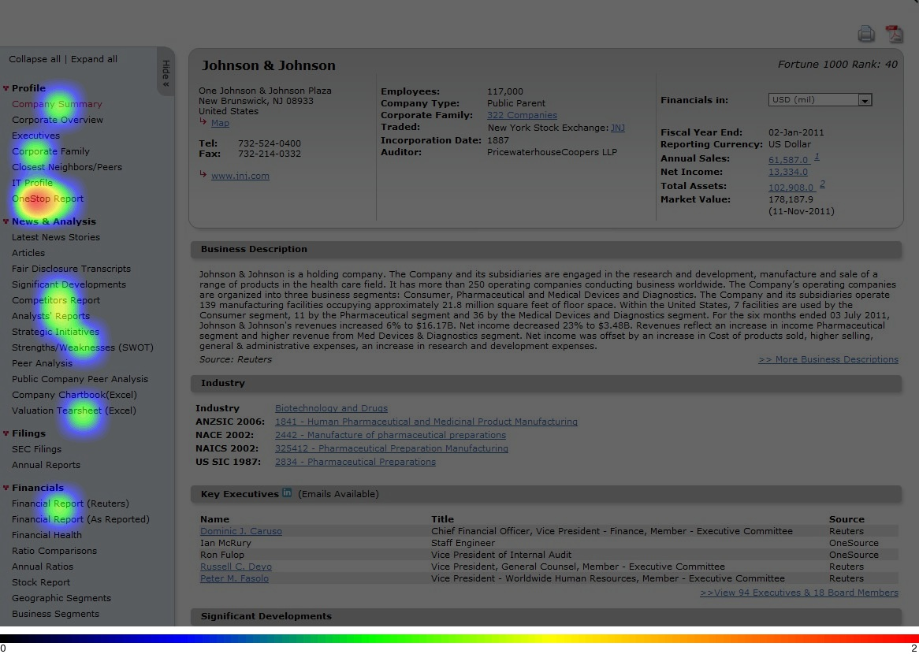
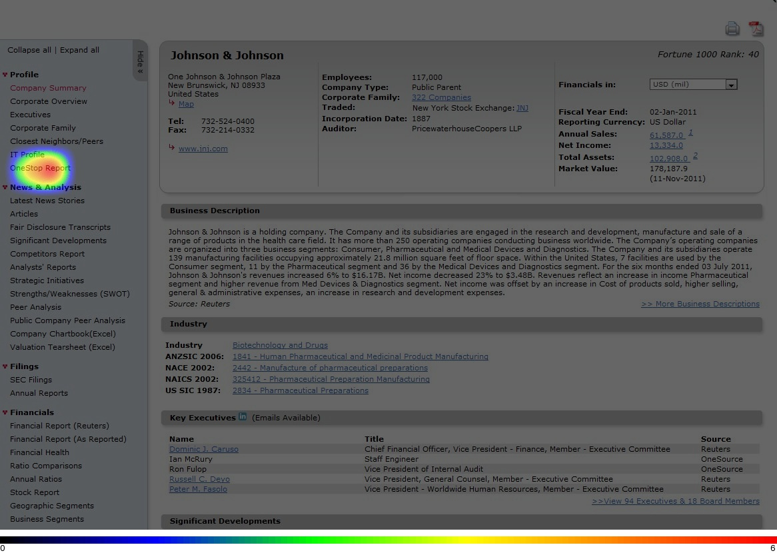
Results Show Learning Has Taken Place
Pre-test Post-test
Notes:
The question here was:
Where would you click to download only sections of the report that you need for your interview? Then scroll down and click on the Next button to go to the next question

Slide 19
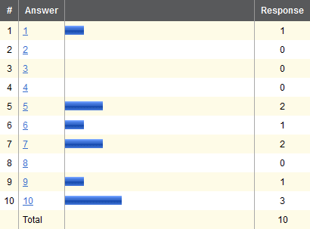
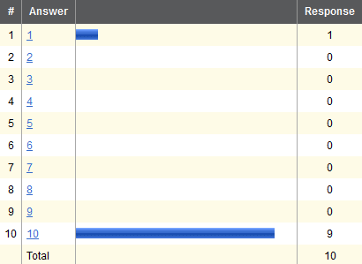
Results Show Confidence Has Risen
Pre-test Post-test
Notes:
The question was “How confident are you in how you completed this task?”
(Not at all confident-1—Very confident--10).

Slide 20
2012 Conclusions
Grad students do learn how to do library database tasks through screencast video tutorials
We would like to do further statistical analysis to pinpoint statistical significance. (UM Center for Statistical Consultation and Research)
Notes:
Further plans include:
SPSS software encapsulates advanced mathematical and statistical expertise to extract predictive knowledge that when deployed into existing processes makes them adaptive to improve outcomes.
Data Collection
Don't settle for what you think you know about people's attitudes, preferences, and opinions.
Statistics
Discover what more than 250,000 customers know: With our statistics family, including IBM SPSS Statistics, you can be confident in your results and decisions.
Modeler
IBM SPSS Modeler enables you to discover hidden relationships in both structured and unstructured (text) data – and anticipate the outcomes of future interactions.
Deployment
Guiding everyday decisions with predictive analytics is the key to success. Integrate the power of analytics into the DNA of your business with the IBM SPSS Deployment family.
Introduction to R
R is a language and environment for statistical computing and graphics. R is available as Free Software under the terms of the Free Software Foundation's GNU General Public License in source code form. It compiles and runs on a wide variety of UNIX platforms and similar systems (including FreeBSD and Linux), Windows and MacOS.
The R environment:
R is an integrated suite of software facilities for data manipulation, calculation and graphical display.

Slide 21
“Bonus Conclusions”
Students’ level of enthusiasm and participation
Large number of thoughtful and helpful comments
Librarians surprised : video tutorials made such a marked difference in student learning outcomes.
Notes:
90% of students tested would be willing to use Kresge video tutorials in the future.
100% would recommend them to friends
Contact MBA Section chairs, come to mtgs.
Work even more closely with Office of Career Development

Slide 22
2010 vs. 2012
BOTH surveys suggest students need and want reminders of Kresge Library services and resources
Video creation is worth our time and is effective way to instruct students

Slide 23
Further research questions
Get students back 2 weeks later—retention and transfer of learning?
Learning styles?
Evaluate video tutorial vs. in-person vs. podcast vs. print using A/B testing?
Notes:
We had comments on what topics to cover:
Create a “feature” to search for tutorials based on what you’re looking for: company info, industry info., etc
A general tutorial broken down by “function”: (Marketing, Banking, etc.) and which databases are the best for each “function.”
How to find journal articles, or articles in frequently used journals like Harvard Business Review.
How to find information for “Core” MBA classes—we already have a WIKI where we create pages for various classes.
Quantitative—find out if our results are statistically significant.

Slide 24
Translating Data into Actions
Know videos are a good tool
Have to decide what topics to cover
How to measure usage
Advertising and placement
Notes:
We had comments on what topics to cover:
Create a “feature” to search for tutorials based on what you’re looking for: company info, industry info., etc
A general tutorial broken down by “function”: (Marketing, Banking, etc.) and which databases are the best for each “function.”
How to find journal articles, or articles in frequently used journals like Harvard Business Review.
How to find information for “Core” MBA classes—we already have a WIKI where we create pages for various classes.

Slide 25
Practical Considerations
Each video represents about 10-12 hours of work
Who will do writing, editing, recording?
How to keep these updated?
What are we going to do with our podcasts?

Slide 26
Questions?
Notes:
PDF article-add to bib
Bibliography--update
Survey Questionnaire—have copy
WEBSITE LINK
Qualtrics notes from Kelly:
Qualtrics is a program that enables the user to easily create surveys for analysis. The program is easily manageable and has a few key features:
Dragging of questions order
Question logic
Skip logic (ex: if the answer to question 3 =”yes” skip to question 5 )
Display logic (ex: if the answer to question 3 =”yes” display to question 4 )
Easy editing of answer type
Ability to add photos and videos
Heat map ability
Look customization
Result tracking , viewing, and analysis
And many more option
The program is relatively easy to use with most of the general options available near the top. When creating a survey, there are quite a few survey templates to choose from, or you can make your own. Then it is as simple as typing out your questions, choosing the answer type, and adding logic if need be. One very important piece of advice is to make sure you have your survey questions planned out in advance. It is essential that the question flow is already in place and diagrammed out to prevent confusion and errors during survey building.
Qualtrics is easy to use and produces easy to read results. That being said, it is not without its flaws:
It is glitchy and can have loading problems; sometimes the question editor does not work properly when editing text
The “Rich Text Editor” has loading issues and sometimes will not load: Many times this had to be done and re-done because the editor would not load the proper image, and would then display blank space. Also, the images tend to be difficult to move in alignment.
Editing sometimes causes words to be compounded: In a few cases while editing questions, the words would lose their spacing causing them to be compounded.
Embedded videos play upon entering the editor: If a video has been embedded in a questions, it will play upon entering into the survey editor, which is somewhat of an annoyance.
Logic does not have a function to skip specific questions; The logic has a “skip to” function, but not the basic “skip” which disallows the skipping of various questions. For example, if question 3 is answered “yes” you may want display question 4 and 5, but skip 6. The “skip to” function only allows skipping to a question which would skip questions 4 and 5 altogether.

