Slide 1

E-Textbooks for Engineering Courses
David Carter
Paul Grochowski
Leena Lalwani
Natsuko Nicholls
Sara Samuel
Special Libraries Association, All Sciences Poster Session
July 17, 2012
Chicago, IL

Slide 2
Background
Rising textbook costs are a concern for students so we try to make textbooks available to students whenever possible through:
  Course reserves
  E-books: Purchase e-textbooks when possible
Fall 2011: Library providing 41 e-textbooks to 2072 students in 36 classes (~ 8% of engineering courses)
Vendors:
  Subscriptions: ebrary, Knovel, Safari, NetLibrary
  Single title purchases: ebrary, MyiLibrary, NetLibrary
  Packages: Elsevier, Springer, Wiley
Are students actually using these e-textbooks?

Slide 3
Method: Survey
Fall 2011
Objectives
  To help us assess usage of e-textbooks.
  To better understand student expectations of e-textbooks.
Methodology
  2072 students in 36 Engineering courses were invited to take a survey.
  15% response rate (n=299).
The survey contained twenty-one questions, divided into three sections: (1) Demographics, (2) Awareness of the existence of the e-textbook, and (3) Student’s e-textbook experience.

Slide 4
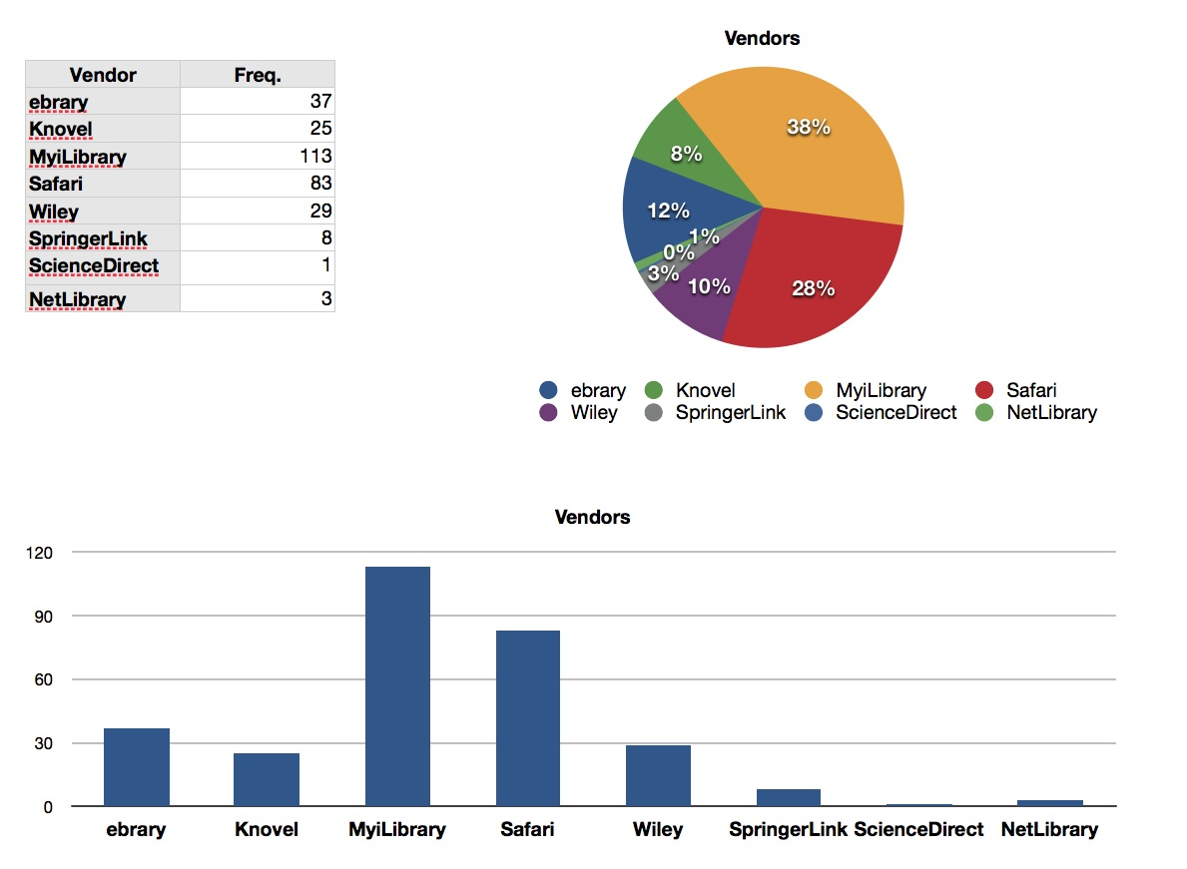
Demographics - Vendors

Slide 5
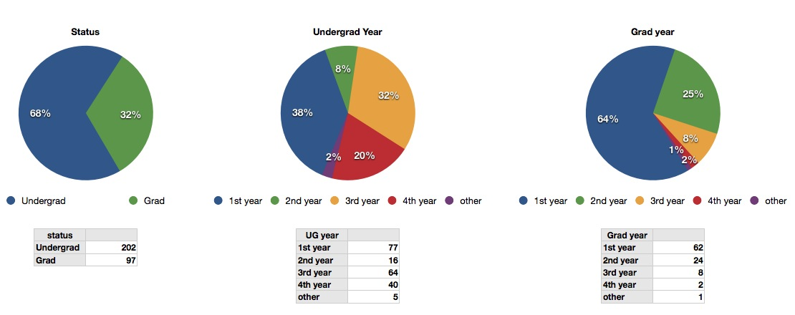
Demographics- Student Status

Slide 6
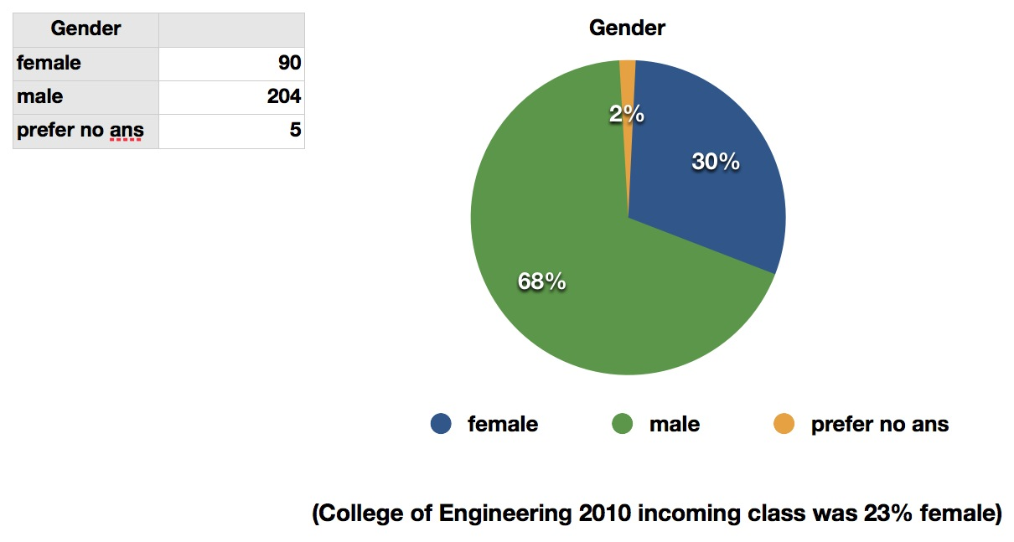
Demographics - Gender

Slide 7
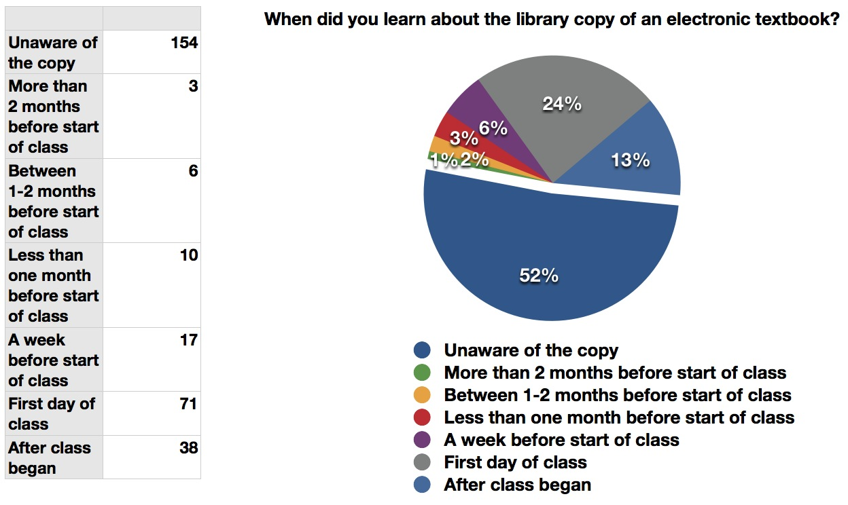
Awareness

Slide 8
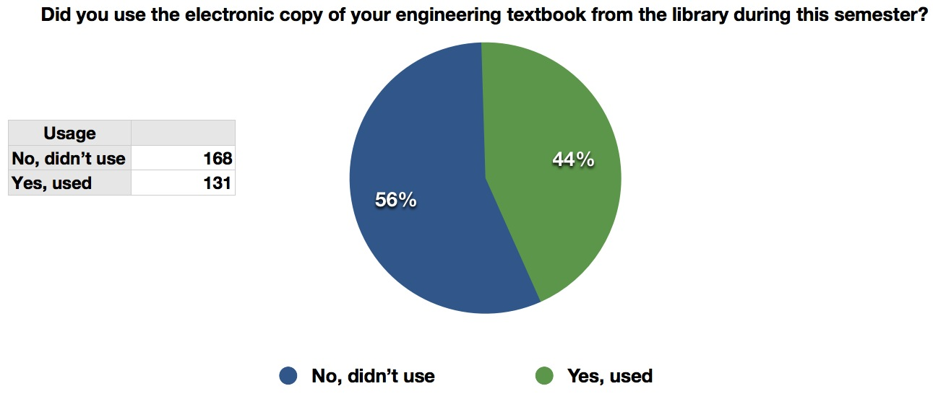
Usage

Slide 9
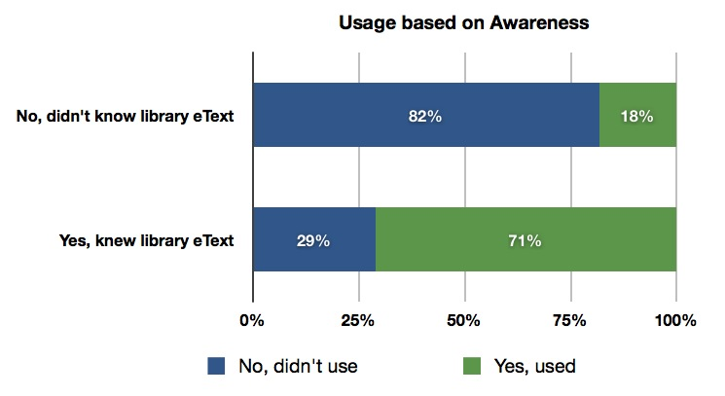
Usage based on Awareness

Slide 10
Library E-Textbook Usage: Awareness Matters
Research Question: What influences Library e-book usage?
Hypothesis: Students are more likely to use an electronic copy of their assigned textbooks from the library when they are informed of its availability
Method: Logit estimation
Findings:
  Students are more likely to use library copies of e-textbooks when they know there is a copy available.
  On substantive side: Students are about 51% more likely to use library electronic copies given the advanced notice.
  By controlling for other variables associated with the outcome of student’s library textbook use, providing students with information about the availability of electronic copies has the most significant impact on increasing student use of e-textbooks from the library.

Slide 11
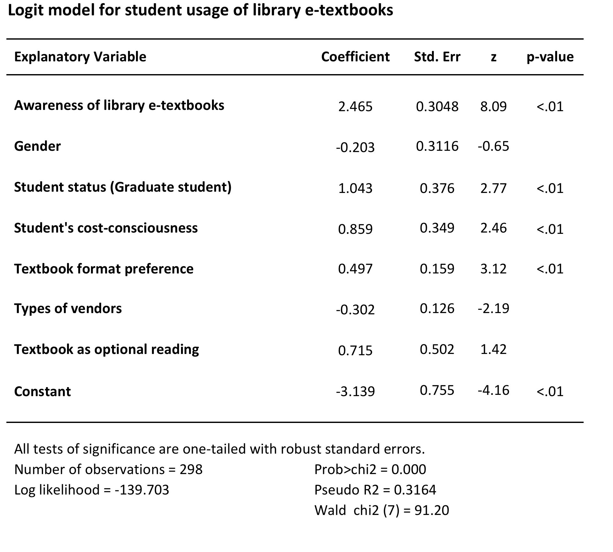

Slide 12
E-Textbook Perception
Our survey asked students for their perceptions of their e-textbooks in regard to 12 criteria. For each criterion (e.g., “Easy to Use”) we asked the students to answer Strongly Disagree, Disagree, Agree, Strongly Agree, or Don’t Know.
When we sort the results by vendor, we gain a glimpse into comparative student perceptions of the platforms offered by the various vendors.

Slide 13
E-Textbook Perception by Vendors
Easy to Use
Agree Disagree
ebrary: 10 9
Knovel: 16 0
MyiLibrary: 39 13
Safari: 9 0
Wiley: 19 2
Springer: 5 2
NetLibrary: 1 0
Totals: 99 26

Slide 14
E-Textbook Perception by Vendors
Easy to Use – Comments
“Easy to use, quick access.” (Wiley book)
“While the textbook is good to have in general, [its] division into multiple subsections is annoying; if you open a given section as a pdf it give ~30 pages, which may or may not be equal to the actual section length.” (Knovel book)

Slide 15
E-Textbook Perception by Vendors
Easy to Access
Agree Disagree
ebrary: 13 6
Knovel: 14 2
MyiLibrary: 42 11
Safari: 9 0
Wiley: 18 2
Springer: 4 3
NetLibrary: 1 0
Totals: 101 24

Slide 16
E-Textbook Perception by Vendors
Easy to Access – Comments
“I can access the textbooks without lugging the hard copies around. Only once did I have trouble accessing the book.” (MyiLibrary book)
“Seemed to be a maximum number of people able to view product [at] a given time. This caused the book to be inaccessible at times.” (MyiLibrary book)

Slide 17
E-Textbook Perception by Vendors
Easy to Read
Agree Disagree
ebrary: 16 7
Knovel: 13 3
MyiLibrary: 30 22
Safari: 9 0
Wiley: 16 5
Springer: 4 2
NetLibrary: 1 0
Totals: 99 39

Slide 18
E-Textbook Perception by Vendors
Easy to Read – Comments
“It was an easy book to [read] online…” (MyiLibrary book)
“The quality is bad so it’s difficult to read even when zoomed in…” (ebrary book)

Slide 19
E-Textbook Perception by Vendors
Easy to Print
Agree Disagree
ebrary: 5 9
Knovel: 10 1
MyiLibrary: 18 19
Safari: 8 0
Wiley: 15 3
Springer: 0 1
NetLibrary: 0 1
Totals: 56 35

Slide 20
E-Textbook Perception by Vendors
Easy to Print – Comments
“I attempted to print out a diagram from the textbook. The diagram was impossible to read, so I just wasted paper by printing it out.” (ebrary book)

Slide 21
E-Textbook Perception by Vendors
Easy to Share
Agree Disagree
ebrary: 6 4
Knovel: 10 1
MyiLibrary: 21 16
Safari: 7 1
Wiley: 10 2
Springer: 1 1
NetLibrary: 0 1
Totals: 55 26

Slide 22
E-Textbook Perception by Vendors
Easy to Copy and Paste Content from E-Books
Agree Disagree
ebrary: 5 9
Knovel: 7 4
MyiLibrary: 12 19
Safari: 6 0
Wiley: 8 5
Springer: 1 1
NetLibrary: 0 0
Totals: 39 38

Slide 23
E-Textbook Perception by Vendors
Easy to Highlight and Take Notes
Agree Disagree
ebrary: 4 12
Knovel: 3 9
MyiLibrary: 9 23
Safari: 5 4
Wiley: 7 8
Springer: 2 2
NetLibrary: 0 0
Totals: 30 58

Slide 24
E-Textbook Perception by Vendors
Easy to Highlight and Take Notes – Comments
“…being able to ‘take notes’ on the pages is key for me. I use a PDF editor that can write on the page…” (Safari book)
“I couldn’t figure out how to high light or take notes.” (Wiley book)

Slide 25
E-Textbook Perception by Vendors
Easy to Share Notes and Highlights
Agree Disagree
ebrary: 1 8
Knovel: 2 8
MyiLibrary: 9 21
Safari: 5 3
Wiley: 7 7
Springer: 1 1
NetLibrary: 0 0
Totals: 25 48

Slide 26
E-Textbook Perception by Vendors
Easy to Search for Particular Words
Agree Disagree
ebrary: 13 3
Knovel: 10 2
MyiLibrary: 35 8
Safari: 6 0
Wiley: 15 2
Springer: 3 3
NetLibrary: 1 0
Totals: 83 18

Slide 27
E-Textbook Perception by Vendors
Easy to Search for Particular Words – Comments
“I can…search the pdf files, which is more efficient than skimming pages of text for a key [word] manually.” (Knovel book)
“The ‘Find’ function doesn’t work very well. It would make using the book a lot easier if it did.” (Knovel book)

Slide 28
E-Textbook Perception by Vendors
[E-Book is] Portable
Agree Disagree
ebrary: 17 2
Knovel: 16 0
MyiLibrary: 40 9
Safari: 8 1
Wiley: 19 1
Springer: 4 2
NetLibrary: 0 0
Totals: 104 15

Slide 29
E-Textbook Perception by Vendors
[E-Book is] Portable – Comments
“It was really useful having the electronic copy because just had to open it up on a computer rather than carry around a book.” (Safari book)
“I always have my laptop with me, so therefore I always have the text book without having to carry around something else.” (Knovel book)

Slide 30
E-Textbook Perception by Vendors
[E-Book is] Environmentally Friendly
Agree Disagree
ebrary: 12 4
Knovel: 14 0
MyiLibrary: 44 1
Safari: 8 0
Wiley: 18 1
Springer: 5 1
NetLibrary: 0 0
Totals: 101 7

Slide 31
E-Textbook Perception by Vendors
[E-Book is] A Positive Benefit to Student Learning
Agree Disagree
ebrary: 13 4
Knovel: 15 0
MyiLibrary: 40 10
Safari: 8 0
Wiley: 15 1
Springer: 5 1
NetLibrary: 1 0
Totals: 100 16

Slide 32
E-Textbook Experience
Overall Satisfaction
Please rate your overall satisfaction with this electronic textbook.
Very Dissatisfied: 1 1%
Dissatisfied: 9 7%
Neutral: 31 25%
Satisfied: 50 40%
Very Satisfied: 34 27%

Slide 33
E-Textbook Experience
Satisfaction Level by Vendors
Please rate your overall satisfaction with this electronic textbook.
 | Satisfied | Dissatisfied | Neutral | %Satisfied
ebrary | 12 | 3 | 4 | 70%
Knovel | 15 | 0 | 1 | 94%
MyiLibrary | 30 | 7 | 15 | 58%
Safari | 6 | 0 | 3 | 67%
Wiley | 15 | 0 | 6 | 71%
Springer | 5 | 0 | 2 | 71%
NetLibrary | 1 | 0 | 0 | 100%

Slide 34
E-Textbook Experience
Student Feedback
We received 50 comments on usability. Selected examples:
“Hard to use, hard to view multiple pages at once on one screen, hard to find online from ctools. Prefer paper copy.” (MyiLibrary book)
“Its not easy to look at two pages at once. For example, end of chapter problems and different sections in that chapter.” (ebrary book)

Slide 35
E-Textbook Experience
Student Feedback
More sample comments on usability:
“Content was not organized exactly the same as the print book so I knew what I was looking for and where it should be but it wasn’t there. I had to waste time looking for it again.” (MyiLibrary book)
“All electronic textbooks have the inherent problem of preventing the readers from forming spatial memory about the text, which is a positive aspect of physical books. Also, fast seeking through the pages is not possible. These are technical issues of all electronic textbooks, not this particular one.” (ebrary book)

Slide 36
E-Textbook Experience
Student Feedback
We received 67 suggestions. Selected examples:
“Please let us know that the electronic version of the textbook is available online at the beginning of the term, not at the end.”
“It should be distributed in any ereader format, not just .pdf, this enhances the use of word search and dictionaries to define words or even translate them.” (Wiley book)

Slide 37
E-Textbook Experience
Student Feedback
More sample suggestions:
“I would prefer a hard copy over the electronic copy of the book since the hard copy is tangible and has less fatigue to the eyes when reading for a long period of time...I would suggest to have more books on reserve at the library.”
“For [my class], we have open-book exams. This means that we can take our book into the exam with us. We cannot have electronic devices, thus eliminating the possibility of using an electronic textbook during an exam.”

Slide 38
Library E-Textbook Usage: Awareness Matters
71% of students who were aware of the e-textbook used it.
We also had some students say they used the book after they received the survey.

Slide 39
Overall Usage Statistics
We had anywhere from 0-25,000 uses of a book.
Vendors provide different statistics so comparing usage between was not possible.
Highest use for most books for the semester was in September.
Springer has print on demand books for $24.95. Only 2 copies were purchased from 5 titles in SpringerLink.

Slide 40
Future Plans
Publicize the books more.
Publicize them early (but in most cases we do not have the information earlier).
Work to have links in our learning management and course registration systems where the book information is originally available.
Do some focus groups to get more information.

Slide 41
Future Plans
We will continue to notify classes of e-textbook access.
We have a few vendors now who let you download books so we will check to see how the students like the download option from these vendors.
University wide e-textbook initiative to start in Fall 2012.

Slide 42
Contact Information
David Carter superman@umich.edu
Paul Grochowski grocho@umich.edu
Leena Lalwani llalwani@umich.edu
Natsuko Nicholls hayashin@umich.edu
Sara Samuel henrysm@umich.edu
Special Acknowledgements:
  Susan Hollar, who worked with us on the survey design and implementation.
  Kathleen Folger, who helped with usage statistics.

